Slide 1
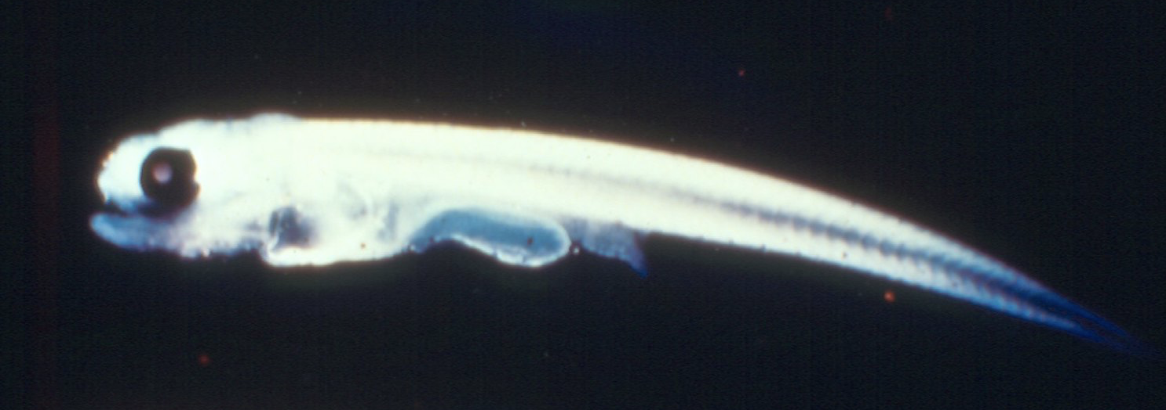
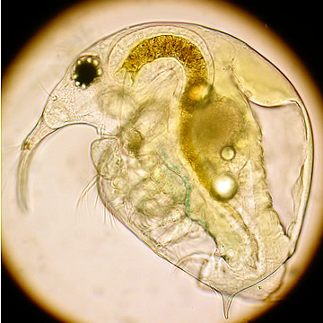
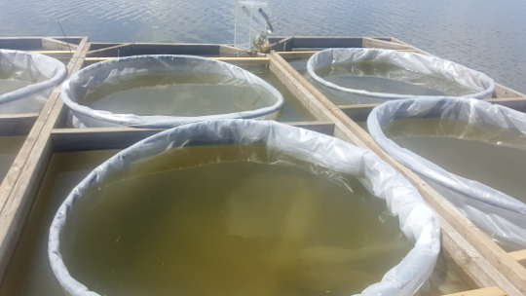
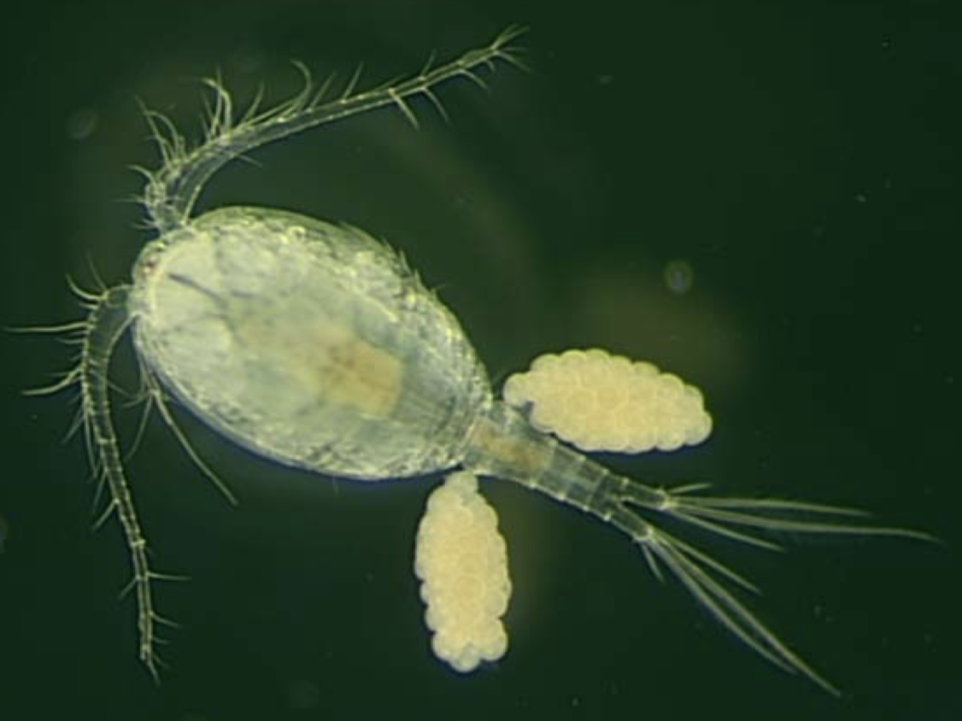
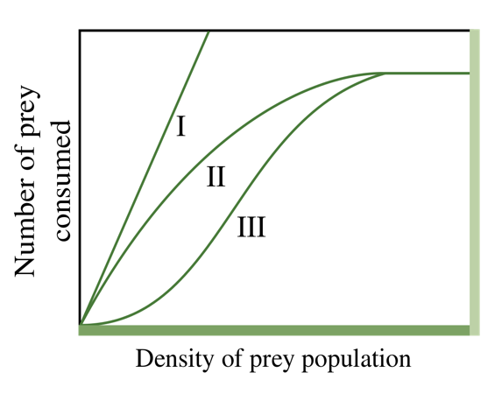
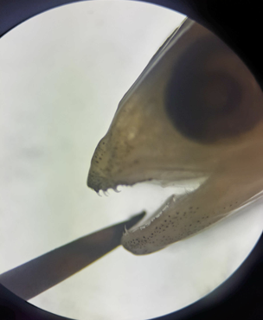
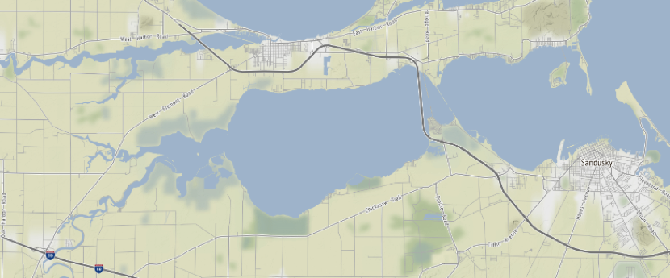
Quantifying Functional Response of Larval Walleye to Zooplankton Densities:
Critical Conditions for Early Survival
David Roach (droach@bgsu.edu) Christopher Kemp, and Jeffrey Miner
Aquatic Ecology & Fisheries Lab, Dept Biological Sciences, Bowling Green State University
Introduction
Methods
Discussion
Our unofficial state fish, Ohio’s Walleye fisheries are important for both recreational and commercial anglers alike.
A Type II functional response is one characterized by an increasing rate of prey (zooplankton) consumption by a predator (larval Walleye) as the density of prey increases, until there is an inevitable leveling off - an asymptote (plateau).
This study will be useful for predicting impacts of environmental changes on early life growth of this species and provide a robust measure of functional responses that has been missing from the literature for this important species.
Larval Walleye were collected from mesocosms of various zooplankton densities: fractions of ambient (0.25X, 0.5X) ambient (1X) and five times ambient (5X).
Diet analysis was conducted on fish extracted at the end of the third day after foraging.
Larval Walleye exhibit a classical Type II functional response to the abundance of zooplankton prey (1, 2).
As prey density and biomass increases, larval Walleye foraging initially increases linearly, but then becomes asymptotic at the maximum consumption rate.
These results using a natural zooplankton assemblage will be used in bioenergetic models of larval Walleye to predict growth in a heterogeneous environment like Sandusky Bay in Lake Erie.
Figure 2. Walleye larvae consumption of Bosmina as a function of zooplankton biomass
Prey of larval Walleye
Figure 3. Walleye larvae consumption of cyclopoid copepods as a function of zooplankton biomass
Results
References
.
Begon, M., Harper, J. L., & Townsend, C. R. 1986. Ecology: Individuals, populations and communities. Blackwell scientific publications.
Madon, S., and D. Culver. 1993. Bioenergetics Model for Larval and Juvenile Walleyes - an in-Situ Approach with Experimental Ponds. Transactions of the American Fisheries Society 122:797–813.
Cyclopoid copepod
Acknowledgements
Bosmina longirostris
Sandusky Bay
Special thanks to Dr. Jeffrey Miner and Christopher Kemp for assistance with this study I thank the BGSU CURS program for supporting my involvement in this research study.
Figure 1. The Functional Response: Biomass consumed as a function of zooplankton biomass in mesocosms.

