Slide 1
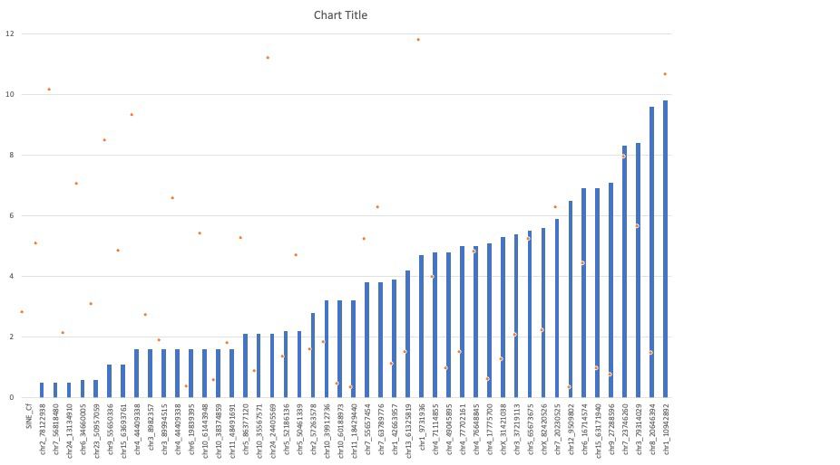
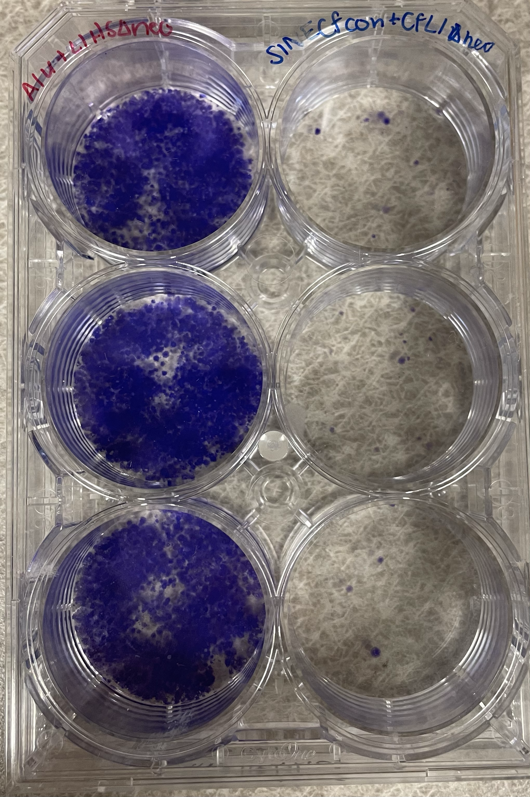
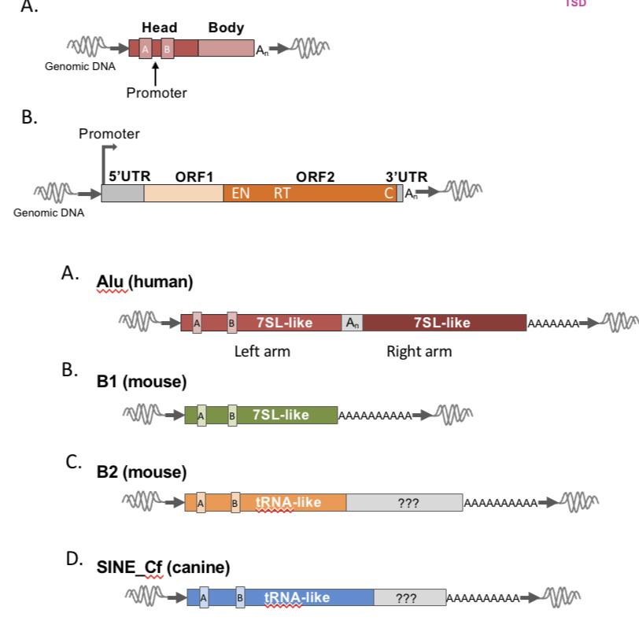
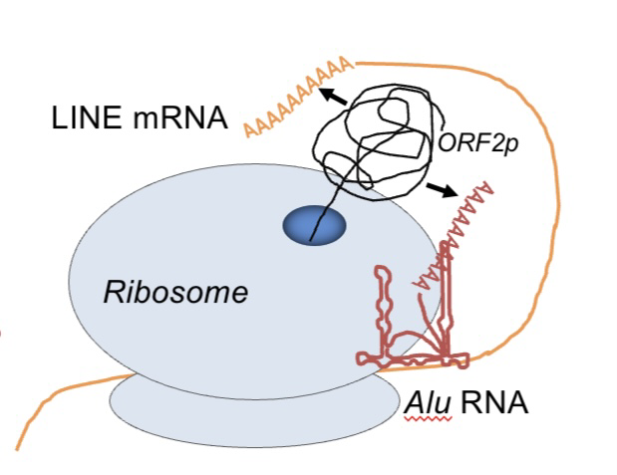
Assaying Individually Cloned SINEs for Activity in Tissue Culture
Baileigh Laipply, Madison Alteri, Abigail Jarosz, Dr. Julia Halo
Department of Biological Sciences, Bowling Green State University, Bowling Green, OH
Abstract
DNA sequences in the human genome that appeared to have no function were thought to have no purpose and even once referred to as ‘junk’ DNA. However, this DNA is now known to contain sequences that have many functions for the host species. These sequences include a group of elements termed ‘transposable elements’, so-named for their ability to mobilize within the genome and cause changes in the host DNA as a result. Short Interspersed Nuclear Elements (SINEs) and Long Interspersed Nuclear Elements (LINEs) are a form of transposable element, called retroelements or retrotransposons, that hijack the host cellular machinery to multiply throughout the host genome, done through a ‘copy and paste’ amplification of existing elements. SINE and LINE lineages have evolved together as pairs because SINEs are non autonomous and rely on a LINE’s enzymatic machinery to mobilize. SINE elements have evolved from several types of cellular RNA, with tRNA derived SINEs being the most abundant, but least understood. These tRNA derived SINEs can be found in mice (referred to as B2) as well as canines (SINE_Cf). Both B2 and SINE_Cf are active in mouse and canine genomes, respectively, however the extent of their mobilization and the resulting genetic polymorphism is unknown. The secondary structure of SINEs and its mobilization in the genome has been shown to be necessary for other non-tRNA SINE elements. This project was aimed at studying the secondary structure of tRNA derived SINEs to understand if and how the structure influences its capability to mobilize. Here, retrotransposition assays as well as genotyping were performed to help determine the effects of the secondary structure and the prevalence and genetic polymorphism of SINE insertions.
Specific Aims:
Specific Aim 1: SINE mobilization in tissue culture. Linking the secondary structure of tRNA derived SINEs to their mobilization should provide insight on their mechanism to associate with the ribosome and hijack LINEs enzymatic machinery.
Specific Aim 2: Genotyping SINE_Cf. Determine the genetic polymorphism across 18 breeds of canine SINECf insertions.
Results
Figure 3. Mobilization rates vs. Percent Divergence of Retrotransposition Assays completed. The Retrotranspostion Assays in progress that are evaluating the SINEs secondary structure and their mobilization rates comparatively. This portion of research is not yet complete.
Background
Figure 1. Features of Retroelements used in the Halo Lab.
A. The canonical structure of a common SINE. B. The canonical structure of a common LINE that contains two ORFs which encode enzymes that aid in the mobilization of both SINEs and LINEs. A. Structure of 7SL derived SINE, Alu. B. Structure of 7SL derived mouse B1 SINE. C. Structure of tRNA derived mouse B2 SINE. D. Structure of tRNA derived canine SINE, SINE_Cf.
Figure 2. Model for SINE (Alu) Retrotransposition. The mobile element, LINE is trancribed into its RNA intermediate, mRNA, in the ribosome. It is then translated on the ribosome, where endonuclease is produced and grabs onto Alu to transport for target primed reverse transcription in the nucleus.
Figure 4. Retrotransposition Assay. The purple phoci represent the HeLa cells that have the SINE insertion and are successfully isolated to help determine mobilization rates.
Figure 5. Genotyping Results. PCR1 results from 17 different Canine DNA samples at 9 different chromosomal locations containing SINE insertions. Results were used to determine if insertions were bimorphic and the genetic polymorphism of SINE insertions in canines.

