Slide 1
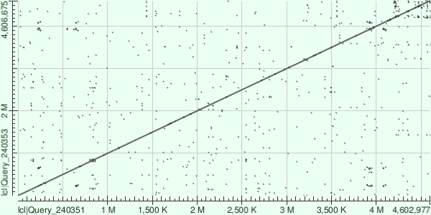
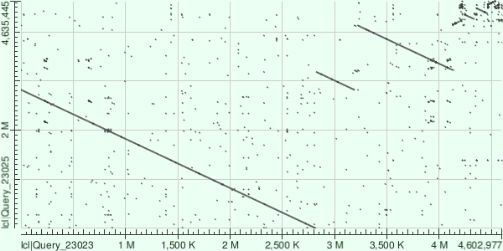
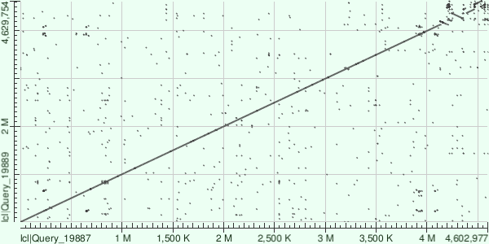
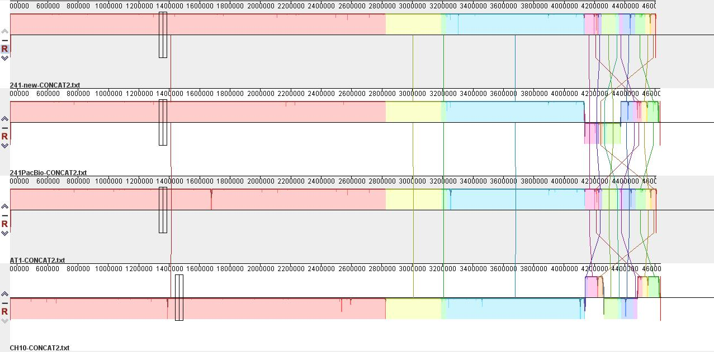
DNA Sequence Sleuthing:
The mystery of 5-aminolevulinic acid sensitivity in Rhodobacter sphaeroides
Dr. Jill Zeilstra-Ryalls, jzeilst@bgsu.edu; Natalie Lewis lewisn@bgsu.edu
Bowling Green State University | Department of Biological Sciences
Abstract
Methodology
Discussion
The growth of Rhodobacter sphaeroides wild type strain 2.4.1 is inhibited by the presence of exogenous 5-aminolevulinic acid (ALA). This is paradoxical in that, at the same time, ALA is an essential metabolite of all cells, and, as is true of many organisms, R. sphaeroides makes its own ALA. For nearly 30 years, it has been known that, in contrast to the wild type strain, growth of mutant strain AT is insensitive to exogenous ALA. It is predicted that comparing the DNA sequence of the AT1 genome to that of the 2.4.1 genome will provide clues as to the basis of this differential ALA sensitivity. DNA sequencing has been performed using two methodologies, which both generate large sets of sequence data that need to be properly assembled to generate the entire genome sequences. The assemblies do not always match up because of the differences in the sequencing and assembly processes. This project focused on comparing the alignments to identify the reconfigurations that need to be made such that the necessary sequence comparisons can be made. It involved mastery of multiple bioinformatic analysis programs, as well as learning the proper way to manage the DNA sequences such that they can be successfully analyzed. Completion of this work will, for the first time, generate "genetic clues" as to why strains of R. sphaeroides are sensitive to, yet also require ALA for growth. Having these clues will lead to possible "culprits" that can subsequently be proven either innocent or guilty using additional molecular techniques, involving testing each one.
Bacterial strains: All R. sphaeroides bacteria are from the laboratory collection.
Sequencing: NGS of wild type 2.4.1 and mutant strain AT1 was performed at the North Carolina State University sequencing core facility. PacBio sequencing was performed at New England Biolabs.
Genome sequence manipulation: These bacteria have two chromosomes and five plasmids each. In order to align the assemblies, these DNA elements were concatenated into a single sequence.
Assembly comparisons: Pairwise comparisons of the assembled sequences were made using the BLASTn program at the National Center for Biotechnology Information (1). The assembled sequences were also globally compared using the progressiveMauve program (2).
This bioinformatic analysis was undertaken as a necessary step to make it possible to properly configure DNA sequencing results obtained for three strains of Rhodobacter sphaeroides such that they can be compared at the nucleotide level. Represented among the three strains are ALA sensitive and ALA insensitive bacteria. Based on the information obtained here, it is now possible to reconfigure the DNA sequences, to generate a complete alignment of the genomes, and they can then be compared for differences at the nucleotide level. The following describes the overall process:
The dot plots and the progressiveMauve alignment results will be used to guide the rearrangement of sequence segments in order to completely assemble the genomes.
Once the rearrangements have been made, an additional program called UGENE will be used to visualize the alignments at the nucleotide level.
This will finally make it possible to generate a list of actual sequence differences between the ALA sensitive strain 2.4.1 and the two ALA insensitive strains AT1 and CH10. Using molecular biology techniques, each sequence difference can then be evaluated for its role in ALA sensitivity/insensitivity.
Results
A. Concatenation order of the two chromosomes and five plasmids (A-E) comprising the R. sphaeroides genomes.
pE
Chromosome I
Chromosome II
pA
pB
pC
pD
B. Dot plots showing pairwise comparisons of the DNA sequences indicates that the plasmids are most problematic with respect to the genome assembly algorithms.
Introduction
Figure 1. Dot plot of NGS 2.4.1 (x-axis) and NGS AT1 (y-axis).
Figure 2. Dot plot of NGS 2.4.1 (x-axis) and PacBio CH10 (y-axis).
Figure 3. Dot plot of NGS (x-axis) 2.4.1 and PacBio 2.4.1 (y-axis)
Acknowledgements
The metabolite 5-aminolevulinic acid (ALA) is synthesized in Rhodobacter sphaeroides by two enzymes that are encoded by the hemA and hemT genes. ALA is the precursor to all tetrapyrroles, compounds that include hemes for respiration, chlorophylls for photosynthesis, and the cofactor vitamin B₁₂ that is required to make nucleotides for RNA and DNA. Therefore, ALA is essential in all cells. Yet, certain wild type strains of R. sphaeroides are sensitive to even tiny amounts of ALA added to media, completely inhibiting growth.
It is possible to isolate mutants of ALA sensitive strains that are no longer growth inhibited by the presence of ALA. Two of these mutants are strain AT1 and its derivative CH10 (isolated by Chelsea Holden, ref. 2). The wild type parent strain 2.4.1 and mutant CH10 have been completely sequenced using PacBio sequencing. This method generates long stretches of DNA. While "some assembly is required" using sophisticated software to put together the entire DNA sequence, it is not nearly so assembly intensive as the method called NGS (next generation sequencing), which was also used to sequence 2.4.1 and AT1. In this method, very short stretches of DNA sequences are determined and then assembled. There are advantages and disadvantages to both and having PacBio sequencing and NGS data makes it possible to assemble the genomes with greater confidence by comparing the order of the partial sequences.
The goal of this project is to be able to generate a full alignment of the bacterial genomes so that meaningful differences can be identified. These differences are candidates for the ALA sensitivity/insensitivity phenotype. Identifying the sequences responsible for ALA sensitivity will likely provide novel insights into ALA metabolism and function.
C. The progressiveMauve alignment displays the relative positions of the homologous regions among all four genomic sequences.
We would like to thank the Center for Undergraduate Research and Scholarship at BGSU for funding this project.
NGS 2.4.1
References
PacBio 2.4.1
Altschul, S.F., Gish, W., Miller, W., Myers, E.W. & Lipman, D.J. (1990) "Basic local alignment search tool." J. Mol. Biol. 215:403-410.
Darling, A.E., Mau, B. & Perna, N.T. (2010) “progressiveMauve: Multiple genome alignment with gene gain, loss, and rearrangement.” PLOS ONE 5:e11147.
NGS AT1
PacBio CH10
Figure 4. Snapshot image of the progressiveMauve global alignment of NGS 2.4.1, PacBio 2.4.1, NGS AT1, and PacBio CH10. Colors indicate homologous sequences, and vertical lines identify relative positions of the homologous sequences. Within the program, the box (indicated by the black arrow) can be moved horizontally across the alignment to identify nucleotide positions of rearrangements.

