Slide 1
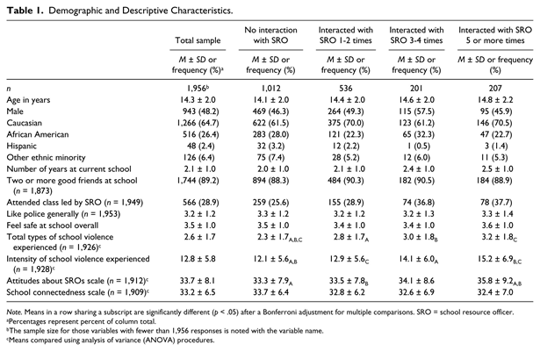
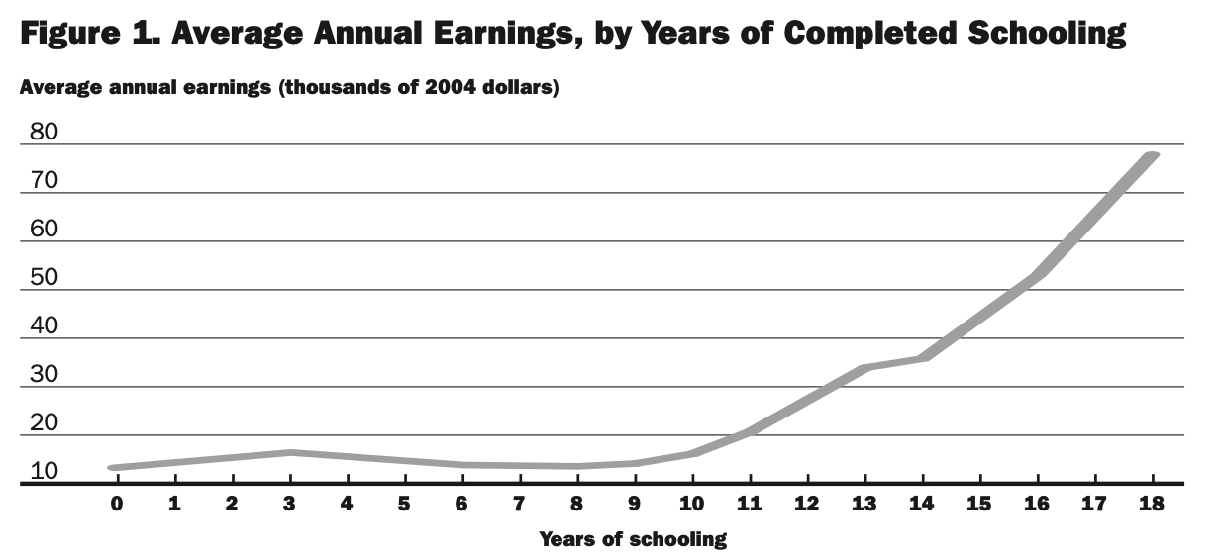
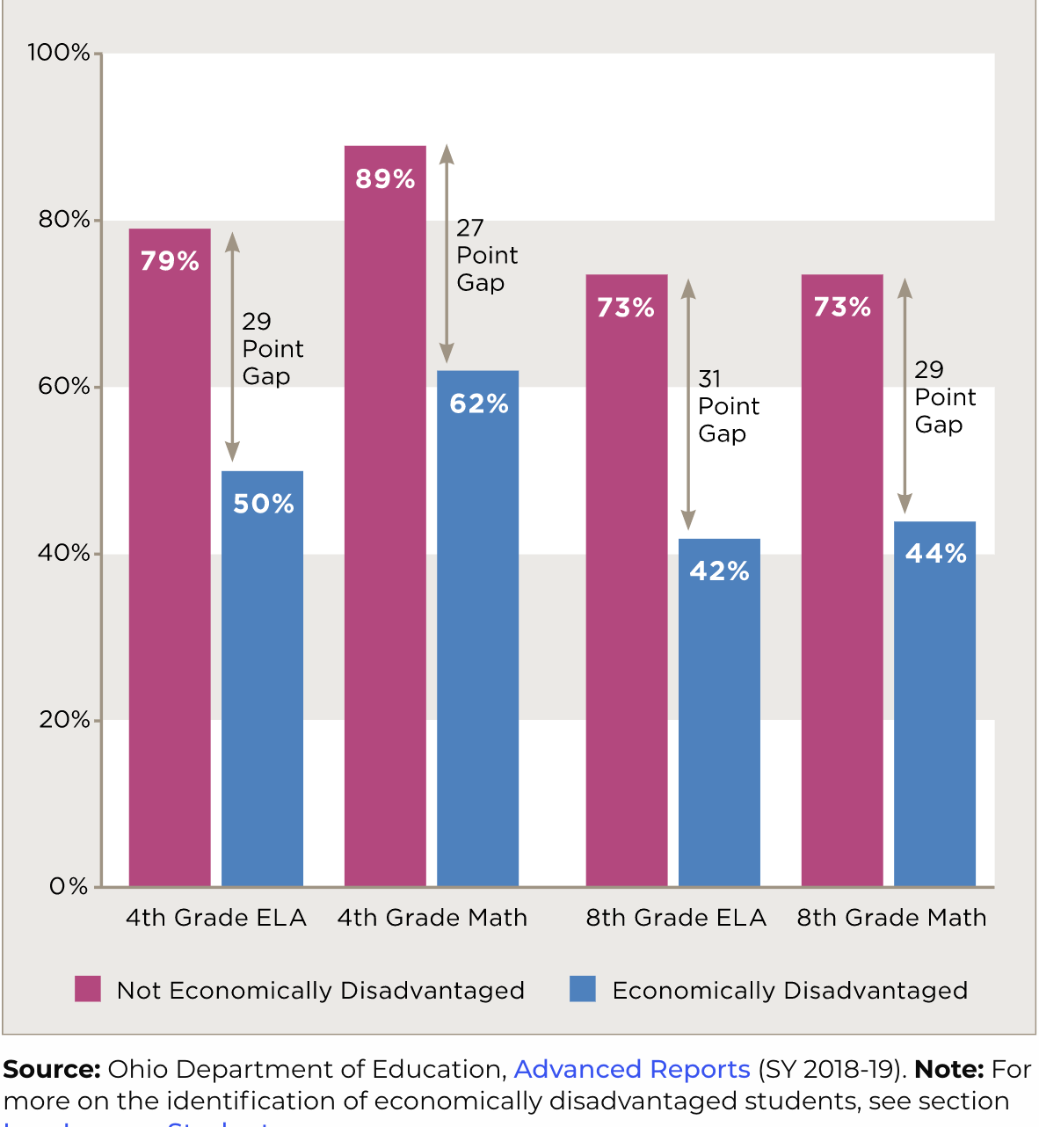
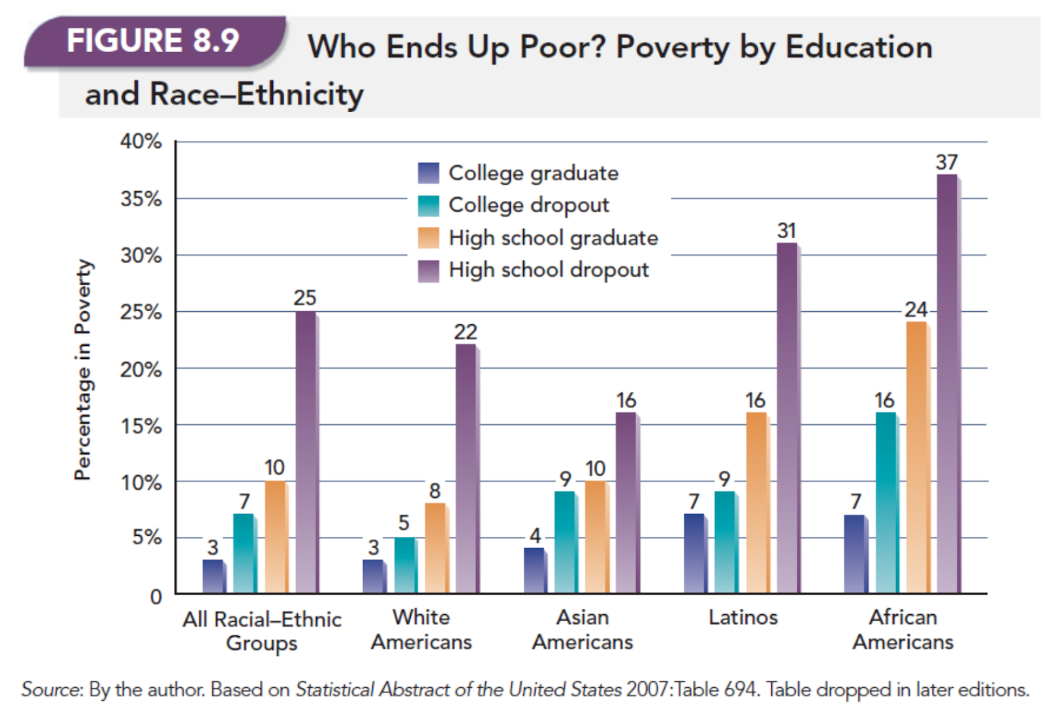
Socioeconomic Status and its Role in Education at Inner City High Schools
Golgi
Rachel Coyne, Paige Utrup, Hope Kromer
Family Living in Poverty
Less Funding for Schools in Low Income Areas Due to Local Funding
Poor Quality of Education and Over Policing in Schools
Low Graduation Rates and Low Chance of Higher Education
Low Paying Jobs and or Mass Incarceration
Social Work Program
Abstract
Results
Discussions & Implications
Mezzo- holding resources drives where the community can donate school supplies, food for lunches, and clothing for the students that may not be able to get these resources from their family
In today’s schooling, growing up in a low-income family can impact the quality of a child’s education. This has more to do with the school’s structural support rather than the child’s commitment. We examined whether the behavior and resources made by wealth and social advantage affect educational attainment. Our findings suggest that the funding that inner city schools are receiving is not substantial to achieve a high-quality education and that these schools need more to be able to provide their students with the proper resources to set them up for success.
Research contributes to theories that encourage more funding to go toward inner-city schools. Further research should be conducted regarding how schools spend grant money, the possibility of adding guidelines to what schools can spend grant money on, and if standardized tests are helpful. Study limitations are the older data due to COVID-19 and inability to conduct primary research.
Micro: by talking with these children in underfunded schools, we can help provide them with a network of resources such as people and websites. We should push to inform them of all of their possible future options.
Mezzo: holding resources drives where the community can donate school supplies, food for lunches, and clothing for the students that may not be able to get these resources from their family.
Macro: implement guidelines for school funding, programs to even out the funding per student schools have, advocate and hire more mental health professionals within school systems
The Bias of School Resource Officers
Issue Statement
Socioeconomic status directly impacts the quality of education received in inner city school which has a lasting effect on the student's adult life
Background & Purpose of the Study
The purpose of this study was to explore quantitative and qualitative data about how students attending inner city high schools in the United States are individually and collectively impacted by classism. This study works to compare the quality of education low income and well-off students receive.
Conclusions
Household spending affected by
amount of schooling
.
Classism affects: the quality of education, the treatment of students based on biases, and contributes to the cycle of poverty. With a low-quality education, students are less likely to attend college and receive a high paying job making it difficult to advance their socioeconomic status. Social workers need to understand classism and its impact on clients while also pushing for legislation that can create a learning environment that helps all students succeed.
Method
Research was conducted
On students who attend high school at a low- income inner city high school. Our hypothesis was that students who attended the low-income public high schools receive a low-quality education compared to well off peers and it continues the cycle of poverty.
References
Rouse, C. A., Barrow, L. (2006). U.S. Elementary and Secondary Schools: Equalizing Opportunity or Replicating the Status Quo? Future of Children, 16(2), 99-123. https://doiorg.ezproxy.bgsu.edu/10.1353/foc.2006.0018
Hochschild, J. L., (2003). Social class in public schools. Journal of Social Issues. 59(4). 821-840. https://scholar.harvard.edu/jlhochschild/publications/social-class-public-schools
Theriot, Matthew T. (2016). The Impact of School Resource Officer Interaction on Students Feelings About School and School Police. Crime and Delinquency. 62(4). https://doi-org.ezproxy.bgsu.edu/10.1177/0011128713503526
Jobs making education necessary
for economic success

