Slide 1
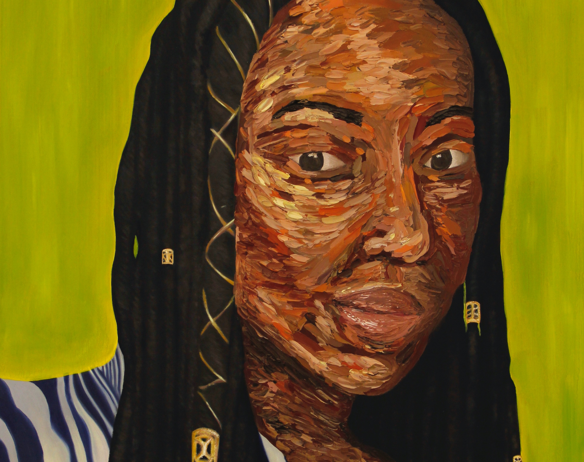
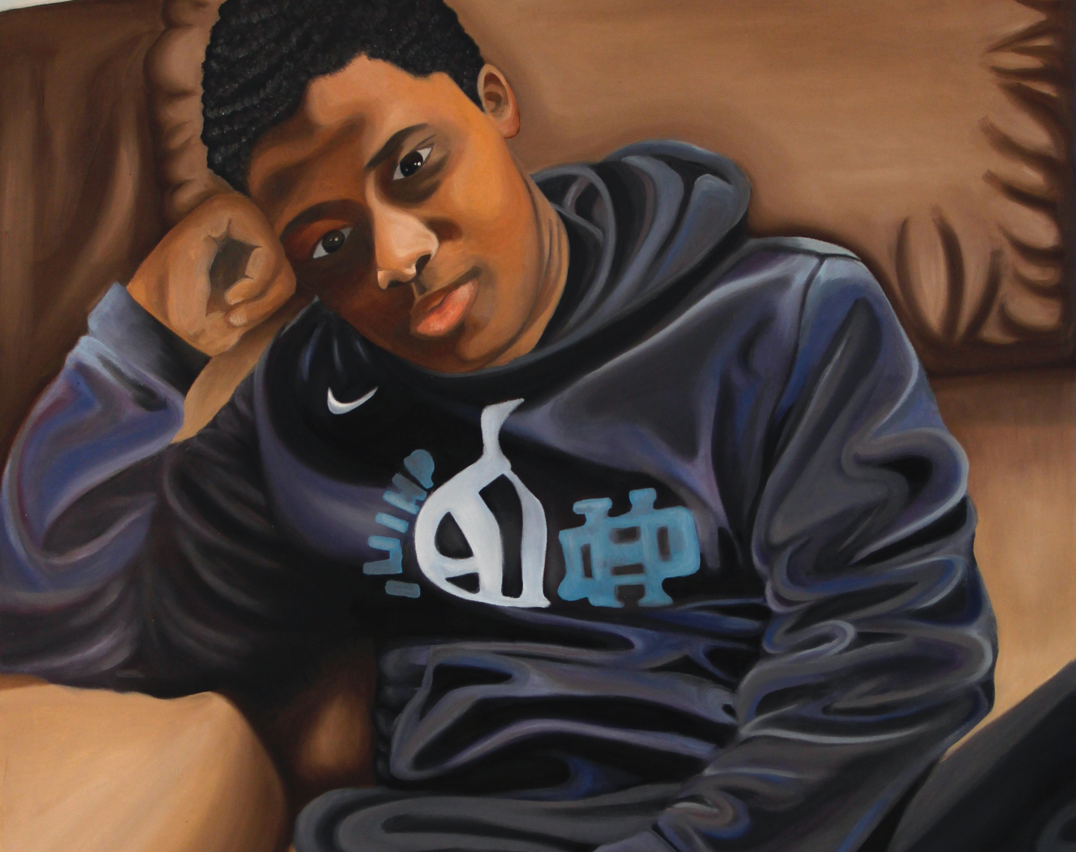
Embracing my Racial Identity Through Visual Arts
By: Tiarra Tufts

Slide 2
Background
Tiarra Tufts
Email:ttufts@bgsu.edu
Year/ Major/ College: Junior/Art Education/Bowling Green State University
Lived: Cleveland OH, Columbus, OH
Other Education: Also Attended SCAD- Savannah College of Art and Design
Notes:
No email

Slide 3
Early Childhood- Art and Belonging
Notes:
Like all children, I began to make art at a young age. From scribbles to coloring, I always loved to make art and it has been a fun activity to do in my pass time for my entire life.
Living in Cleveland Ohio for my early childhood, I was one of many minority children but despite that, I did not experience viewing artists of color.
Tiarras experience as a poc because its my own experience.

Slide 4
Middle School
Most people begin by mimicking artwork, which just means I copied art exactly as it was to learn the techniques or drawing and painting
Mimicking Western European art because it was the only kind of artwork I was exposed to.
Notes:
My artwork began to get more serious in my middle school years. I went from coloring in coloring books and making simple school art projects to creating my own work, invented from mimicking the artwork around me.
Most people begin by mimicking artwork, which just means I copied art exactly as it was to learn the techniques or drawing and painting
Even though I went to a majority black school, I was only learning about western European art in the school curriculum, which means the that this was the only artwork I would mimic.
I want to explain just how damaging this can be for minority children.

Slide 5
Why the current Art Curriculum is Damaging/ Misconceptions
1. You can only be a famous artist if you are a white artist.
2. Minorities are a not good subject matter.
3. If minority children want to make art, it must be by using western European techniques.
Notes:
To begin speaking about how I felt “pushed away” from the art field, I must first speak on how the schooling system failed me as a young black artist.
By teaching children, especially children of color about only white artists, you are telling them three things that can push them away from the art field and into different hobbies that are more inviting to black children, like sports.
It is damaging to teach black children that they can only prosper in sports like basketball and football because it narrows the roads we can take tremendously and tells us that we are not good enough or smart enough to possibly do anything else.

Slide 6
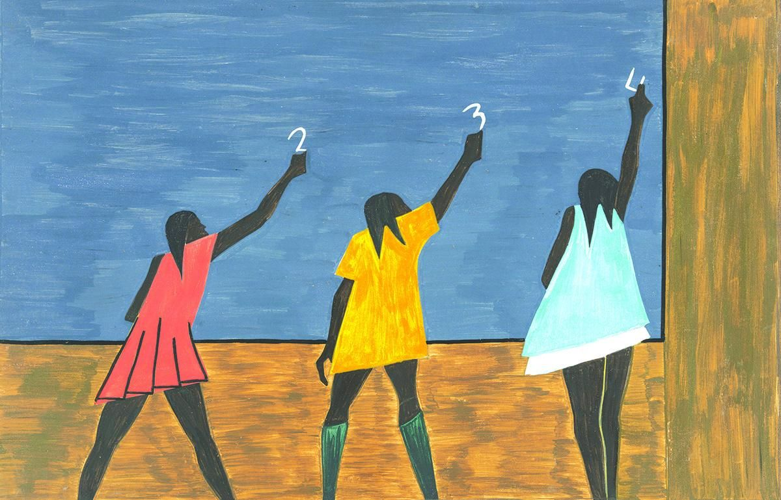
“You Can Only Be A Famous Artist If You Are A White Artist.”
The world is very small for children, they have not prior knowledge of art works and famous artists in different continents.
I was only taught about the famous white artists in school so I felt like I would never be able to make art like that, like I was not capable of doing things like that, because I was a black girl.
By expanding the diversity range of the artists chosen to all races, we teach children that there are artists that look like them and they now have that representation to inspire them.
It’s important to learn about Van Gogh and Picasso but think about how we can improve and progress into a more inclusive classroom by showing the African American artist Jacob Lawrence or Kerry James Marshall.
Jacob Lawrence
Notes:
While this is not something art teachers say to students bluntly, teaching the students only about western European artists tells them that they are the only artists that have “made it”.
The world is very small for children and they only know things that are being taught to them, they are not wise enough to teach themselves about artworks made in Africa or Asia if they have no prior knowledge of that. Because of this, children like myself often only learn what is taught in schools and that’s the only thing wee can compare it to. For example, I was only taught about the famous white artists in school so I felt like I would never be able to make art like that, like I was not capable of doing things like that, because I was a black girl.
By expanding the diversity range of the artists chosen to all races, we teach children that there are artists that look like them and they now have that representation to inspire them.
Yes, its important to learn about Van Gogh and Picasso but think about how we can improve and progress into a more inclusive classroom by showing the African American artist Jacob Lawrence or Kerry James Marshall for an example.

Slide 7
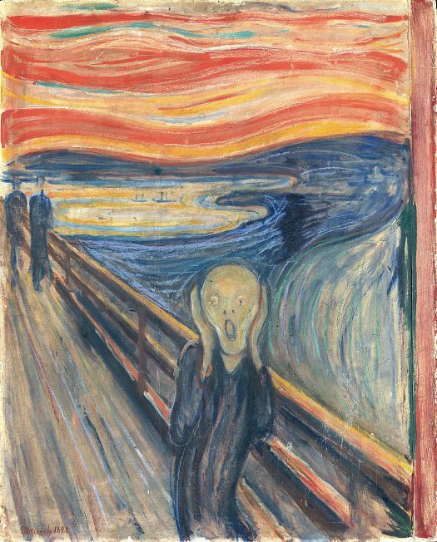
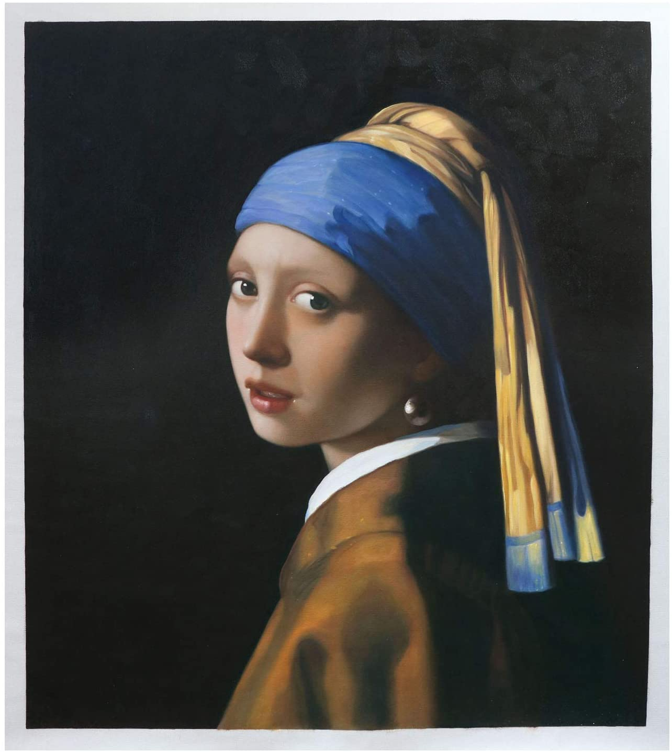
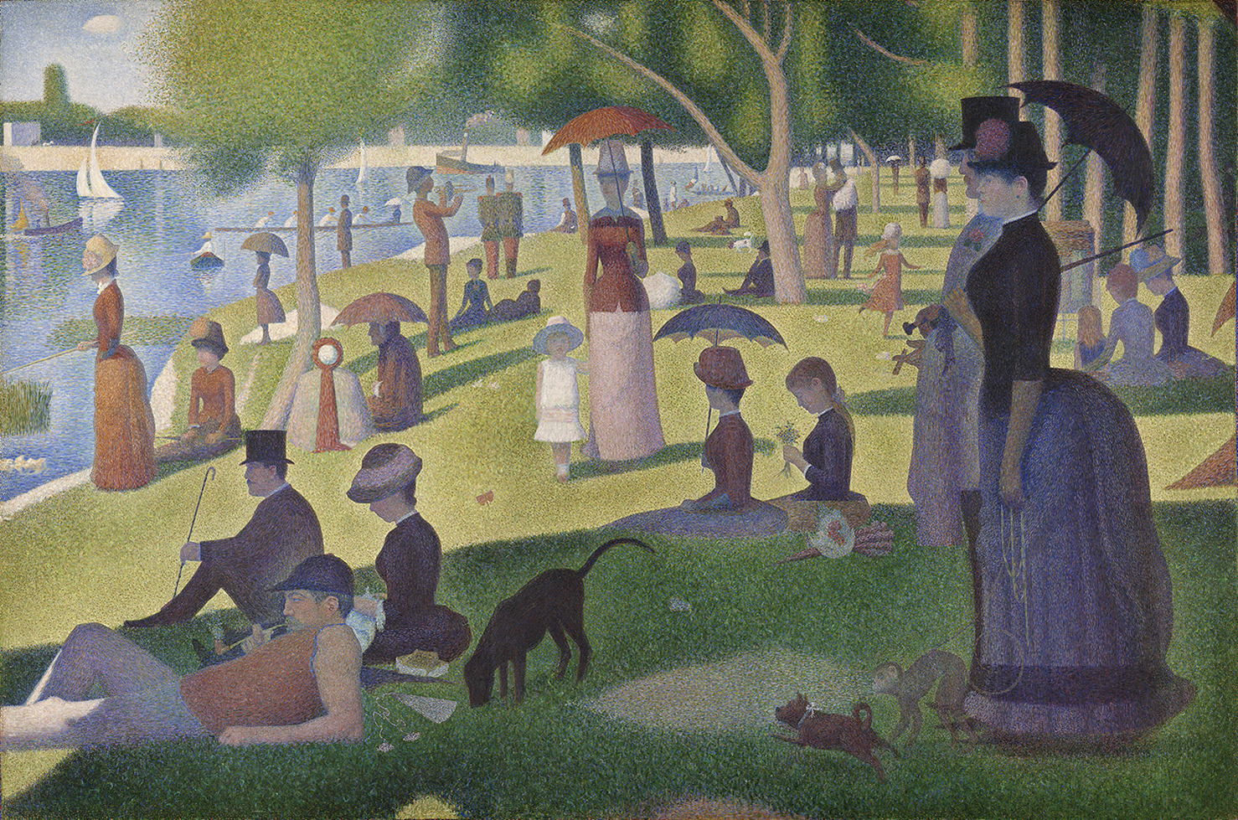
Do you recognize these paintings?
Mona Lisa Leonardo da Vinci
The Scream Edvard Munch
Girl with a Peal Earring Johannes Vermeer
A Sunday Afternoon on the Island of La Grande Jatte Georges Seurat
Notes:
Representation matters for many reasons. It is important for black children to see people that look like them in artwork because it teaches them that they are just as beautiful as any other race and that dark skin is good enough to be painted too. For example, does anyone recognize any of these paintings? Most of these works of art are shown to children in schools as examples of artwork.
Think about how this can affect children of color.

Slide 8
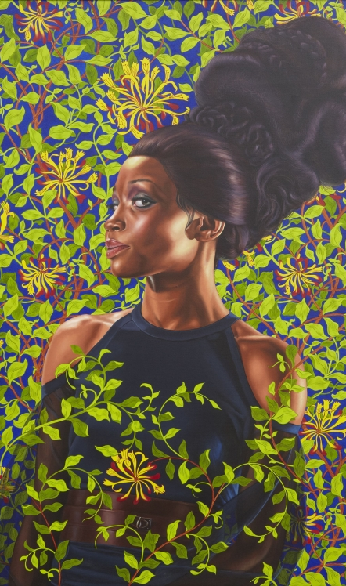
Do you recognize these paintings?
Shantavia Beale ll Kehinde Wiley
The Sugar Shack Ernie Barnes
Charles White. Sound of Silence
School of Beauty, School of Culture Kerry James Marshall
Notes:
Now look at these pieces, does anyone remember learning about these works of art in school? Why is it that we make European art a standard for learning, but we don’t teach children about artwork that shows black subject matter?
This leads to our next misconception.

Slide 9
“Minorities Are A Not Good Subject Matter.”
Only showing works of art with European subject matter shows black children that they are not good enough to be found in works of art.
This same idea forced itself into my mind because of the lack of exposure to black subject matter.
Notes:
Because I believed that Black people were not good enough to be in a painting, my artwork consisted of only white subject matter for a very long period of time.
I fell in love with art because it allowed me to express myself in a way that interested me, but the relationship with art and I was not strong because I could not find my own style that I truly enjoyed.
Because I was unaware that Black people could possibly be in paintings my artwork suffered tremendously and I was not connecting with anything I created.
If we teach children that art can consist of many different things, then we give them a chance at creating art that connects with them. This only grows the relationship with visual arts and makes it more enjoyable for everyone, instead of the experience being just for white people.

Slide 10
“If Minority Children Want To Make Art, It Must Be By Using Western European Techniques”
Notes:
This point goes along with the last point a lot because it basically teaches children that there is only one way of painting and it must include typical western European styles that African-American art does not hold.
By teaching black children about black artists, again, will show them that there are different styles of art that we can make and there is no one answer in art. Not only does it benefit black children, but it benefits all children because not all white children want to create Western European styled art as well.

Slide 11
My Own Self Discovery In Subject Matter
Notes:
These next few slides are going to be examples of my artwork before I found my own interests. The timeframe of these works range from high school to sophomore year of college.

Slide 12
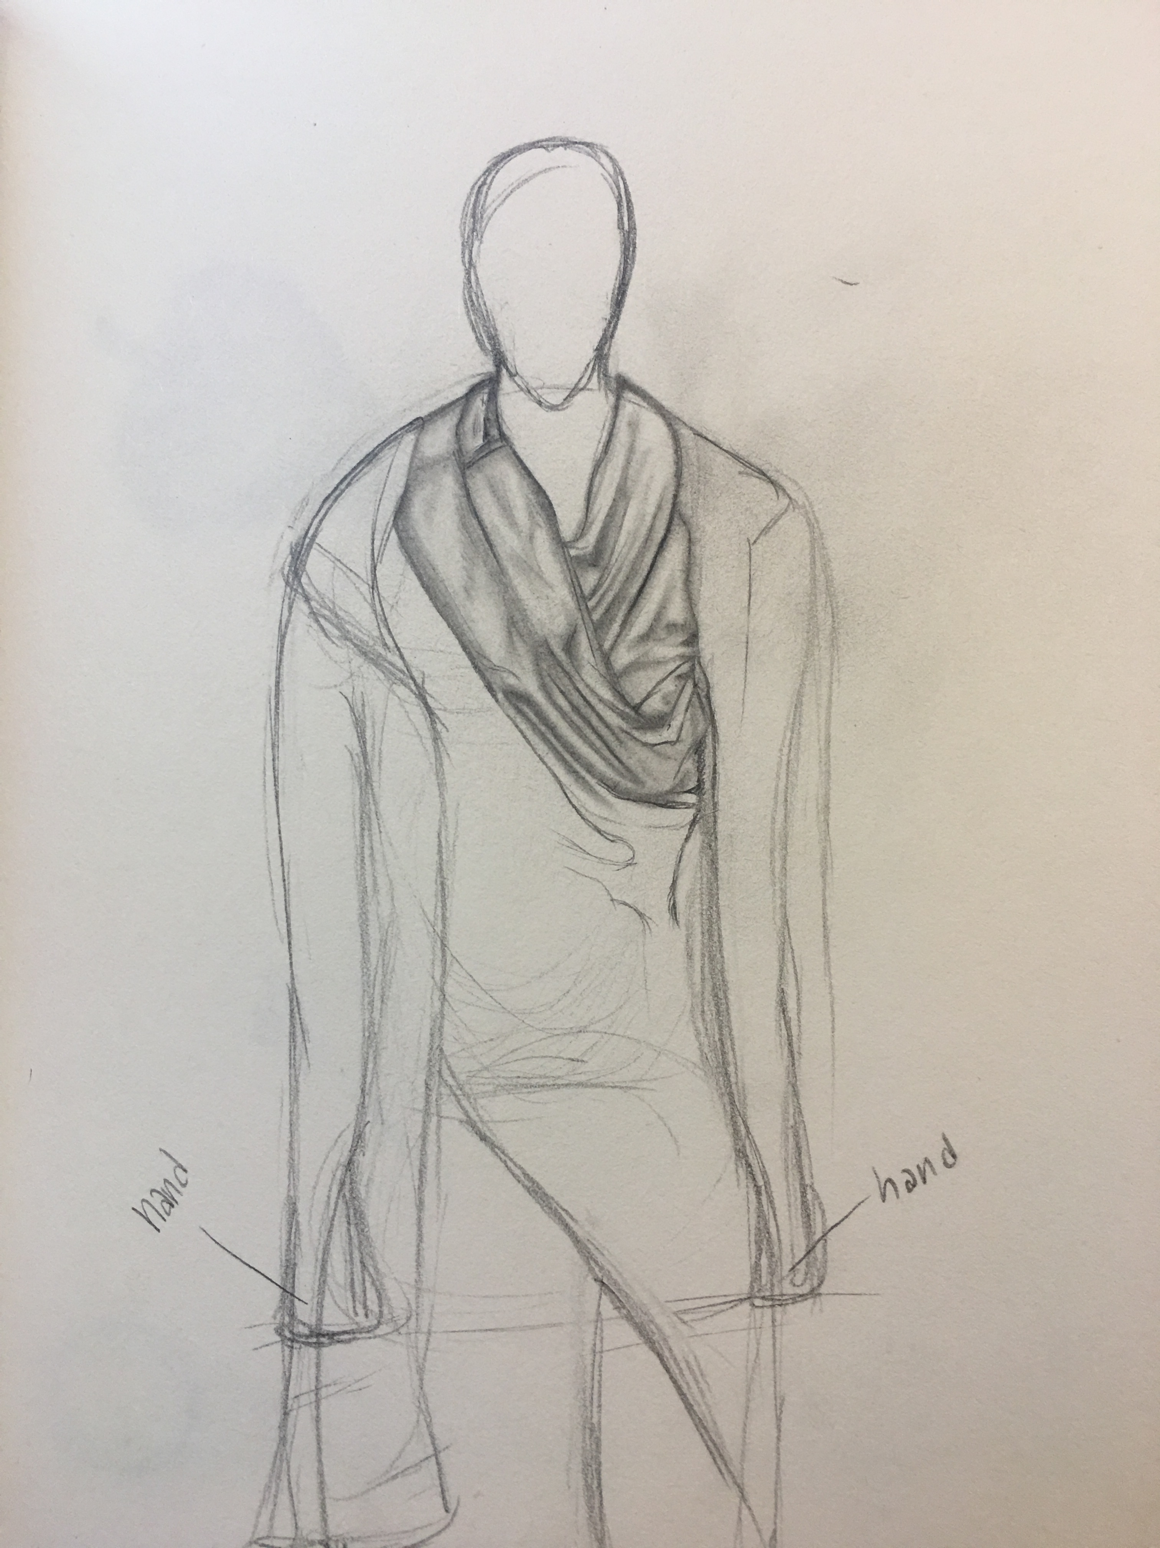
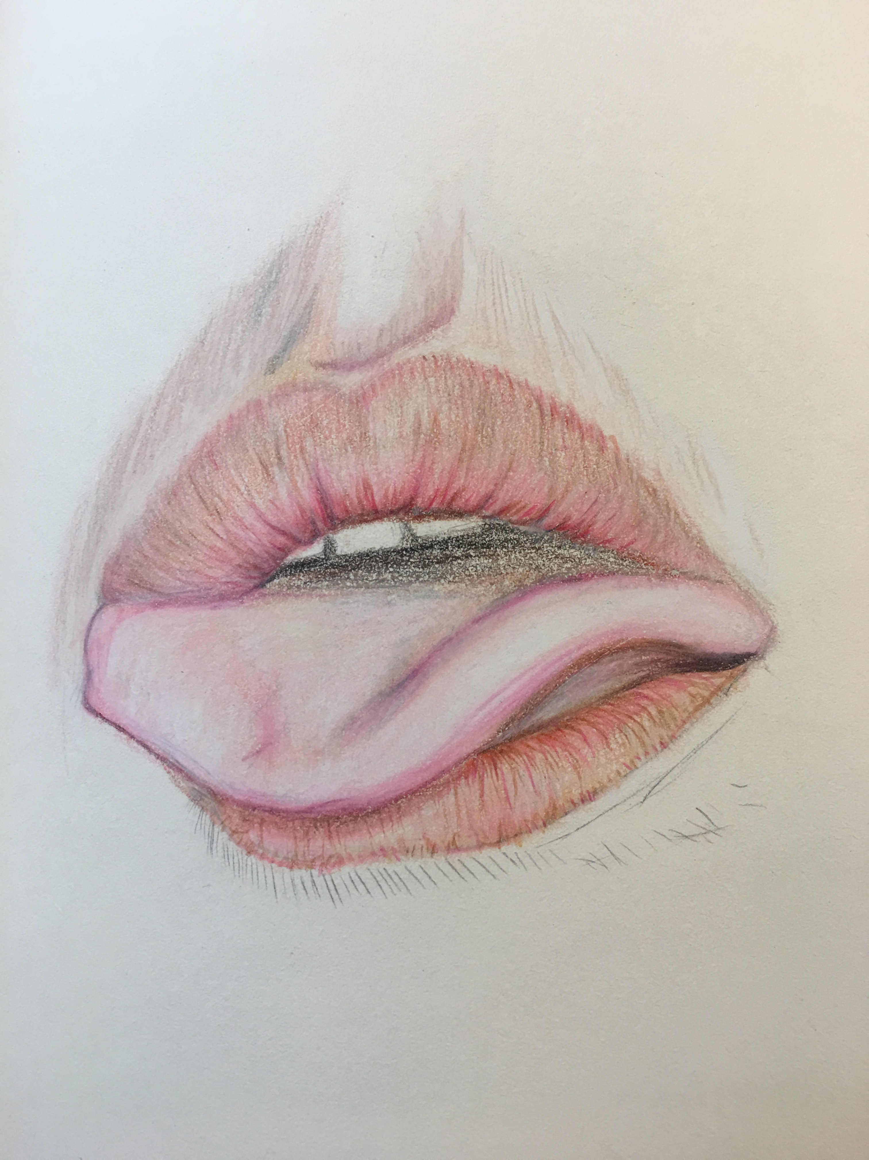
The Unfinished And Uninterested
Notes:
As you can see by these three examples, I found myself never finishing any of my pieces of art and always becoming uninterested and detached. My subject matter consisted of only European models and never people that looked like myself.
I found that there is nothing that attach me to these works because there were no similarities between the work of art and myself, nothing I could connect with. As I stated before this is such a huge problem because it takes artist like myself and pushes them away from the community because they feel as though it is themselves that is the problem. I felt like I couldn’t finish my artwork because I was just not a good enough artist and that it was just too hard for me. I saw the artists around me that were predominantly white, and I noticed there are prospered in ways that mine never could.
For a certain moment by walked away from visual arts and distanced myself from the art community in a way of giving up because I felt like I was just not talented enough to be involved.

Slide 13
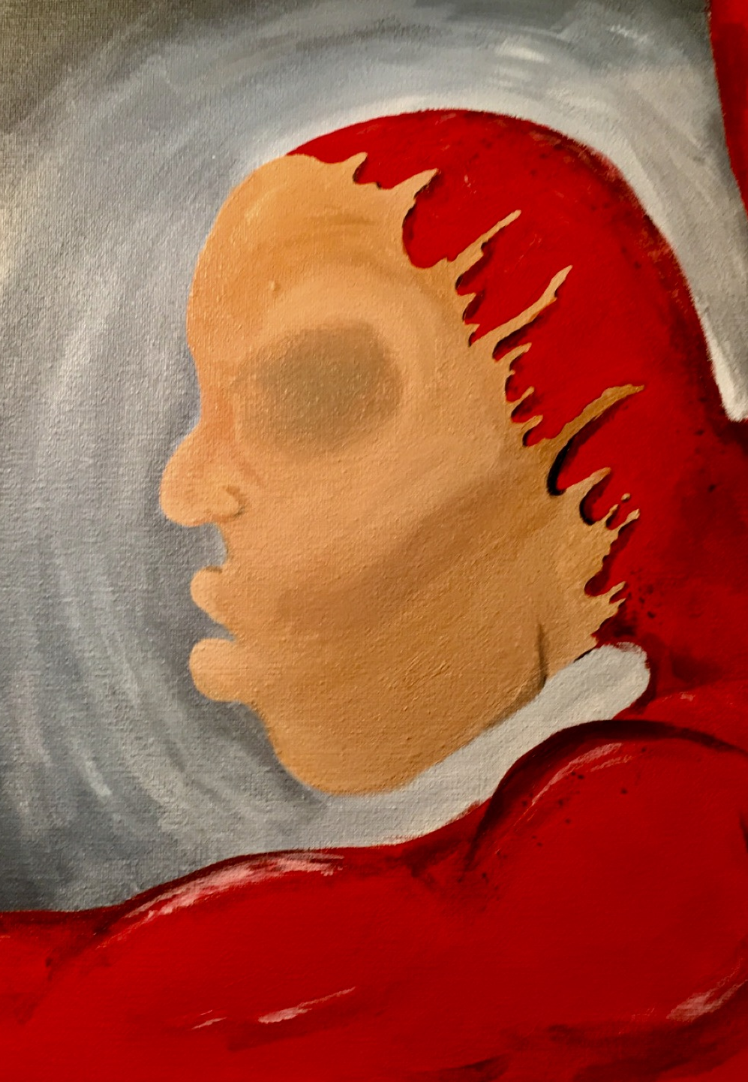
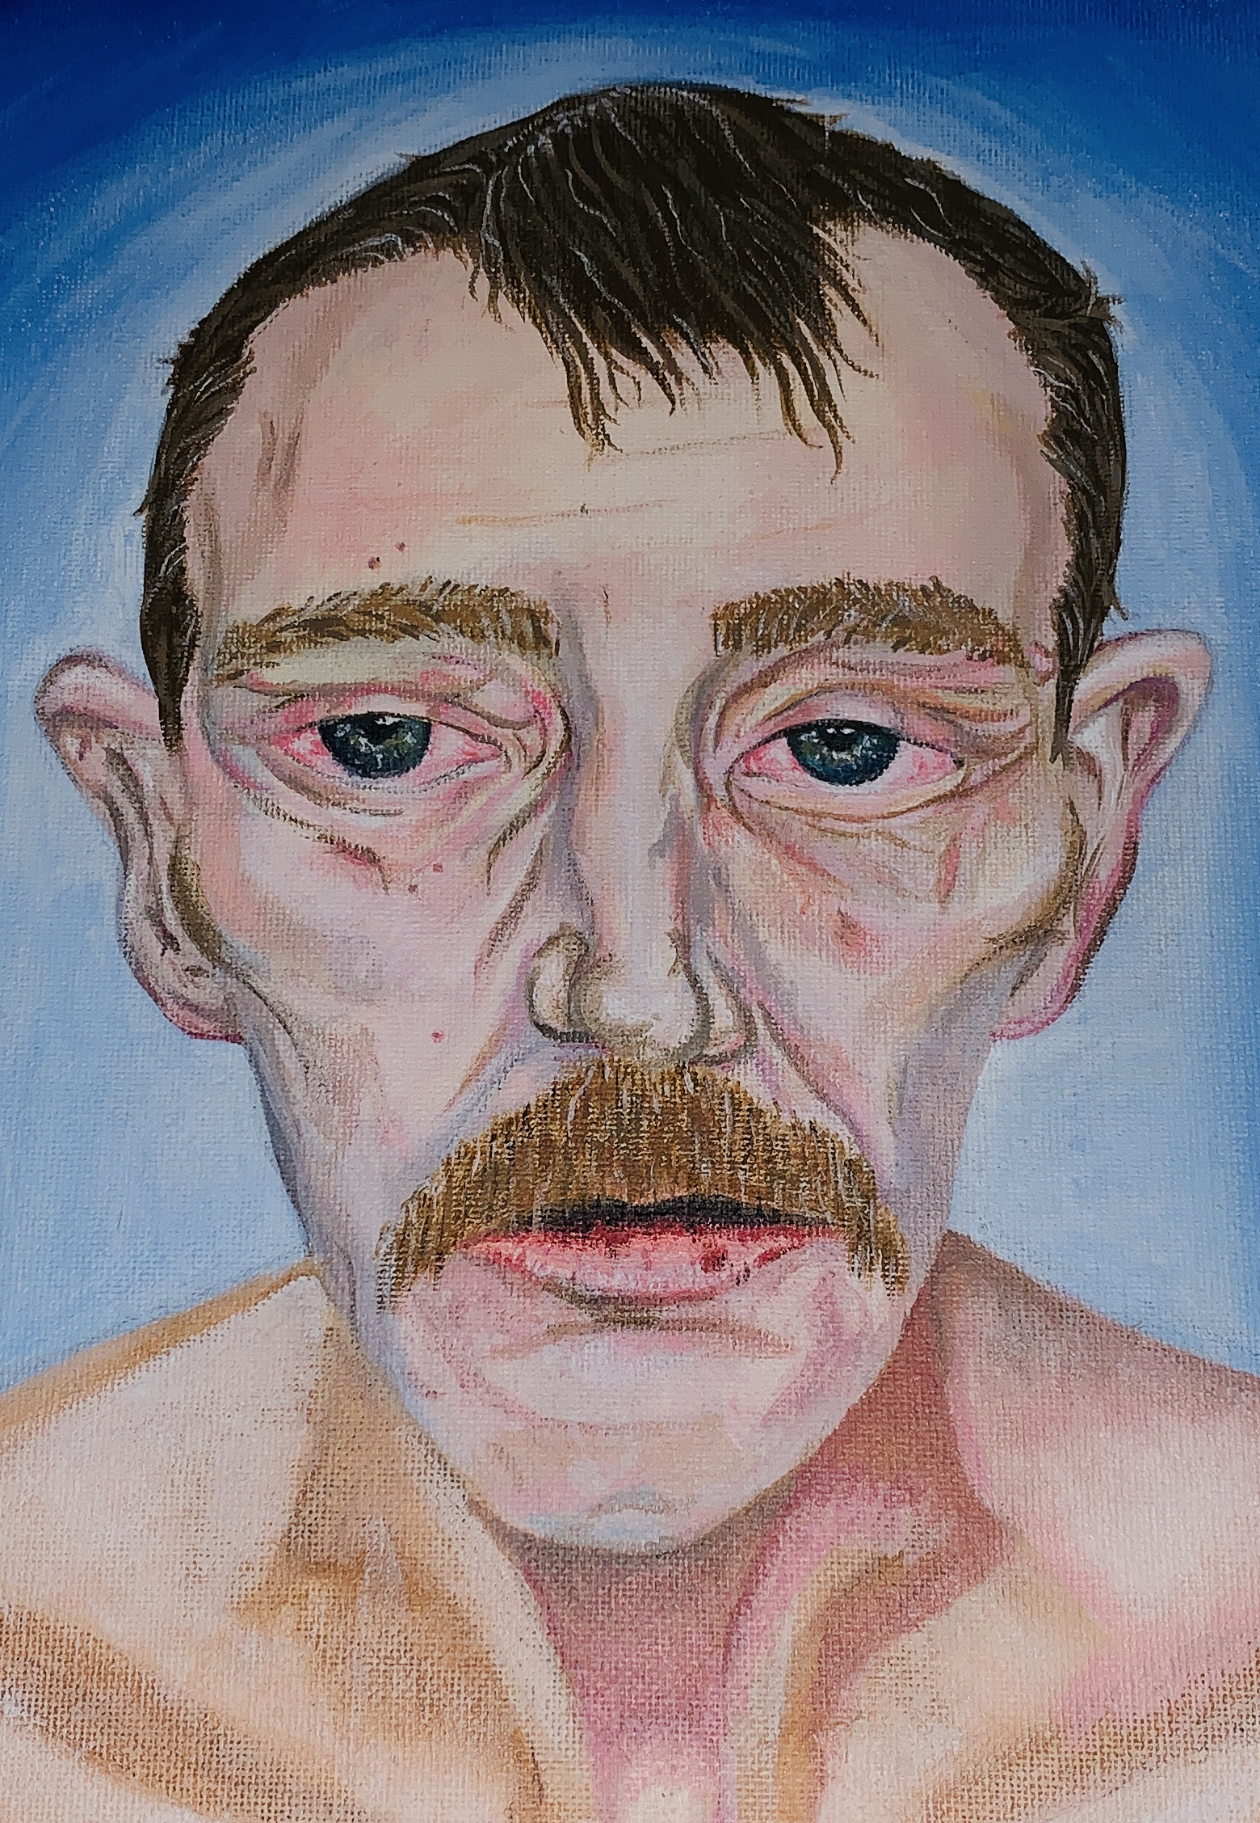
The Select Few
Notes:
In my high school years, I begin to get closer to art again and find my own path through social media. Although I enjoyed making these pieces, I found that I was still very disconnected to the work and I was never fully satisfied with the result.
These select few were the ones I chose because they were finished completely. I had the same problem I had before with finishing my works, so it was very hard to find paintings that I made that had the canvas completely covered. I found myself discovering meaning through works of art, for example, the first piece talks about religion. I wanted to convey that demons can wear masks and pretend to be people butt underneath their evil. The second one wanted to convey beauty within “ugliness”. I wanted to show how societies meaning of beauty can still be art. Sadly, I was just touching the surface with this idea because I could never connect us with African-Americans being art too. Lastly the third paining was me trying to convey the idea of people being insincere with their emotions, in a way, wearing a mask.
As you can see, I was able to form ideas behind my art, but I still wasn’t satisfied because I didn’t feel connected to any of these works.

Slide 14
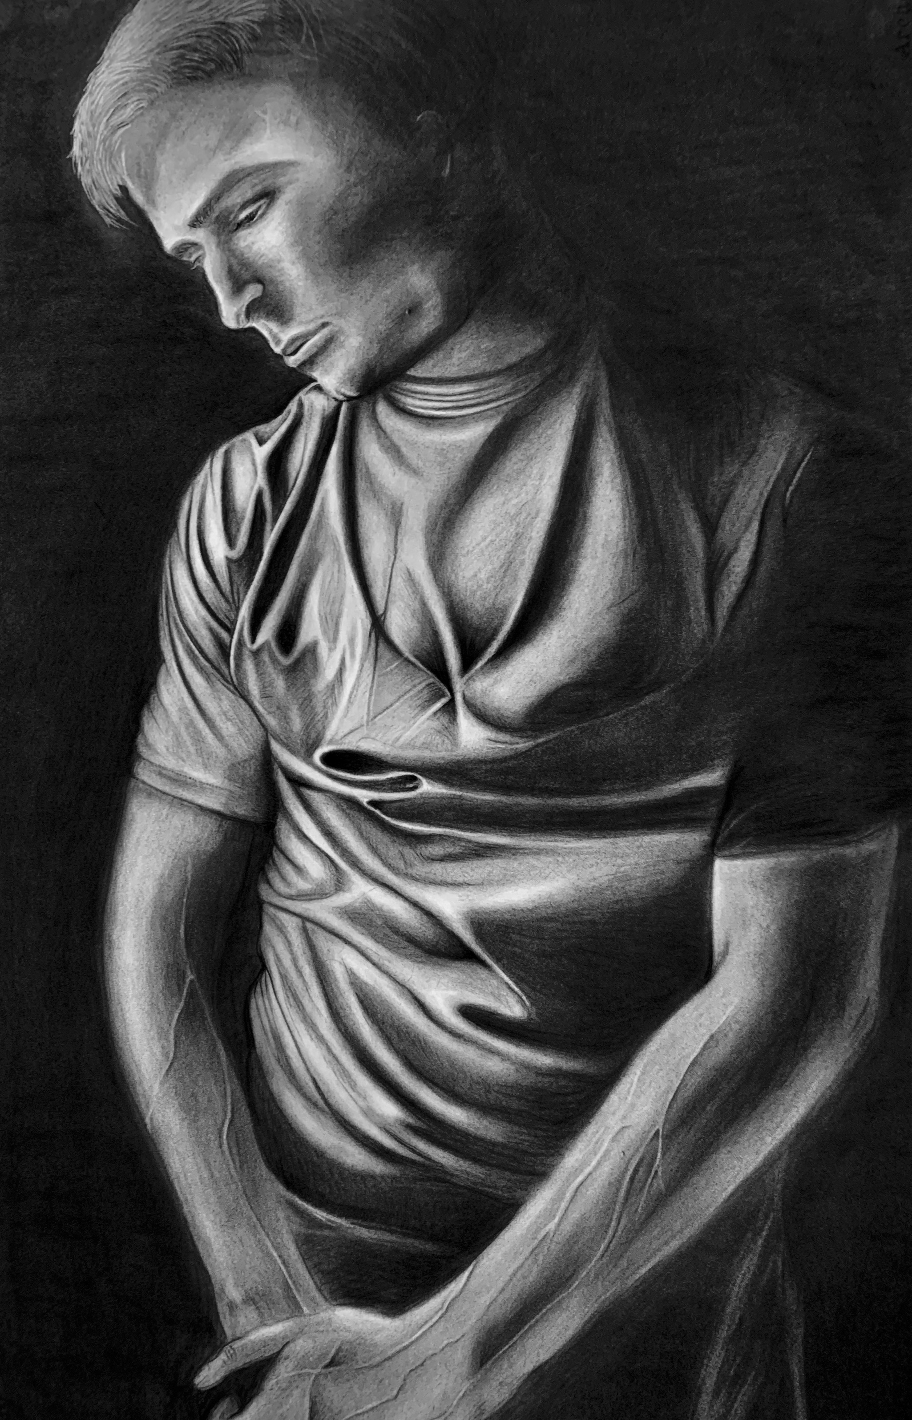
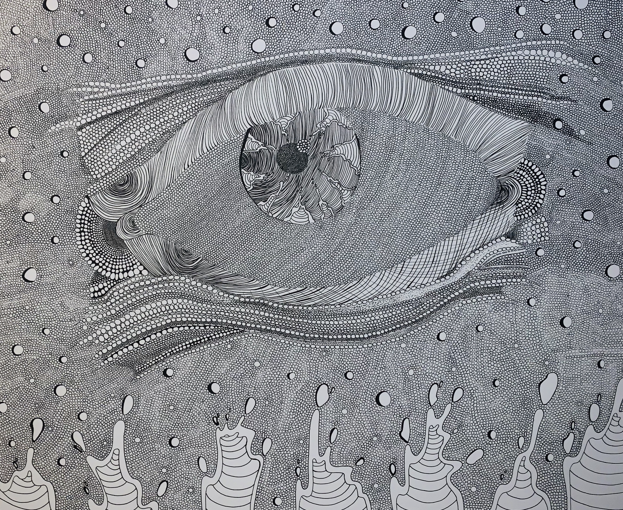
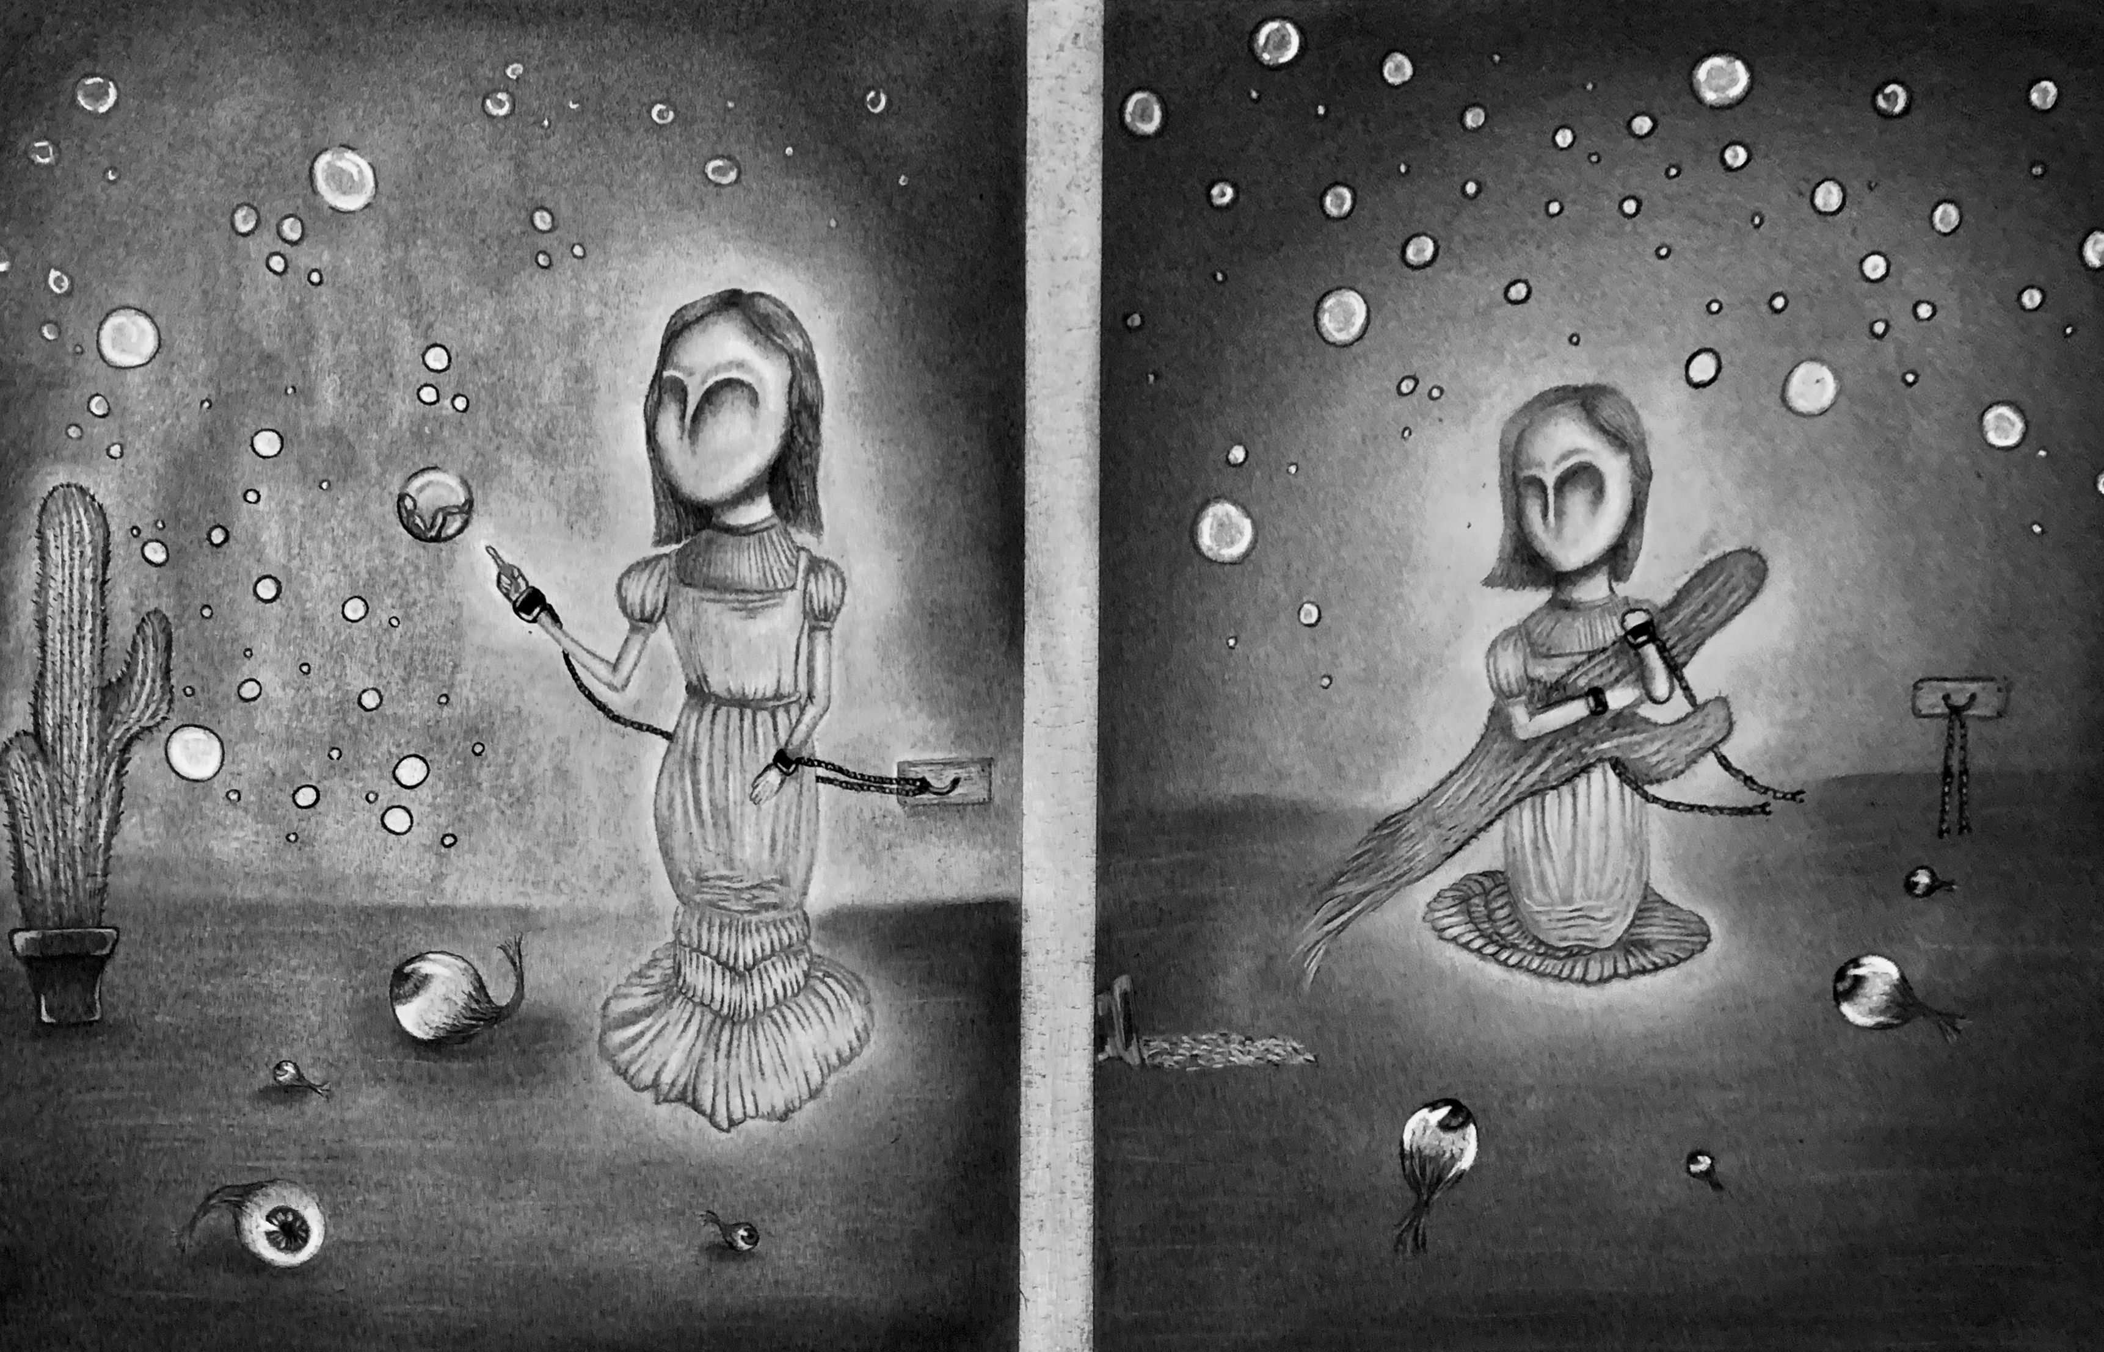
Freshman/Sophomore Year Of College
Notes:
My Art progressed tremendously in my freshman and sophomore year at bowling green university.
At this point in my life, I was learning more about technique and how to do things in visual arts that I have not learned before.
I was learning more about different artists that I haven't yet heard of but unfortunately the same curriculum problem persisted.
The standard of learning had still not changed. Instead of learning about a diverse set of artists, the first set of art history classes taught to students is only European artwork.
This same problem continued to trouble me and push me away from visual arts because I felt like an outcast.
I felt like I was somewhere I did not belong.
It is so hard to go through life continuing to believe that you and your racial community are not included in the standard. If you want to learn about black art history, you can, but it is a side course, but you must learn about European history. The problem is that it is required for everyone to learn about one and not the other. This shows black students that their history is not nearly as important or beneficial to learn about.

Slide 15
Self-portrait
Notes:
Unfortunately, when only European techniques are taught to students of color, our education is hurt.
I was never taught how to properly make skin colors that I could use for my own skin because of this issue. I was never able to learn in the same way my peers were learning, and I found myself having to figure things out in my own way.
It is very hard to for students or color to go about learning in a non diverse curriculum. The education system needs to be more inclusive to help produce better artists of all races.

Slide 16
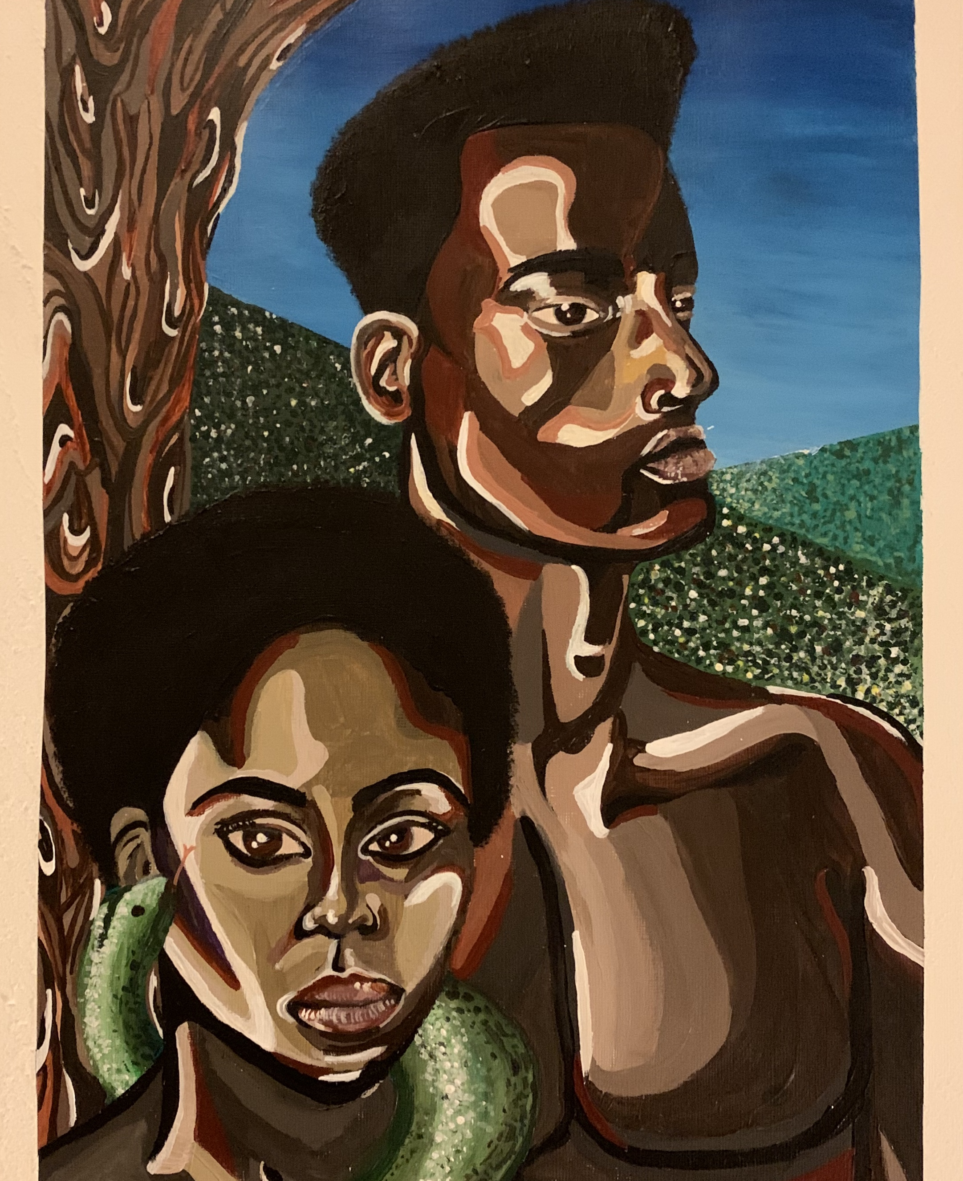
My Epiphany

Slide 17
Gerald Lovell
Chalane Gerald Lovell
Notes:
The artist in this picture is Gerald Lovell. Gerald Lovell is a young artist in Atlanta Georgia who focuses mainly on African-American representation and impasto like painting.
I share a lot of common ground with Gerald Lovell considering he is Puerto Rican and African-American and I am Mexican American and African American. We have a lot of the same interests when it comes to content in subject matter within our artwork.
I discovered Gerald Lovell in my second semester of my sophomore year in the contemporary concepts in painting course. My professor Mille Guldbeck decided that our class should do a master copy.

Slide 18
Skyla
Notes:
The assignment required that we pick an artist from the provided selection and we do our own take on their paintings. This means that we do not copy their work completely, but we take certain aspects of the painting and we use those in our own paintings but with our own subjects.
I am so very thankful that my professor decided to give her students a diverse set of artists that we could choose from instead of picking only western European artists. Of course, I would be able to do the assignment if she were to use only European artists but like I’ve stated, I would not feel a certain connection to my work.
When I saw Gerald Lovell’s name as one of the artists and I looked into him more I immediately was inspired. This was my first time ever being provided with a black artist in my entire life by a teacher and it changed my life completely. Even though this sounds a little overdramatic, I can’t even put into words how thankful I am to Mille and I can say wholeheartedly that she how to make me into the artist I am today, and the artist I will be in the future.
The reason I mention this is because I want to emphasize how important a teacher's influence is on their students.

Slide 19
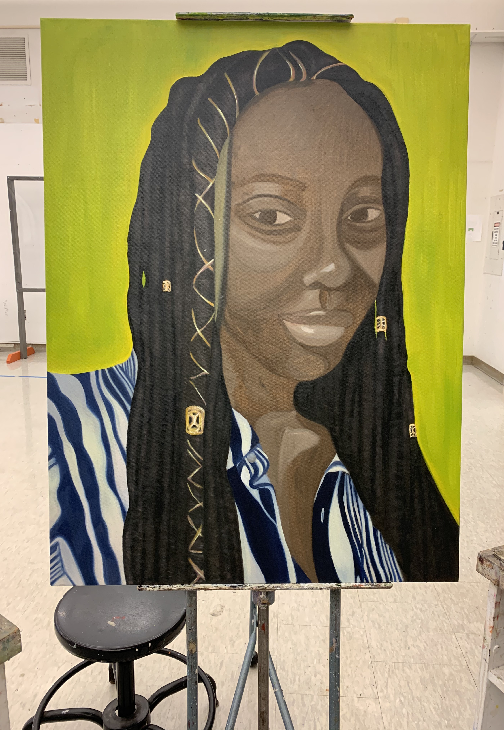
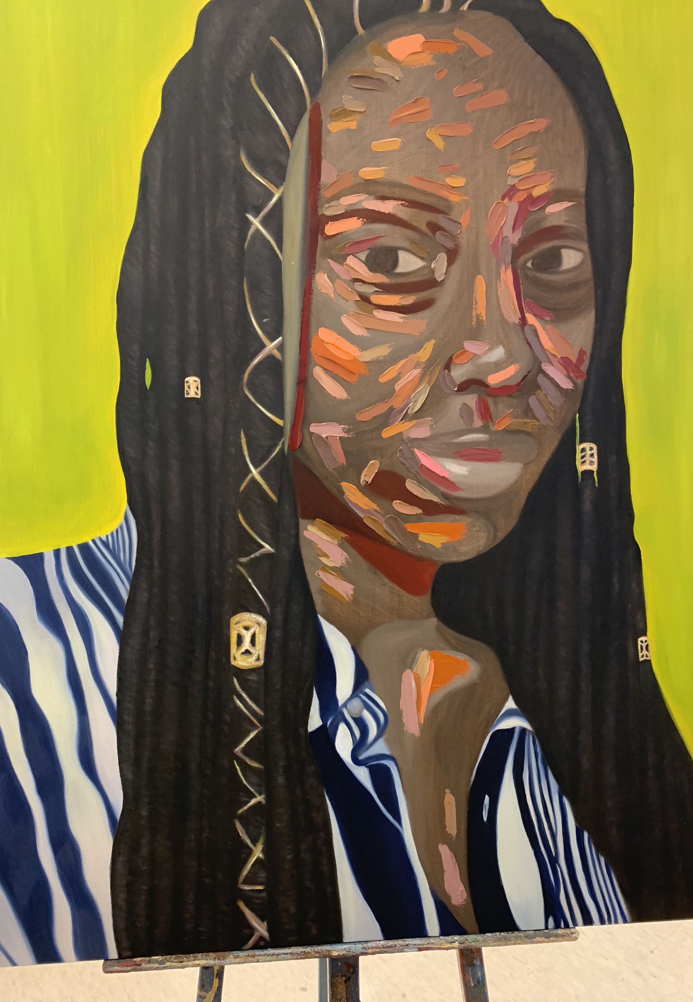
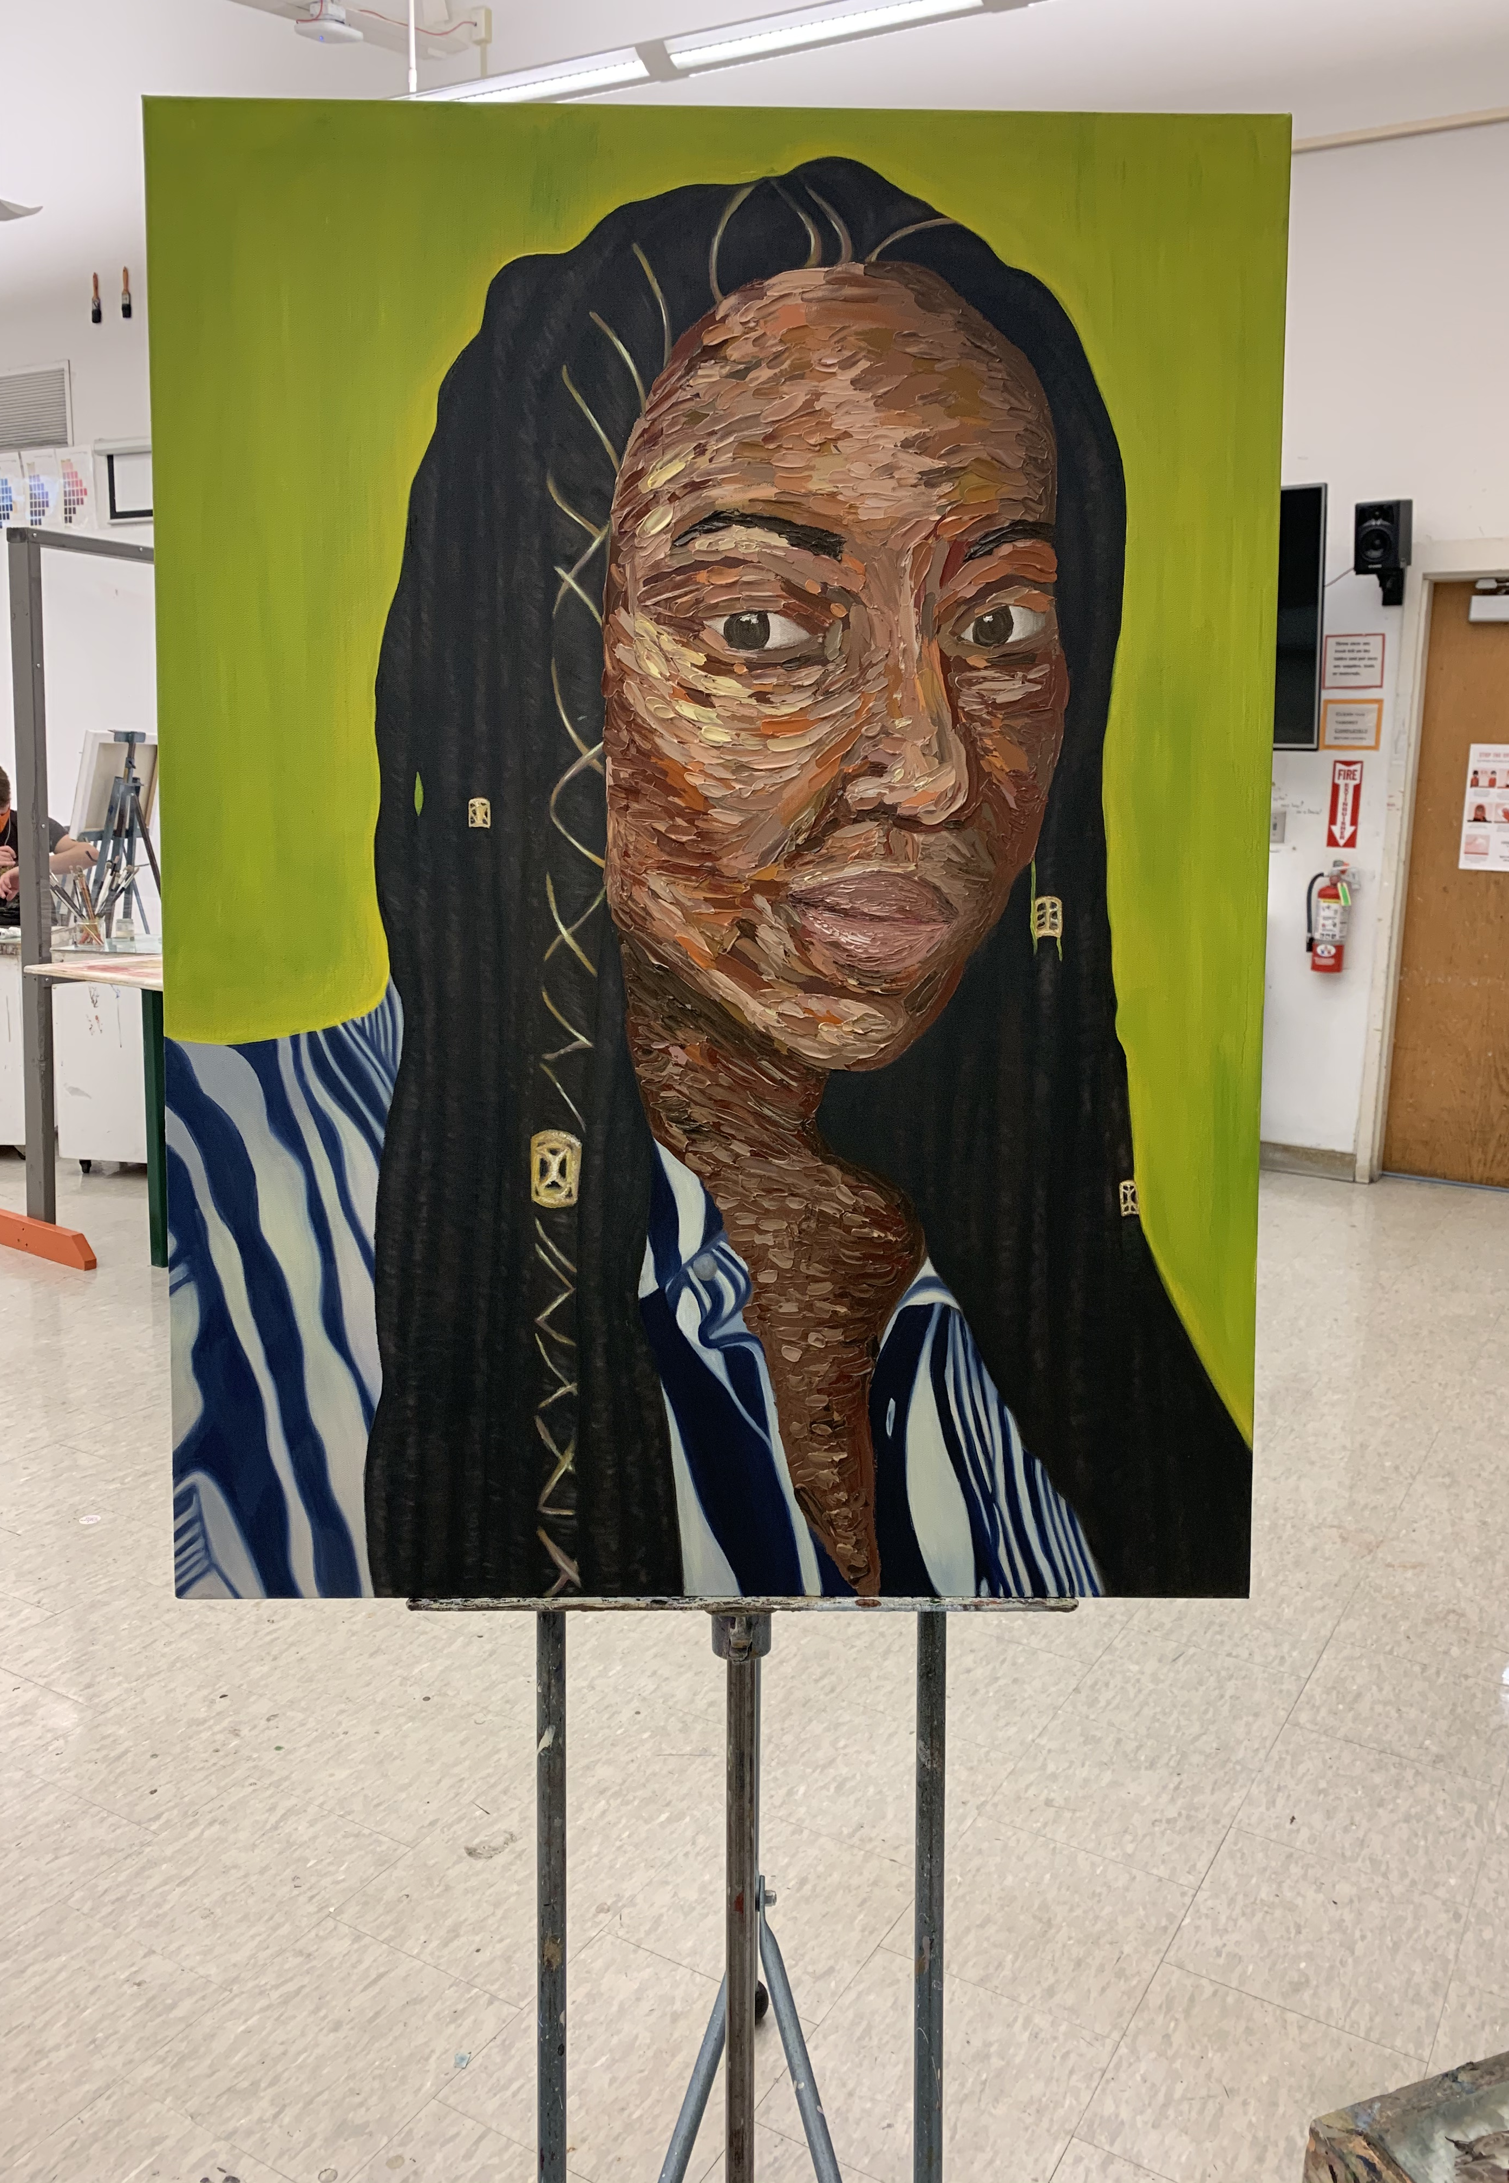
Progression Of Skyla
Notes:
My professor, and at the time, faculty advisor Mille Guldbeck continuously worked with me every day whether it was in class or scheduling meeting times out of class to help me with this painting.
Mille gave me a safe space in the classroom to speak about race comfortably and without judgment.
She allowed me to finally feel welcomed into the art community and gave me lot of inspiration to help me express myself for who I was.
This step in my life allowed me to find my own style and techniques. It allowed me to develop into an artist and I could physically see the improvement in my work and mentally within my own confidence and sense of belonging.

Slide 20
Skyla, 2020
Notes:
It is so very important for representation to be shown to all students. Like a little girl seeing princesses that look the same as her and share her same pigment, or little black boys seeing a superhero that looks just like him, all people deserve to be inspired. Especially African Americans who are often ignored when it comes to seeing people like them in positions of power or authority.
Seeing people that look just like us doing the things that we want to do proves to us that we can make it. I went from never seeing a black artist making it in the world to seeing someone that looked just like me doing the things that I wanted to do in life. This part of my life changed me immensely

Slide 21
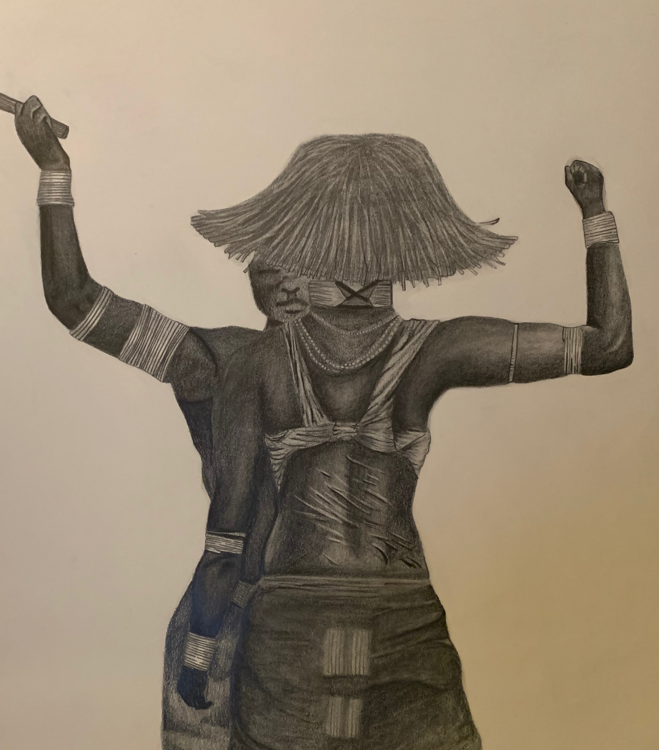
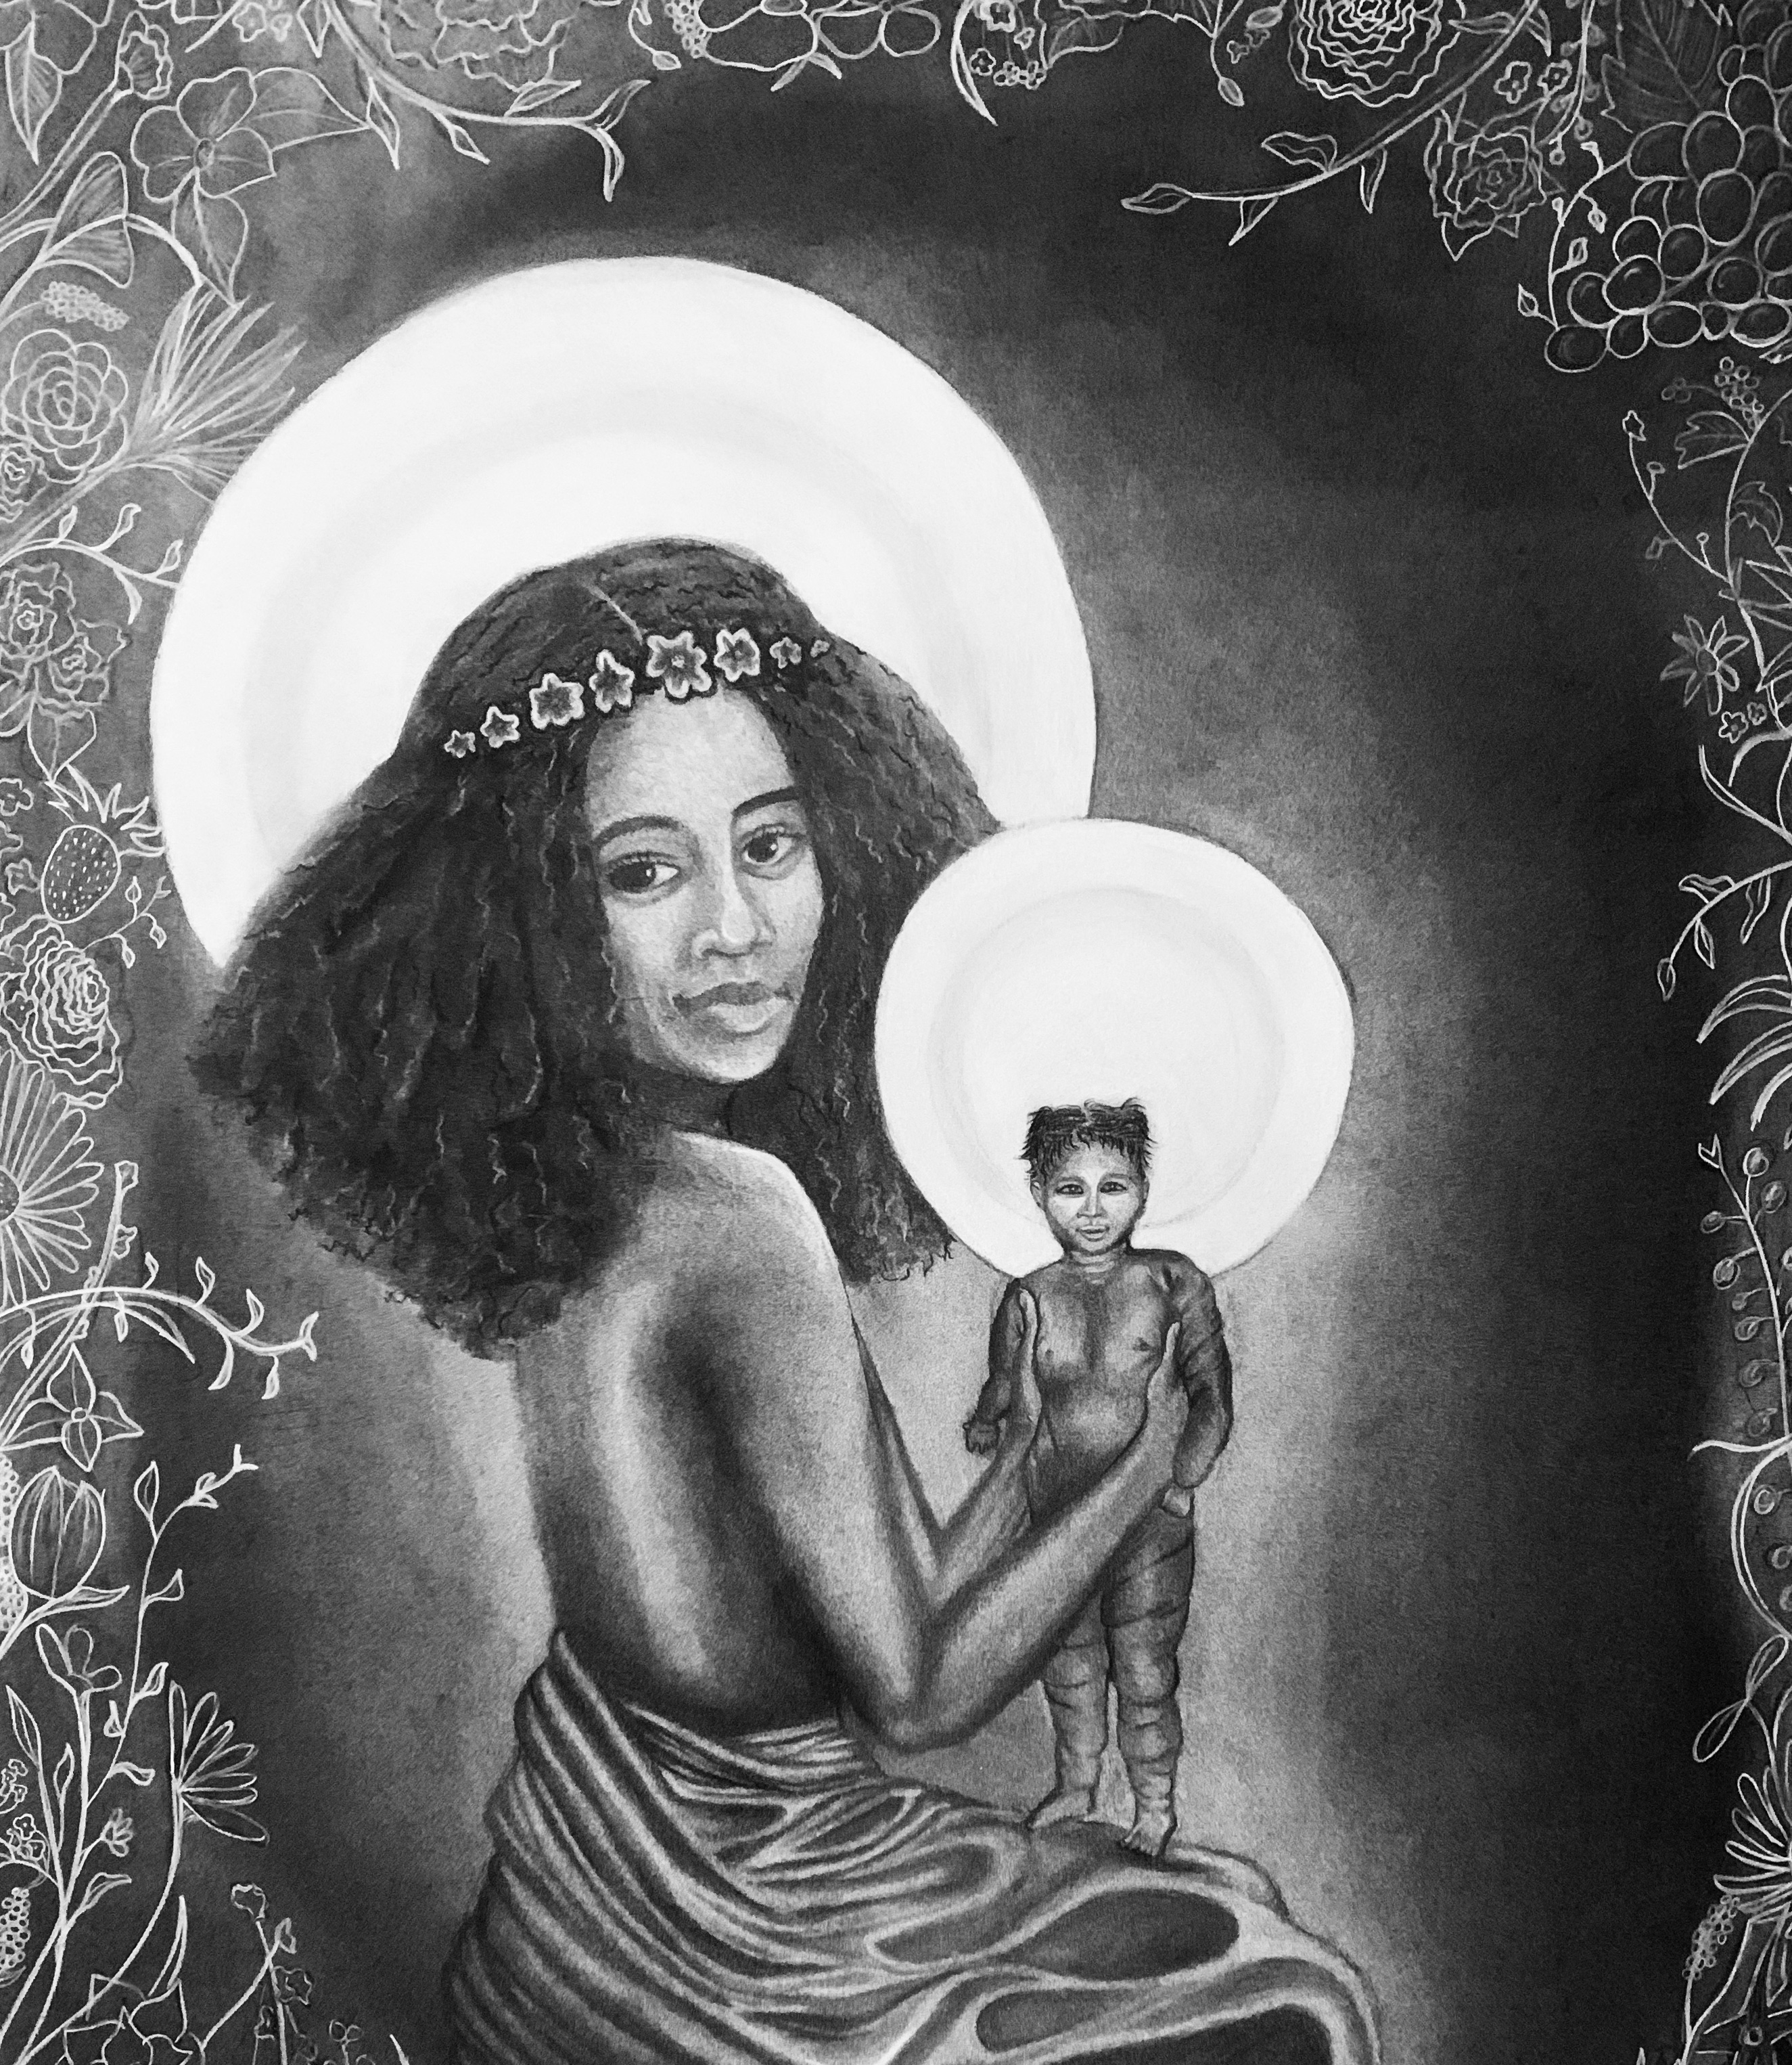
Blackness and Comfortablility
Notes:
Through the shift in my life, I was able to discover my talent.
It’s amazing how much I improved just based on feeling more confidence and finding my own path in visual arts.
Here are some more works of mine that show African-Americans within art. They are displayed as beautiful and worthy of being exactly where they are. They are the main focus; they show confidence within themselves which is exactly what I was striving for.

Slide 22
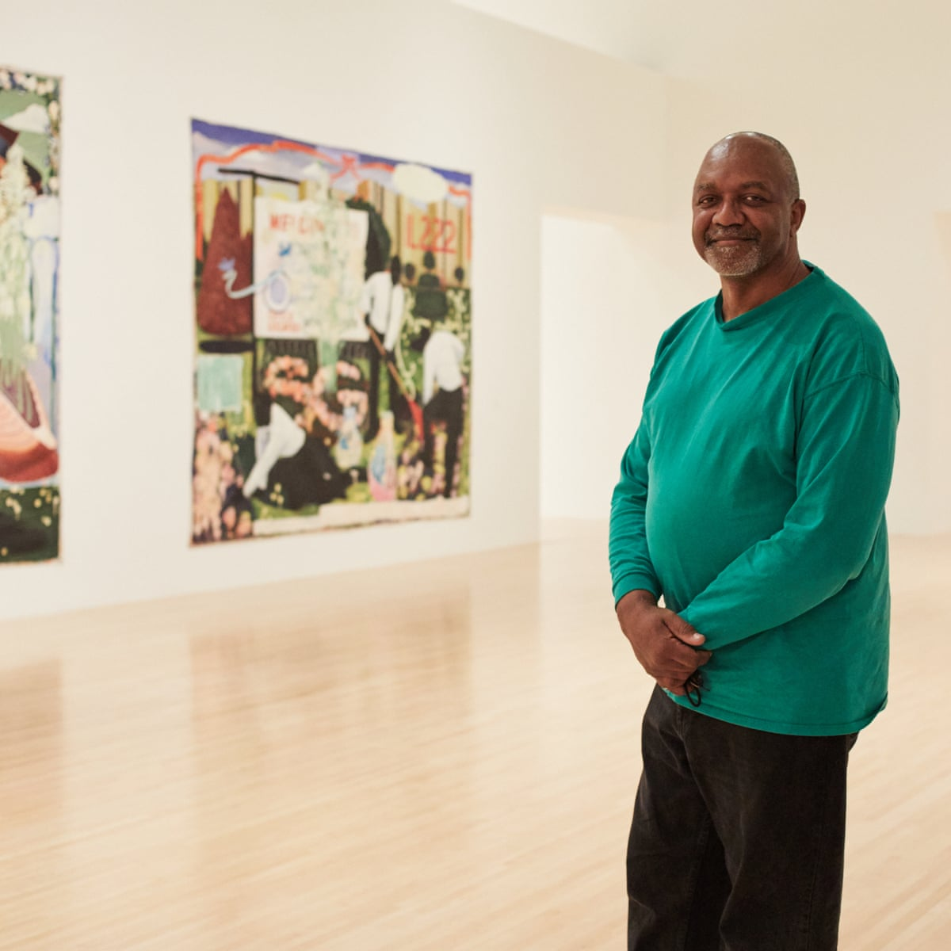
Kerry James Marshall
Born October 17th, 1955
Birmingham, Alabama
African-American artist

Slide 23
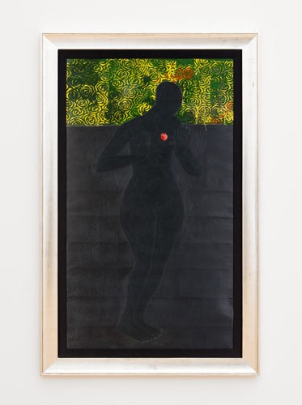
Kerry James Marshall
“Up until then, I had not considered that a black woman could be considered as a goddess of love and beauty. Even I took the classic European ideal for granted. After reading La Venus Negra I wanted to develop a stylized representation of the beauty that would be unequivocally black”
La Venus Negra Kerry James Marshall
Notes:
After my professor, Mille Guldbeck, introduced me to the artist Kerry James Marshall, my eyes were opened completely to the idea that I was not the only black artist out there that suffered from western European standards pushed upon black people.
Like Kerry James Marshall, I was able to step out of these ideas and into my own style of art that involved a lot of black subject matter.
A lot of KJM’s art is mainly focused on black history, living and economic status.
I am very inspired by his work because its exactly the type of interest I have. I think all students should know about KJM and teachers should look into adding him into their art lessons and or art history lessons. His art deals with African American struggles as wll as praises African American beauty and strength. He will inspire many in his life and after.

Slide 24
Art Education and Race
Notes:
I learned a lot in my life about education, race and inclusion from having to go through it all as a child and young adult.
From my growth as an artist, I can say that the biggest thing that helped me the most was and a good professor who is available for you and makes you feel included.
Through my own teaching as a future art educator, I want to focus on how I can improve the classroom for all students. I know how hard it is to feel uninvolved in most aspects of school, so I want to do my best to make sure I eliminate that in my future classroom. There are some ways I can actively change this situation for the better.

Slide 25
Diversity In Curriculum
Showing students of all nationalities a diversity set of artists
Teaching students how to make all skin tones
Diverse teaching staff

Slide 26
Showing Students Of All Nationalities A Diversity Set Of Artists
All students of the class learn about all the different kinds of artists in the world.
All children feel represented equally
No child feels left behind or unwelcomed
Inspiration that comes from all around the world and all types of cultures

Slide 27
Teaching Students How To Make All Skin Tones
Notes:
I will strive for the upmost equality, which means that I want all my students to be taught the same things.
Teaching a child how to make all types of skin tones is only the beginning of this situation. I use this as more of an example because it stands for something way more important. A sense of belonging.
As I stated previously, I struggled with this very issue because I was never taught how to make my own shade of brown in art school until I was twenty years old.
Even if it seems like a simple problem, it just goes to show how many black art students are overlooked and ignored.
Inclusivity means so much for children. Like my professor Mille, I will strive to make time for every student. Making the environment a safe space.

Slide 28
Diverse Teaching Staff
Percentage distribution of teachers in public elementary and secondary schools, by race/ethnicity: School years 2003–04 and 2015–16
National Center for Education Statistics
Spotlight a: Characteristics of public school teachers by race/ethnicity. (n.d.). Retrieved March 25, 2021, from https://nces.ed.gov/programs/raceindicators/spotlight_a.asp
Notes:
Lastly, we need to ensure that American public schools and colleges hire more people of color.
This last one seems to be out of my control, but it truly is not.
I can push to inform all people of this problem and work hard to change it. Raising awareness is key to solving many issues.
There is power in numbers and if I can use my voice to shed light on injustice, I will.
This is a statistic from the National Center for Education Statistics. It is the Percentage distribution of teachers in public elementary and secondary schools, by race/ethnicity: School years 2003–04 and 2015–16.
It shows the unequal spread of teachers throughout the country starting from 2003-4 school year and comparing that to the 2015-16 school year. As you can see, it proves that not much has changed at all.
There is a drastic shift from white to black teachers. Students need to have more teachers of all races. This shows students that they can have jobs like that one day, it shows them people that look like them in positions of power and it allows teachers to be able to relate to a student.
Because I went through a lot of inquality because I was a black student, I understood how that made me feel and hurt me. I am able to use what I learned to relate to future black students and end the cycle of inequality.
Inequality instead of injustitce

Slide 29
Notes:
In closing, America is full of people of all nationalities and ethnicities. To ensure all students are receiving equal education, we must change the way we teach.
Through education and art, we can help children find their own identity and talents. To help them thrive, teachers, and future teachers like myself need to do more to ensure equality.
I was able to grow an artist but most importantly, as a person through inclusivity and equality. I became more comfortable in myself and in my art after struggling with both for so long. I can finally say that I am proud of myself because of how much I was able to grow and I can't wait to help children like my past self grow into confident artists and human beings.
Thank you for listening

