Slide 1
Cassandra Waltmire

Slide 2
What does California look like from a mid-western’s perspective?

Slide 3
I wanted to experience west coast culture while exploring architecture, local artists, and designers. I planned to capture the art, culture, and social issues of California through photos and videos.
Since I had never been to the west coast, I wanted to share my thoughts on everything as well as show what it’s like for other people who can’t go to California.

Slide 5
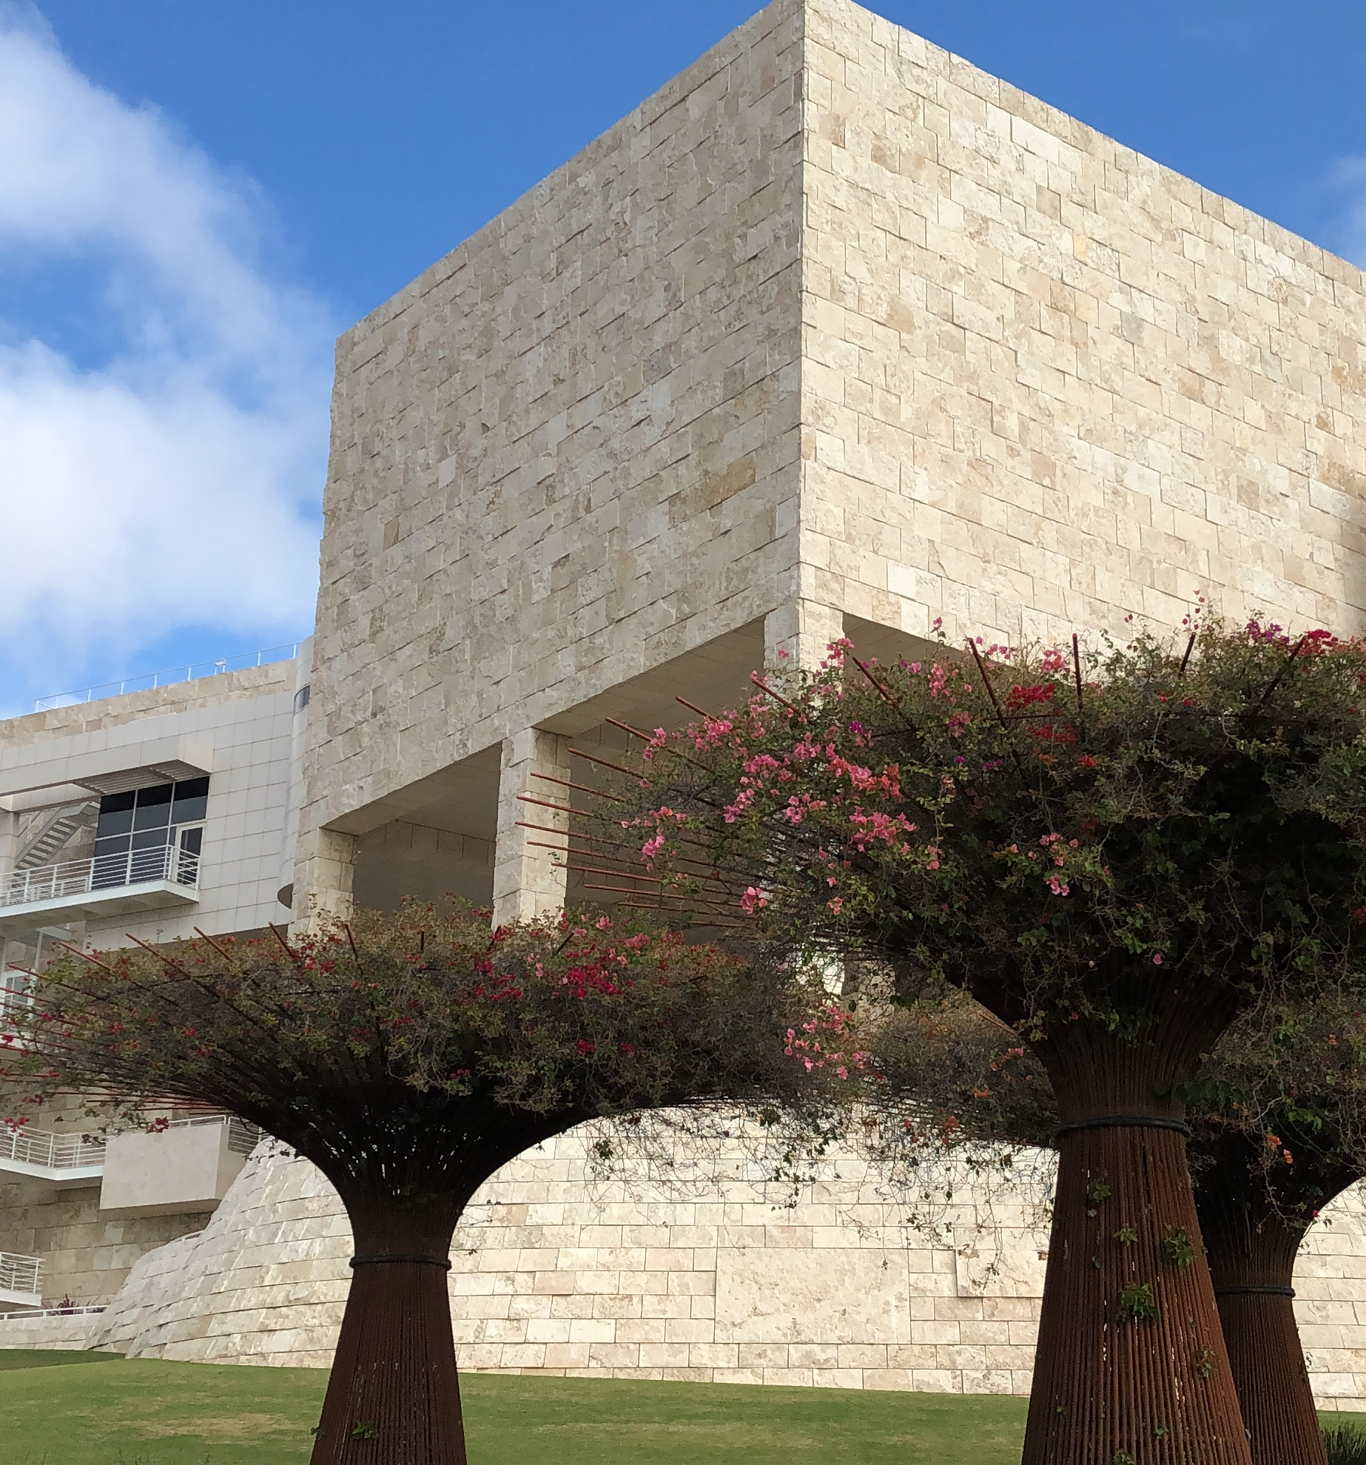
THE GETTY

Slide 6
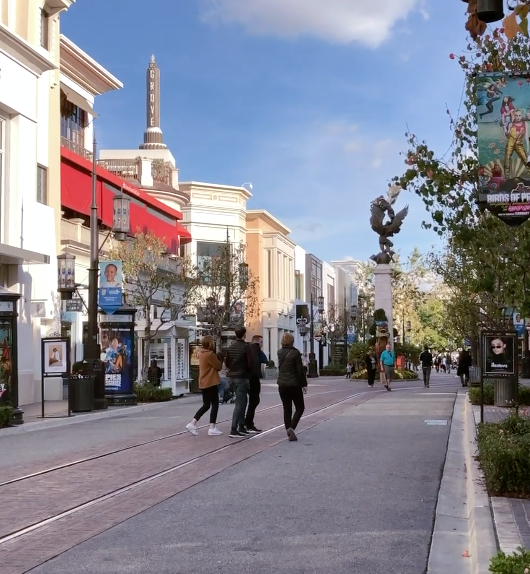
MELROSE AVENUE

Slide 7
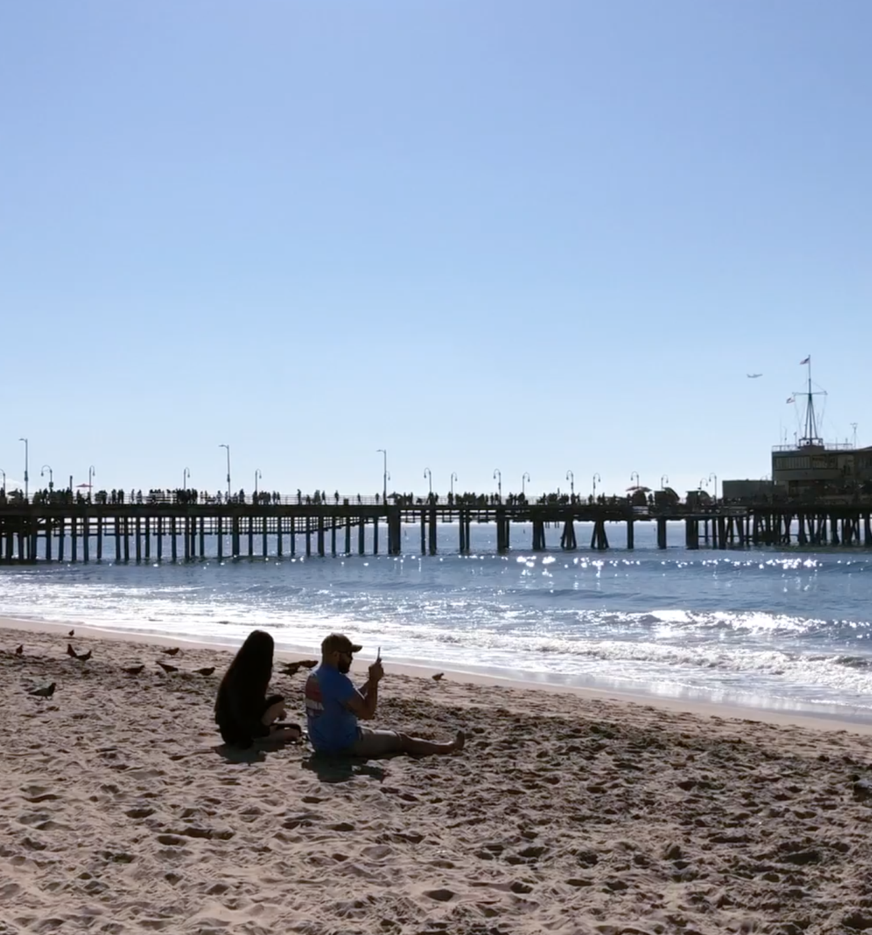
SANTA MONICA

Slide 8
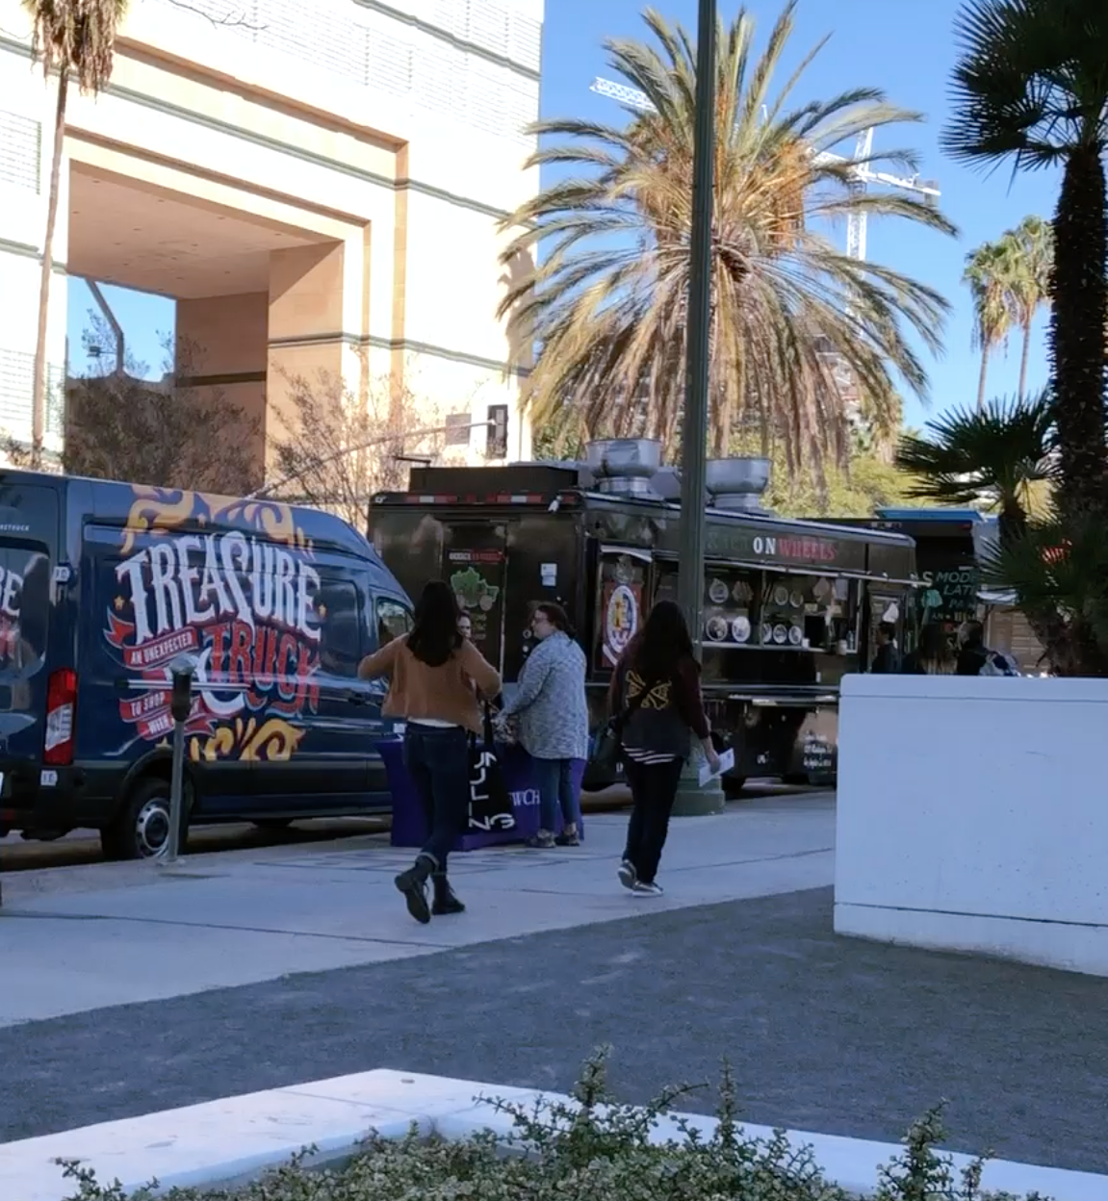
THE FOOD

Slide 9
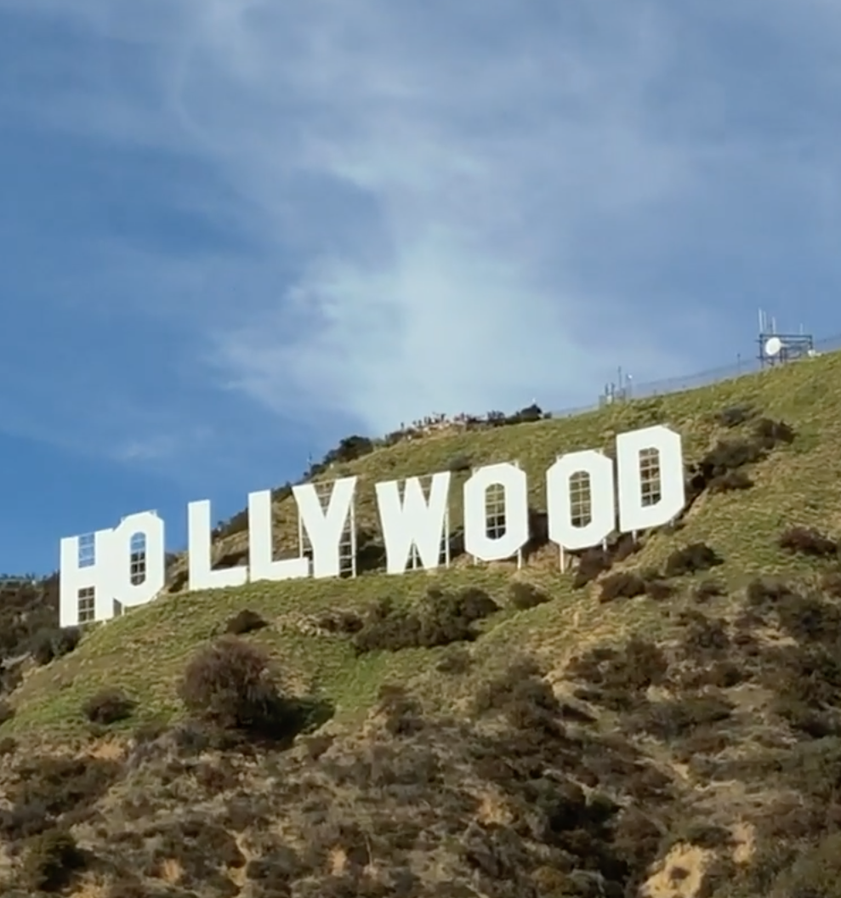
THE HOLLYWOOD SIGN

Slide 10
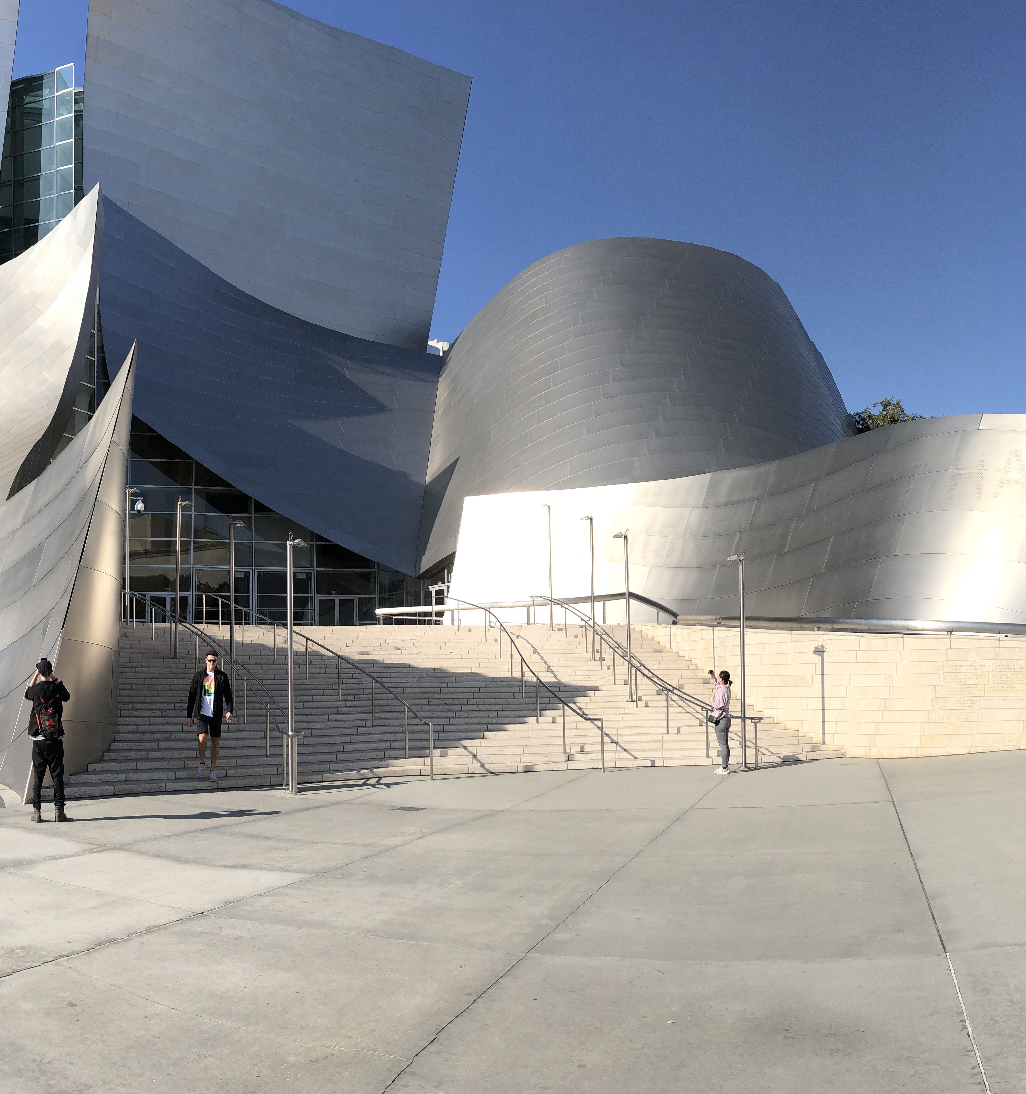
DISNEY CONCERT HALL & THE BROAD

Slide 11
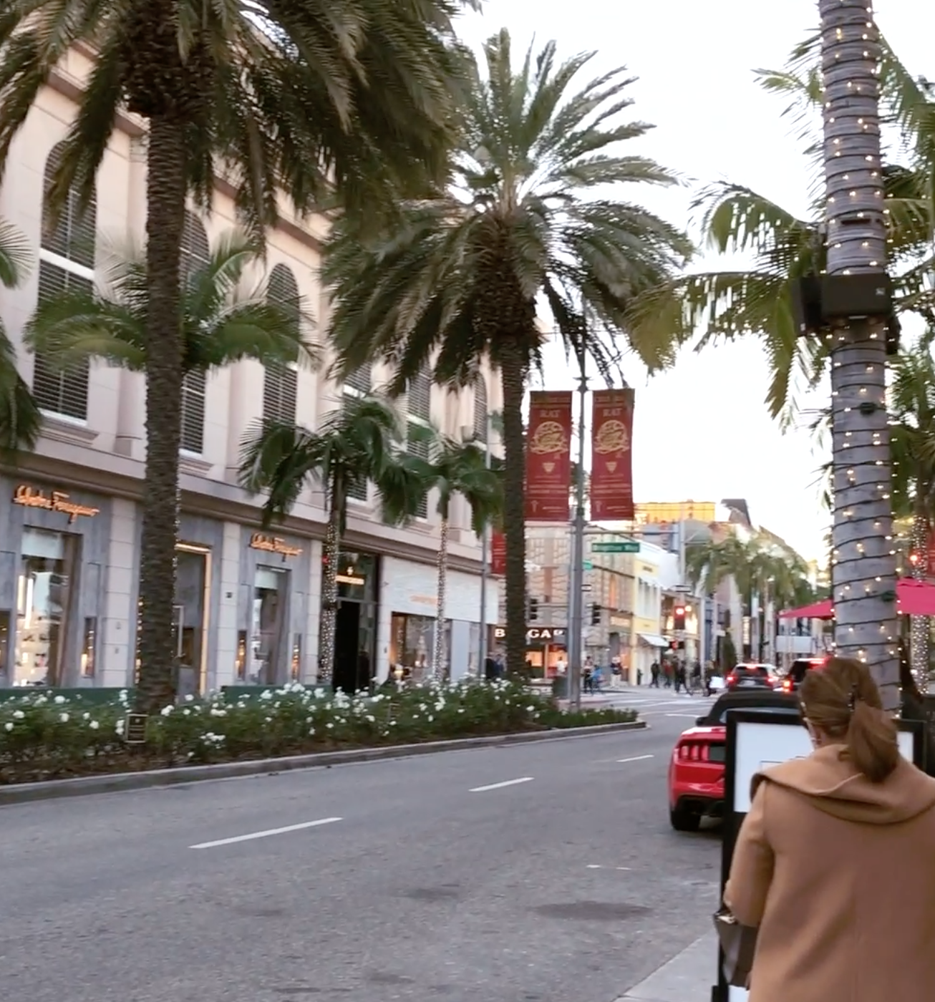
RODEO DRIVE

Slide 13
Everyone spoke Spanish

Slide 14
The buildings are beautifully designed

Slide 15
People were friendly – especially on public transportation

Slide 16
Everyone has a dog to keep them company

Slide 17
There’s street art everywhere

Slide 18
It’s sunny and beautiful every day

Slide 19
Traffic is crazy

Slide 24
LA Culture
Cassandra Waltmire

