Slide 1
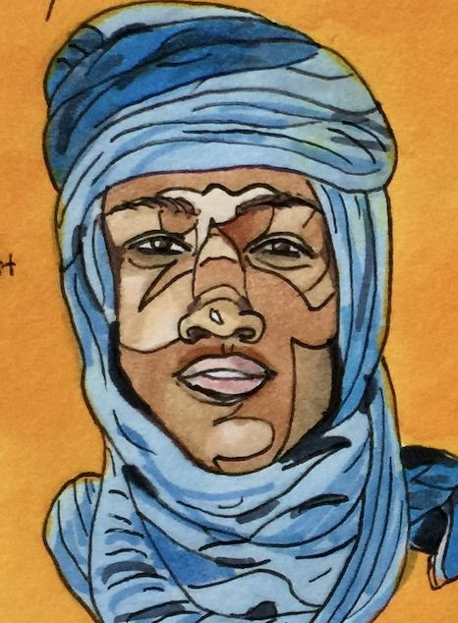
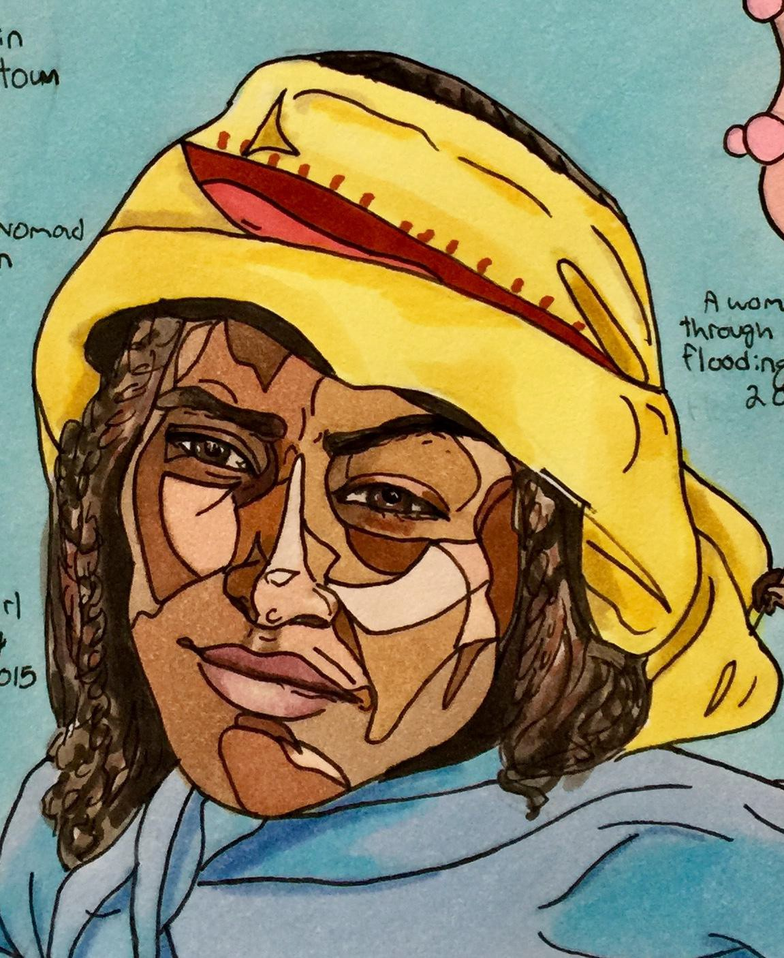
The Illustrated Atlas of Africa
By Samantha Davis

Slide 2
“And if we cannot end now our diﬀerences, at least we can help make the world safe for diversity. For, in the ﬁnal analysis, our most basic common link is that we all inhabit this small planet. We all breathe the same air. We all cherish our children's future. And we are all mortal.”

Slide 3
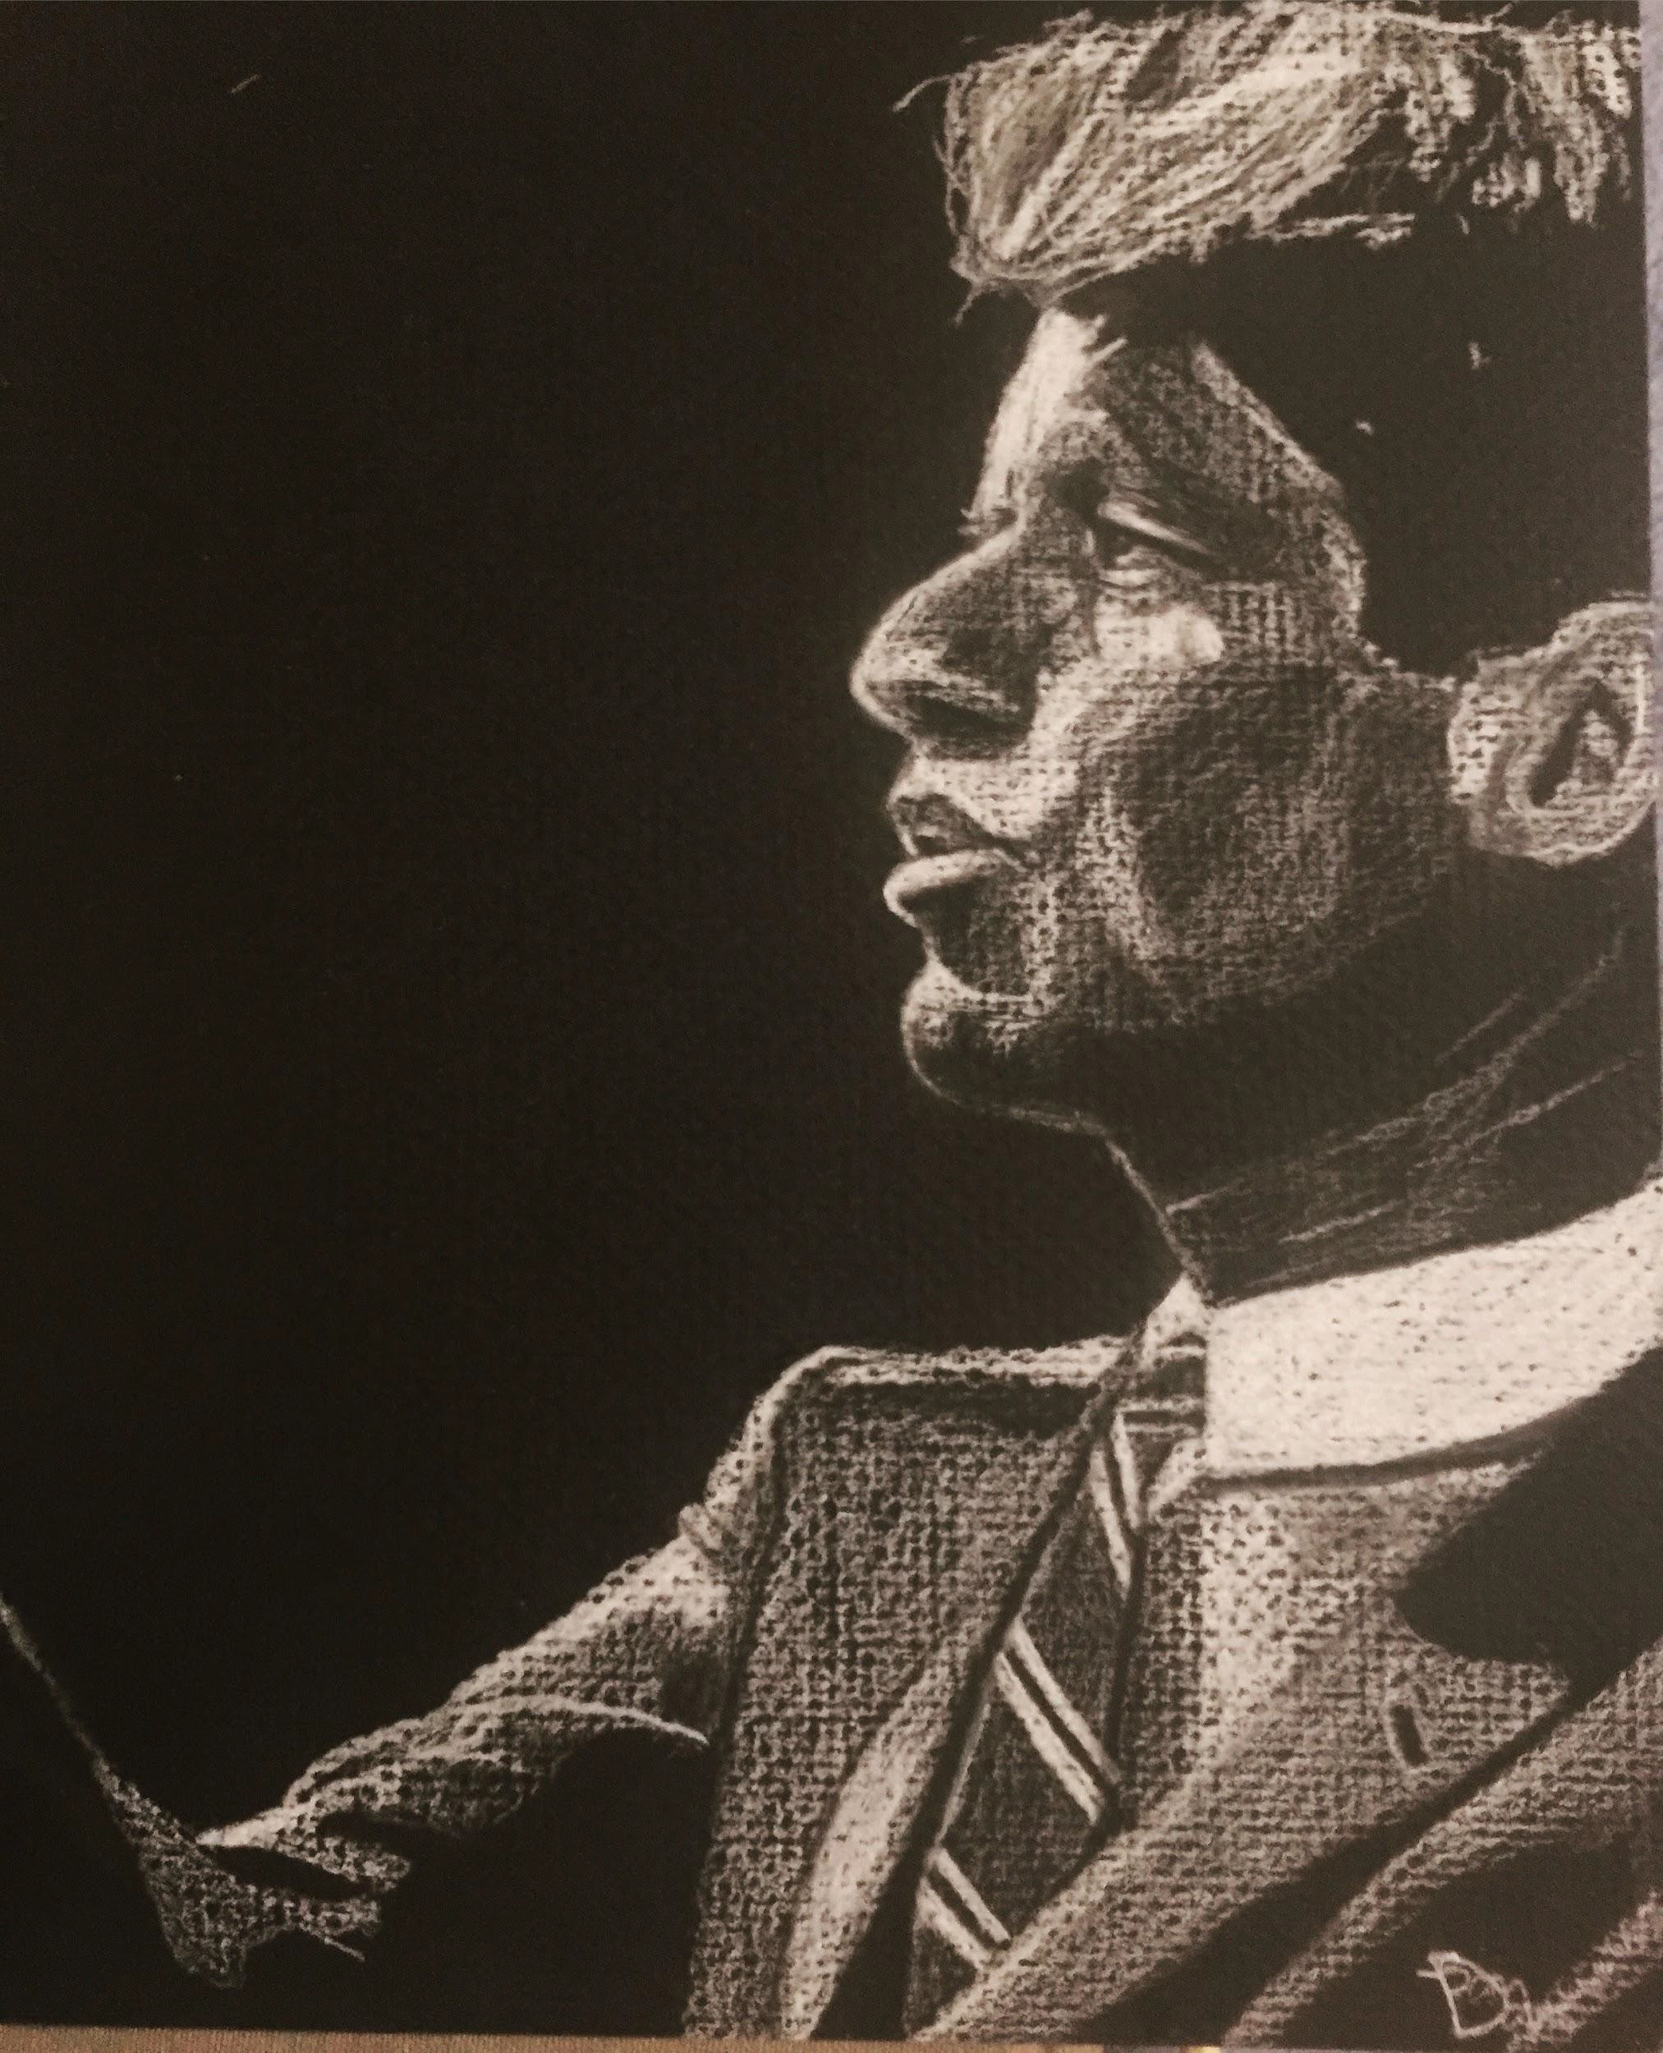
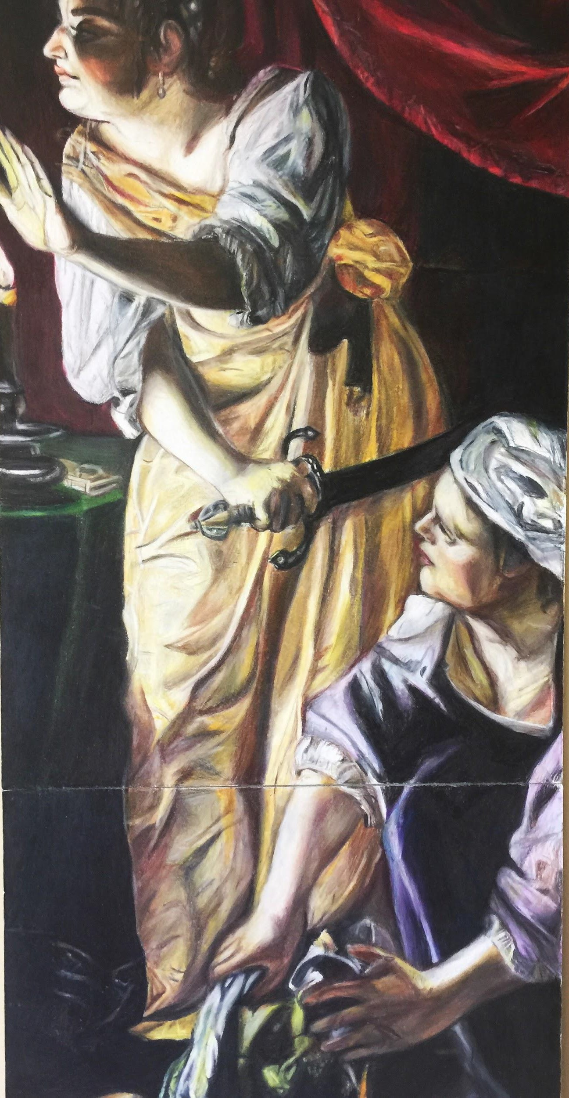
About Me
History major and artist
Geography nerd
Specializing in African studies
Working on an illustrated atlas of the world for the past year and a half

Slide 4
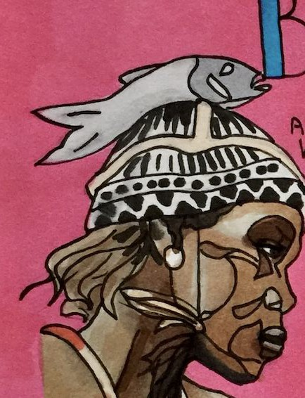
My Project- Why Africa?
Wanted to focus on a single continent to complete
Africa is the continent Americans learn the least about
I want to dispel common stereotypes about Africa
I want to educate people in a fun and engaging way

Slide 5
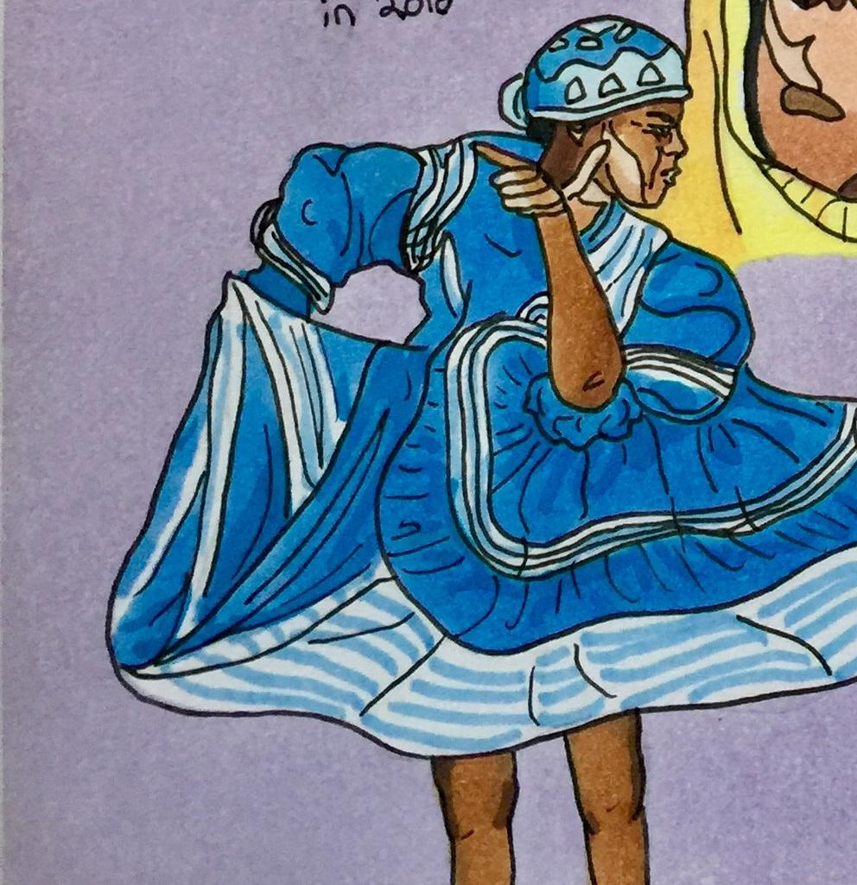
Research and Photos
Finding valid, accurate information about third world
nations requires many sources
I begin by reading about the nation in books
I make sure to use/compare sources from inside and outside of Africa
I consulted my African studies teacher a few times

Slide 6
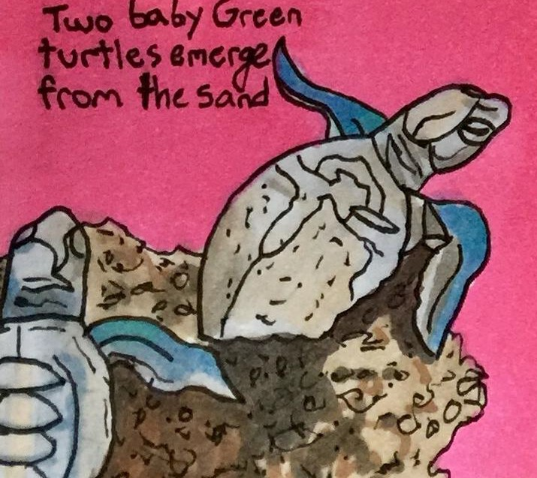
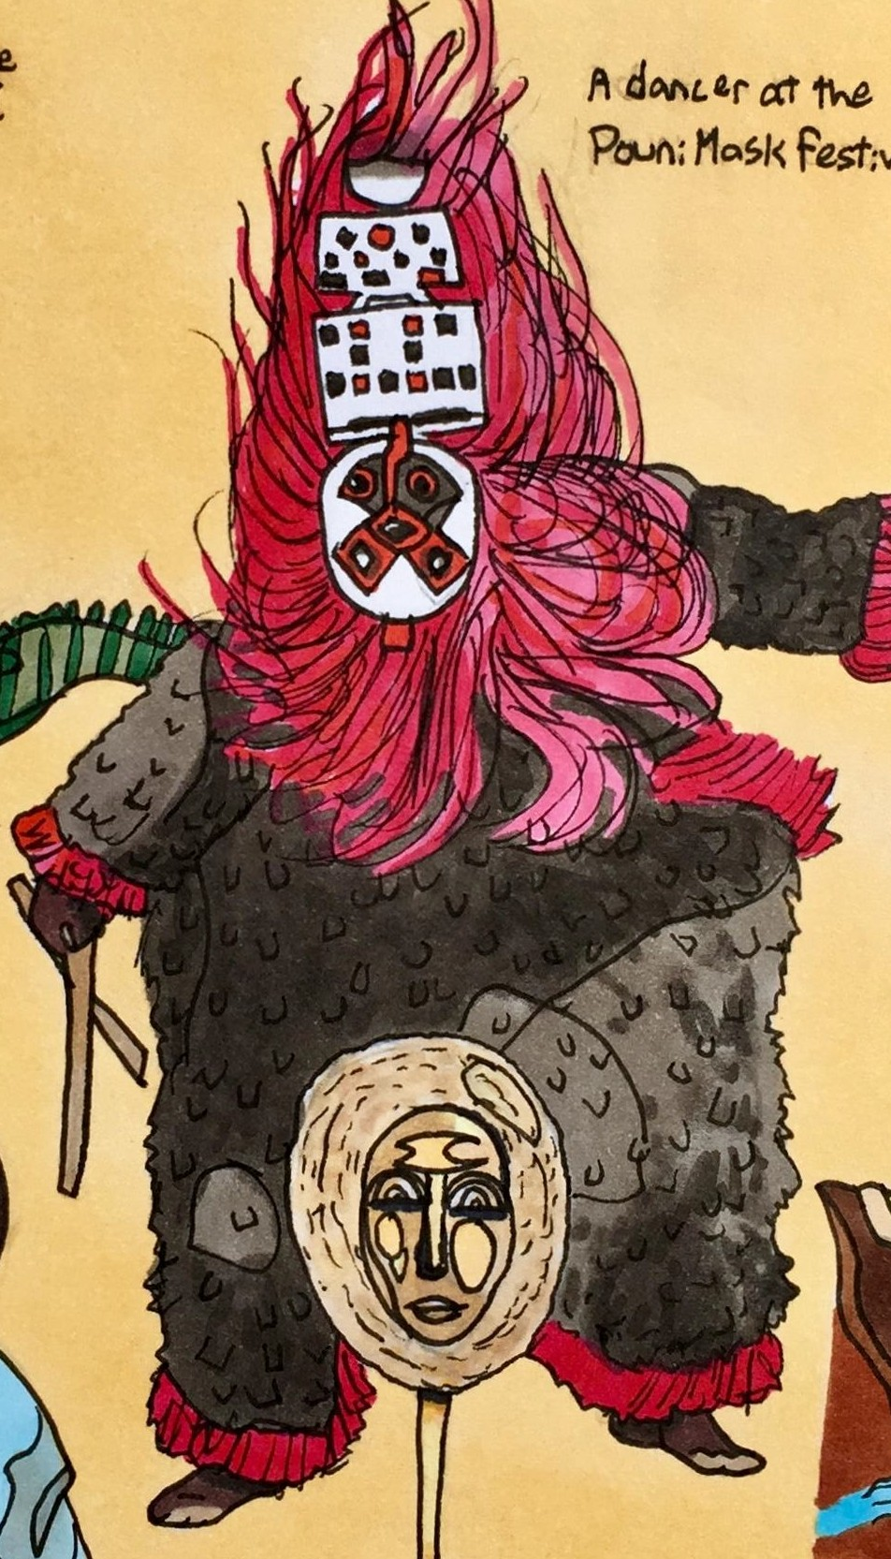
Getting Started
There are 54 African nations, each one gets a page
Every page includes ﬁve drawings and a hand-lettered title
I need to buy a lot of paper, pens, and copic markers

Slide 7
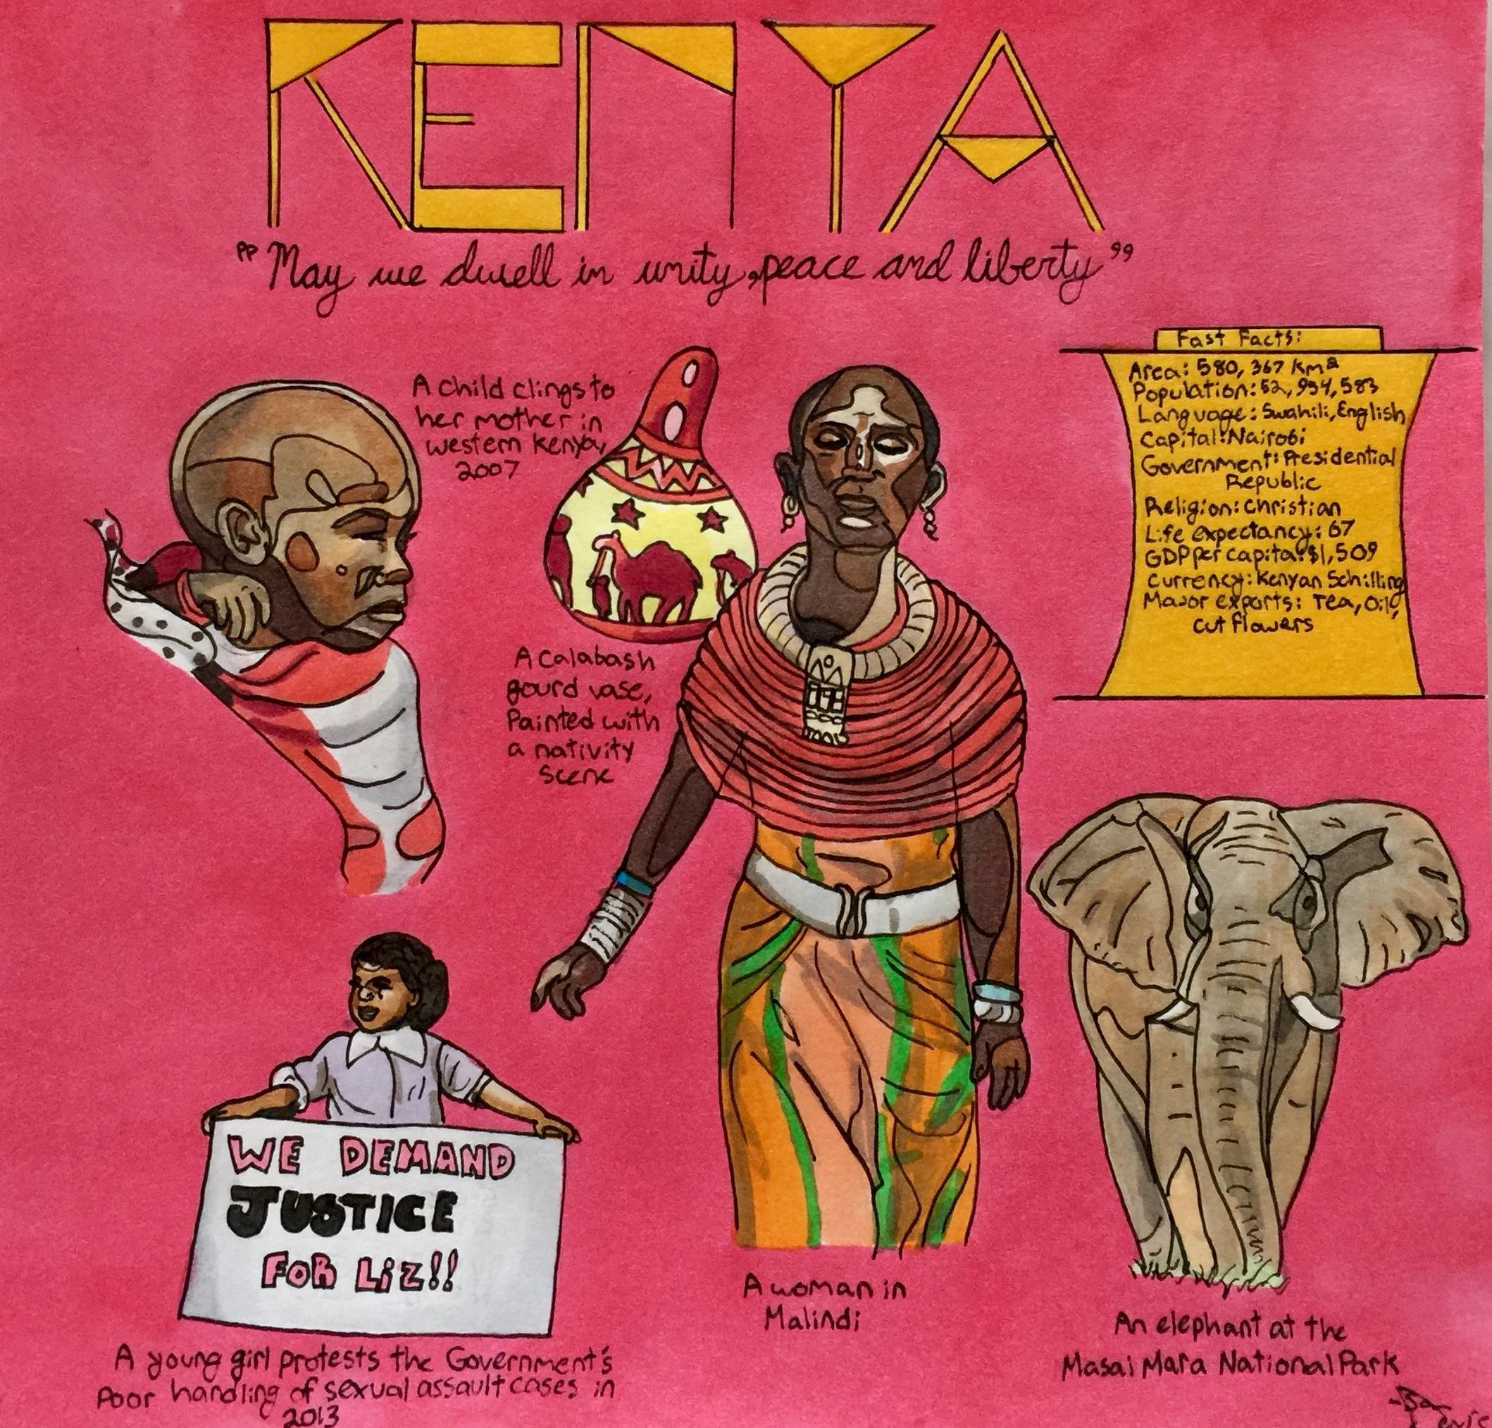
Anatomy of a Page
1
2
Hand-drawn title
Quote from national anthem
A “Fast Facts” box that contains 10 important
3
5
4
things to know
A drawing of a person in everyday life
A drawing of a piece of art, architecture or
6
7
a monument
8
A contemporary or historical issue
An example of culture or traditional dress
Am example of native wildlife

Slide 8
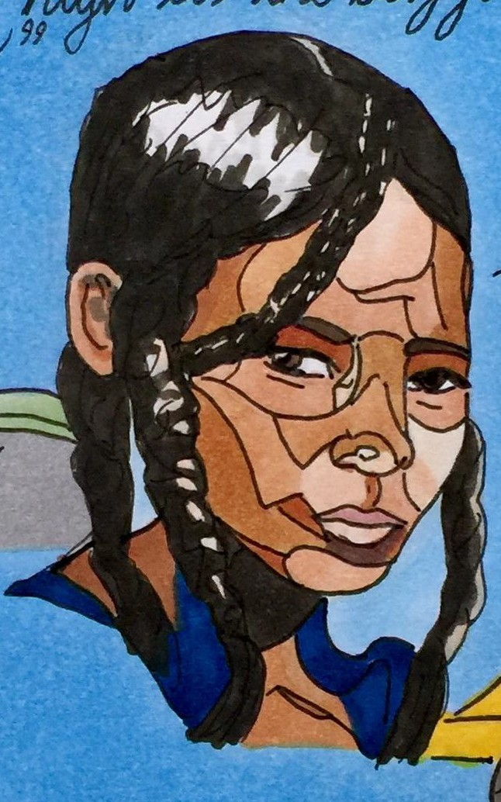
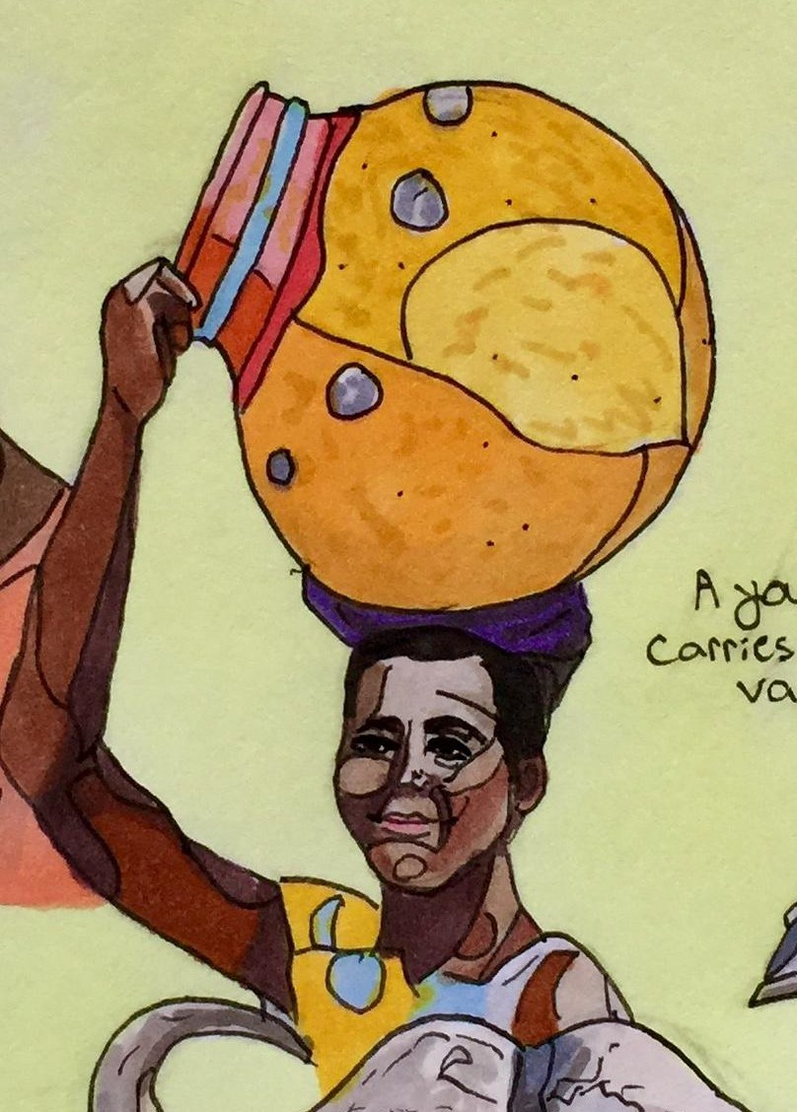
My Drawing Style
I have always drawn people by dividing up areas of light with outlines
I am using a limited number of colors with markers- unlike with paint, blending is hard
I think of it as resembling pop-art stained glass

Slide 9
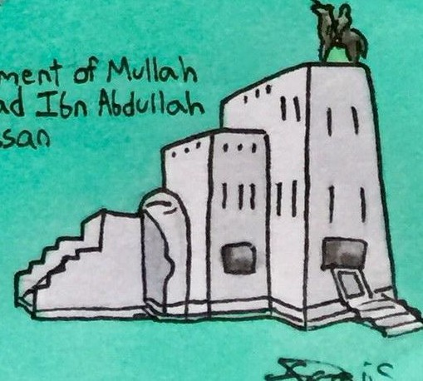
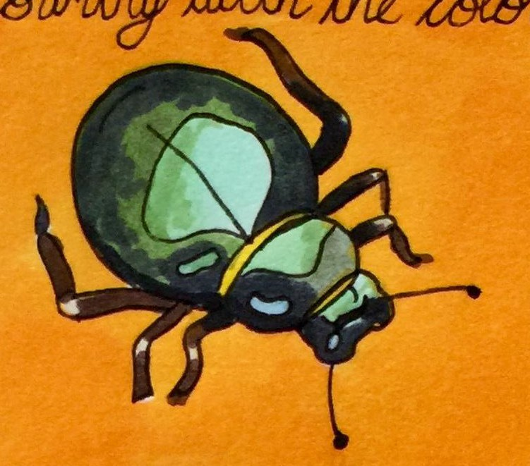
Challenges and Obstacles
Finding information in English without a Western bias
Hand-drawn art allows for no mistakes!
Avoiding sources centered on “poverty tourism”
Updating information as Africa changes

Slide 10
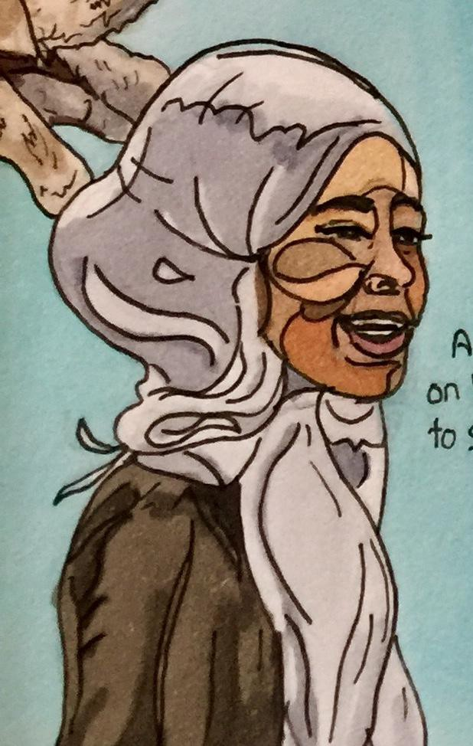
Finished Product
Over 200 individual drawings completed
Designed a cover and digitized the drawings
Over one quarter of the world’s countries in one book!
Learned about setting goals, research and my art

Slide 11
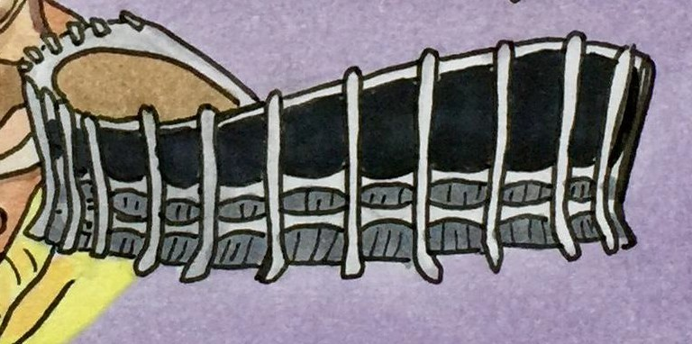
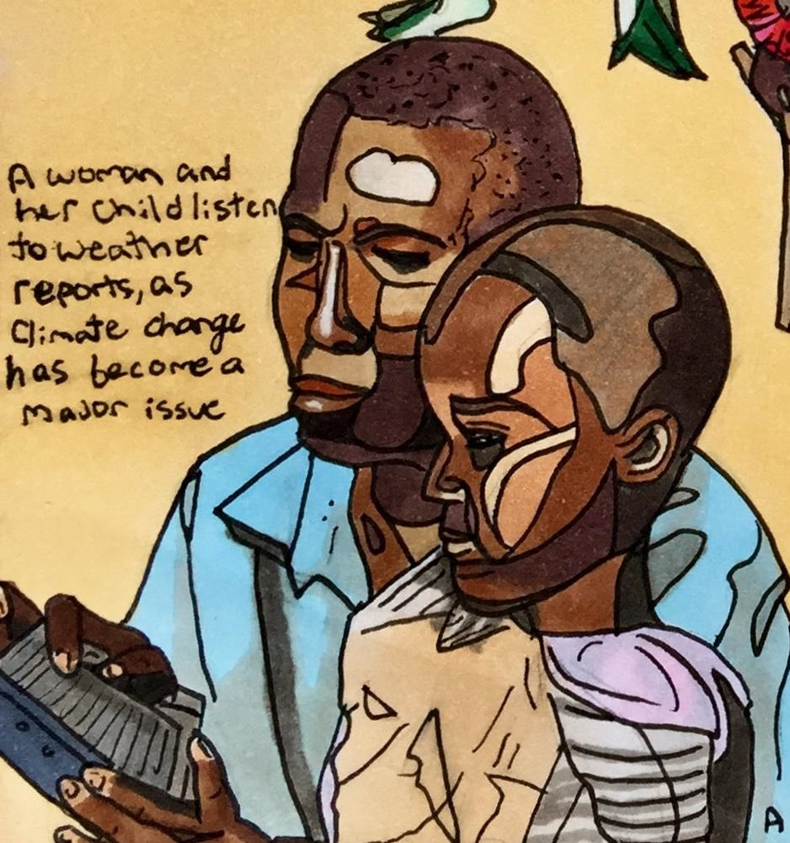
Sharing my Project
I shared my book with the education department
BG student-teachers can bring valuable and engaging information to young students
Education on Africa is very sparse in the U.S.
I plan to share my book through publication

Slide 12
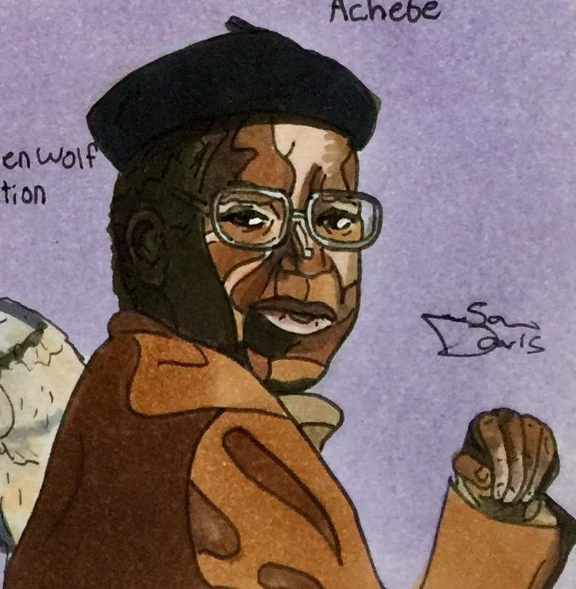
Not Finished Quite Yet...
I’ve completed all of Africa, but there are ﬁve other continents to go!
I have all nations that begin with letters A-K completed
I plan to continue on by focusing on one continent at a time- The Americas will be next!
Soon, every country will be completed and in a single book that I hope to publish

