Slide 1

The Presence of the Italian Renaissance in Modern Italy
Kait Adams

Slide 2
Outline
Introduction
  Purpose of research
Research Questions
Methodology
Limitations of Research
Results
Conclusion

Slide 3
Introduction
Italy is known for its great food, expansive landscapes, bold architecture, vivid colors, and explorative artists. Studying and understanding different time periods through school, Italy is a place of cultural shift throughout time. These monumental buildings, paintings and sculpture still inspire builders, artists, designers, and the like. But, what caused Italy to expand inﬂuence over many different nations?
The Renaissance began around 1400 in Florence, Italy and eventually spread throughout Milan, Rome, and the rest of Europe. The Renaissance spanned from the 14th to the 17th Century and it was the most profound art movement, it was the enlightened age of art and architecture due to a renewed cultural interest in classical antiquity (Richman-Abdou, 2017). The Italian Renaissance is known as the golden age of music, literature, and art, and has been the muse for many famous Renaissance artists: da Vinci, Michelangelo, Raphael, Botticelli, just to name a few, and father of Renaissance architecture Brunelleschi.

Slide 4
Purpose of Research
The purpose of this research project was to study the preservation and continuation of the arts and architecture of the Italian Renaissance in modern Italy, during the study abroad course, FCS 4800: Cultural Explorations in Italy. We visited several different cities: Rome, Sorrento, Florence, Cinque Terre (La Spezia), and Milan, these locations will be the case studies used in this research.

Slide 5

1. What were the factors that led to the emergence of the Italian Renaissance?
2. How did the Italian Renaissance impact modern Italy?
Research Questions
3. How prominent is the renaissance in modern Italy?

Slide 6
Methodology
Information was collected and analyzed from books, articles, pictures, and videos relating to Italian Renaissance inﬂuenced buildings and art in Rome, Alberobello, Sorrento, Florence, Milan, and Cinque Terre (La Spezia) in Italy.
The cities were then compared against each other to determine the prominence of that era in their modern state.

Slide 7
Limitations of Research
Location selection
Availability of time for visitation

Slide 8
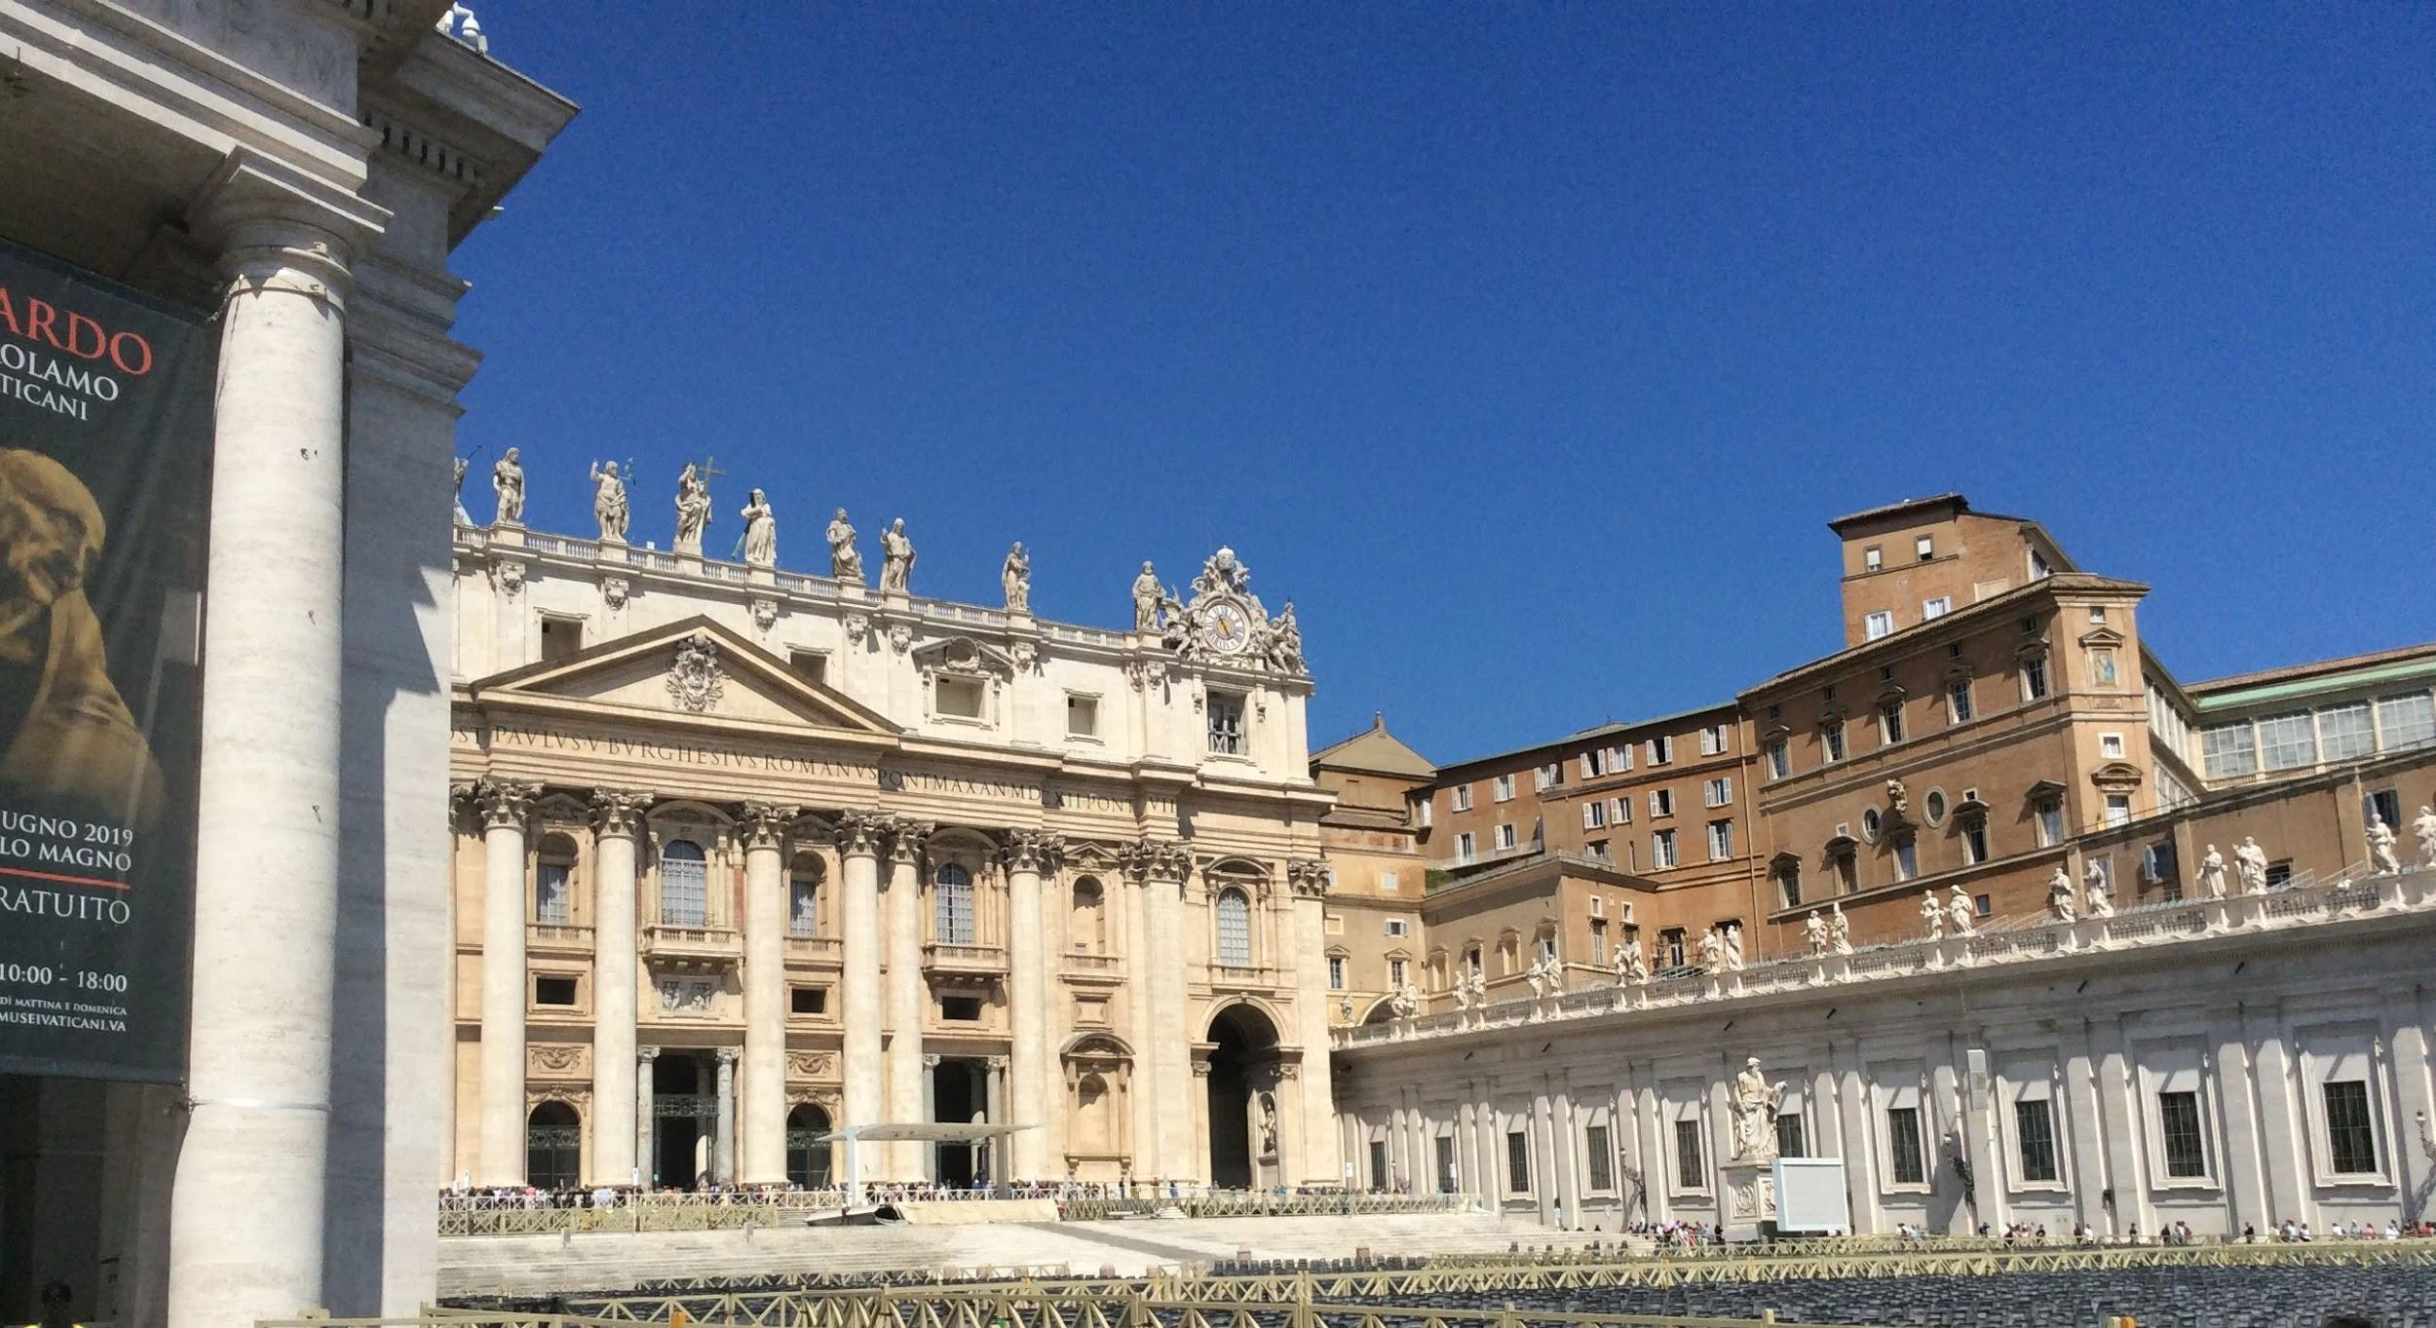
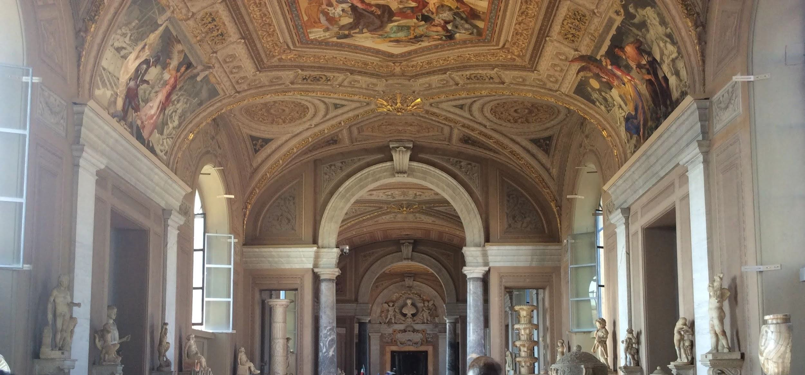
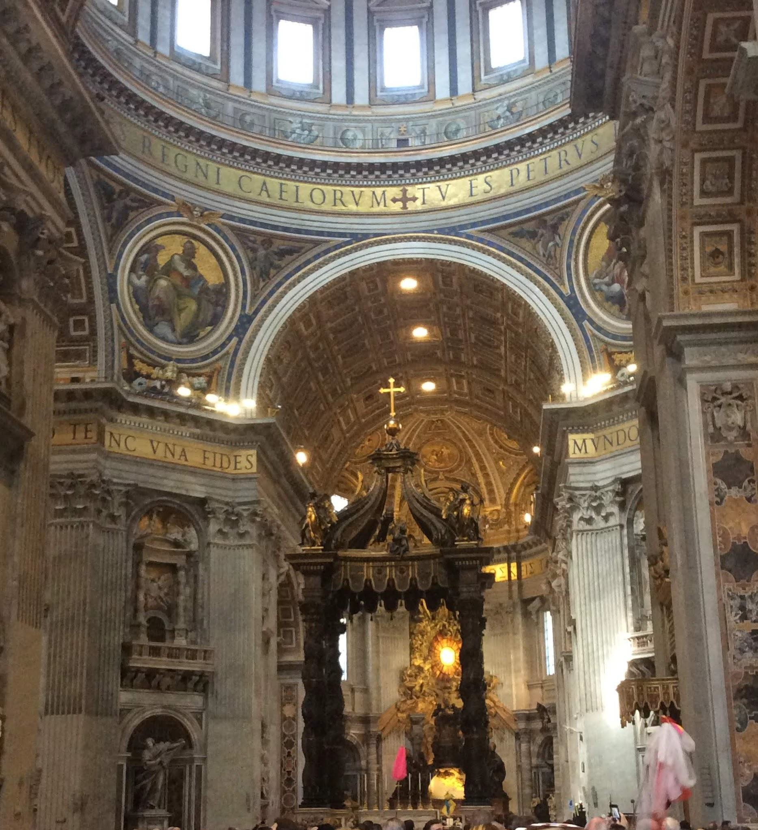
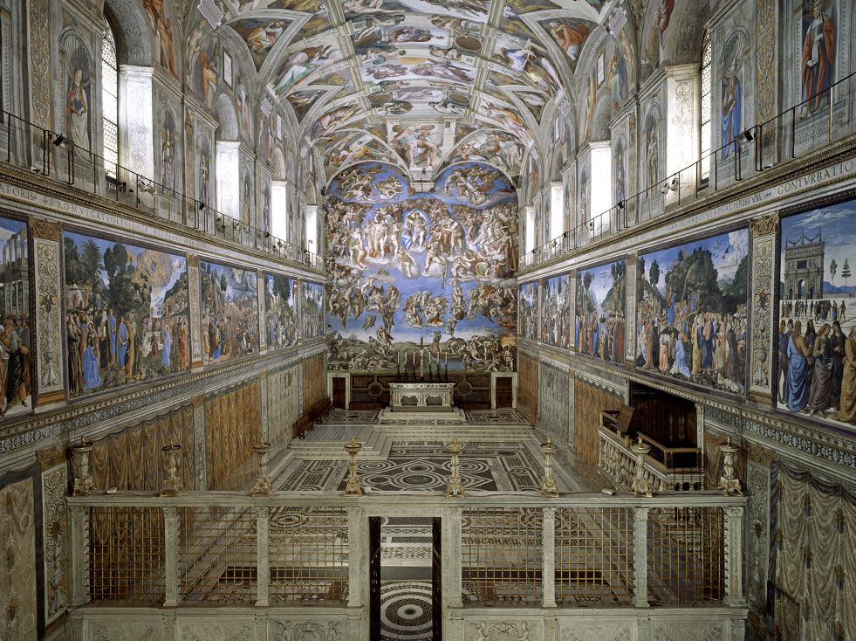
Results Location 1: Rome
Figure 1. St. Peter’s Square
Figure 3. The Vatican Museum
Figure 2. St. Peter’s Basilica
Figure 4. Sistine Chapel. (Cerisola, 2010)

Slide 9
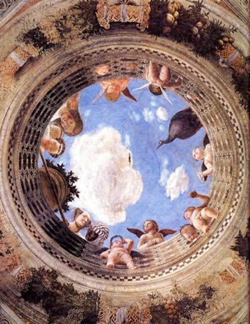
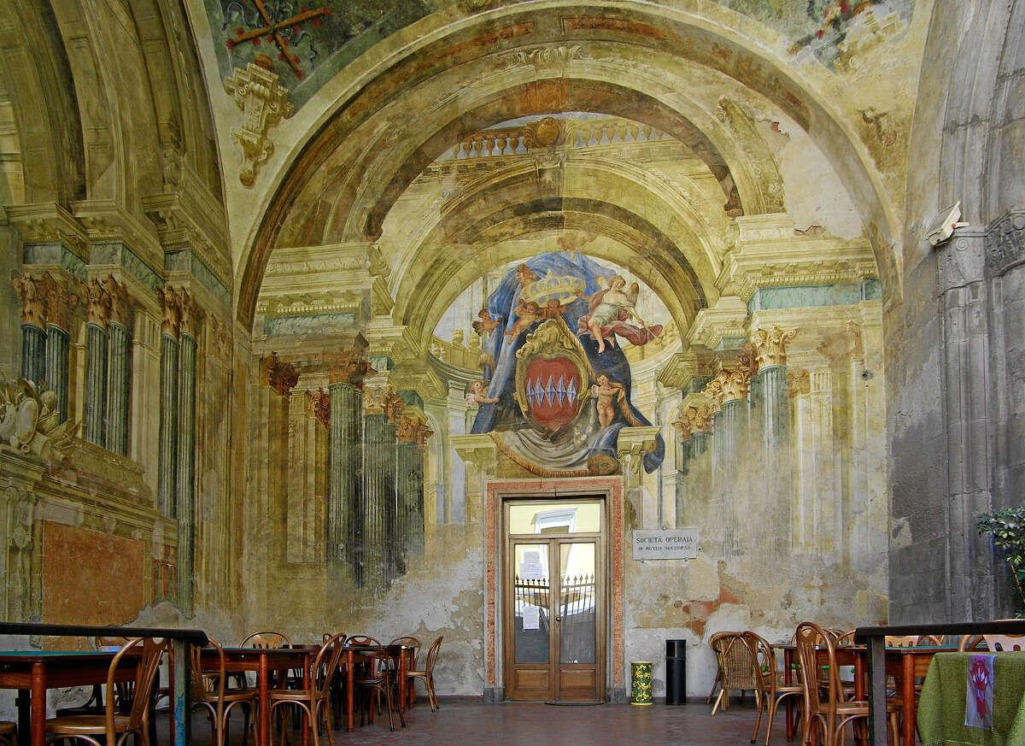
Location 2: Sorrento
Figure 5. The Sedile Dominova
Figure 6. The Oculus also Known as Camera Degli Sposi. (Mantegna, 1473).

Slide 10
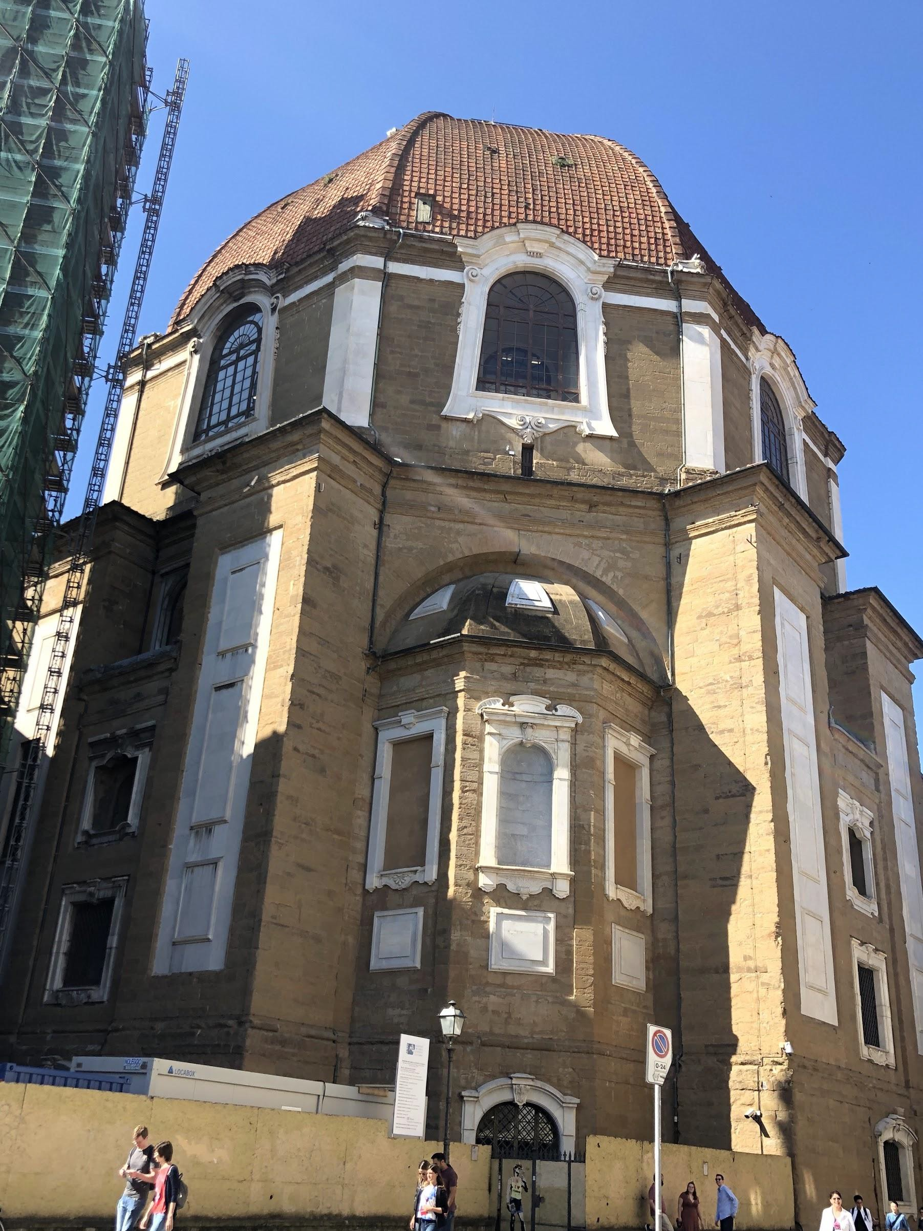
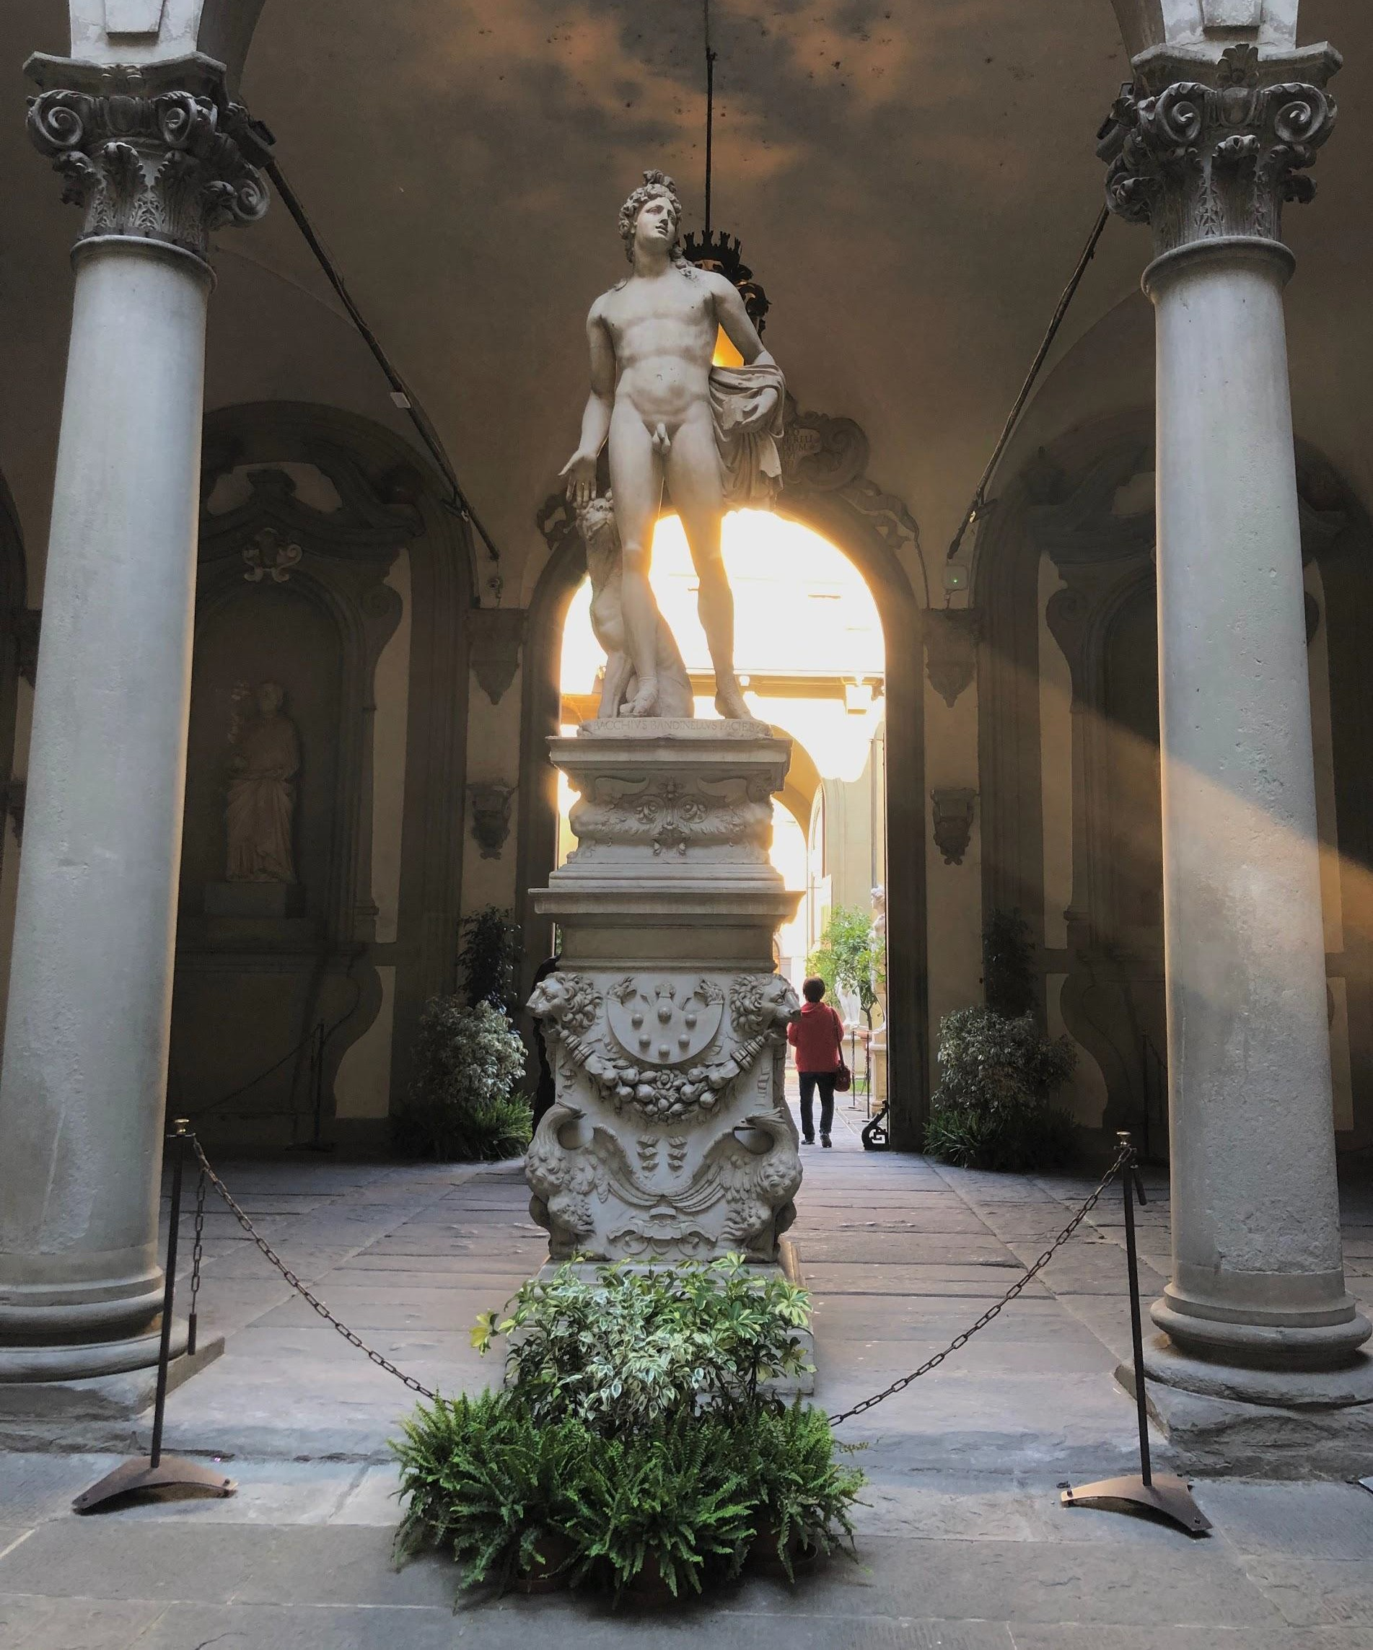
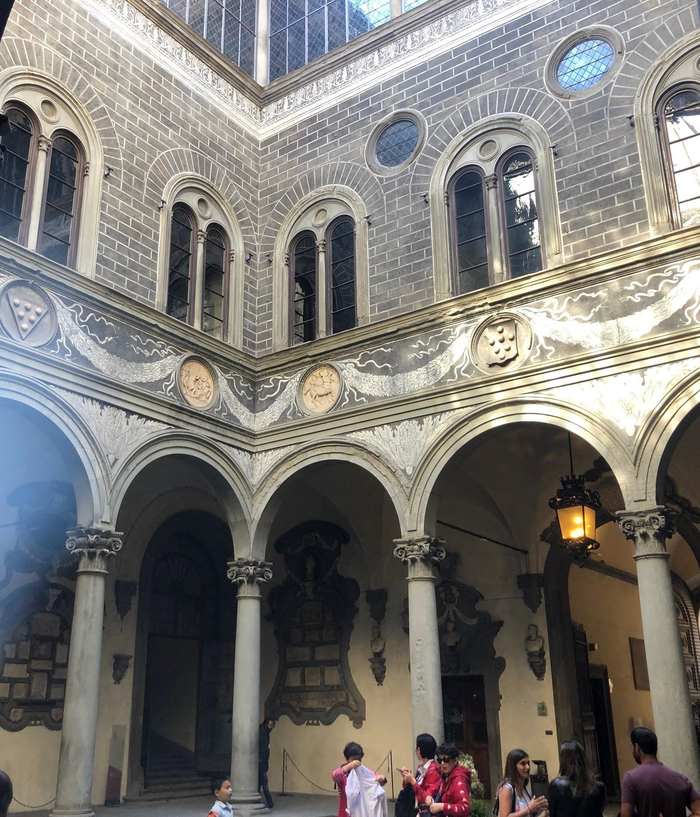
Location 3: Florence
Figure 7. Chapel of the Princes
Figure 8. Bartolommeo Bandinelli’s Orpheus
Figure 9. Medici Palace courtyard

Slide 11
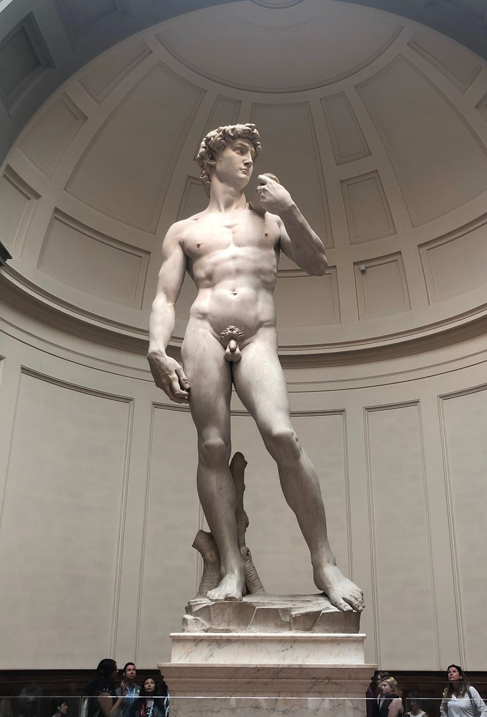
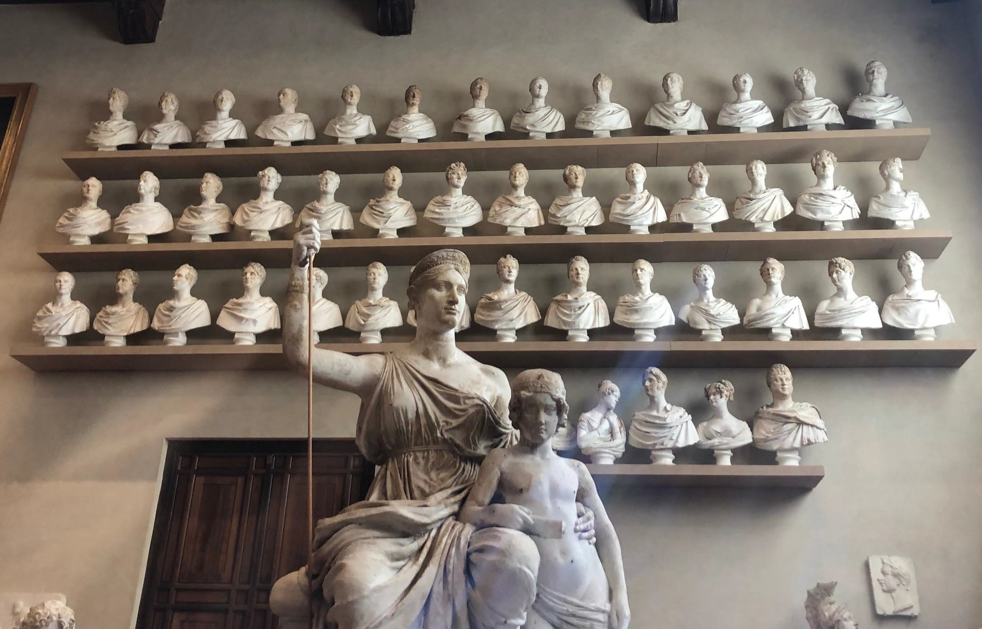
Location 3: Florence (Cont.)
Figure 10. Michelangelo’s David
Figure 11. Sculptures in the Galleria dell’Accademia

Slide 12
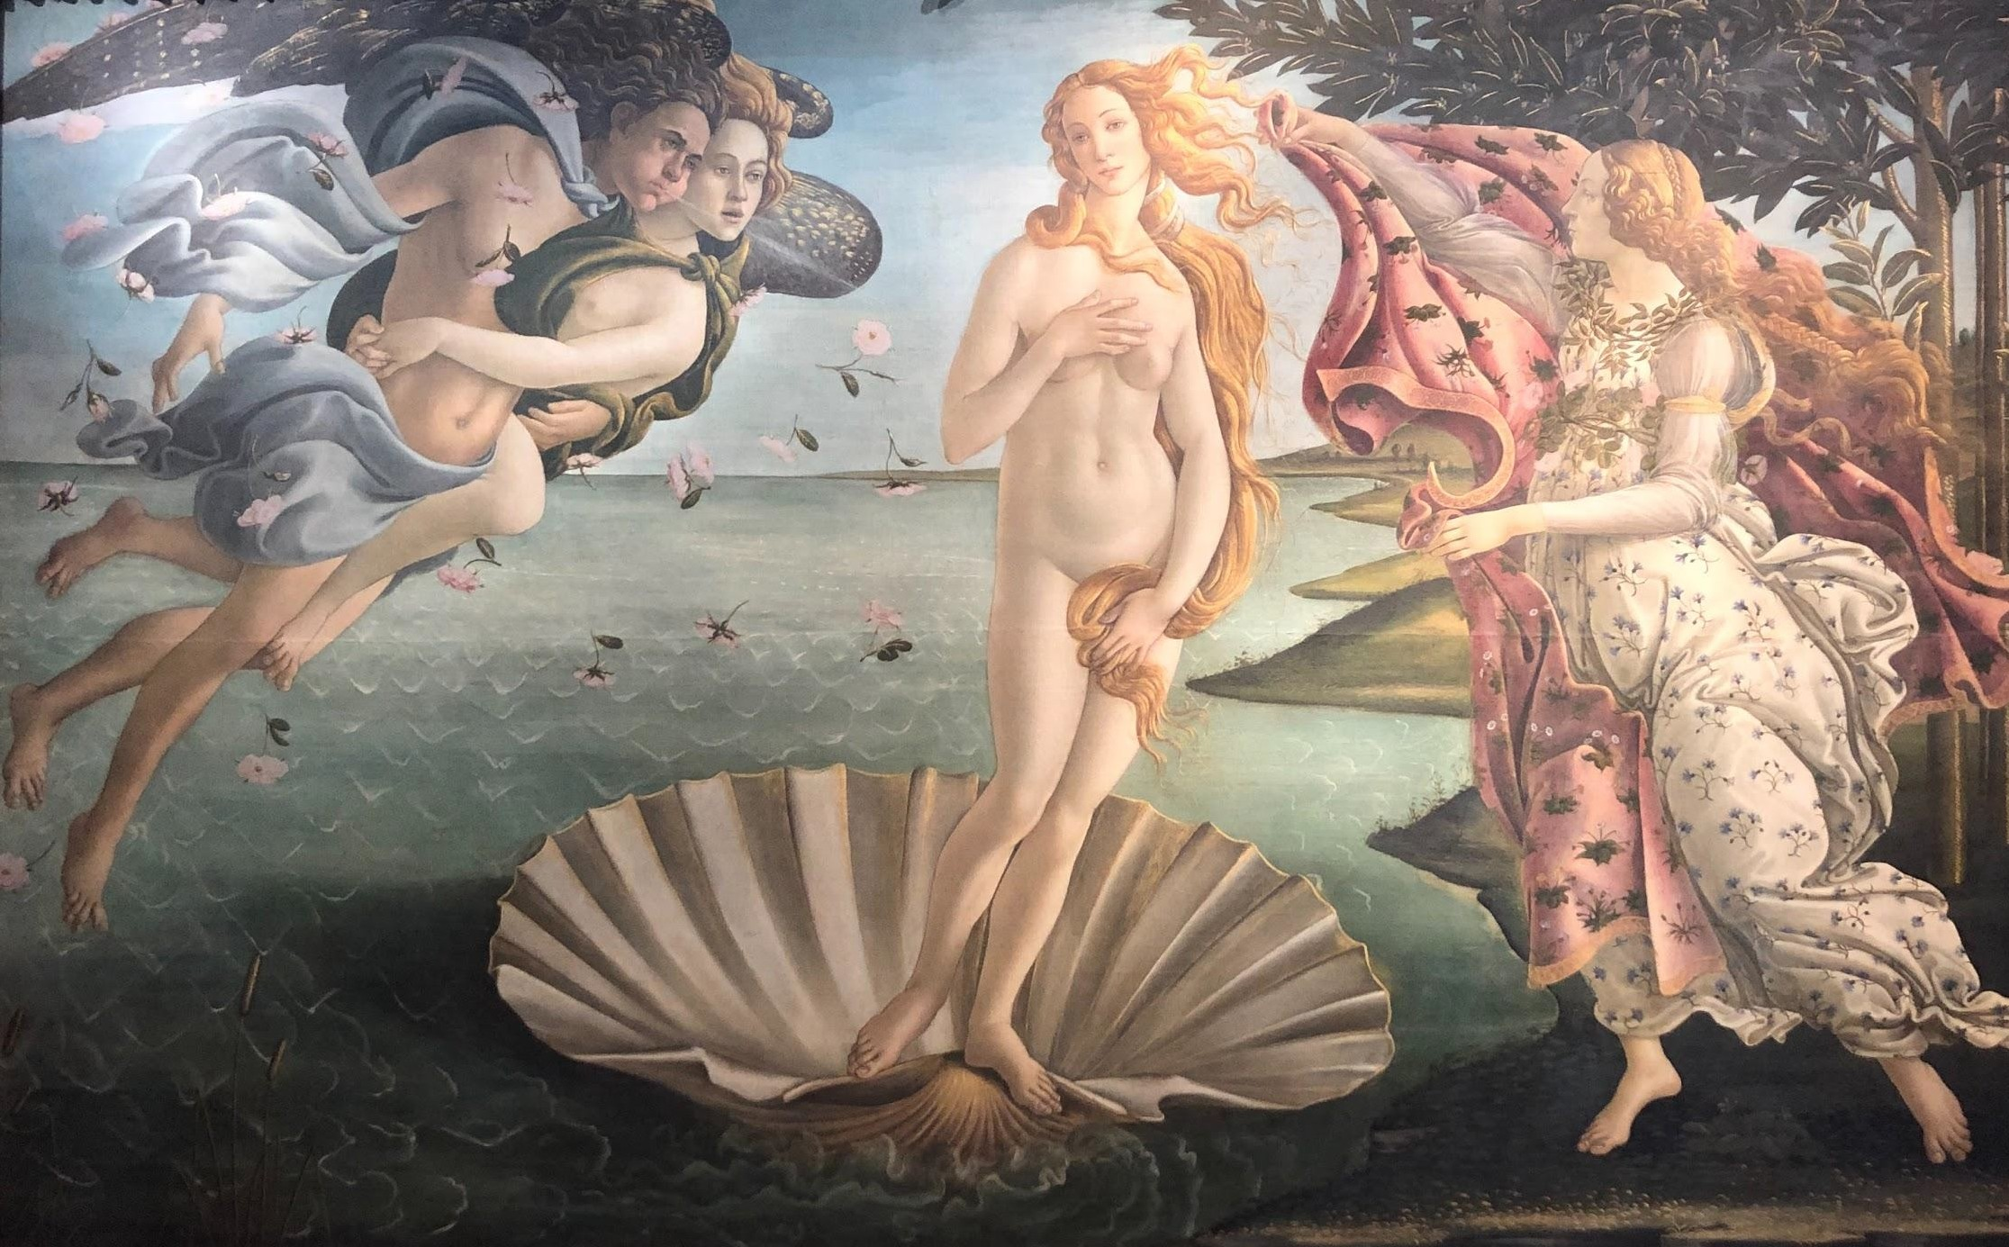
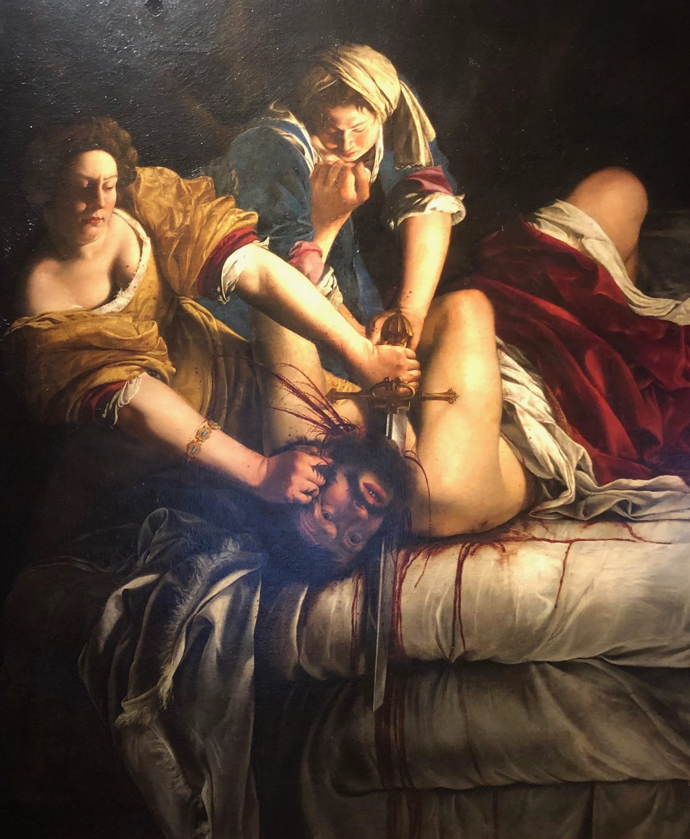
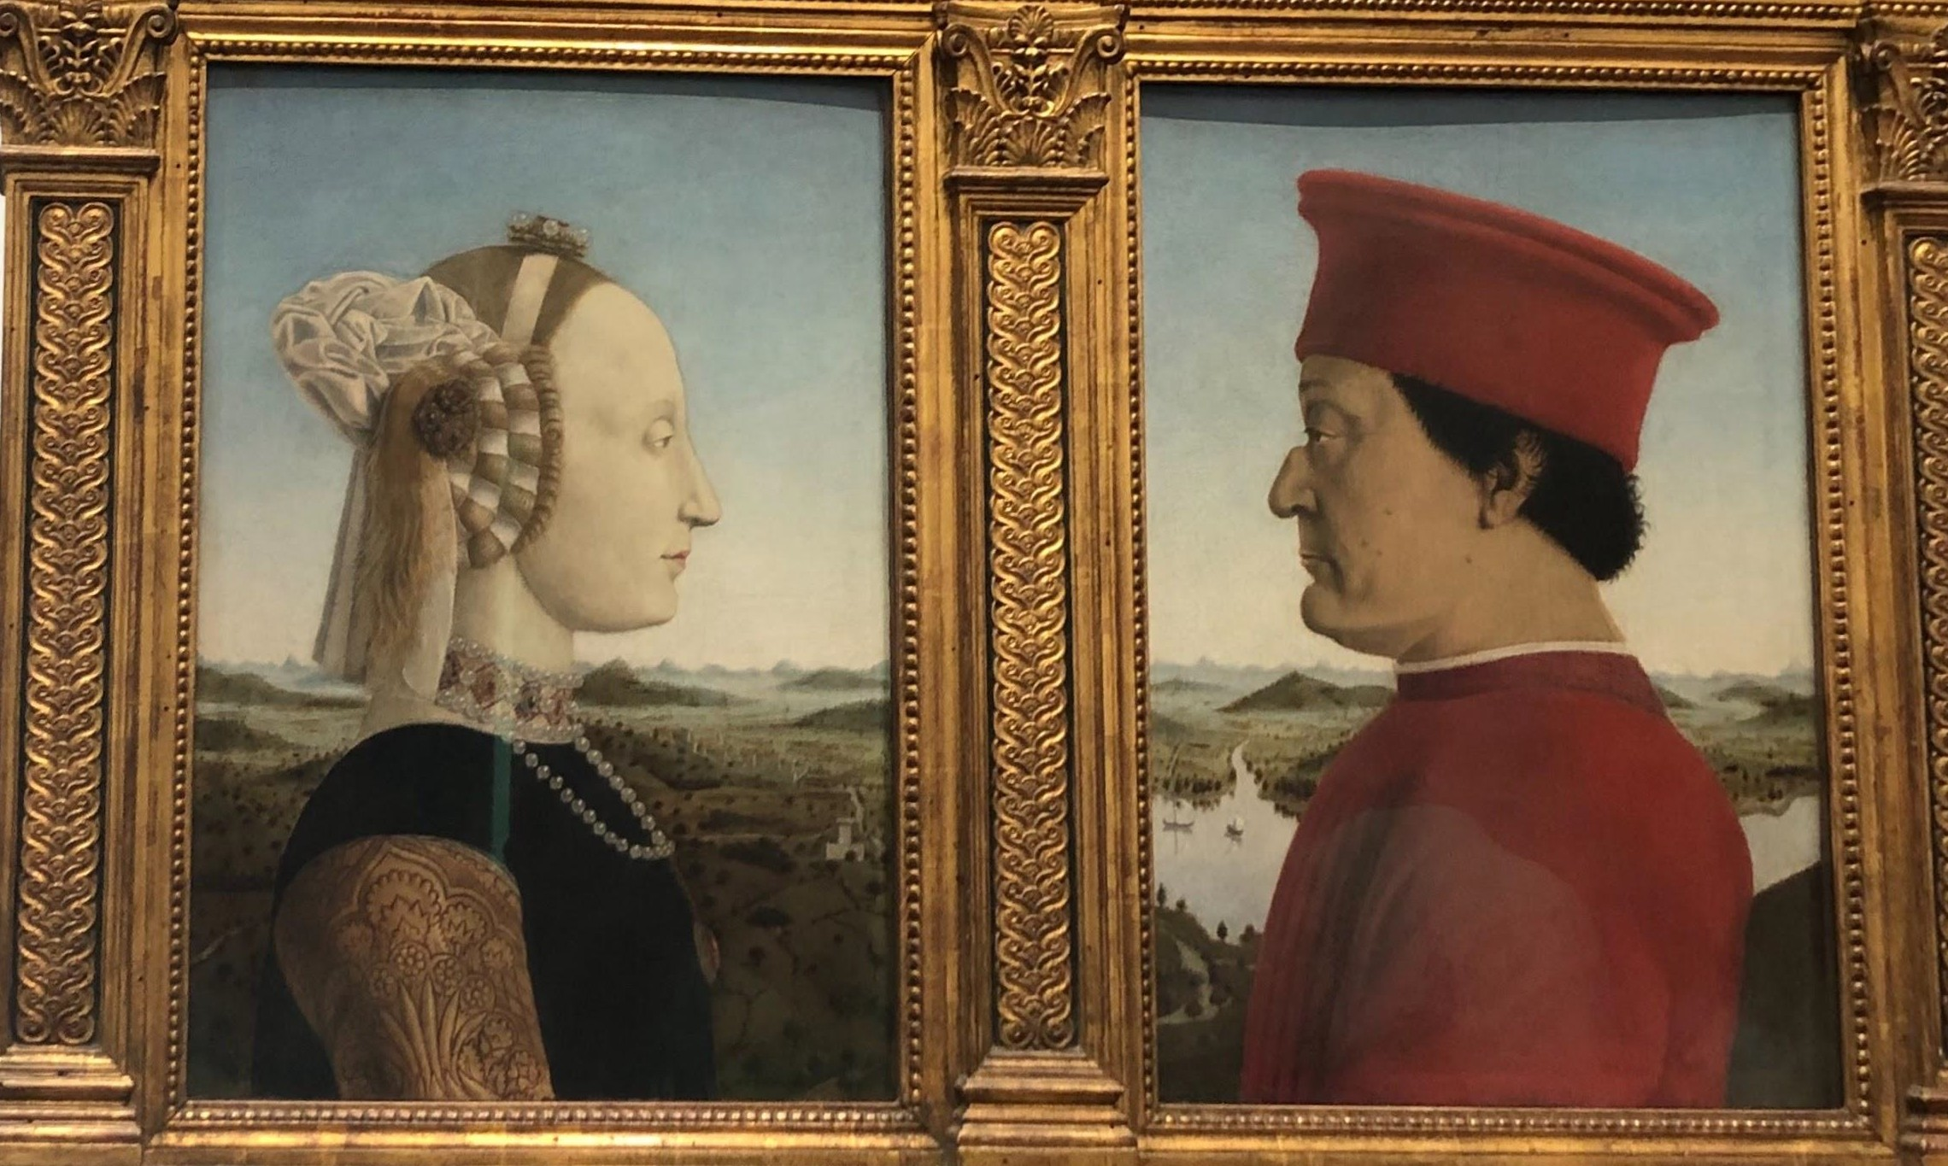
Location 3: Florence (Cont.)
Figure 14. Botticelli’s Birth of Venus
Figure 12. Gentileschi’s
Judith Slaying
^{Holofernes} Figure 13. Piero Della Francesca’s The Duke and
Duchess of Urbino

Slide 13
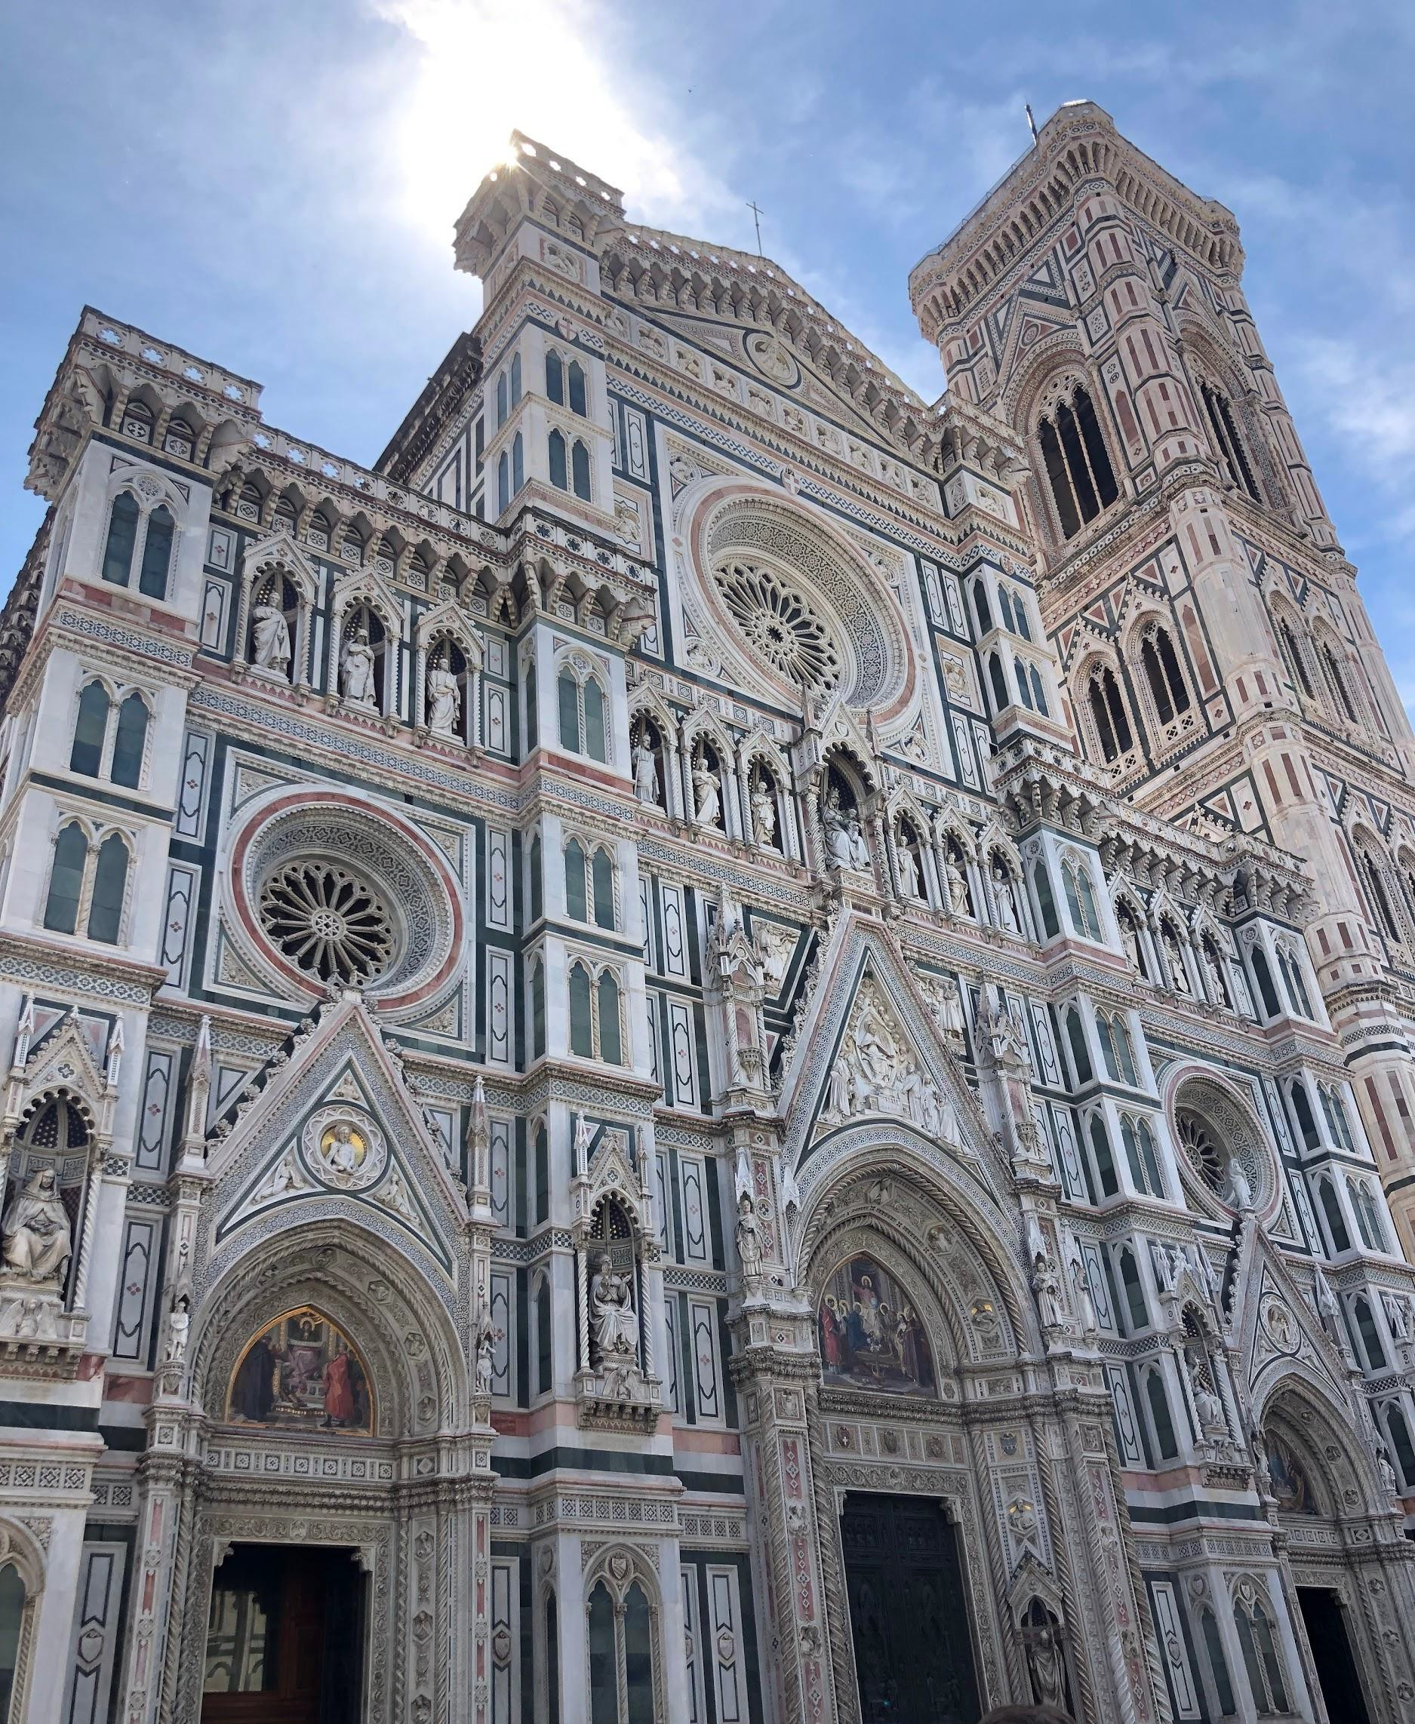
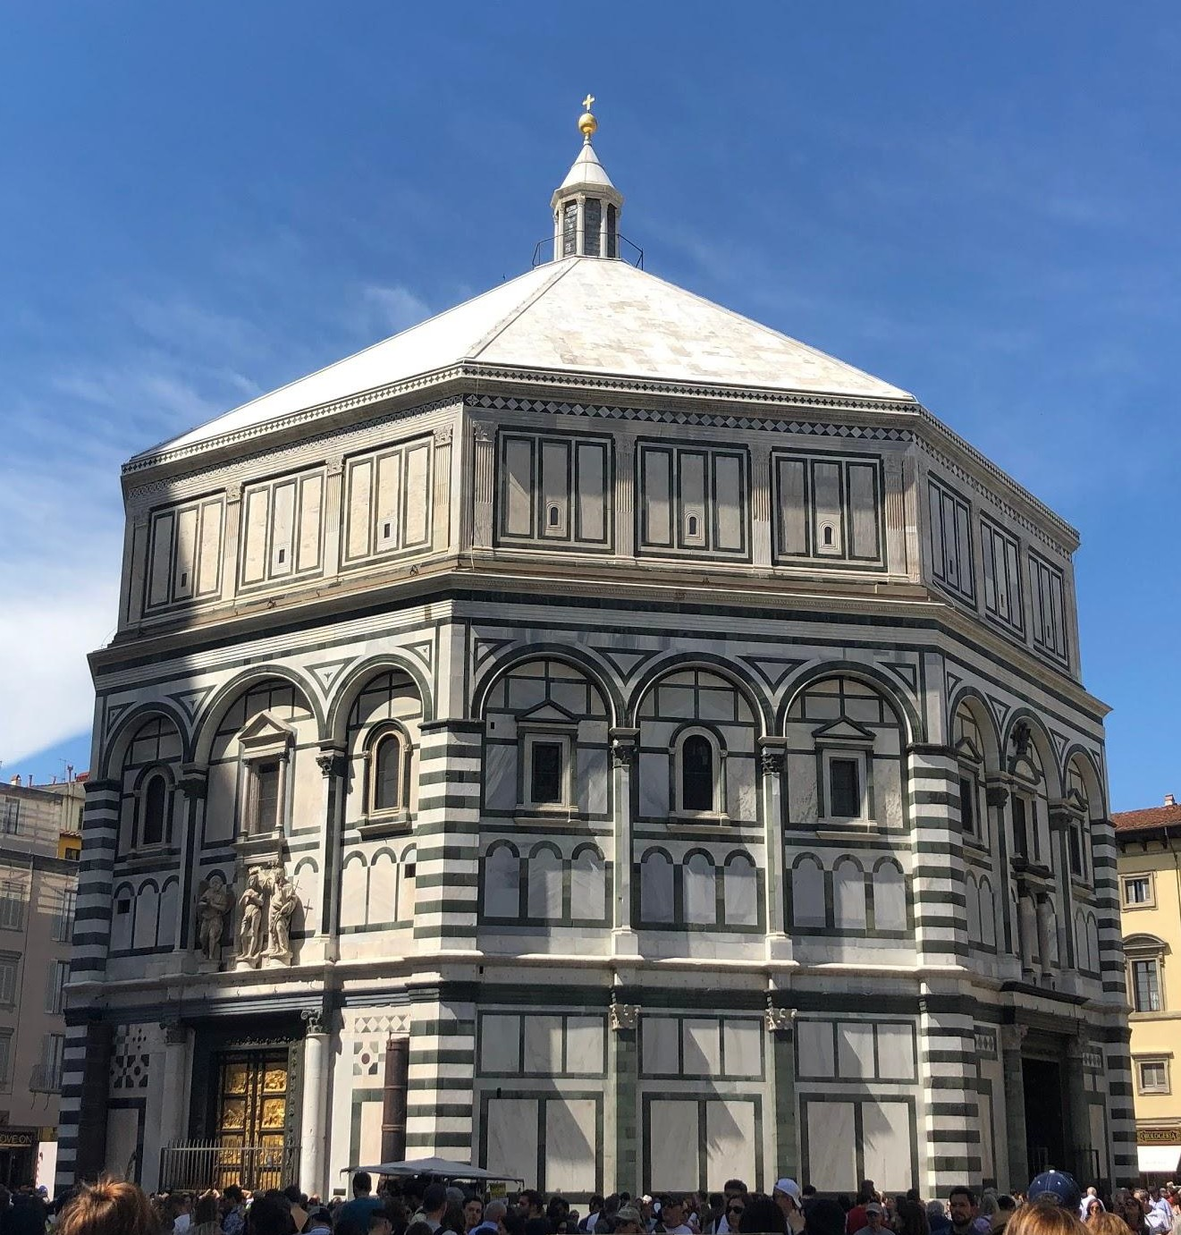
Location 3: Florence (Cont.)
Figure 15. The Baptistery of St. John
Figure 16. The Florence Cathedral

Slide 14
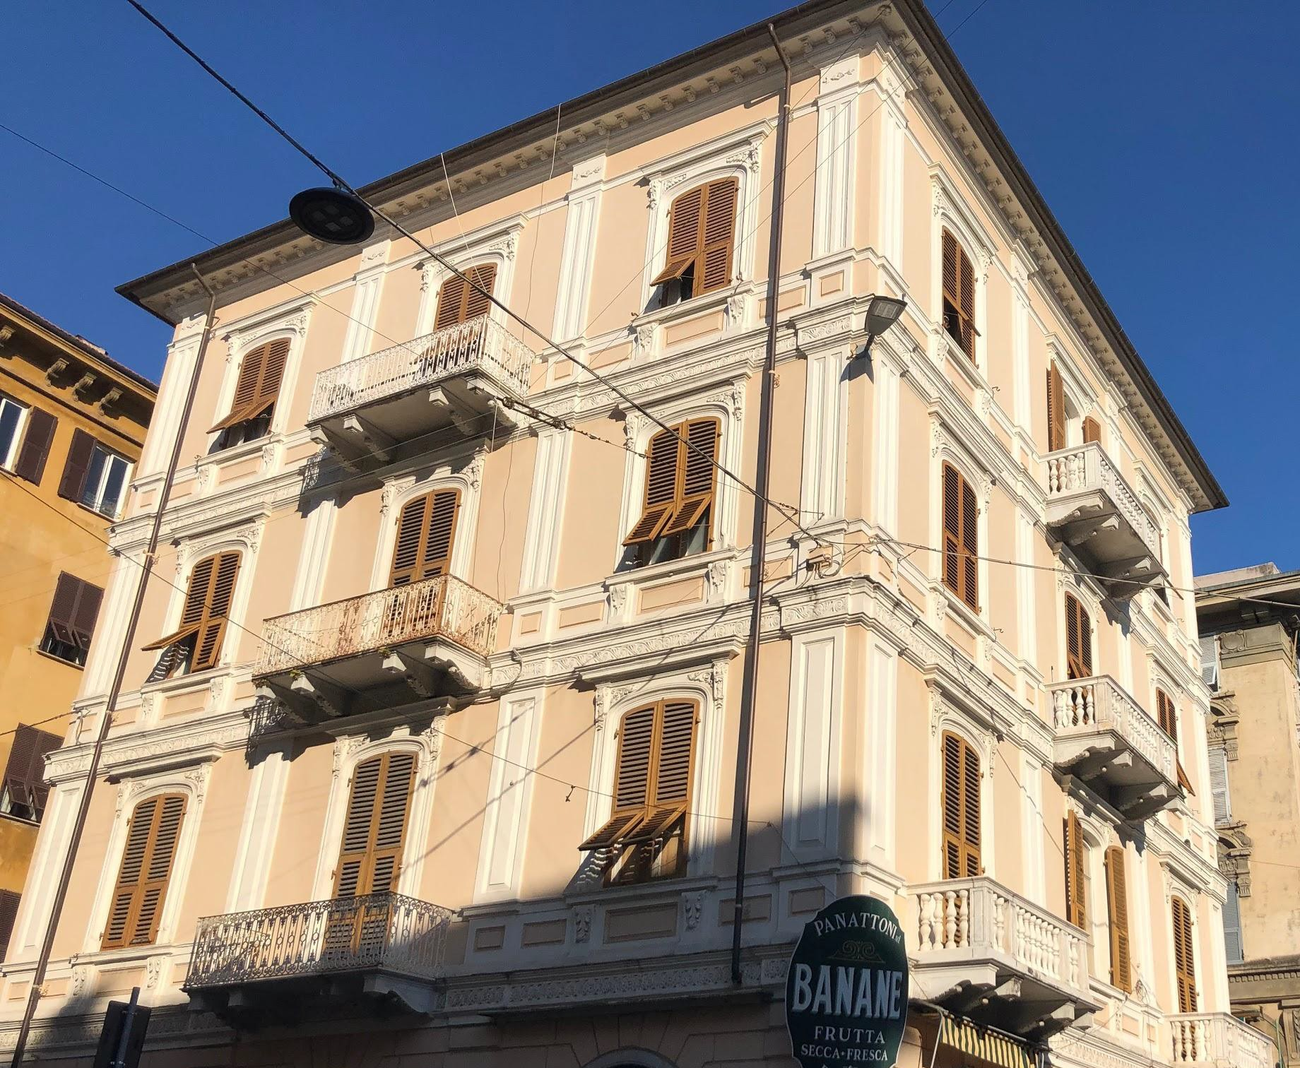
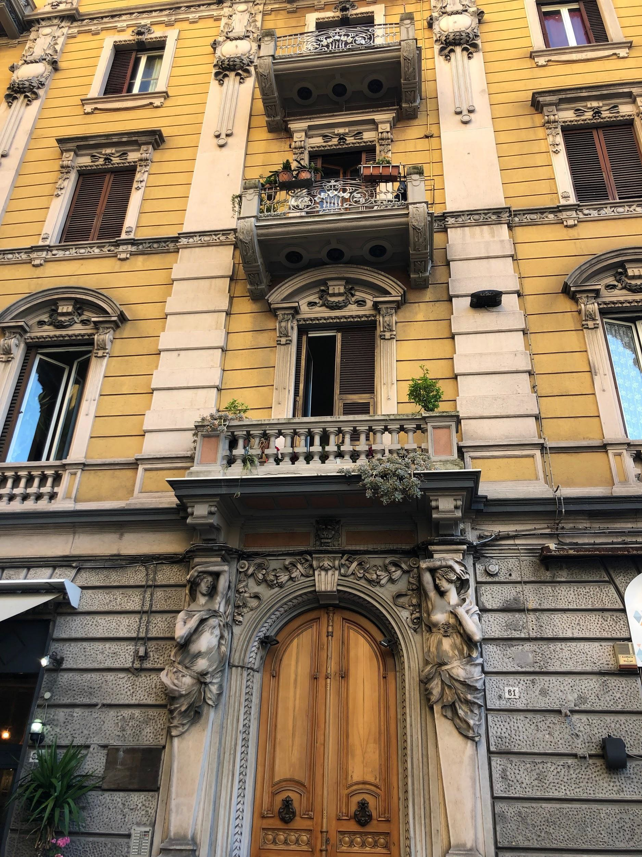
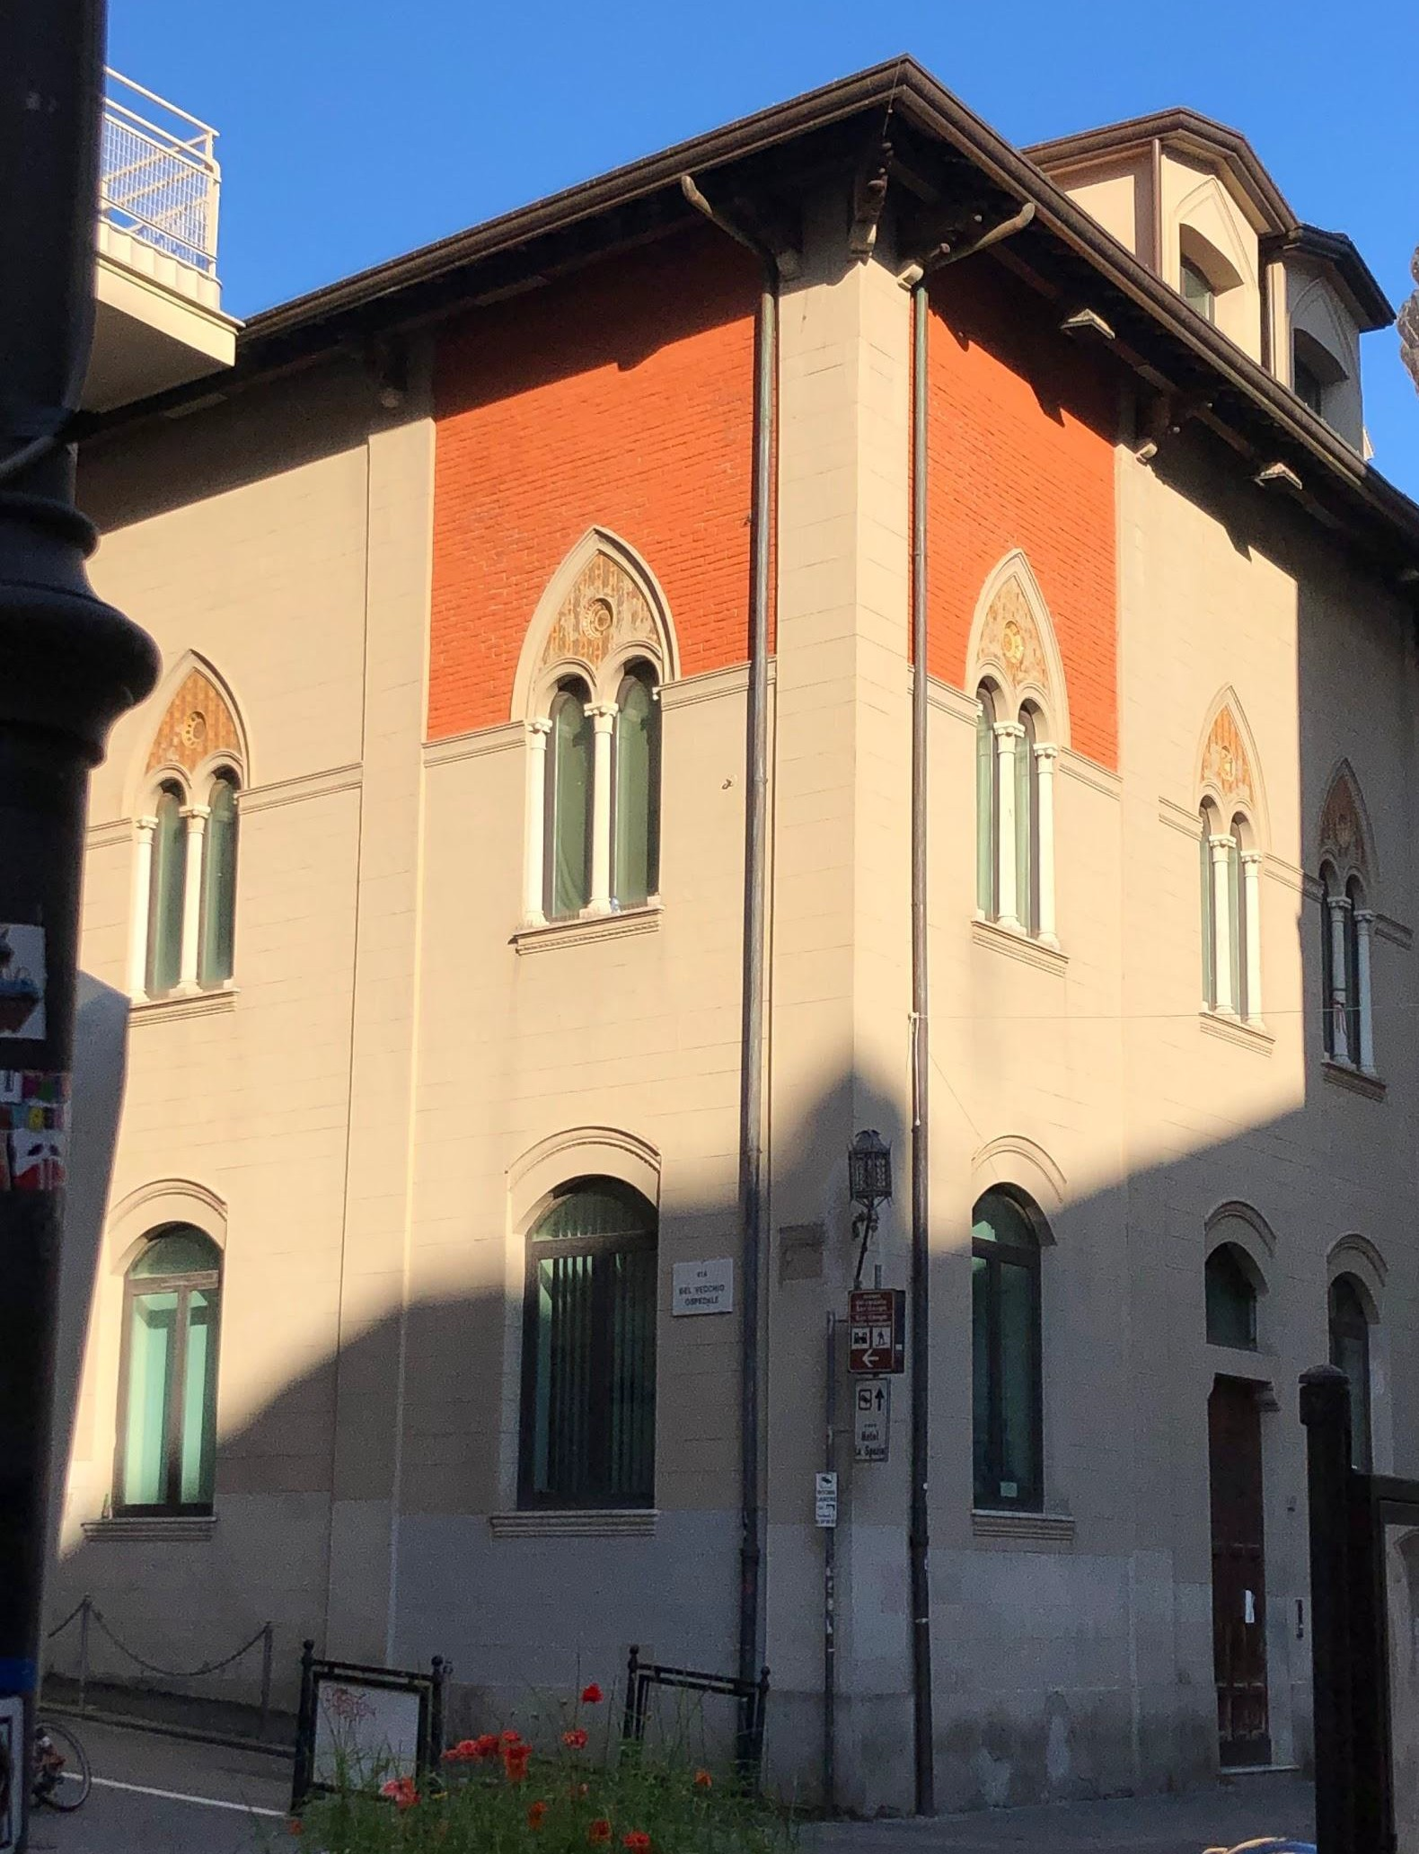
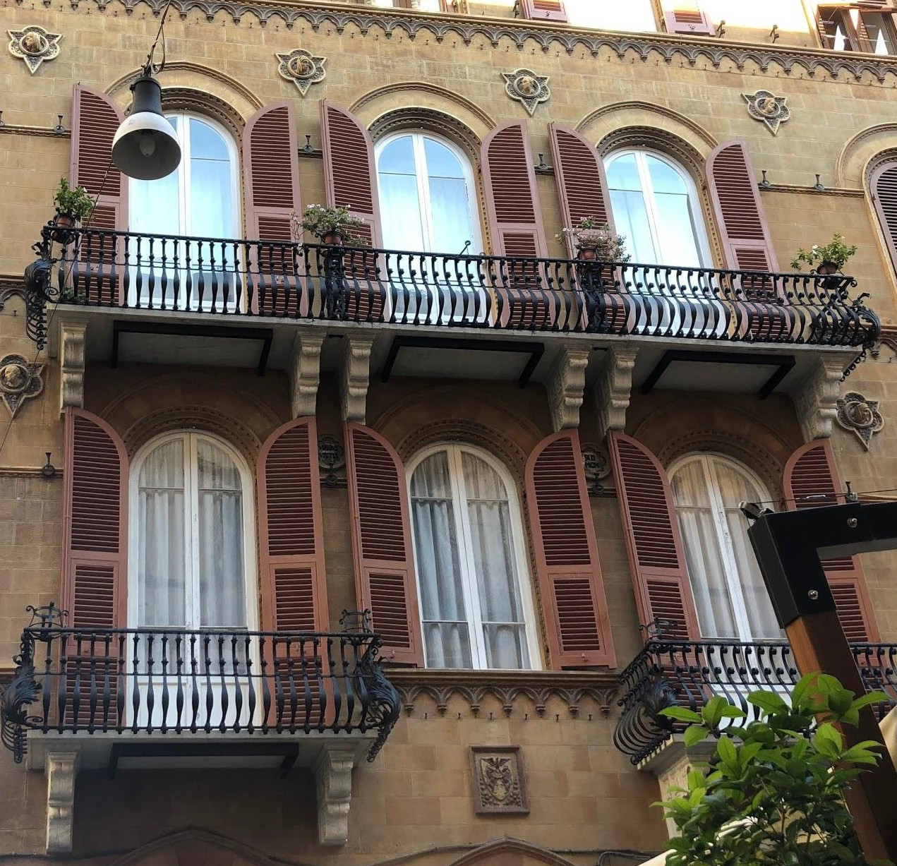

Location 4: La Spezia
Figures 17-20. Residential buildings that have been built in the past 10 to 20 years had decorative elements of the Renaissance style.

Slide 15
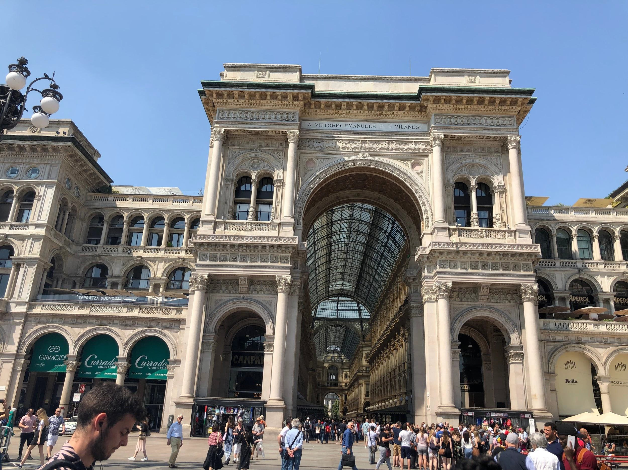
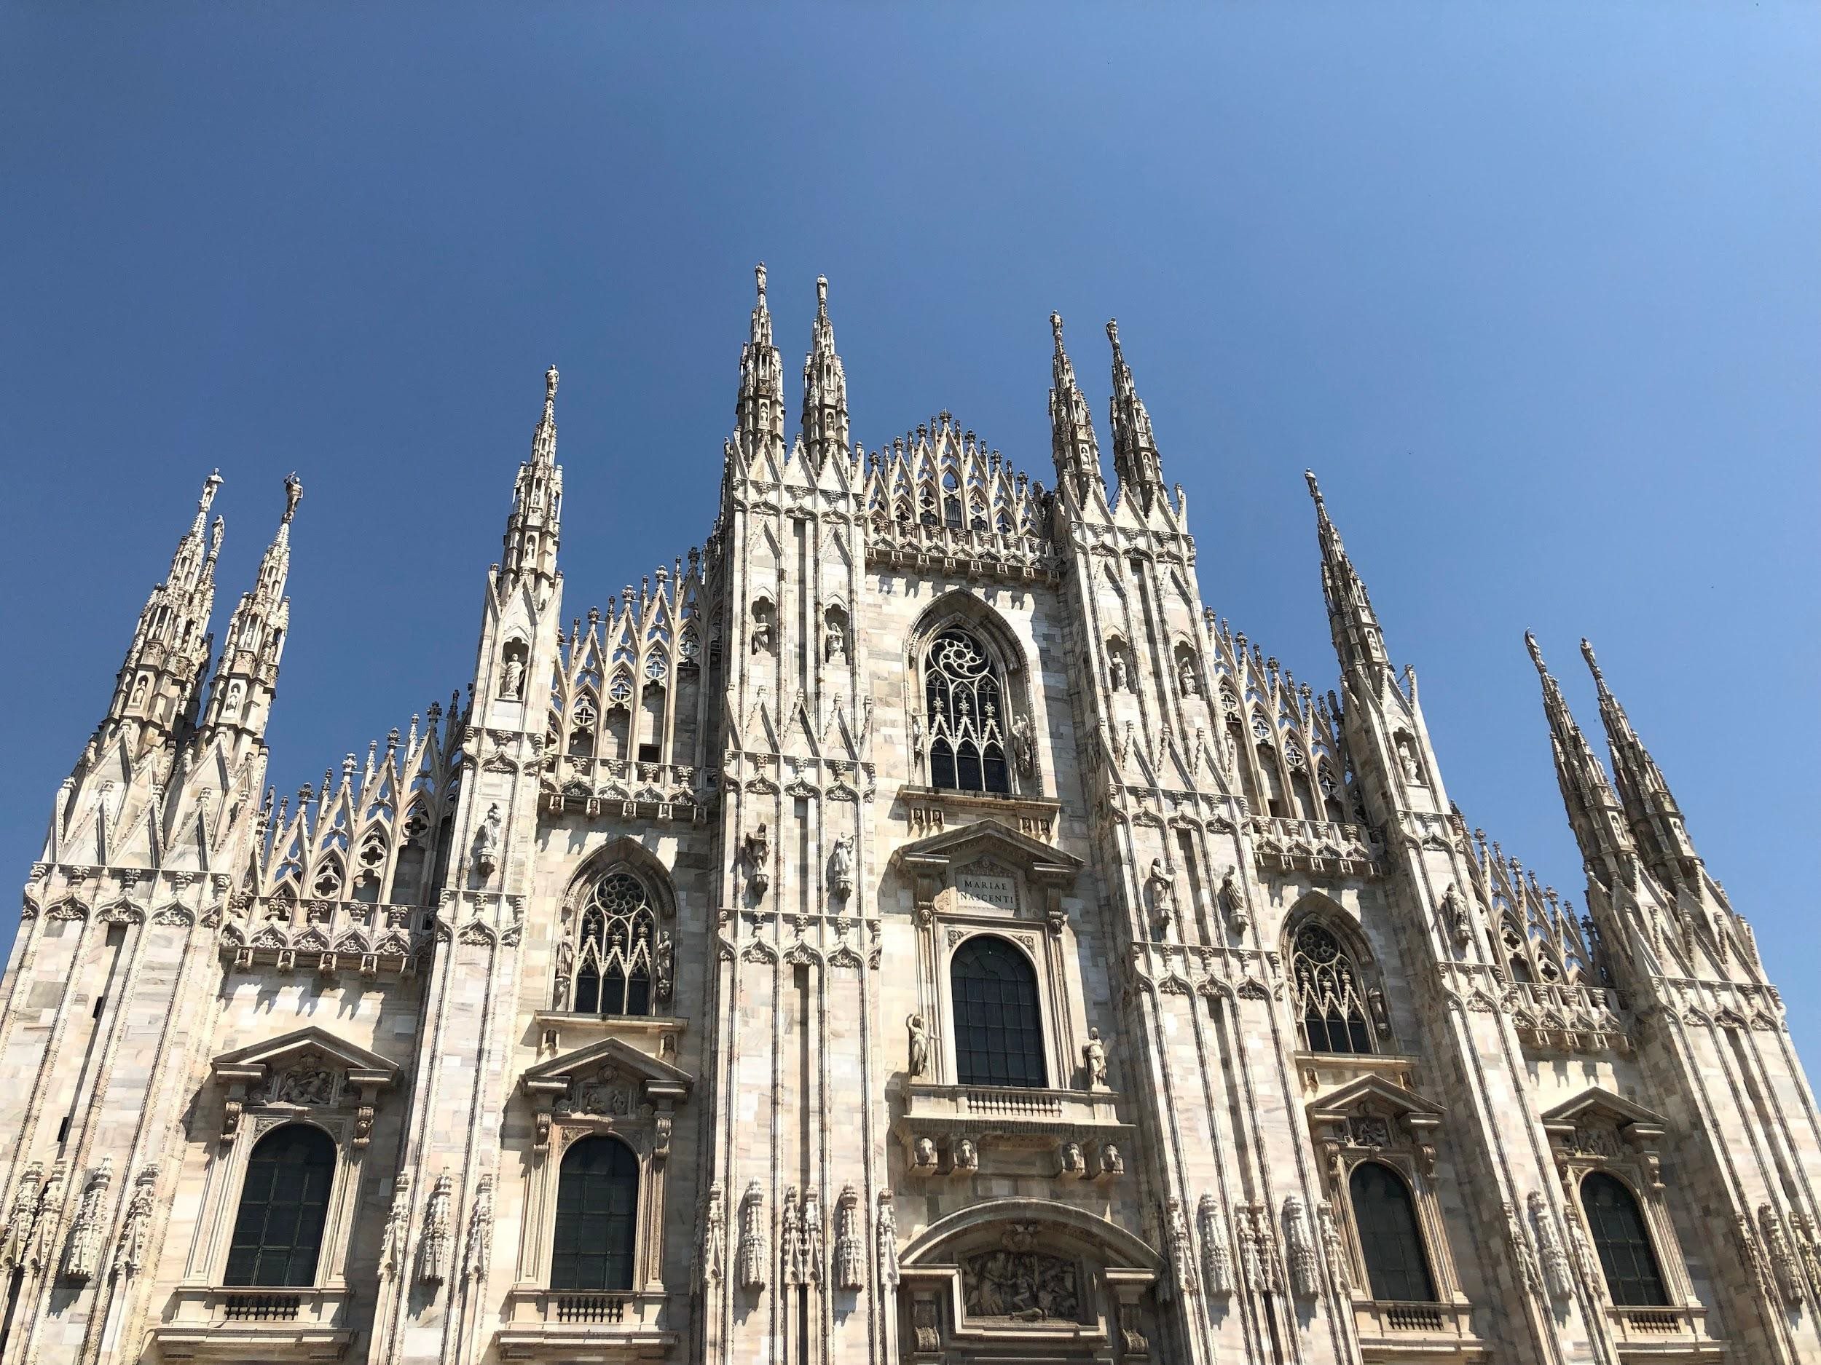
Location 5: Milan
Figure 22. Duomo di Milano
Figure 21. The Galleria Vittorio Emanuele II

Slide 16
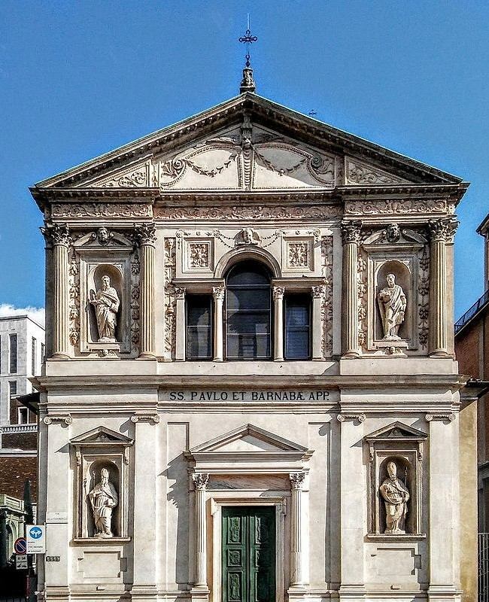
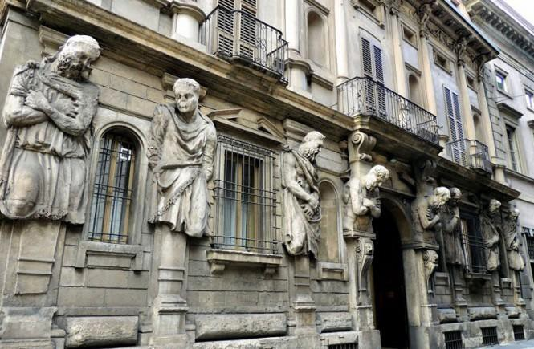
Location 5: Milan (Cont.)
Figure 23. Casa degli Omenoni. (Bancu, 2017)
Figure 24. San Barnaba. (Loquis, 2017)

Slide 17
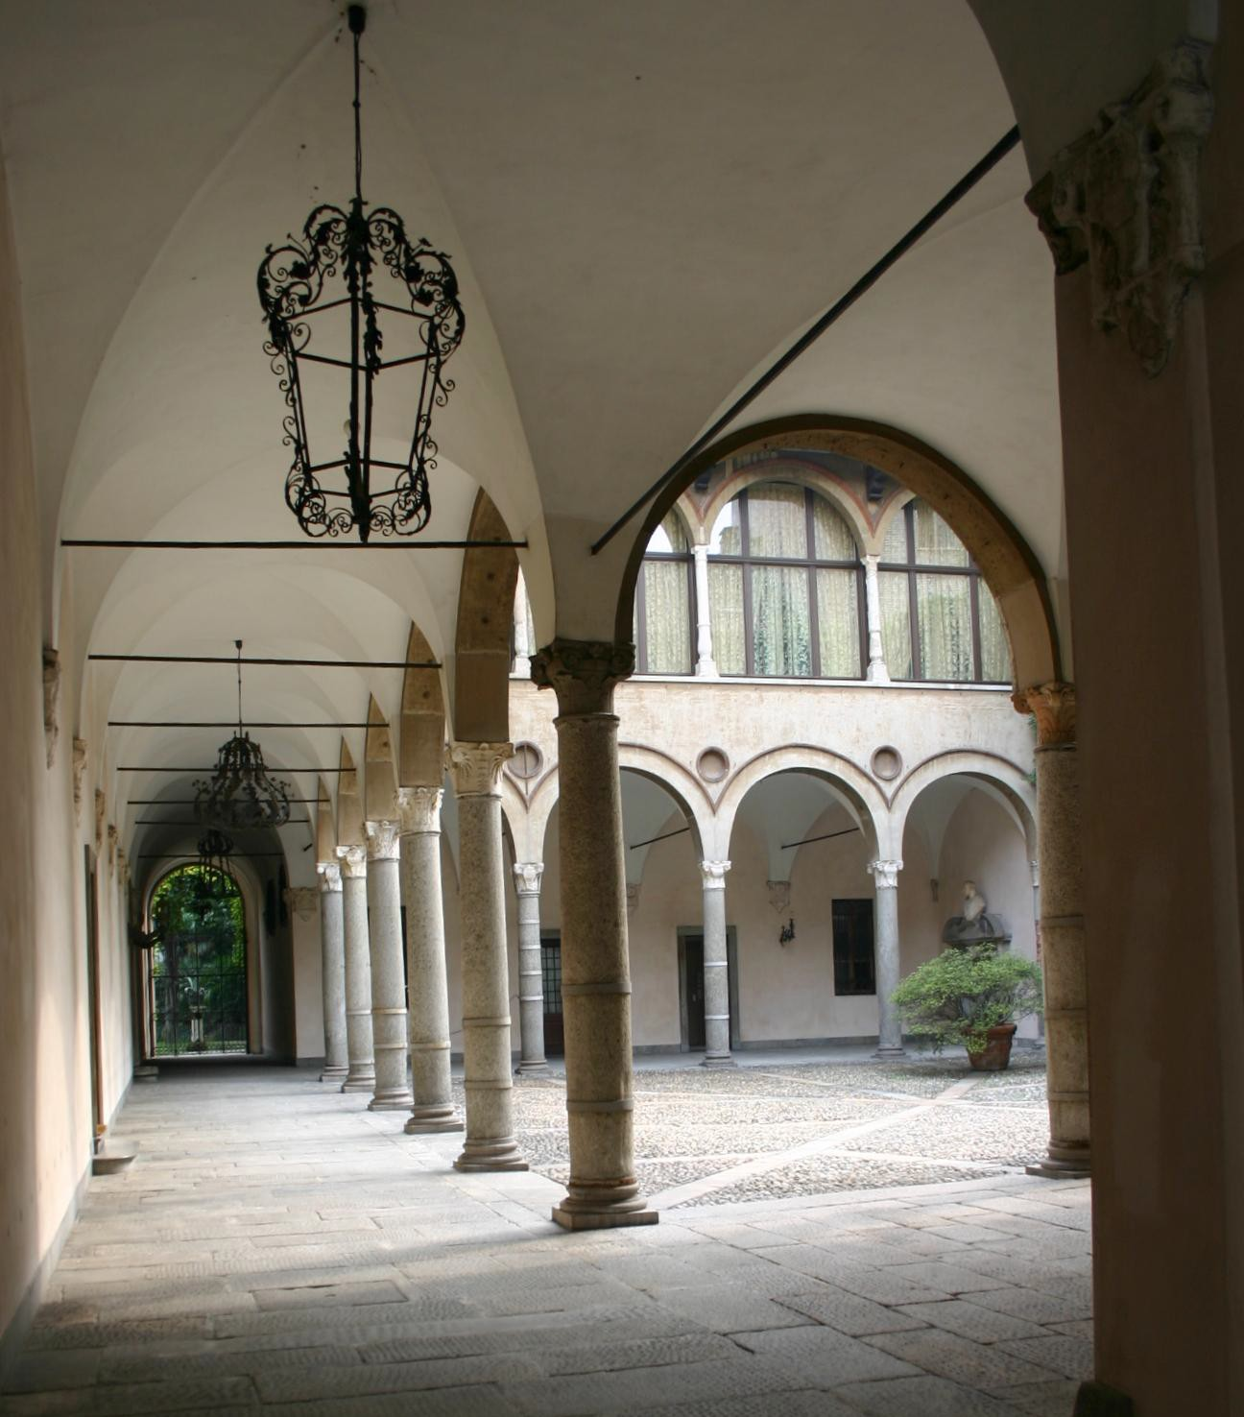
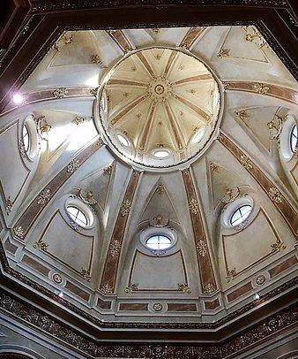
Location 5: Milan (Cont.)
Figure 25. San Carlo al Lazzaretto. (Stefano91, 2017)
Figure 26. Casa Fontana-Silvestri Courtyard. (Dallorto, 2007)

Slide 18
Conclusion
While religious cathedrals occupied some of the most detailed architecture and infamous paintings and sculptures from Renaissance artists, we are exposed to a time where music, whimsical designs, and color theory shaped the new worlds for centuries. The Italian Renaissance will continue to have an inﬂuence in Italy and the presence will remain, if not grow over future years. The Renaissance is found throughout each city’s art, architecture, and design, which was predicted in the anticipated outcomes of the research.

Slide 19
References
Foot, J. & Larner, J. (2019) Italy. The Early Italian Renaissance. Retrieved from https://www.britannica.com/place/Italy/The-Early-Italian-Renaissance
Pile, J. & Gura, J. (2014) A History of Interior Design. Hoboken (N.J.): Wiley Richman-Abdou, K. (2017) The Captivating History of Enduring Inﬂuence of
Italian Renaissance Art. Retrieved from: https://mymodernnet.com/italian-renaissance-art-deﬁnition/

Slide 20
References
Figure 4. Cerisola, R. (2010). Sistine Chapel. Retrieved from http://www.museivaticani.va/content/museivaticani/en/collezioni/musei/cappella-sistina/storia-cappella-sistina.html
Figure 6. Mantegna, A. (1473). The Oculus also Known as Camera Degli Sposi Retrieved from https://www.aaronartprints.org/mantegna-theoculus.php
Figure 23. Bancu, A. (2017). Omenoni, Holding the Weight of Art. Retrieved from http://www.italianways.com/wp-content/uploads/2017/03/casa-omenoni-milano-7-665x435.jpg
Figure 24. Loquis. (2017). San Barnaba (Milan). Retrieved from https://www.loquis.com/loquis/23348/San-Barnaba-(Milan)
Figure 25. Stefano91. (2017). San Carlo al Lazzaretto. Retrieved from https://www.tripadvisor.co.za/LocationPhotoDirectLink-g187849-d3294982-i285325838-San_Carlo_al_Lazzaretto- Milan_Lombardy.html
Figure 26. Dallorto, G. (2007). Casa Fontana Silvestri Courtyard. Retrieved from https://upload.wikimedia.org/wikipedia/commons/a/ae/1875_-_Milano_-_Casa_Fontana_Silvestri_-_Cortile_-_Fo to_Giovanni_Dall%27Orto%2C_25-Sept-2007.jpg

