Slide 1
Salient identities, identity gapS & identity negotiation
Presented by mason trinh
Advised by Dr. Sandra Faulkner

Slide 2

Rationale
Salient identities: identities that a person considers most important to their self-concept (Morris, 2013)
Intersectionality highlights the idea that individuals have multiple overlapping and intersecting identities that influence how they experience oppression (Crenshaw, 1991).
Communication Theory of Identity (CTI) focuses on identity as interaction between frames of identities (Faulkner & Hecht, 2006):
  Personal
  Enacted
  Relational
  Communal
Individuals can experience identity gaps when there is dissonance between frames. individuals negotiate their identities in different ways (Faulkner & Hecht, 2011)
Identity gaps can cause psychological distress & relationship difficulties.
We need more research on how salient identities are negotiated when individuals experience identity gaps.

Slide 3
Research purposes
To learn about the range of identities that individuals define as salient.
To understand how identity gaps or a lack thereof exist in terms of the four identity frames.
To explore varying pathways of identity negotiation.

Slide 4
method
Participants (N=20) (Mean age=20.15) were recruited through campus updates, office of multicultural affairs, and the LGBTQ+ resource center.
20 confidential one-on-one in-depth interviews.
Each participant received one $15 Amazon gift card as a compensation.
Inductive thematic analysis of interviews

Slide 5
demographics

Slide 6
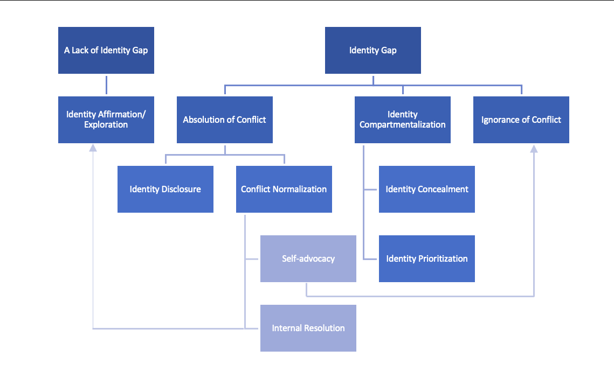
findings

Slide 7
Findings (cont.)
There are a variety of combinations of identity gaps between layers of two salient identities
  personal layer of being Catholic vs. communal layer of being Catholic vs. enacted layer of being queer
  enacted layer of being a cis woman vs. communal layer of being queer
  relational layer of being biromantic vs. personal layer of being asexual
Identity Compartmentalization
  Identity Concealment
  Identity Prioritization
Absolution of Conflict
  Identity Disclosure
  Conflict Normalization
    Self-advocacy
    Internal resolution
A lack of identity gap -> Identity affirmation/ Exploration

Slide 8
Identity gaps
    Definition: the dimensions in which two identities of an individual conflict.
    Single-layered identity gaps: any one of the four frames
      Example of an identity gap of the personal frame: “it's definitely a hard thing as what I'm feeling very masculine, and the idea of black men being more dangerous… sometimes that does get reflected upon me as well” (Black X Genderfluid)
    Multi-layered identity gaps: any two or more of four frames simultaneously
      Example of an identity gap of the personal, enacted, and communal frames: As she realizes that there is no LGBTQ+ people being out or creating their own sub-community in her tribal community, she confesses “I definitely feel like I don't have as much of a space within [her tribal community] to fully express myself like I would in the LGBTQ+ community” (Native American X Bisexual)

Slide 9
Identity compartmentalization
Definition: the separation of two salient identities in attempt to prevent the identity gap
Identity Concealment: the decision to ‘closet’ or hide one or both salient identities.
  Contextual Factors: family, friendship, community, and personal distress
  Example: “I was afraid that if I would talk to my queer friends about it about me being queer, then they would want to know like, how does that work with you being Catholic? versus if I talked to my Catholic friends” (Catholic X Queer) – friendship
Identity Prioritization: an attempt to select one of two salient identities that leads self-concept in a particular context.
  Contextual Factors: friendships, community, romantic relationships, and personal distress
  Example: “I can't be both in the same spot. I've kind of got to be apart to to be what I truly am”. he shares that, while he discusses baseball games with his sports groups or friends who are also sports enthusiasts, he would go into length about his “boy issue” or gay relationship problems with his gay friends (Sports fan X Gay) - friendship

Slide 10
Absolution of conflict
Definition: attempting to resolve one’s identity gap
Identity Disclosure: one’s decision to reveal a salient identity or both identities or ‘come out’ to people in particular setting where the conflict between two identities can arise.
Conflict Normalization: actions that one take to resolve the conflict between their two identities in their own perceptions or others’ perceptions.
  Self-advocacy: a range of actions that one takes to persuade others about the lack of conflict between the person’s two identities.
  Internal Resolution: a type of conflict normalization that enables a person to attempt to resolve an identity gap in their own perceptions

Slide 11
A lack of identity gap
Definition: the harmony or a lack conflict between two identities in terms of one or more identity frames.
Single-layered: any one of the four frames
  Example: “there isn't [a conflict] because Wicca is very big on the whole idea of everything is fluid there is no really clear line between the male and female because there are two sides of the same coin. There is the female aspect which is the goddess and then there's the male aspect which is the God. So it would make perfect sense that there is space in between. And that would be where I am…” (Wiccan X Genderfluid)- Personal frame.
Multi-layered: any two or more of four frames simultaneously
  Example: “Telling him I'm bisexual was just kind of like he took a he obviously took it very well because he was like, “Oh, I am too” and share feelings for understand each other for as well as but also I think I think he just helped me grow more. And then with my native American identity, telling him about that. He was just interested, not afraid of me, my family because of me, he got to know me more both. In both situations, he got to know me more. And he still wants me.” (Native American X Bisexual) – Relational Frame & Personal Frame

Slide 12
implications
Clinicians, social workers, & advocates can inform their services for LGBTQ+ individuals by acknowledging:
  Identity gaps between salient identities exist in a complex manner
  There are various ways of identity negotiation
  Identity Compartmentalization is a complicated mechanism of identity negotiation
  Successful internal resolution can result in identity affirmation/ exploration

Slide 13
Implications (cont.)
Future research should address the following limitations:
  A lack of racial diversity in the sample
  Time constraint
  Interview questions with loaded language
  Participants with minimal exploration or understanding of their identities
Future research should focus on identity compartmentalization to better understand the implications of intersectionality.

Slide 14
references
Crenshaw, K. (1991). Mapping the Margins: Intersectionality, Identity Politics, and Violence against Women of Color. Stanford Law Review, 43(6), 241-1299.
Faulkner, S. L., & Hecht, M. L. (2006). Tides in the ocean: A layered approach to culture and communication. Explaining communication: Contemporary theories and exemplars, 383-402.
Faulkner, S. L. & Hecht, M. L. (2011). The negotiation of closetable identities: A narrative analysis of lesbian, gay, bisexual, transgendered queer Jewish identity. Journal of Social and Personal Relationships, 28, 829-847.
Morris, R. C. (2013). Identity Salience and Identity Importance in Identity Theory. Current research in social psychology, 21, 23-26.

