Slide 1
Listening and Learning: Lessons from the Land
An Environmental Oral History Project
Madi Stump
Winter and Spring 2020

Slide 2
Important terms
Interviewer: the person who is recording the story and, often, coming up with questions/topics and transcribing after the interview
Narrator: the person who is telling their story on record
Transcription: the written words of the interview, often created via online software or program

Slide 3
Oral History
Study of historical information through recorded interviews with living persons who have knowledge or experience of an event, idea, or group of historical significance

Slide 4
Environmental History
Tries to see the role of non-human nature in human history
Does not treat humans as separate from nature
Explores relationships between humans and natural systems
William Cronon, environmental historian and professor, U.Wisconsin-Madison

Slide 5
Why oral history (in general)?
Supplement more traditional historical records
Fill in gaps from documented history
Empower and give voice to the historically silenced
Create accessible and enjoyable hiSTORIES

Slide 6
Why oral history (for this project)?
Hearing the land is a product of intimacy
Listening is an under utilized skill in our lives, especially with nature

Slide 7
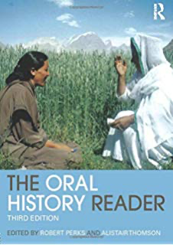
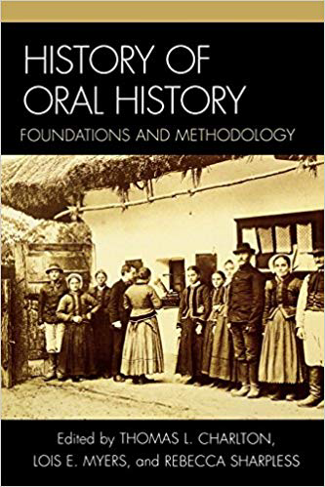
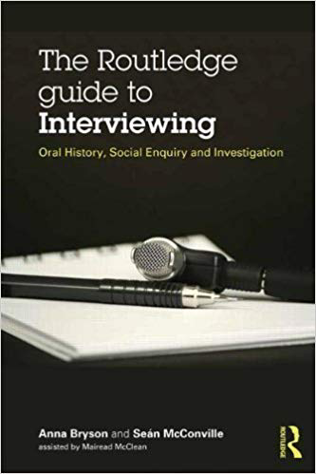
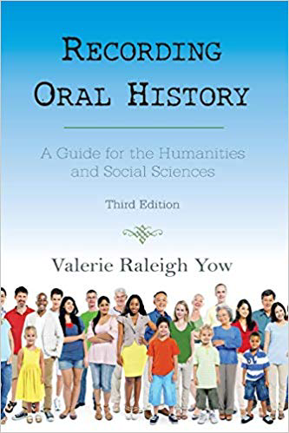
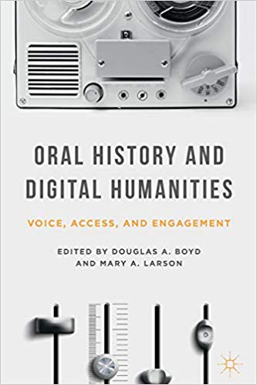
Literature review

Slide 8
What to do:
Create and follow a general topic outline
Take quick note of acronyms or spelling questions
Meet where and when the narrator is comfortable
Be mindful of power dynamics

Slide 9
What not to do:
Create a questionnaire in verbal form
Take extensive notes during the interview
Conduct a phone interview (unless absolutely necessary)
Create a hypothesis or expected research outcome (this is not research)

Slide 10
Environmental History Topic
Native landscaping/preservation
Native plants: certain species and/or varieties of plants that were here when Europeans arrived, based on historical records

Slide 11
Interview with Cinda
CS: But there was a lot of learning curves where we would try something on a specific species, as far as trying to kill it and it would backfire, it wouldn’t die. Just like, well that was a waste of time and energy. But then there were other times where you would throw a bunch of seeds out and you wouldn’t see anything for a while but then a couple years later, a plant would just go “poof! Here I am!” And we would go “oh, my gosh it worked.” And then I would figure out, that plant’s happy place is kind of this soil and this amount of water and this amount of sunlight, so that I could focus my energies taking seeds and transplants there. So sometimes it was just a lot of trial and error, throwing seeds around seeing what grew where or why.
MS: So learning about what are the resources here for the plants that the books don’t say…
CS: Yeah, every plant has got its own mind, is what I’ve decided. So if there’s.. some plants are really easy to restore. A handful of seeds, boom, done. And peoples are just, you know, “that lupin, it’s such a phenomenal plant” and I’m just “yeah, that took no effort. I’m so glad you guys love it”… it was totally happy. If you give it what it needs, which is sand and sun, it will take off and have a mind of its own. Other plants seem to be a lot more picky about being reintroduced.

Slide 12
Interview with Chris
“Anyway, so I made a pact with myself that I will not leave this job until non-native invasive species are under control at Winter Garden and we have grown as big as we possibly can get within the City of Bowling Green, and that will be in the next couple of years. So that kind of tells you what my retirement plan is. Then I knew I couldn't do this alone. There was no possible way that this could be done alone.”
“I’m not a scientist. I’m a storyteller.”
“So I think that the more we can do to get people to be involved and what we do is we definitely try to do that. We worked with kids throughout the community and get them out here, and they have had a hand in planting [native] plants and removing non-native invasives. And so, it's extremely important to them because they'll come back and they'll say, "You see that field of lupine? I planted that. Now, they may have planted two or three of them, but, hey, listen, they planted that. And that's good because they feel a sense of pride and ownership in the environment. And I think we have to get that through to people that we have to feel like this is a part of our life. We can't live without this.”

Slide 13
Interview with Chad
Madi: What role do you see gardening or more particularly native gardening playing in healing our broken relationship to land?
Chad: Oh, these are such beautiful questions. Yes. And what a good one and what a big one, right? With significant implications. Absolutely, a few pieces to that. I think in the early part of that question, I think it calls to mind some of the conversations. Again, I know you and I have had and I know we've each been exploring in some of our research and scholarship, looking at the concept of place. And when I think of place as opposed to just say location or setting, the determining feature there and what many scholars of place look at is a location, a geographic place to which we have assigned meaning or significance. And in some ways when you talk about maybe our fractured relationship to the land, I think it can be helpful to think of that relationship as you might to any other interpersonal relationship you have, right?
That is we maintain friendships or we grow relationship with other humans through interaction with them, through caring about them through, I'm going to commit to making sure I send a letter to so and so. Or I spend time with someone or if I see that they are having a difficult time, I'm going to respond. I kind of see it that way. That is I think that we, again, we grow concern for and commitment too, and relationship with a place by learning the names of the creatures, of the organisms, of the physical and scientific properties and processes that take place in them. I think part of it is we have to continue to educate ourselves.
I think part of it too, in terms of what you asked specifically, what can native gardening do to address that, I very much see my work in my tiny quarter of an acre suburban garden as a form of activism. Something that I would put right on board, right at top with voting, with philanthropic activities that I or others may be a part of. I see this as very much yet another example of that sort of community minded investment in place and in space.
For instance, when I as with any of us, when I feel overwhelmed or I'm aware that it can be very overwhelming to read the news in 2020, as I'm sure are our parents and ancestors before us wrote we're never at a shortage of things to maybe be anxious or concerned about or overwhelmed by. When I look at a large number of problems facing people on this planet or in my community, both with a small or big C, local or extended community, I see plenty of problems for which I feel very ill equipped to respond or that even if there are options available for me to act, I don't immediately see an impact or relief of someone's suffering. And that's not to mean that we should only be looking for instant gratification. Of course, I will say one I think pleasant and more immediately rewarding result of gardening, of really cultivating a sense of place with your local geography and property is maybe that often more instant gratification.
That is I may be able to plant a shagbark hickory tree in the yard fully knowing that it's not going to come to fruit for 120 years or more. And that my great grandchildren will be lucky to eat from this. That's a little harder to get people excited about perhaps, although still important. But like I've said in the short time I've been on this current piece of land that has really become a place with a capital P as someone I know has suggested, it's been just really remarkable to see how life, how insect life, invertebrate life, how mammalian life, how the avian creatures in the neighborhood, and how myself and other humans I share my life with have benefited in one way or multiple ways from the relationship that I have nurtured and cultivated and shared with others.
I think it's really important. I don't think we heal and I should say I don't ultimately know necessarily what a healed world or environment looks like or what is truly possible, but I don't think we heal or really take meaningful steps towards healing without doing the hard, close, intimate work of relationship building and I should be careful hard makes it sound like it's truly difficult. I should say we don't do that without, I would say maybe the committed regular work of relationship building.

Slide 14
The Ultimate Goal
Sharing local stories from local residents
Highlighting the various roles nature plays in our lives
Cinda – learning space
Chris – sensory experiences
Chad – healing relationships
Providing agency to nature
Learning to know nature is a slow process

Slide 15
Bibliography
Bryson, Anna and Sean McConville. The Routledge Guide to Interviewing: Oral history, social enquiry and investigation. New York, NY: Routledge, 2014.
History of Oral History: Foundations and Methodology. Edited by Thomas L. Carlton, Lois E. Myers, and Rebecca Sharpless. Lanham, Maryland: AltaMira Press, 2007.
The Land Speaks: New Voices at the Intersection of Oral and Environmental History. Edited by Debbie Lee and Kathryn Newfont. New York, NY: Oxford University Press, 2017.
Oral History and Digital Humanities: Voice, Access, and Engagement. Edited by Douglas A. Boyd and Mary A. Larson. New York, NY: Palgrave Macmillan, 2014.
The Oral History Reader, third edition. Edited by Robert Perks and Alistair Thomson. New York, NY: Routledge, 2016.
Rafert, Stewart. The Miami Indians of Indiana: A Persistent People 1654-1994. Indiana: Indiana Historical Society, 2016.
Wall Kimmerer, Robin. Braiding Sweetgrass: Indigenous Wisdom, Scientific Knowledge, and the Teachings of Plants. Minneapolis, Minnesota: Milkweed Editions, 2013.
Yow, Valerie Raleigh. Recording Oral History: A Guide for the Humanities and Social Sciences, third edition. Lanham, Maryland: Rowman & Littlefield, 2015.

Slide 16
Acknowledgements
Dr. Amilcar Challu, advisor, History Department
Cinda, Chris, and Chad
Center for Undergraduate Research and Scholarship
Institute for Cultural Studies

