Slide 1
Harry Potter as a Discussion of Environmental Harm and Protection
Madi Stump
Bowling Green State University, Honors College

Slide 2
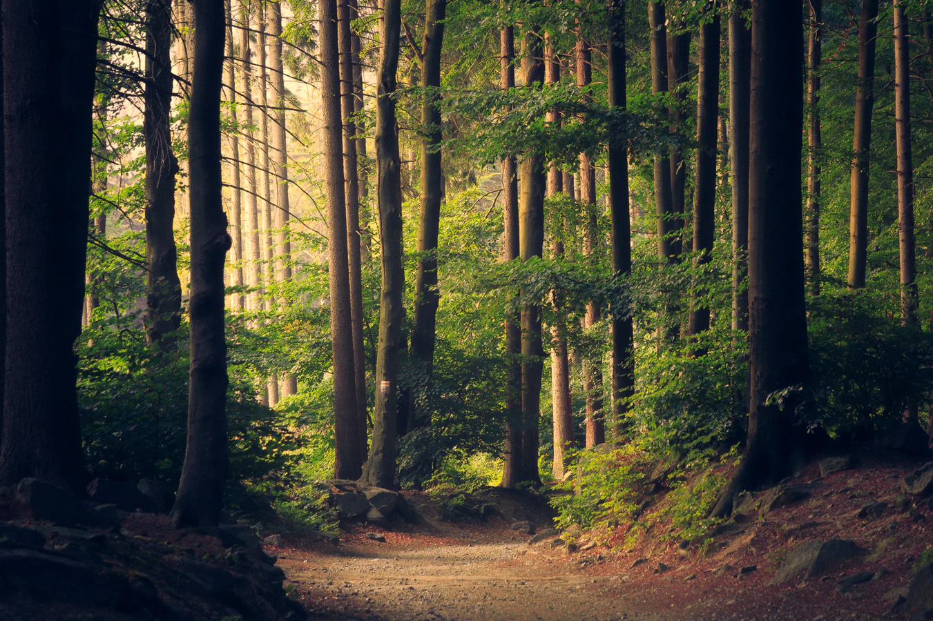
"Little choice but to use the forest resources to survive" (Kefa et al.)
"This forest is not safe." (pp. 256)
"Swaying darkly in the distance" (pp. 144)
"Narrow, winding earth tracks" (pp. 250)

Slide 3
Land Management – Kakamega Forest

Slide 4
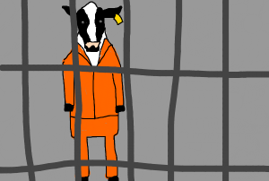
Land Management – Kakamega Forest

Slide 5
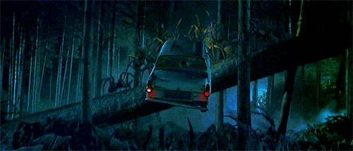
Land Management – Forbidden Forest

Slide 6
Land Management – Kakamega Forest
Kenya Wildlife Service
Kenya Forest Service

Slide 7
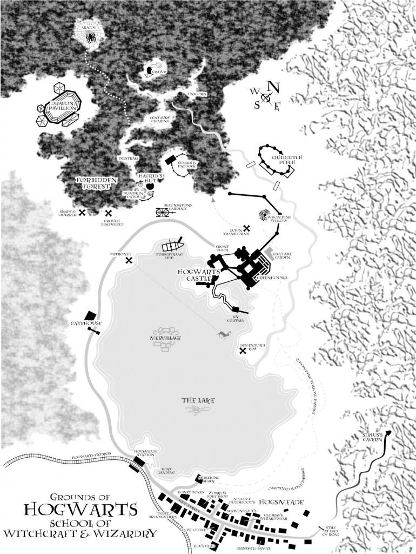
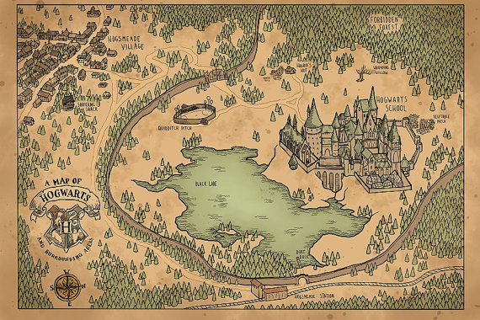
Land Management – Forbidden Forest

Slide 8
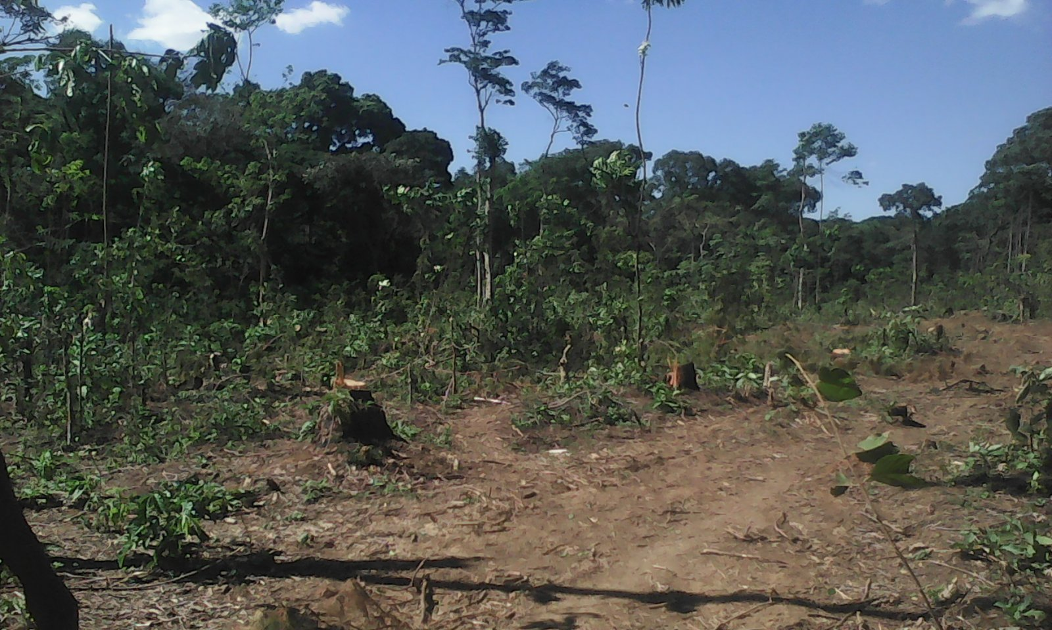
Human Impact – Kakamega Forest
“There are hiking trails in the forest that allow for forest walking, camping, hiking, primate watching, bird and butterfly watching, game watching and a village walks… However, this would not last if the forest is encroached.”
From “Kakamega Forest is Faced with Demise”

Slide 9
Human Impact – Forbidden Forest
“Harry could make out Hermione’s neat writing, Ron’s untidy scrawl, and even a scribble that looked as though it was from the Hogwarts gamekeeper, Hagrid.” (Book 2, pp. 260)

Slide 10
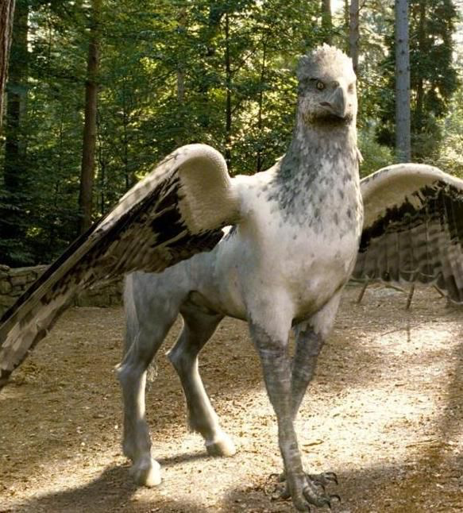
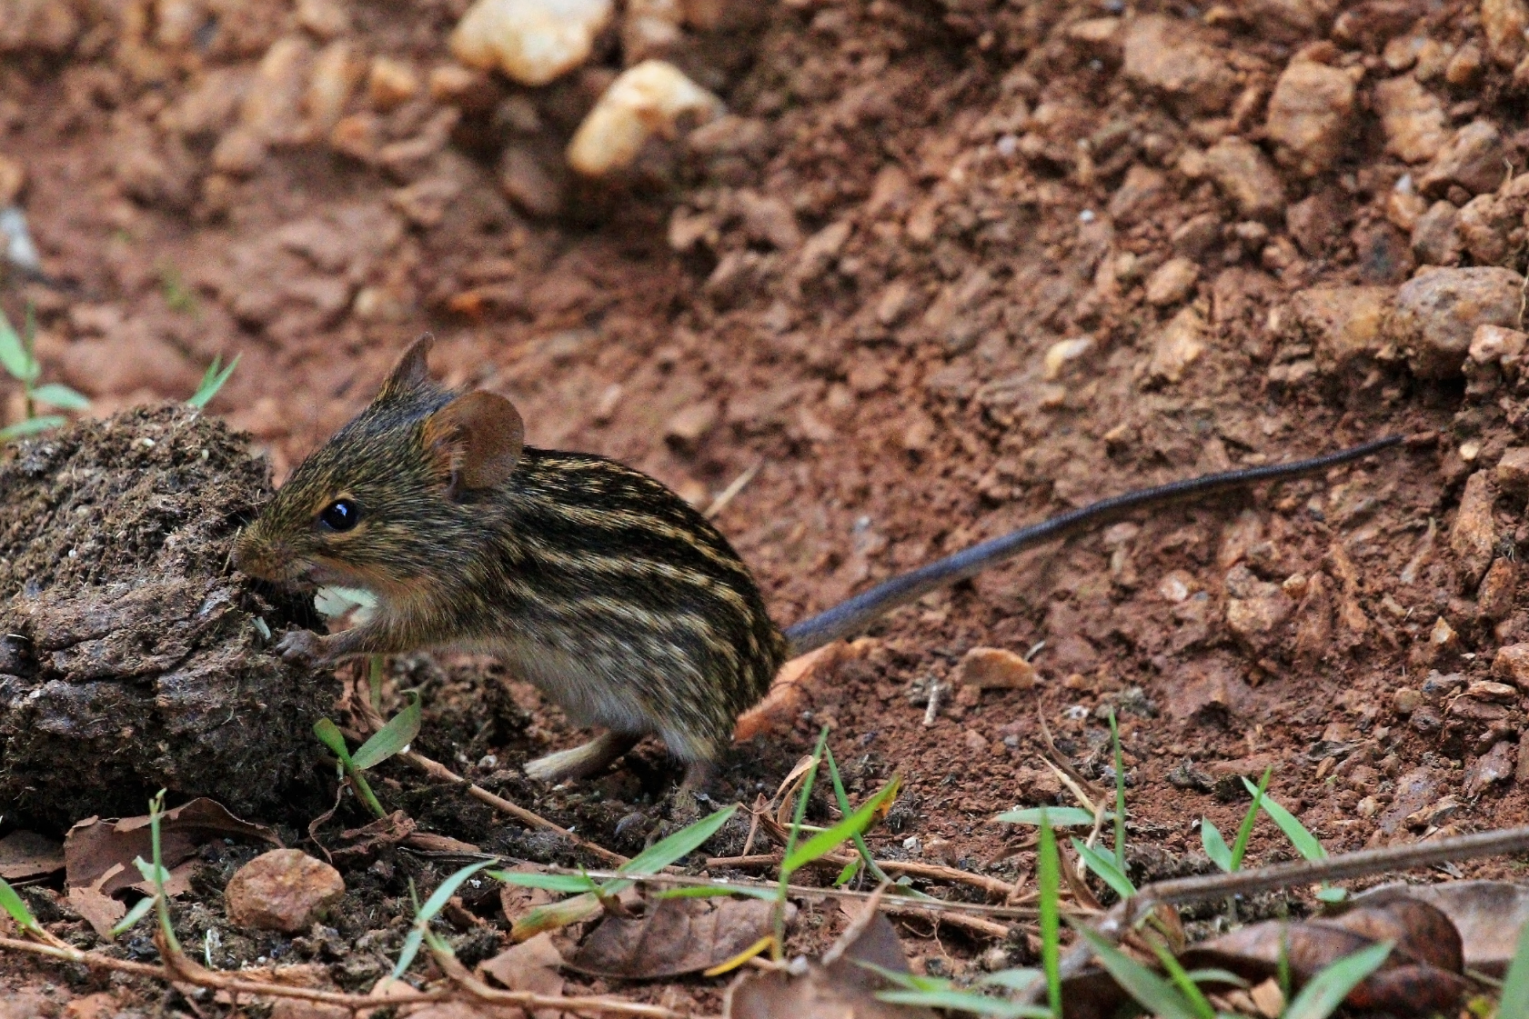
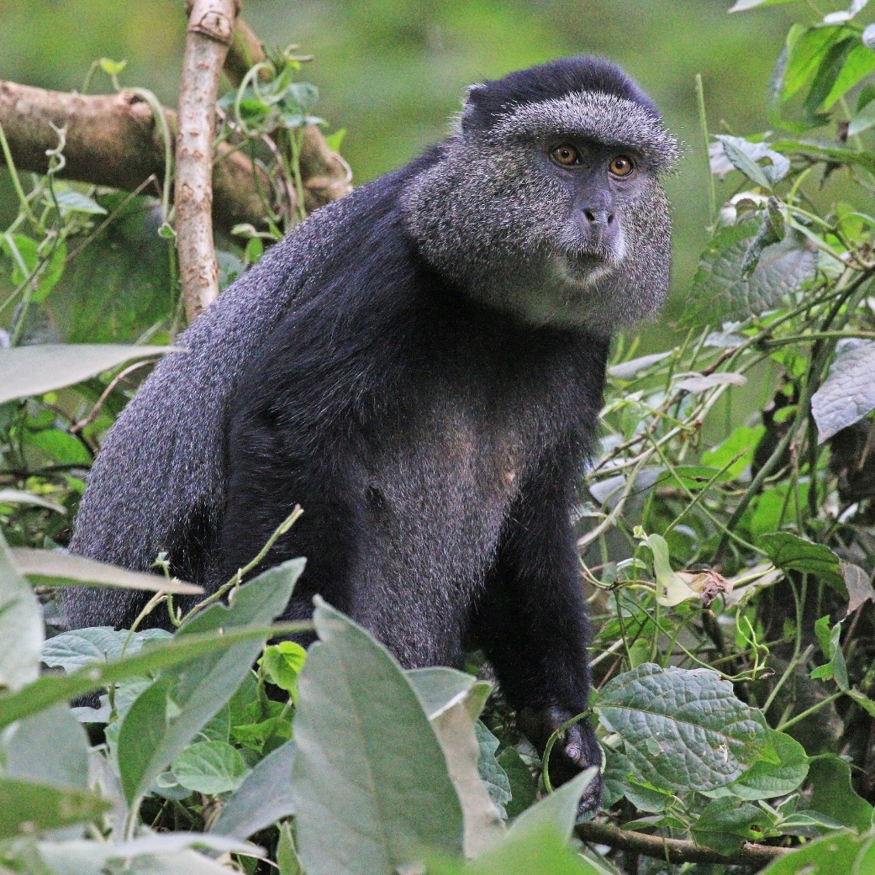

Slide 11
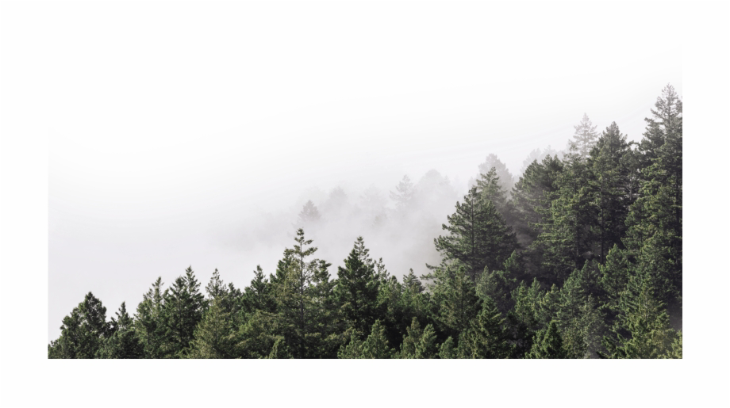

Slide 12
From “Harry Potter fans fill King’s Cross to celebrate the day his son ‘starts’ at Hogwarts”

Slide 13
References
Mukoche, Lilian. “Kakamega Forest is Faced with Demise.” worldpulse.com, Mar 18, 2016. Accessed Oct 14, 2019.
“Harry Potter fans fill King’s Cross to celebrate day his son ‘starts’ at Hogwarts.” ITV.com, https://www.itv.com/news/london/2017-09-01/harry-potter-fans-fill-kings-cross-to-celebrate-day-his-son-starts-at-hogwarts/. Sept 1, 2017. Accessed Sept 20, 2019.
Esipisu, Isaiah. “Local communities rush to save Kenya’s only lowland rainforest”. Mongabay Series: Evolving Conservation, Global Forest Reporting Network. Mar. 29, 2016.
Photo References
Gregory, Andrew. BGSU. Created with ArcMap 10.7.
9greenbottles, “Cow in jail.” Via Google. Aug 3, 2018.
Harry Potter and the Chamber of Secrets film.
“Hogwarts and the Environs from the Books.” The Harry Potter Lexicon.

Slide 14
Special thanks to
Dr Heath Diehl, English Department, Honors College
Dr Andrew Kear, Department of Environment and Sustainability
Dr Andrew Gregory, Department of Environment and Sustainability

