Slide 1
Taking a Dive in the Big Data Lake: Web Scraped Data For Constructing Sampling Frames of Swimming Pools
Parker Kemp
Dr. Trent Buskirk

Slide 2
Background
This presentation summarizes and analyzes the data collection and data evaluation process within the scope of a larger predictive modeling project.
Here we explore several options for gathering data –vendor curated data, web scraped data, and data obtained from APIs (Application Programming Interface).
The scope of this project is gathering property level data from several counties across the United States, so our investigation focuses on gathering and evaluating data from real estate websites, their API services, and Marketing Systems Group (MSG), a market research sampling firm.

Slide 3
Background
Project Steps:
Identified counties and gathered county level property data
Using county data, web scrape google search results to create list of URLs which will then be scraped for property data, use Zillow API to gather data, and get curated data file from vendor
Evaluate proportion of sample availability across data sources and counties
Create infrastructure for web scraping real estate site URLs using prior results
Compare consistency of results across data sources
Build and evaluate predictive models for presence of swimming pools utilizing various data sources

Slide 4
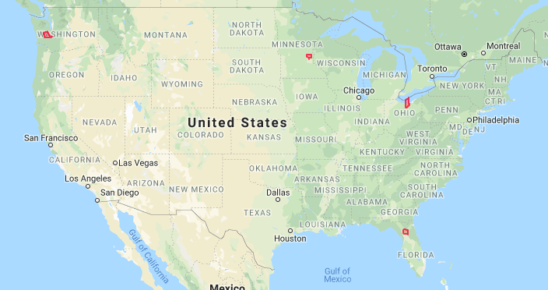
Gathering the County Data
We selected counties from geographically different regions of the country, in order to get a more complete representation of swimming pool presence in various geographic regions of the US. Note: Selection of these counties was limited by availability of county level data.
Thurston County, Washington
Anoka County, Minnesota
Lorain County, Ohio
Alachua County, Florida

Slide 5
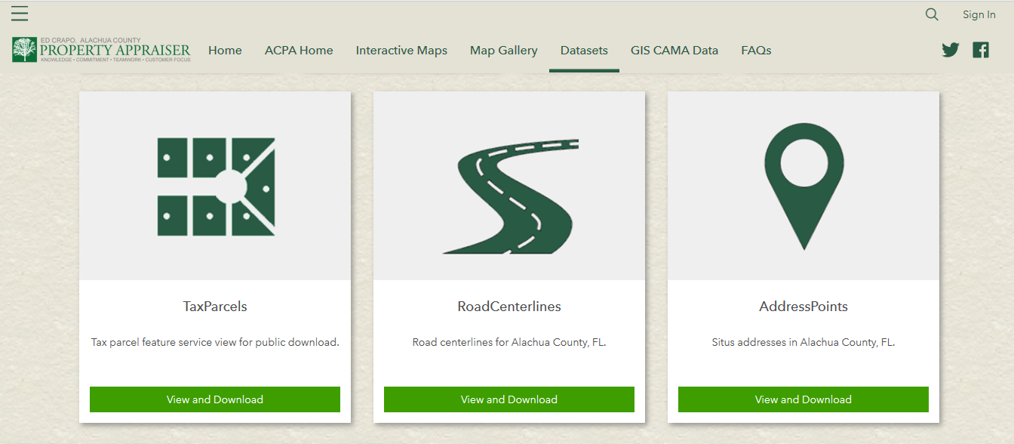
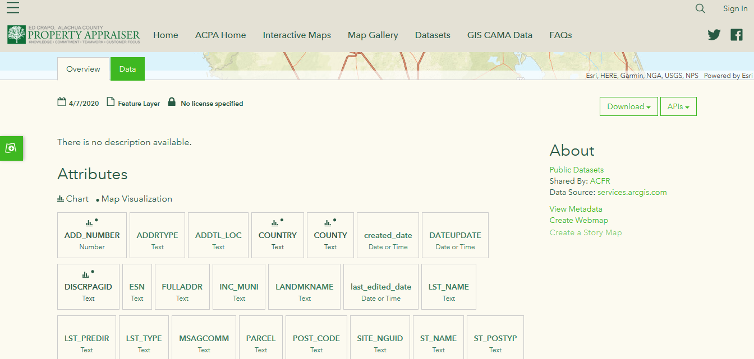
Example of County Website: Alachua
Some of the datasets available from Alachua county.
A look at the AddressPoints dataset page. Here we can see the variables available and have several options for downloading the data.

Slide 6
Data Collection Approaches and Sources
Web Scraping
Gather URLs of websites for web scraping using custom script
Process and scrape property data from gathered URLS
Two websites of interest: Zillow.com and Trulia.com
Vendor Data
Provide Marketing Systems Group, our vendor, with spreadsheet of address sample and get data back on addresses they were able to match
Zillow API
Use Zillow’s provided API in R to request data for addresses from sample

Slide 7
Data Collection Flowchart
Get Data from County Websites
Randomly Sample 4,000 Single Family Homes
Supply sample to vendor to return data on matched addresses
Search google for addresses and store URL for web scraping Zillow and Trulia
Gather data from Zillow API

Slide 8
Address Matching from URL Web Scrape
We want to see if the above addresses match.
To match a returned URL with the respective search address, we performed exact matching (i.e. if the addresses were not identical, it is a non-match – even if in reality they are the same)
County Address:
Notice that in this address from Thurston county, the street address direction appears in different locations, so these addresses would not be considered a “match” under our approach.
Zillow URL Address:

Slide 9
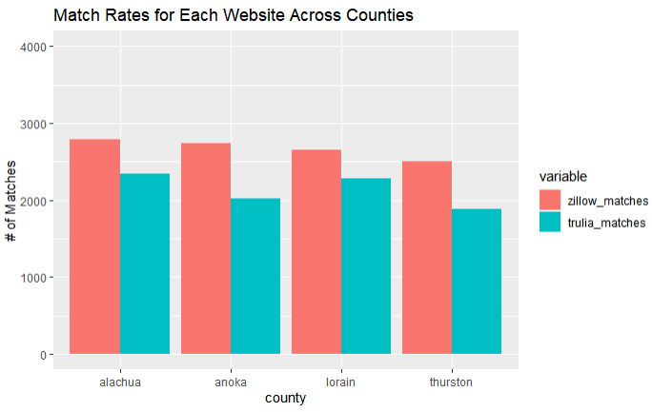
Google Web Scraping Match Rates

Slide 10
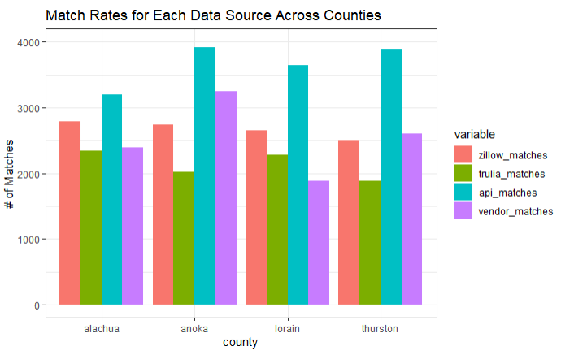
Match Rates Across Data Sources
Here we compare the proportion of our sample for which we have access to data across both web scraping sites, MSG data, and the Zillow API.

Slide 11
Feature Availability Across Data Sources
Parking Info
Vendor Data
Resident Demographics
Web Scraped Data
Resident Purchasing Habits
Number of Stories
API Data
Sun Score
Year Built
Credit Card Preference
# of Bedrooms
Home Square Footage
Parking Info
Flooring
# of Bathrooms
Hobbies and Interests
Lot Size
Heating
Cooling
Children and Ages
And Many More…

Slide 12
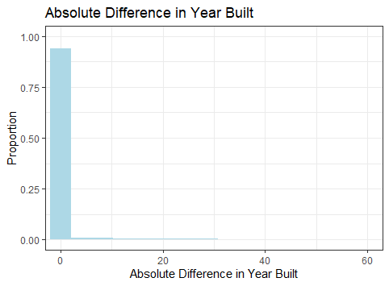
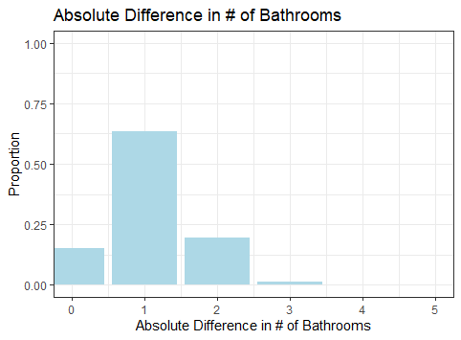
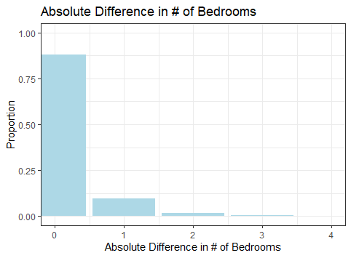
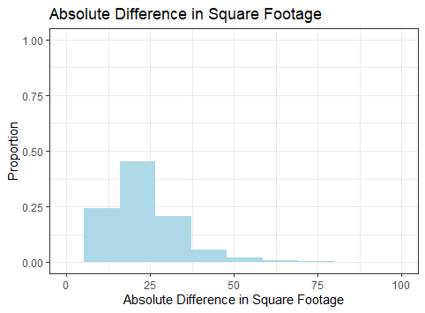
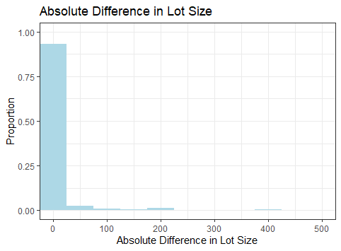
Data Consistency: Vendor vs. API (Alachua)

Slide 13
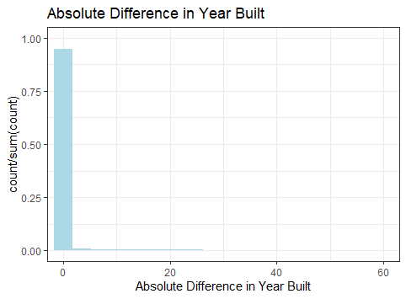
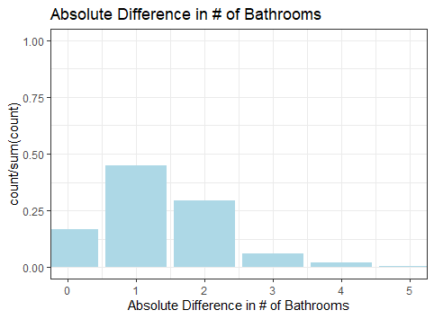
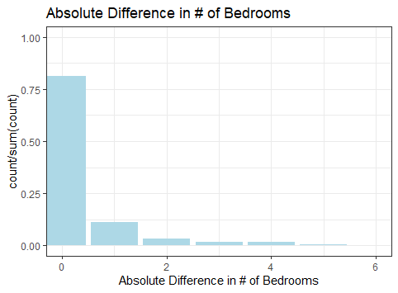
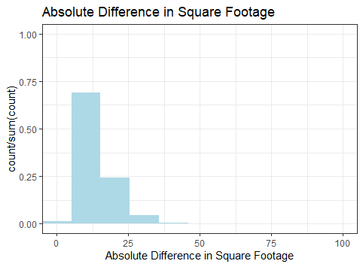
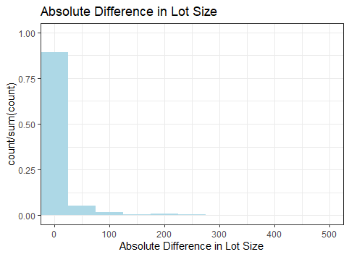
Data Consistency: Vendor vs. API (Anoka)

Slide 14
Insights
Some preliminary conclusions can be stated briefly as follows:
By means of web scraping URLs, Zillow appears to have a more complete set of addresses than Trulia. This could indicate that Zillow is a more popular real estate platform.
The Zillow API gave the most complete set of results, across all counties. If it provided a greater variety of variables, the API would likely be the best data source to use.
While an API was available for Zillow, Trulia did not provide one. Therefore, when considering data sources for real estate data, we may prefer Zillow, as it gives us a more accessible means of obtaining our data, as well as having a greater web scraping match rate.
The vendor data displayed some inconsistency with the API data, indicating some disconnect between the sources. This will require further investigation to determine the cause of this disparity and verify which data source is most accurate and complete.

Slide 15
Insights on Open Source Data Collection
Government data sources for gathering address information differ greatly in ease of use and quality of data. Some counties provide open data portals, data dictionaries, and consistent formatting, while others do not.
Address formatting is a potential problem when working with data of this type. Ideally, you would standardize all addresses you are working with to avoid introducing potential bias into your processes.
Some potential data sources may provide an API, while others do not. The first task of the data collector should be to evaluate the potential data sources to ensure the most complete data collection strategy possible.

Slide 16
Next Steps
Scrape data from Zillow.com and Trulia.com
Perform more complete evaluation of data consistency across all data sources for all counties and make formal conclusions about data source quality
Train predictive models for predicting presence of swimming pools using each data source and compare results

