Slide 1
American Perceptions of Arab Countries in Film: Midwestern Students in Morocco
Tay Sauer

Slide 2
J-Term in Morocco
3 weeks in Morocco
2 weeks in Fes
Excursions to Khamlia (Sahara Desert), Marrakech, Meknes, and Volubilis
Pre-trip and post-trip survey of Midwestern students studying abroad in Morocco
Perceptions of Morocco, Islam, and American portrayals of Muslim and Arab countries
Discussions on institutionalized racism and Islamophobia, identifying how the media perpetuates negative stereotypes

Slide 3
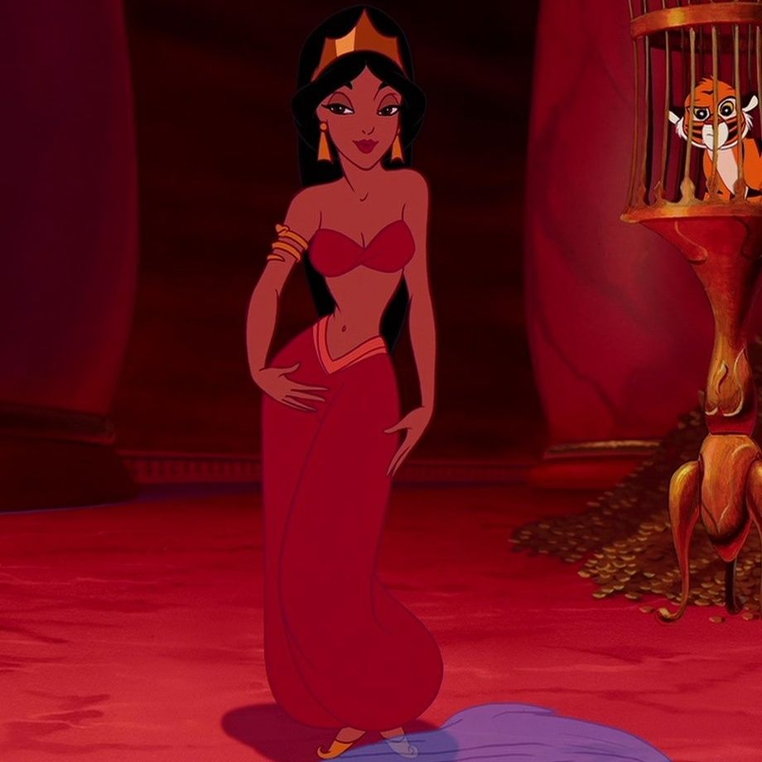
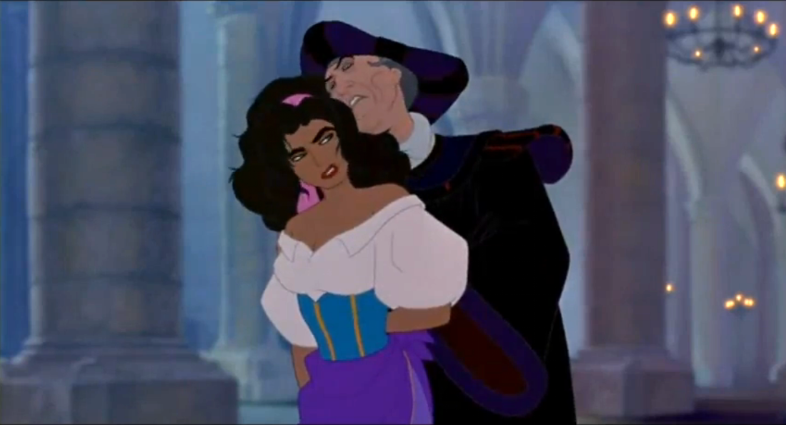
Hypersexualization of Arab Women
Jasmine and Esmeralda having older men attempting to seduce them is normal because brown women are seen as inherently sexual. Elsa wearing a form-fitting dress is seen as a disgrace because white women are inherently “pure”
Aladdin (1992)
The Hunchback of Notre Dame (1994)

Slide 4
Hypersexualization of Arab Women cont.
Aladdin is seen entering a brothel in a PG rated movie
Jasmine has the most revealing outfit of all of the Disney Princesses
Covering up is seen as oppression rather than empowerment. Western values dictate that performance for the male gaze is both empowering and demeaning. Covering up is also seen as complying with patriarchy and thus oppressive, though many women find both empowerment and oppression in both styles of presentation.

Slide 5
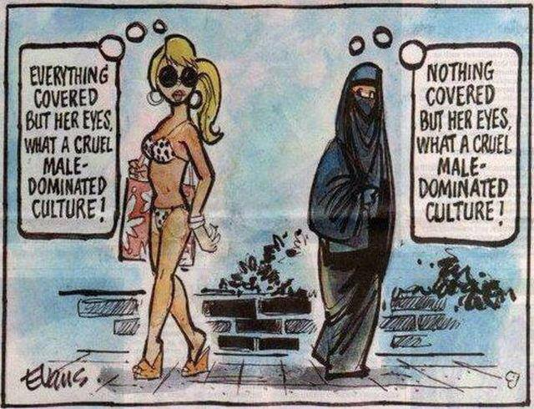
Image courtesy of evanscartoons.com

Slide 6
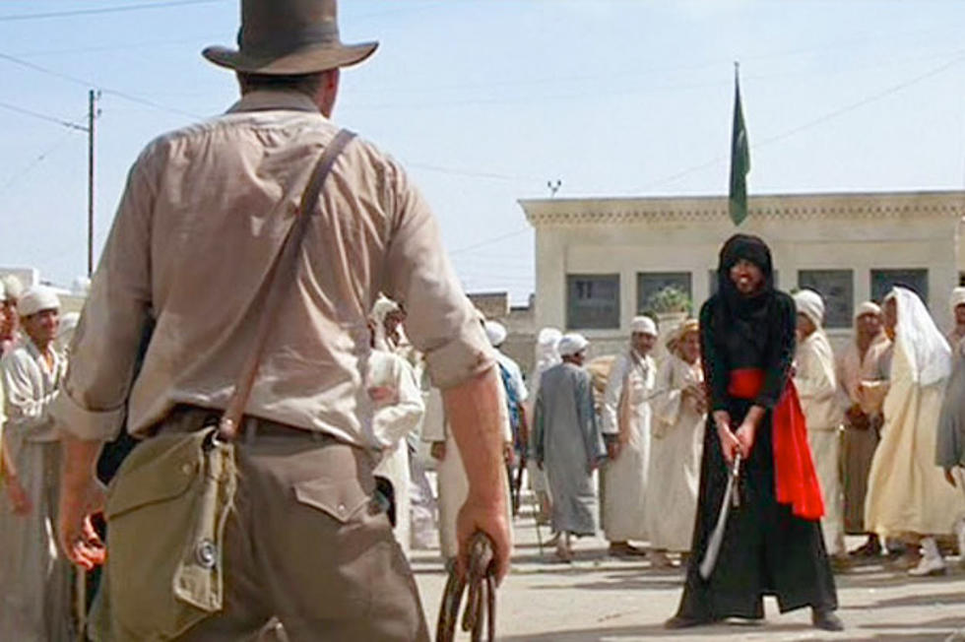
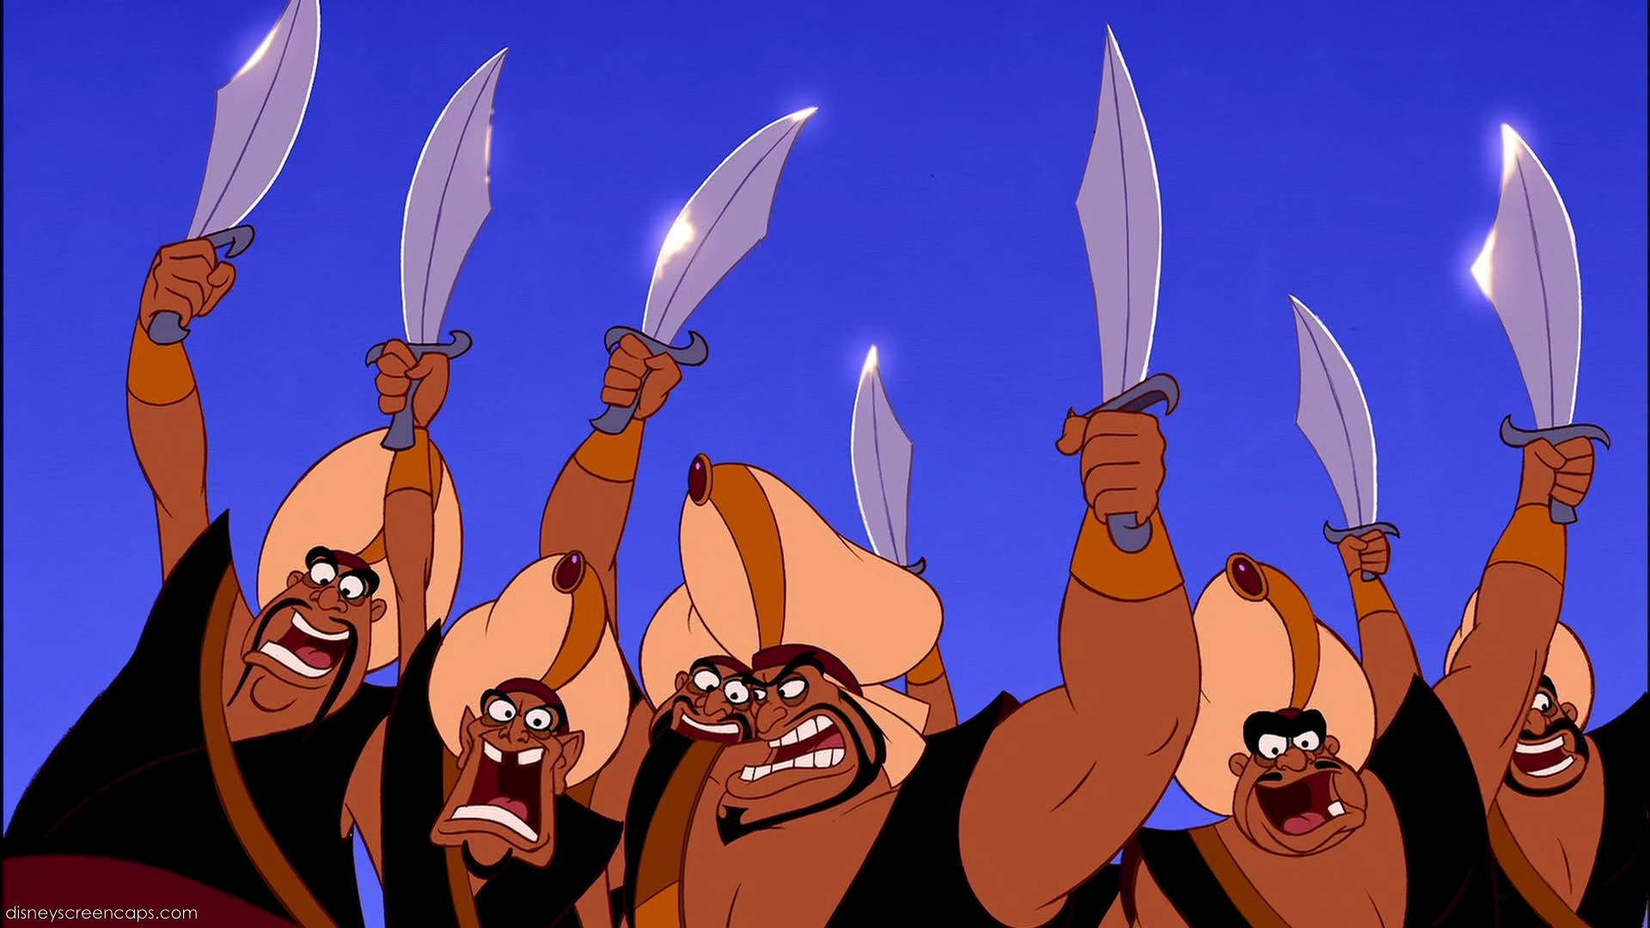
Demonization of Brown Men
Stereotype is large, bearded, ugly, dark-skinned
Snake charmers as a stereotype
Mena Massoud (Aladdin in Aladdin (2019)) being unable to find work even after Aladdin made over $1B at the box office
Aladdin (1992)
Raiders of the Lost Ark (1981)

Slide 7
Colorism in Film and Media
In The Prince of Persia (2010), in what is now modern-day Iran, all of the main characters are portrayed by white actors except for the villains, who are dark-skinned Africans
Colorism is the concept of equating beauty and value to lighter skin tones over darker skin tones

Slide 8
Harmful Amalgamation of Arab Countries
According to film and media, all Arab countries are desert wastelands with the same cultural dress, same food, same cultural influences.
“Agrabah” of Aladdin is a fictional country. Thus, no inherent ties to Islam.
“It has become increasingly common for the country of the terrorist characters in television dramas to go unnamed. This strategy rests on the assumption that leaving the nationality of the villain blank eliminated potential offensiveness; if no particular country or ethnicity is named, then there is less reason for any particular group to be offended… Fictionalizing the country of the terrorist can give the show more latitude in creating salacious storylines that might be criticized if identified with an actual country.” -Evelyn Alsultany, Arabs and Muslims in the Media After 9/11: Representational Strategies in a ‘Postrace’ Era

Slide 9
The Riz Test
Coined by rapper Riz Ahmed. Any film with at least one identifiably Muslim character can be put to the test. The test asks, is the character:
Talking about, the victim of, or the perpetrator of terrorism?
Presented as irrationally angry?
Presented as superstitious, culturally backwards or anti-modern?
Presented as a threat to a Western way of life?
If the character is male, is he presented as misogynistic? or if female, is she presented as oppressed by her male counterparts?

Slide 10
Midwestern Perceptions: Student Study
Parents expressed concern at going on a “nontraditional” study abroad
Fear of greater danger or violence in an Arab country, despite the fact that other “Level 2 Travel Advisory” countries at the time, according to the US Department of State, included France, Germany, Italy, and Denmark
Students assumed that women had to wear hijab or niqab, did not know that the garb was optional
One student observed that if all Muslims and Arabs were judged by the actions of terrorist groups, then all white Christians should be judged by the actions of the KKK
Students said that institutionalized racism and Islamophobia was more easily-identifiable post-study abroad

