Slide 1
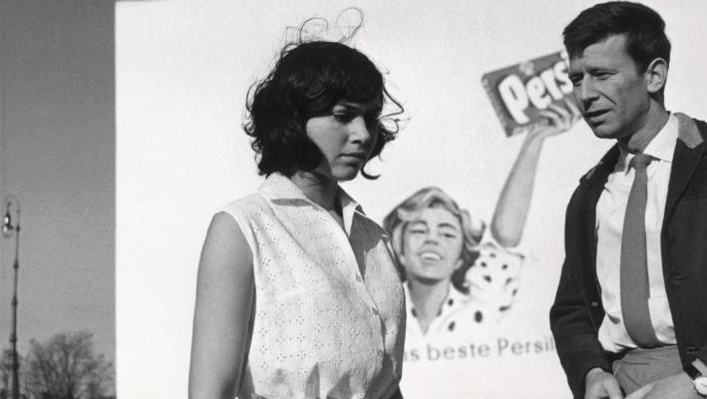
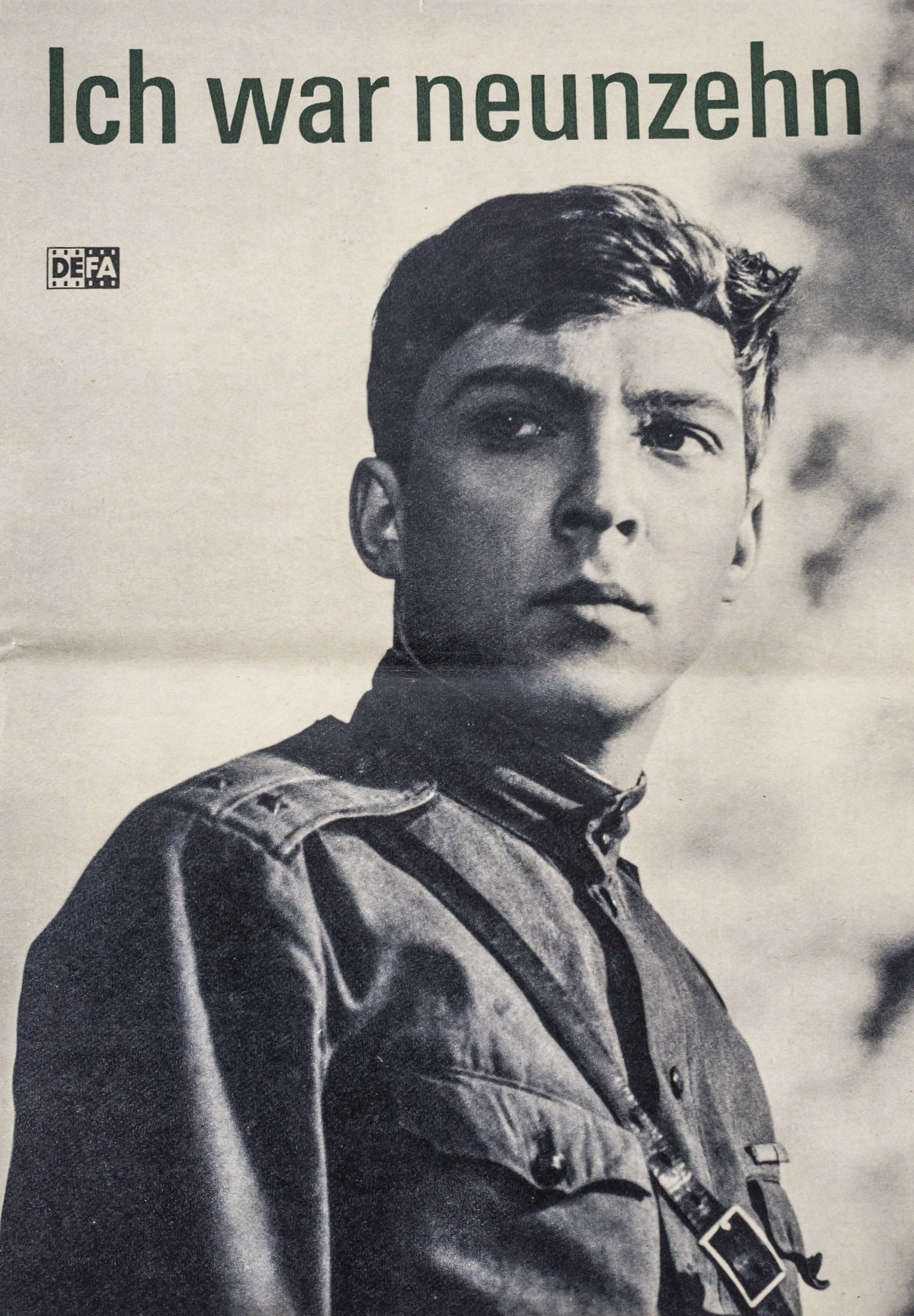
Youth in Konrad Wolf’s Divided Heaven and I Was Nineteen
Jack Riegert
Bowling Green State University 2020

Slide 2
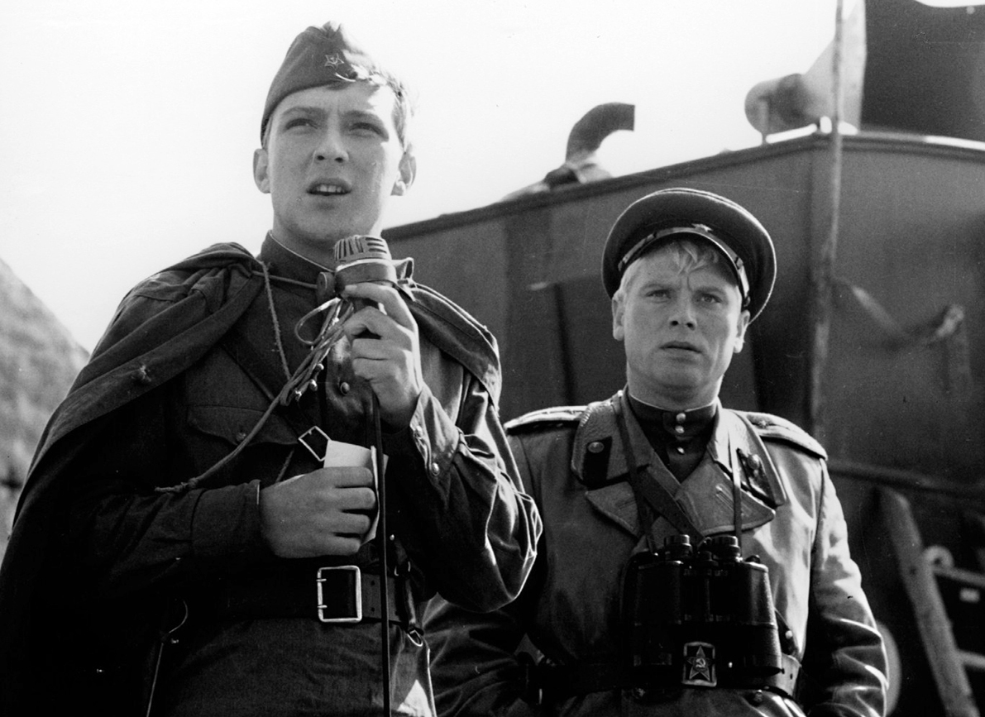
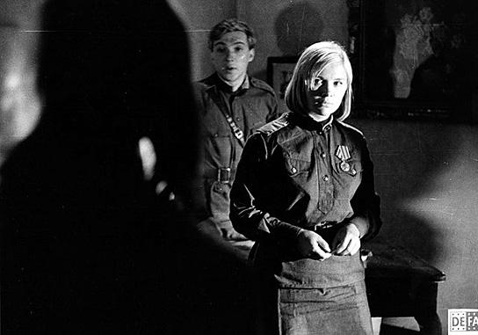
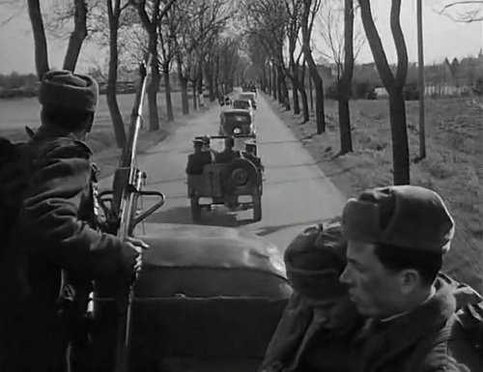
I Was Nineteen
1
2
Gregor and a comrade are communicating with the surrendering German soldier
Gregor and a subordinate officer speak with the desperate German girl after occupying an East German town
Gregor and the invading Soviet troops go further into Germany (Landscape shot)
3

Slide 3
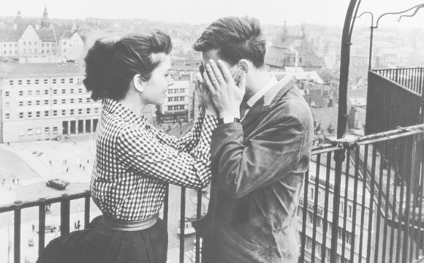
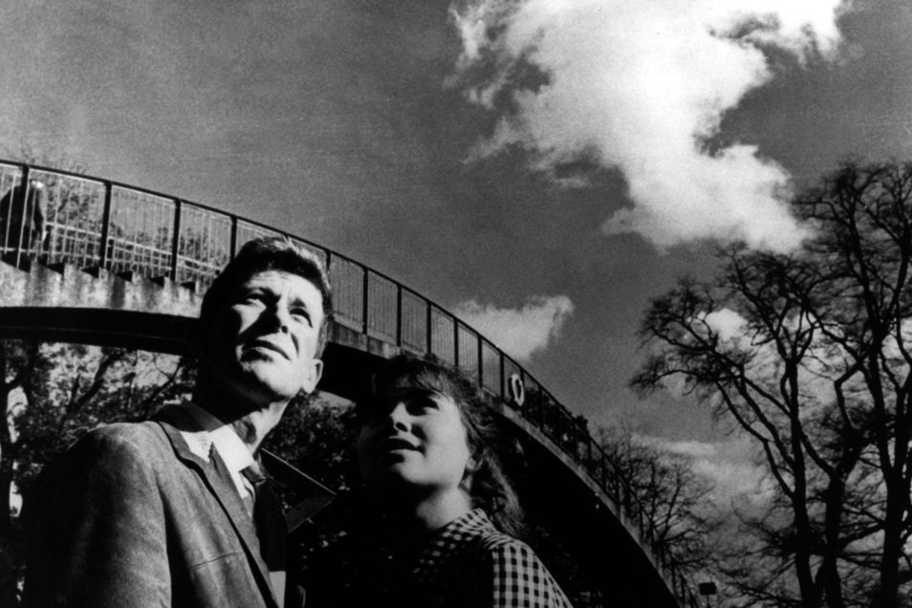
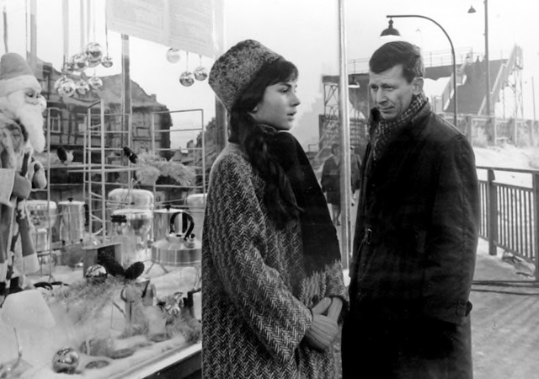
Divided Heaven
1
2
Rita and Manfred smelling coffee
Rita and Manfred by the bridge they often visit
Rita and Manfred walking around town, seeing the store front (cluttered shot)
3

