Slide 1
Managing the Sleeping Germ: An Experiential Narrative of the Implications that Political Decisions had on Exacerbating the HIV/AIDS Epidemic in South Africa
Audra Gill | 2020 Hoskins global scholar

Slide 2
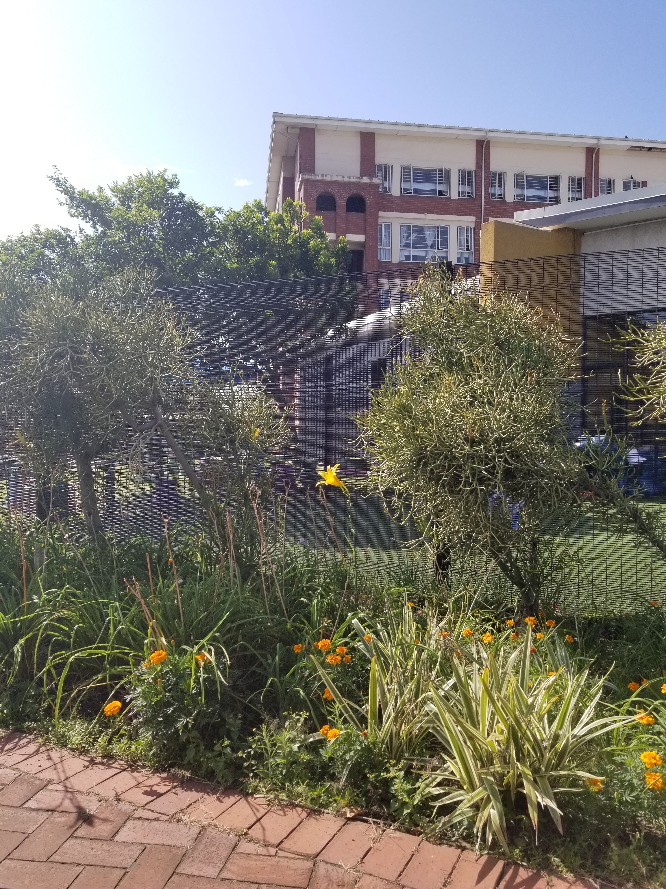
Presentation Overview
Project Purpose
Research Question
Project Origination
Historical Background
Methods & Experiential Learning
Discussion, Conclusion & Takeaways
Reflection of Process

Slide 3
Project Purpose
The purpose of this project was to investigate the HIV/AIDS epidemic of South Africa through an ethical, global health learning opportunity.

Slide 4
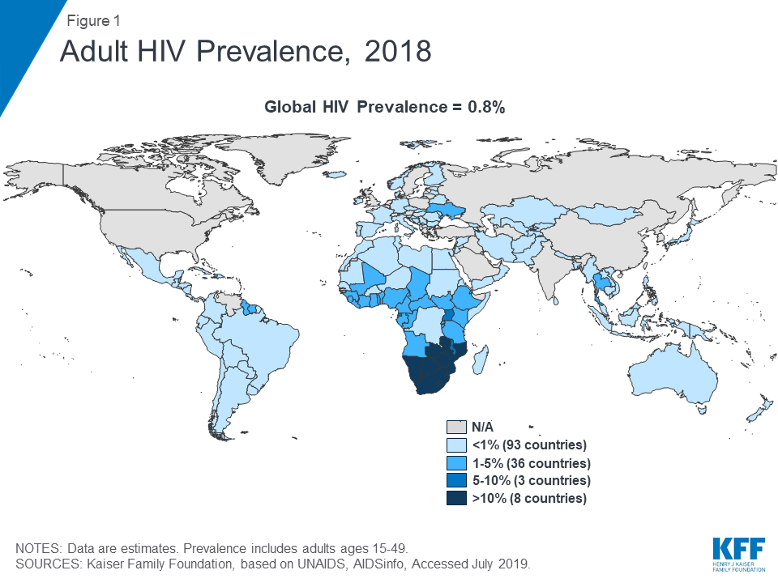
Why South Africa?
71% of all HIV cases worldwide are in sub-Saharan Africa (26 ½ million cases)
Management of HIV/AIDS in the United States still does exist, but there are an increasing amount of programs, resources and treatments
I wanted to learn specifically about the epidemic in South Africa and investigate the healthcare system to see if differences in HIV treatment can be attributed to those differences

Slide 5
Research Question(s)
Why is South Africa, a country regarded by the United Nations as having a mid-to-high economic status, struggling with an HIV/AIDS epidemic?
What are the contributing factors to the HIV crisis?
How has the epidemic been dealt with by healthcare professionals and government officials?
Notes:
Why is South Africa, a country regarded by the United Nations as having a mid-to-high economic status, struggling with an HIV/AIDS epidemic?
What are the contributing factors to the HIV crisis? Research was pointing towards limited resources and education, but I wasn't quite convinced.
How has the epidemic been dealt with by healthcare professionals and government officials? - A research question that was not initially intended but became the focus of my experience.

Slide 6
Learning Objectives
Learn about the healthcare system in South Africa through public health rotations in variety of healthcare settings.
Engage with organizations that specifically work to address HIV/AIDS within the Durban, Kwazulu-Natal community.
Interact with patients and professionals at care centers whose every lives and occupations are affected by HIV/AIDS care and treatment.

Slide 7
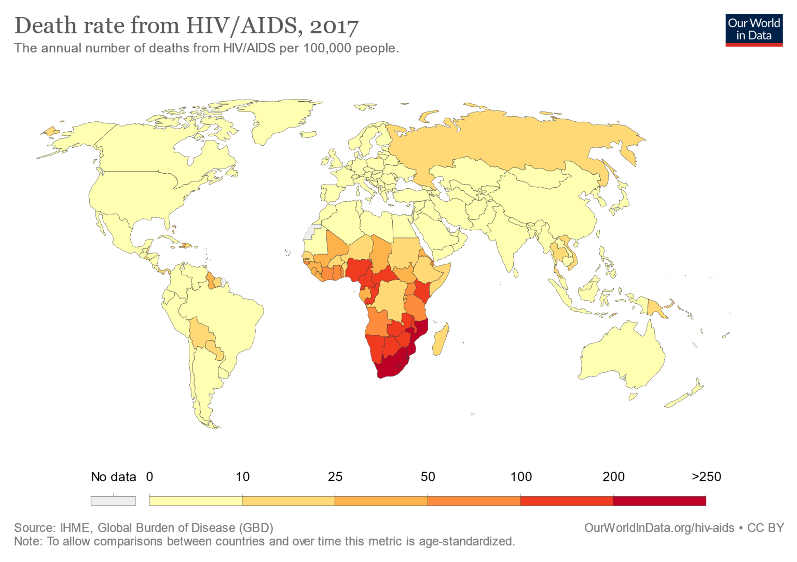
Project Origination
HIV epidemics have in recent decades, been described as a social justice issue
As a public health student, I have developed a passion for social justice, especially relating to healthcare
Led to the search for ethical global health programs
Notes:
The initial motivations for this project stemmed from my interest in global health efforts and most specifically the HIV/AIDS epidemic in sub-Saharan Africa. In the recent decade, since HIV disproportionally affects lower income areas, marginalized racial and gender groups as well as developing countries, HIV epidemics are commonly being referred to as social justice issues. A social justice issue is one that can be defined as the inequitable distribution of resources, human rights or opportunities based upon identification or self-classification of an individual within a social group.
During my time at BGSU, I have become most passionate about advocating for social justice as well as public health efforts, thus the HIV epidemic in sub-Saharan Africa has been an interest of mine for a little while now. Wanting to engage in a potential service-learning opportunity in Africa, I began to research ethical global health programs that were ideally longer than one or two weeks in length, fully immersive, yet culturally component and respectful of the home community.

Slide 8
Child Family Health International
Non-profit organization that works to foster reciprocal partnerships and empowerment in local communities, transforming perspectives about self, healing and global citizenship among participants
Offer academic, experiential global health learning opportunities all across the world including the following countries: Argentina, Bolivia, Costa Rica, Ecuador, Ghana, South Africa and many others
United Nations Economic Social Council Affiliate

Slide 9
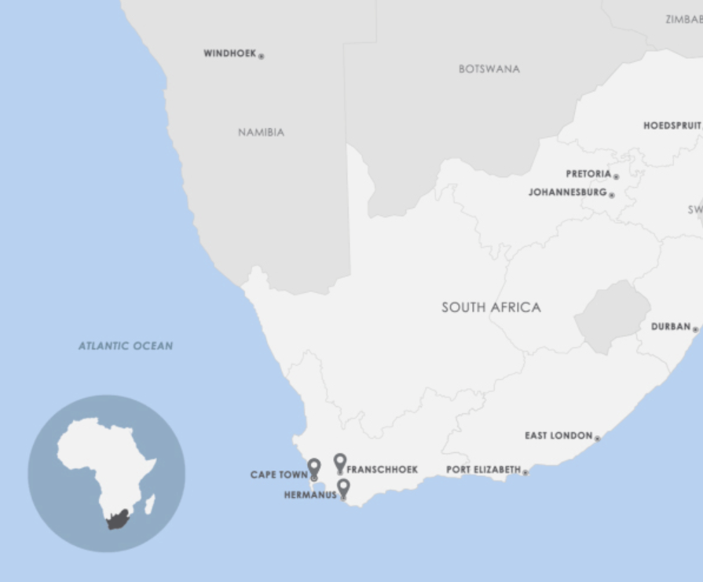
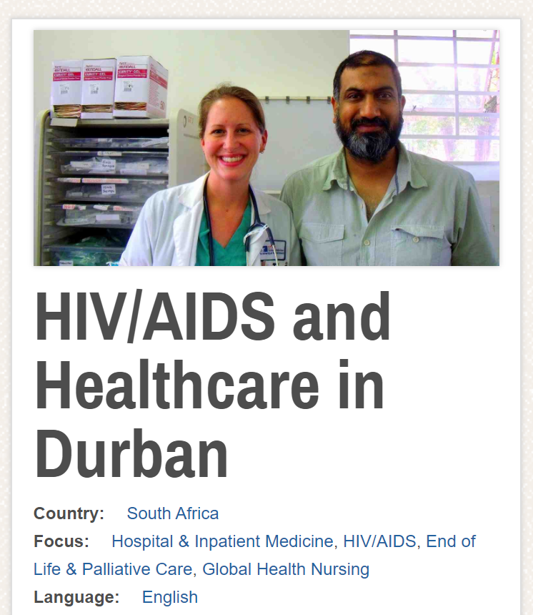
CFHI Program Overview
Duration
Dec. 31, 2019 – Jan. 26, 2020
Location
Durban, Kwazulu-Natal, South Africa
Focus
HIV/AIDS and the Healthcare System
Mission
Provide students with an overview of the South African healthcare system and the burden of HIV/AIDS
Rotations
Public health rotations take place throughout a tertiary hospital, a hospice center, a wellness center and a rural health clinic

Slide 10
Cultural and Historical Orientation
Notes:
Something that CFHI values alongside myself is the power of education and knowledge to which I received an abundance of throughout this experience. During this next section, I will provide you all with the background information I received upon arriving in South Africa, in addition to other supplemental literature that I have found while compiling this paper to fill in any gaps and provide validity.

Slide 11
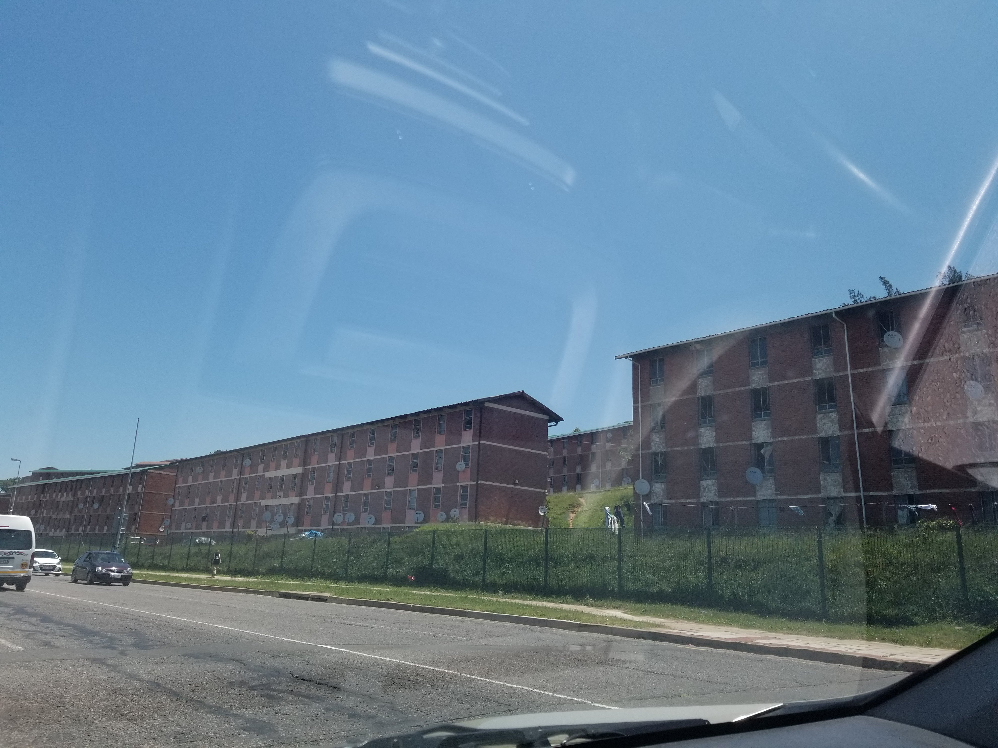
Cultural Orientation
History of South Africa
Pre-imperialization, South Africa was the home of many tribes, the grounds of many wars, experienced Dutch settlement and was later unionized by the British.
MODERN HISTORY
Union of South Africa founded in 1852 by white leaders
African National Congress: black union created in social protest of the white leaders in power
Apartheid: regime that began in the1948 by the National Party - group called Afrikaners
Group Areas Act: legislation that assigned racial groups to specific residential areas in 1961
People of color were assigned to less desirable regions
White people were designated capes, coasts and well-developed areas
Racial groups: Blacks, Indians, Coloureds, and Whites
Very similar to the "separate but equal" doctrine taken up by the US at this time
(Republic of South Africa, 2019)
Notes:
Though whites accounted for less than 20 percent of the population, they kept control of more than 80 percent of the land.

Slide 12
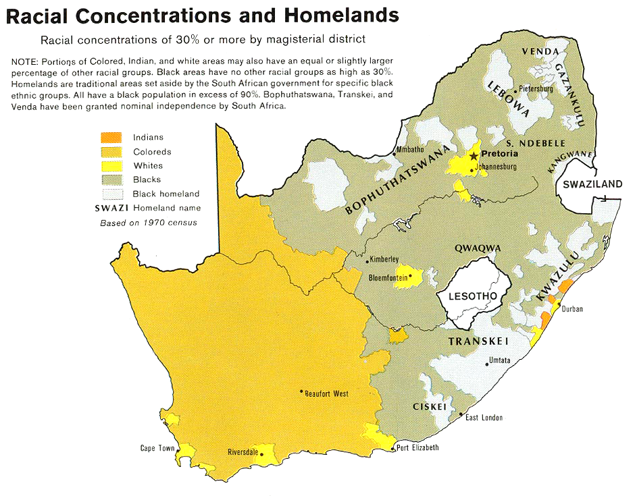
U.S. Central Intelligence Agency

Slide 13
Cultural Orientation
History of South Africa
Late 1980s - President F.W. de Klerk began making important administrative changes
Released resistance leaders from prison, like Nelson Mandela
Unbanned political parties like ANC
Stepped down encouraging political change
1994 - Nelson Mandela became the first black head of state and first person to be elected in a fully representative democratic election
Country was re-organized into 9 provinces based on geographic location and population distribution

Slide 14
The South African Healthcare System

Slide 15
Cultural Orientation
HIV/AIDS & the Healthcare System
Post-Apartheid, people were able to go to any clinic or hospital that was accessible to them
Overcrowded hospitals
"Brain Drain" to private sector and other countries
Overwhelmed public sector professionals
Healthcare system changes
2002 – Government allowed physicians to work in both sectors
2007 – Remuneration strategy to increase physician compensation
2008 – National nursing strategy
Notes:
WHO estimates - even though there is a much higher need for physicians in the public sector that serves 84% of the population, that these professionals are estimated to make up 30% of the healthcare workforce in South Africa, with the other 70% of healthcare workers having employment in the private sector for only 16% of the population

Slide 16
The Impact of HIV/AIDS
HIV is a virus that is thought to have originated from the Congo prior to the 1970s and began to spread throughout the world
Transmission:
Contact with human semen, blood, vaginal secretions, anal fluids and breast milk
Immunobiology:
Virus attacks host's immune system
Virions destroy and hijack CD4 cells
Treatment:
Antiretroviral therapy (ART) uses different combinations of antiretroviral medications (ARVs) which fight the viral cells that are killing the body's white blood cells
If started early enough, ARVs can suppress the virial load to an undetectable amount meaning viral suppression
(Avert, 2020)
Notes:
As the country was getting oriented to the new political government and addressing the new challenges within their healthcare system, South Africa was faced with a new challenge: the Human Immunodeficiency Virus (HIV) accompanied by its successor, the Acquired Immunodeficiency Syndrome (AIDS). During the late twentieth century, much of the world was attempting to tackle this new virus that would entirely change the country of South Africa for decades to come.

Slide 17
Viral Suppression
If taken correctly and started early enough, ART is very efficient at reducing the viral load in the blood
(U.S. Department of Health and Human Services, 2020)

Slide 18
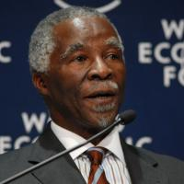
HIV in South Africa
ART restricted by the government between 2000-2005
President Thabo Mbeki was skeptic of the virus and treatments
Government withdrew support from clinics that were using a drug that reduced mother-to-child transmission and restricted a donated drug that reduced newborn infections
Over 330,000 deaths during this time period are attributed to not using ART
Healthcare professionals unionized and protested
2001 – South Africa's highest court ruled that the government rightfully owed the public ARV distribution
Thabo Mbeki, President of the Republic of South Africa from 1999-2008

Slide 19
Experiential Learning and Application

Slide 20
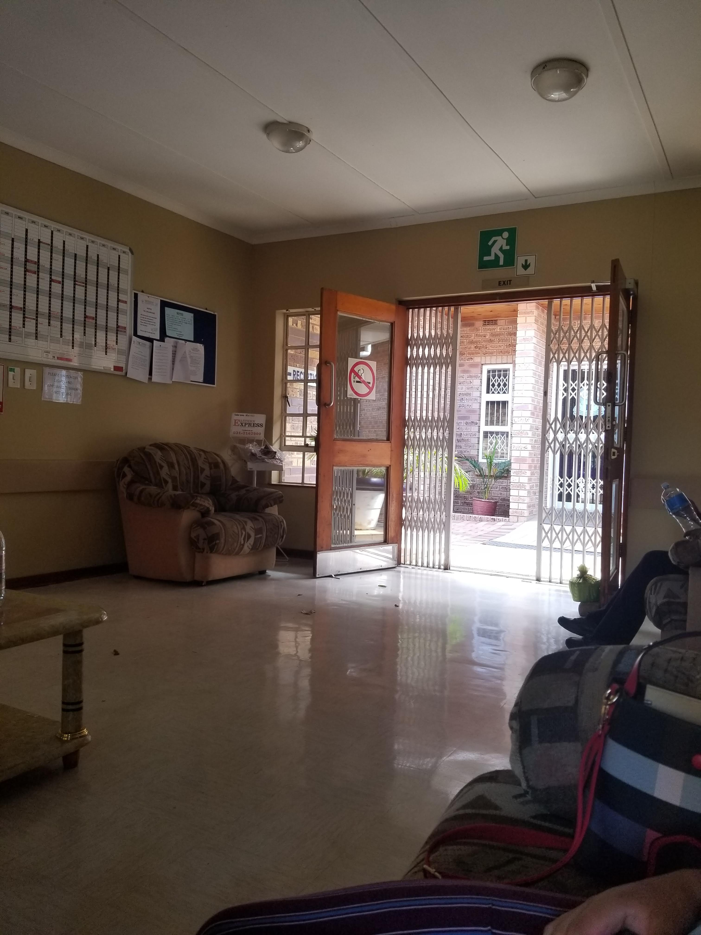
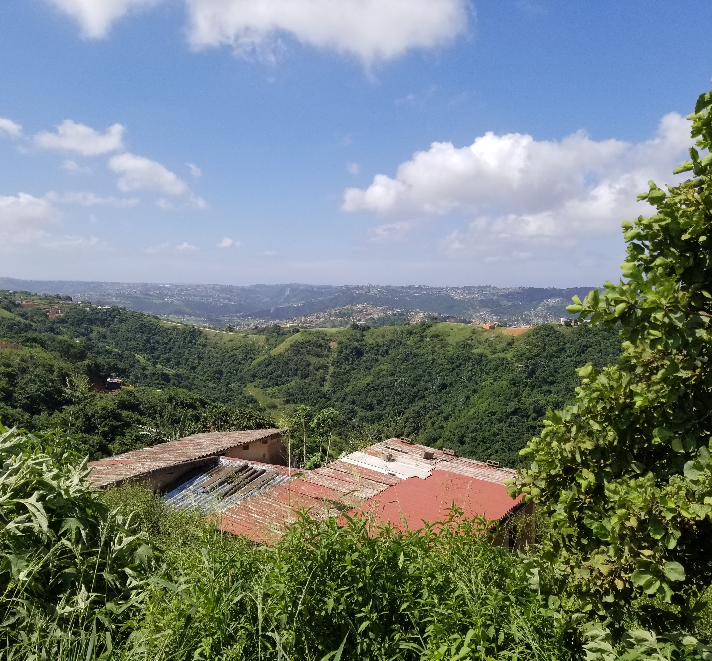
Placements
Malukazi Islamic Clinic
Shadowed 70 patients interactions in 4 hours
Chatsworth Hospice
Visited in-patient ward and attended 12 home visits
Example of overburdened health facilities
Nurses performed common physician duties
Cancer-related illnesses (no HIV conversations)

Slide 21
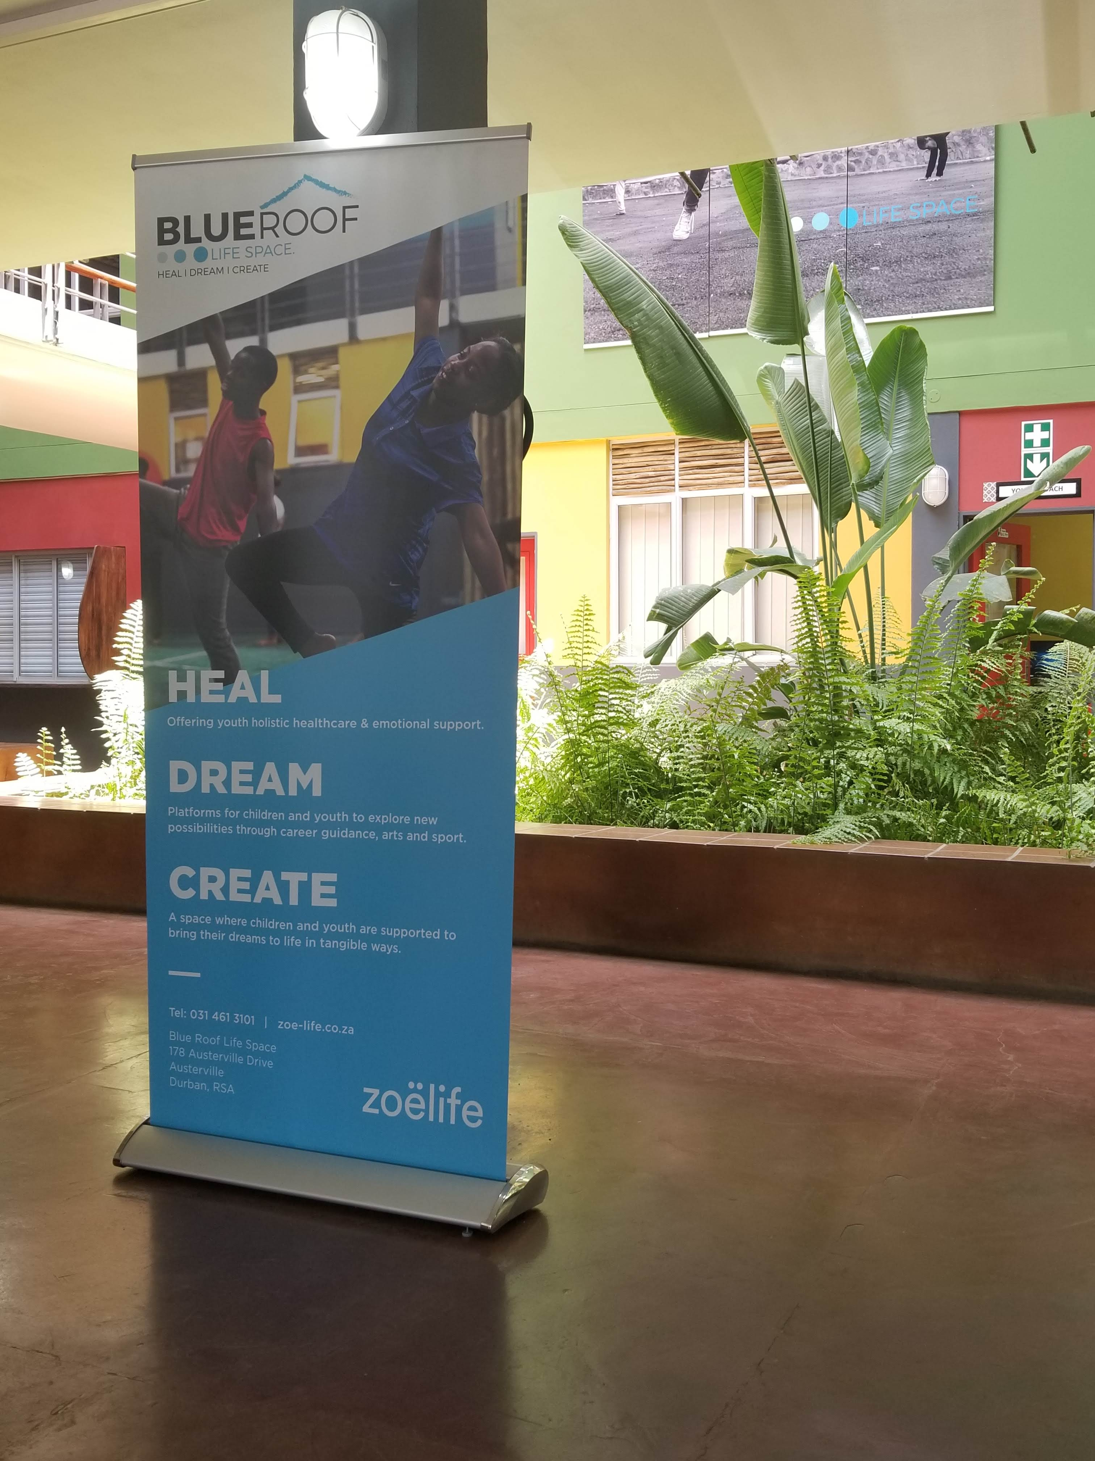
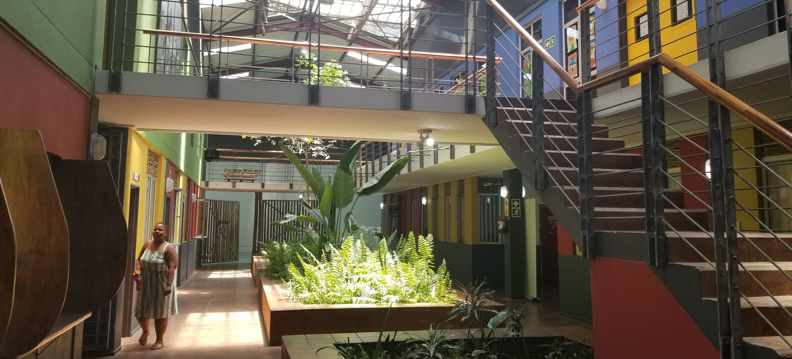
Placements
Blue Roof Wellness Clinic
Formerly one of the largest nightclubs in Durban
HIV/AIDS Clinic opened by Keep A Child Alive
Pharmacy
HIV Testing & Contraceptives
Lalela: Art and Dance
Made For More
Now funded through Zoe Life
Life Coaching
HIV/AIDS Counseling
Clinical Care

Slide 22
Managing the "Sleeping Germ" at Blue Roof

Slide 23
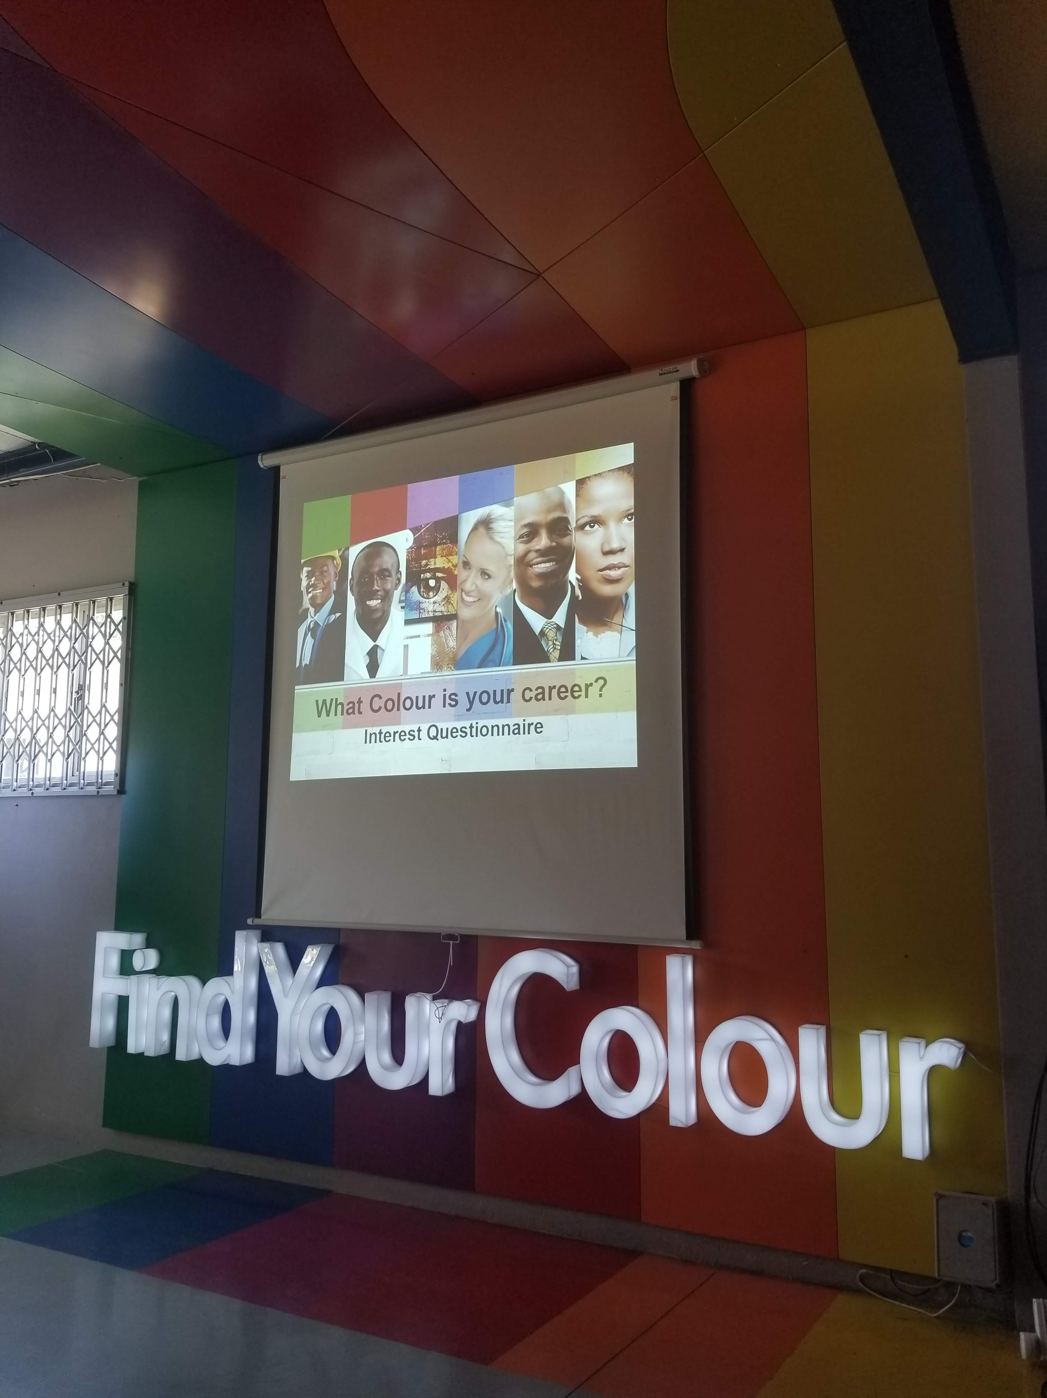
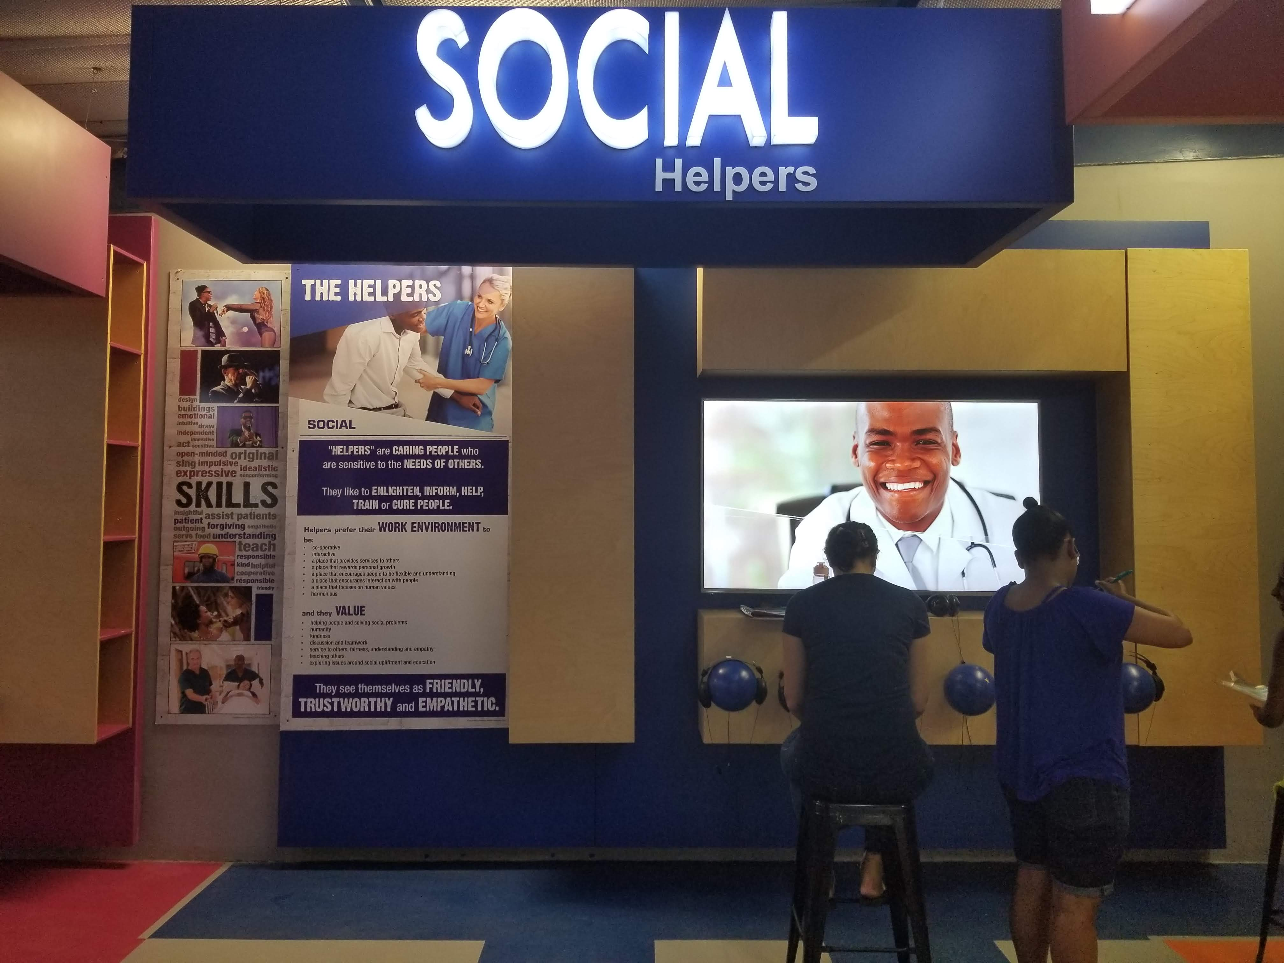
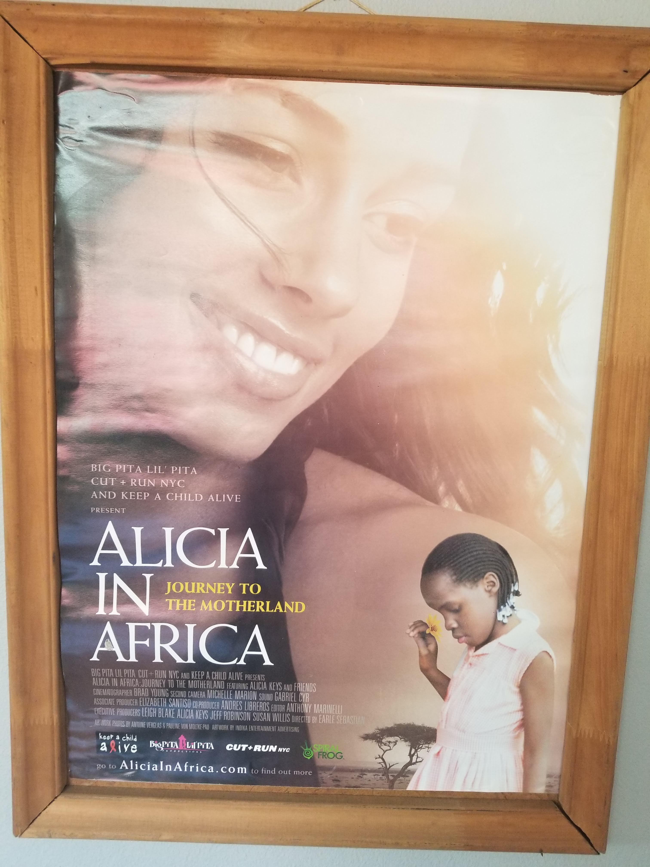
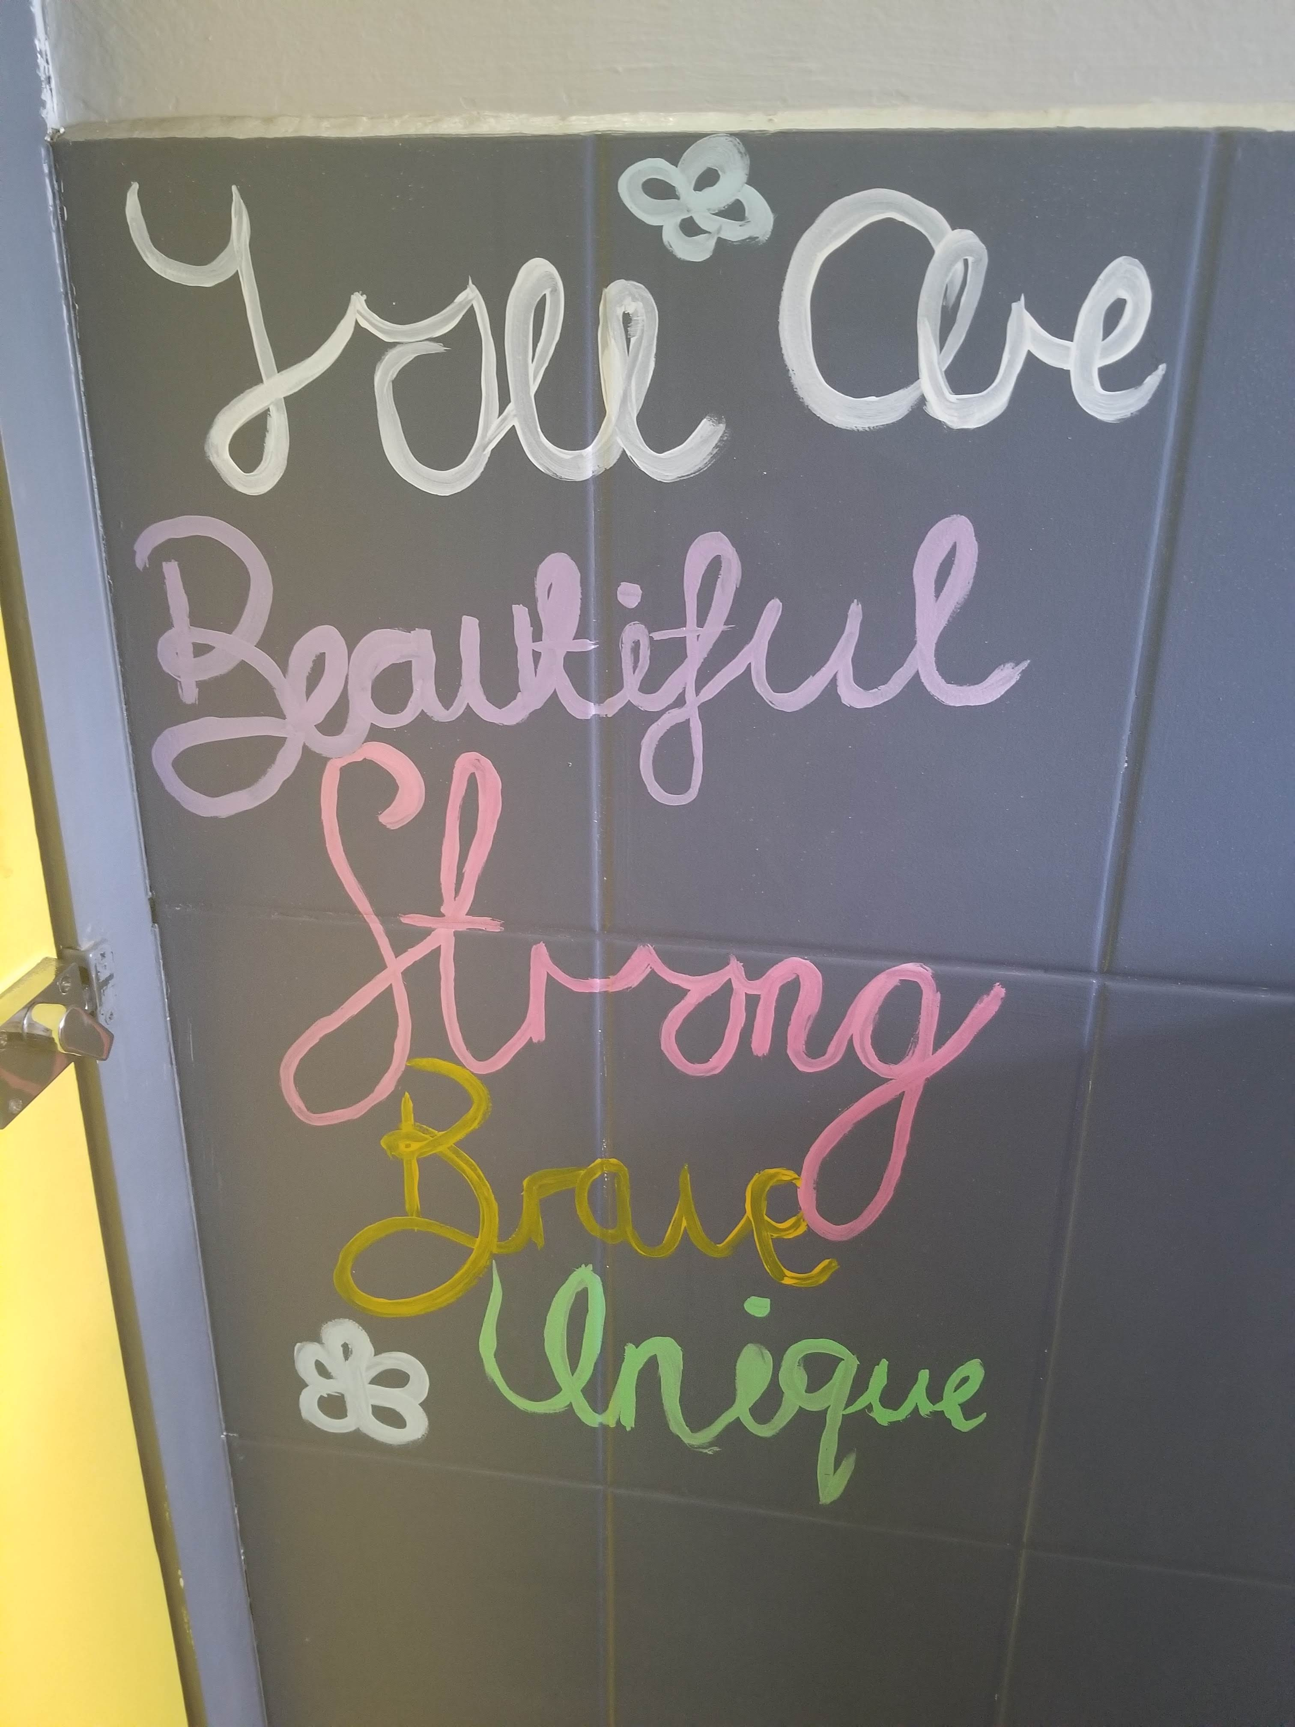
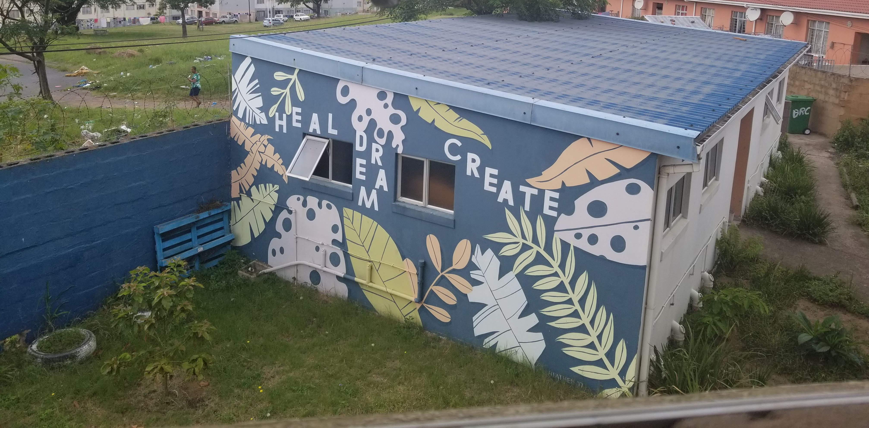
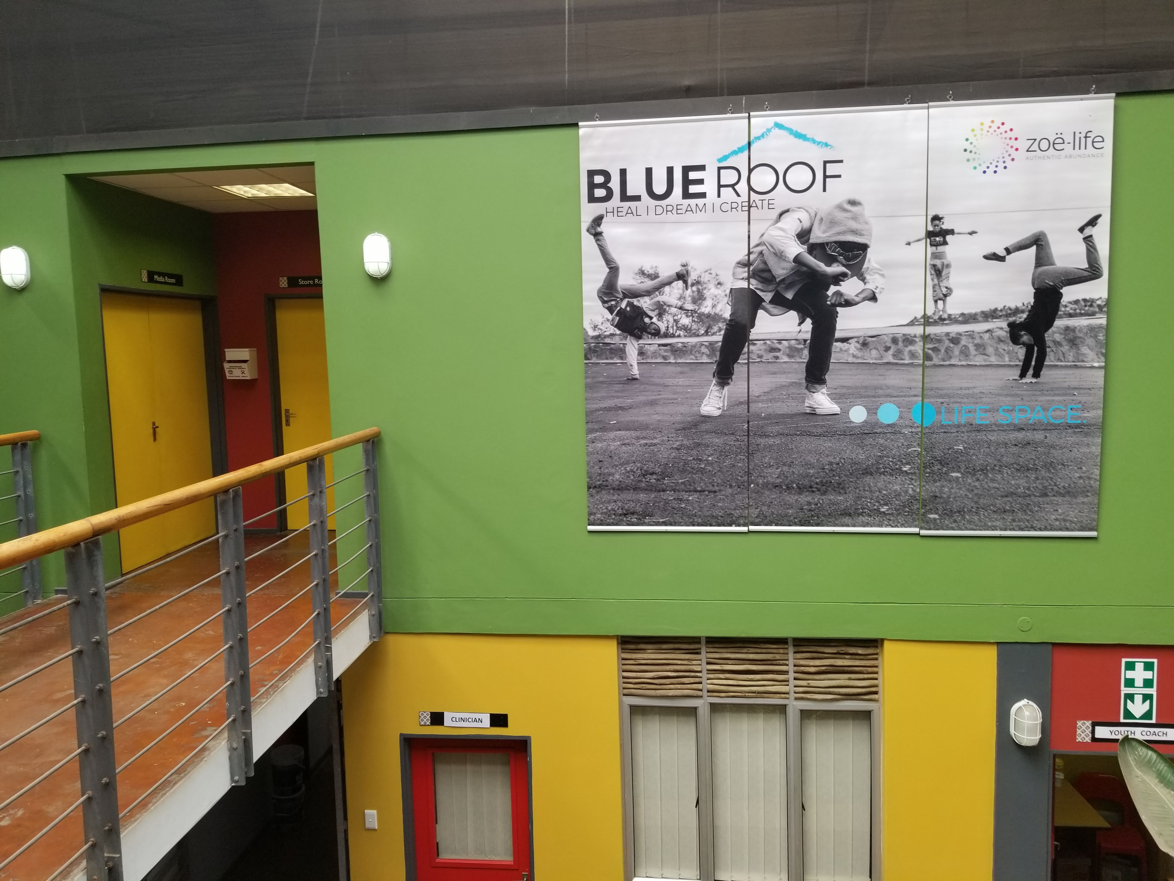

Slide 24
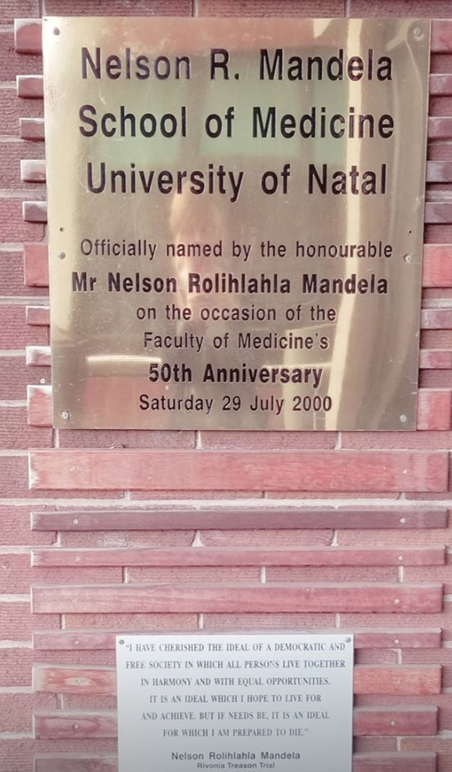
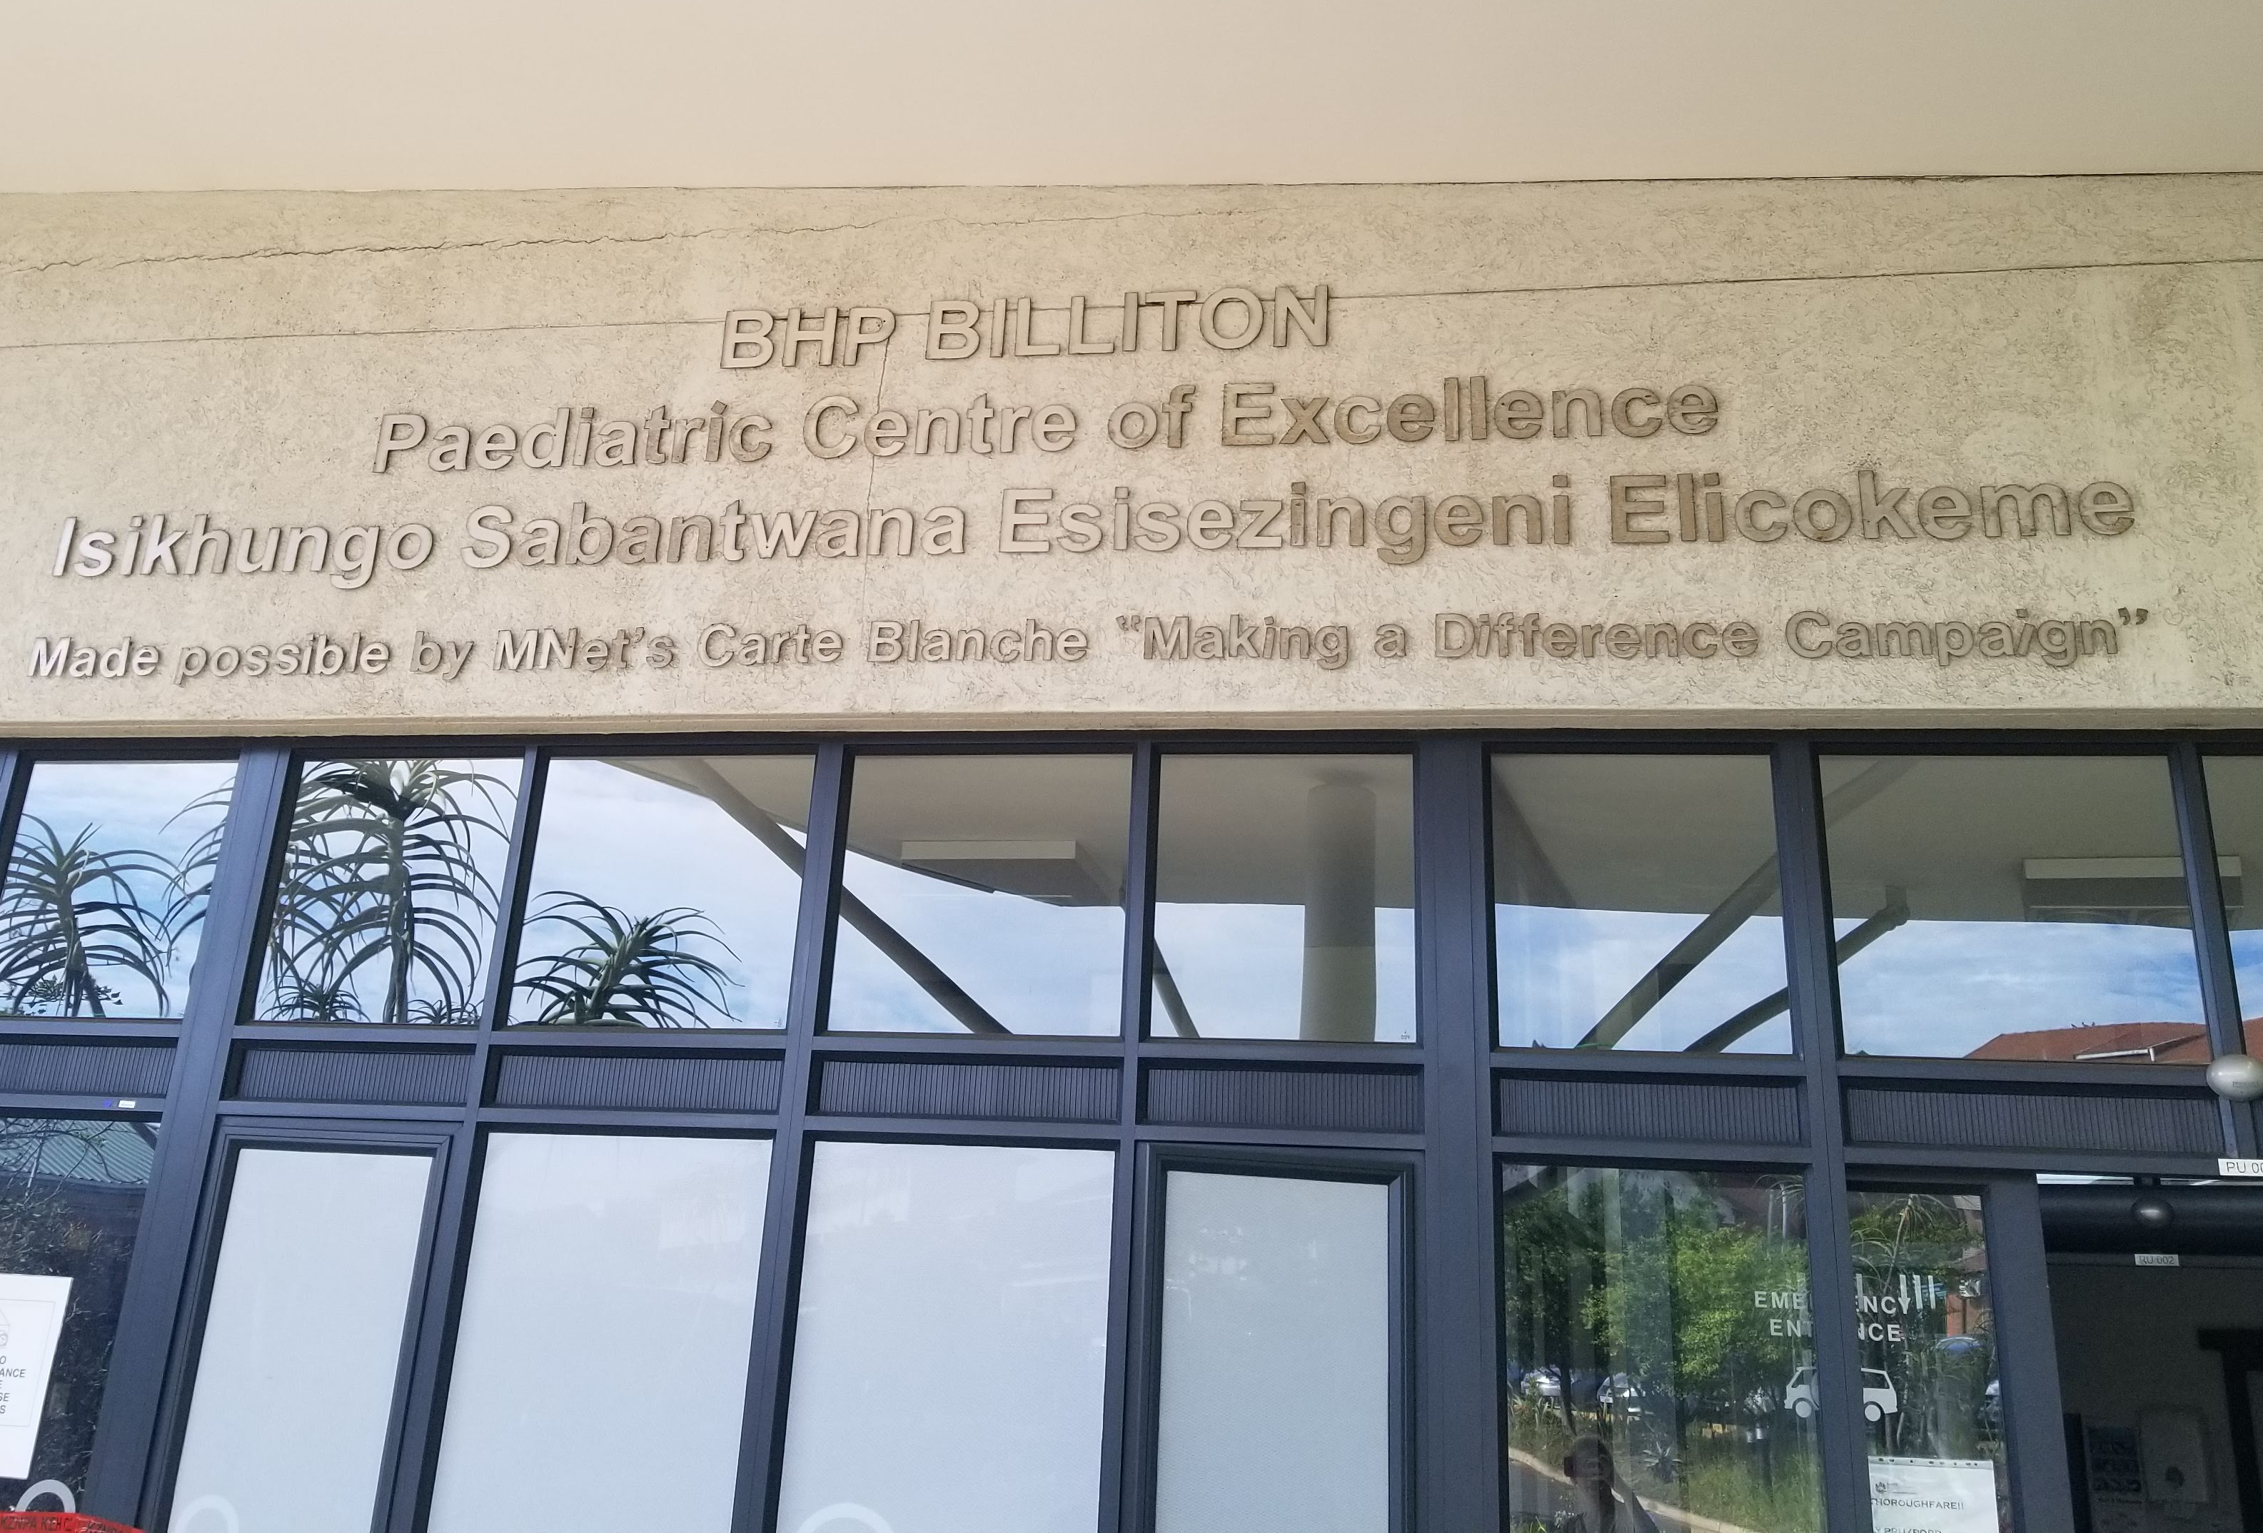
Placements
King Edward VIII Teaching Hospital
University of KwaZulu Natal Nelson R. Mandela School of Medicine
Physicians discussed frustrations with early 2000s administration and the number of people impacted for years to come
Shadowed medical students and residents conducting rounds in the Pediatric Department
Visited an ARV clinic, shadowing physicians

Slide 25
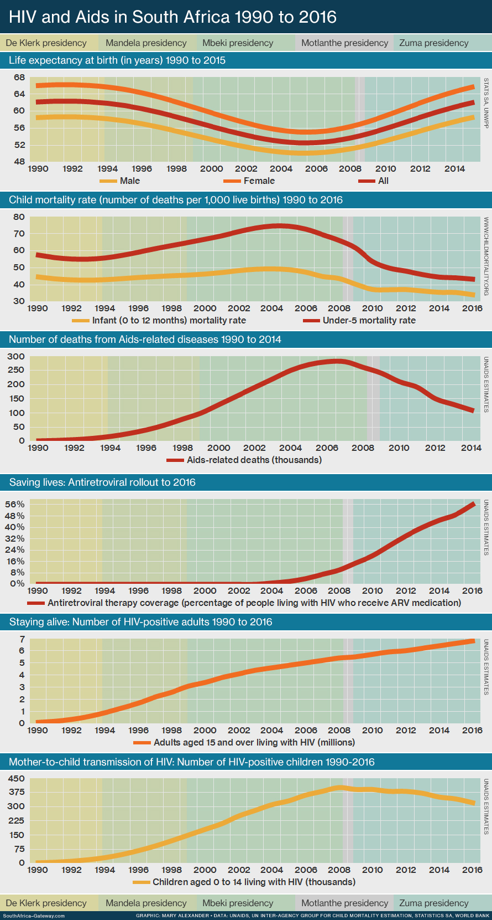
The Road to Recovery
(Alexander, 2019)
Source: UNAIDS

Slide 26
South Africa's Road to Recovery
Quick stats of 2018:
50% decrease in mortality rate between 2010-2018
HIV infections decreased from 390,000 to 240,000
90% of people living in South Africa were aware of their HIV status
Of the HIV positive population:
62% was on treatment
54% was virally suppressed
Since Mbeki's Presidency, ART programs have been initiated all across the country, often providing ARVs to patients regardless of their ability to pay
International donations and support through independent agencies and PEPFAR (U.S. President's Emergency Plan for AIDS Relief) have greatly contributed to the decreasing HIV rates
(UNAIDS, 2020)

Slide 27
Reflecting on the Experience

Slide 28
Challenges Encountered & Lessons Learned
Challenges Encountered
Maneuvering international stereotypes
Being aware of my identity
Needing to learn the rich cultural history of the area
Staying firm in my values and speaking up about things that make me uncomfortable
Reminding myself of the intentions of my trip
Reflecting on the skills I have and qualifications I possess
Lessons Learned
Media portrayal of countries, especially across international boundaries, does not accurately depict cultural norms or values
Politics truly play an integral role in healthcare provision
Systems of oppression and privilege commonly influence all aspects of social justice including equitable healthcare

Slide 29
Honors Project Discussion
I originally planned to do something entirely different, however my experiences in South Africa called me to tell the narrative of HIV in South Africa from a more critical lens.
The strength and complexity of the South African economy and healthcare system
What was different from the proposed project?
Surprises?

Slide 30
Honors Project Discussion
Unexpected conclusions?
Project strengths?
While many social determinants of health are at play in South Africa to worsen the HIV/AIDS epidemic for specific marginalized groups, the ultimate catalysts that exacerbated the health crisis were the uninformed political decisions made that disregarded the findings of the global scientific community.
Narrative of a real-life epidemic influenced by the government failing to integrate science into concern for citizens (very real application to COVID-19)
Healthcare workers use empathy, resources and hard work to combat HIV/AIDS stigma
Shows the devastating risk to communities when elected officials make decisions they are unqualified to make or without the consult of healthcare professionals

Slide 31
Shaping My Future Career
In South Africa, I grew more passionate about social justice and advocacy than ever before.
I learned the importance of political participation and speaking up for what you believe in.
Wanting to continue learning about HIV/AIDS in the United States, I will be volunteering in Community Care Clinics for low-income communities of Toledo.
I'm planning to pursue a Master of Public Health in Global Health and potentially looking for opportunities in HIV/AIDS counseling.

Slide 32
Project Acknowledgements
This project would not have been possible without the help of the BGSU Honors College, the Hoskins Global Scholars Program, Mr. Mike Hoskins and Honors Project Advisors, Sharon Schaeffer and Tim Brackenbury.
Thank you!

Slide 33
References
Avert. (2020, March 4). What are HIV and AIDS? Retrieved from Avert: https://www.avert.org/about-hiv-aids/what-hiv-aids
“Civil Rights Museum President: Mandela a 'Great Soldier'.” WBBJ TV, 4 Dec. 2015, www.wbbjtv.com/2013/12/06/civil-rights-museum-president-mandela-a-great-soldier/.
Daley, Suzanne. “The Day Apartheid Died: Photos of South Africa's First Free Vote.” The New York Times, The New York Times, 8 May 2019, www.nytimes.com/2019/05/08/world/africa/south-africa-1994-election-photos.html?auth=link-dismiss-google1tap.
Department of Health. (2010). Remuneration Policy for Health Professionals Employed in the Public Health Sector. Republic of South Africa.
Dickens, Peter. “South African Flags.” The Observation Post, 2019, samilhistory.com/tag/south-african-flags/.
Harvard School of Public Health. (2019). The cost of South Africa’s misguided AIDS policies. Harvard News Spring 2019.
Ighobor, K. (2016-2017, December - March). Diagnosing Africa's Medical Brain Drain. Africa Renewal. Retrieved from UN Magazine: Africa Renewal.
Kon, Z. R., & Lackan, N. (2008). Ethnic Disparities in Access to Care in Post-Apartheid South Africa. American Journal of Public Health, 2272-2277.
Mahlathi, P., & Dlamini, J. (2015). Minimum Data Sets for Human Resources for Health and the Surgical Workforce in South Africa's Health System: a rapid analysis of stock and migration. African Institute for Health and Leadership Development.
Merriam-Webster. (2020). Brain Drain. Retrieved from Merriam-Webster: https://www.merriam-webster.com/dictionary/brain%20drain
Miriam-Webster. (2020). Apartheid. Retrieved from Merriam-Webster: https://www.merriam-webster.com/dictionary/apartheid
NAACP. (2015, December 1). Reframing HIV as a Social Justice Issue to Win the War Against the HIV Epidemic in Black America. Retrieved from NAACP.org: https://www.naacp.org/latest/reframing-hiv-as-a-social-justice-issue-to-win-the-war-against-the-hiv/
Republic of South Africa. (2019). About SA: History. Pretoria: 2018/19 Official Guide to South Africa.
U.S. Department of Health and Human Services. (2019, June 21). Symptoms of HIV. Retrieved from HIV.gov: https://www.hiv.gov/hiv-basics/overview/about-hiv-and-aids/symptoms-of-hiv
U.S. Department of Health and Human Services. (2020, 4 26). Viral Suppression. Retrieved from AIDS Info: https://aidsinfo.nih.gov/understanding-hiv-aids/glossary/1650/viral-suppression
UNAIDS. (2020). South Africa. Retrieved from UNAIDS: https://www.unaids.org/en/regionscountries/countries/so
United Nations. (2020, February 20). On World Social Justice Day, the UN labour agency says ‘put people and planet first'. Retrieved from UN News: https://news.un.org/en/story/2020/02/1057811
World Health Organization. (2006). World Health Report. Geneva, Switzerland: World Health Organization.

