Slide 1
Research on Ga2o3 semiconductors
Ethan Reed

Slide 2
Background of semiconductors
Semiconductors are useful in all forms of electronics
Resistivity decreases with temperature
Can control the conductivity of a sample using different methods (doping, annealing, etc.)
Electrons at rest are in the valence band, when excited then enter the conduction band
The energy gap between is known as the band gap

Slide 3
Why Ga2O3
Silicon is currently the most common semiconductor
Uniquely wide band gap (4.8 eV)
Allows for high voltage
Due to this, could have unseen applications
Very little research has been done
Could be even more unique properties
Doping
Annealing
Notes:
In comparison to other semiconductors, Ga2O3 has a very high Baliga Figure, meaning its breakdown voltage, bandgap and electron mobility is overall higher than many popular semiconductors such as Silicon. Because of its high voltage, it allows us to create devices that can hold much more power. This will be especially useful as our need for computing power grows. In computing, Ga2O3 could be used as transistor and diodes.

Slide 4
Physics of Thermoluminescence
Electrons jump from valence band to conduction band
Photons can allow the electrons to make the jump
Excited electrons can get stuck in the traps made by defects in the structure
We can free these trapped electrons by changing the temperature
The freed electrons reemit a photon and decay back down to the valence band
We can detect these reemitted photons
Notes:
Thermoluminescence helps us gain a detailed view of the defect structure of our samples and is my main characterization tool for this data set.

Slide 5
Thermoluminescence process
Thermoluminescence (TL) is a measurement technique that allows us to detect defects (traps) in the crystal structure of semiconductors
We use liquid nitrogen to lower the temperature to -190C
Shine a strobe on the sample for 30 minutes to excite the electrons into traps
We then begin acquiring spectra and raising the temperature at the same time
When the intensity of the light spikes, we know there is a trap there

Slide 6
TL Contour Graph
We use a contour graph because there are three important variables, Wavelength (nm), Temperature (C), and Intensity (arb.).
This sample of Iron-doped Ga2O3 shows a peak from 0C-75C in the 800nm-650nm range.
Notes:
This peak is very sharp, showing its defect structure.

Slide 7
Undoped Ga2O3
Dep 2 as grown
Notes:
Very small peak, little data on the defect structure

Slide 8
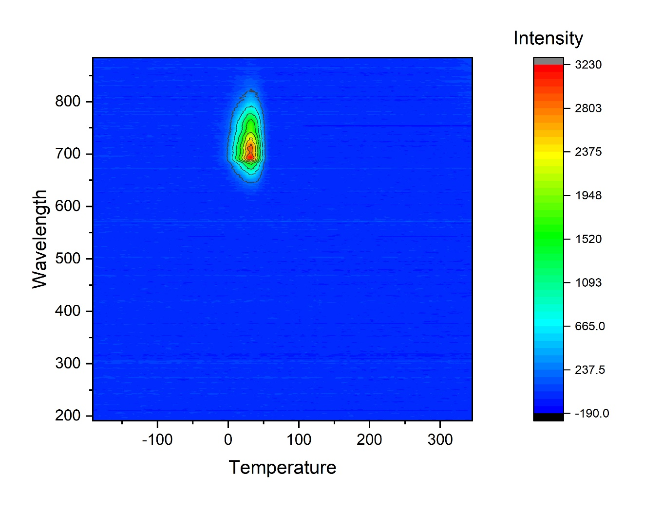
Iron doped Ga2o3
Fe-Doped Cz-grown Annealed in Argon
Fe-Doped Tamura sample, Annealed in Argon
Fe-Doped Cz Sample Annealed in H2
Notes:
Iron seems to have this specific peak, however our Tamura sample is an oddity with its twin peaks and possible smaller third. More data is needed, possibly another Tamura sample could be analyzed. It doesn’t seem to be due to annealing, as the Cz-Grown sample is also annealed in argon so this is possibly due to growth techniques.

Slide 9
Iron doped
We can see that iron creates a specific trap that emits 800nm-650nm range
This is seen even when annealed in different substances
The Tamura sample is an outlier, not sure what causes its strange behavior yet

Slide 10
Tin doped Ga2O3
Sn-Doped annealed in O2
Sn-Doped annealed in H2

Slide 11
Tin doped
We can see that the presence of tin causes no traps, regardless of annealing
However, new growth techniques or more samples could reveal something not yet seen.

Slide 12
Effects of annealing For air and argon
Air- sample becomes incredibly resistive
Too resistive for our set up to measure
Argon- reduces the resistivity of the sample, has large vacancy clusters

