Slide 1
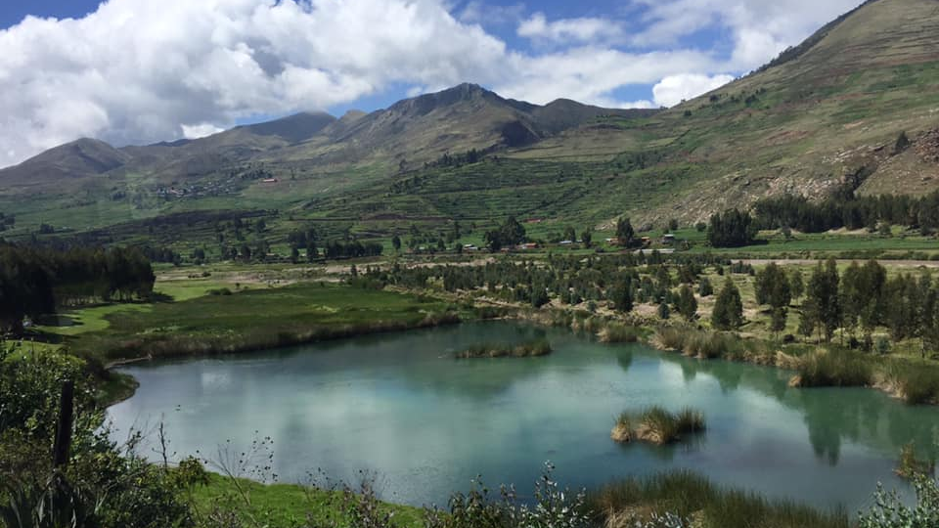
Healthcare and Structural Violence
By Clare Sunderman

Slide 2


Introduction
Notes:
My name is Clare Sunderman and over J term, I went on a Service Learning Trip with MEDLIFE

Slide 3
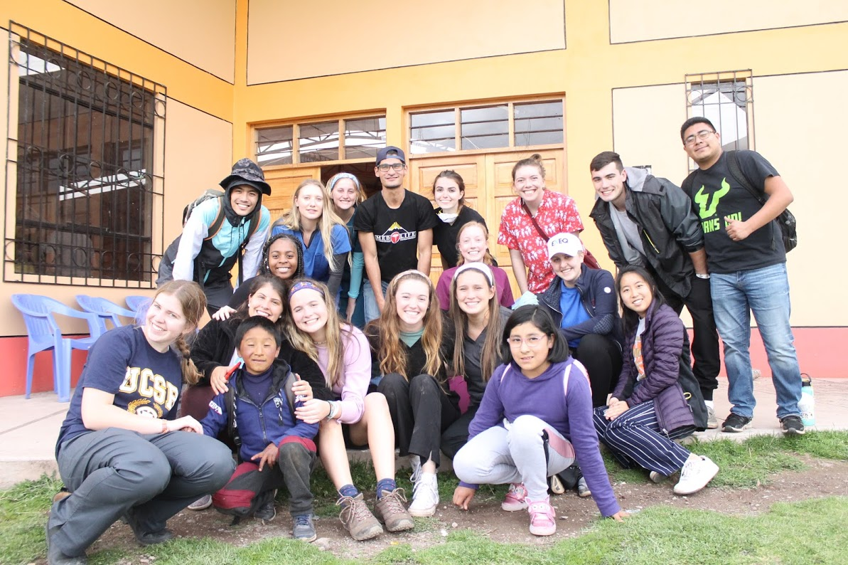
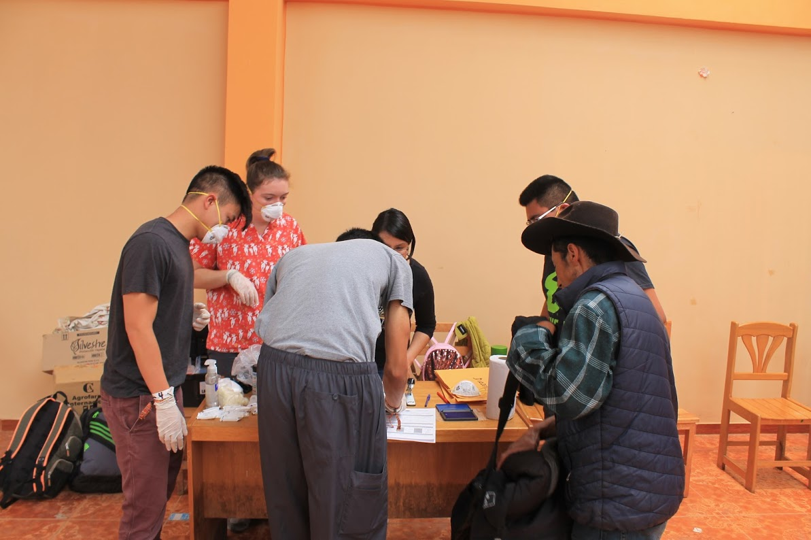
What is MEDLIFE?
MEDLIFE partners with low-income communities in Latin America and Africa to improve their access to quality healthcare, education, and a safe home
Volunteered at a mobile clinic that offered basic medical and dental treatment at three separate locations in Cusco, Peru
Notes:
MEDLIFE stands for Medicine, education, development for low income families everywhere. I spent 9 days in Cusco, Peru learning about the culture and need for healthcare in the region

Slide 4
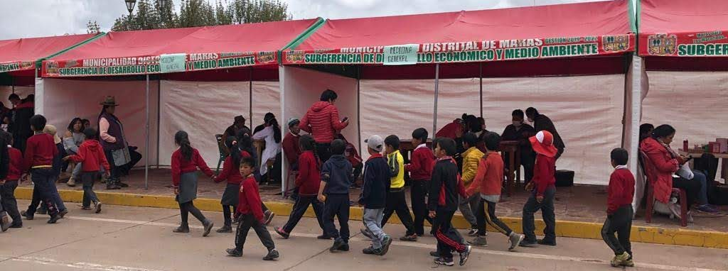
What I will be talking about today
Healthcare in the United States vs. Healthcare in Peru
Notes:
Before going on this trip, I was planning on comparing the United States healthcare system vs. Peru’s. After going on this trip, I decided to focus on one main similarity between the two countries’ healthcare systems

Slide 5
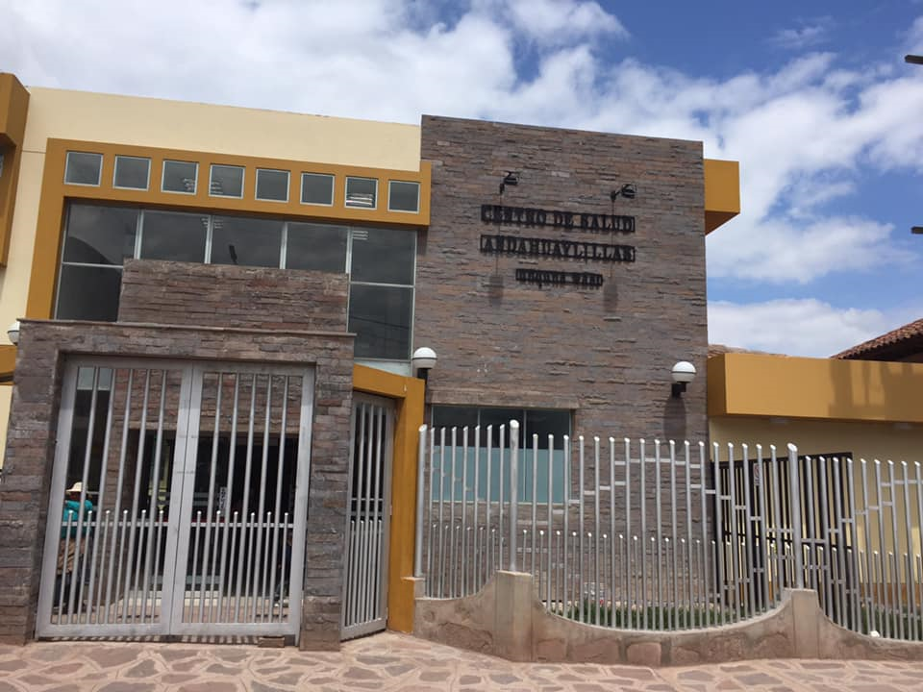
Healthcare in the US vs. Peru
United States
Peru
Population: 326.6 million (2018)⁶
Average life expectancy: 78.87 ¹
Average health spending per person: $10,224 (2018) ²
No uniform healthcare system- Private health insurance covers 74% of the population⁴
Number of hospitals: 6,146
Population: 31.99 million (2018)⁶
Average life expectancy: 76.62
Average health spending per person: $333 (2017) ³
Decentralized healthcare system- Ministry of Health provides health services for 60% of the population⁵
Number of hospitals: 606¹²
Notes:
The clinic in the background is one we passed in Secsencalla

Slide 6
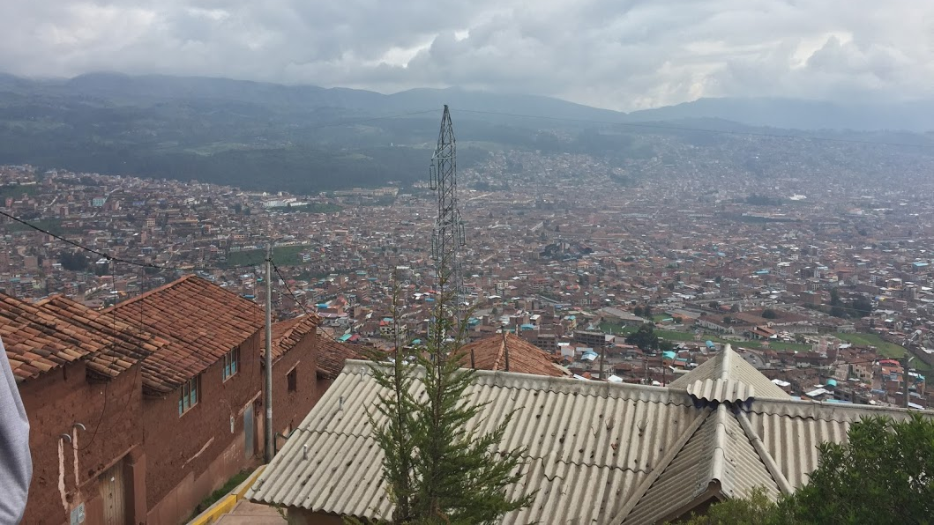
Historical context
From 1980 to 2000, terrorism plagued Peru
Over the 20 years, an estimated 70,000 people died in the internal conflict
56% of the victims were farmers as 79% of the attacks occurred in rural settings¹¹
This conflict caused those living on the outskirts of cities to move inward
  This left the economically disadvantaged on the edges of cities
Notes:
Picture is an overview of the city of cusco

Slide 7
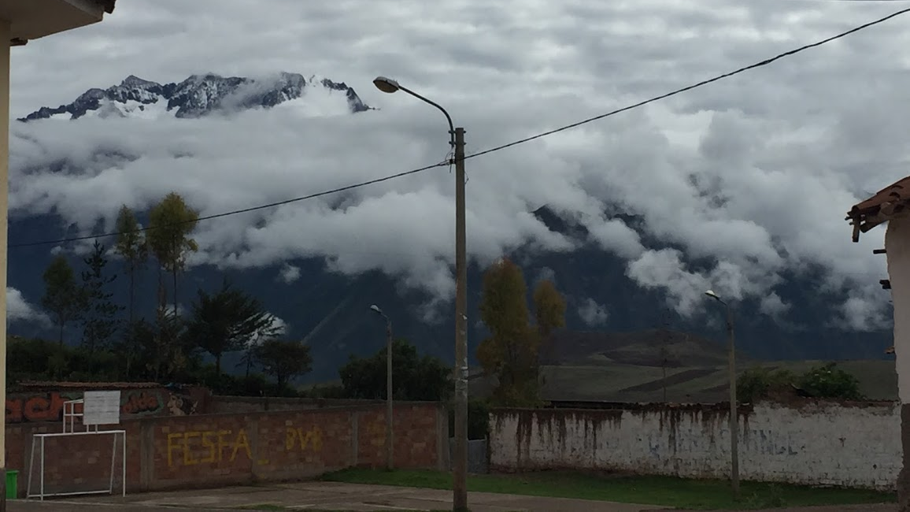
Structural violence
Refers to a form of violence wherein some social structure or social institution may harm people by preventing them from meeting their basic needs
Term ascribed by Johan Galtung
Notes:
Give story on two children going to the same school, one with parents who went to college and those who didn’t

Slide 8
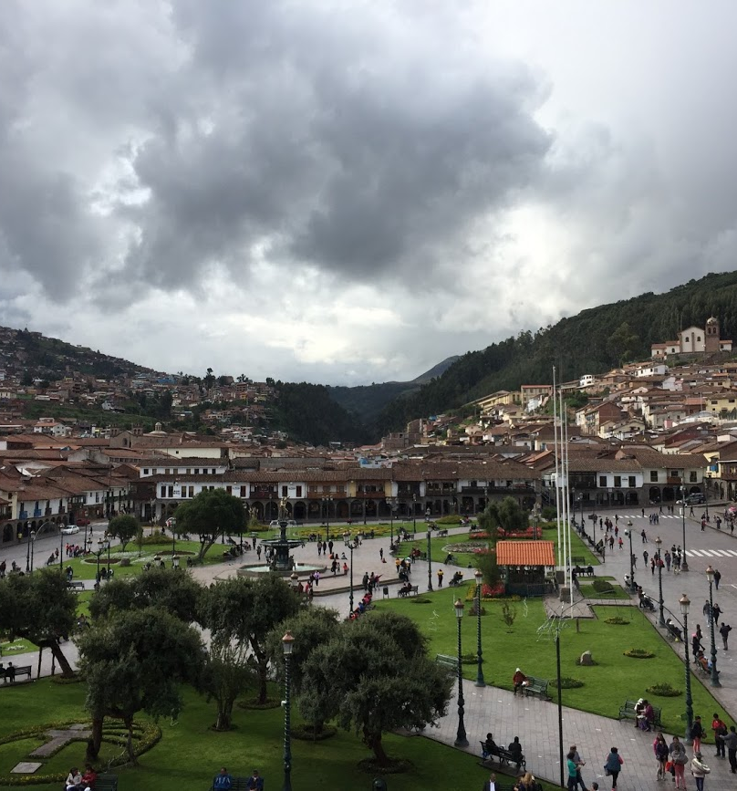
Defining topics discussed
Language: how the language a person speaks affects the quality of the healthcare they receive
Economics: the socio-economic status of a person and how that affects the level of care they can obtain
Gender- how one's gender affects their ability to get adequate healthcare
Geography- how one's location, in an urban setting, rural setting, or in between affects the ability to receive healthcare
Notes:
On my trip, I learned through experience, research and education that these four categories were the main culprits for structural violence in healthcare

Slide 9
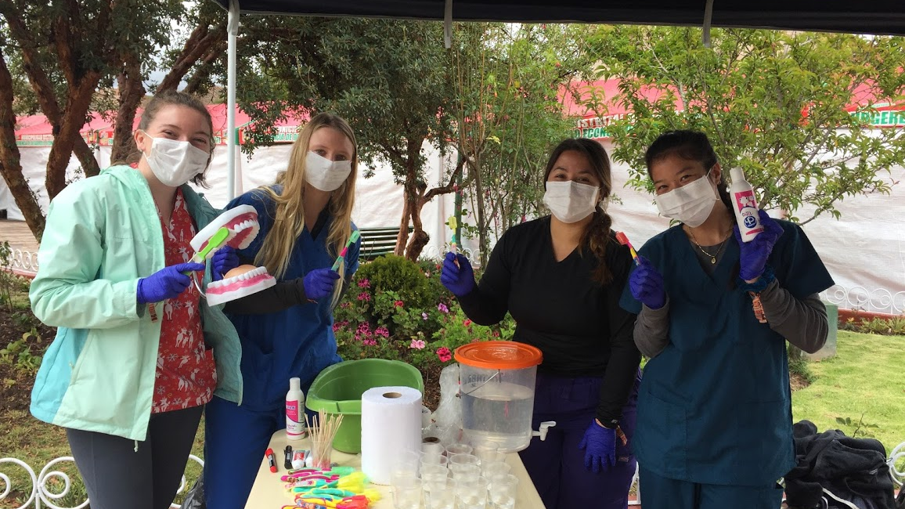
Structural violence in Peru
Language- every one out of nine Peruvians speak Quechua, and in rural areas it is every six out of ten⁷
  Most healthcare professionals speak only Spanish, so it is hard to go to the doctor without access to a translator
Economics- although the government covers those who cannot afford healthcare, people may be waiting months to see a doctor because they cannot access private clinics
  We spoke to a man who said it could take up to 60 days to see a doctor
Gender- Women living in rural areas have limited access to see obstetricians
  In 1996, 53% of women living in rural areas did not receive any prenatal care⁹
  Family planning and maternal health is covered by MINSA but not gynecology
Geography- Most of the hospitals are concentrated in main cities while outer towns maybe have one clinic that cannot perform as many treatments as a hospital
  There is an inequitable geographic distribution of healthcare workers
    Highest in Lima, Peru and costal areas, lower in jungle and mountainous areas

Slide 10
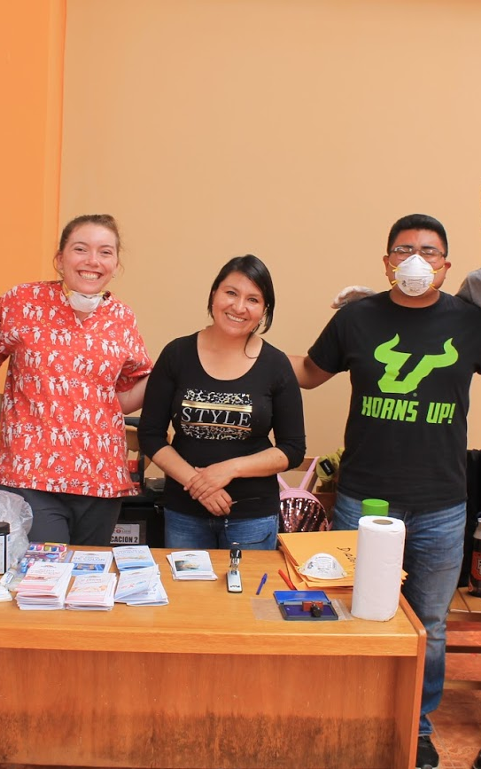
Structural violence in the US
Language- 22% of the US population does not speak English at home⁸
  Only 36.2% of physicians in the US speak Spanish¹⁰
Economics- 27.5 million people do not have health insurance
  Makes it difficult to pay for hospital expenses, may avoid going to the doctor at all¹³
Gender- diseases that mostly affect women are under-researched, many times leaving women undiagnosed and forced to see many doctors before getting answers¹⁴
Geography- life expectancy can be correlated to where in the country you live¹⁵

Slide 11
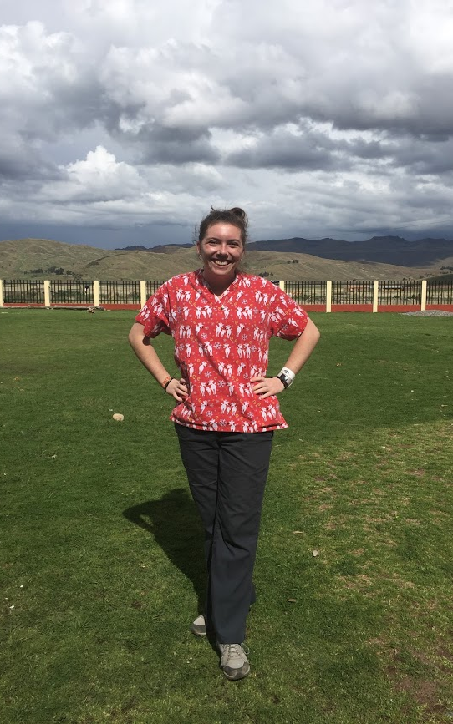
Challenges and what I would do differently
Getting very specific data for the United States and broad data for Peru
I cannot find data online for much of the information I learned in Peru
Many of the patients I talked to only spoke Spanish or Quechua so I was communicating through a translator
Learn Spanish to be able to better communicate with patients
Do more research before going to Peru to be able to ask questions
Get access to Peru websites to get data

Slide 12
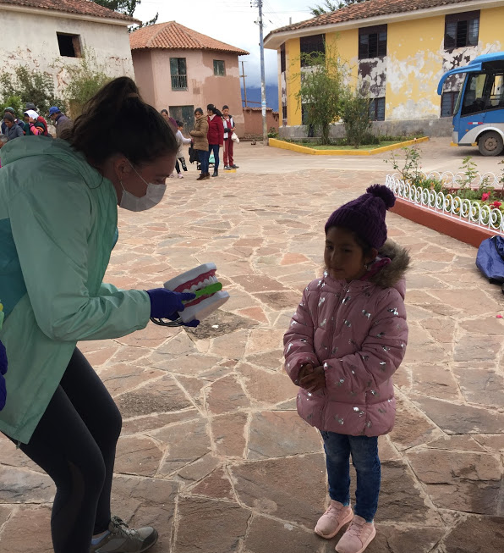
Call to action
What can you do in your own communities?
Change your perspective
How this relates to COVID-19
  How many people lost their health insurance because it was tied to their jobs

Slide 13
Resources
http://www.ajuronline.org/uploads/Volume_16_2/AJUR_Vol_16_Issue_2_September_2019_p17.pdf
https://www.healthsystemtracker.org/chart-collection/health-spending-u-s-compare-countries/#item-average-wealthy-countries-spend-half-much-per-person-health-u-s-spends
https://knoema.com/atlas/Peru/Health-expenditure-per-capita
https://www.ncbi.nlm.nih.gov/pmc/articles/PMC4193322/
https://www.who.int/workforcealliance/countries/per/en/
https://data.worldbank.org/country
https://revista.drclas.harvard.edu/book/quechua-spanish-bilinguals
https://www.washingtonexaminer.com/washington-secrets/22-of-us-population-does-not-speak-english-at-home
https://reproductiverights.org/sites/default/files/documents/Peru%20CEDAW%201998.pdf
https://s3.amazonaws.com/s3.doximity.com/press/Doximity%20Language%20in%20U.S.%20Health%20Care%20Report.pdf
https://www.ncbi.nlm.nih.gov/pubmed/15074494
https://www.statista.com/statistics/820491/number-healthcare-facilities-peru-type/
https://www.census.gov/library/publications/2019/demo/p60-267.html
https://greatergood.berkeley.edu/article/item/how_to_address_gender_inequality_in_health_care
https://www.ncbi.nlm.nih.gov/books/NBK215365/

