Slide 1
Do Students from Public Secondary Schools Have Access to Notions of Global Citizenship in Post-Communist Nations? The Case of Romania
By Andrew Harper

Slide 2
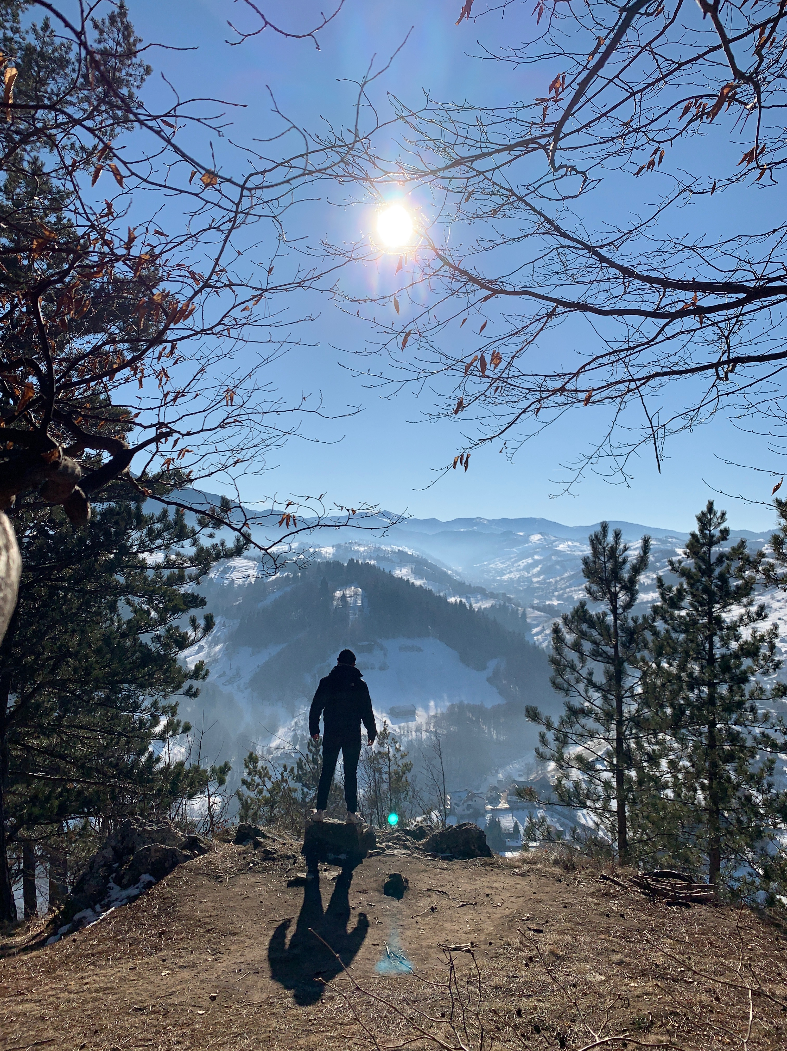
Background
Why Romania/ Eastern Europe?
My background with traveling
Why I chose my question
Notes:
Hello My name is Andrew Harper.I am an international studies major minoring in peace and conflict studies. In my life I have been very fortunate to travel to many different parts of the world, from Asia to Europe to South America, however I have never been to the eastern side of Europe. In fact, while I have visited the western side of Europe quite a few times the thought of journeying east had never even occurred to me. I began asking friends and family about what they know of the eastern side of Europe and to my surprise there were many who had little to no knowledge on the area apart from the key words like ‘Communism’ or ‘Slavic’. This lack of understanding of the area made me quite curious as even in my scholarly career there was little mention of eastern Europe aside from a quick overview of the events of past conflicts such as world wars. As I mentioned before, I have had the opportunity to travel quite frequently in my life. This is due to me being a long-time member of an international peace education NGO called CISV. CISV is an organization that promotes peace and understanding between different cultures by providing camps where delegations of children from different parts of the world have the chance to live, learn and play alongside the children from other cultures that are represented in the camp. CISV also promotes the idea of global citizenship by exposing the participants to other cultures early in their life which greatly broadens their horizons and cultivates compassion for other countries as they may have a dear friend that lives in a different country. With that in mind, I was curious about the impact of the communist regime on the education system and if the ideals were still being partially carried out by the school curriculum in a post communist country, meaning specifically, if the schools were promoting ideas of global citizenship within their students. I brought these questions to my faculty mentor and previous professor, Dr. Stefan Fritsch, and inquired if he had any leads in the eastern portion of Europe that I may be able to work with to research my curiosity and simultaneously gain field experience as a scholarly researcher. Luckily, he was able to put me in contact with Dr. Stefan Cibian, who is based in Romania and from there I began to formulate a solid specific research question that I would be examining while in Romania.

Slide 3
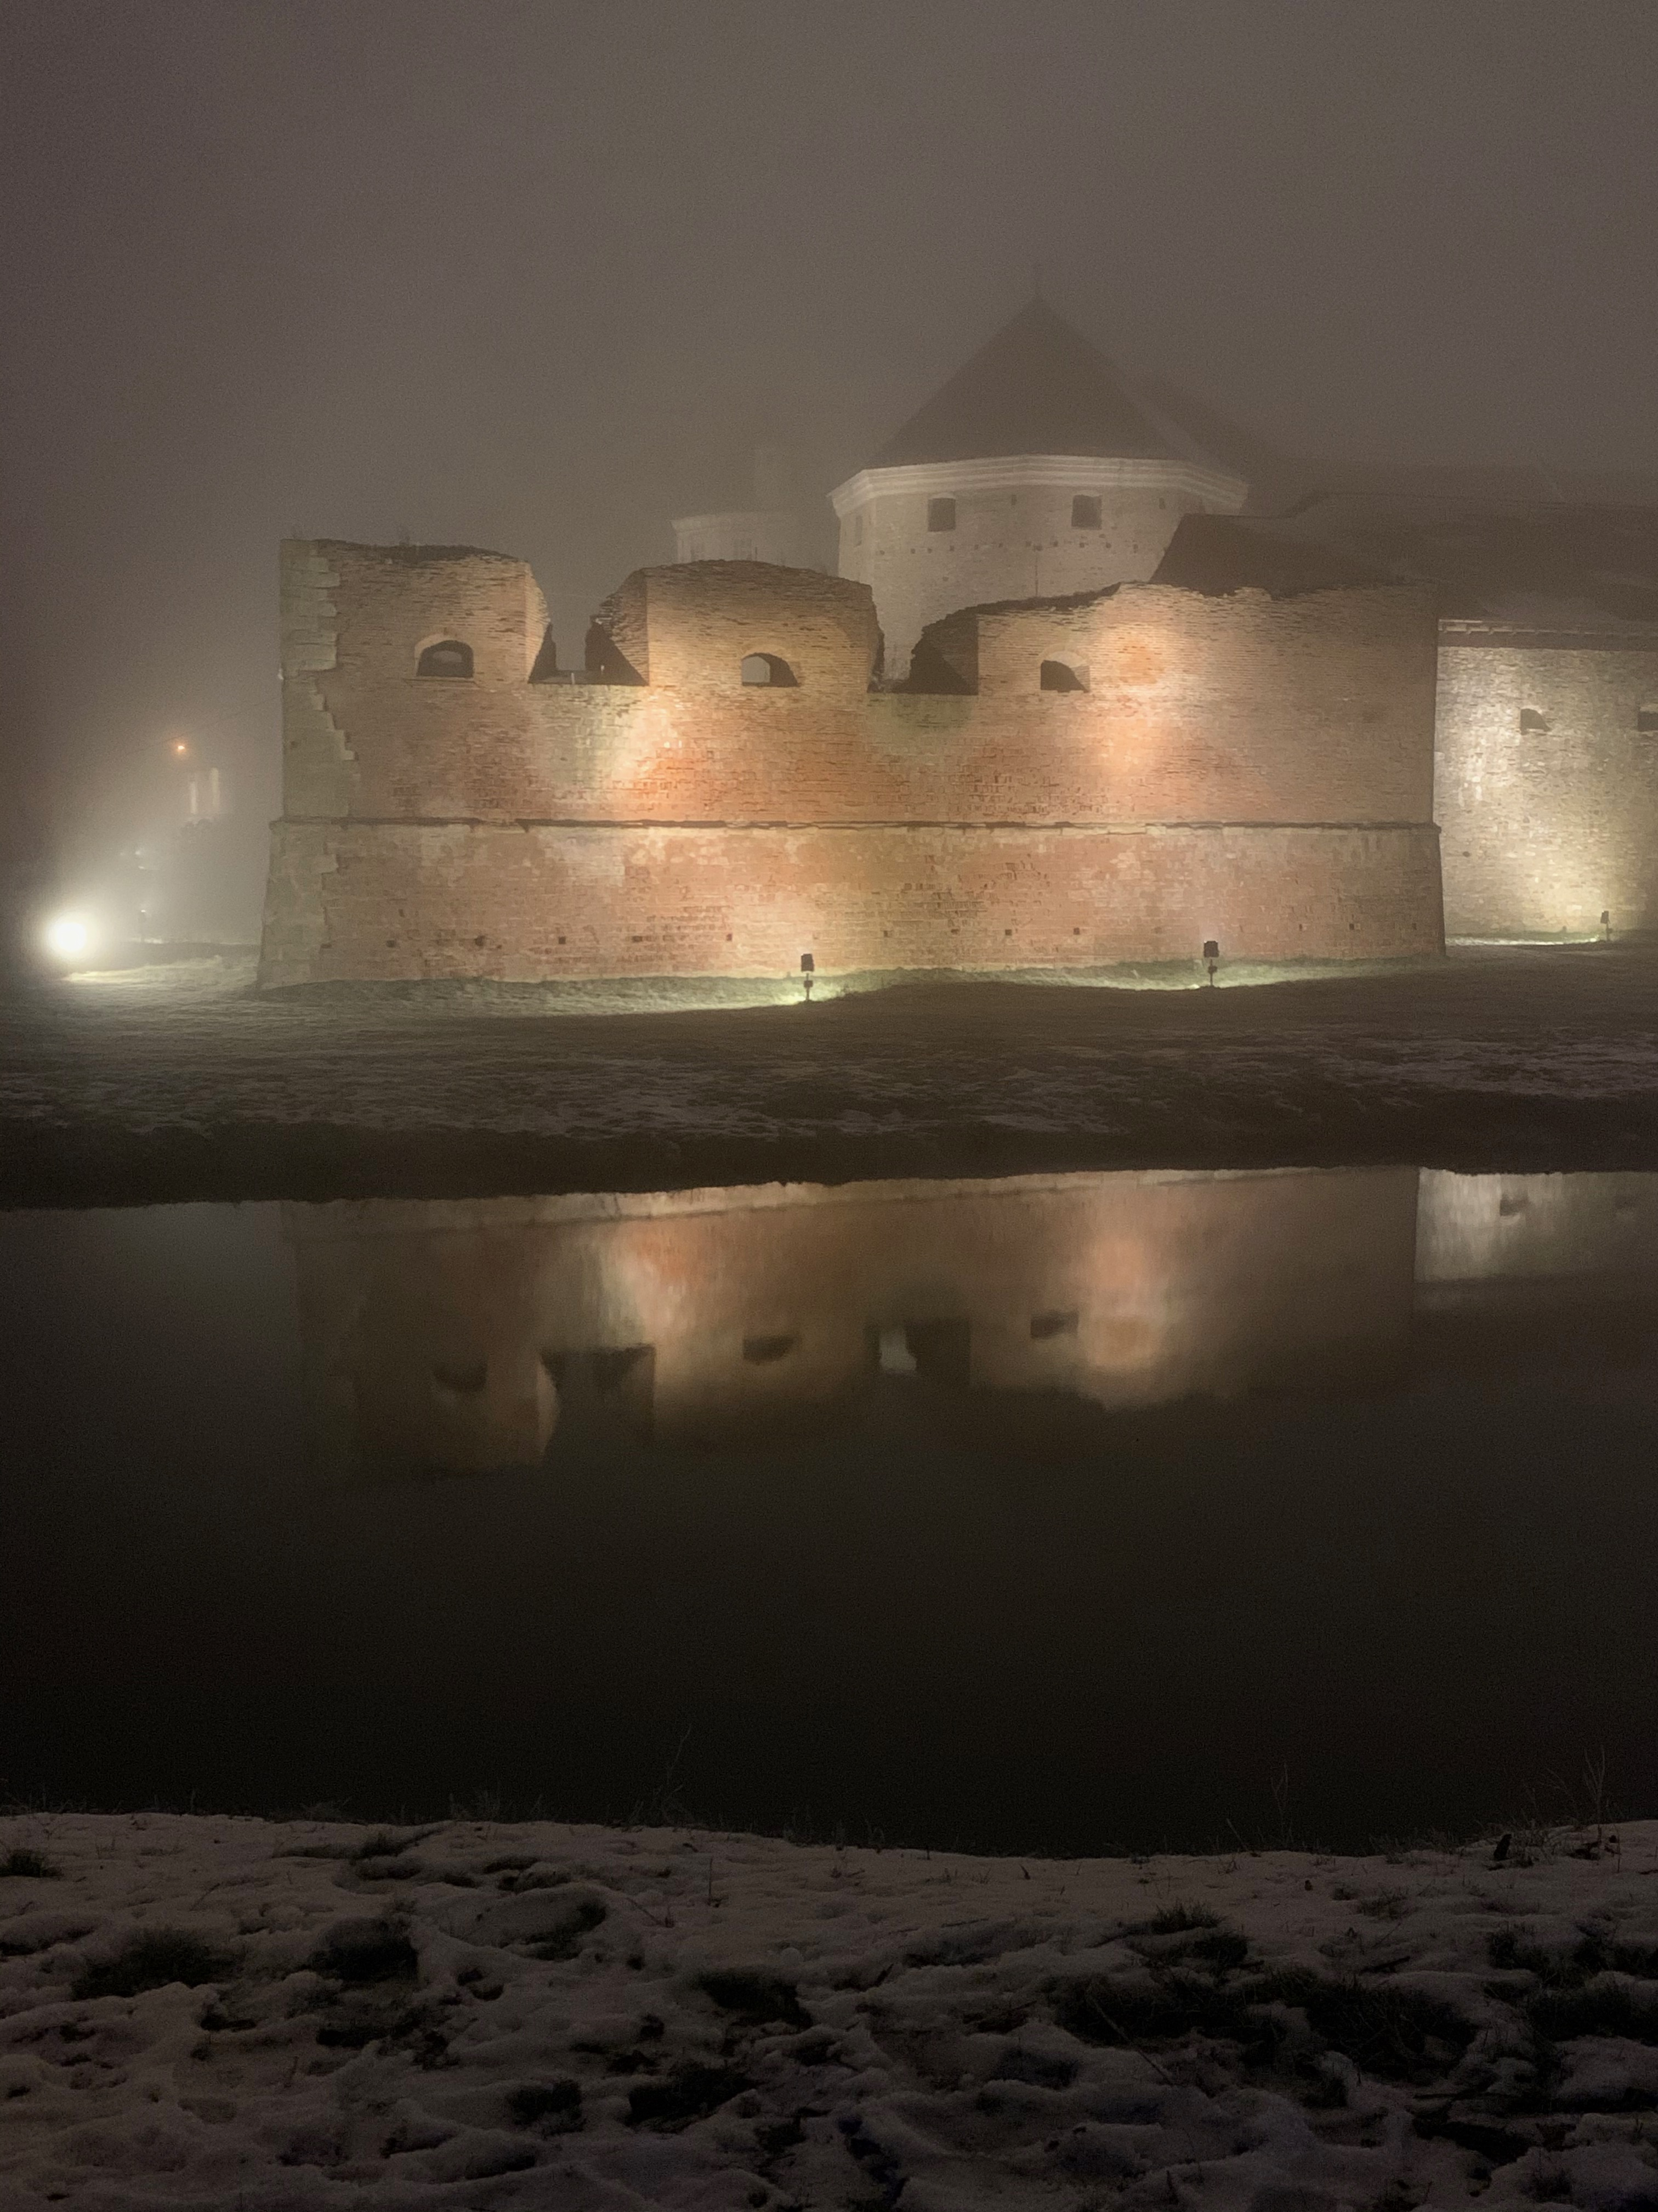
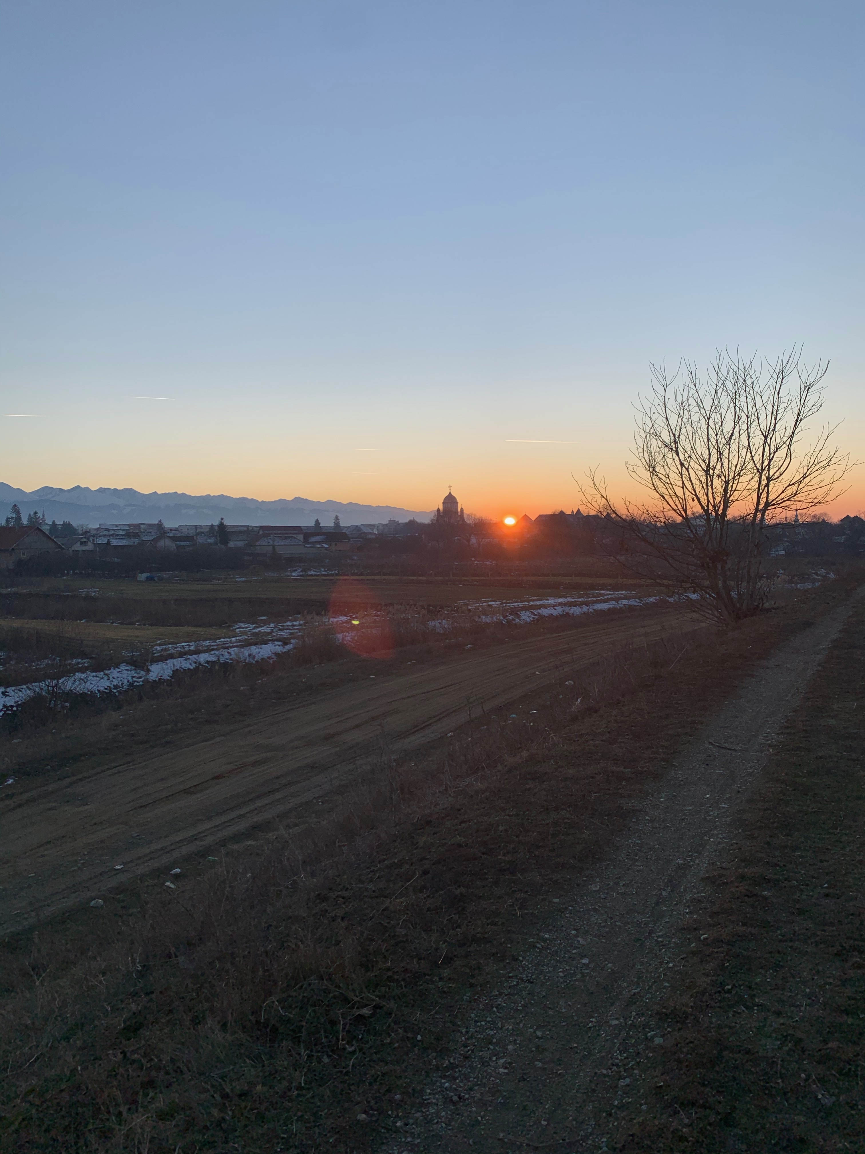
Făgăraș
Population
28,000 (2011)
Large attractions
Făgăraș Citadel
Notes:
During my stay in Romania I was based in Făgăraș which is in the historical Transylvania providence and I decided to focus my research on the town as I thought it would have a interesting perspective to present as it is a smaller town with a population of only 28,000 as of 2011. I felt that the population being so small would be a factor worth making note of as I imagined the students would have greater access to more resources, but the students of smaller communities were at risk of falling through the cracks and being overlooked, so I was glad to gain the perspective I felt otherwise would not be included or examined otherwise. One of the main attractions of the city is the Făgăraș Citadel. The citadel was originally created as a fortress as princes and their families to stay in in 1301 after the previous wooden fortress was burned by the tartars. However in 1948, Făgăraș Fortress was taken over by the communists and functioned as a political prison until it was turned into a museum.

Slide 4
@home in Făgăraș
Where I stayed during my time as a researcher
Notes:
During my stay in Romania I was very fortunate to have the chance to stay at the residence of Dr. Cibian which doubles as the NGO called “@ home in Făgăraș”. This initiative is one that I was very fortunate to be a part of as the main goal of the organization is to provide researchers such as myself a place to stay and get involved in the community. The physical house was the residence of Dr. Cibians grandparents, but it has been repurposed to serve as a sort of home base for researchers staying in Făgăraș. The house made me feel apart of the community even though I was very much an outsider because it is a traditional Romanian farmhouse and I felt as though I was living as a true Romanian as opposed to a hotel. This gave me a deeper connection to the community as I would frequently pass neighbors in my commute to buy groceries or conduct research and while the interaction may have simply been a waving of hands, interactions like that made the cold month feel warm and welcoming.

Slide 5
Research question
To what extent do students in public secondary school from Făgăraș have access to educational experiences after 1989 that integrate questions of globalization, global citizenship and common global challenges and their consequences and opportunities for Romania?
Notes:
While formulating my research question I revised it many times under the guidance of Dr. Cibian and Dr. Fritsch. I initially was thinking much to generally and my questions were much to broad which would make it difficult for me to formulate research that could encompass all of the ideas I had, so I was challenged to specify in detail exactly what I would be looking to research. This proved to be more of a challenge then I imagined as I learned I tend to think of problems and questions in a broad sense in order to leave room for different questions that may branch off from the original question. However, this approach would not be beneficial as I learned through this process that It is necessary to be concise when formulating the question I am researching and the methods of producing results. After many hours of thinking and discussing I finalized the research question to: “To what extent do students in public secondary school from Făgăraș have access to educational experiences after 1989 that integrate questions of globalization, global citizenship and common global challenges and their consequences and opportunities for Romania?”. This allowed me to conduct research that I would be able to draw conclusions from while being direct and concise in my findings.

Slide 6
How I chose to conduct research
Who?
Students, Teachers
What?
Qualitative Data
Where?
Făgăraș Romania
Why?
To collect data pertaining to the research question
How?
Informal interviews
Notes:
I decided that I would be gathering qualitative research by means of informal interviews. I divided the types of individuals I would interview into two categories and began thinking of different sets of interview questions to ask each. The categories were: Students and Teachers.
I decided that in order to craft questions I would first need to find what data I was hoping to receive from each type of interview. From students I wanted to know how students have access to learning about global citizenship, as well as topics such as awareness and understanding of the broader world, awareness about the situation of countries in development, how countries relate to one another, international organizations, human rights challenges, environmental challenges, etc. As for the perspective of the teachers I wanted to collect data pertaining to student access to educational experiences including opportunities to participate in an experience that grants students’ knowledge or engagement of the broader world, as well as if the school curriculum provides students with opportunities to learn about global issues and if there are any school endorsed or extra-curricular opportunities for students to learn about the broader world. Also, I wanted to collect data pertaining to student access to educational experiences including opportunities to participate in an experience that grants students knowledge or engagement of the broader world and if the school curriculum provides students with opportunities to learn about global issues.

Slide 7
Interview Questions: Students
Students
Are you a part of any school clubs or other organizations that allow you to have access to think or learn about global issues? If so can you tell me more about them?
Where would you go to learn about concepts of global citizenship for example to learn about how you can gain more insight about the broader world?
How would you have access to resources that would teach you about the global economy?
Have you been able to learn about environmental issues that threaten the whole globe such as climate change or deforestation? If so where?
Have you ever traveled outside of the country with an organization or your school to learn about other cultures?
Have you had access to learning about cultural transfers? For example, how Romanian culture has influenced other parts of the world?
Notes:
In this slide I have selected a few questions that I asked the students. The students were all in secondary school at the time of the interviews and I found in most cases their answers were quite similar with the difference being in the type of student they were. This does not refer to the student's personality but rather what track they are in high school as the Romanian school system splits sophomore year into specialized fields such as sciences or humanities which dictates their class topics for the remainder of their secondary school experience. This distinction was very obvious as some of the students had little interest in even learning about such topics as globalization as they were too occupied with the science classes they were enrolled in. One answer that stood out to me was from the question “Have you had access to learning about cultural transfers? For example, how Romanian culture has influenced other parts of the world?”
They answered with “We have a weekly talk with our geography teacher who encourages global thinking for environmental issues”. I found this answer intriguing because it shows the teacher is going above and beyond to teach about current global challenges.

Slide 8
Interview questions: Teachers
What is your perception of student’s access to resources to gain a larger understanding of the world?
Are there classes at the high school level devoted to teaching about global affairs?
How can students learn more about the outside world?
If I were a student what could I do to learn more about the broader world and the issues that impact the globe as a whole?
Do you think students in Făgăraș have access to learning about global challenges?
Notes:
When I was crafting the questions for the teachers, I wanted to be able understand how they felt in regard to what they were instructed to teach based on the curriculum they must adhere to made by the ministry of education in Romania. Also, I wanted to know what resources or opportunities regarding traveling or global engagement they may know about as teachers that may not be particularly advertised to students. I also wanted to know if they could see any difference in the topics that they were teaching compared to the topics that they learned under the communist regime. One answer that stood out to me was “you can kill communism, but you can’t kill the communist”. This quote was particularly powerful to me because it highlights the struggle a nation faces in trying to overcome an oppressive regime and the many remnants of the Soviet ideals which still exist in today’s curriculum.

Slide 9
Research conclusion
Yes but also no
Students can connect through the internet
Scarce opportunity to travel due to the size of the town
Communist ideals are still playing a role in society
Notes:
Based on the data I collected I was able to come to a few conclusions. Firstly, students in Făgăraș do have access to resources pertaining to learning about the broader world. In interviews with teachers and students alike I found answers along the lines of yes technically students have access to such ideas through means such as their cell phones and the internet but if they choose to pursue educational ventures regarding the globe is entirely dependent on the student. Furthermore I found that the national curriculum does not call for specific classes about current global affairs, rather, the students learn about other nations retroactively during units about world wars for example. Secondly, I found that the opportunity to join clubs and travel to foreign countries is scarce due to the size of the town of Făgăraș and in multiple interviews I learned that opportunities to travel outside of Romania would require students to get involved in a larger neighboring town or the capital Bucharest. Thirdly, I found that there are still ideals and practices from the communist regime that are still alive and well in the education system and Romania as a whole. One way to describe the situation in Romania would be to imagine a kettle of water representing Romania and a tea bag representing communism. After the fall of communism the tea bag was removed however the water was never changed. One limitation I faced in my research was the element of time because I only was able to stay in Romania for approximately one month, if I had more time I would have been able to conduct more interviews and potentially travel to larger cities to gather data.

Slide 10
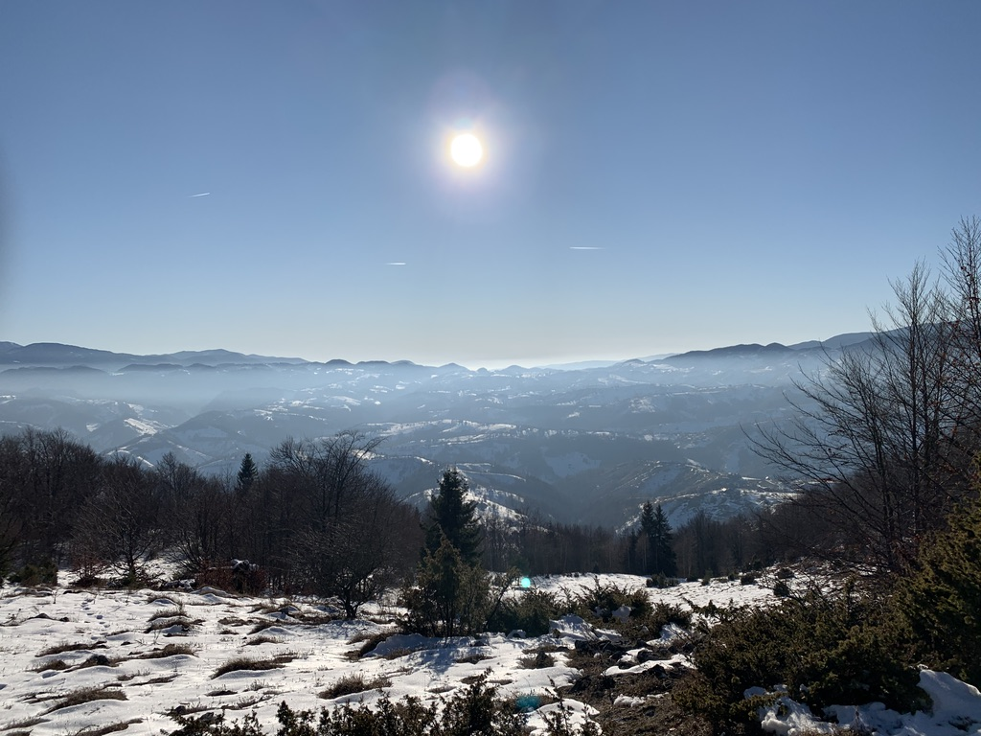
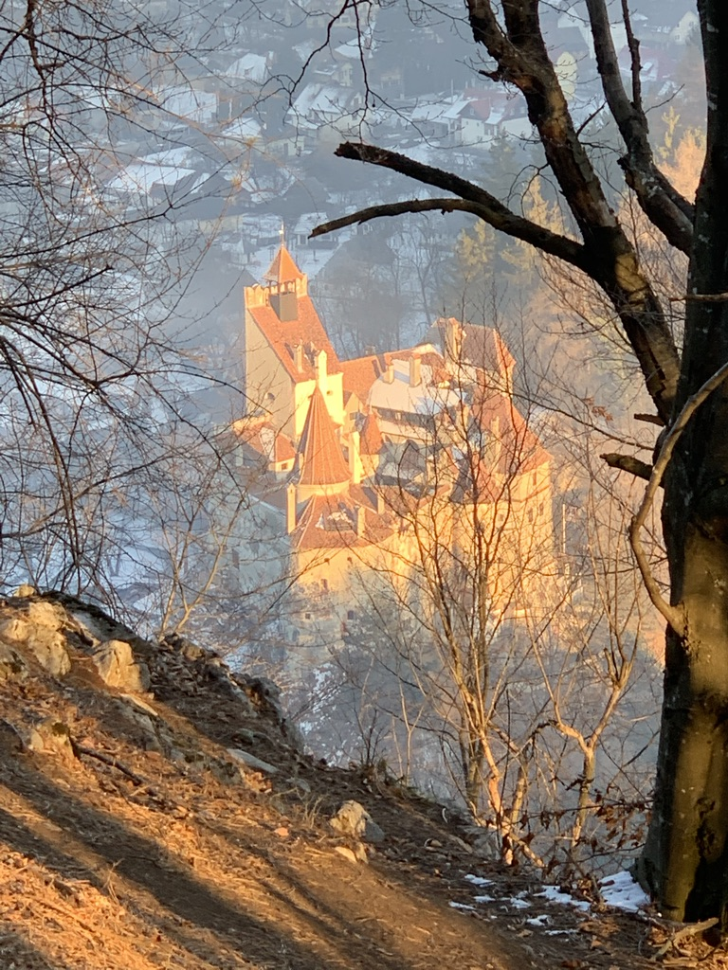
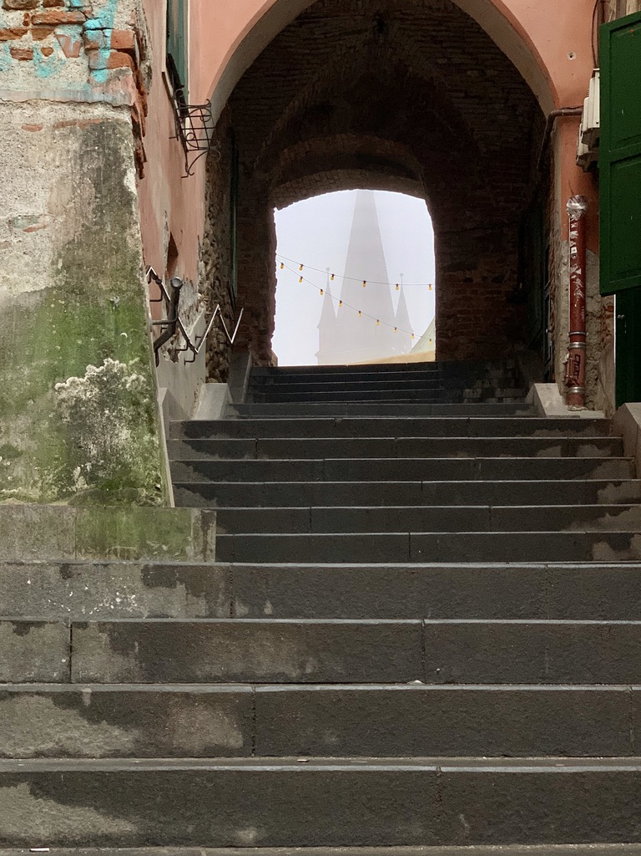
Reflection
Notes:
During my time in Romania I learned a tremendous amount about many things, mostly the Romanian culture and history, but also about myself as I was put in a completely new environment alone with a large language barrier and expected to conduct research. While the challenge was tough, I was able to overcome and conduct valuable research all while living mostly alone and being self sufficient. I also was able to travel to a few neighboring cities in Transylvania and experience the historical districts and local foods as I was able to get lost in the city and explore my new surroundings. I also learned a tremendous amount about conducting research thanks to the guidance of my mentors Dr. Fritsch and Dr. Cibian. I believe this experience will be something I can draw upon for many future endeavors. Finally, I would like to thank the CURS program for awarding me the grant to make this all possible. I am very thankful I was given the opportunity to experience so many new sights, sounds and ideas in Romania and contribute to my field of study back in the United States and the world as a whole.
Thank you.

