Slide 1
THE TEMPORAL ORDERING OF COMMON GUN CARRYING CORRELATES IN ADOLESCENT CRIMINAL OFFENDERS
Megan Gressley and Meagan Docherty, PhD

Slide 2
Background
-Many Factors
-Crime Facilitation Theory
-Aggressive-reactive victim
-Antisocial lifestyle orientation and antisocial predisposition hypothesis
-Mass shootings
-Needed interventions
Notes:
There are many different factors linked to gun carrying and affecting the lives of young men who will go on to carry a gun. Being a member of a gang is extensively associated with gun use due to the typical happenings for gang members. Gangs often find themself in situations where they are at odds with other individuals or a different gang and feel the need to protect themselves if things go south. Being a gun carrier also serves as a level of status for gang members and may be a drawn in for adolescents (Lizotte et al., 2000). Related to the gang interaction, the Crime Facilitation Theory explains that individuals who get involved in delinquent behavior or crime are more probable to carry a gun because it gives them extra leverage to warrant obedience from a victim and participation from a co offender (Docherty et al., 2019). Behavior that also showed strong relations to gun carrying were drug use as well as drug sales, which often may result in unexpected violence and warrant having a gun for such situations. Those who have been a victim of bullying may be drawn to retaliation though antisocial and violent action, making them known as the aggressive-reactive victim, which may predispose them towards gun violence. Likewise, intense exposure to trauma as well as violence may create a paradox of symptoms including both emotional numbing and hypervigilance (Reid et al., 2017). In accordance numbing of emotions, an antisocial lifestyle orientation was seen as linking common behaviors of drug dealing, peer delinquency, aggressive behavior, and neighborhood disadvantage were observed with higher levels of gun carrying (Docherty et al., 2019).The Antisocial Predisposition Hypothesis goes further to explain that as individuals carry a gun they become more predisposed to develop conduct problems and act defiantly towards others (Beardslee et al., 2018). Additionally, individuals who were victims of crime were seen to have deterioration in mental health, emotional health, anxiety, depression, hostility and fear (Reid et al., 2017). Not only isolated cases of violence warrant carrying a gun but the rise in mass shootings has also added controversy over access to guns and the characteristics that may lead someone to obtain a gun and potentially use it to harm others. In fact, sixty percent of mass shootings were linked to psychological symptoms of paranoia, delusions, and depression (Reid et al., 2017). In response to all the effects of gun violence and dangerous nature of carrying a gun, it is indicative that there are programs in place to steer individuals away from engaging in crime, and assist those who are already involved.

Slide 3
Method
Pathways to Desistance
1354 participants
Adolescent criminal offenders
Eleven interviews
Seven year span
Notes:
The data set we used came from the Pathways to Desistance Study inspired by the MacArthur Foundation Research Network on Adolescent Development and Juvenile Justice. Pathways is a longitudinal study that studied 1354 young men between the ages of 14 and 18 who had previous behavior categorizing them as criminal offenders and serving a variety of sentences. Pathways was conducted in multiple locations but focused on interviewing individuals from Phoenix, Arizona and Philadelphia, Pennsylvania. Interviews included a baseline assessment in November, 2000 and following interviews were conducted every six months for a full span of seven years. This analysis aimed to gather information that could lead policy makers and professionals in the juvenile justice system to better understand the inner workings of the system and shed light on the experiences of many of the young men affected by crime. Information ranging from individual behaviors of offenders to their wellbeing and interaction with others may also lead to improvements and readjustments in the current justice organization.

Slide 4
Method
Research question
Literature review
Hypothesis
How we gathered data
Our goal
Notes:
Our examination centered on the following research question: which gun carrying factors seem to proceed, follow, and occur simultaneously as gun carrying behavior in adolescents and why do they differ in temporal ordering? In order to theorize in response to this question we conducted an extensive literature review learning about the existing studies and data collections on gun carrying and violence and the frequent factors that are linked to gun carrying. Following our exploration we settled on a few of the numerous variables considered in the Pathways to Desistance study to associate with reports on whether the adolescent males were or were not carrying a gun. The factors we decided on included anxiety, depression, hostility, psychological distress, future orientation, antisocial behavior, and impulse control. We hypothesized that such attributes and mental health factors may contribute to the initiation of carrying a gun as individuals experience a shift in their mental health, future prospect, and interaction with others. Experiencing these factors whilst carrying a gun may be explained by the reaction from witnessing gun violence and the possibility to use a violent weapon. Finally, we may see a rise in such factors as individuals face the reality of frequent gun carrying concurrents ranging from gang involvement to the perpetration of violence. To test this hypothesis we ran individual statistic significance testing across time periods to analyze the connections between timing and the common factors related to gun carrying. Allowing to distinguish between interview periods will furthermore construct a more elaborate timeline of occurrences that coincide with obtaining a firearm. Our goal in using the data to research the connection between gun carrying correlates and their temporal ordering is to add to the current literature that often does not mention timing of factors associated with gun carrying and lead to advancements in programs that aid adolescents affected by gun carrying and usage.

Slide 5
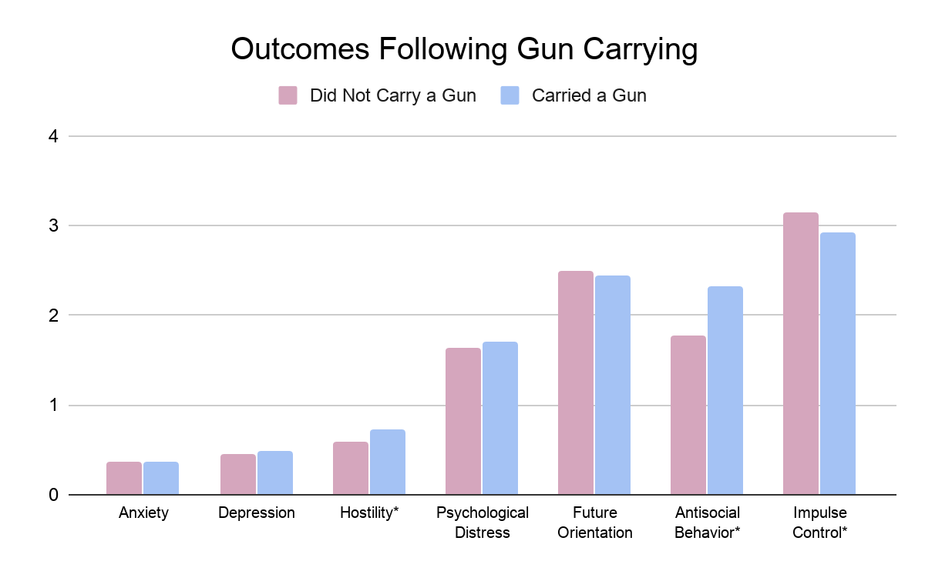
Results
Notes:
This bar graph compares the means for each of the factors related to gun carrying status to analyze which factors are significant in the period following first reported gun carrying. According to significance tests, hostility, impulse control, and antisocial behavior all were all significantly different based on whether an individual reported either carrying or not carrying a gun. Furthermore, this data may implicate that the decision to carry a gun may be followed with depersonalization or a hostile opposition towards others. We also may see impulse control decline as situations can be escalated quite quickly and the use of a gun may be carried out before a long thought process evaluating the consequences of violent action. Impulsive behavior also may rise because individuals feel they have an extra layer of protection, increasing feelings of invincibility or urging them towards making immediate decisions to engage in risk taking behaviors.

Slide 6
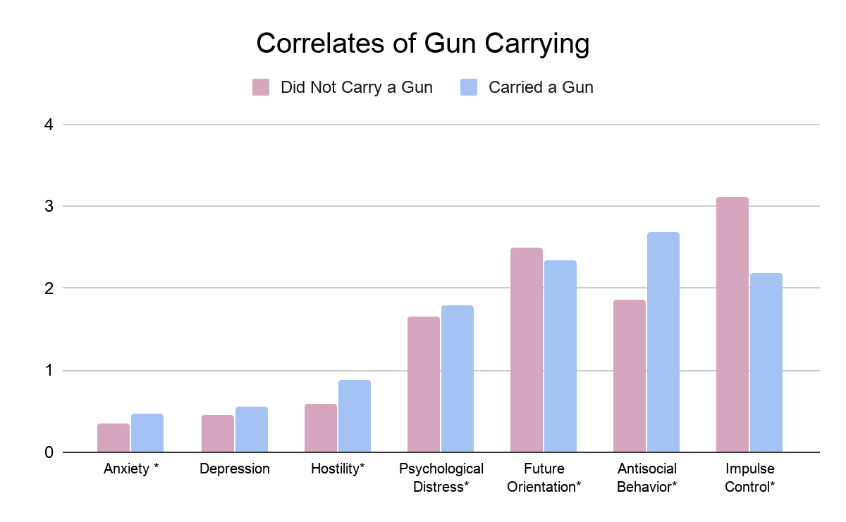
Results
Notes:
This bar graph compares the means for each of the factors related to gun carrying status to analyze which factors are significant in the same time period as reported gun carrying. When running significance tests on this data set we found that anxiety, hostility, psychological distress, future orientation, antisocial behavior, and impulse control were all significantly differed based on an individual's gun carrying status at that time. In short, the compelling relationships between carrying a gun and reporting significant behavioral traits or mental health factors included every variable besides depression. Anxiety may lead an individual to feel they need a weapon to ease their worries to the degree that he feel a sense of security that he can protect himself when threatened by any type of harm. Similarly, one may obtain a gun when they have lowered inhibitions and do not think of long term consequences of possessing a gun illegally as well as the potential violence that may ensue, showing a low degree of impulse control and a decreased notion of future orientation. Possessing a gun may lead an individual to see others as hazards especially if they witness other individuals acting violently with no regard for the human condition, leading to increased reports of antisocial behavior and hostility for gun carriers. Concurrently, heightened levels of psychological distress including fear, sadness and extreme discomfort might concur with one’s need to diminish fear and protect themself. Additionally, investing in a gun may lead one to feel more at peace with distress as the result of being a witness or victim to gun use.

Slide 7
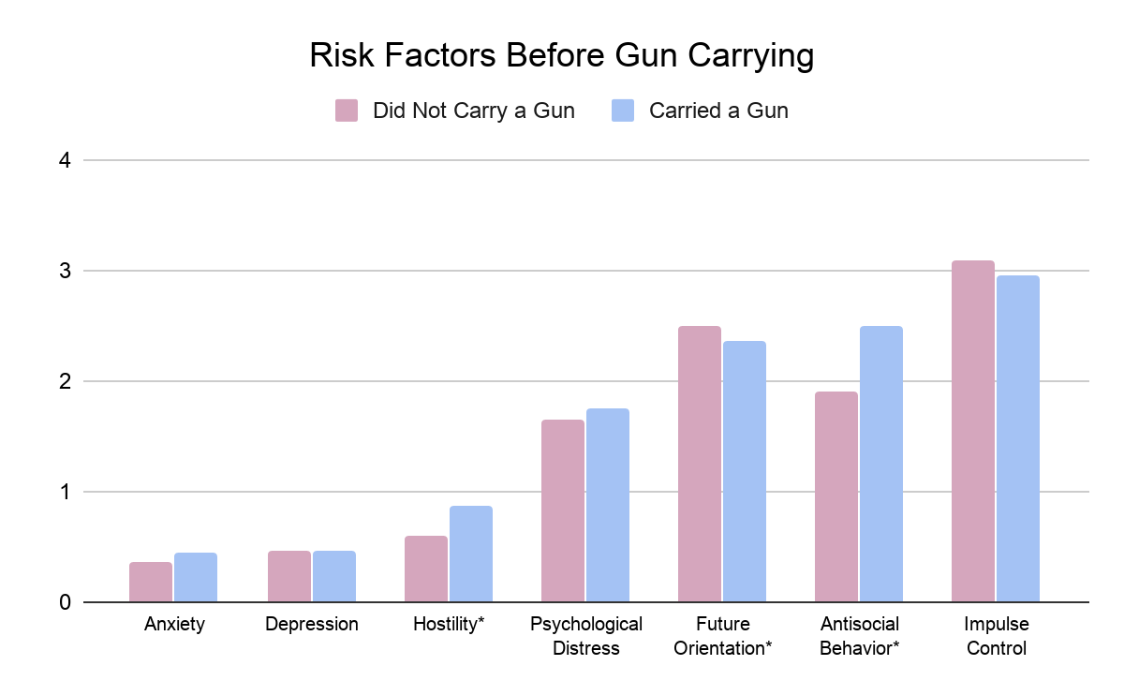
Results
Notes:
This bar graph compares the means for each of the factors related to gun carrying status to analyze which factors are significant in the period preceding reported gun carrying. Analysis of the data showed a significant link between antisocial behavior, future orientation and hostility for the first collection period based on gun carrying in the following period. Each of these factors may provide insight into which characteristics may contribute towards initiation of carrying a gun. Increased levels of hostility and deterioration in one’s sense of universal care and concern for others may also bring someone to feel they need to act destructively towards others, a gun being the most efficient way to retaliate violently and fulfill antisocial behavior. Furthermore, Decreased levels of future orientation advance risk behaviors which may include the decision to acquire a gun and perhaps be prepared to act instinctively or violently to potential threat.

Slide 8
Conclusion
Temporal ordering of variables:
Later gun carrying: hostility, future orientation, antisocial behavior
Simultaneous gun carrying: anxiety, hostility, psychological distress, future orientation, antisocial behavior, impulse control
Earlier gun carrying: hostility, antisocial behavior, impulse control
What this tells us
Notes:
In conclusion, we have discovered a substantial amount not only about how certain variables can interact with gun carrying behaviors in adolescent males, but also how the temporal ordering of each variable create a timeline for behavior. Through significance tests using different data collection periods but with the same participants, we were able to analyze the interaction of various factors before, during, and after reported gun carrying. First we were able to establish that heightened levels of hostility, antisocial behavior as well as poor future orientation were each predictors that an individual would go on to carry a gun. Moreover factors that were seen significant in the same time period as recorded gun carrying included anxiety, depression, hostility, psychological distress, future orientation, antisocial behavior, and impulse control. Following gun carrying we saw a significant presence of hostility, antisocial behavior, and lowered impulse control. This tells us first that there are additional factors at play while one is in possession of a gun that are not as substantial before and after ownership. Across all time periods we saw a significant presence of both hostility and antisocial behavior, indicating that these factors are exceptionally important to consider throughout the entire period of criminal behavior. We can furthermore use the knowledge of varying factors to better understand the factors in a specific time period.

Slide 9
Conclusion
Moving forward:
programs
response
awareness
Notes:
Moving forward we can use the information we have gathered to respond to the needs and challenges of adolescents who may be involved in crime or at risk to being implicated in potential gun violence. Such action may include the development of preventionary programs as well as those who assist individuals who have already been affected by the repercussions of carrying a gun and potential crime. Knowing the key factors and mental health struggles that an individual is experiencing aids in helping individuals recover and deter them from future crime. Developing an accurate response based on these key factors will aid in the purpose of restorative justice, allowing criminal offenders to grow from what they have experienced and evade the cycle of crime. Likewise, better awareness about and significant components in the timeline of gun acquisition gives more insight into the experience of individuals who have been motivated to carry a gun. Essentially, programs to address adolescents perceived desire for a gun can allow for a system address the misguidance of young men.

Slide 10
REFERENCES
Beardslee, J., Docherty, M., Mulvey, E., Schubert, C., & Pardini, D. (2018). Childhood risk factors associated with adolescent gun carrying among Black and White males: An examination of self-protection, social influence, and antisocial propensity explanations. Law and human behavior, 42(2), 110.
Docherty, M., Beardslee, J., Grimm, K. J., & Pardini, D. (2019). Distinguishing between-individual from within-individual predictors of gun carrying among Black and White males across adolescence. Law and human behavior, 43(2), 144.
Lizotte, A. J., Krohn, M. D., Howell, J. C., Tobin, K., & Howard, G. J. (2000). Factors influencing gun carrying among young urban males over the adolescent‐young adult life course. Criminology, 38(3), 811-834.
Mulvey, E. P., Schubert, C. A., & Piquero, A. (2014). Pathways to desistance. US Department of Justice, Office of Justice Programs, National Institute of Justice, Washington, DC.
Reid, J. A., Richards, T. N., Loughran, T. A., & Mulvey, E. P. (2017). The relationships among exposure to violence, psychological distress, and gun carrying among male adolescents found guilty of serious legal offenses: A longitudinal cohort study. Annals of internal medicine, 166(6), 412-418.

