Slide 1
Decreased Reaction Time In Esport Competitors Equivalent To That Of Physical Athletes
Anh Luu, Avory Winans, Rema Suniga, Vicki A. Motz
Ohio Northern University

Slide 2
INTRODUCTION
Reaction time (RT): time interval between a signal and the reaction to it (Radák, 2018)
Measured by:
Ruler Drop Test (Latorre-Roman et al., 2018)
Visual stimulus (Bucsuházy et al., 2017)
Sound stimulus (Kemp, 1984)
Tactile stimulus (Hernández, 2005)
RTs in response to different stimuli (i.e. visual vs auditory) can be different (Spierer et al., 2011)
Notes:
In this study, we tested the reaction times of football players, esport players, and those who do not participate in either. Reaction time is the time interval between a signal and the reaction to it. Previous studies have measured reaction times through responses to visual, sound and tactile stimuli. Ruler Drop test is also an example of visual stimulus. Different stimuli can also have different reaction times.

Slide 3
Comparison between groups
RT is faster in video gamers than in non-actives
Hand-eye coordination (Gozli et al., 2014)
Flashed-stimulation test (Dye et al., 2009)
Action gamers had faster RTs than story gamers (Kowal et al., 2018)
RT is faster in physical athletes than in non-actives
Faster RT associated with better 60M sprint performance (Gürses et al., 2019)
Button-pressing response to visual cue, faster in tennis players than non-actives (Wang et al., 2013)
Notes:
Studies have found those who play in competitive video games have better hand-eye coordination and respond faster to flashed stimulation than non-gamers. Trained first-person shooting gamers also had faster reaction times than those who were trained to play Sims. This helped us decide on using competitive esports players as a group, since they went on action game tournaments.
Likewise, physical athletes have a faster reaction time than those who are not athletes. Previous studies have shown that a faster reaction time for sprinters allows for faster performance, along with visual cues being faster in tennis players compared to non-athletes.

Slide 4
Premise of study
No comparison between gamers and physical athletes yet
Hypothesis: esport players have faster RT than football players
Notes:
There are no known direct comparisons between esports players and physical athletes, and that was what we attemped to do here.
Our hypothesis for the study was that esport players will have a faster overall reaction time than football players. This is on the premise of the amount of stimuli that esport players receive compared to football players, and the relation to the theory of feedforward processing. Feedforward processing relates to what we see as muscle memory. If you are introduced to a stimuli continuously over long periods of time, you start to predict what will happen subconsciously even before you start to react, therefore improving your reaction time.
This idea is the premise for why athletes and esport players have faster reaction times. Following this idea, continuous strenuous activity for the mind can create even faster reaction times. Football players take breaks between plays, whereas esport players can be in a match anywhere from 6 minutes to 40 minutes without much of a break, causing an increase in their mind’s processing.

Slide 5
Study groups
IRB approved
Subjects: 18-22 year-old healthy male college students (N=12 each group)
Football team members
Esport team JV and Varsity members
Controls
Notes:
For our IRB approved study, we tested 36 male ONU students between the ages of 18-22. There were 12 students per testing group. Our first testing group was the ONU football team players. These subjects could not be involved in competitive video games and could not be currently involved in other sports. Our second testing group was the competitive esport players from the ONU esport team, and none of the subjects could be involved in the past 5 years in a physical sport. Our control group consisted of male students who did not participate in competitive video gaming, nor were they active in an athletic sport in the past 5 years.

Slide 6
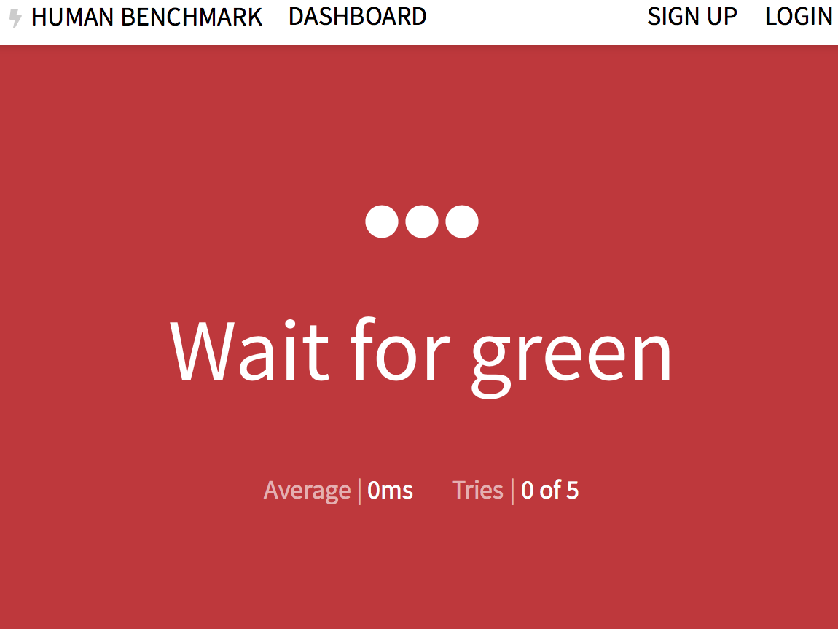
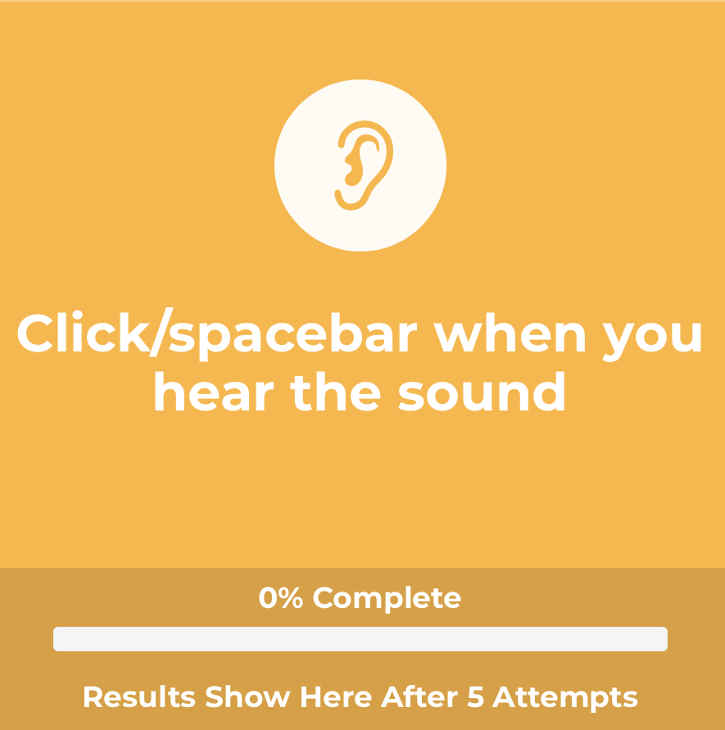
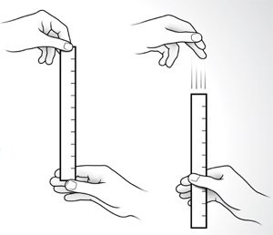
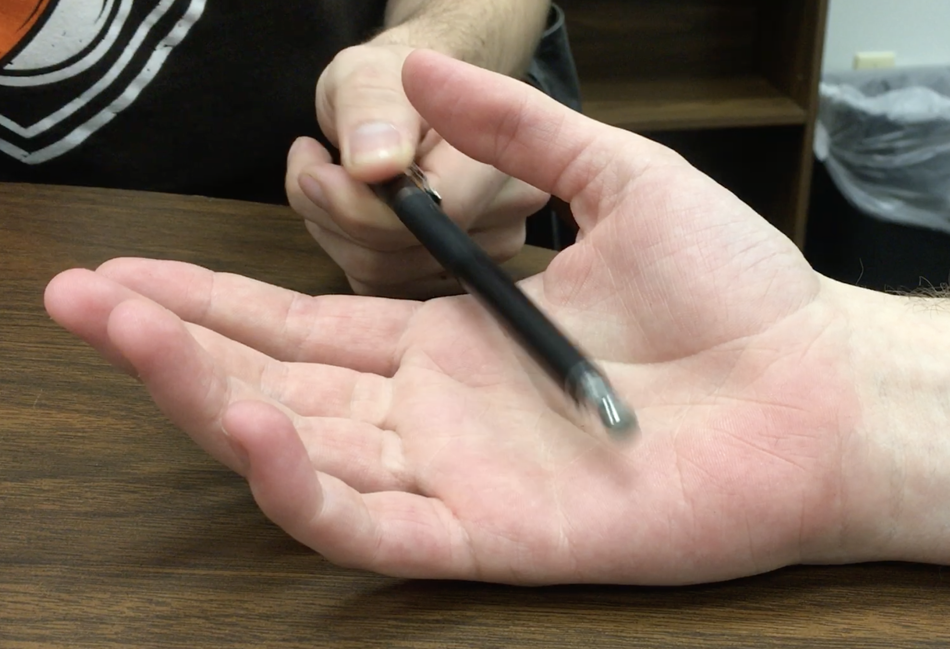
METHODOLOGY
Tests
Color Cue
Sound Cue
Ruler Drop
Probe Grabbing
https://www.humanbenchmark.com/tests/reactiontime
https://cindyzhanginvestigation.weebly.com/the-experiment.html
https://playback.fm/audio-reaction-time
Statistical analysis: ANOVA, post hoc t-test
Notes:
For this study, we conducted 4 different tests measuring 3 parameters, given in random order and in duplicate. The first test was the Color Cue test, which tested visual stimuli. This test was conducted on the computer, and the subject would watch a red screen, and when the subject saw the screen change to green they had to click the mousepad. This test was measured in milliseconds. The second test is the Sound Cue test, which tested auditory stimuli. Similar to the color cue, it was conducted on the computer. The subjects eyes would be closed, and when they heard the sound from the computer they would click the spacebar. This test was also measured in milliseconds. The third test was the Ruler Drop test, which also tested visual stimuli. The subject would place his forearm on the table with his hand over the edge of the table, with his hand in a “C” shape. A ruler would be held at the top of the fingers, and when the subject saw the ruler drop he would grab the ruler as fast as possible. The distance travelled would be recorded and converted into milliseconds. The final test was the Probe Grabbing Test, which tested tactile stimuli. With the subject’s eyes closed and their palm open on a table, a pen was used as a probe to lay across the hand of the subject while being recorded. As soon as the subject felt the probe in their hand, they were to close their hand fully as fast as they could. The video was used to get an accurate time for how long it took from initial contact to full grip, and was measured using a video editing software to go frame by frame. ANOVA tests were conducted for all groups, and if significance was found a post hoc t-test was conducted.

Slide 7
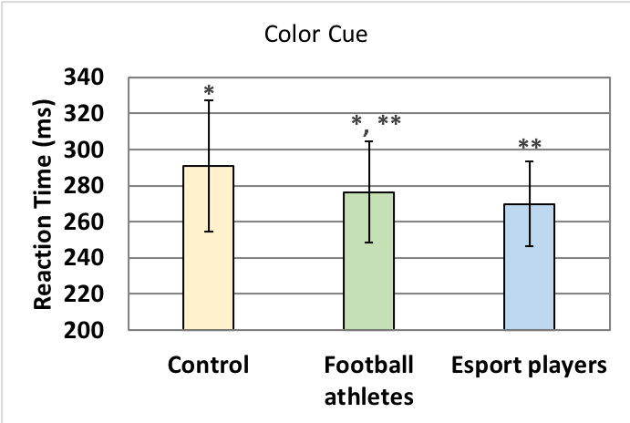
RESULTS - Color Cue
Significant difference between esport players and controls (p=0.05, N=12).
Similar results
Green et al. (2010) for gamers
Notes:
These are what we found. As you can see in this graph and the other ones, lower reaction time means faster reaction time. Asterisks indicate significance.
For this Color Cue test, esport have significantly faster reaction times than controls. But controls vs football, and football vs esport are not significantly different. These results are similar to those in the study by Green and others, which tested response by gamers and non-gamers to visual cues on the computer screen. However, Green didn’t take into account whether the participants played physical sports or not.

Slide 8
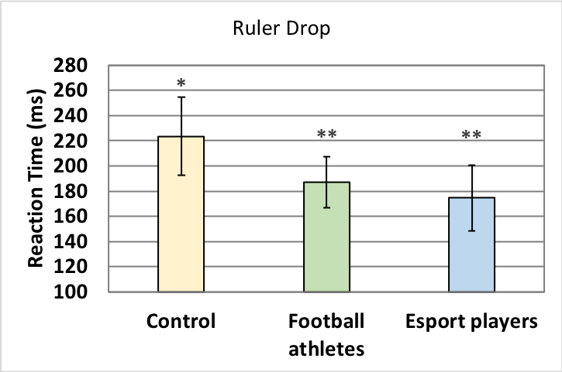
RESULTS - Ruler Drop
Significant difference between esport and controls (p=0.0002, N=12), and between football and controls (p=0.0013, N=12).
Similar results
Better hand-eye coordination (Gozli et al., 2014) and faster saccadic RT (Mack et al., 2014) in gamers
Notes:
For the Ruler Drop test, both esport and football had significantly faster reaction times than the controls, although there’s no significant difference between football and esport. We can explain the results of esport with the findings from other studies. They found that, compared to non-gamers, gamers had better hand-eye coordination and faster saccadic reaction time (in this case it means eye movement in response to a visual stimulus). Esport would have had an advantage in Ruler Drop, since this test was based on response to an object’s movement.

Slide 9
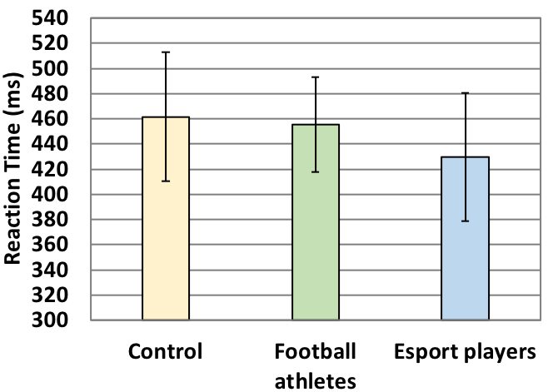
RESULTS - Sound Cue
No significant difference was detected between groups.
Notes:
For the Sound Cue test, there was no significant difference between groups.

Slide 10
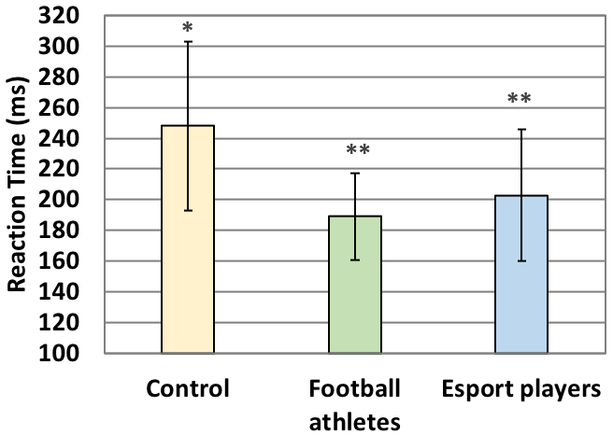
RESULTS - Probe Grabbing
Significant difference between esport and controls (p=0.0175, N=12), and between football and controls (p=0.0016, N=12).
Notes:
For the Probe Grabbing test, again, both esport and football have significantly faster reaction times than control but no significant difference between football and esport. This is also the only test in which football had faster reaction times than esport, which we expected because football athletes had plenty of exposure to tactile stimuli through grabbing and touching, whereas in gaming, gamers are only exposed to visual and auditory cues.

Slide 11
RESULTS - Composite
Significant difference between esport and control (p=0.0025, N=12), and between football and control (p=0.0046, N=12).
Notes:
Overall reaction times are represented by composite reaction times. These scores incorporated reaction times from all 3 stimuli: visual, auditory and tactile. Esport and football have significantly faster composite reaction times than control, which we expected. And although no significance was found between football and esport, esport trended towards having the fastest reaction times, followed by football and last is control. This trend is similar to results from all tests except Probe Grabbing.

Slide 12
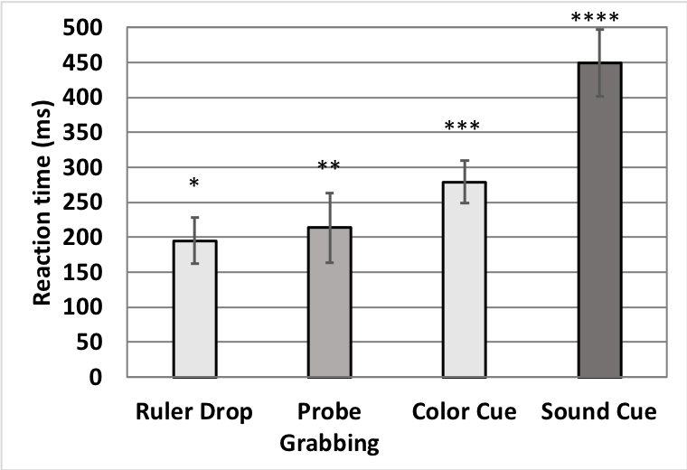
RESULTS - 4 tests
RT to tactile is faster than visual stimuli (Godlove et al., 2014)
RT to visual is faster than auditory stimuli
Similar to Spierer et al. (2011)
Contradicts with Jain et al. (2015)
Ruler Drop: fastest due to coactivation (Miller 1982)
Significant at F_{(140,3)}=286.5, p=1.5E-59
Notes:
This is to compare reaction times of everyone in each test, and all four tests had significantly different reaction times from each other.
Reaction time to tactile stimuli was faster than to visual stimuli, similar to what Godlove and others have found.
Reaction time to visual stimuli was faster than to auditory stimuli. Spierer and others achieved the same results when they tested on soccer players. On the other hand, Jain and others found the opposite, that auditory reaction time was faster than visual among medical students of various lifestyles.
Ruler Drop is an interesting test here, having the fastest reaction time. We think it might have been due to coactivation, meaning when there are 2 simultaneous signals of different modalities, reaction time is faster than when there’s only 1 signal. It’s possible that in addition to seeing the ruler falling, the subject also felt a non-contact pressure generated by the ruler’s movement.

Slide 13
CONCLUSION
Football athletes and esport players have faster composite RTs than controls
RTs of esport players are not significantly different from RTs of football athletes
Unclear on a causative relationship
Need more research on pre-trained and post-trained
Notes:
In conclusion, our study found that both football players and esport players have faster composite reaction times than the control group. Although there was a trend towards esport players having faster composite reaction times than football players, the data was not significant enough to state this with certainty.
Involvement in esport and football was associated with faster reaction times, but it is unclear whether those activities improved reaction times, or people with inherently fast reaction times were just good at gaming or sports. Further research on this topic should focus on pre-trained and post-trained individuals, and also expand testing to other physical sports besides football.

Slide 14
REFERENCES
Bucsuházy, K., & Semela, M. (2017). Case Study: RT of Children According to Age. Procedia Engineering, 187, 408-413. doi:10.1016/J.PROENG.2017.04.393
Dye, M. W., Green, C. S., & Bavelier, D. (2009). Increasing Speed of Processing With Action Video Games. Current Directions in Psychological Science, 18(6), 321–326. doi: 10.1111/j.1467-8721.2009.01660.x
Godlove, J. M., Whaite, E. O., & Batista, A. P. (2014). Comparing temporal aspects of visual, tactile, and microstimulation feedback for motor control. Journal of Neural Engineering, 11(4), 046025. doi: 10.1088/1741-2560/11/4/046025
Gozli, D. G., Bavelier, D., & Pratt, J. (2014). The effect of action video game playing on sensorimotor learning: Evidence from a movement tracking task. Human Movement Science, 38, 152–162. doi: 10.1016/j.humov.2014.09.004
Green, C. S., Pouget, A., & Bavelier, D. (2010). Improved Probabilistic Inference as a General Learning Mechanism with Action Video Games. Current Biology, (17), 1573. doi: 10.1016/j.cub.2010.07.040
Gürses, V. V., & Kamiş, O. (2019). The Relationship Between RT and 60 m Performance in Elite Athletes. Journal of Education and Training Studies, 6(12a), 64. doi: 10.11114/jets.v6i12a.3931
Hernandez, O. H. (2005). Behaviorally Fractionated RT To An Omitted Stimulus: Tests With Visual, Auditory, And Tactile Stimuli. Perceptual and Motor Skills, 100(4), 1066. doi: 10.2466/pms.100.4.1066-1080
Jain, A., Bansal, R., Kumar, A., & Singh, K. (2015). A comparative study of visual and auditory reaction times on the basis of gender and physical activity levels of medical first year students. International Journal of Applied and Basic Medical Research, 5(2), 124. doi: 10.4103/2229-516x.157168
Kemp, S. (1984). RT to a tone in noise as a function of the signal-to-noise ratio and tone level. Perception & Psychophysics, 36(5), 473-476. doi:10.3758/BF03207501

Slide 15
REFERENCES
Kowal, M., Toth, A. J., Exton, C., &amp; Campbell, M. J. (2018). Different cognitive abilities displayed by action video gamers and non-gamers. Computers in Human Behavior, 88, 255–262. doi: 10.1016/j.chb.2018.07.010
Latorre-Roman, P. Á., Robles-Fuentes, A., García-Pinillos, F., & Salas-Sánchez, J. (2018). RTs of Preschool Children on the Ruler Drop Test: A Cross-Sectional Study With Reference Values. Perceptual and Motor Skills, 125(5), 866–878. doi: 10.1177/0031512518789563
Mack, D. J., & Ilg, U. J. (2014). The effects of video game play on the characteristics of saccadic eye movements. Vision Research, 102, 26–32. doi: 10.1016/j.visres.2014.07.010
Miller, J. (1982). Divided attention: Evidence for coactivation with redundant signals. Cognitive Psychology, 14(2), 247–279. doi: 10.1016/0010-0285(82)90010-x
Radák, Zsolt. (2018). The Physiology of Physical Training. London: Elsevier/Academic Press.
Reaction Time Test. (n.d.). Retrieved from https://www.humanbenchmark.com/tests/reactiontime
Spierer, D. K., Petersen, R. A., & Duffy, K. (2011). Response Time to Stimuli in Division I Soccer Players. Journal of Strength and Conditioning Research, 25(4), 1134–1141. doi: 10.1519/jsc.0b013e3181d09e4c
Wang, C.-H., Chang, C.-C., Liang, Y.-M., Shih, C.-M., Muggleton, N. G., & Juan, C.-H. (2013). Temporal Preparation in Athletes: A Comparison of Tennis Players and Swimmers With Sedentary Controls. Journal of Motor Behavior, 45(1), 55–63. doi: 10.1080/00222895.2012.740522
What is Your Reaction Speed to Sound? (n.d.). Retrieved from https://playback.fm/audio-reaction-time

