Slide 1
Autonomous Driving RC Car / LIDAR Detection
Malik Walls, Carl Gruhn, Cole Burley, Dakota Jenkins, Jenelysc Martinez, Ngoc Long Duong, Maurice Adika. | Advisors: Resmi Krishnankuttyrema, Mikhail Shilov

Slide 2
Project Statement
How can we create an autonomous car on a scaled down model, which can be “aware” of its current position on a racetrack. Also, how can this car adjust itself to stay on the track and not collide with obstacles or other vehicles.

Slide 3
Project Goal
The goal of this project is to understand the fundamentals of programming an autonomous car by creating a scaled down model. It is also to procure this goal by developing a successful navigation and object avoidance system with the appropriate tools that can ensure the safety of the vehicle as well as the safety of those around it.

Slide 4
Project Overview
The SunFounder car needs more connections for sensors in order to collect the appropriate amount of data for proper functioning. SunFounder red Hardware Attached on Top (HAT) board became an obstacle since it was not compatible with other equipment.
New methods of data collection and guidance need to be developed. A LIDAR is an ideal candidate for obstacle avoidance and navigation support system that is accurate and reliable. Implement LIDAR system and program it for car navigation.
The Model of choice was the SunFounder Pi Car–S Model. This model was chosen because it is compatible with Raspberry Pi and because it came with several sensors such as Ultrasonic Range Sensors, Light follower, and Line Follower.

Slide 5
Variables to Consider
Non-compatible HAT
The HAT allows for one SunFounder type of sensor only. It was built in a manner such that any external sensors cannot be connected.
LIDAR Components that need to considered.
It is necessary to find a LIDAR device that can work cross-platform and that can cover an ideal range.
Algorithm Components that need to be considered.
How can LiDAR sensor data can be processed and utilized to communicate with different algorithms.

Slide 6
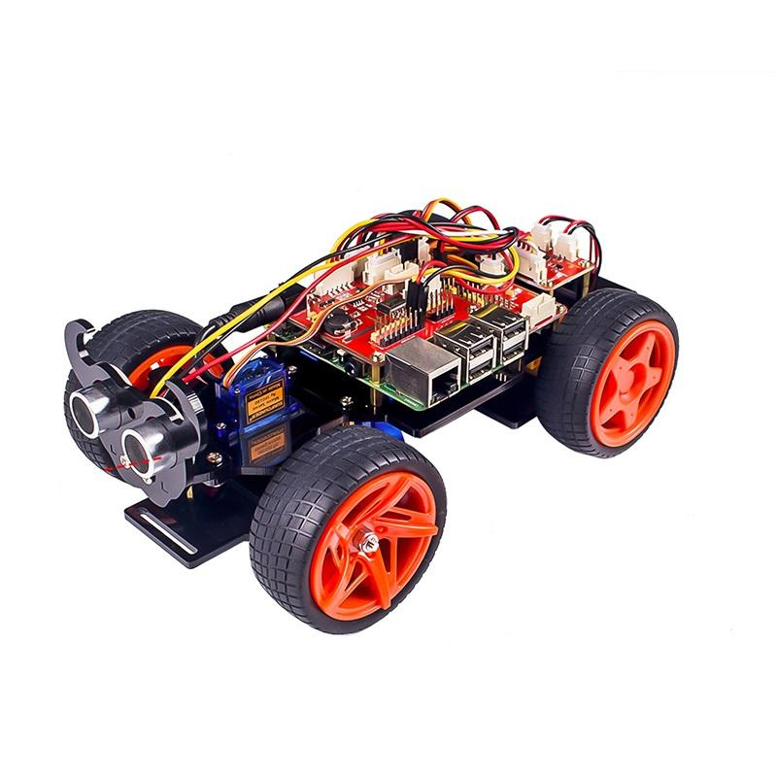
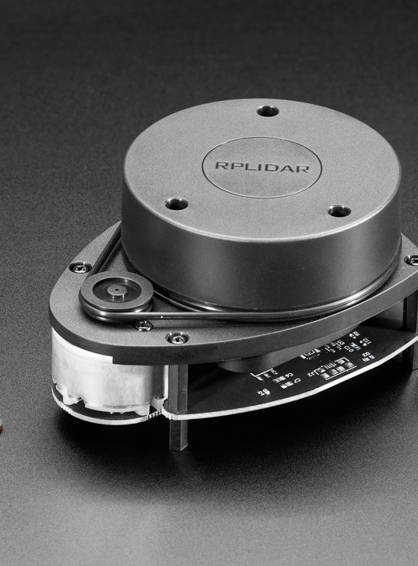
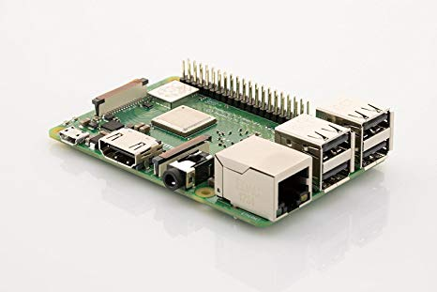
Materials
SunFounder Car Kit
Micro controller (Raspberry Pi)
SlamTec 360 RPLiDAR A1
RoboStudio
SlamWare C++ SDK

Slide 7
Procedure
Step 1
Analyze the circuit board of the SunFounder to find any indication that only a certain quantity of sensors can be added to the model.
Step 2
Step 3
Step 4
Finding a method that can transport the LIDAR data to an algorithm that communicates with the model vehicle actuators.
Test SlamTec RPLiDAR to see if it meets team expectations software and hardware wise.
Focused on hardware control. The idea is, instead of using a HAT, connecting components directly to the boards while utilizing driver boards approprietely.

Slide 8
Results
The SunFounder Model has limited the scope of the project. Its HAT cannot handle the addition of other sensors. The HAT could not provide additional space for more then one Ultrasonic range Sensor. Furthermore, the SunFounder platform restricts the usage of advanced algorithms such as machine learning and computer vision.
Among a variety of sensors considered, LIDAR stood out for its reliability. The SlamTec RPLiDAR A1 covers a distance range of 20m, a maximum mapping area of 300m*300m, and an accuracy of <0.02m.

Slide 9
Results
The RPLiDAR is equipped with a useful mapping tool that can register the environment around the LIDAR. The mapper delivers real time Laser data as well as real time coordinates. Furthermore, the mapper makes it easier for the person monitoring the vehicle to visualize the obstacles. The image in Figure 1 shows the view from a RPLiDAR inside a wooden box.
Since the RPLiDAR will be used in conjunction with Computer Vision algorithms, the laser system will serve as a safety net of object detection as well as position. The LiDAR’s primary location would be in the front of the car to help detect the distance of any obstacles that could hinder the vehicle.

Slide 10
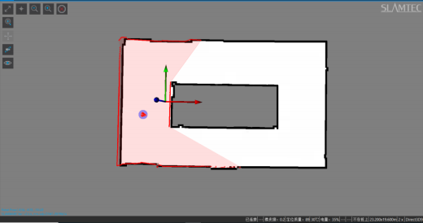
Figure 1: An Image showing LiDAR range.
The image was obtained with RoboStudio software.

Slide 11
Conclusion and Future Plans
Overall, the RPLiDar provides good range of detection that can aid a model vehicle and a possible full-scale prototype.
Further research is needed on certain aspects of the LIDAR such as the maximum traveling speed that the LIDAR can handle to provide accurate data.
Future plans for the project include better understanding of the algorithm that reads and interprets the data and how that algorithm can be used to communicate with different navigation and object avoidance algorithms.

Slide 12
External Resource
Programming and debugging: Http://github.com/sunfounder/SunFounder_PiCar
SlamTec Mapper Laser mapping Sensor.PDF. (2019, July 19). Shanghai.

