Slide 1
Autonomous Racer
Computer vision and machine learning

Slide 2
GOALS

Slide 3
Goals
Construct modified RC car with:
3D printed frame
Attached Raspberry Pi
Raised camera
Capability LIDAR and other sensors
Develop Computer Vision software to:
Follow a given path
Track and avoid obstacles and other vehicles
Train Machine Learning Algorithm

Slide 4
Current status

Slide 5
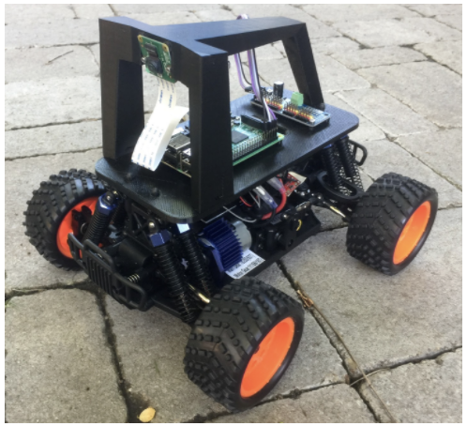
Current status
Goals
Construct modified RC car with:
3D printed frame
Attached Raspberry Pi
Raised camera
Capability LIDAR and other sensors
Develop Computer Vision software to:
Follow a given path
Track and avoid obstacles and other vehicles
Train Machine Learning Algorithm
*Image from DonkeyCar GitHub Repository: https://github.com/autorope/donkeycar/blob/dev/docs/assets/build_hardware/donkey.png.

Slide 6
Current status
Goals
Construct modified RC car with:
3D printed frame
Attached Raspberry Pi
Raised camera
Capability LIDAR and other sensors
Develop Computer Vision software to:
Follow a given path
Track and avoid obstacles and other vehicles
Train Machine Learning Algorithm
OpenSource AV Software Installed and Tested (DonkeyCar)

Slide 7
DONKEY CAR OVERVIEW

Slide 8
DONKEY CAR OVERVIEW
What is Donkey Car?
Donkey Car is an open source platform for building your own small-scale autonomous RC car.
It is based on Raspberry Pi, using python as its programming language.
A selection of different RC cars are compatible with the Donkey Car platform.
It uses a combination of machine learning and computer vision to teach the car to move based on previously recorded driving data.

Slide 9
DONKEY CAR OVERVIEW
How does it work?
When running the Donkey Car, the current state of the vehicle is gathered many times in a second. This state includes taking a picture with the camera, as well as getting the steering and throttle data from the user.
This data is saved into an image file that is the image it took at the moment, as well as a corresponding .json file that saves the steering and throttle data.
The input data is then fed into a machine learning algorithm using the python libraries Keras and Tensorflow, it uses this input data to train an autopilot.
This autopilot uses previously gathered data to make decisions based comparing previous data with the current input it is gathering from the camera, as well as steering and throttle.

Slide 10
Next steps

Slide 11
Next steps
Before Quarantine
Order additional parts including high quality camera
Train RC car to navigate racetrack
Coordinate with other AV racer groups to integrate:
LIDAR data
Short distance proximity sensors
Convert to full-sized go-kart
Focus: Adapt Opensource Software for Full Sized Race

Slide 12
Next steps
Current
Without access to additional supplies, the current build of the donkey car will be tested and worked with.
Develop a separate software model that can train a simulated vehicle through a platform like unity or another game engine to follow roadways, avoid obstacles, and avoid other vehicles.
Focus: Develop and Train AV Software Simulation

