Slide 1
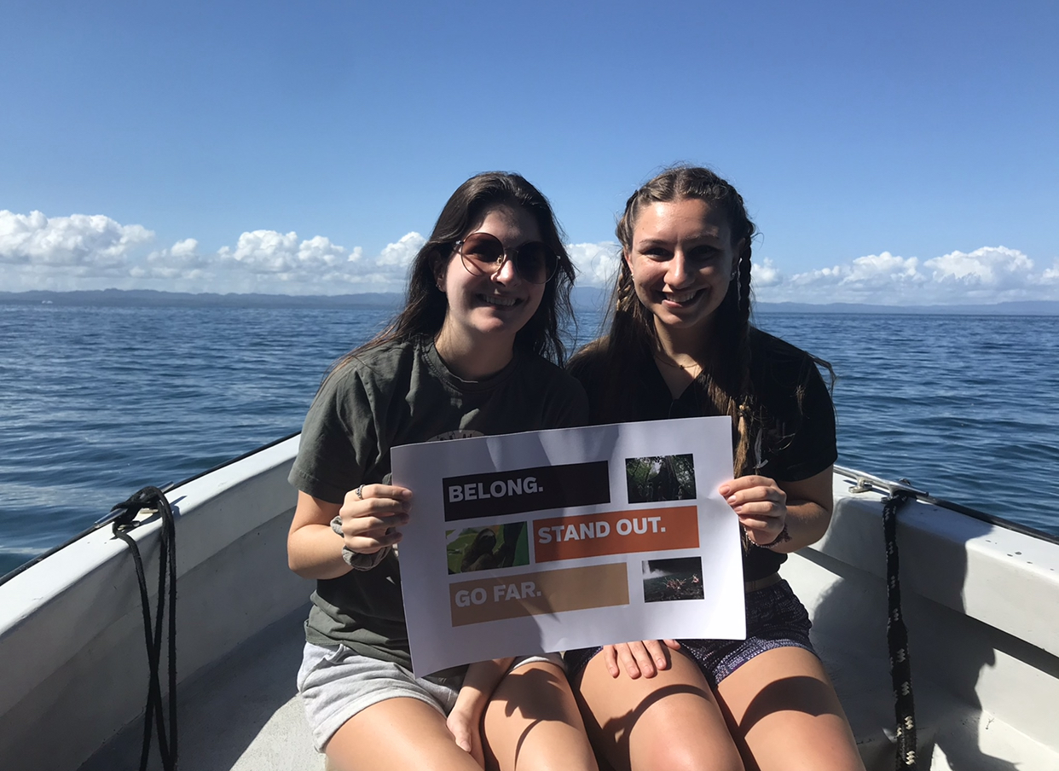
Observational Speech, Language, and Hearing Findings in Costa Rica
Anna Marie Sulminski

Slide 2
What is speech?
Speech is a tool utilized for communication among people of society.
Speech and language abilities are very important for proper developmental goals.
We begin to use speech and language at a very young age and use these skills to communicate wants and needs
Factors such as gender, socioeconomic status, age, cultural background, educational levels, etc. all play an important role in speech and language¹
Various cultures and backgrounds will create different dialects and social interactions among interlocutors.

Slide 3
Research Questions
How does the dialect and social interaction in Costa Rica among speakers differ from the dialect and social interactions among speakers in the United States?
How does the Spanish language differ from English such as comparing the pragmatic skills, morphemes, semantics, and phonemes?

Slide 4
The Spanish Language
English vs Spanish
Syllable Shapes
Stressed Syllables
The official language of Costa Rica is Spanish. Although Spanish has different grammatical structures and phonemes used in their language, we are still able to compare the English and Spanish language to one another. “Spanish has 5 vocalic sounds and 19 consonant phonemes (24 in English).”² Comparing the English phonetic alphabet and the Spanish phonetic alphabet shows that the Spanish language includes all the letters of the standard English alphabet.
When discussing the production of words, it is easy to use symbols such as C for consonant and V for vowels to describe the shape of the word. The syllabic structures that are most generally used among beginning speakers in English are a CV followed by CVC. ³ In Spanish, they follow the same developmental norms as their most frequent syllabic patterns that are used are CV followed by CVC. ⁴
The way in which words are pronounced in English are based upon the stressed syllable which we are taught naturally through the development of language. To explain this in greater detail, each word in English will have a stressed syllable in which our voice may become louder, longer, or more articulated. ⁵ The fact that English non-stressed syllables are reduced compared to stressed ones is a difficult trait for Spanish learners of English as L2.”² This means that the unstressed pattern that is typically used by English speakers can be a difficult task to learn for Spanish speakers who are learning English as a second language.

Slide 5
Substitution Processes
A phonological process occurs when a child substitutes a phoneme for another phoneme that is easier to produce. ⁶
For a bilingual speaker, natural speech tendencies will default to their first language. For example, in Spanish, all words that contain the ‘s’ sound are preceded by an ‘ɛ’phoneme .
The /ɛ/ phoneme was not consistent before the /s/ phoneme within the veterinarian’s discussion at the Animal Rescue Center
For words that included /θ/ and /ð/ which is the stressed and unstressed ‘th’ sound, he substituted these phonemes for /d/.
Students at the University of Costa Rica also used /t/ and /d/ instead of /θ/ and /ð/.
This substitution process is logical as /θ/ and /ð/ are not within the Spanish phonemic inventory ⁷

Slide 6
Spanish Vs. English Developmental Norms
Spanish
English
/p / and /b/ were used correctly 90% of the time by age 3;3 ⁸
Based upon a study, /p/ and /b/ were used correctly 90% of the time by age 3;0
For both Spanish and English /p/ and /b/ are the first phonemes mastered during language development. While three months does not seem like a long period of time, children are still developing language and pragmatic skill at this age. 3 months can look very different between individuals.

Slide 7
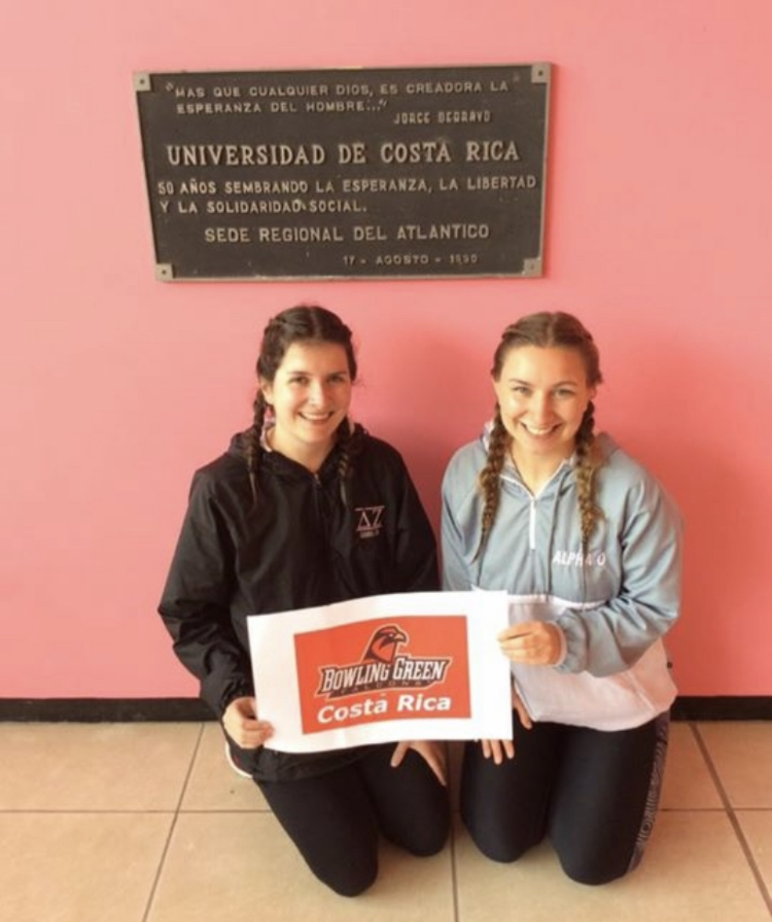
Acoustics
For a person who uses hearing aids, poor acoustics can cause the targeted sound to become echoed or interfere with the hearing aid. A proper signal to noise ratio is essential in order for a person with hearing aids to understand speech accordingly.
A signal to noise ratio describes the target signal combating background noise.
An example of this ratio would be a speech signal of 82 dB and a noise signal of 72 dB would create a signal to noise ratio of +10 dB. An extremely well signal to noise ratio would be +12dB ⁹
In this condition, a child with a hearing impairment would have a speech perception score of 60% which is a small percentage considering typical hearing peers have speech perception scores of 83% ⁹
The classroom at the University of Costa Rica had a very poor signal to noise ratio. It was very difficult for myself and some of my other classmates to hear the presentation. Although I am not sure how Costa Rica accommodates hearing impairments nor am I aware how architecture is built for presentation usage, this observation was interesting to me.

Slide 8
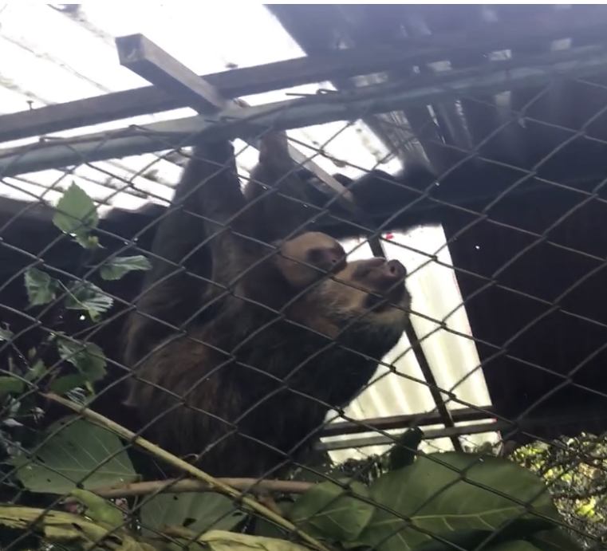
Animal Rescue Center
29 sloths in total – 3 of these sloths had a cleft palate
The cleft palate does not affect food consistency provided
Digestive tract may become an issue because the sloths could swallow larger chunks of food
”In captivity, citrus fruits, lettuce and bananas are accepted by three-toed sloths… it has been argued that three-toed sloths may starve to death on a full stomach if the wrong selection of food is made, due to the slow digestion of leaves” ¹⁰
“leaves have only a low available caloric density. Since the maximal daily bulk that can be processed is limited, the energy available from this diet is low” ¹⁰

Slide 9
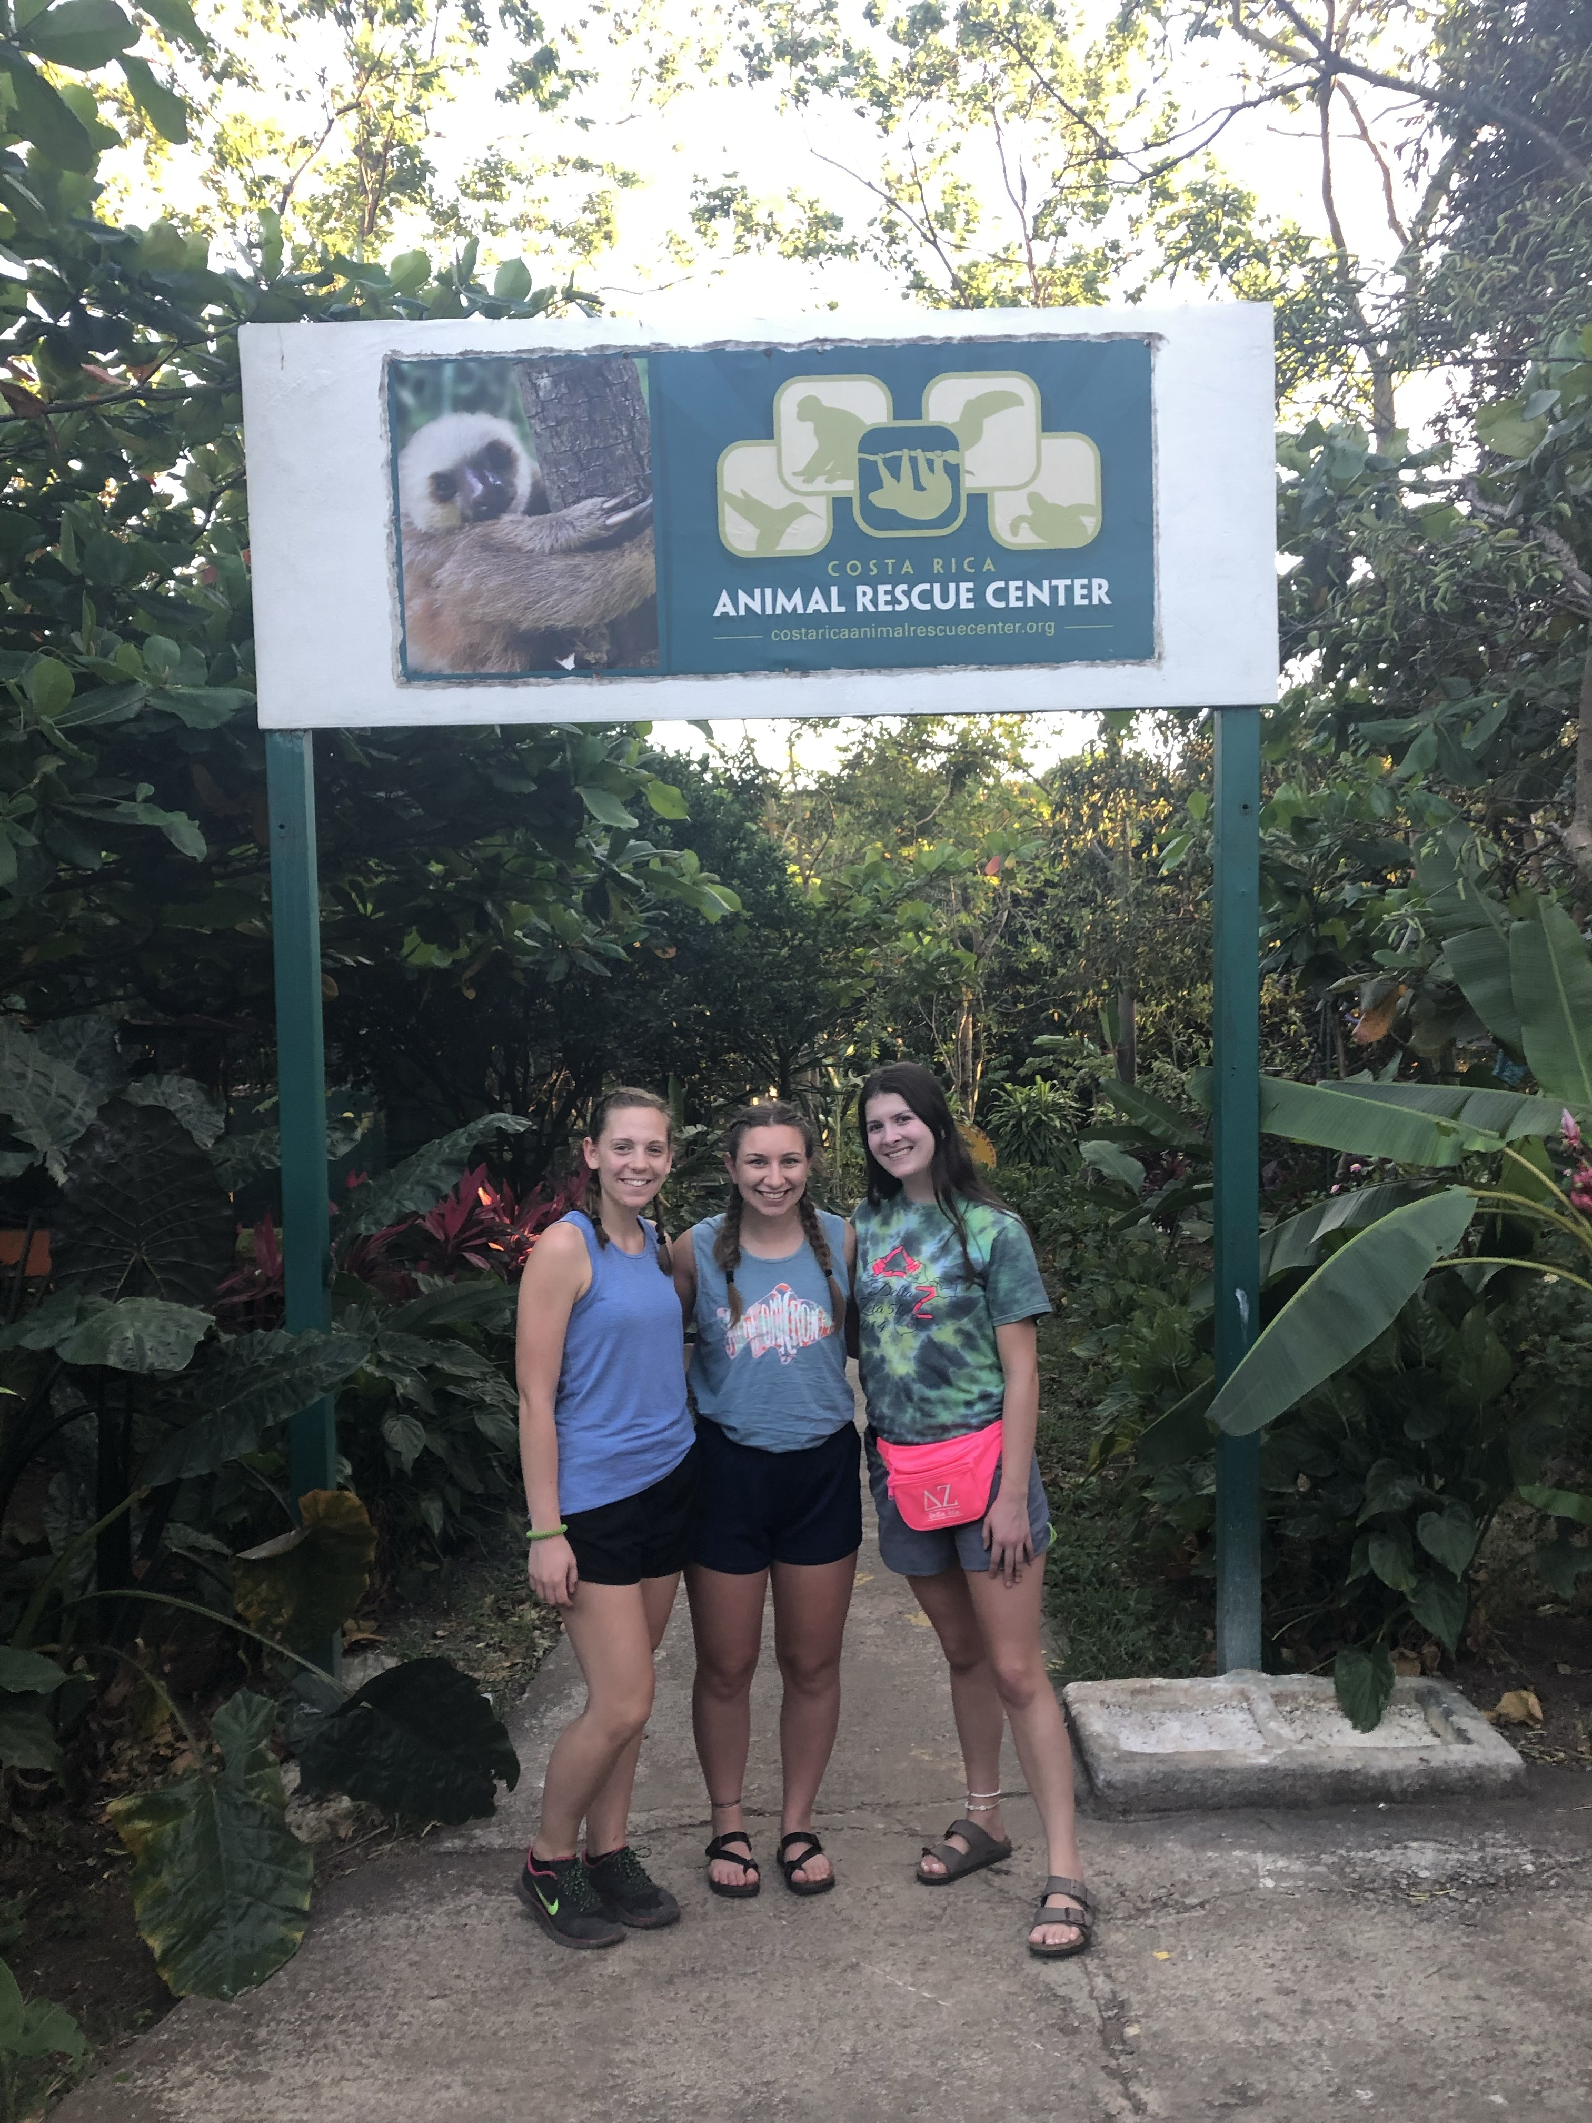
Animal Rescue Center
There were a large variety of birds at the Animal Rescue Center
Some of the birds were able to articulate and produce words such as “hola” and “Hannah,” a name of one of the main volunteers there
The birds who had speech communication abilities are no longer able to be released to the wild since the birds would then teach other animals in the wild how to speak
“Birds do not have vocal folds in their larynx. Instead, the vocal folds are used to vocalize are found in what is known as the syrinx...They produce pitch and volume by changing the pressure of the forced air from lungs into the syrinx, and exercising the muscles of the syrinx” ¹¹

Slide 10
Conclusions
Speech and language skills are used similarly in Costa Rica compared to the United States. There are some slight differences between these two languages. However, this trip has shown that social skills and observations that were made can also be made within our own environment. It is essential to use communication. This may be through an interpreter or using a second language, even if the second language is not mastered. It is not clear what factors have played a role for the people of Costa Rica on English as a second language. These observations that have been made show that various backgrounds and cultures can still communicate with one another to reach a goal.

Slide 11
References
Conti-Ramsden, G., & Durkin, K. (2015). What factors influence language impairment? Considering resilience as well as risk. Folia Phoniatrica et Logopaedica, 67(6), 293–299. https://doi.org/10.1159/000444750
Mariscal S., Auza Benavides A. (2017). Typical language development of monolingual spanish-speaking children. Language Development and Disorders in Spanish-speaking Children, 14, 3-36. https://doi.org/10.1007/978-3-319-53646-0_1
Levelt, C., Schiller, N., Levelt, W. (2009). The acquisition of syllable types. Language Acquisition, 8 (3), 237-264. 10.1207/S15327817LA0803_2
Guirao, M., Manrique, A. M. B. (1972). Identification of spanish vowels. Proceedings of the Seventh International Congress of Phonetic Sciences, 514-520. https://mtss.madison.k12.wi.us/files/mtss/Spanish-Syllable-Types-and-Patterns.pdf
Pathare, E. (2019). Word Stress. British Council. https://www.teachingenglish.org.uk/article/word-stress
Rajakumari, J. J. C., Amritha, M. L., Sushmi, S. C., & Sundaresan. (2018). Phonological process in tamil speaking monolingual and bilingual children - A comparative study. Language in India, 18(5), 202–209.
Jimenez, B. C. (1987). Acquisition of Spanish consonants in children aged 3-5 years, 7 months. Language, Speech, and Hearing Services in Schools, 18, 357–363. https://doi.org/10.1044/0161-1461.1804.357
Sander, E. (1972) When are speech sounds learned? Journal of Speech and Hearing Disorders, 37, 55-63. https://doi.org/10.1044/jshd.3701.55
Goldstein, B. (1999). Cultural and linguistic diversity resource guide for speech-language pathologists. Cengage Learning.
Crandell, C., Smaldino, J. (2000). Classroom acoustics for children with normal hearing and with hearing impairment. Language, Speech, and Hearing Services in Schools, 37, 15-19. https://doi.org/10.1044/0161-1461.3104.362
Gilmore, D. P., Da Costa, C. P., Duarte D. P. F. (2001). Sloth biology: An update on their physiological ecology, behavior and role as vectors of arthropods and arboviruses. Brazilian Journal of Medical and Biological Research, 34(1) 9-25. https://doi.org/10.1590/S0100-879X2001000100002
Rowe, M. (2019). A look at how parrots talk. Lafeber Company. https://lafeber.com/pet-birds/a-look-at-how-parrots-talk/
Gilmore, D. P., Da Costa, C. P., Duarte D. P. F. (2001). Sloth biology: An update on their physiological ecology, behavior and role as vectors of arthropods and arboviruses. Brazilian Journal of Medical and Biological Research, 34(1) 9-25. http://www.scielo.br/scielo.php?script=sci_arttext&pid=S0100-879X2001000100002

