Slide 1
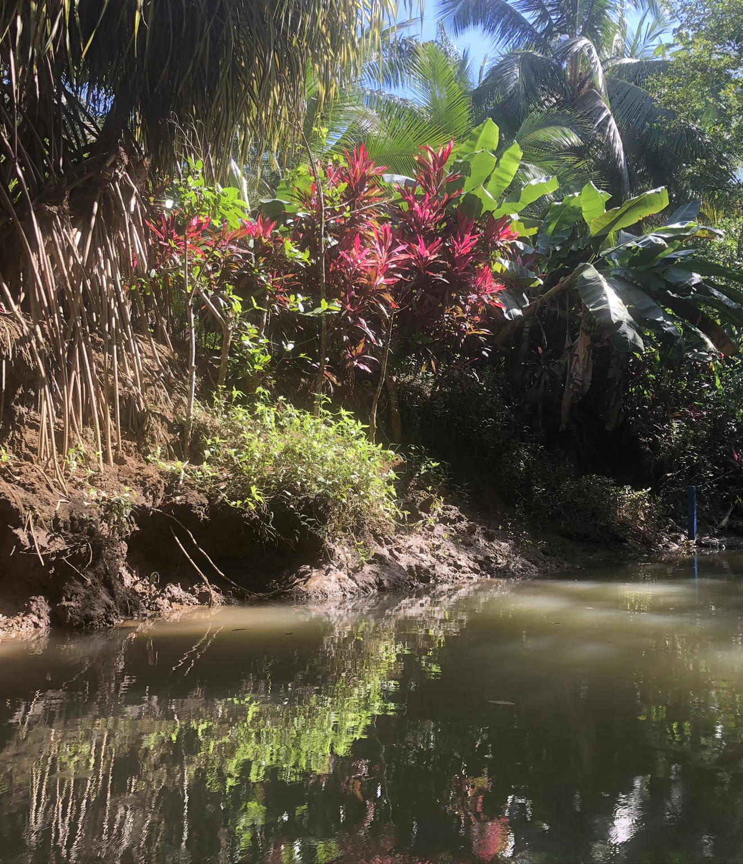
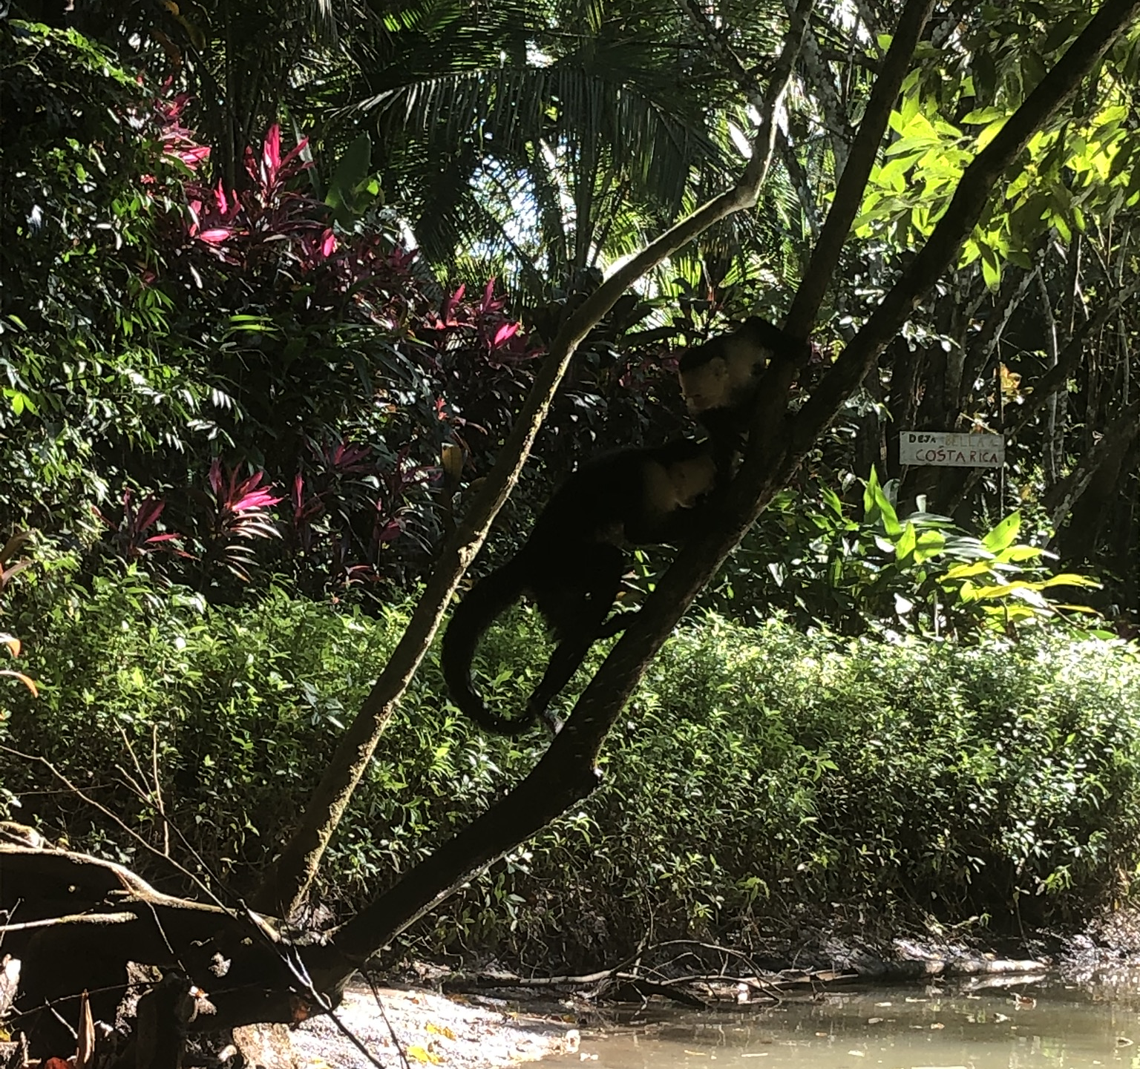
Sustainability and Growth: The Mangroves of Costa Rica
Kylie Stewart Winter Session 2020

Slide 2
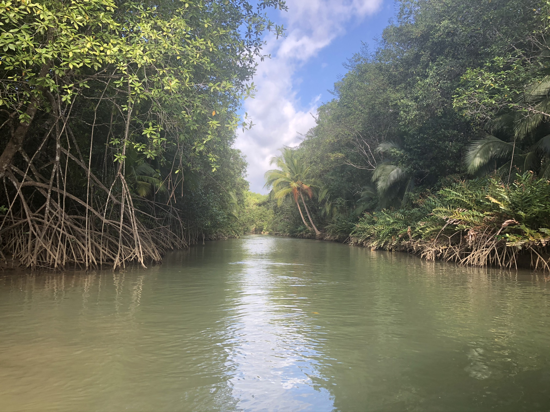
What is a Mangrove?
Dense, biodiverse forest that grows on coastlines
Brackish water
Found in warm, humid climates
Defined as both a plant species and an environment
Plants are flooded during high tides, at least partially submerged

Slide 3
What Lives Within a Mangrove?
Algae, barnacles, mollusks
Crabs
Birds
Fish
Capuchins
Other mammals and amphibians

Slide 4
Why are Mangroves Important?
Detritus
Oxygen production
Water filtration
Aquaculture
Lumber
Coastal protection during storms

Slide 5
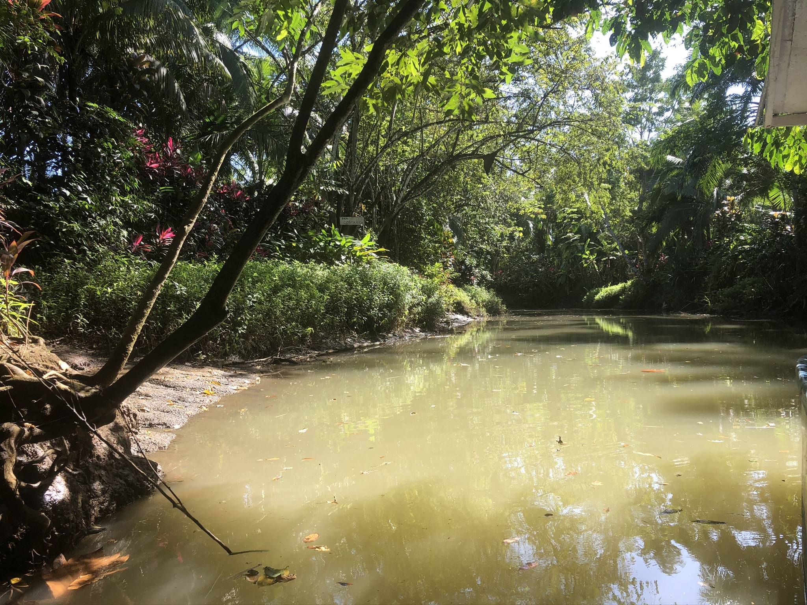
Why are Mangroves Endangered?
Overfishing
Water pollution
Deforestation
Climate Change

Slide 6
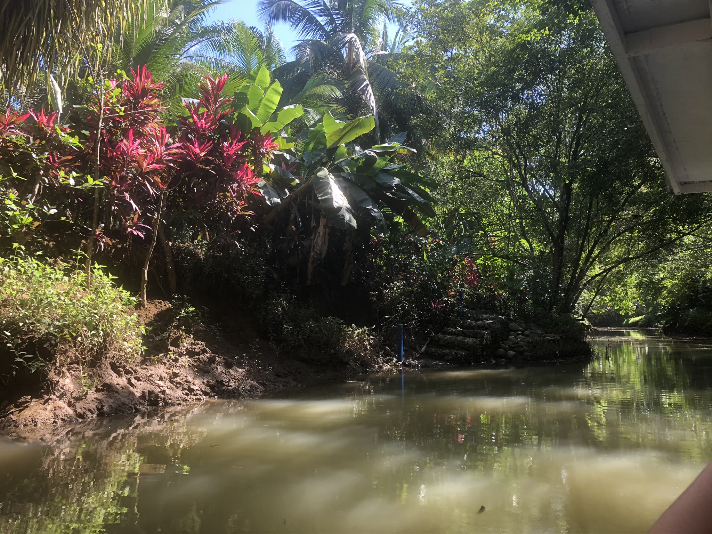
Costa Rican Mangrove Protection
Environmental policy
Cutting trees, fallen trees
Pollution prevention
National parks and protected areas
Manuel Antonio
80 protected mangroves
Ecotourism
Mangrove tours
Education

Slide 7
Mangroves in the United States
Not as extensive as Costa Rican mangroves
Found along Gulf Coast
Primarily swamps
Preservation:
Mangrove Trimming and Preservation Act
Replanting lost mangrove trees

Slide 8
Differences in Conservation Strategies
Culture
Costa Rica more focused on environmental education
Tourism large part of Costa Rican economy
Legal System
Difficulty passing environmental protection policies in the United States
Habitat destruction considered unethical in Costa Rica
Environment
Mangroves represent smaller portion of United States’ land
Swamp-like mangroves less appreciated than tropical ones

Slide 9
The Future of Mangroves
Rapidly disappearing
Domino effect
Recovery can continue
Passing more environmentally-focused laws
Education
Pollution reduction

Slide 10
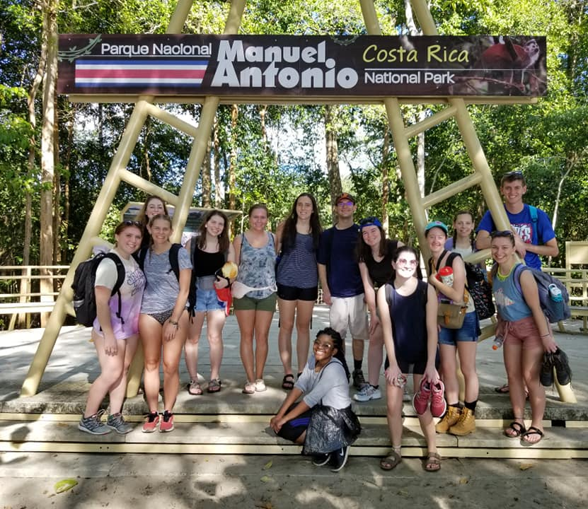
Enriching a Global Education
Hands-on experience and learning about another culture
Studying a new, previously unheard-of topic
Learning about differing environmental policies and implications

