Slide 1
Exploration of the Ongoing Success in Protecting Biodiversity in Costa Rica
Katherine Marita & Payton Rohrer

Slide 2
Project Itinerary
Phase I: Alajuela Province & Costa Rica Animal Rescue Center (CRARC)
Phase II: Sustainability along the Central Pacific Coast
Phase III: Indigenous Communities and Cultures in the Southwestern Pacific
Phase IV: Central Highlands and the Central Valley

Slide 3
Environmental Agencies
MINAE
Considered the first
SINAC
Division of MINAE
IUCN
International

Slide 4
Tenets of Environmental Legislation
Important actions:
National parks system
Debt reduction through land conservation
Ecotourism development
Sustainable forestry practices
Government and industry collaboration

Slide 5
What is a Protected Area?
National park
Indigenous land reserves
Refuges
Reserves
Corridors

Slide 6
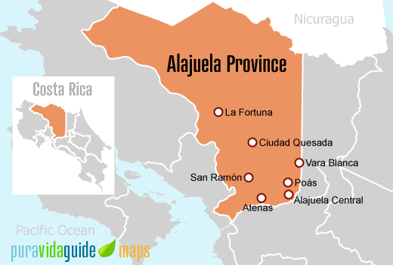
Phase I: Alajuela Province and the Costa Rica Animal Rescue Center
Specific Phase Focuses:
Community-Based Service Learning
Lecture on the Future Sustainability and Animal Welfare in Costa Rica
Manuel Antonio National Park
Vulcan Irazú

Slide 7
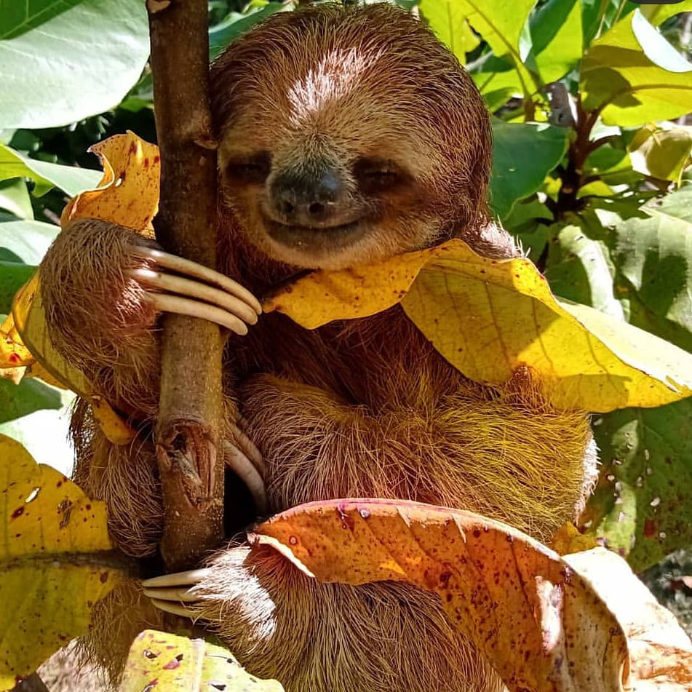
CRARC 1. Service Learning 2. Sustainability and Animal Welfare
Volunteer-based
Mission: to lead change for animal welfare and sustainable human coexistence with wildlife
Dr. Andres Perez lecture
“biodiversity bomb”
Wildlife Conservation Law 7317

Slide 8
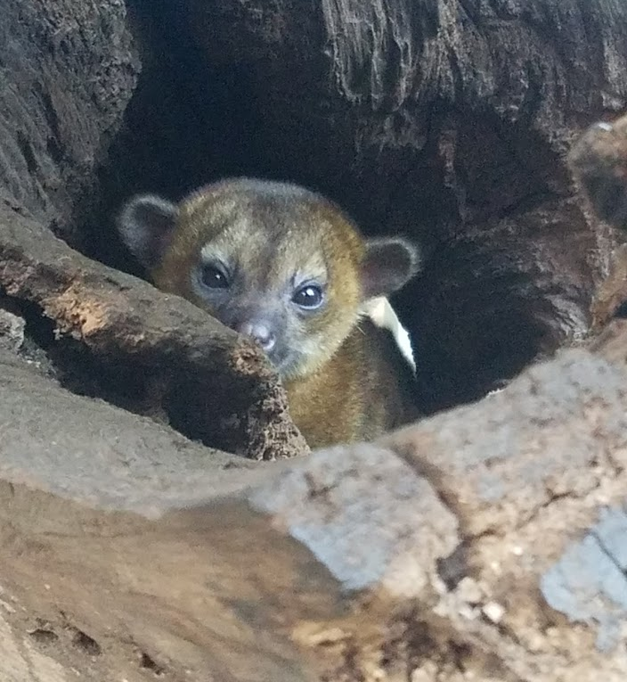
CRARC - Animal Documentation
Kinkajous
White-tailed deer
Raccoons
Monkeys (white-faced capuchin, howler, spider)
Bird variety (green and scarlet macaws, parakeets, parrots, ect.)
Two- / three-toed sloths
Peccary
Coati
Porcupine
Fer-de-lance snakes

Slide 9
Manuel Antonio National Park
Wildlife observations
5% of the world’s biodiversity
Government-issued land protections
28% landmass protected
Tourist – animal interactions
Pathways
Food restrictions

Slide 10
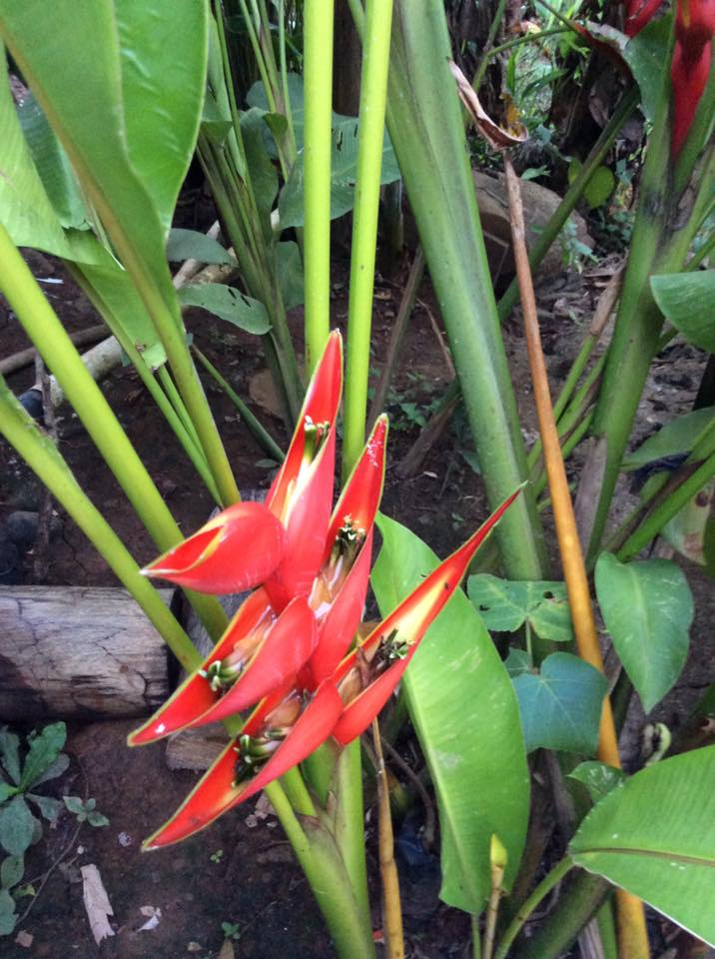
Phase II: Sustainability along the Central Pacific Coast
Specific Phase Focuses:
Crocodile habitat in Rio Tárcoles
Turtle conservation at Playa Hermosa
Reforestation lecture at Palo Seco mangrove swamp

Slide 11
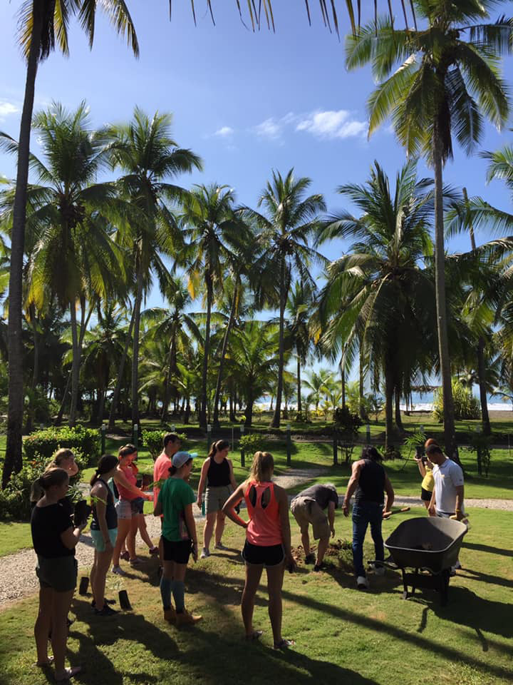
Reforestation – Palo Seco
Mangrove Importance
Vegetation covering tropical region coastlines
20+ tree species
Resist rotting
Prevent flooding damage
House hundreds of bird, fish, and invertebrate species

Slide 12
Mangroves
Essential to combat climate change
1% of mangroves are destroyed each year
National Wetlands Plan (2017)
Ecotourism
Education
Funds for restoration and protection

Slide 13
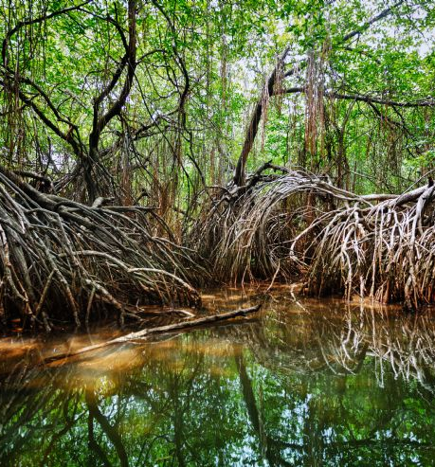
Palo Seco Cont.
Mangrove Threats
Misuse of coastal resources
Irrigation / land use of freshwater
Decrease in rivers / creeks
Increase in dumping waste

Slide 14
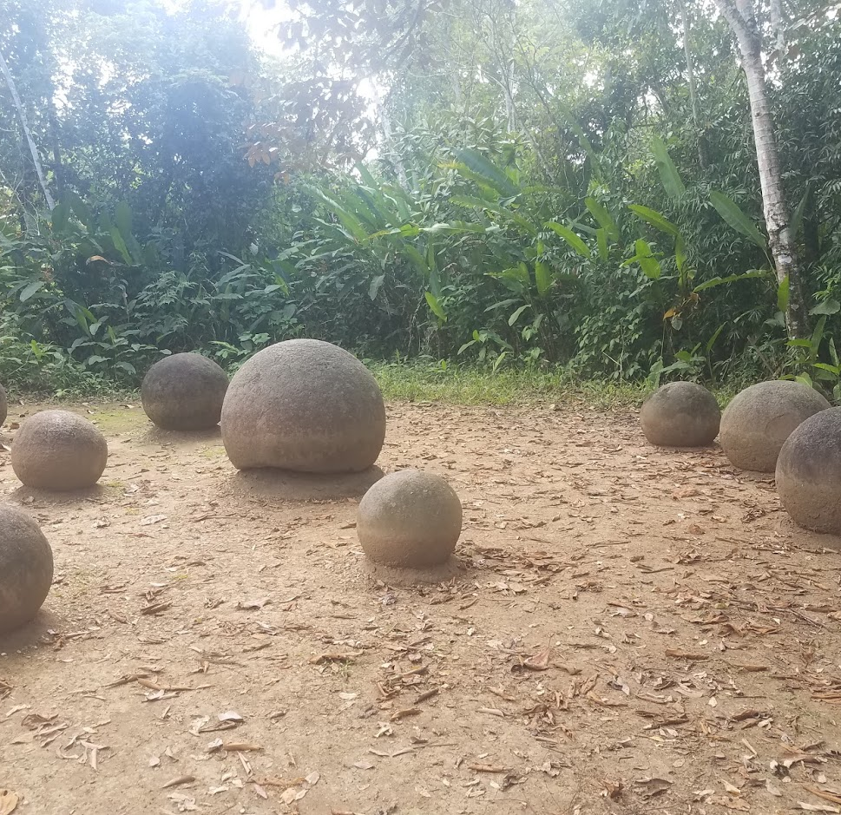
Phase III: Indigenous Communities and Cultures in the Southwestern Pacific
Specific Phase Focuses:
UNESCO World Heritage Site – Pre-Columbian spheres
Golfito ecotourism and sustainability lecture – University of Costa Rica
Cultural heritage lecture with Térraba indigenous tribe

Slide 15
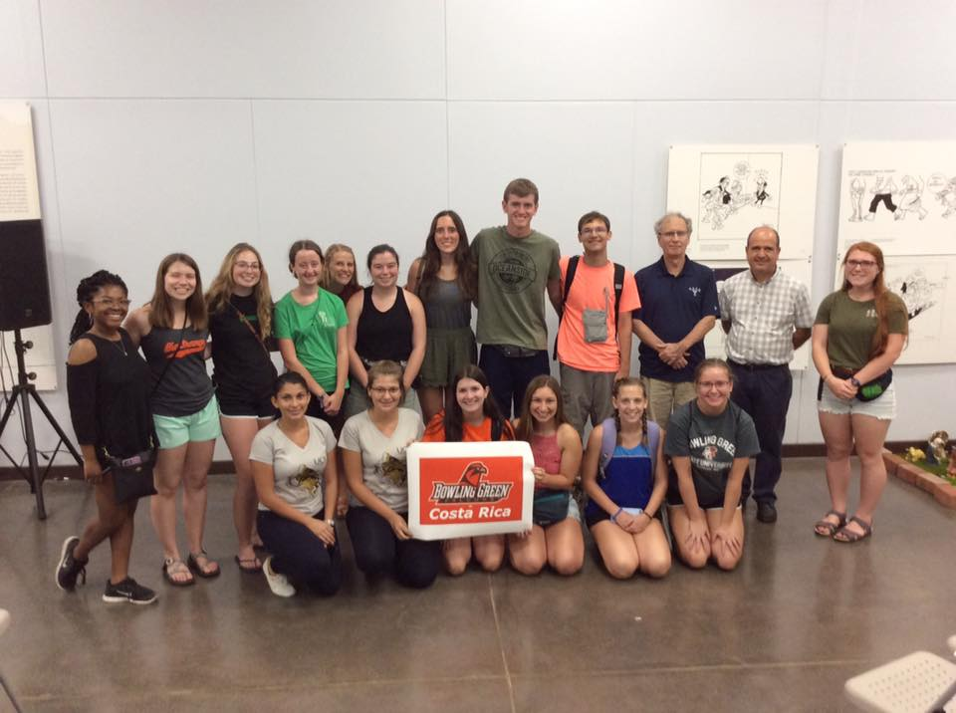
Golfito – Ecotourism
“Nature – oriented travel”
Costa Rica is the most visited country in Central America
Tourism is a huge source of revenue

Slide 16
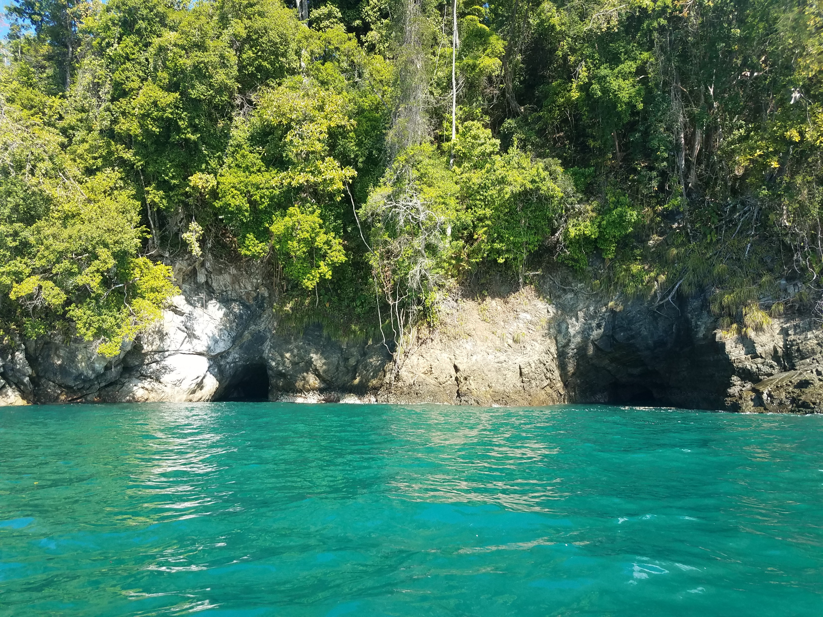
Sustainability Connection to Ecotourism
Pairs economic benefit with environmental improvement
Revenue used for park management, wildlife protection, and sustainability efforts
Protect tourist areas: beaches, rainforests, mountains, and national parks
Other sources of less sustainable income become secondary to tourism
Agriculture, lumber, cattle ranching, and oil palm plantations
Decrease in deforestation

Slide 17
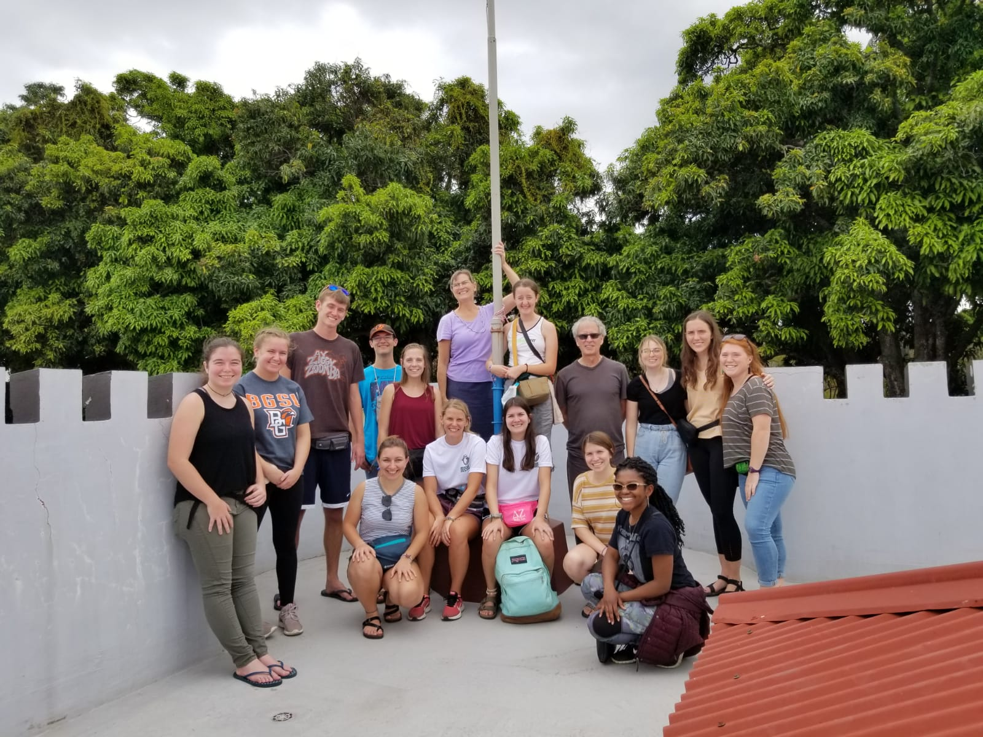
Phase IV: Central Valley and the Central Highlands
Specific Phase Focuses:
Orosi Valley
Alajuela historical city walking tour

Slide 18
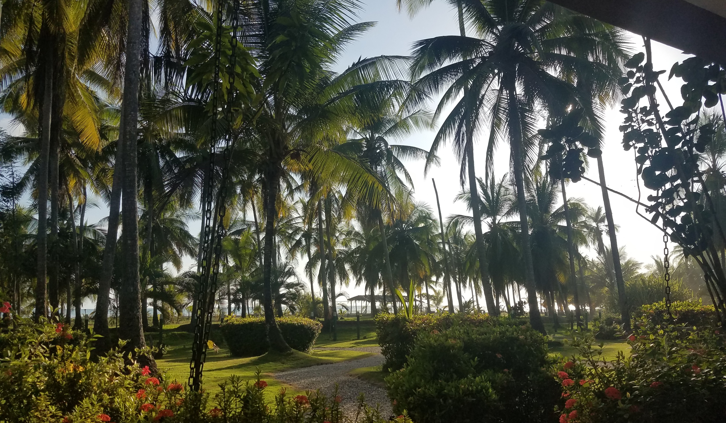
Conclusions
Costa Rica serves as a global example of strides in sustainability and animal protection
Explored the importance of biodiversity and means of protection
Hands-on experience

