Slide 1
Trends in Ceramic Colorants and the Firing Process
By: Emma Robinson
Funding Provided by the Center for Undergraduate Research

Slide 2
Background Information
Mason Stains are commonly used pigments that can be added to a liquid base medium such as slip, glaze, and washes. They are used to achieve complex colors in surface design.
When ﬁred in high temperatures, the colorants are often lost or greatly altered from the intended results. In order to understand why these variants occur and how they can be prevented, this research investigates a variety of factors which inﬂuence the ﬁnal pigmentation. These factors include: when the stains are applied and how, what kinds of clay they are applied to, how strong the percentage of pigmentation present is, and how diﬀerent ﬁring processes change the resulting pigmentation.

Slide 3
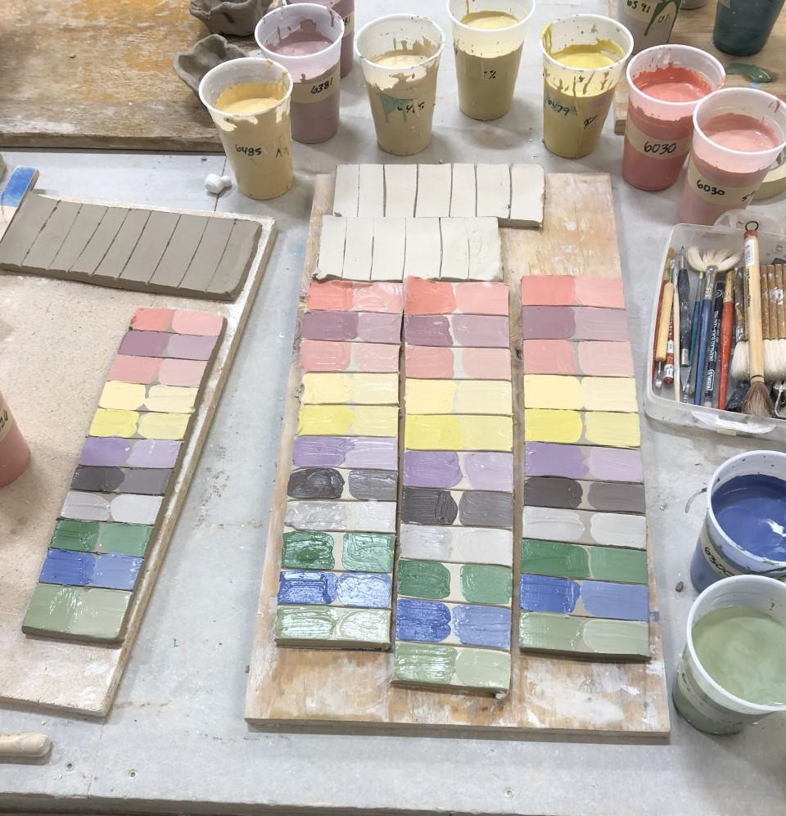
Testing
To begin testing, I obtained twenty diﬀerent colors of mason stains. The stains were then added to a base of 500 grams of white slip at both 5% and 15% percent.
The tests were then applied to two types of clay (porcelain and stoneware)while the clay was still wet using a brush. The tests were then left to dry, bisqued to cone 04 (1750 Degrees F), and later ﬁred in a gas, wood, and salt kiln.

Slide 4
Wood Kiln
The wood kiln is the most lengthy ﬁring process, averaging a total ﬁring curve of about 75 hours. The kiln is fairly unpredictable due to the fuel source. The kiln is fueled using wood, which contains the widest variety of elements that impact the reduction process. Firing with wood introduces a multitude of chemical elements into the atmosphere that interact with the elements present in the clay body and the glazes and slips present.
The wood kiln is one of the least predictable environments for colorants to be tested. The tests that resulted from the ﬁring contained the highest level of burnout across the board. Tests at 5% percent were the least likely to hold their pigmentation through the ﬁring process. Tests at 15% tended to yield better results, but the resulting colors tended to be quite diﬀerent than the original predicted color.

Slide 5
Gas Kiln
The gas kiln has a short ﬁring curve of about 24 hours. Typically, gas ﬁred kilns yield the most consistent glaze results when ﬁred correctly. There is limited crystalline growth compared to atmospheric ﬁrings such as the wood kiln. The colorants tend to burn out at a far lesser rate than any other ﬁring process that was tested. The pigmentation stayed the most true to its original bisque ﬁred colors and maintained its pigmentation more consistently at the lower 5% concentration. Additionally, the 15% color concentrations yielded the most pigmentation overall.

Slide 6
Salt Kiln
The salt kiln had the median length of ﬁring curve at about 40 hours. The main diﬀerence between the gas ﬁred kiln and the salt kiln is the addition of sodium to the kiln. The salt kiln follows a similar pattern to the wood kiln, allowing for more volatile interactions between elements and changing the attributes of glazes and other colorants more drastically with less predictability than the gas kiln.
The salt kiln yields more consistent results than the wood-kiln, but allows for a wider variety in characteristics than the gas kiln. The tests from the salt kiln tended to darken in pigmentation and followed a similar pattern of burn out that the gas kiln did.

Slide 7
Additional Tests
For the ﬁnal round of tests, I wanted to ﬁgure out a way to apply the slip to the clay body following the bisque ﬁring. Traditionally, slips do not contain enough ﬂux to stick to the clay body in its greenware, or bisqueware state. However, I found that if I added 10% of a clear powdered cone 6 glaze, with the addition of two tablespoons of CMC solution to the remaining 500 gram batches of colored slip, the slip maintained its liquid consistency long enough to absorb and to bond to the bisqued surface.
Therefore, another round of testing was needed to explore the eﬀects the addition of new materials would have on the ﬁnal pigmentations.

Slide 8
Additional Tests
Once the additional materials were added, another layer of complexity was added to the pigments. The pigments were again painted on, this time onto bisque wares. Once the slip was dried to the wares, for every stain color, eight diﬀerent glazes were brushed overtop the stain and ﬁred in a salt kiln. Thus, revealing not only how the stains themselves would look, but also how the pigments interacted with commonly used glazes to further enhance the research and its applicability to surface design.

Slide 9
Results
In total, over four hundred combinations of glazes and colorants were tested under four separate ﬁring conditions and each were applied on both stoneware and porcelain clay bodies. The most consistent and cleanest pigmentation was found using porcelain clay bodies. The stoneware typically yielded darker, browner hues. Likely caused by the higher content of iron found in the stoneware clay body.

Slide 10
Conclusions
In conclusion, the results of the described testing will aide the ceramic community in a multitude of ways. It resulted in over four hundred documented combinations of commonly used pigments and how they look once ﬁred in four types of kilns. The addition of a second round of tests opened up new ways to approach when and how these slips and colorants can be applied to ceramic wares. To me personally, this work will greatly aid my own understanding of color theory and how colors can be used to manipulate surface under diﬀerent circumstances. Additionally, it allowed me to fully explore a variety of processes that can be used to add sophistication to my approach to surface design. The knowledge will help others to more accurately predict how diﬀerent colorants will change in appearance and physical properties under a variety of circumstances.

Slide 11
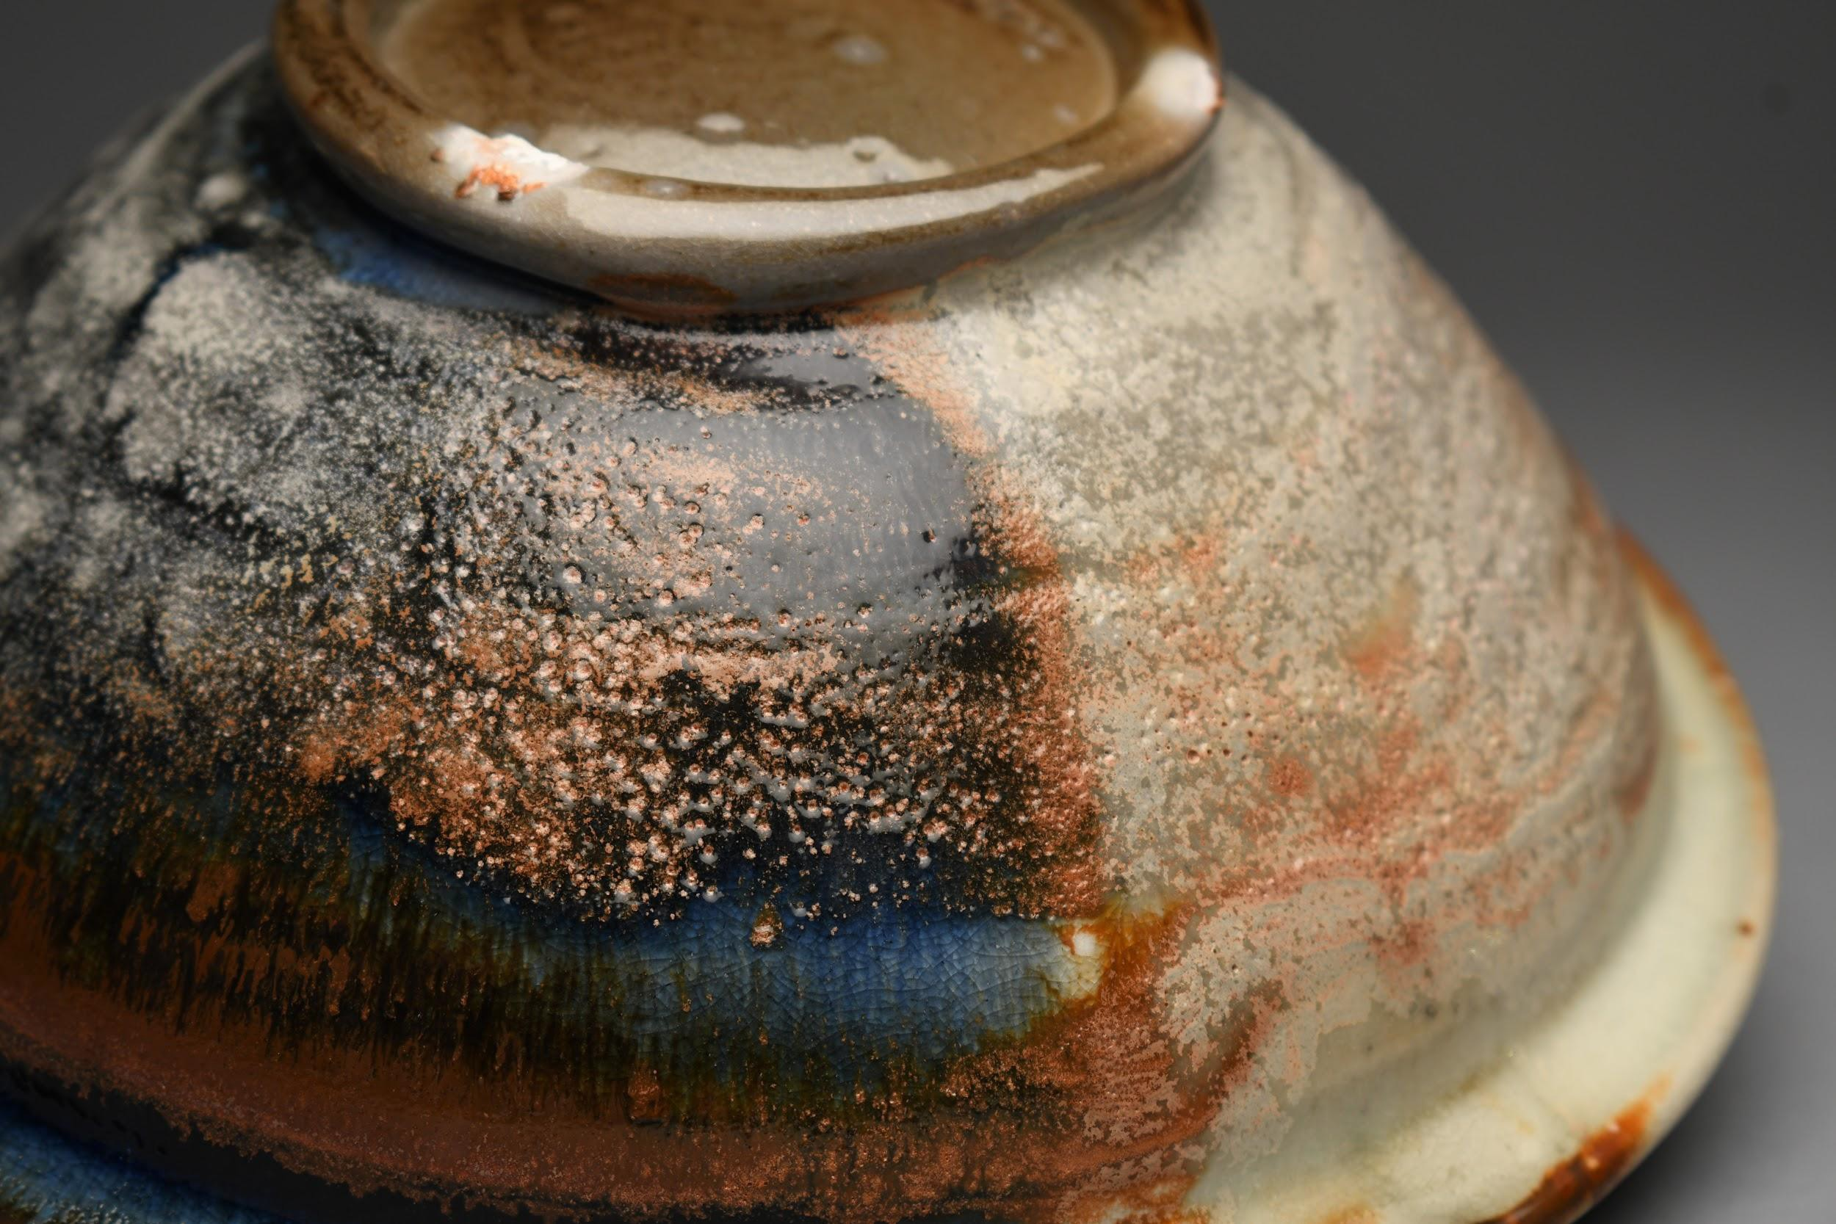
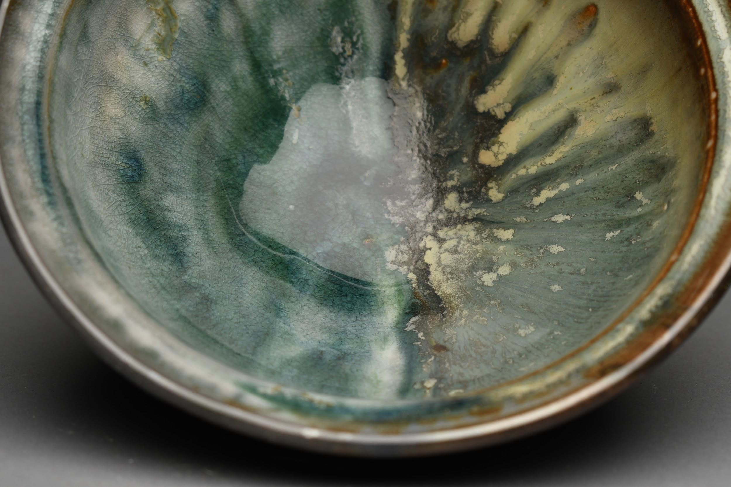
Results
Test #68 and #70 ﬁred in salt kiln

Slide 12
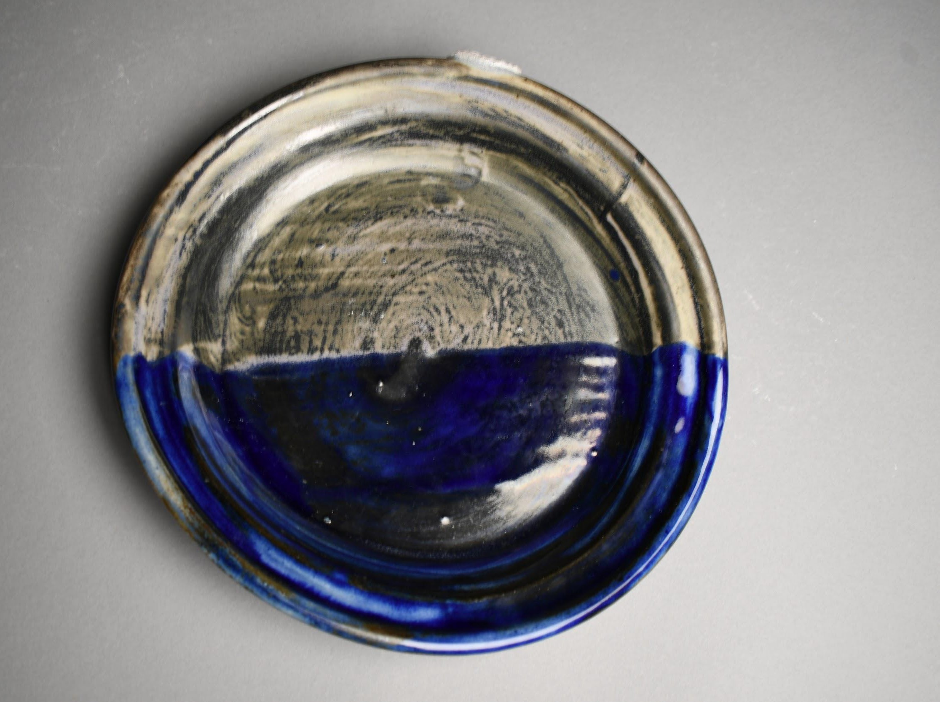
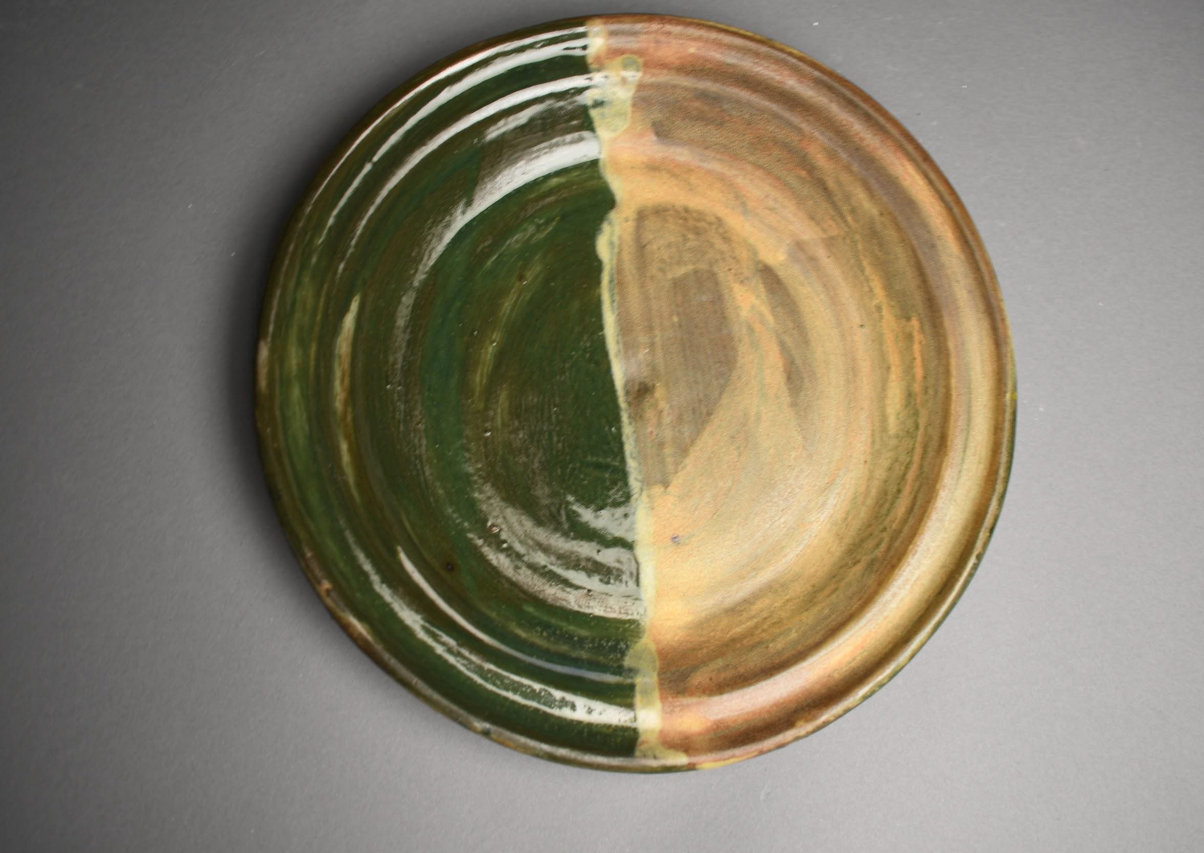
Results
Tests #24 and #25 ﬁred in salt kiln

Slide 13
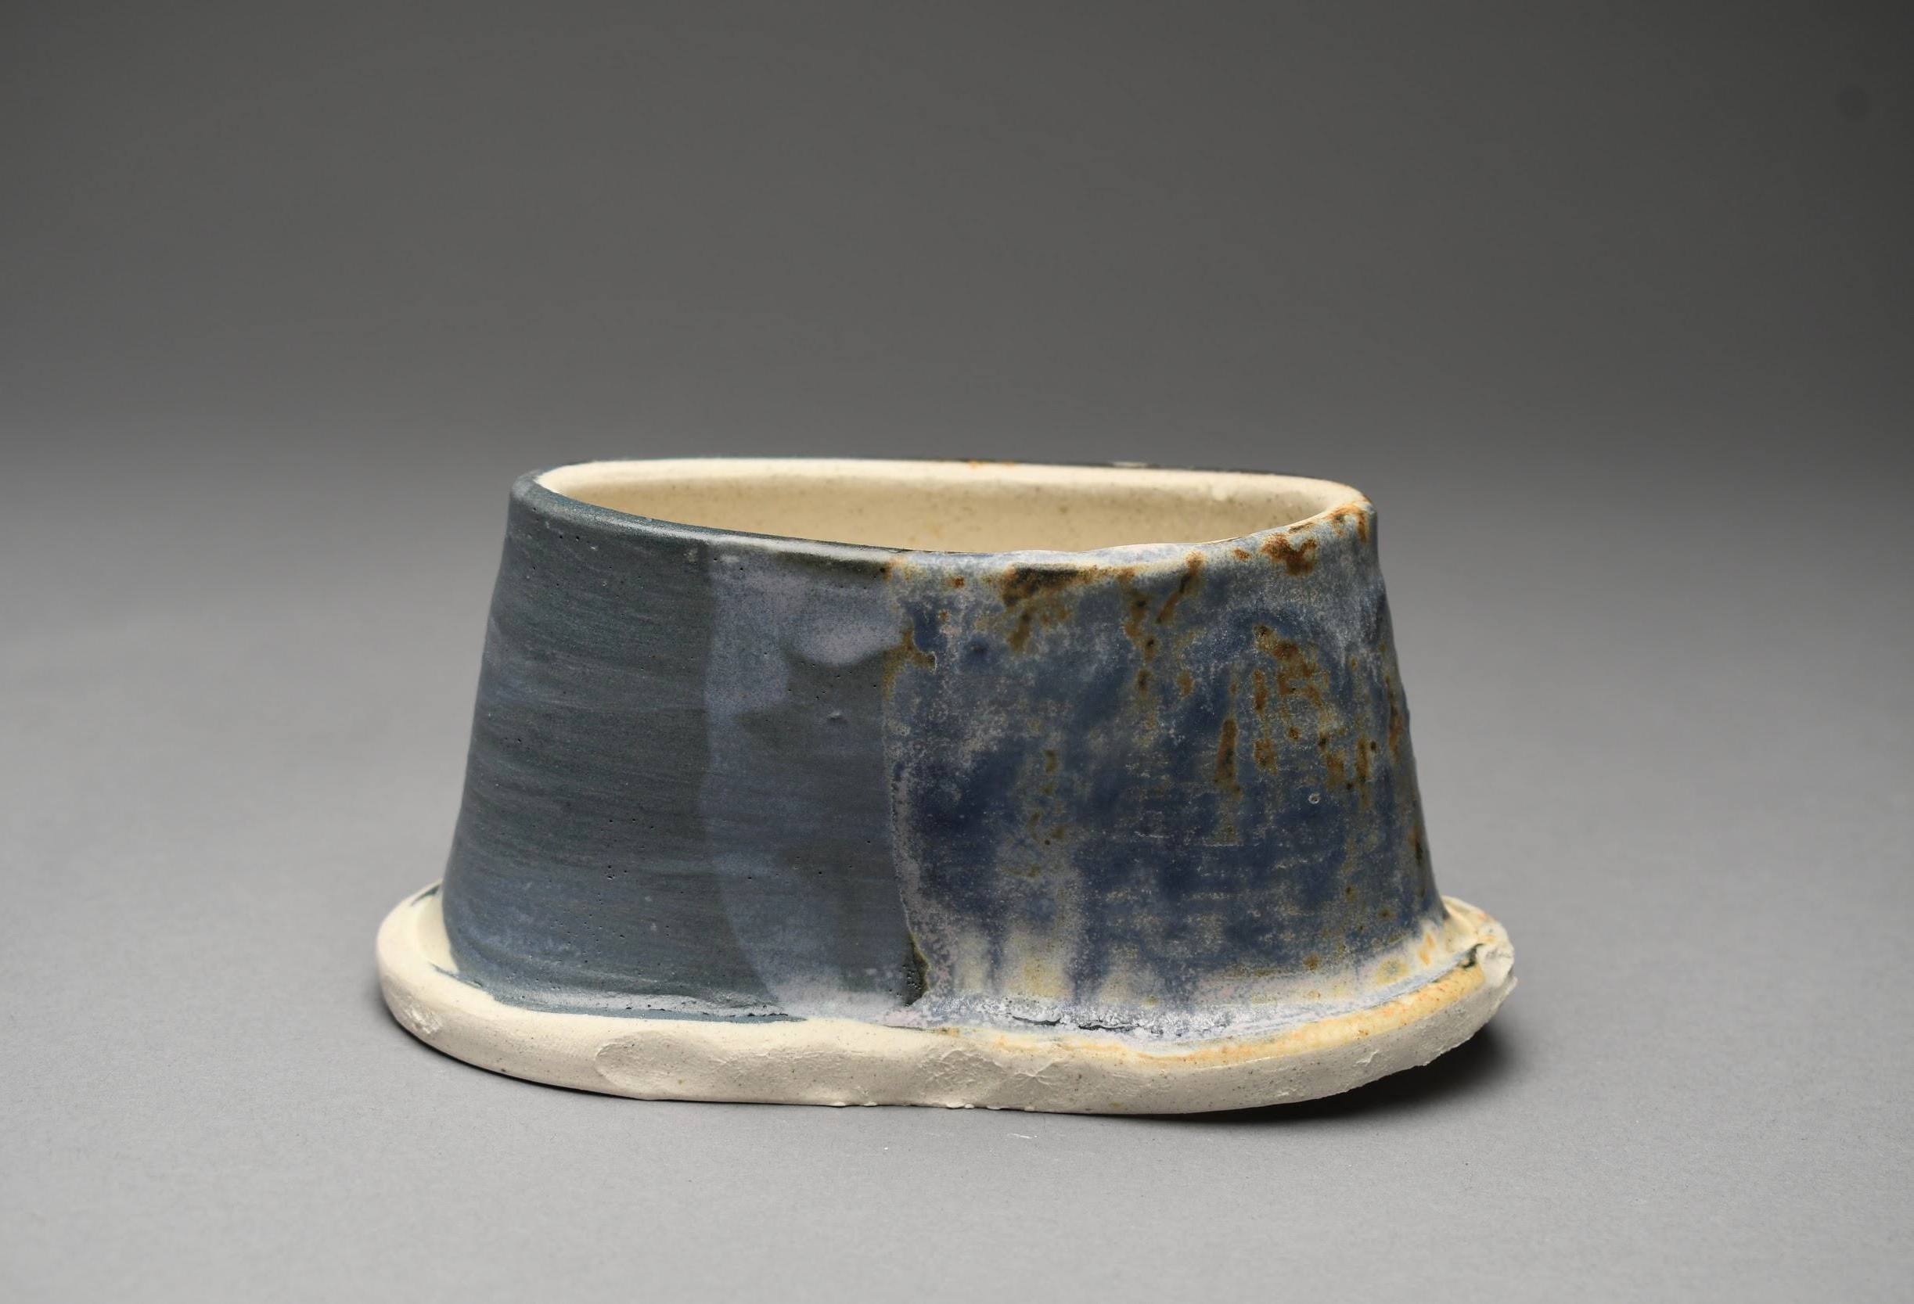
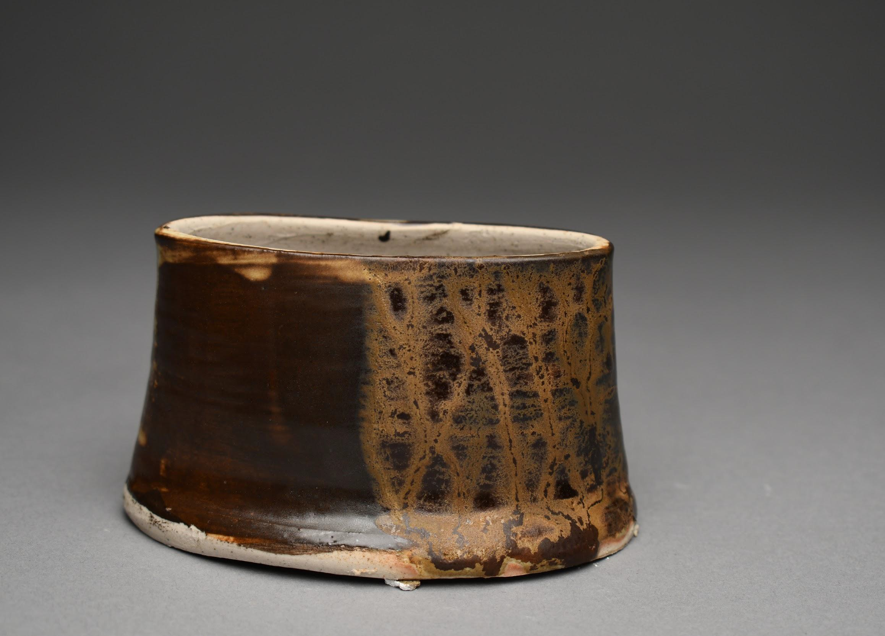
Results
Tests #101 and #104 ﬁred in wood kiln

