Slide 1
Meander: An Evening Adrift
Stephanie Childers

Slide 2
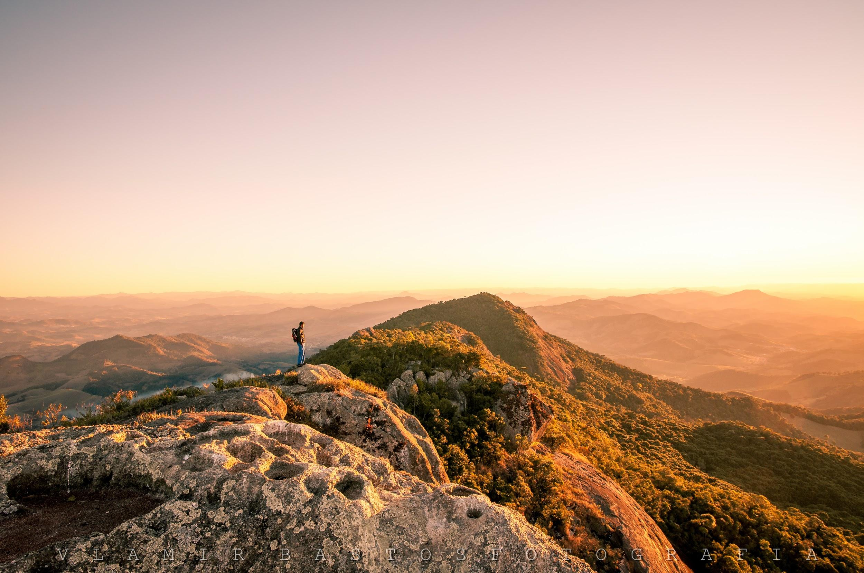
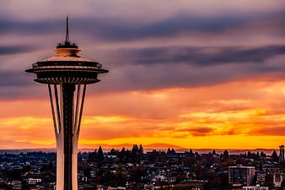
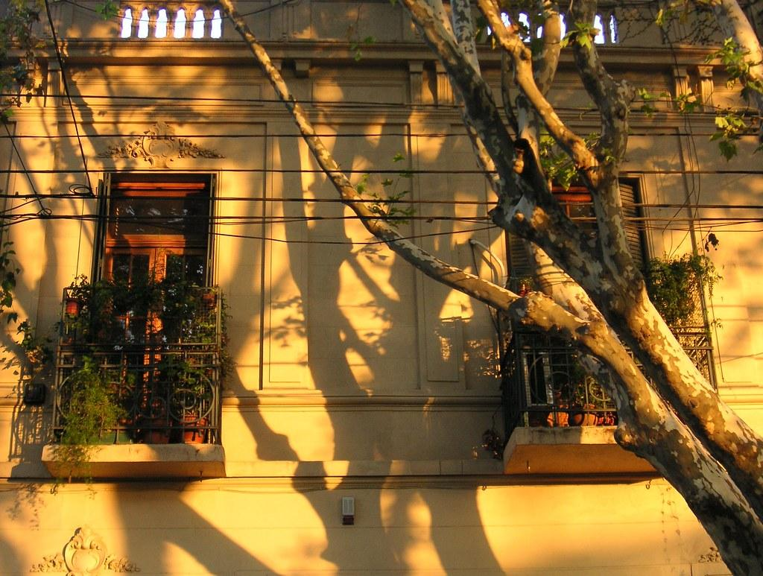
Introduction
An immersive video installation and animation environment modeled in Autodesk Maya and captured in Unreal Engine 4
Golden Hour examples:
*images are taken from Creative Commons and labeled for free reuse.

Slide 3
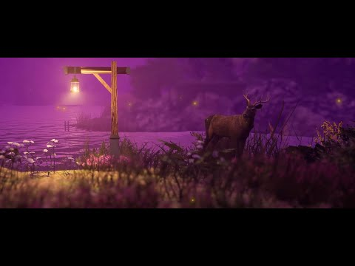

Slide 4
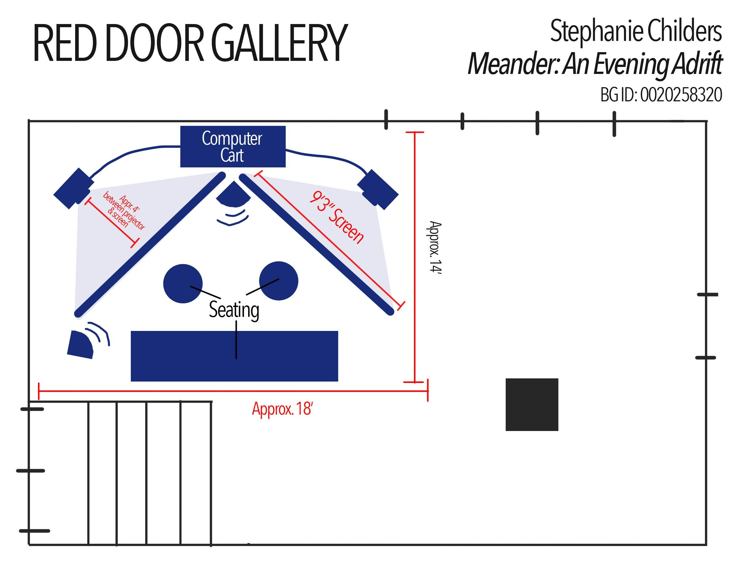
Due to COVID-19
The plan for installation if I had been able to install it.
Other decorations included fake plants and shrubbery, cushions made to look like stumps, and nature scent diffusers.

Slide 6
Behind Meander
Golden hour
Liminal states
Examples: Marriage, graduation, golden hour, seasons, etc.
Using a liminal state as the timeframe of the piece and then putting it into a looping format further emphasizes the fragility of these states while also engaging us in a conversation about escapism and the potential of natural phenomena that can act as pleasant distractions.

Slide 7
Conclusion
Despite challenges of COVID-19, Meander: An Evening Adrift successfully explores topics of escapism, liminal states, and meditation by taking an animated environment and bringing it into a real space by installing it.
Thank you for your time.

