Slide 1
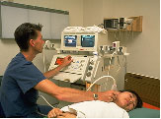
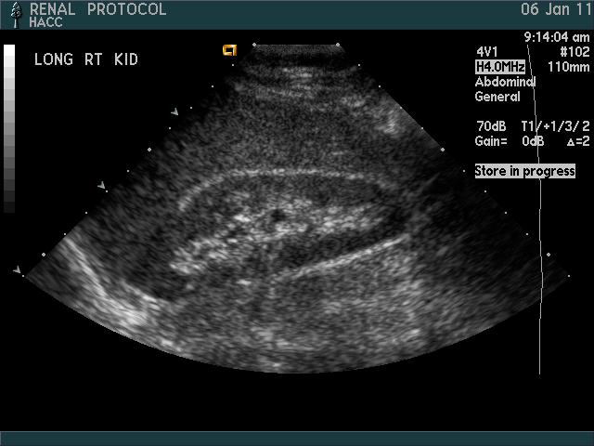
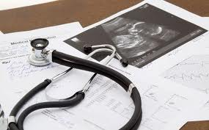

DIAGNOSTIC MEDICAL SONOGRAPHY

Slide 2
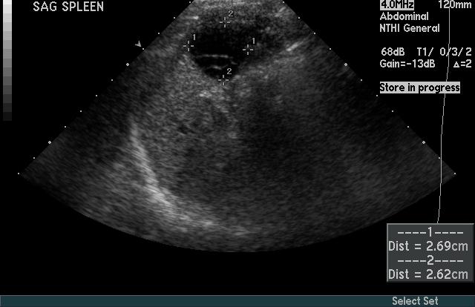
DUTIES OF A SONOGRAPHER
Perform procedure to obtain diagnostic images to be read by a physician

Slide 3
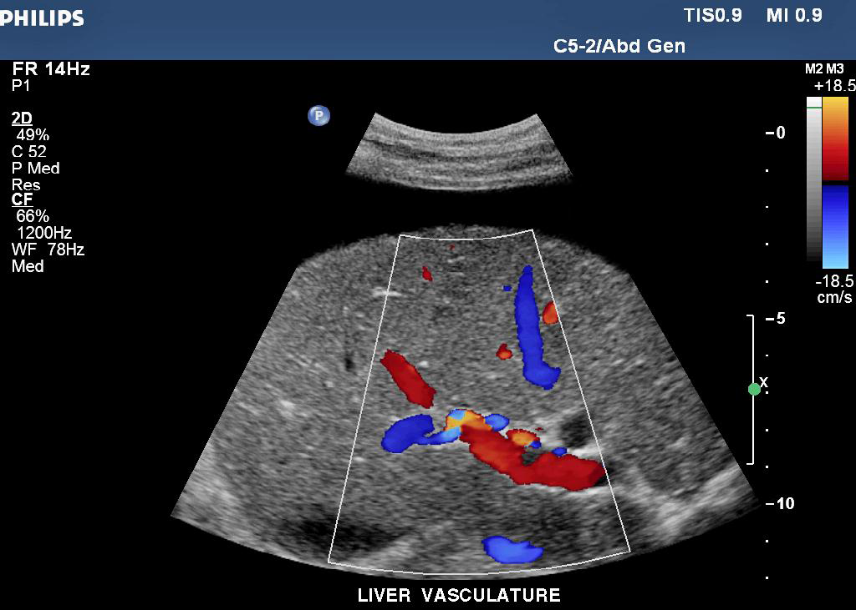
DUTIES OF A SONOGRAPHER
Use critical thinking skills to acquire the optimal diagnostic image

Slide 4
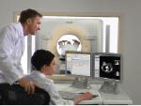
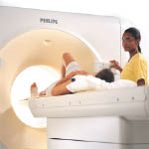
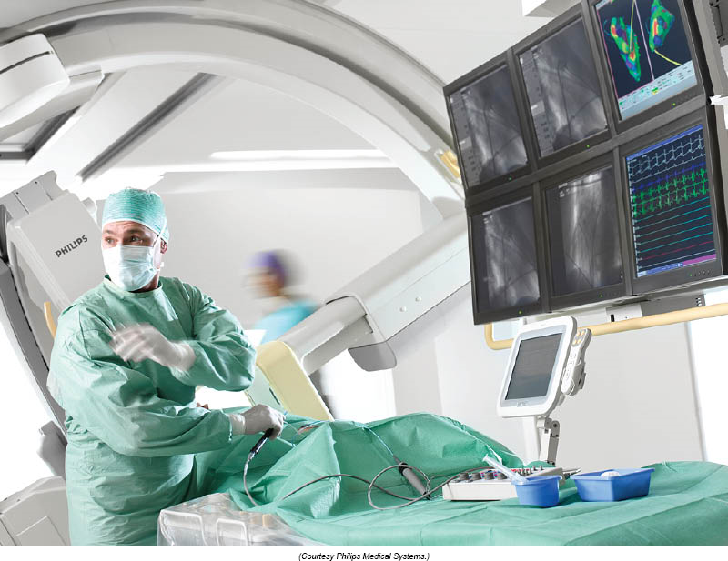
DMS CAREER
Part of the Imaging/ Radiology Department Team

Slide 5
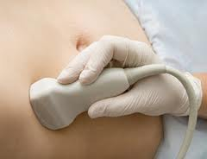
DMS CAREER
• Hospitals
• Imaging centers
• Application Specialist
• Systems Sales
• Education

Slide 6
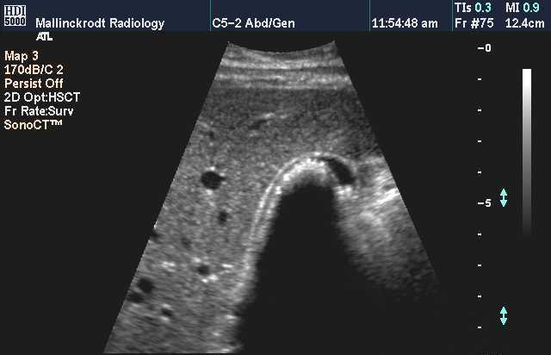
DUTIES OF A SONOGRAPHER
The sonographer needs to have the knowledge base regarding the abdomen to understand pathology and to describe what is seen and give an impression.
Description: echogenic area with shadowing filling the gallbladder lumen
Impression:
cholelithiasis

Slide 7
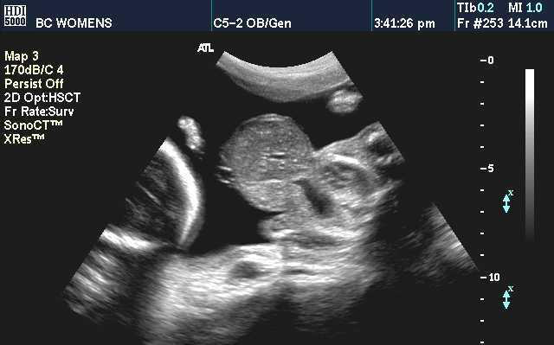
DUTIES OF A SONOGRAPHER
The sonographer needs to have the knowledge base regarding the fetus to understand pathology and to describe what is seen and give an impression.
Description: anterior abdominal wall mass
Impression:
omphalocele

Slide 8
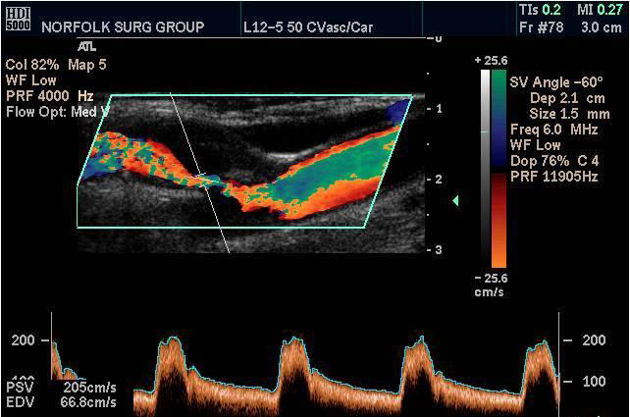
The sonographer needs to have the knowledge base regarding vascular structures to understand pathology and to describe what is seen and give an impression
Description: turbulent flow with increased velocity in the ICA
Impression:
ICA stenosis

Slide 9
KNOWLEDGE , APPLICATION
AND ANALYSIS
The general sonographer must understand the anatomy, pathology, physiology and sonographic appearance , both normal and abnormal of the following:
Abdominal vessels, Liver
Gallbladder and Biliary tract, Pancreas
Urinary system, Retroperitoneum
Spleen, GI track

Slide 10
KNOWLEDGE , APPLICATION
AND ANALYSIS
The general sonographer must understand the anatomy, pathology, physiology, and sonographic appearance, both normal and abnormal of the following :
Scrotum, Prostate, Thyroid
Neonatal head, hips, and spine
Breast, Uterus, Ovaries, and Adnexa

Slide 11
KNOWLEDGE , APPLICATION
AND ANALYSIS
The general sonographer must understand the
Obstetrical details:
normal and complications of characteristics pregnancy
Obstetrical measurements, Fetal Growth Assessment
High Risk Pregnancy, Congenital Anomalies

Slide 12
KNOWLEDGE , APPLICATION
AND ANALYSIS
The general sonographer must understand the Sonographic Principles and Instrumentation:
Sound and Ultrasound
Transducers and Instruments
Doppler
Artifacts
Performance
Safety

Slide 13
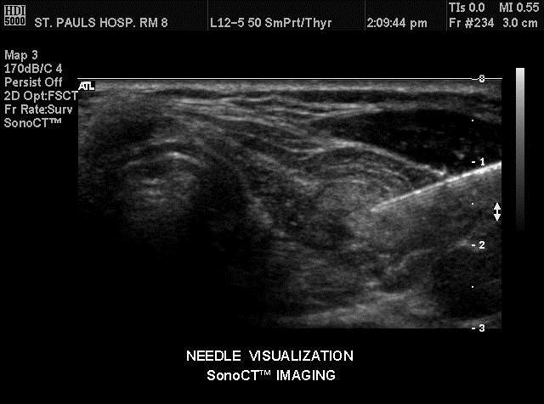
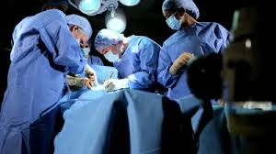
DID YOU KNOW THAT
SONOGRAPHERS assist with biopsies

Slide 14
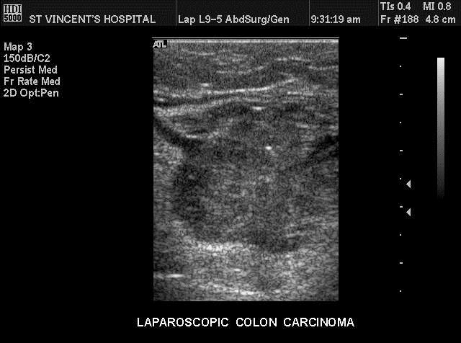
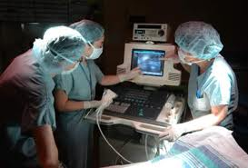
DID YOU KNOW THAT SONOGRAPHERS ASSIST IN THE OR ?

Slide 15
ULTRASOUND PROCEDURES PERFORMED
BY A PHYSICIAN WITH THE SONOGRAPHER
ASSISTING:
Thyroid biopsy
Breast biopsy
Breast cyst aspiration
Prostate
Amniocentesis
Thoracentesis
Paracentesis

Slide 16
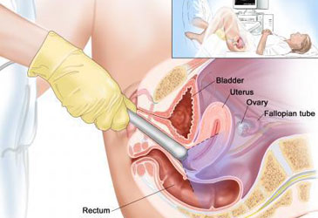
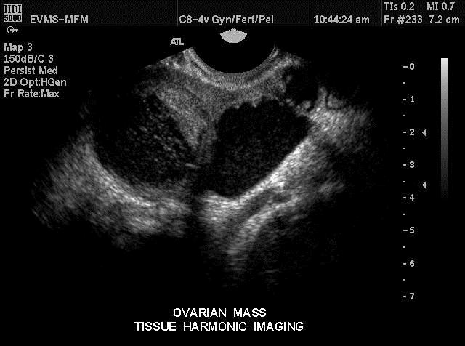
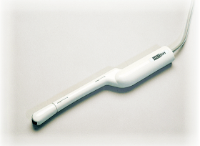
DID YOU KNOW THAT SONOGRAPHERS
perform transvaginal imaging ?

Slide 17
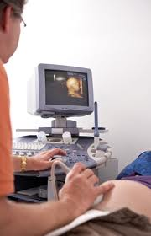
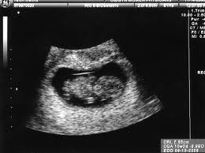
DID YOU KNOW THAT SONOGRAPHERS
• provide quality patient care
• serve the patient community

Slide 18
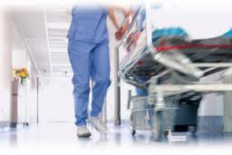
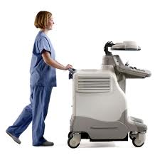
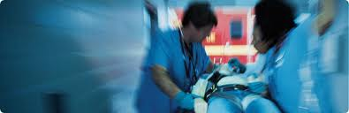
DID YOU KNOW THAT SONOGRAPHERS
have Physical Demands

Slide 19


DID YOU KNOW THAT SONOGRAPHERS
deal with
• Stressful Situations
• Frustration
• Personnel/personality
issues

Slide 20


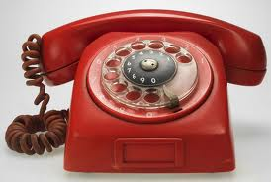
DMS CAREER
Day shift
Evening shift
Night shift
On call
Weekends
Holidays

Slide 21
Technical Standards
To participate in the clinical education portion of the Sonography program, the applicant must possess additional non-academic skills. These technical standards are consistent with the duties of the entry-level sonographer in a professional position. The applicant must have the ability to:

Slide 22
Technical Standards
Lift and carry 50 pounds of weight.
Lift and transfer patients to and from wheelchairs, stretchers, beds, and imaging tables.
Move, adjust, and manipulate equipment to perform imaging studies.
Position patients for exams.
Respond appropriately to sounds such as the patient’s voice and movements at a normal conversational volume.
Review and evaluate recorded real-time images to determine the quality of the image, as well as demonstrate visual accuracy in differentiating among subtle shades of grays used in Diagnostic Medical Sonography.
Respond appropriately to equipment signals such as sound and light.
Manipulate the necessary hospital equipment for patient care and patient imaging, such as dials, switches, push buttons, and keyboards.
Stand and perform ultrasound exams for a prolonged period without breaks in a typical shift of eight hours.
Speak English fluently.
Position a transducer device in a back and forth manner while maintaining balance.
Communicate orally and in writing with patients, doctors, and other personnel; clearly and effectively, and be able to follow verbal and written directions.
Pass a scanning proficiency final in the Hands-On Scanning class before being assigned a clinical rotation.

Slide 23
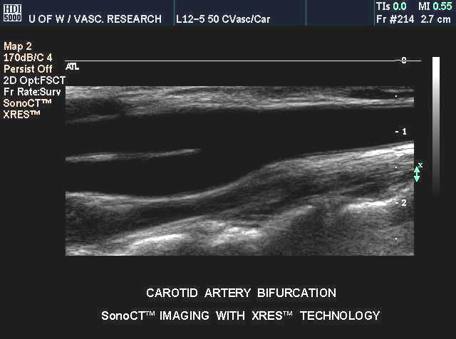
The BGSU DMS program is a general sonography program which also covers an Vascular sonography:
Extracranial cerebrovascular
Peripheral arterial
Peripheral venous
Hemodynamics
Doppler

Slide 24

DMS CAREER
DMS CREDENTIALS
ARDMS
• ABDOMEN/Sm. Parts
• OBSTETRICS & GYNECOLOGY
• SONOGRAPHY PRINCIPLES & INSTRUMENTATION www.ARDMS.org

Slide 25
DMS CAREER
Salary in our area:
Range- 22.00 to 26.00 an hour or for full time 45,760.00 -54,080.00
Yearly raises may or may not be given

Slide 26
Program Time commitment
First semester yr 1: 2 full days of classes and lab /open labs and studying
Second semester yr 1 : 2 full days of classes and lab /open labs and studying: 8 hours clinical time
Summer yr 1 : 1 day of class and lab /open labs and studying and 24 hours of clinical time
First semester yr 2: 1 day of class /open labs and studying and 32 hours of clinical time
Second semester yr 2: 1 day of class and lab /open labs and studying and 32 hours of clinical time
Summer yr 2: 1 day of class /open labs and studying and 24 hours of clinical
(hours subject to change)

Slide 27
Program Time commitment
Sonography program are time consuming
It is recommend to limit your work schedule working may be a challenge for some; balancing work an school schedules will be challenging!
The time commitment will effect your relationships, work, and recreational activities please plan accordingly
If you have children make sure you have adequate child care
These courses are different than you have taken before and will require considerable time commitment

Slide 28
Study time
It is estimated for every credit hour a week 2 hours of study time is needed.
Reading and comprehending is required
It is suggested you review your anatomy before you begin the program if you have not had the material recently
The program assumes you are prepared to cover and expand on material in which anatomy courses have covered.

Slide 29
Clinicals
Are assigned!
You will need to provide transportation
You may need to drive a distance to get to a clinical site
You may have clinicals on Saturdays, evenings, and 12 hour shifts

Slide 30
Application Process
Apply to BGSU Firelands: have all transcripts sent and course evaluated for transfer credit
Apply to Sonography Program Separate application See website for deadline, Obtained online.
Complete 4-8 hours job shadowing and fill out job shadowing form obtain from program director
Attend an information session Must obtain signed sheet! Available at the end of this presentation of at meeting
Volunteer as a patient in the sonography lab (not required) contact program director

Slide 31
Application Process
GPA 2.5 or above to apply
The applications will be evaluated for overall GPA and prerequisites core course grades GPA. Completion of prerequisites must be completed or in progress before the beginning of the sonography program.
Preference given to students who have all support courses completed at application time
If a course is a transfer course and BGSU does not grant equivalent credit the program director can ask for an Academic Board Review of the course.
The college still may not count course toward another degree and it may need to be REPEATED. There is a process to do this allow plenty of time and speak to program director

Slide 32
Application Process
Interviews will be granted to select individuals
Number of interviews granted my vary each year
Selection process completed and notification letters will be sent

Slide 33
Application Process
One class is selected each year
Number of students selected depends on clinical affiliations
No waiting list!
Each year is a new pool of applicants
You must re-apply each year with a NEW application if you do not get selected
Criteria may change from year to year

Slide 34
Pre-requisite courses required
GSW 1120 is required.
MATH 1220, MATH 1150, MATH 1200 or STAT 2000 is required.
*** MATH1210 not a (QL)
AHS (MEDT)3010 or AHTH 1100 medical terminology
BIOL 3310 AND 332o human anatomy and physiology(prefered) or AHTH 1310
PHYS 1010 or 2010 or RADT 1410: Physics

Slide 35
Courses Required
PSYC 1010*(S) General Psychology
COMM 1020 or 3060
AHTH 2300 Pathophysiology or PUBH 3400
A BG elective
AHTH 2400 Cross sectional anatomy
All DMS courses taken while in program

Slide 36
Clearance for Clinical Courses
Background check/fingerprinting
Drug screening completed before entry and may be random
Physical /health screening/current immunizations
TB test each year/ annual Flu shots
CPR training (completed during program)
HIPAA training(completed during program)
Health insurance

Slide 37
Clinical Clearance/ Employment potential
Many healthcare facilities (potential employers) have strict policies regarding employment of individuals with visible body art and body piercings. These healthcare facilities also have strict policies involving employment of individuals who are tobacco users.
No tattoos visible in the standard uniform attire.
No visible body piercings beyond ear piercing.
You must adhere to all clinical affiliation policies.

Slide 38
Background checks
First-Time Applicants must disclose information regarding all previous violations of ARDMS Discipline Policies to the ARDMS with their initial application for examination. All future violations must then be reported to the ARDMS within fourteen (14) business days of the violation incident.

Slide 39
Background checks
If you are presently charged with, or been convicted or found guilty of or plead nolo contendere to any crime (felony and/or misdemeanor), other than a speeding or parking violation, you may have questions concerning this rule and may wish to obtain clarification as to how it pertains to your circumstances.
ARDMS conducts a "pre-application review", for a $125 non-refundable fee, for individuals who wish to determine the impact of a previous criminal matter on their eligibility to apply for ARDMS certification. The pre-application review process is recommended for individuals who have not yet applied for examination and are contemplating employment in the field of sonography and/or enrollment in a sonography program. Individuals who have already completed a program and are ready to apply to the ARDMS for examination should simply respond to the questions on the ARDMS examination application relating to criminal matters and provide the requested documentation regarding such matter(s).
www.ardms.org

Slide 40
Labs
Dedicated lab with live simulations and phantoms
Labs are scheduled along with DMS courses
Open labs are additional and some are required
Time in the lab is essential to your education
Plan on spending practice time in the lab
Practice , Practice, Practice!!!

Slide 41
Computer skills
Basic computer skills are needed: email, research, Canvas
Some assignments require the use of a computer and internet access

Slide 42
Program progression
You must pass each course didactic and clinical rotations with a C average of above to continue in the program
Grading Scale:
100-93 A
92- 85 B
84- 74 C
73-65 D
65-0 F

Slide 43
Extra Fees Estimation
Tuition
Books $1500
Lab supplies estimated $45 / semester
Trajecsys clinical reporting system $150
Scrubs/ shoes $250
Physical/ background/Drug screening $250
Transportation/gas to clinical rotations
SDMS $45
CPR $50
Access to a computer and internet

Slide 44
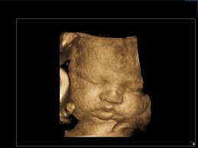
DIAGNOSTIC MEDICAL SONOGRAPHY
A Challenging program awaits you…….. Clinical Rotations
Labs
DMS courses

Slide 45
REMEMBER !!
To be a health care professional you have to elevate your study skills. Students who want to be professionals have to work very hard at their classes, lab and clinical rotations.
This is where you start to become a professional, by learning the necessary knowledge and skills.
Your studies, your time in this program, must be your number ONE priority while you are here.

Slide 46
NOW YOU KNOW...
To be a sonographer you have to put in study time to have the knowledge base to provide the best quality of care for your patients.
You also need the scanning skill…which is very challenging

Slide 47
Accreditation
BGSU is accredited by:
The University is accredited by the Higher Learning Commission and a member of the North Central Association, 30 LaSalle Street, Suite 2400, Chicago, IL 60602-2504, (800) 621-7440.

Slide 48
Programmatic accreditation
The BGSU Firelands College Diagnostic Medical Sonography program is accredited by the Commission on Accreditation of Allied Health Education Programs (www.caahep.org) upon the recommendation of the Joint Review Commission on Education in Diagnostic Medical Sonography.
They can be reached at 25400 US Highway 19 North Suite 158 Clearwater, Florida 33756 or www.caahep.org
727-210-2350

Slide 49
Resources at BGSU
Teaching and Learning center
Financial aid office
Admissions
Student services
Disability services
Library

Slide 50
Sonography resources
SDMS :Society of Diagnostic Medical Sonography www.sdms.org
ARDMS : American Registry of Diagnostic Medical Sonography credentialing body www.ardms.org
SVU: Society of Vascular Ultrasound www.svunet.net
CAAHEP: Programmatic accreditation www.caahep.org

Slide 51
Attendance Confirmation
You must print off the verification document and send in form with application as confirmation of attendance.
CLICK HERE TO
DOWNLOAD VERIFICATION FORM

Slide 52
Contact us with any questions!
Cara M. Vickery MSEd RDMS RT (R), (M),(CV)
Program Director/Instructor
Diagnostic Medical Sonography
cvicker@bgsu.edu
419-372-0884

