Slide 1

STEM Inside and Out
Meg Draeger
CJ STEMM Coordinator
Chaminade Julienne Catholic High School
Dayton, OH
NWO Symposium on STEM Teaching
Bowling Green State University
Bowling Green, Ohio
Saturday, November 18, 2017

Slide 2

What is STEM – mostly nouns?
Source: New Providence, NJ school district
Notes:
Several years old from the Center for Elementary Math & Science Education at the University of Chicago – The STEM School Study (S3)
Kind of education-focused terminology and student (and teacher?) perceptions

Slide 3
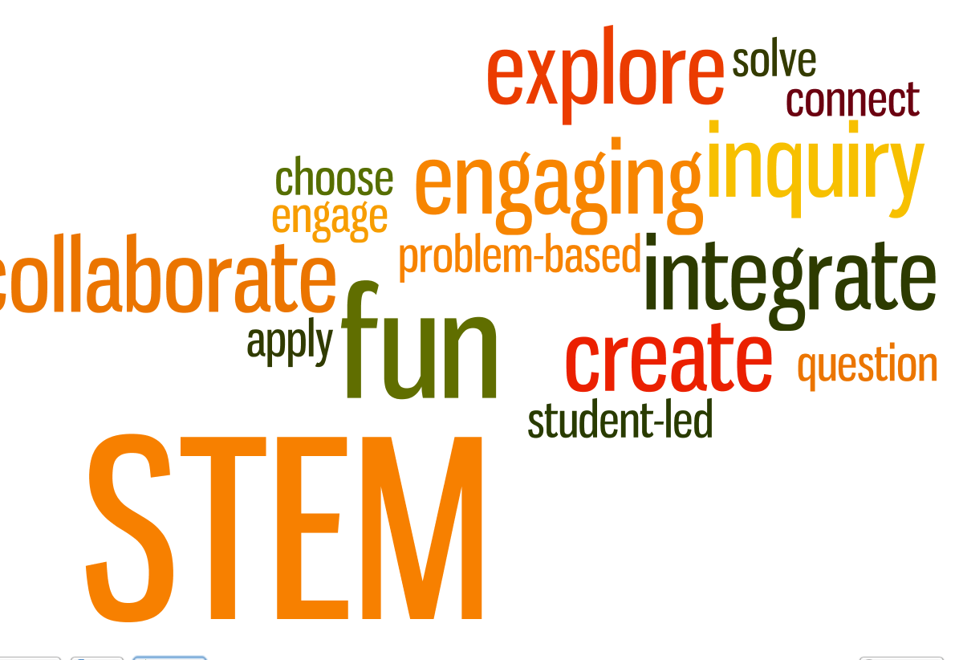
What is STEM – mostly verbs and adjectives?
Source: Dr. Alice Christie Bureau of Education & Research (BER)
Source: Researchers Without Borders, CEMSE S³
Notes:
Dr. Alice Christie – President’s Professor Emeritus Arizona State University
Kind of education-focused terminology and student (and teacher?) perception

Slide 4
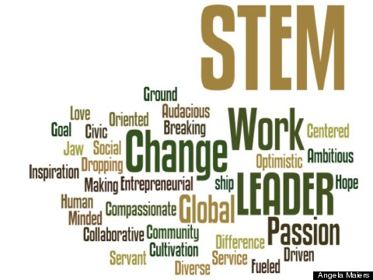
New STEM words – perhaps more enticing?
Source: Huffington Post Girls in STEM Mentoring
Notes:
Kind of business/industry-focused terminology
More positive, forward-thinking, looking outside the classroom at STEM practitioners and work

Slide 5
Turn Inside Out /Cross the Fine Line
Students and educators seek
cognitive demand
curiosity
learning customization
role models and mentors
inspiration and motivation
connections between lessons and the outside world
Business and industry seek
future employees
cooperation and teamwork
autonomy and risk-taking
integrated disciplines
understanding of current education environment
community engagement
Make the Connection:
Bring the STEM community in to schools.
Take education out to the community.
Notes:
Curiosity leads to creativity and innovation
A Curious Mind: The Secret to a Bigger Life book by Brian Grazer

Slide 6
Why STEM?
STEM literacy has a profound and growing impact on our day-to-day lives. It helps us make critical decisions about our health care, our finances and our retirement. It illuminates the ever more complex issues that govern the future of our democracy, and it reveals to us the beauty and power of the world we inhabit.
A literate nation not only reads.
It computes, investigates and innovates.
Change the Equation

Slide 7
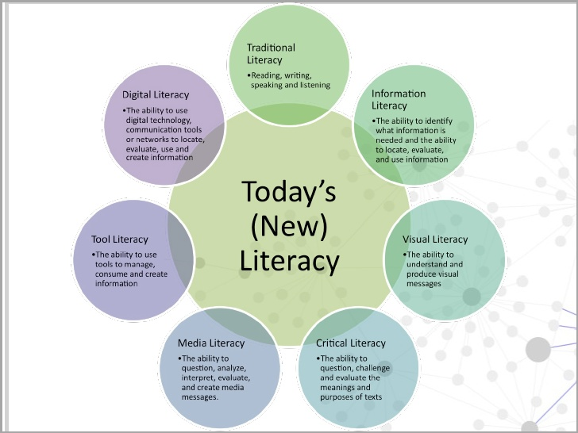
One Model: CJ STEMM
Notes:
Started in 2008-09

Slide 8
One Model: CJ STEMM
fosters literacy in STEMM subjects, exposure to STEMM careers, and a confident innovative spirit…
(motivated problem solvers who are curious,
can communicate, and pay attention to detail)
CJ STEMM –
Catholic Values and Social Justice in
Science, Technology, Engineering, Math & Medicine
Empowering students to serve the world
Innovative Collaborative Global
Notes:
Started in 2008-09

Slide 9
STEM assets in your school
School parents
School alumni
Faculty and staff friends, neighbors and relatives
Companies the school does business with (e.g. IT, plumbing, electrical, construction, local government)
Coaches’ friends, neighbors, and relatives
Notes:
Dayton, Ohio is a STEM-rich region of historic innovation and collaboration
2013-14 school year – 100 individual adult volunteers for CJ STEMM, including 17 CJ alumni

Slide 10
STEM assets beyond the school
Newspapers
STEM employers
Professional and technical organizations (ACS, AIA, AIAA, ASA, ASCE, ASME, BMES, IEEE, IISE, NACME, NCTM, NSTA, SME, SWE)
Community organizations – MetroParks, Scouts, museums,
public library systems
Colleges and universities, esp. those attended by faculty and staff
Regional and national conferences (ASEE K-12, NSTA, ITEEA)
Regional and state STEM Centers (e.g. OSLN, NWO STEM)
Hospitals and Health care systems
Government organizations (CDC, DNR, FDA, NASA, NICCS, NIH, NIMH, NIOSH, NOAA, NPS, OSHA, USAEOP. USGS)
Notes:
Dayton, Ohio is a STEM-rich region of historic innovation and collaboration
2013-14 school year – 100 individual adult volunteers for CJ STEMM, including 17 CJ alumni

Slide 11
Partnerships
Spectrum of engagement – What to ask for?
One-time: class or guest speaker, project review, competition mentor, job shadowing
Ongoing: advisory board, mentorships, financial support, annual outreach events
(One may evolve into the other)
Who, When, and How to Ask?
Partner Cultivation and Relationship Management
Notes:
Dayton, Ohio is a STEM-rich region of historic innovation and collaboration
2013-14 school year – 100 individual adult volunteers for CJ STEMM, including 17 CJ alumni

Slide 12
Slide Show
Notes:
Dayton, Ohio is a STEM-rich region of historic innovation and collaboration
2013-14 school year – 100 individual adult volunteers for CJ STEMM, including 17 CJ alumni

Slide 13
Learn and share more!
www.cjeagles.org
Navigate to STEMM page
mdraeger@cjeagles.org

