Slide 1
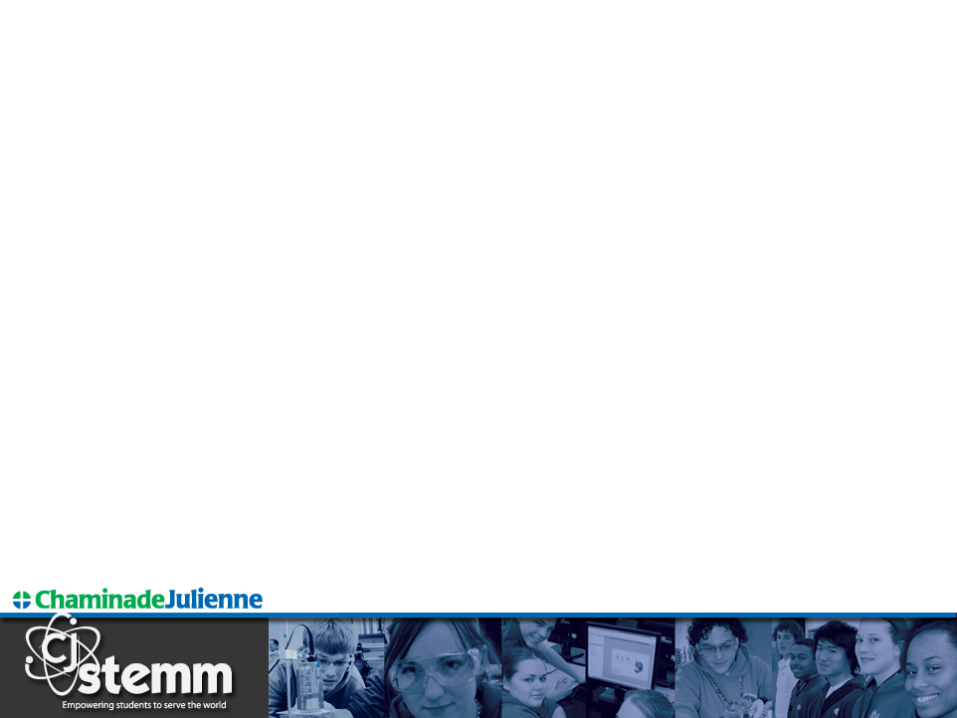
STEM Care Instructions
Turn Inside Out
Meg Draeger
CJ STEMM Coordinator
Chaminade Julienne Catholic High School
Dayton, OH
NWO Symposium on STEM Teaching
Bowling Green State University
Bowling Green, Ohio
Saturday, November 19, 2016

Slide 2
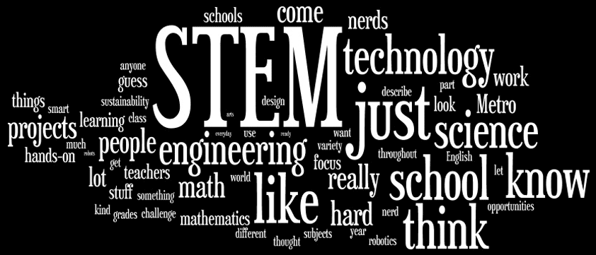
What is STEM ?
Source: Researchers Without Borders, CEMSE S³
Notes:
Several years old from the Center for Elementary Math & Science Education at the University of Chicago – The STEM School Study (S3)
Kind of education-focused terminology and student (and teacher?) perceptions

Slide 3
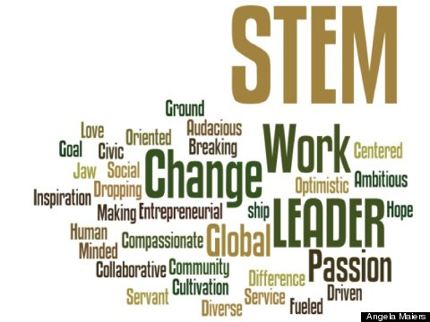
New STEM words
Source: Huffington Post Girls in STEM Mentoring
Notes:
Kind of business/industry-focused terminology
More positive, forward-thinking, looking outside the classroom at STEM practitioners and work

Slide 4
Turn Inside Out
Students and educators need
  curiosity
  role models and mentors
  inspiration and motivation
  exposure to STEM work
Business and industry need
  future employees
  understanding of current education environment
  community engagement
Bring the STEM community in to schools
Take education out to the community
Notes:
Curiosity leads to creativity and innovation
A Curious Mind: The Secret to a Bigger Life book by Brian Grazer

Slide 5
Why STEM?
STEM literacy has a profound and growing impact on our day-to-day lives. It helps us make critical decisions about our health care, our finances and our retirement. It illuminates the ever more complex issues that govern the future of our democracy, and it reveals to us the beauty and power of the world we inhabit.
A literate nation not only reads.
It computes, investigates and innovates.
Change the Equation

Slide 6
One Model: CJ STEMM
fosters literacy in STEMM subjects, exposure to STEMM careers, and a confident innovative spirit…
(motivated problem solvers who are curious,
can communicate, and pay attention to detail)
CJ STEMM –
Catholic Values and Social Justice in
Science, Technology, Engineering, Math & Medicine
Empowering students to serve the world
Innovative Collaborative Global
Notes:
Started in 2008-09

Slide 7
Asset Management
“The key to success in the STEM areas is the leveraging of all the different assets that already exist… many essential assets already exist.”
Dr. Thomas J. Lasley II, Executive Director, Learn to Earn Dayton
Identify and use assets at various levels… which requires creativity and resourcefulness on the part of educators, which is exactly what we’re hoping students learn!

Slide 8
STEM assets in your school and district
School parents
School alumni
Faculty and staff friends, neighbors and relatives
Companies the school does business with (e.g. IT, plumbing, electrical, construction, local government)
Coaches’ friends, neighbors, and relatives
Notes:
Dayton, Ohio is a STEM-rich region of historic innovation and collaboration
2013-14 school year – 100 individual adult volunteers for CJ STEMM, including 17 CJ alumni

Slide 9
STEM assets in the Dayton region
Local newspapers
STEM employers
Local chapters of professional organizations (ACS, AIA, AIAA, ASCE,
ASME, ASQ, DRMA, IEEE, IISE, SME, SWE) - and their newsletters
Community organizations – MetroParks, Scouts, K12 Gallery,
museums, library systems, churches – and their newsletters
TechFest
Colleges and universities – Central State, Clark State, Miami U, SCC,
UC, UD, WSU – and their alumni news publications
Dayton Regional STEM Center and the Regional STEM Collaborative
Premier Health and other health care systems
Wright-Patterson Air Force Base – EO Office and more
Notes:
Dayton, Ohio is a STEM-rich region of historic innovation and collaboration
2013-14 school year – 100 individual adult volunteers for CJ STEMM, including 17 CJ alumni

Slide 10
STEM assets beyond the Dayton region
STEM employers
Professional and technical organizations (ACS, AIA, AIAA, AMS,
ASA, ASCE, ASME, ASQ, BMES, IEEE, IISE, NACME, NCTM, NSTA,
SME, SWE)
Community organizations – MetroParks, Scouts, museums,
library systems
Colleges and universities, esp. those attended by faculty and staff
Regional and national conferences (ASEE K-12, NSTA, ITEEA)
Regional and state STEM Centers (e.g. OSLN, NWO STEM)
Health care systems
Government organizations (CDC, DNR, FDA, NASA, NICCS, NIH, NIMH, NIOSH, NOAA, NPS, OSHA, USAEOP. USGS)
Notes:
Dayton, Ohio is a STEM-rich region of historic innovation and collaboration
2013-14 school year – 100 individual adult volunteers for CJ STEMM, including 17 CJ alumni

Slide 11
Partnerships
Spectrum of engagement – What to ask for?
One-time: class or guest speaker, project review, competition mentor, job shadowing
Ongoing: advisory board, mentorships, financial support, annual outreach events
(One may evolve into the other)
Who, When, and How to Ask?
Partner Cultivation and Relationship Management
Notes:
Dayton, Ohio is a STEM-rich region of historic innovation and collaboration
2013-14 school year – 100 individual adult volunteers for CJ STEMM, including 17 CJ alumni

Slide 12
Next Steps for regional collaboration
Develop a recommended elem/middle/high school progression through STEM programming – courses, summer programs, career exploration, competitions, volunteer service, capstone, internship
Further develop active young alumni (college students and young professionals) as mentors
Develop a unified regional Employer Network for STEM education
“Engaged and networked communities of practice” (STEM 2026 report)
Continue to educate parents and general community about STEM
Notes:
STEM 2026: A Vision for Innovation in STEM education – released 9/15/2016

Slide 13
The Future of STEM Education
STEM 2026: A Vision for Innovation in STEM Education
Report released September 15, 2016
American Institutes of Research
Notes:
STEM 2026: A Vision for Innovation in STEM education – released 9/15/2016

Slide 14
Learn and share more!
www.cjeagles.org
Navigate to STEMM page
mdraeger@cjeagles.org

