Slide 1
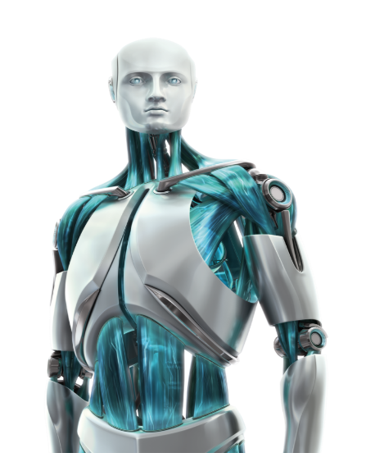
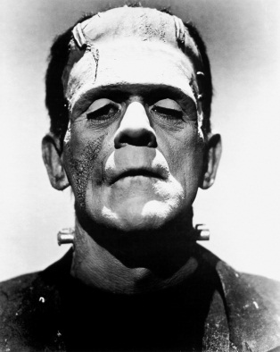
From Frankenstein to Robotics
Team Teaching & Collaboration Between STEM and English
Becky Rice – RiceB@GJPS.org
Tyler Bruns – BrunsT@GJPS.org
Gahanna Lincoln High School

Slide 2
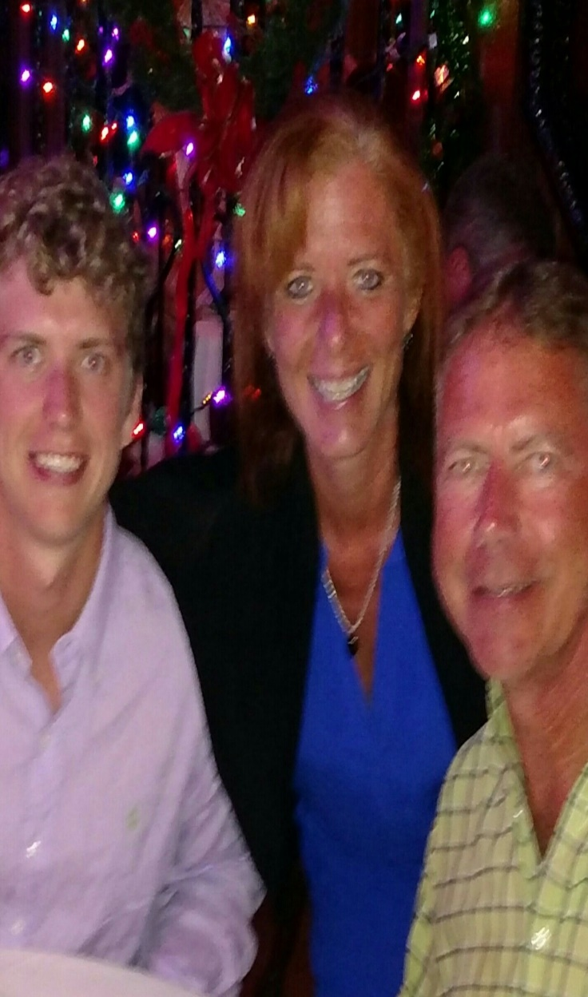
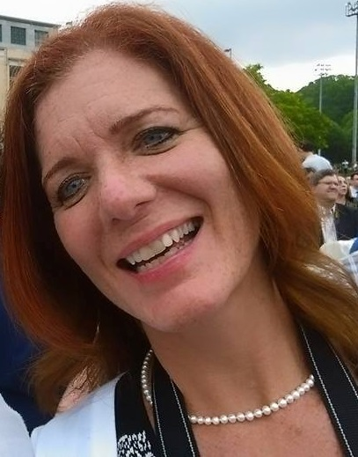
About the Presenters – Becky Rice
English – 7-12
Reading Certified – K-12
Gifted – K-12
BS in English Education from OSU
MA in Administration from OSU
National Board Certified
Master Teacher
30 Years Teaching Experience

Slide 3
About the Presenters – Tyler Bruns
Chemistry – 7-12
Earth Science – 7-12
BS in Science Education from MU
MA in Administration from AU
6 Years Teaching Experience

Slide 4
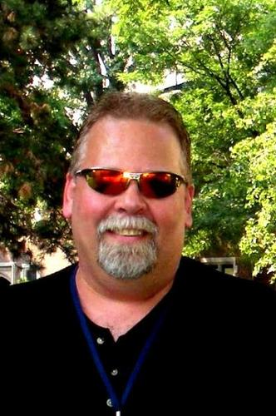
Fred Donelson
Co-created the courses with Becky Rice.
Retired in 2015.
Currently teaching at Capital University.
Also freelancing as the “Transferable Teacher”
Master Teacher
Motivational Speaker
Educational Consultant
Google: Transferable Teacher Fred Donelson

Slide 5
Course Overview
Three Courses:
Special Aspects (One Semester)
Scientific Literature and Composition (All Year)
Honors Bionics (One Semester)
Schedule
One Double Period, Everyday
Students earn 1 English and 2 science credits
Credit Stacking

Slide 6
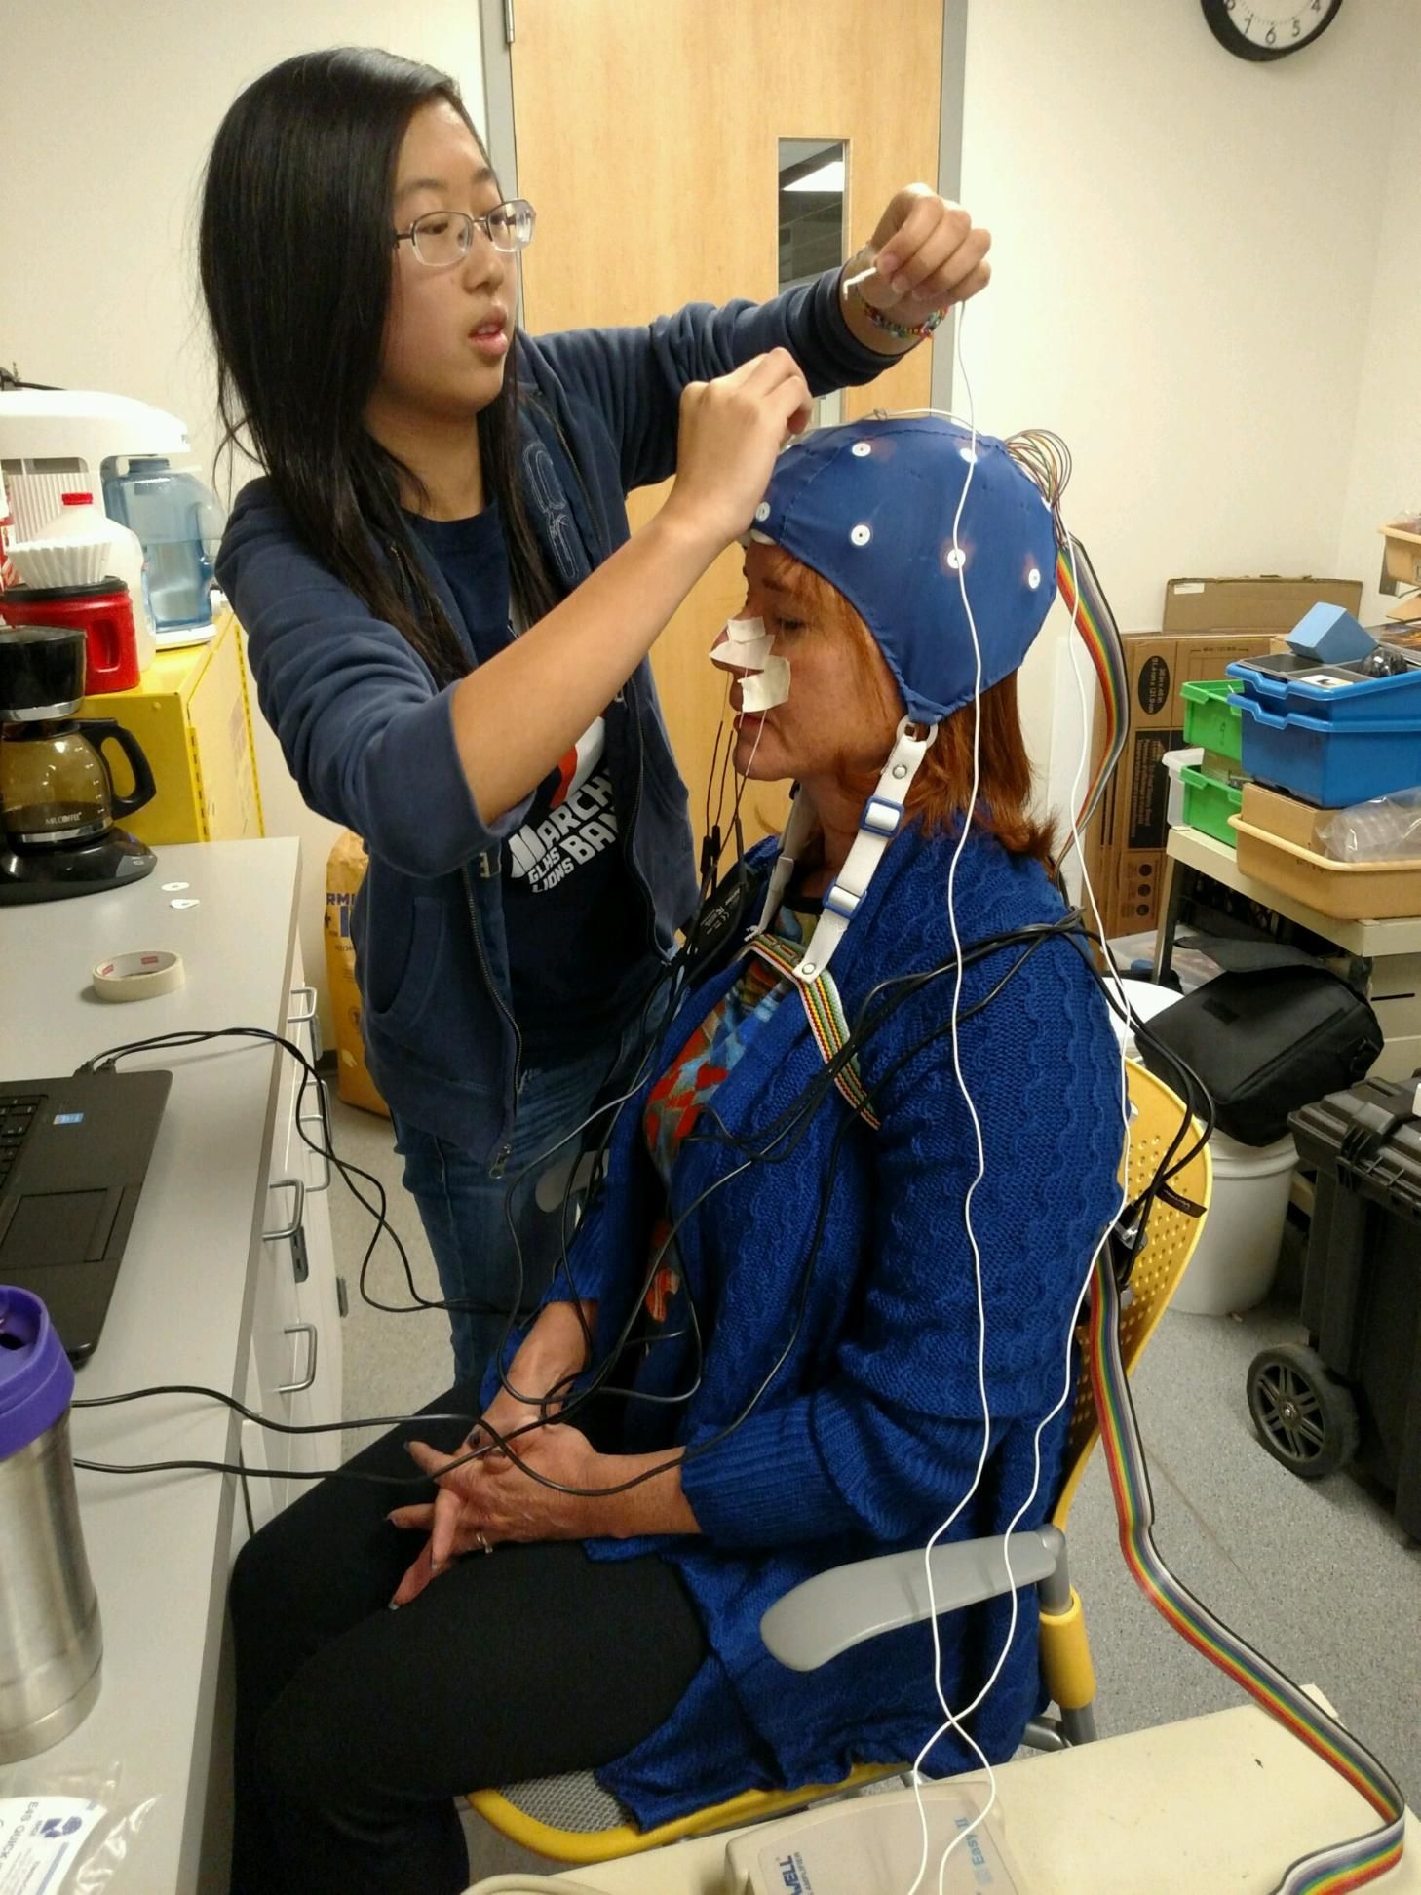
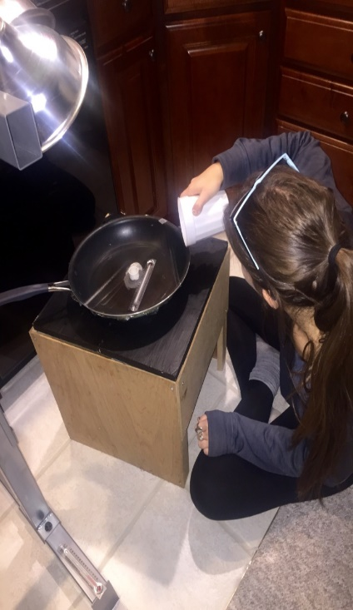
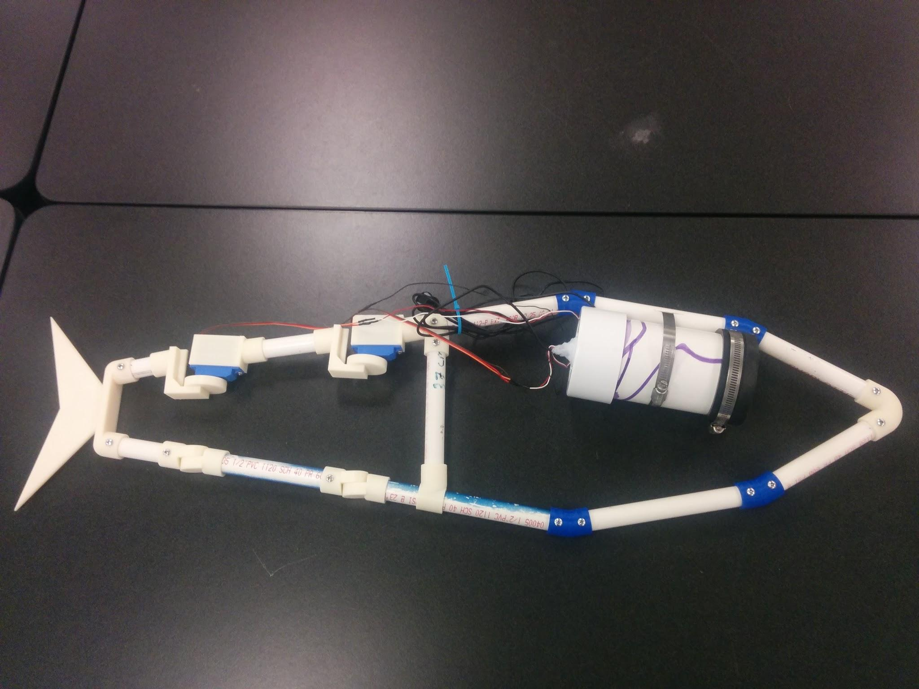
Special Aspects - Overview -
Scientific Research Capstone Class
Student-selected topic
Design and carry out an experiment
Collect and analyze data
Draw conclusions
Present their findings
Utilizes National Science Foundation Standards

Slide 7
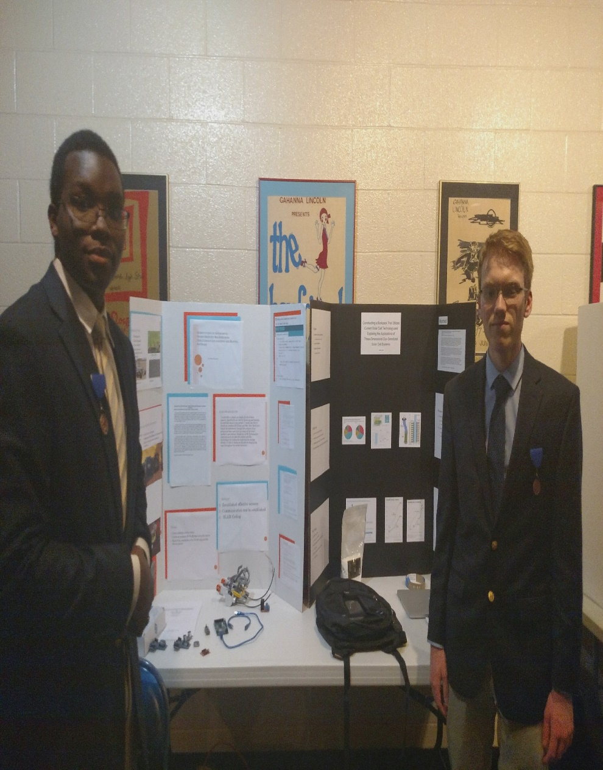
Student Products
20-50 page paper
Professional PowerPoint presentation
Poster
Presented to an authentic audience at least twice
~250-500 work hours
Notes:
Link to student paper example

Slide 8
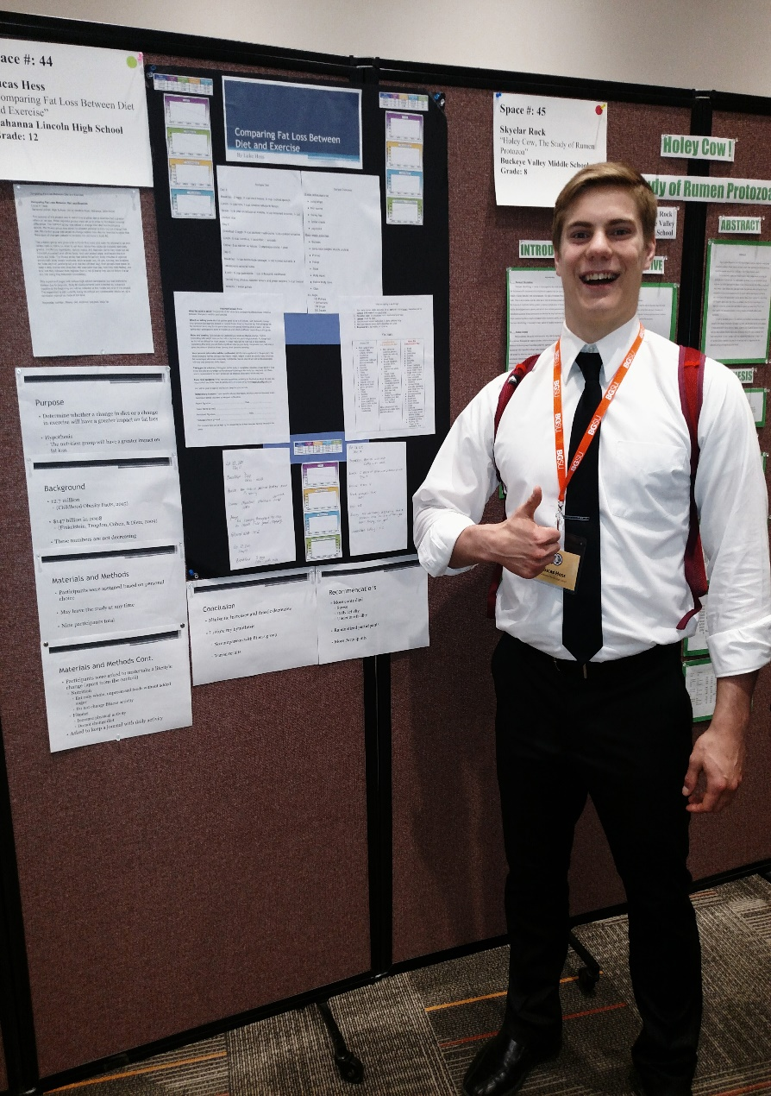
Course Content
First Two Weeks
Learning Inventory
Pre-Assessments
Introductory Lab
Topic selection
The Scientific Method
Controlling variables
Using statistics to analyze data
Drawing proper conclusions
Communicating effectively!
Students become experts on their topics

Slide 9
Twitter Activity
You can work alone or in groups.
Look at the paper in front of you and skim through it.
Make four total tweets on the major sections of the paper (Purpose, Procedure, Data, & Conclusion).
One tweet per section.
Each tweet is limited to 140 characters, but acronyms or abbreviations are acceptable.
Use the hashtag #GLHSSA

Slide 10
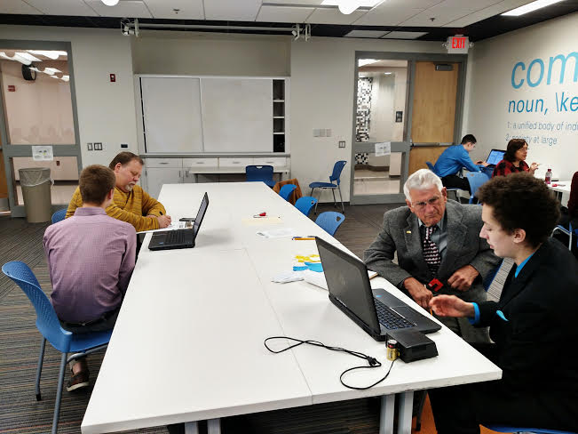
Scientific Lit. & Comp. with Special Aspects
Technical research writing focus (APA)
Analyze scholarly abstracts
Abstract writing
Review of Literature writing
Effective PowerPoints and Presentations
Emphasis on individual help
Notes:
Collaborate with School’s Media Specialist
Utilize scholarly databases to find journal articles

Slide 11
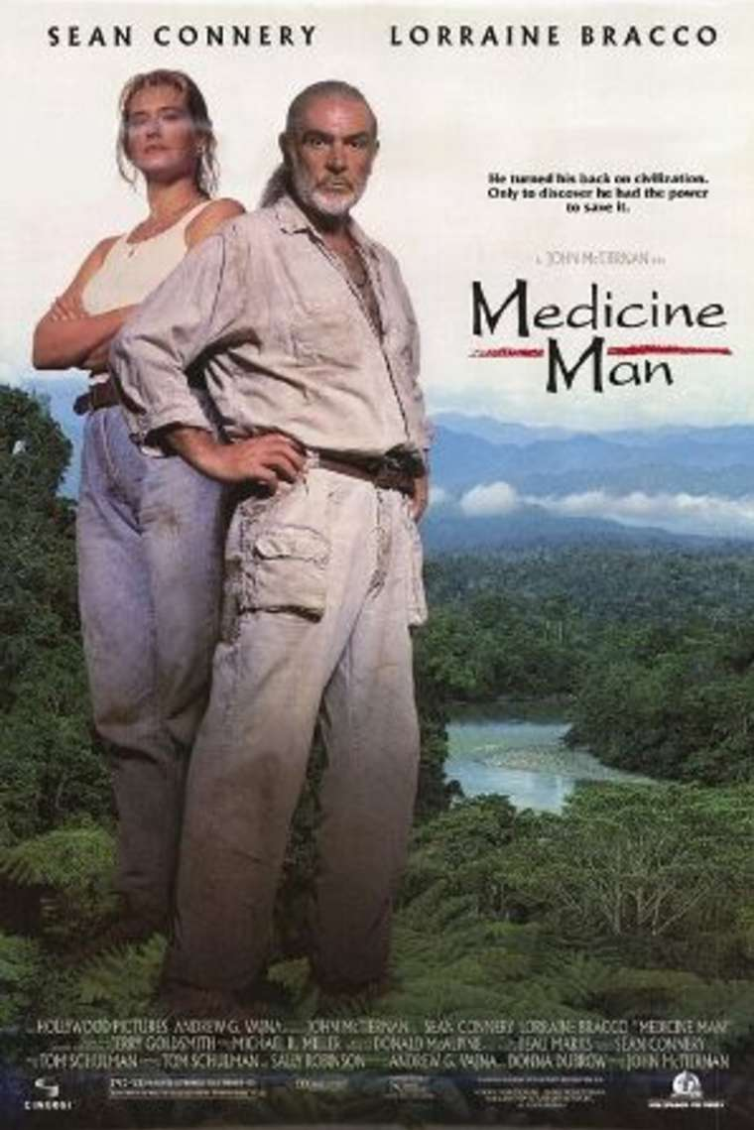
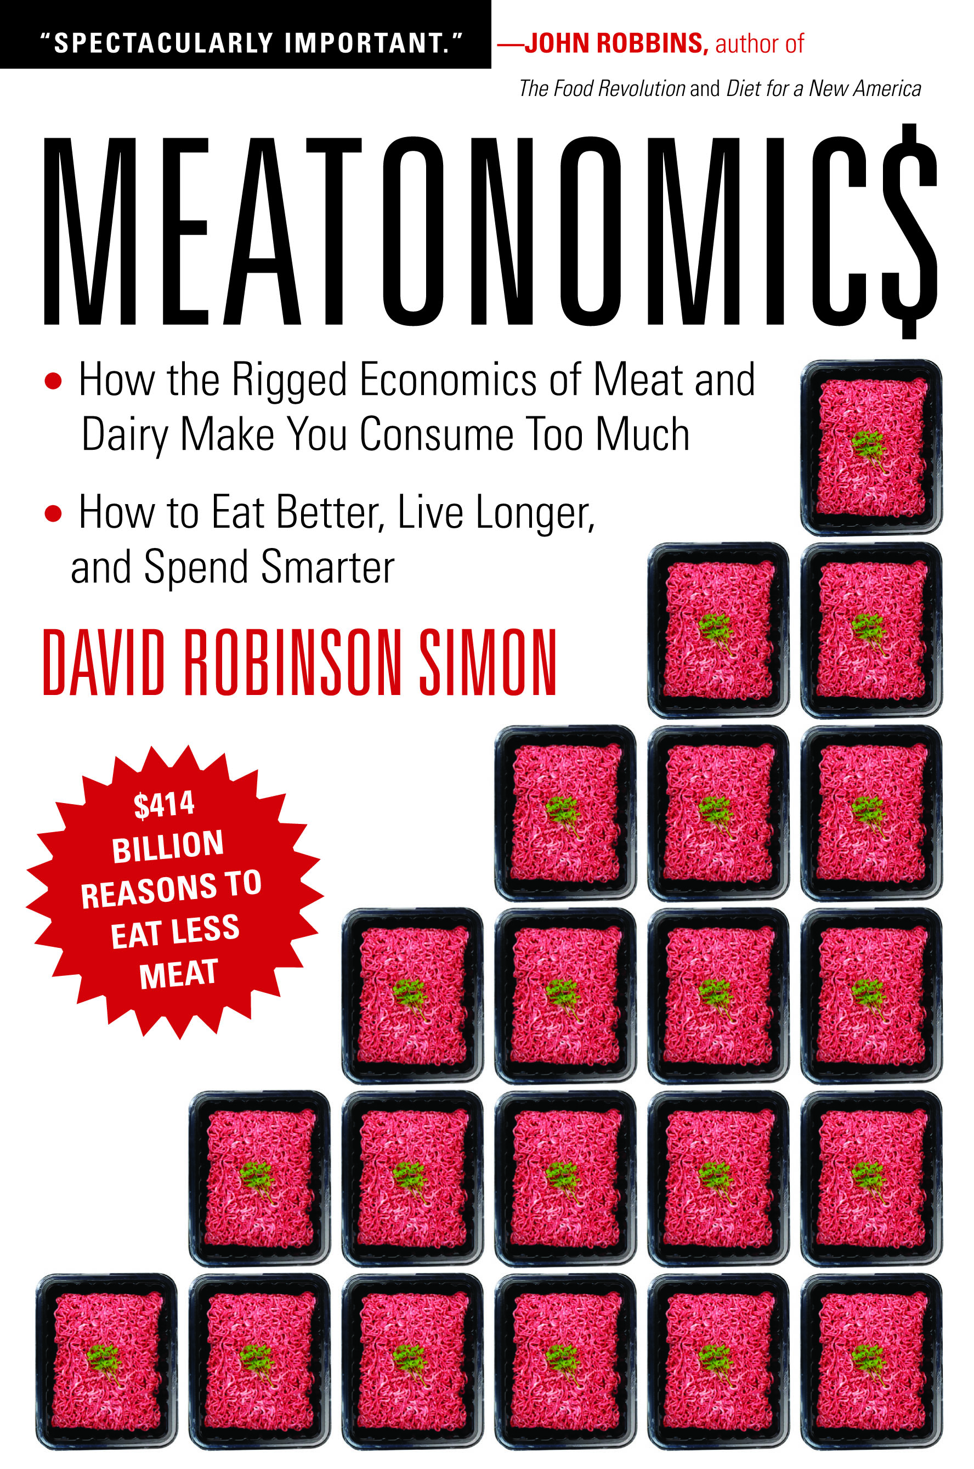
Scientific Lit. & Comp. with Special Aspects
Introduction to Scientific Ethics
Hunger Games
Mind Walk
Real Genius
Medicine Man
Student-selected book report
Identify ethical issues
Presentation to the class
Notes:
Links to a Hunger Games Clip and a student presentation on Meatonomics

Slide 12
Discuss with a Partner…
What science or science fiction is involved in this Hunger Games clip?
What ethical issues are present?
How does this apply or impact society and/0r scientific research?

Slide 13
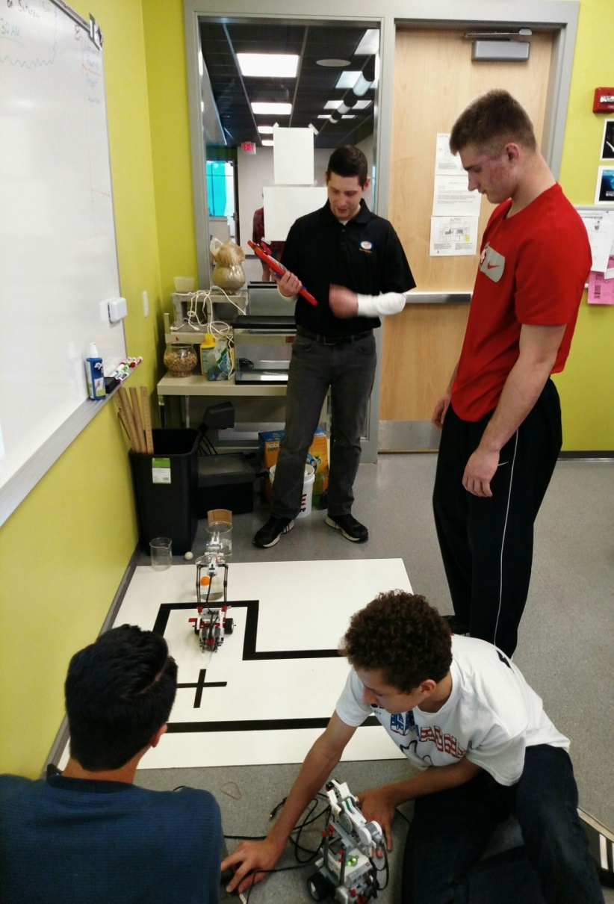
Honors Bionics - Overview -
Continuation of Special Aspects
Reinforces Scientific Method
Additional Curriculum
Biology
Anatomy
Robotics
Programing
Engineering
Notes:
Science Symposium, Competitions, etc.
Scientific Method such as experimental design, data collection/analysis, and communicating findings orally and textually.
Integration of biology and anatomy with robotics, programing, and engineering.

Slide 14
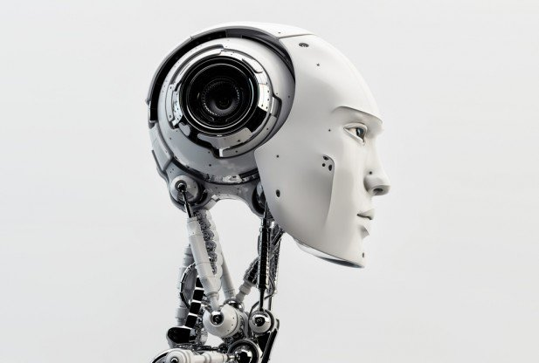
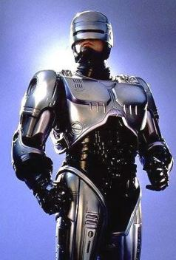
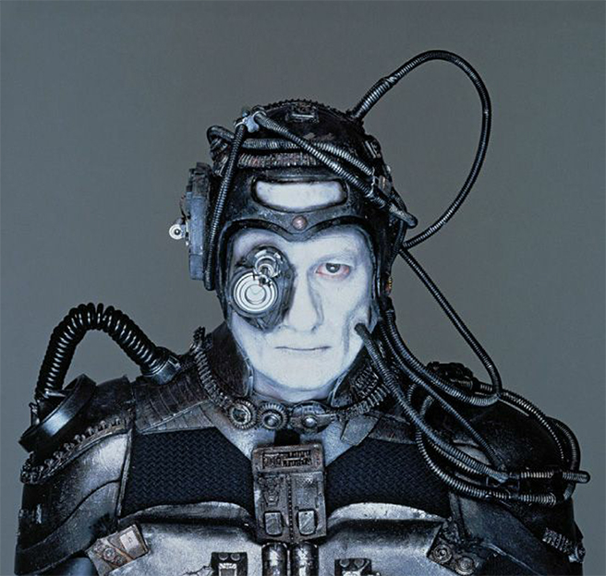
Bionics
What comes to mind?
Notes:
Speak briefly with your partner

Slide 15
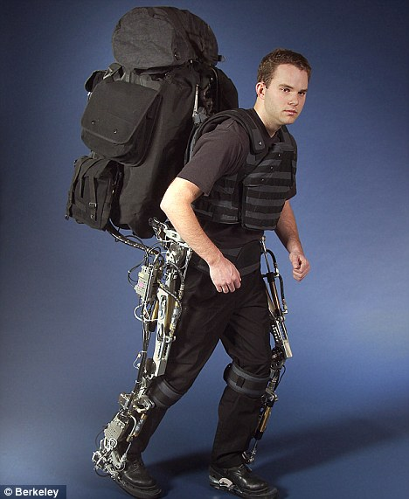
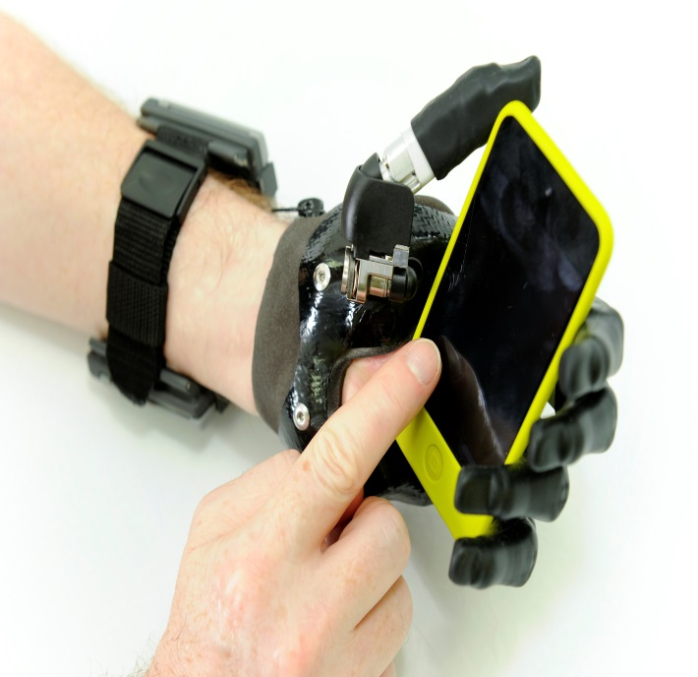
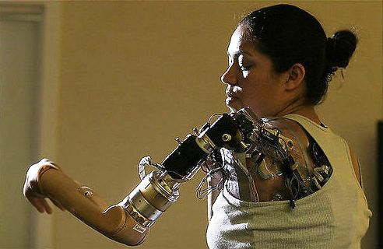
What is Bionics?
Bionics is the application of biological methods and systems found in nature to the study and design of engineering systems and modern technology.

Slide 16
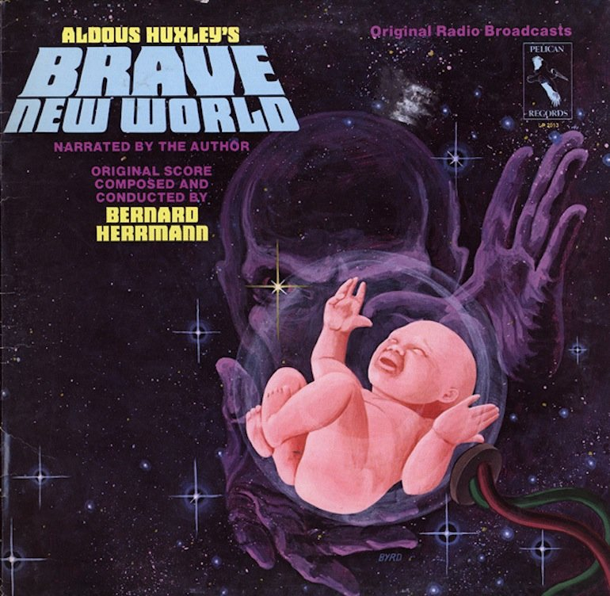
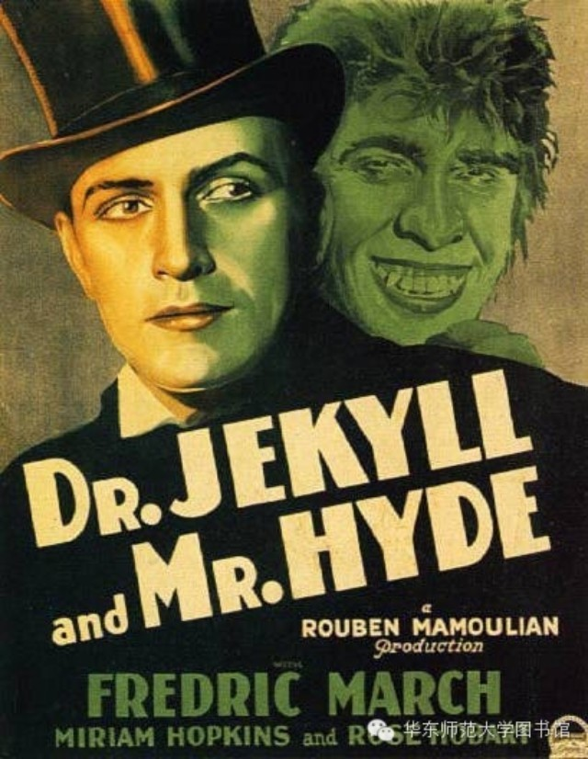
But Where Did It Show Up First?

Slide 17
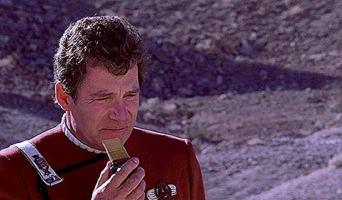
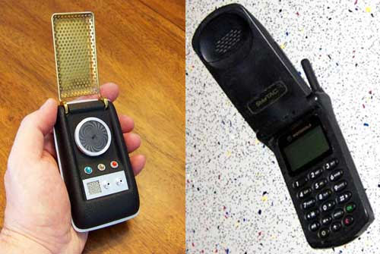
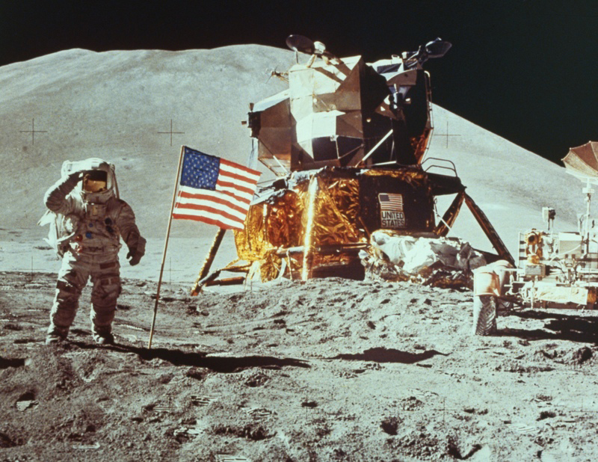
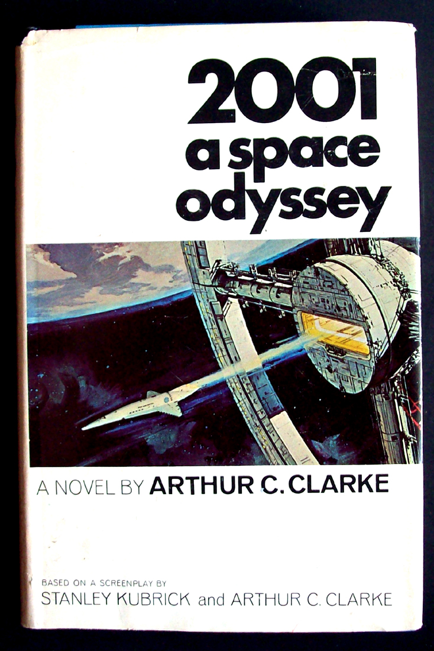
Science Fiction
Often predicts actual developments:

Slide 18
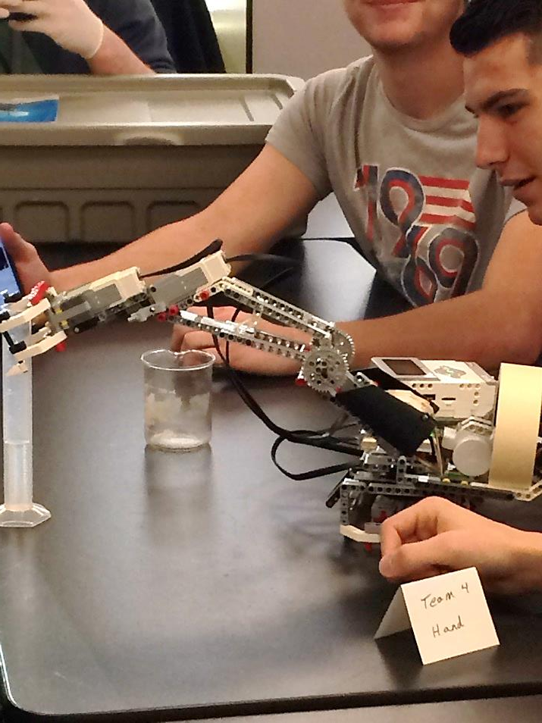
Project Cyborg
Culminating Project
Students Design & Build:
Robotic Hand
Helmet w/ LEDs
Synthetic Skin
Multiple Performance-Based Assessments
Technical Paper

Slide 19
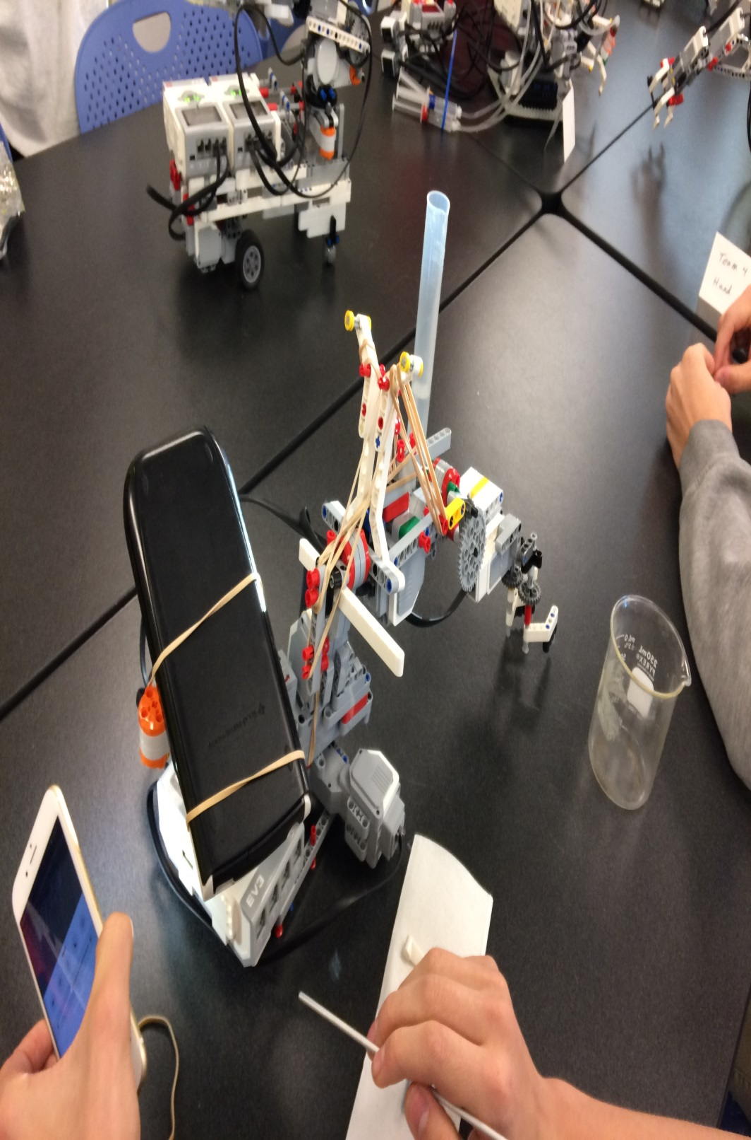
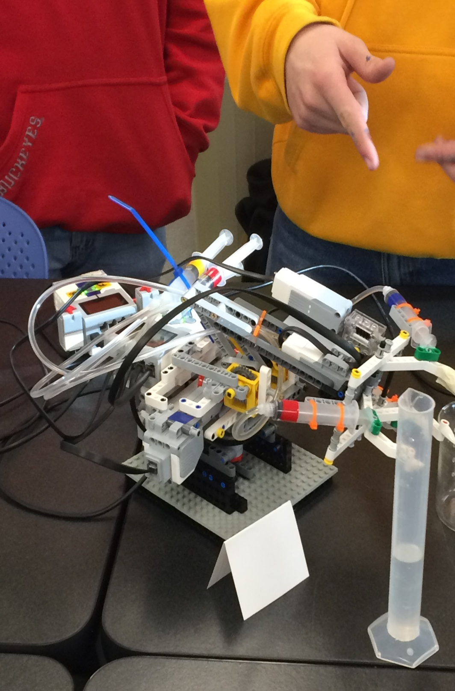

Slide 20
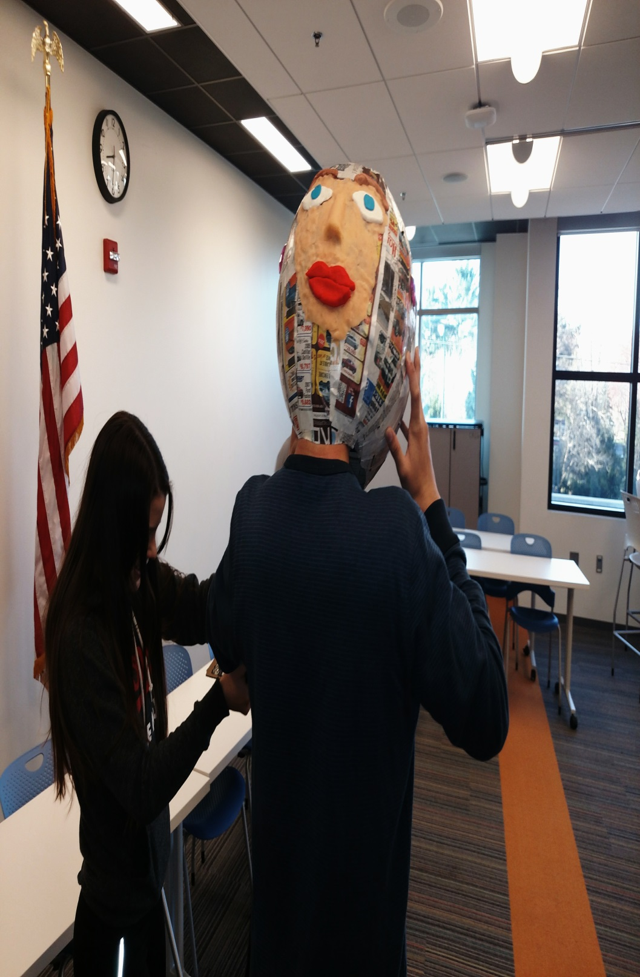

Slide 21
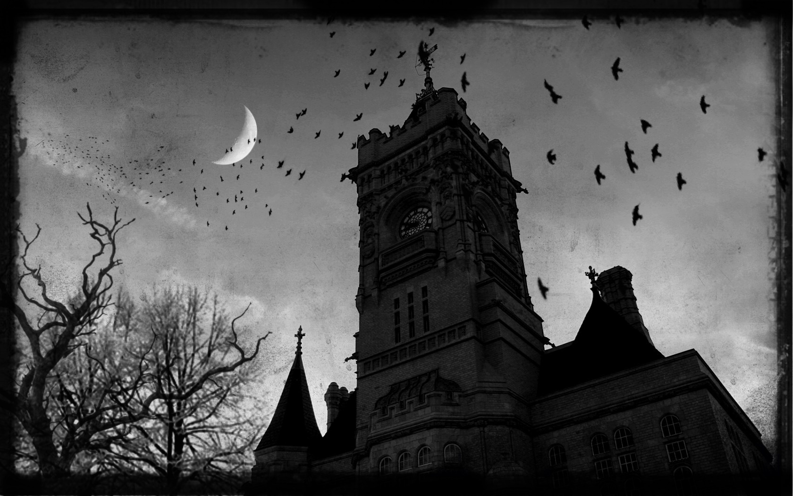
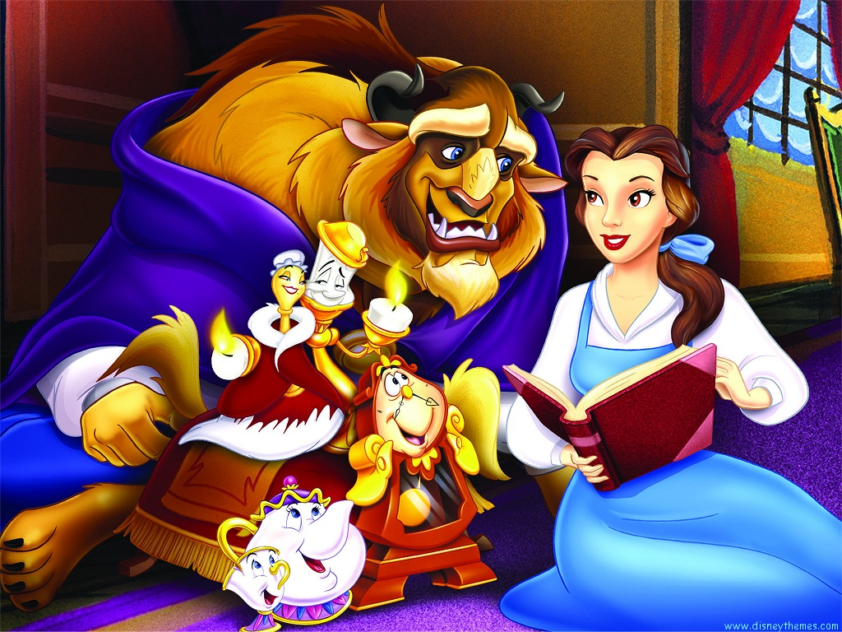
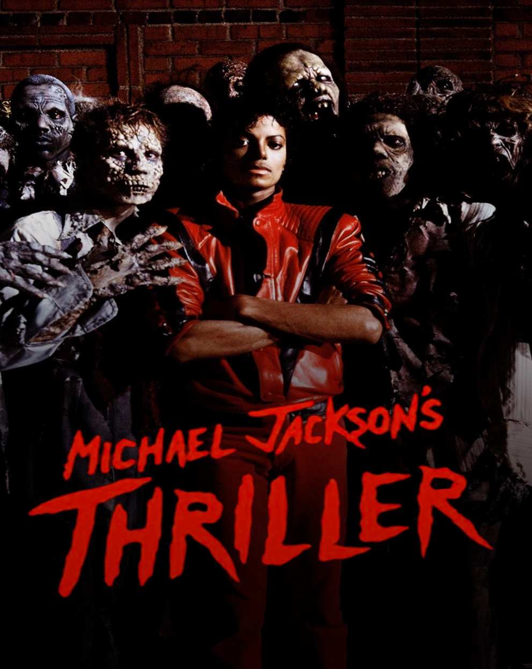
Scientific Lit. & Comp. with Honors Bionics
Required Reading
Frankenstein
Dr. Jekyll & Mr. Hyde
Brave New World
Gothic Literature
Scientific Ethics
Socratic Seminars

Slide 22
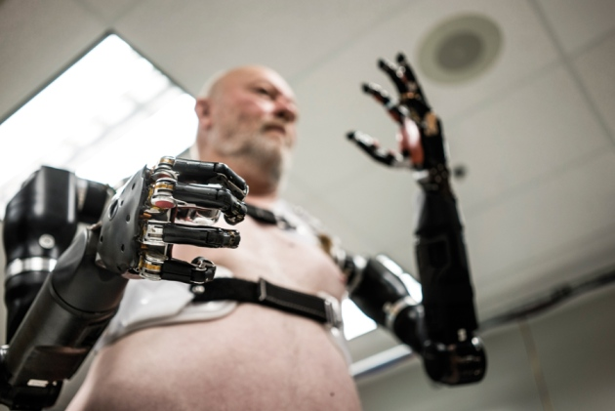
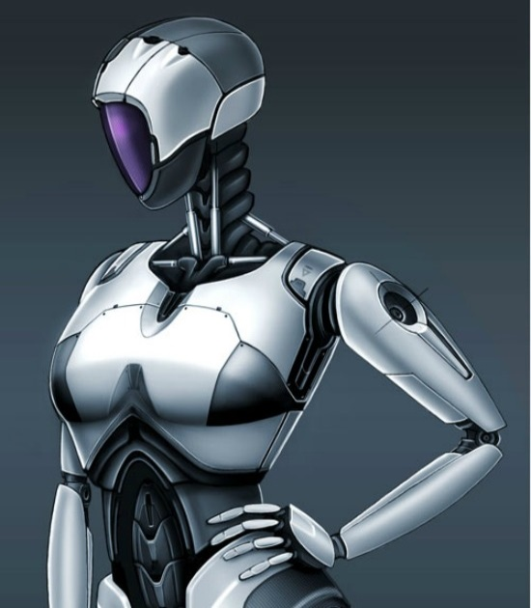
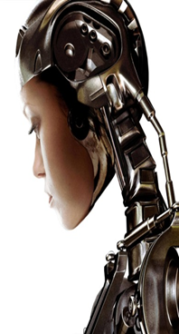
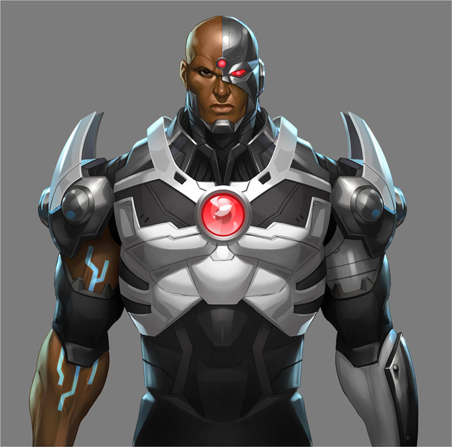
Ethical Considerations
What’s human? What’s not?
Who or what has rights?

Slide 23
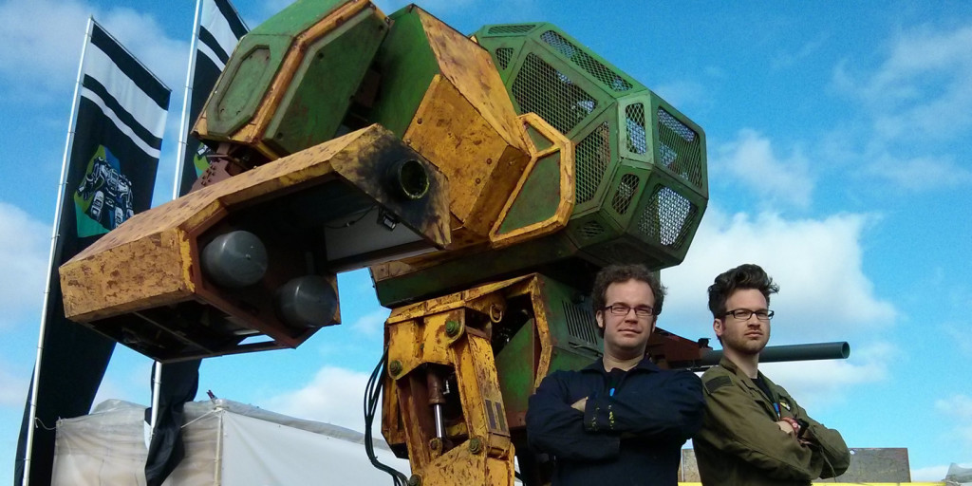
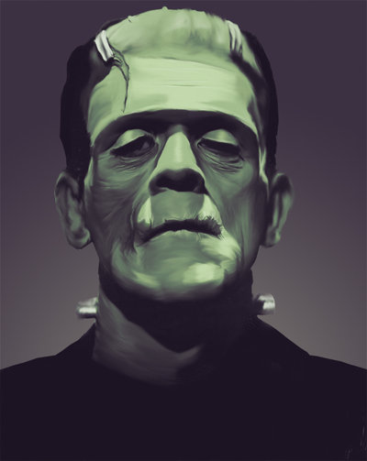
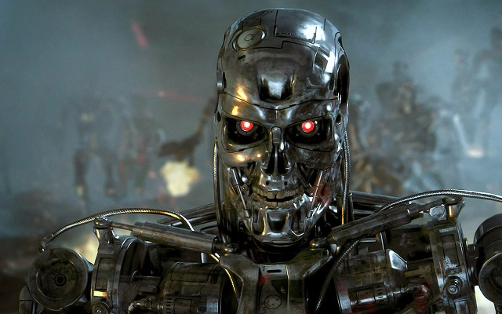
Ethical Considerations
Are scientists responsible for their innovations?

Slide 24
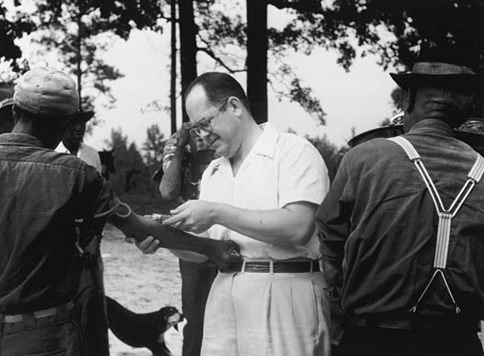
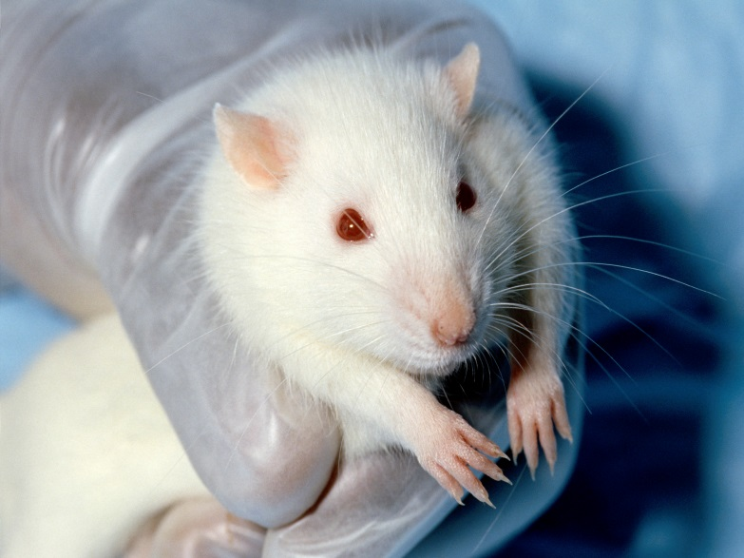
Ethical Considerations
How do we go about testing?
Who or what can be testing subjects?

Slide 25
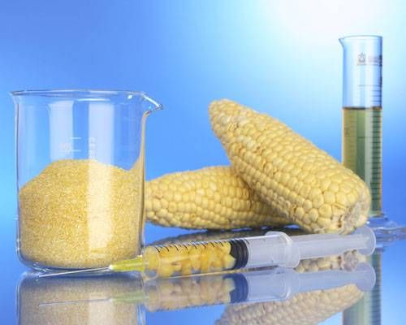
Ethical Considerations
How much should we meddle with natural biology?
What about genetic & reproductive manipulation?

Slide 26
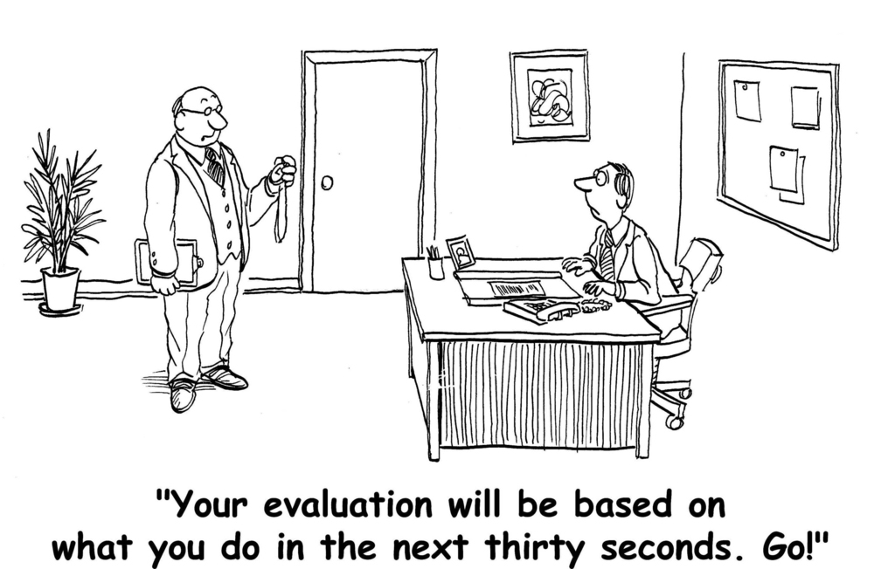
Integrating with SLO’s
Build Pre & Post assessments around measureable components of the class
Learning Style Inventories
Statistics and Analysis
Abstract Writing

Slide 27
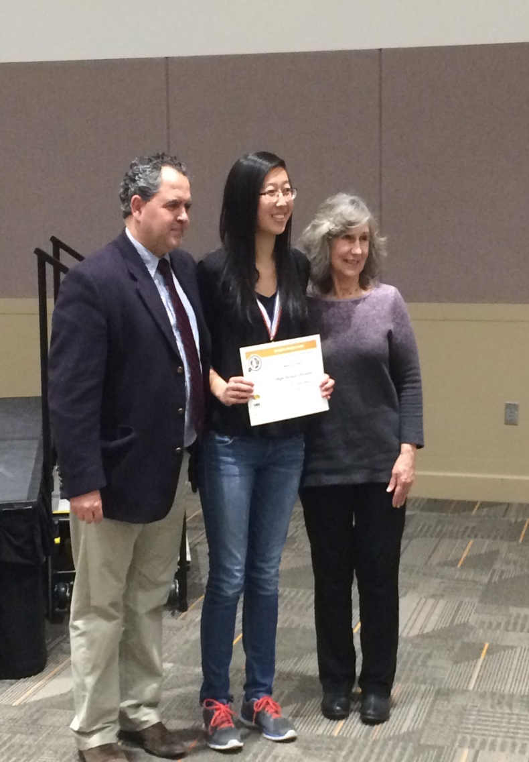
Student Outcomes (Why it’s worth it)
Competitions & Scholarships
Scientific Writing & Reading Skills
Science Application
Oral & Written Communication Skills
Understanding of the Scientific Method
Increased Resiliency
Research Experience

Slide 28
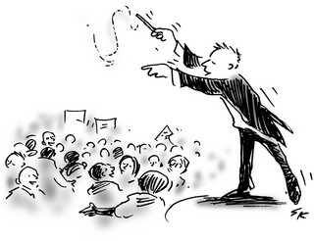
How this looks from the Teacher’s Side
Facilitators
Editors
Guides
Discussion leaders
Respond to a question with a question, not an answer
Organization and management
Minimal direct instruction
Independent learners

Slide 29
Questions?
Becky Rice – RiceB@GJPS.org
Tyler Bruns – BrunsT@GJPS.org

