Slide 1

The Chemistry of Art
Elizabeth Wise
Department of Chemistry and Physical Sciences
ewise@lourdes.edu

Slide 2
Overview
Background
Course Information
Sample PowerPoint Presentation
Shrinky Dinks®

Slide 3
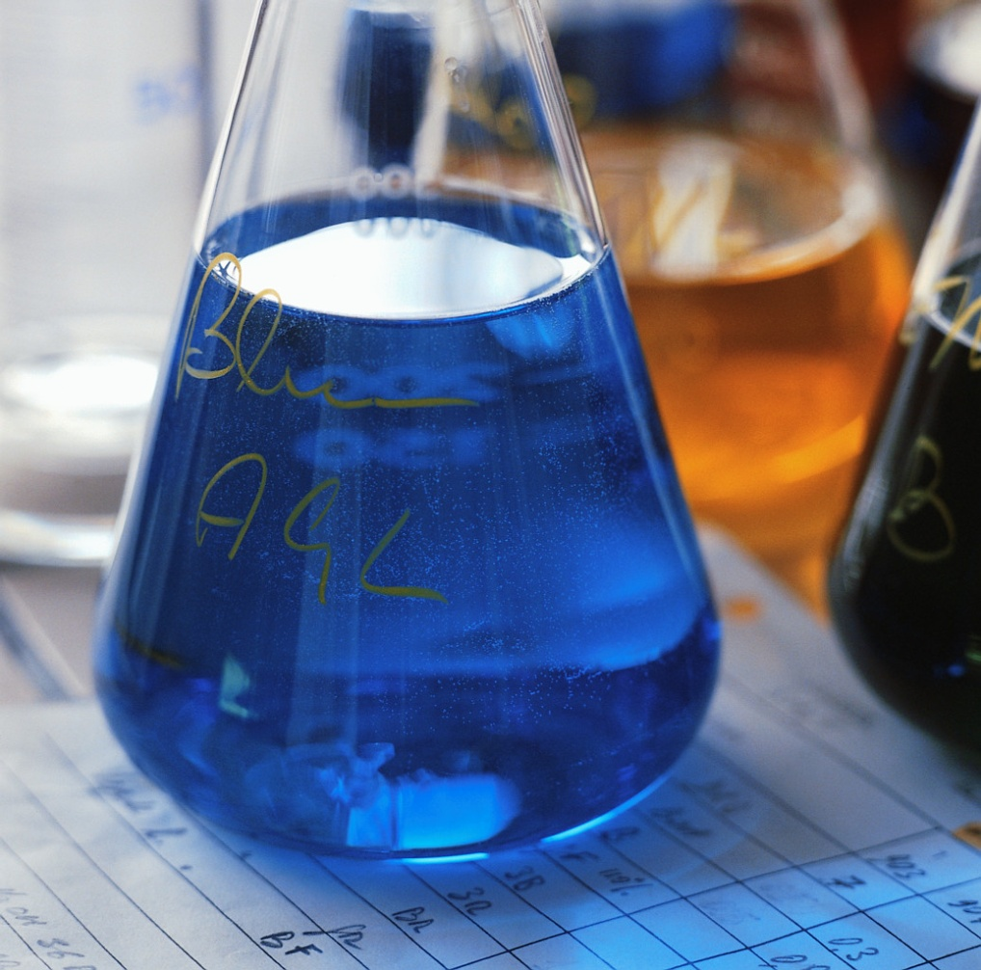
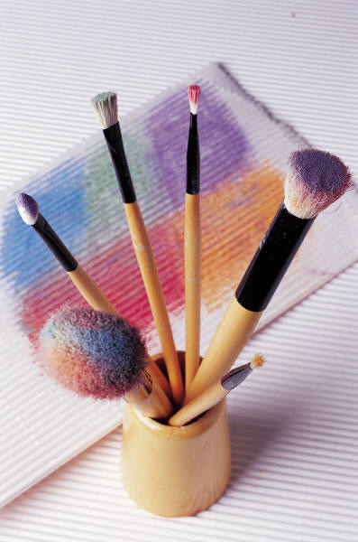
Background
Appreciation of Art
The Chemistry of Art

Slide 4
Course Information

Slide 5
Course Preparation
Course Materials: NSF-sponsored Chemistry Collaborations, Workshops & Communities of Scholars, http://www.ccwcs.org/
Text: Barbara R. Greenberg and Dianne Patterson, Art in Chemistry; Chemistry in Art. Teacher Ideas Press: Westport, Connecticut, 2008.

Slide 6
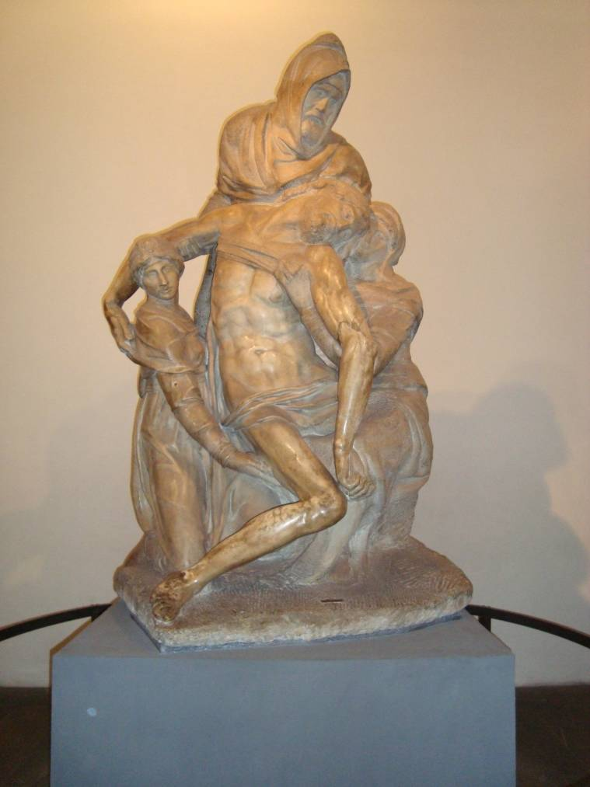
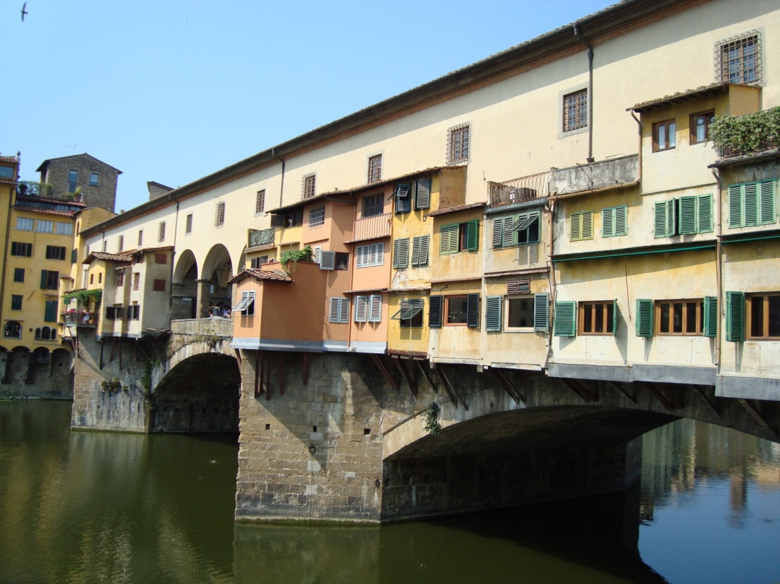
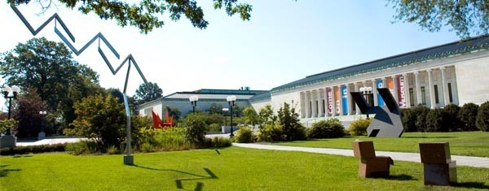
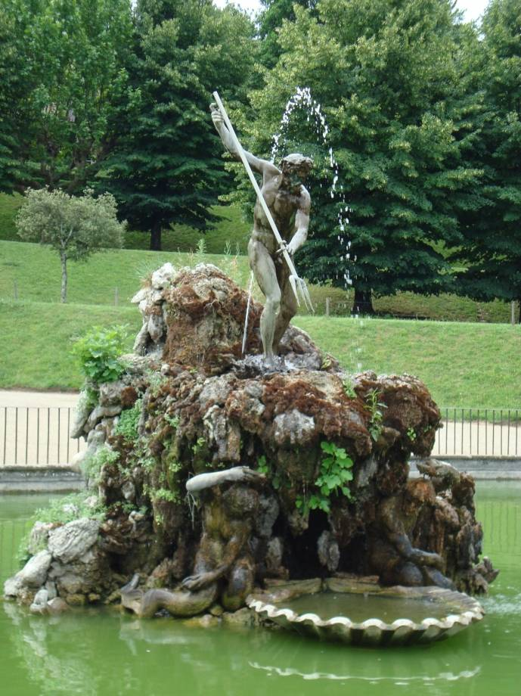
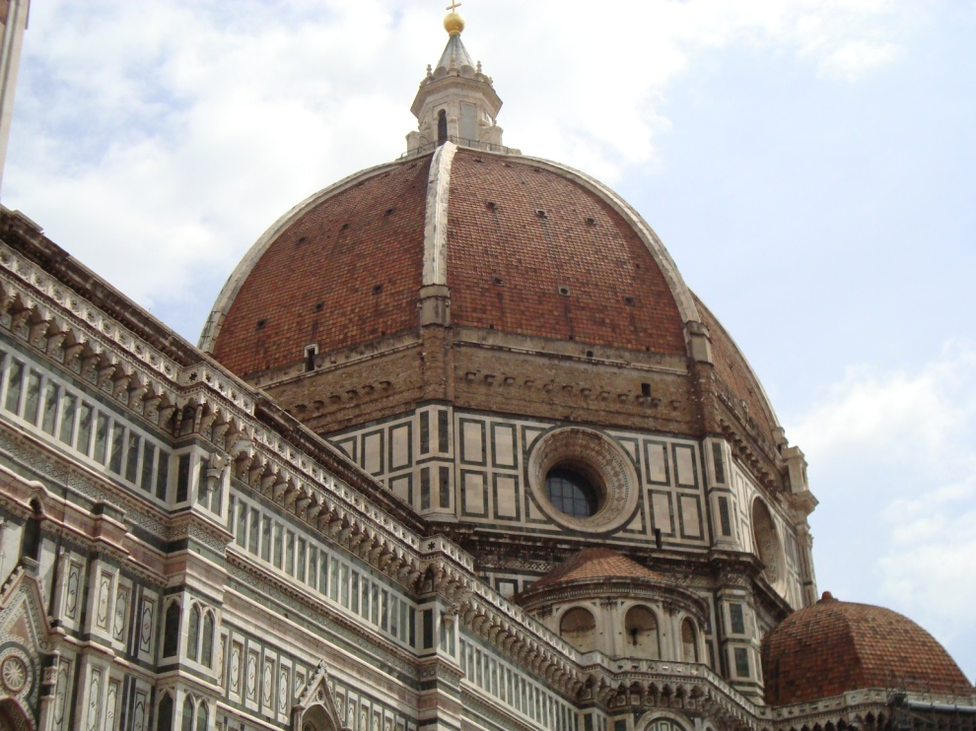

Slide 7
General Information
Audience: undergraduate non-science majors; undergraduate science majors; high school students; summer workshops for students in grades 5-10 or for teachers
Format: 2.5-hour class with integrated lab/studio activities

Slide 8
Overview of Topics
Basics
  ▪ Light, Color, and Matter (inorganic & organic)
Applications of Chemistry in Art
  ▪ Paint Media
  ▪ Pigments and Dyes
  ▪ Polymers
  ▪ Glass and Ceramics
  ▪ Metals
  ▪ Photography
  ▪ Conservation and Restoration

Slide 9
Ohio Revised Science Standards
Chemistry, Grades 9-12
Atomic structure
Periodic table
Intramolecular chemical bonding
Representing compounds
Quantifying matter
Phases of matter
Intermolecular chemical bonding
Chemical reactions
Moles
Radioisotopes

Slide 10
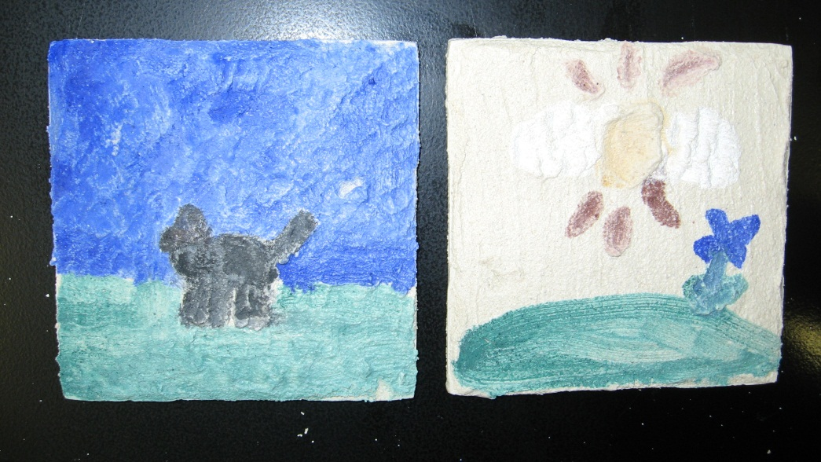
Class Activities
Chromatography of pen inks
Compare/contrast different paint media
Shrinky Dinks
Borax crystal shapes
Frescoes
Etched glass
Super sculpey
Anodize niobium wire
Cyanotypes

Slide 11
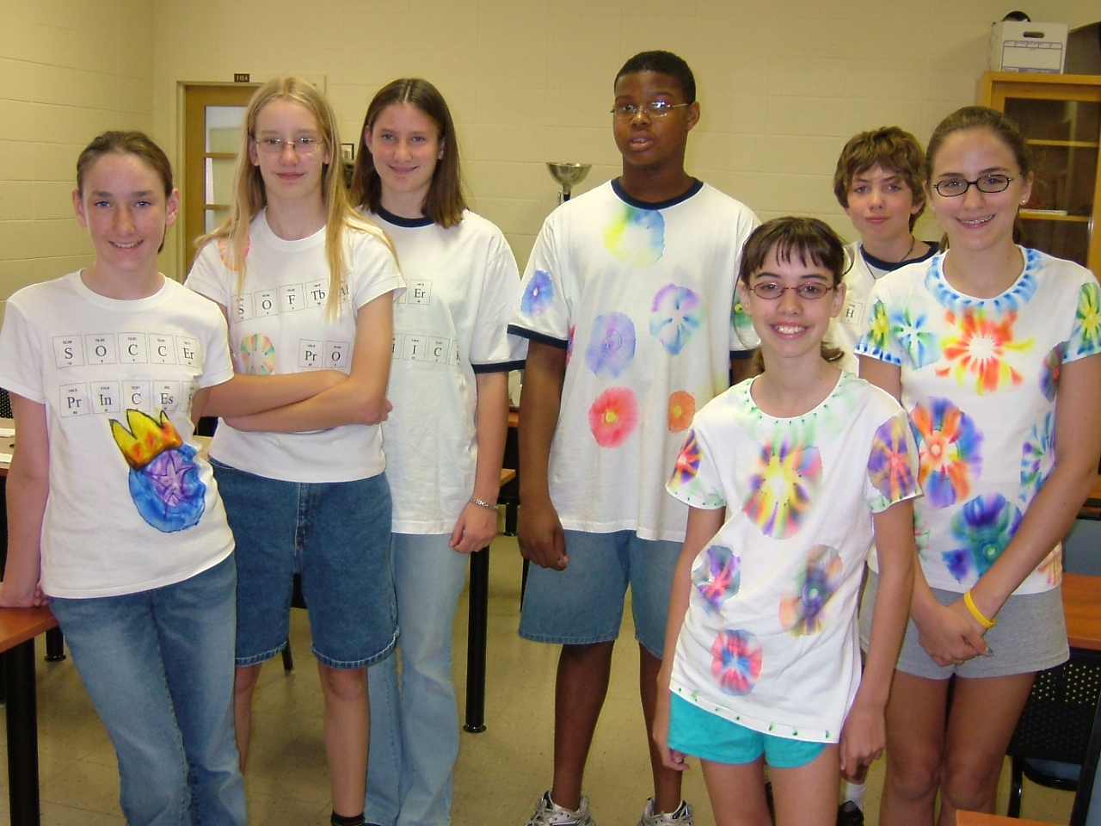

Slide 12
Demonstrations
Karen Timberlake, author of GOB and basic chemistry texts
Steve Spangler, http://www.stevespanglerscience.com/

Slide 13
Components of Presentation
Ask for input
Provide information
Evaluate learning
Class Activity

Slide 14
Sample Presentation
Polymers in Art

Slide 15
Work with a partner to...
List examples of
Can you describe basic polymer structure?
Polymers

Slide 16
Polymers — What Are They?
POLY = many MER = parts or units
MONOMER = basic unit
Hundreds or thousands of monomers
MACROMOLECULES - high mol. wt.
Natural and Synthetic Polymers

Slide 17
Natural Polymers Came First
Proteins
Hair, wool, fur, silk, casein
Carbohydrates
Cellulose (cotton), starch, plant gums
Rubber
Extract of rubber tree

Slide 18
Natural Polymers
Proteins
Carbohydrates

Slide 19
Synthetic Polymers = Plastics
Celluloid - 1869 - substitute for ivory
Rayon - 1878 - substitute for silk
Bakelite - 1907 - first wholly synthetic
Nylon - 1939 - intro at NY World’s Fair
Polyethylene, polyesters, Teflon® -1930’s
Polycarbonates - 1950’s
Polyaramids - bullet-proof vests

Slide 20
Plastics are Polymers
Thermoplastic polymers
  soften and flow when heated
  re-harden when cooled
  easily molded
  easily recycled
Thermoset polymers
  do not soften with heat, cannot be remelted
  heat resistent
  rigid and hard

Slide 21
Types of Polymers
Linear Polymers — THERMOPLASTIC
Branched Polymers — THERMOPLASTIC

Slide 22
Types of Polymers
Cross-linked Polymers — THERMOSETS
Usually more rigid or stiff

Slide 23
Polymers in Art
Paper
Fibers
Paint Binders and Glues

Slide 24
Learning Check
Which type of polymer, thermoplastic or thermoset, may be recycled easily?
What is an example of a natural polymer?
What modern paint binder is a polymer?

Slide 25
Shrinky Dinks®
Thank You!

