Slide 1
Science and Mathematics for a New Generation
NWO Symposium
Daniel J. Brahier
Bowling Green State University
St. Rose School, Perrysburg
Saturday, November 21, 2015
8:30 – 9:45 a.m., 101 Olscamp Hall, BGSU

Slide 2
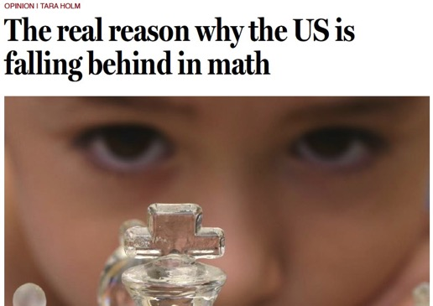
Boston Globe Article
Did you see this Opinion piece in the Boston Globe from February 12, 2015?

Slide 3
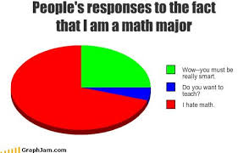

Slide 4
Best Jobs (CareerCast, 2014)
Mathematician
Tenured University Professor
Statistician
Actuary
Audiologist
Dental Hygenist
Software Engineer
Computer Systems Analyst

Slide 5
Best Jobs (CareerCast, 2014)
Mathematician
Tenured University Professor
Statistician
Actuary
Audiologist
Dental Hygenist
Software Engineer
Computer Systems Analyst

Slide 6
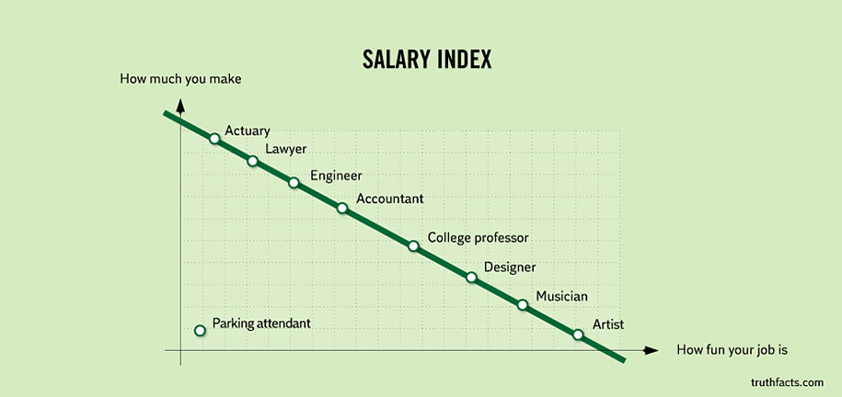

Slide 7
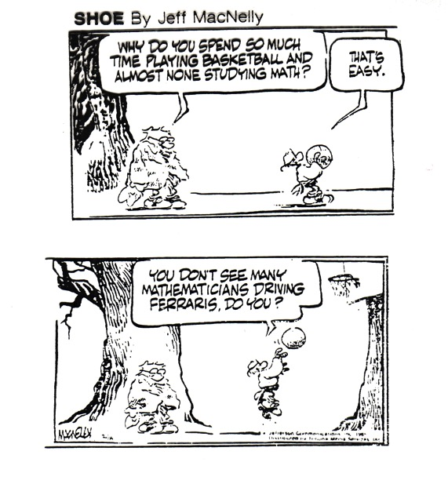

Slide 8
Some History
1989 – NCTM Curriculum Standards
1991 – Ohio Model (8 Strands)
2000 – NCTM Principles and Standards
2002 – Ohio Academic Content Standards
2010 – Common Core State Standards
2011 – Ohio Model Curriculum

Slide 9

Principles to Actions:
Ensuring Mathematical Success for All

Slide 10
Principles to Actions:
Ensuring Mathematical Success for All
Now, twenty-five years later, the widespread adoption of college- and career-readiness standards, including adoption in the United States of the Common Core State Standards for Mathematics (CCSSM) by forty-five of the fifty states, provides an opportunity to reenergize and focus our commitment to significant improvement in mathematics education.

Slide 11
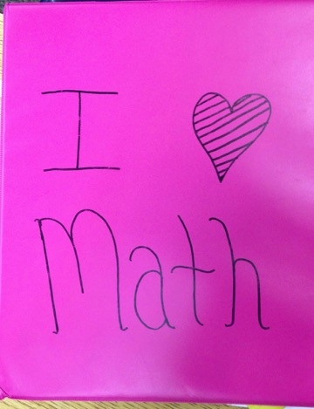
The “End Product”?

Slide 12
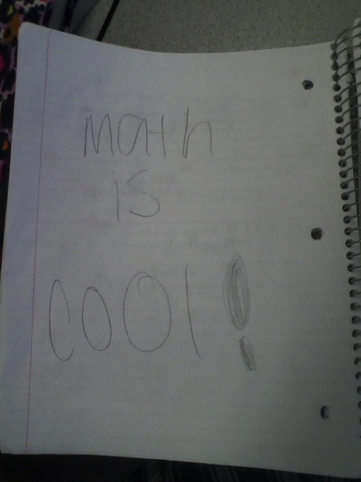

Slide 13
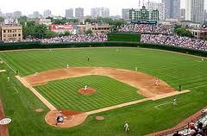
Batting Averages
Batting Average = ratio of “hits” to “times at bat” (e.g., 3 hits for 10 at bats is a 0.300 Average)
0.132
Hits a Single!
0.154

Slide 14
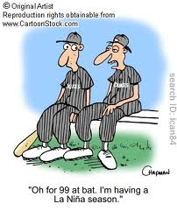
How many hits does the player have, and how many times has he been “at bat” so far this season?
Can you think of at least two different ways to come up with a solution?
0.132 → 0.154

Slide 15
Simultaneous Equations

Slide 16
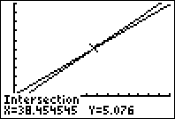
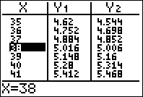
Graph/Table

Slide 17
Premise/Assumption
Technology is an inescapable fact of life in the world in which we live and should be embraced as a powerful tool for doing mathematics. Use of technology can assist students in visualizing and understanding important mathematical concepts and support students’ mathematical reasoning and problem solving.
-Principles to Actions, page 83

Slide 18
Methods Student - Technology
“Since the students were unable to download the Puffin Application to their iPads, the technology specialist gave the class a laptop cart to use. This is where we hit another problem. The laptops they used had to be logged into with a password. Luckily, one of the students discovered that the password was “pchs”. Once logged on, it was discovered that the students did not have internet access. As a class, we went through some different strategies and successfully got the internet to work. After that, students went to an internet browser where it said that the latest Adobe Flash Player had to be installed. So, each student downloaded the latest version and then proceeded to the website that had the virtual manipulatives. When we finally got to the website, the lesson officially began.”

Slide 19
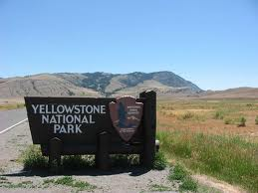
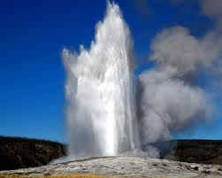
Investigation
Let’s examine some data to see if we can predict when Old Faithful Geyser will erupt.

Slide 20
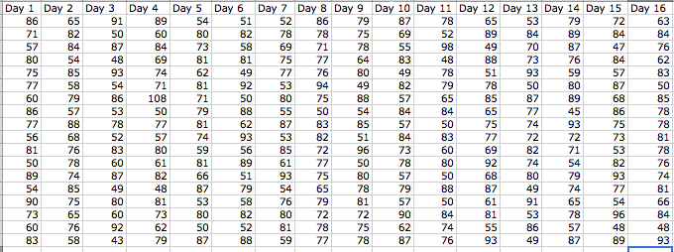
Data Table

Slide 21
Process
Each table randomly chooses 2 days.
Each person asks, “What do I notice? What do I wonder about?”
Each person creates some kind of display of the data by hand.
Team compares displays, chooses favorite, and predicts wait time.
Each team presents solution.

Slide 22
Graphs – Day 1

Slide 23
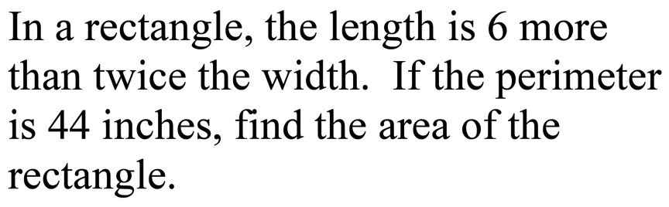
Problem

Slide 24
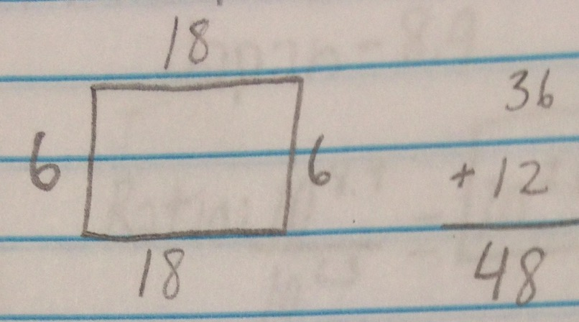
Samantha

Slide 25
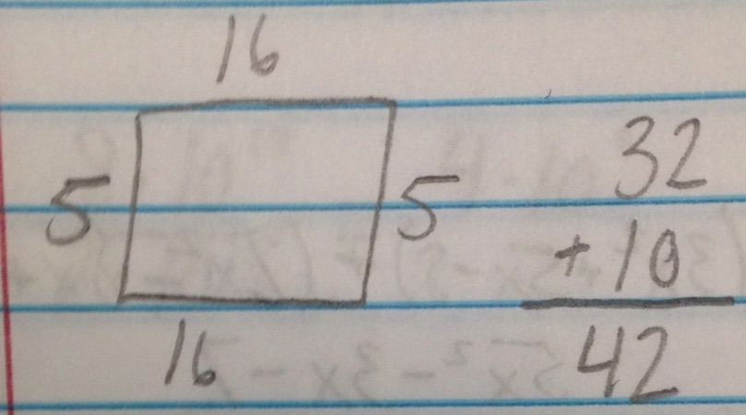
Samantha

Slide 26
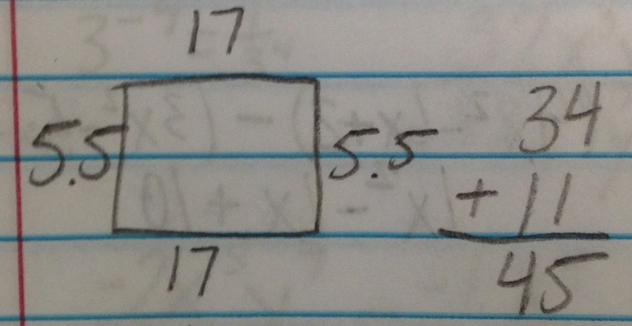
Samantha

Slide 27
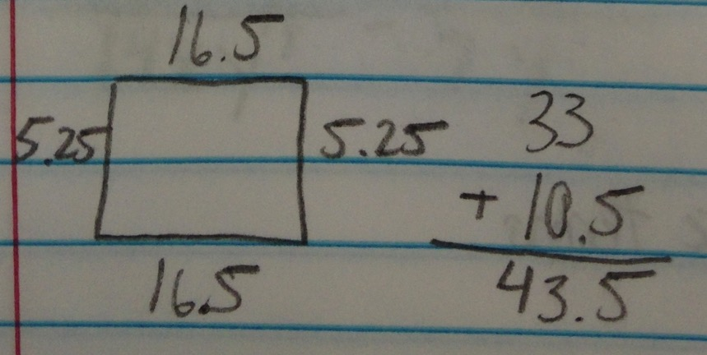
Samantha

Slide 28
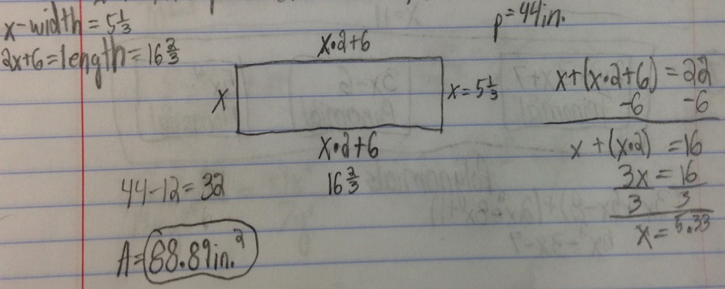
Eric

Slide 29
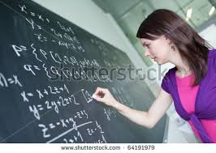

Discussion Questions
Would you want Samantha or Eric to present her/his solution first to the class? Why?
Is it necessary or even important for both of them to present their solutions?

Slide 30
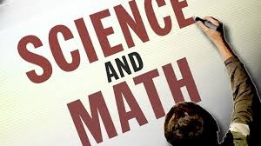
Common Ground in Mathematics and Science
Mathematical/Scientific Practices
Modeling
Use of Variables (Algebra)

Slide 31
Standards for Mathematical Practice
Make sense of problems and persevere in solving them.
Reason abstractly and quantitatively.
Construct viable arguments and critique the reasoning of others.
Model with mathematics.
Use appropriate tools strategically.
Attend to precision.
Look for and make use of structure.
Look for and express regularity in repeated reasoning.
Notes:
You will become more familiar with these in the breakout sessions in grade bands.

Slide 32
Practices for Science and Engineering
Asking questions and defining problems
Developing and using models
Planning and carrying out investigations
Analyzing and interpreting data
Using mathematics and computational thinking
Constructing explanations and designing solutions
Engage in argument from evidence
Obtaining, evaluation, and communicating information
Notes:
You will become more familiar with these in the breakout sessions in grade bands.

Slide 33
Practices for Science and Engineering
Asking questions and defining problems
Developing and using models
Planning and carrying out investigations
Analyzing and interpreting data
Using mathematics and computational thinking
Constructing explanations and designing solutions
Engage in argument from evidence
Obtaining, evaluation, and communicating information
Notes:
You will become more familiar with these in the breakout sessions in grade bands.

Slide 34

Action Research
Two high school teachers asked Precalculus students to complete the phrase,
“I like math most when …”

Slide 36

Discussion
How do you explain the results of this survey?

Slide 37
Modeling
Identifying the key variables in the problem
Creating models (algebraic, geometric, etc.) using the variables
Analyzing the relationships and performing operations to draw conclusions
Interpreting the results
Validating the conclusions, with the possibility of modifying the model
Common Core State Standards for Mathematics, 2010

Slide 38
Uses of Variables
#1
Represent a number in a generalized pattern
Example: a + b = b + a

Slide 39
Uses of Variables
#2
Represent a fixed but unknown number
Example: The letter “x” in the equation 2x – 3 = 7

Slide 40
Uses of Variables
#3
Represent a quantity that varies, especially in relation to another quantity
Example: The letters “x” and “y” in 3y = x

Slide 41
Uses of Variables
#4
Represent a parameter (i.e., a quantity whose value determines the characteristics of another variable)
Example: The letter “m” in y = mx or in E = mc²

Slide 42
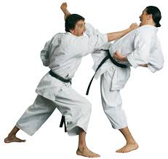
Application of Formulas
Consider F = ma

Slide 43
Uses of Variables
#5
Represent an arbitrary or abstract place holder in an algebraic process
Example: The letter “t” in the statement, “Factor the trinomial: t² + 3t - 10

Slide 44

Myth About “Being Bad” at Math
Consider this article published in September 2015

Slide 45
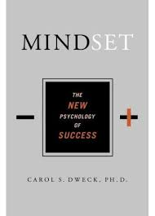
Mindset – Dr. Carol Dweck

Slide 46
Thought
Advice to teachers:
Avoid saying, “You’re so smart” and, instead, acknowledge the work they did to accomplish something (e.g., “I can only imagine how long you spent studying for this test”).

Slide 47
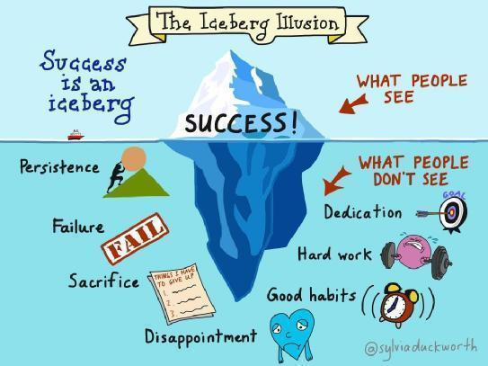

Slide 48

A “Gift”?
“It’s hard to watch, and it’s even harder to not jump in when we see our kids frustrated or upset … [but] learning that comes with challenge is stored more effectively and more durably in the brain than learning that comes easily … errors are an integral part of learning” (2015, pp. 39-41)

Slide 49
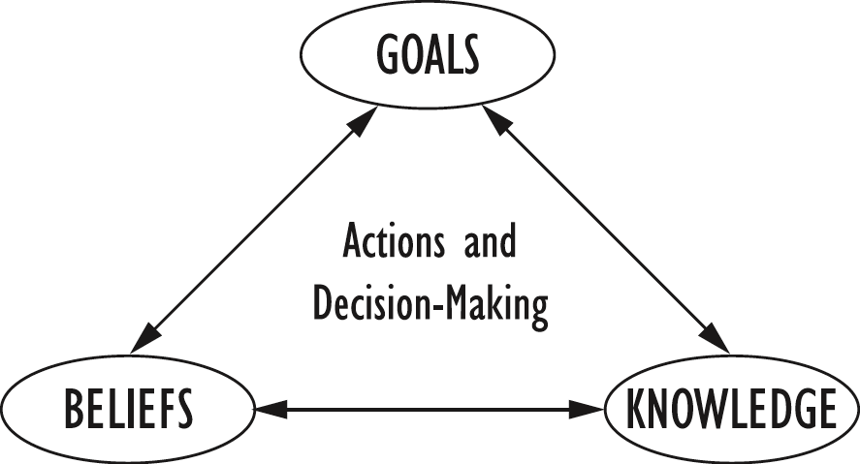

Slide 50
Lessons Learned in Singapore
“Just because our students were #1 in the world last year doesn’t mean they will be next year.”
“If our students aren’t scoring 100%, then we can do better – we can always improve.”

Slide 51
Final Thought
Instead of saying “I can’t do this because” …
say
“I can do this until” …
Steve Meiring, Retired, Ohio Department of Education

Slide 52

Joel Barker, Futurist
“Those who say it cannot be done should get out of the way of the people who are already doing it!”

Slide 53
Science and Mathematics for a New Generation
NWO Symposium
Daniel J. Brahier
Bowling Green State University
St. Rose School, Perrysburg
Saturday, November 21, 2015
8:30 – 9:45 a.m., 101 Olscamp Hall, BGSU

