Slide 1
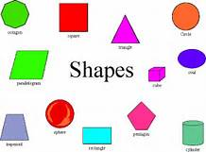
Monday Morning
Creating, Describing, and Comparing Shapes

Slide 2
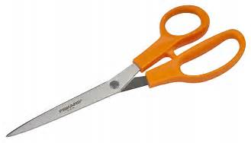
Making Shapes
Square piece of paper
Scissors

Slide 3
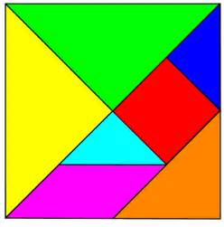
Tangram Puzzle

Slide 4
Perimeter and Area
How do the perimeters of the pieces compare (Grade 3 – attributes of shapes)?
How do the areas of the pieces compare (Grade 4 – areas of rectangles, Grade 5 – area and volume)

Slide 5
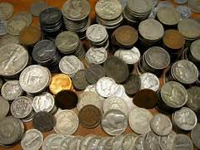
Problems
Can you create shapes with certain “dollar values”?

Slide 6
Ohio’s New Mathematics Standards Geometry
Kindergarten
Identify and describe shapes
Describe, compare, create, and compose shapes
Grades 1, 2, and 3
Reason with shapes and their attributes
Grade 4
Draw and identify lines and angles, and classify shapes by properties of their lines and angles

Slide 7
Ohio’s New Mathematics Standards Geometry
Grade 5
Graph points on the coordinate plane to solve real-world and mathematical problems
Classify two-dimensional figures into categories based on their properties

Slide 8
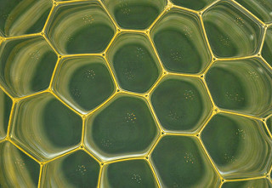
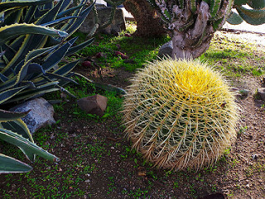
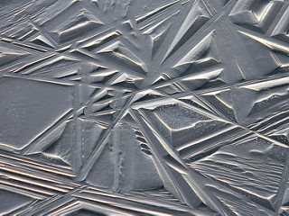
Tuesday Morning
Mosaics of Shapes and How Children Develop an Understanding of Geometry

Slide 9
Geometry Mosaic
Cut out all of the pieces
Determine the most descriptive name for each of the pieces
Let’s try putting pieces together to form new shapes

Slide 10
A Little Psychology …
So, how do children come to know and understand “shapes” and their attributes?

Slide 11
The Van Hiele Model
Teaching and Learning Geometry

Slide 12
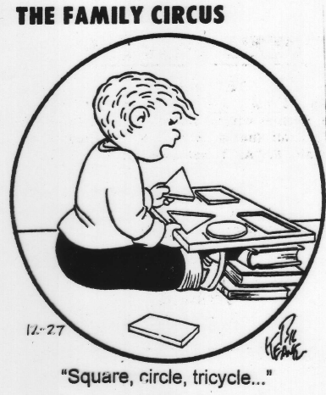

Slide 13
Pierre Van Hiele (1959)
Why do students struggle so much in geometry?

Slide 14
Stages of Development
Level 0 – Visualization (whole shapes)

Slide 15
Stages of Development
Level 1 – Analysis (characteristics/properties)

Slide 16
Stages of Development
Level 2 – Informal Deduction (interrelationships)

Slide 17
Stages of Development
Level 3 –Deduction (postulates, theorems, proof)

Slide 18
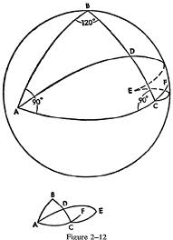
Stages of Development
Level 4 –Rigor (other geometric systems)

Slide 19
Properties of the Levels
Development is sequential
Advancement is dependent upon instruction
Linguistics typical of each level
Mismatch between instruction/textbooks and the level at which students function

Slide 20
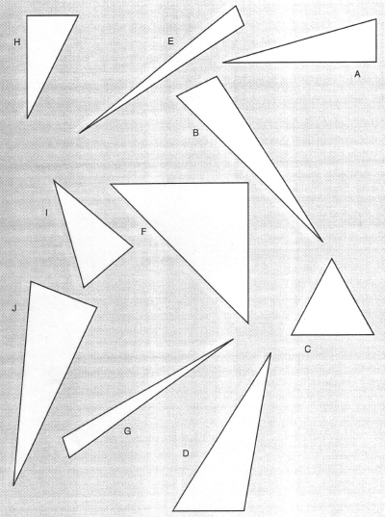
How many triangles do you see?

Slide 21
From Focus on Reasoning and Sense Making (NCTM)…
“Thinking, questioning, and justifying should occur whenever students encounter a situation that is new to them, both within and outside of the school setting, and not only when a proof is required in geometry class. We rarely need to line up statements and reasons in our daily life, but we frequently need to provide a rationale … as to why we do or say particular things. Reasoning and sense making should be regular parts of the geometry curriculum, with or without formal proof writing. All students … must be able to reason and make appropriate decisions. Geometry provides an environment that can allow and encourage students to ‘practice’ the process of reasoning and sense making, for the benefit of all.”

Slide 22
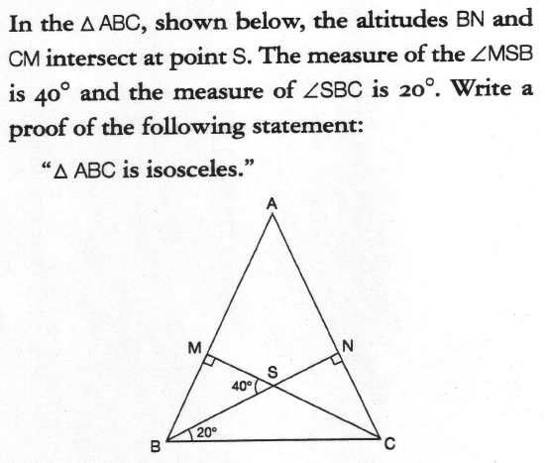
% of 12th Graders?
International
49%
United States
19%

Slide 23
Discussion Question
What are the implications of the Van Hiele’s research on how we plan our lessons?

Slide 24
Practice/Assessment
Let’s visit a tangrams puzzle online app to practice manipulating shapes and using them to create other shapes:
http://www.abcya.com/tangrams.htm

Slide 25
Ohio’s New Mathematics Standards Geometry
Kindergarten
Identify and describe shapes
Describe, compare, create, and compose shapes
Grades 1, 2, and 3
Reason with shapes and their attributes
Grade 4
Draw and identify lines and angles, and classify shapes by properties of their lines and angles

Slide 26
Ohio’s New Mathematics Standards Geometry
Grade 5
Graph points on the coordinate plane to solve real-world and mathematical problems
Classify two-dimensional figures into categories based on their properties

