Slide 1
Wednesday Morning
Ratios to Proportions:
An Introduction

Slide 2
Counting Activity
On the next slide, count the total number of vowels that you see – you will have 30 seconds.

Slide 3
Dollar Bill Dice Tricycle Four Leaf Clover Hand Six-Pack Seven-Up
Octopus
Cat Lives Bowling Pins Football Team Dozen Eggs Unlucky Friday Valentine’s Day Quarter Hour

Slide 5
Words
Write down any words you remember from the previous slide

Slide 6
Look for Patterns

Slide 7
Look for Patterns
Dollar Bill Dice Tricycle Four Leaf Clover Hand Six-Pack Seven-Up
Octopus
Cat Lives Bowling Pins Football Team Dozen Eggs Unlucky Friday Valentine’s Day Quarter Hour

Slide 8
Looking Again
How many words do you remember this time?
Are you “smarter” than you were the first time you were asked to list words? What changed?
You can significantly increase your performance on a learning task if they:
Are very clear about what you will be required to do
Have a strategy for “noticing” things so you can link and relate to the information

Slide 9
Chances
The chances of finding “it” are greatly increased if you are asked to look for “it”!

Slide 10
What Fraction of the Picture is Blue?

Slide 11
Division Problem
Consider the problem
What does the ½ in the answer represent?
½ of ¾
½ of ½
½ of 1
None of these

Slide 12
Ratios and Proportions
Perhaps the most important issue to “notice” when working with ratios and proportions is thinking about what represents the “whole”

Slide 13
What Number Do You See?

Slide 14
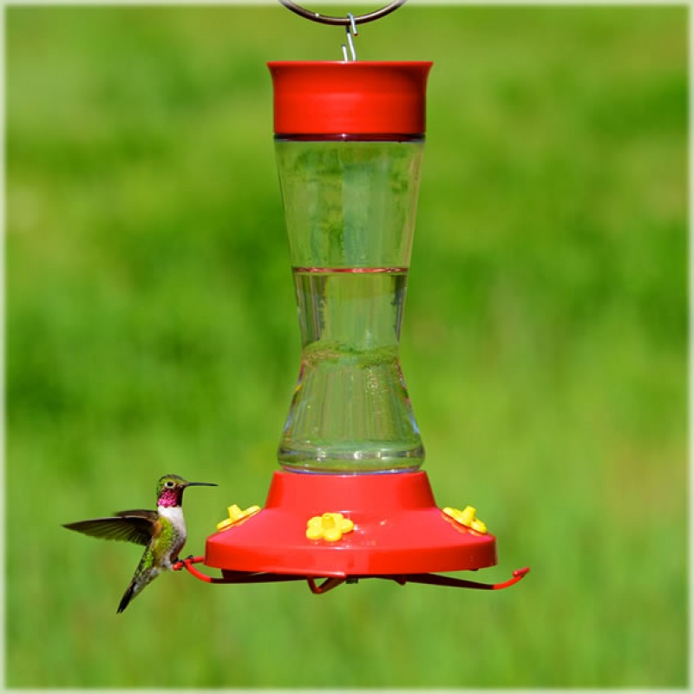
Hummingbird Feeder
Nectar for the feeder is to include ¼ cup of sugar for every cup of water.
What ingredients will I need to make 30 cups of nectar for the feeder?

Slide 15
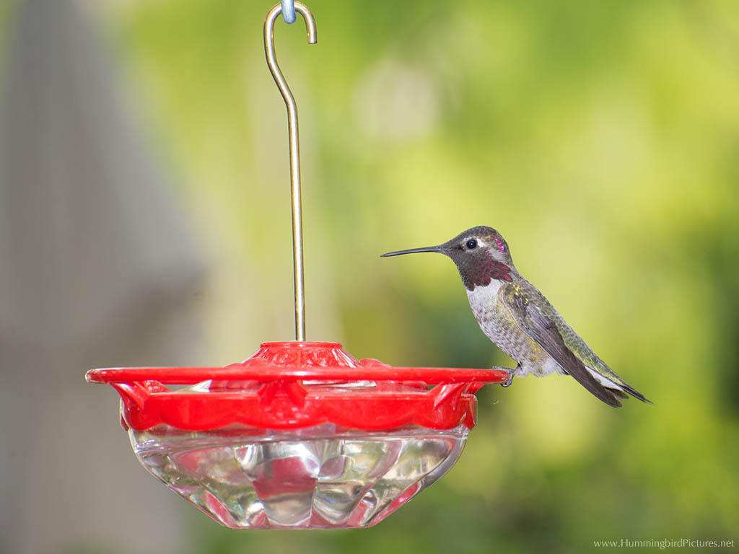
Hummingbird Feeder
I just bought a 12-fluid-ounce hummingbird feeder. If I want to make enough nectar to fill the feeder twice, approximately how much sugar and how much water will I need?

Slide 16
Mixing Paint
Jessica gets her favorite shade of purple paint by mixing 2 cups of blue paint with 3 cups of red paint. How many cups of blue and red paint does Jessica need to make 20 cups of her favorite purple paint?
Use snap cubes to model this.

Slide 17
Mixing Paint
Let’s see how an actual Grade 6 class handled this task on the first day of their Ratios Unit:
VIDEO

Slide 18
Mixing Paint
Questions
What misconceptions did the children appear to have?
How did the teacher attempt to resolve those misconceptions?
What suggestions would you have for changing the lesson and for where she should go next with the lesson?

Slide 19
Mixing Paint
Questions
How can we use Cuisenaire Rods to model this problem?
What other approaches can be used to model and solve this problem?

Slide 20
Mixing Paint
Let’s look at a download from the Illustrative Mathematics website that poses the problem and six different solution methods …

Slide 21
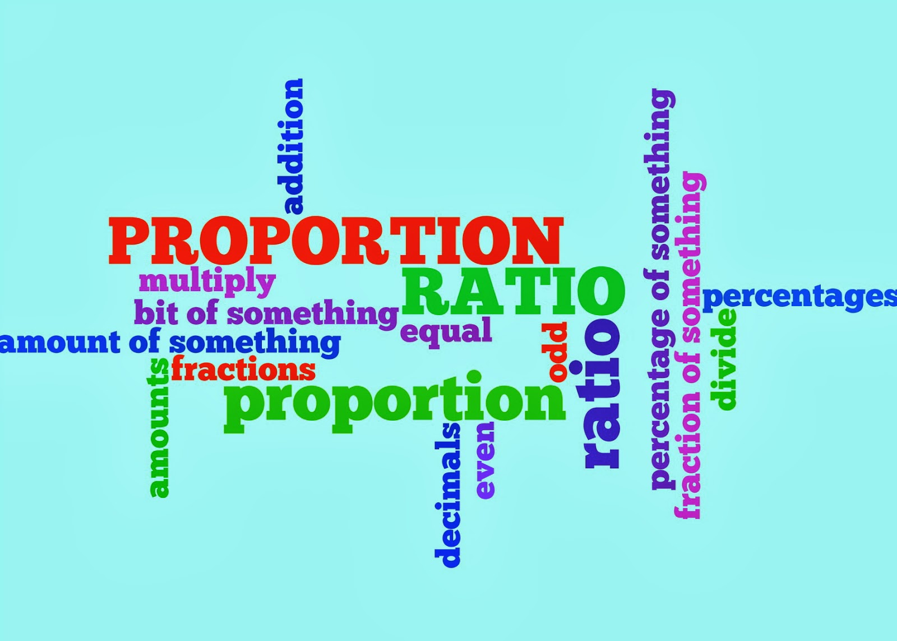
Thursday Morning
Ratio, Proportion, and Algebra

Slide 22
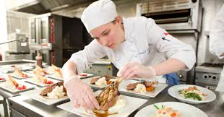
A Problem
Carol spends 17 hours in a 2-week period practicing her culinary skills. How many hours does she practice in 5 weeks?
Come up with as many ways of representing and solving this problem as you can think of and be prepared to share solutions.

Slide 23
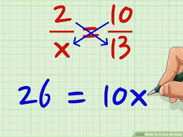
Proportions
Why does “cross multiplication” work as a method for solving proportions?

Slide 24
The Ball Bouncing Experiment

Slide 25
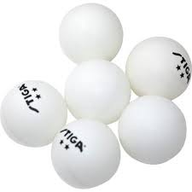
The Problem/Task
Which ball bounces “best” – a super ball, a golf ball, a tennis ball, or a ping pong ball?

Slide 26
Ball Bouncing – Questions
What does the slope of the line of best fit represent in “real life” terms?
Which ball bounces the best from a freefall? How do you know?
What are the mean, median, mode, and range of the slopes for each ball?

Slide 27
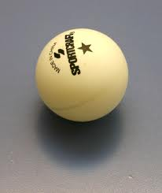
Ball Bouncing Activity
Students divided into teams of 3 or 4
Each team given a tennis, ping pong, golf, and super ball and a meter stick
Students drop each ball from at least 5 different heights, recording the drop height (x) and the bounce height (y) for each
Data are organized into tables
Scatter plots are drawn for each ball

Slide 28
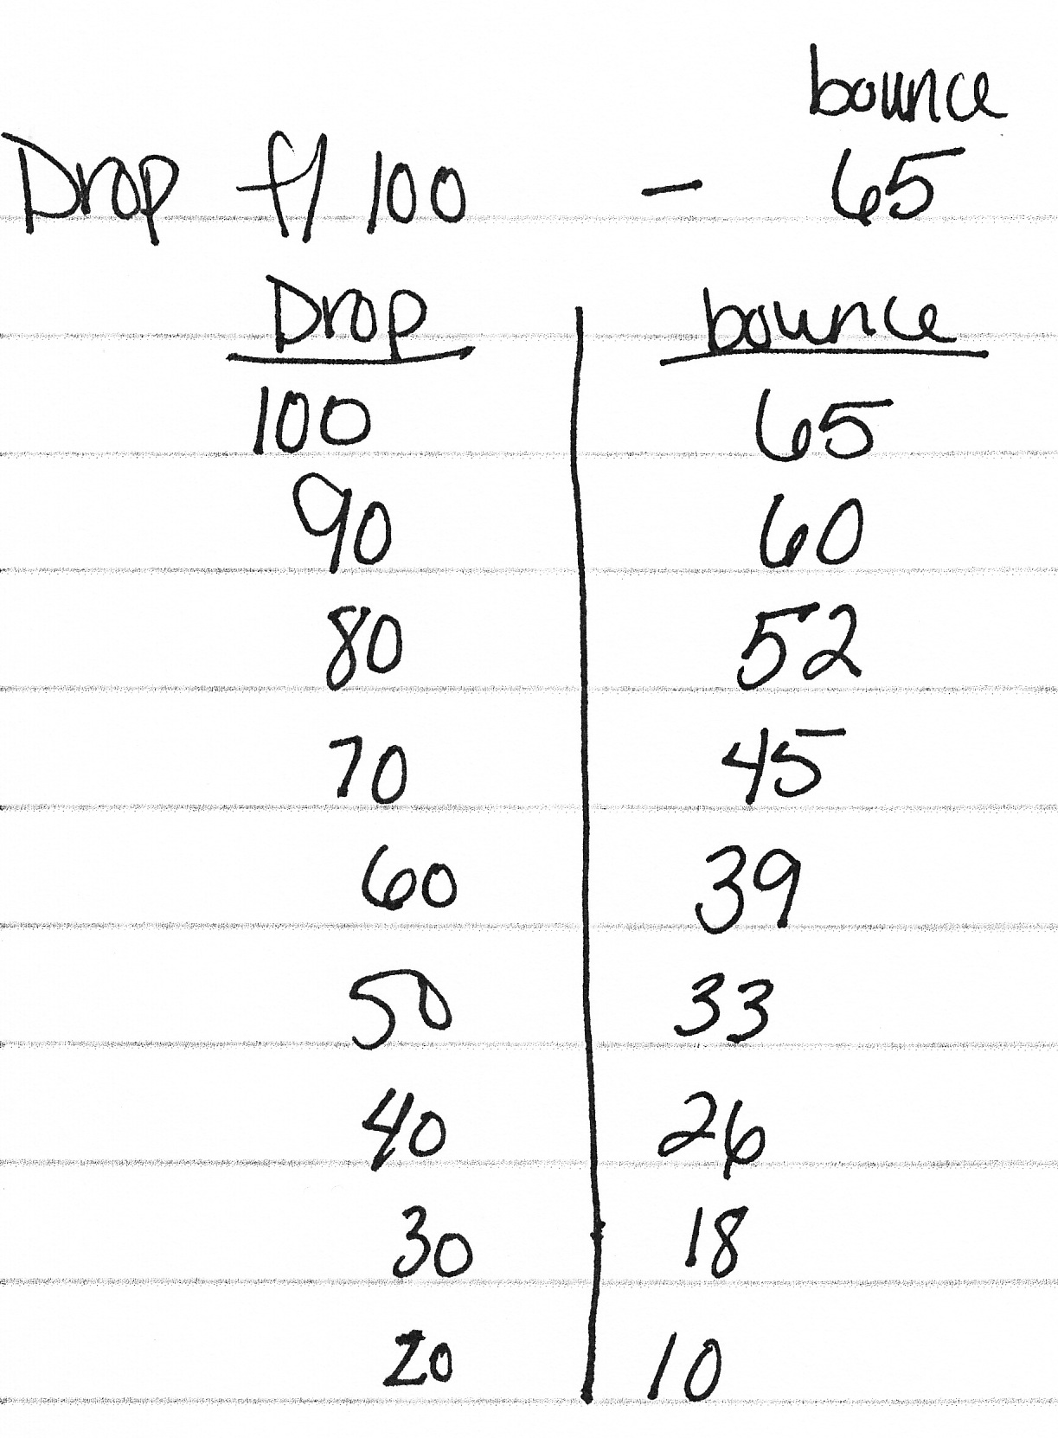
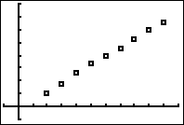
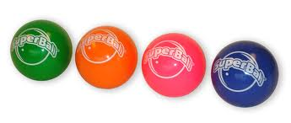
Superball Scatterplot

Slide 29
Ball Bouncing – Group Data

Slide 30
Slope
In each case, the slope represents a rate of change – a ratio that can be used to determine bounce height for a ball dropped from any height.
Bounce heights can be determined by using proportions based on the slope (e.g., how high would we expect the tennis ball to bounce if dropped from 85 cm?).

Slide 31
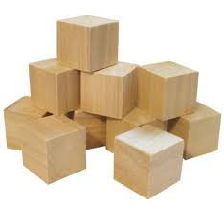
Wooden Cubes Task
In this task, we make a comparison of two different types of wooden cubes by weighing them on a balance.

Slide 32
Wooden Cubes Task
How do the slopes of the lines compare?
What does this tell us about the two types of wood?
Can we write an inequality that compares these slopes?

Slide 33
Ohio Learning Standards
Grade 6
6.EE.7 Solve real-world and mathematical problems by writing and solving equations of the form x + p = q and px = q for cases in which p, q, and x are all nonnegative rational numbers.
6.EE.9 Use variables to represent two quantities in a real-world problem that change in relationship to one another; write an equation to express one quantity, thought of as the dependent variable, in terms of the other quantity, thought of as the independent variable. Analyze the relationship between the dependent and independent variables using graphs and tables, and relate these to the equation. For example, in a problem involving motion at constant speed, list and graph ordered pairs of distances and times, and write the equation d = 65t to represent the relationship between distance and time.

Slide 34
Ohio Learning Standards
Grade 7
7.EE.3 Solve multi-step real-life and mathematical problems posed with positive and negative rational numbers in any form (whole numbers, fractions, and decimals), using tools strategically. Apply properties of operations to calculate with numbers in any form; convert between forms as appropriate; and assess the reasonableness of answers using mental computation and estimation strategies. For example, if a woman making $25 an hour gets a 10% raise, she will make an additional 1/10 of her salary an hour, or $2.50, for a new salary of $27.50.

Slide 35
Ohio Learning Standards
Grade 8
8.F.2 Compare properties of two functions each represented in a different way (algebraically, graphically, numerically in tables, or by verbal descriptions). For example, given a linear function represented by a table of values and a linear function represented by an algebraic expression, determine which function has the greater rate of change.
8.F.4 Construct a function to model a linear relationship between two quantities. Determine the rate of change and initial value of the function from a description of a relationship or from two (x, y) values, including reading these from a table or from a graph. Interpret the rate of change and initial value of a linear function in terms of the situation it models, and in terms of its graph or a table of values.

Slide 36
Message
The topics of ratio and proportion are not intended to be taught in a vacuum.
There are many opportunities within the study of “algebra” to address the issues of ratio and proportion and integrate these standards.

