Slide 1
CONGRATULATIONS, 2020 GRADUATES!
The Department of English at Bowling Green State University
honors our 2020 graduating undergraduates and graduates from the following programs:
BFA, Creative Writing
BA, English Literature
MFA, Creative Writing
MA, Literary and Textual Studies
PhD, Rhetoric and Writing

Slide 2
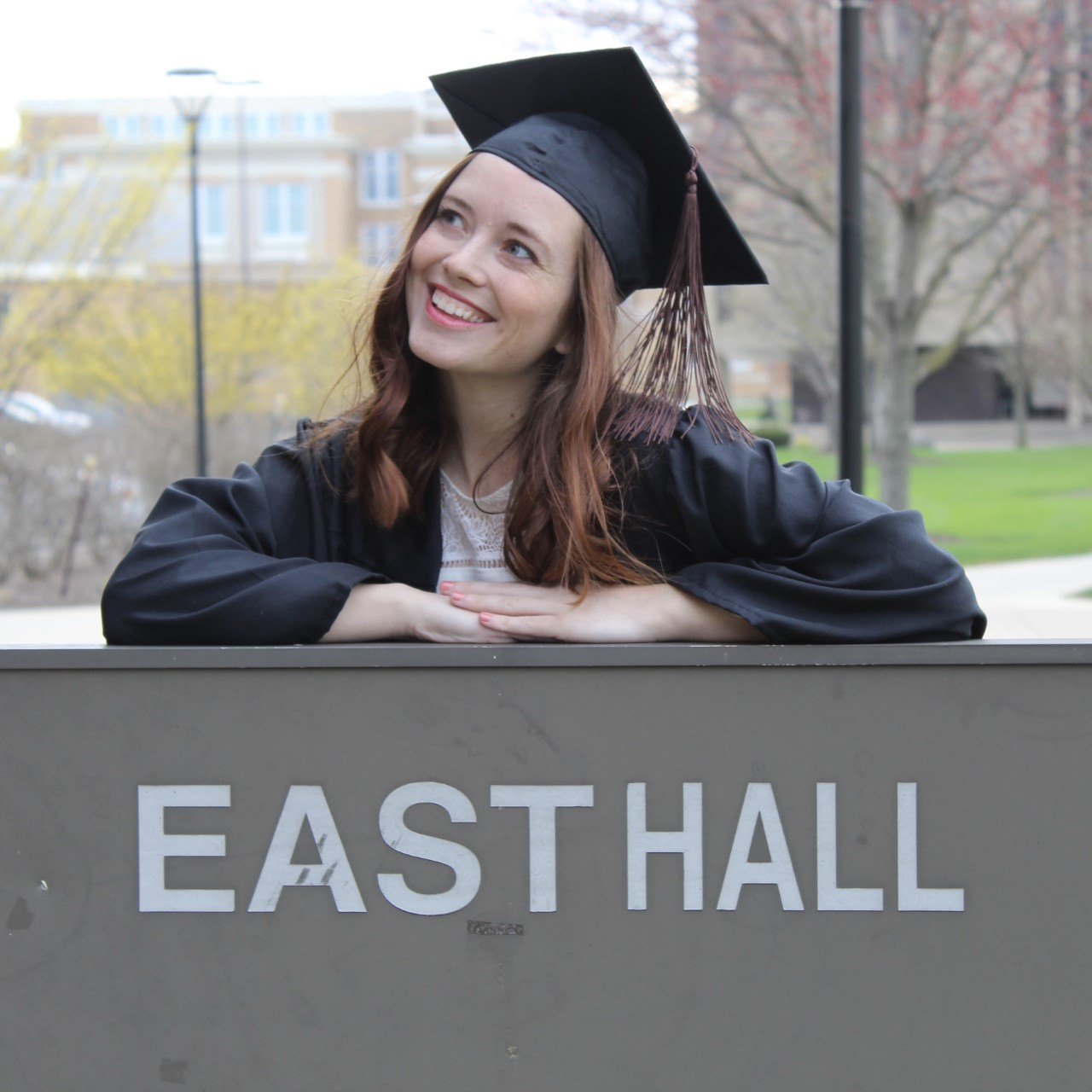
Abbey Warschauer
BFA, Creative Writing
Thesis Title: “Dystopian Utopia”
Hometown: Warsaw, OH
Future Plans: Marketing Assistant at Barbour Publishing
Favorite Memory: End of the semester potluck party in senior fiction class last fall

Slide 3

Jayce Rubel
BFA, Creative Writing/BS, Computer Science
Thesis Title: “Themes from Humanity”
Hometown: Pickerington, OH
Future Plans: To publish a few pieces in my thesis and find a local/online writers group to keep me focused.
Favorite Memory: Getting my first piece published and sharing that time with my peers.

Slide 4
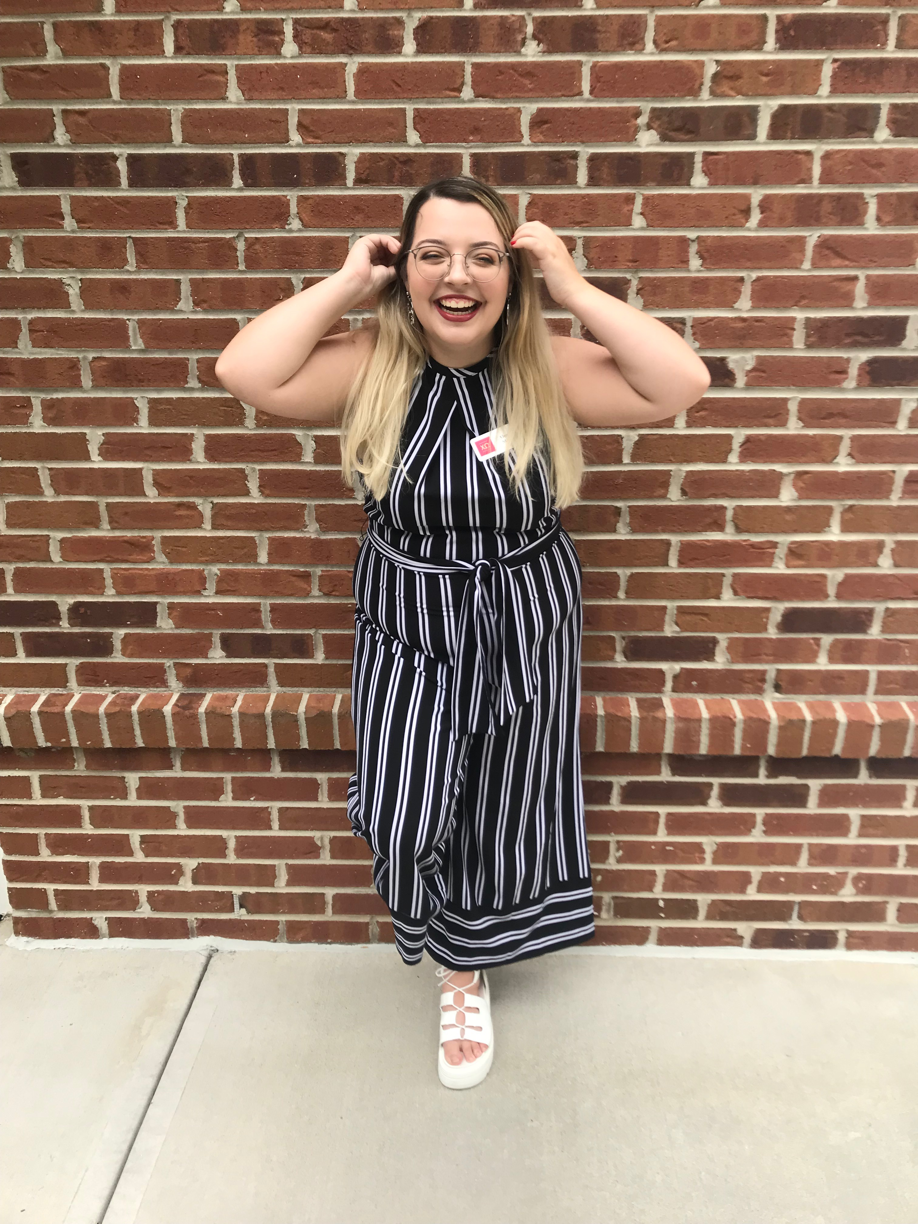
Alexis Mills
BA, English
Thesis Title: “Traveling to the View:
The Intersections of Class, Sexuality, and Location in A Room with a View”
Hometown: North Ridgeville, OH
Favorite Memory: It’s more of a collection
of all the laughs and commiserations with
the friends that I’ve made—it’s been a blast getting to work with such amazing people, faculty and peers alike!

Slide 5
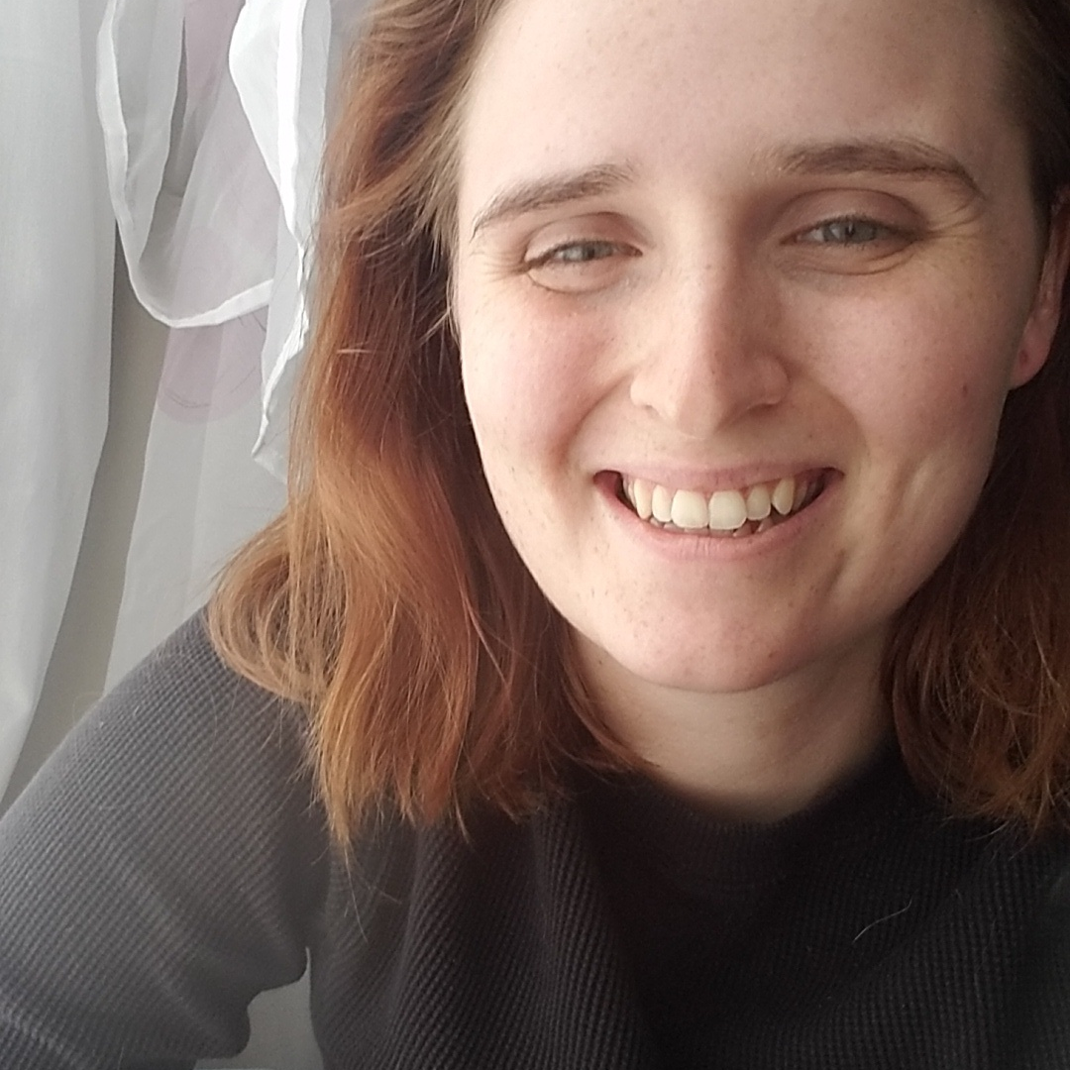
Karmann Ludwig
BA, English
Thesis Title: “’What Do You Want, a Ring?’ The Paradox of Normative Heterosexuality in The Odd Couple on Stage and on Screen”
Honors Project: ”New York, 1965: A Queer Retelling of The Odd Couple (Stage Play)”
Hometown: Maumee, OH
Future Plans: I have been accepted to Northern Michigan University’s English Master’s Program, where I will also work as a Teaching Assistant.
Favorite Memory: I’ll always remember how ethereal and mind-blowing Literary Criticism (ENG 3020) was, especially as Dr. Coates informed us that there is no inherent “table-ness” to a table. The faculty were all truly fantastic. There are so many more classes I wish I could have taken. My advice: make the most of every day in class. (I’ll also miss pushing around the chairs in East Hall 114 several times per day.)

Slide 6
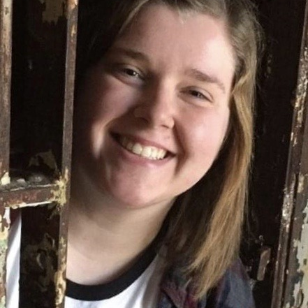
Emma Vallandingham
BA, English
Thesis Title/Honors Project: “’And gladly he wolde lerne’: Facilitating Discussion Based Learning About Medieval and Regency Literature Through Interactive Technologies”
Hometown: Russia, OH
Future Plans: I'm returning to BGSU
in the fall to purse an MA in Literary and Textual Studies!

Slide 7
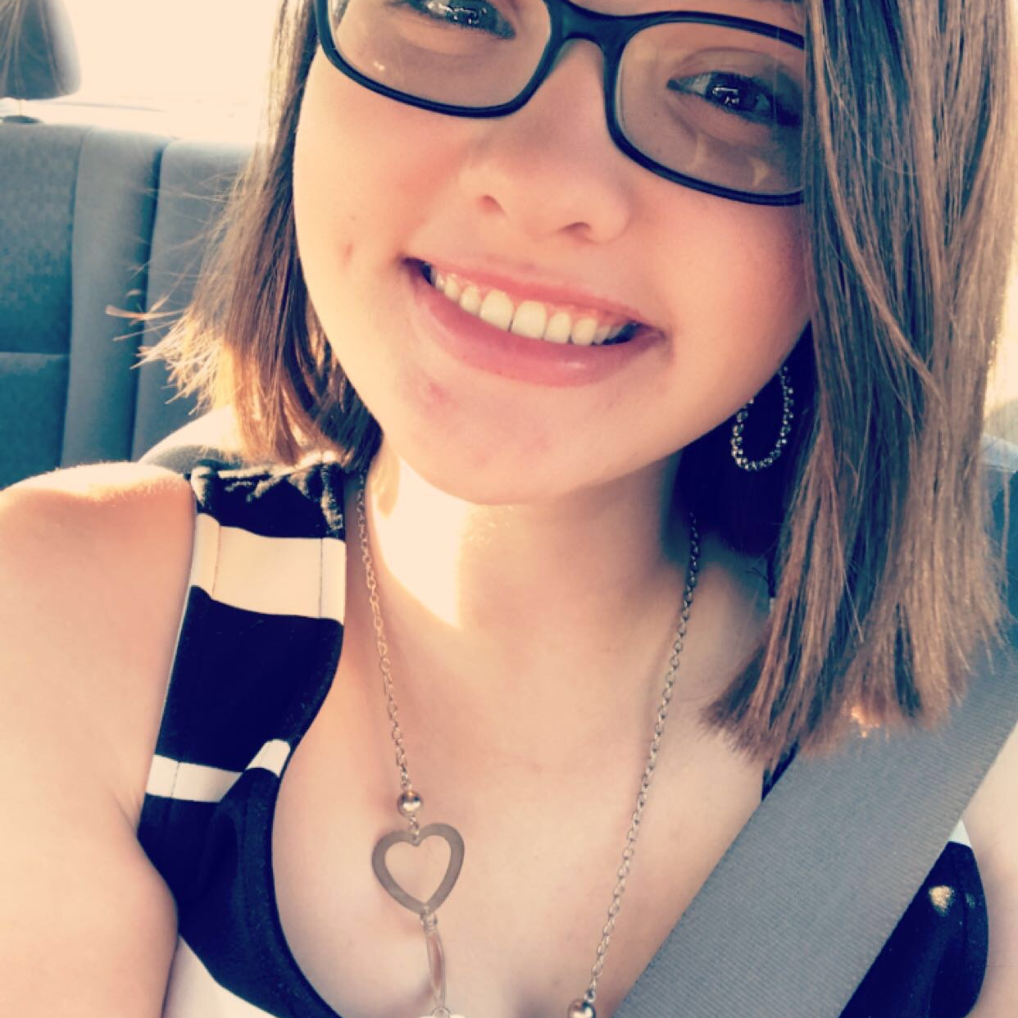
Julie Steinen
BA, English
Thesis Title: “Much More Than a 'Fiendlike Queen': Rehabilitating Lady Macbeth”
Hometown: Van Wert, OH
Favorite Memory: The friends that I made along the way. I’ve met so many fascinating people that have changed my life and have made my BGSU experience unforgettable.

Slide 8
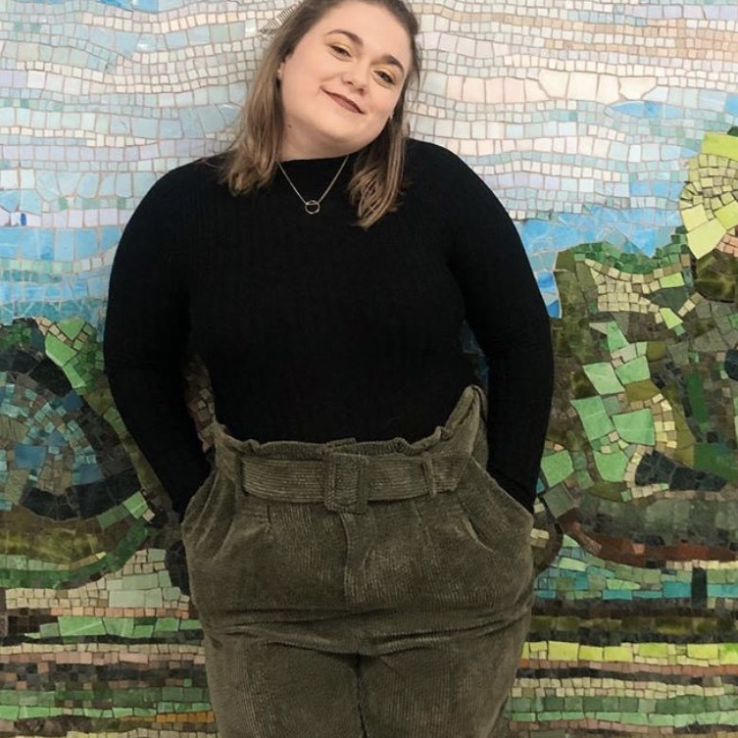
Morgan fryar
BA, English
Thesis Title: “Voice in Contemporary Fiction: Naïveté, Trauma, and Addiction Told Through Metaphor and Reflective Narration”
Hometown: Wadsworth, OH
Future Plans: I’ll be attending the University
of Illinois at Urbana-Champaign for my Masters in Library Science!

Slide 9
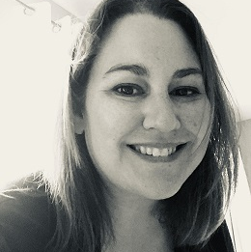
Darlene Johnston
PhD, Rhetoric and Writing
Dissertation Title: “Making Their Voices Heard: How Women in Kosovo Used Amplification to Ensure Representation
in a Newly Created Democracy”
Hometown: Bluffton, OH
Future Plans: I am currently teaching at Ohio Northern University.
Favorite Memory: Getting to know all of the amazing faculty and staff and my truly inspiring fellow classmates.

Slide 10
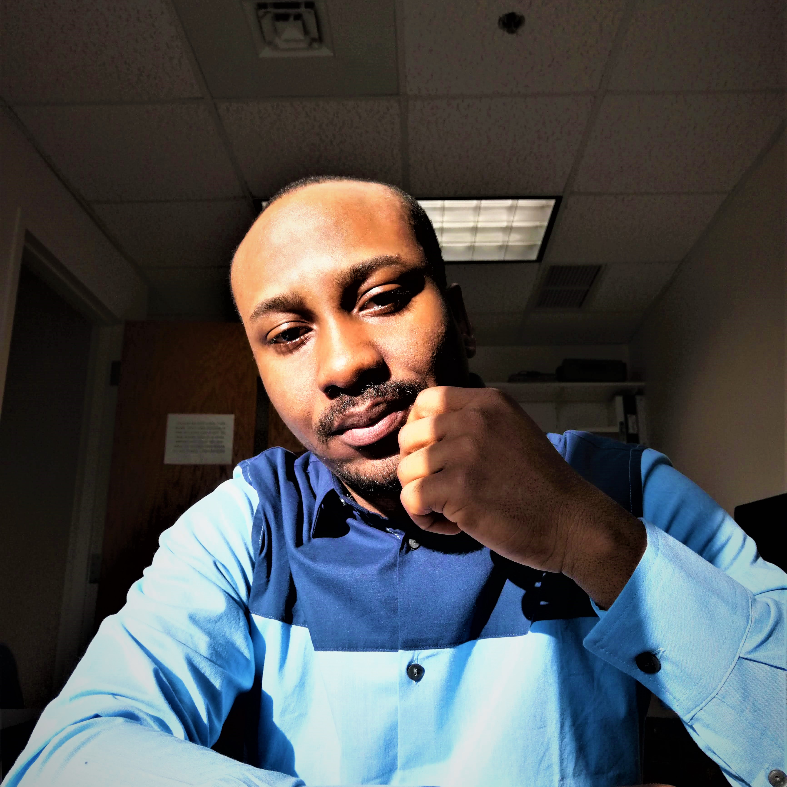
Michael oshindoro
MA, Literary and Textual Studies
Thesis Title: “Myth is Its Own Undoing: Approaching Gender Equity Through Gender Dialogue in Ayọbami Adebayo’s Stay With Me (2017) and Lola Shonẹyin’s The Secret Lives of Baba Sẹgi’s Wives (2010)”
Hometown: Akure
Favorite Memory: The vibrant academic environment and sense of community. The faculty is warm and so are the members of staff. What I most admire is the flexibility to stretch the limits of one's learning through its interdisciplinary configuration.
Future Plans: Doctoral Program

Slide 11
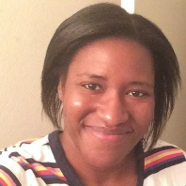
Triauna carEy
PhD, Rhetoric and Writing
Dissertation Title: “The Revolution Will Be Spotified: A Rhetorical Analysis of Music as a Mode of Resistance in the 21st Century”
Hometown: Allen, TX

Slide 12
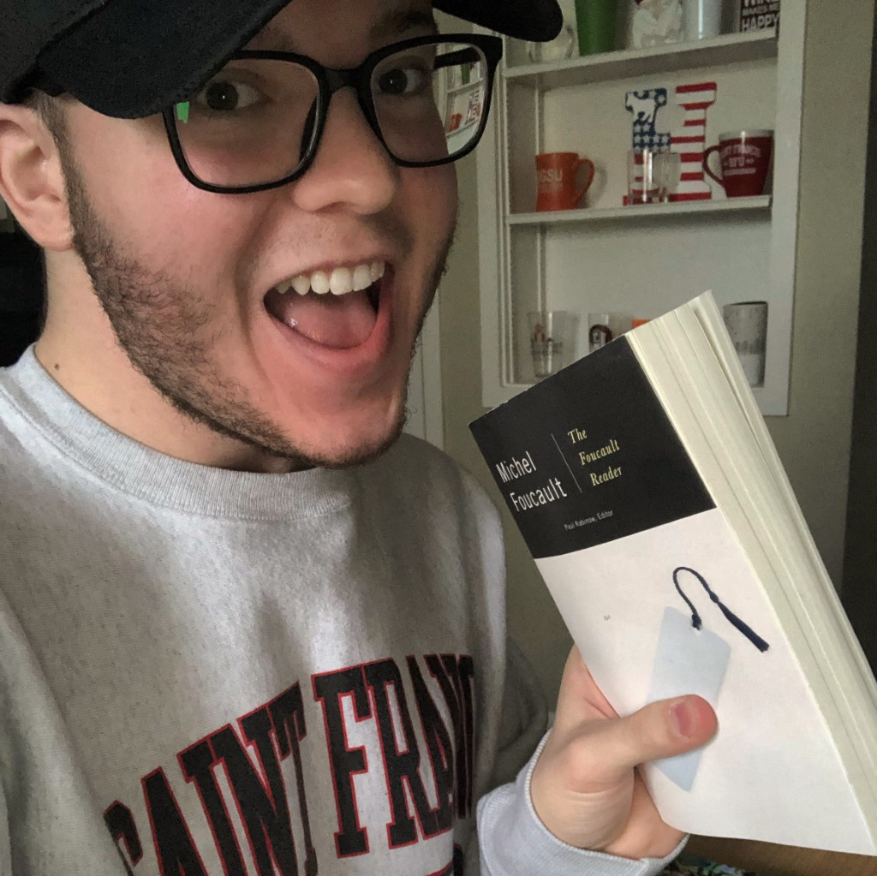
Harry Olafsen
MA, Literary and Textual Studies
Portfolio Title: “Gender, Race, and Class in Various Aspects of American Literature: A Portfolio”
Hometown: Norristown, PA
Favorite Memory: I will forever be grateful for the supportive English Department community at BGSU, and I look forward to learning and growing as an instructor, colleague, student, and scholar throughout my academic career.

