Slide 1
Community-Based Learning Fundamentals
Paul Valdez, Associate Director
BGSU Center for Public Impact
paulv@bgsu.edu
419-372-9287

Slide 2
Agenda
Definitions
Benefits of community-based learning
Modes of engagement
Critical reflection
Online community-based learning
Example Courses
Questions

Slide 3
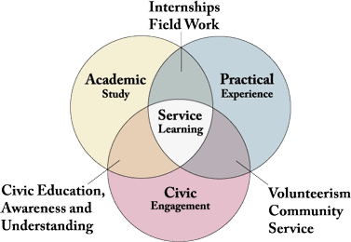
Defining Community-Based Learning
Community-Based Learning, also known as service-learning, is a class based, credit-bearing educational experience which integrates academic material, relevant community-based engagement and/or service activities, and critical reflection based on a reciprocal partnership that engage students, faculty/staff, and community members in achievement of academic and disciplinary learning objectives and civic outcomes to advance public purposes.
https://education.uoregon.edu/service-learning-program/service-learning-roundtable-0
Adapted from R.G. Bringle and J.A. Hatcher, A Service-Learning Curriculum for Faculty, Michigan Journal of Community Service-Learning, 1995, 2: 112-122.

Slide 4
Is it CBL?
Notes:
A faculty member in biology teaches an ecology class for junior and senior level students. For the course students take field trips to local parks and conservancies. During the field trips they learn from representatives from the park about the ecology of the location. At the end of the class students are asked to write a final paper to demonstrate their cumulative learning about ecology. The faculty member establishes a criteria for this paper that the students must incorporate how the field trips and conversations with park representatives informed their learning.

Slide 5
What’s the difference: Community-based learning and service-learning?
Service-learning
Value laden
Implies a unidirectional relationship
Misleading -> direct service as only form of engagement
Community-based learning
Broader opportunities (direct service, advocacy, research)
Community issue focused
Flexibility in approaches

Slide 6
Benefits for Students
Academic
Retention of knowledge
Application of theory
Critical thinking
Writing
Problem solving
Analysis
Cognitive development
Interpersonal
Communication
Collaboration
Leadership
Understanding of social issues
Cultural/racial understanding
Reduction of stereotyped thinking
College experience
Persistence
Retention
Personal
Spiritual growth
Moral development
Empathy
Efficacy
Personal and social responsibility
Commitment to service after college
Jacoby, B. (2015). Service-learning Essentials: Questions, Answers, and Lessons Learned. San Francisco, CA: Jossey Bass.

Slide 7
Faculty and Institutional Benefits
Interactive teaching and reciprocal learning.
New insights and dimensions to class discussion.
Lead to new avenues for research and publication.
Help reach university-wide goals.
Networking opportunities between faculty and community.
Increase student retention.
Impact on the public good.

Slide 8
Modes of Engagement
Direct – Face to face interaction with client population at the service site or elsewhere (tutoring, serving food, coaching)
Nondirect – Occur at the community site, but do not come into contact with population being served (sorting food, removing invasive species)
Indirect – Physically distant from site and population served (developing a website, advocating for legislation that benefits community members, writing a grant proposal, public policy project)
Community-Based Research – Collaborative research partnership that addresses community-identified questions or issues.
Delve, G.I., Mintz, S.D., & Steward, G.M. (Eds.). (1990). Community Service as Values Education. New Directions for Student Services (no. 50). San Francisco, CA: Jossey Bass.

Slide 9
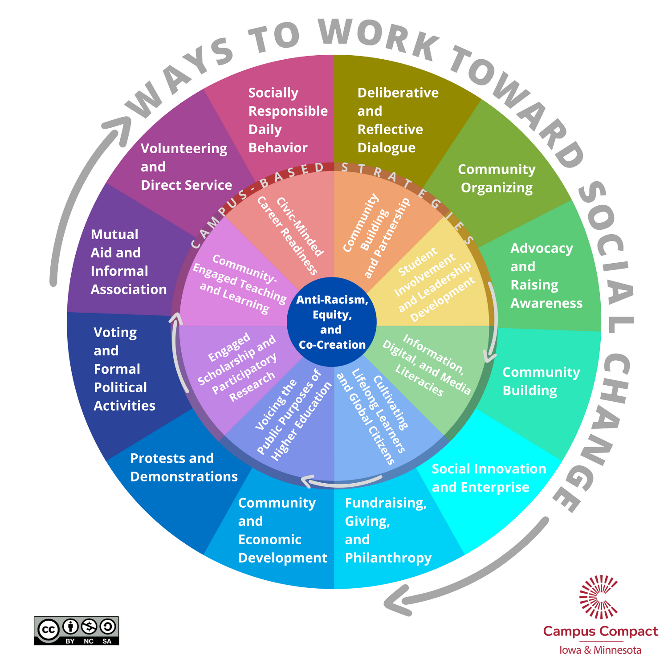
https://mncampuscompact.org/resource-posts/social-change-wheel-2-0-toolkit/

Slide 10
Critical Reflection
“Critical reflection is the active, persistent, and careful consideration of any belief or supposed form of knowledge in the light of the grounds that support it and the further conclusions to which it tends.”
Experience + Reflection = Learning
Jacoby, B. (2015). Service-learning Essentials: Questions, Answers, and Lessons Learned. San Francisco, CA: Jossey Bass.

Slide 11
4 Cs of Reflection
Continuous throughout the course
Connected to content and experience
Challenging students to think critically
Contextualized for course format and goals
Eyler, Giles and Schmiede (1996), A Practioner’s Guide to Reflection in Service Learning. Vanderbilt University
Notes:
Continuous – Reflection activities integrated throughout the course that are both formal and informal.
Connected – Ensure students connect the academic and the experiential
Challenging – Students should be asked to examine their experiences, identify their biases and assumptions, and how that applies to their learning.
Contextualized – The reflection activities you incorporate should complement and align with the course. For example, if you are teaching a capstone course

Slide 12
D.E.A.L. Model of Reflection
Describe – Objective description of experience
Examine – Analyze experience through academic/disciplinary lens
Articulate Learning – What was learned, how it was learned, why it matters, what it means for my future behavior

Slide 13
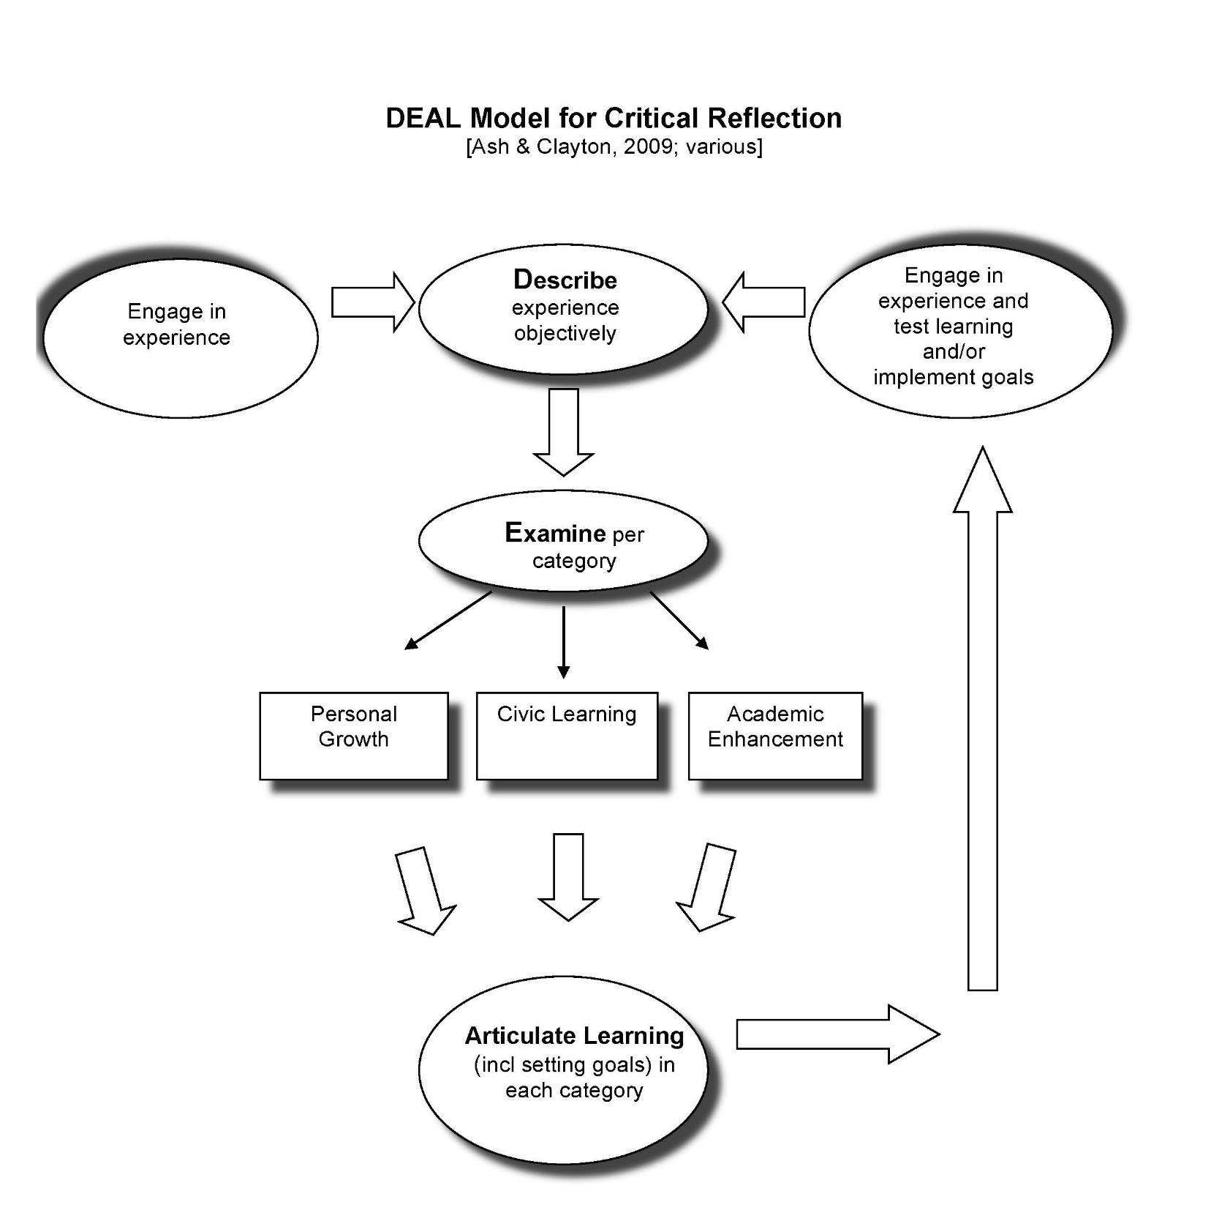
Notes:
Handout

Slide 14
Civic Learning Outcomes
Civic Knowledge – History, cultures, structures
Civic Skills – Communication, collaboration, critical thinking
Civic Values – Empathy, freedom, equity
Civic Identity – Personal and professional
Collective Action – Organizing,

Slide 15
Variation in Intensity
IUPUI Taxonomy for Service-Learning Courses
Reciprocal Partnerships and processes shape the community activities and course design.
Community activities enhance academic content, course design, and assignments.
Civic competencies (i.e. knowledge, skills, disposition, behavior) are well integrated into student learning.
Diversity of interactions and dialogue with others across difference occurs regularly in the course.
Critical reflection is well integrated into the student learning.
Assessment is used for course improvement.

Slide 16
Types of e-service-learning
Service
Onsite
Online
E-service-learning Hybrid Type III
Traditional Service-Learning
(T-SL)
E-Service-Learning Hybrid
Type II
E-Service-Learning Hybrid
Type I
Extreme Service-Learning
(XE-SL)
Onsite
Instruction
Online
Waldner L.S., McGorry, S.Y., & Widener, M.C., (2012). E-Service-Learning: The Evolution of Service-Learning to Engage a Growing Online Student Population. Journal of Higher Education Outreach and Engagement, 16(2), pp 123-150

Slide 17
Online Community-Based Learning Resources
Keep Teaching CBL LibGuide
Falcons Help webpage
Service-learning during Coronavirus: Easy ideas for every subject, Dr. Shannon Orr

Slide 18
Online Equity Rubric, Version 2.0
Technology
Student Resources and Support
Universal Design for Learning
Diversity and Inclusion
Images and Representation
Human Bias
Content Meaning
Connection & Belonging
Peralta Online Equity Initiative, 2019
Notes:
The four in bold lend themselves well to reflection activities. For example a human bias assessment can be a pre-reflection activity integrated into the course. A reflection assignment asking students to mine their past experiences and apply course content that is relevant to their past lived experiences can help with the content meaning.

Slide 19
Other Pandemic Considerations
Community-based activities should still be selected to enhance academic and civic learning outcomes
New needs and opportunities of partners
Safety
Flexibility, nimbleness
Course type
Notes:
Academic and civic learning outcomes can be contextualized differently now in light of COVID-19. A common crisis we are all experiencing and there are new opportunities to examine how each discipline is relevant to addressing this wicked problem.
As in the past faculty members may choose what mode of activity will best supplement the academic content of a course. Direct community engagement and indirect community engagement are still available options. Do not rule out direct engagement, but instead there may be different ways it is implemented.
Safety of students and those they serve has always been integrated into CBL. However, there is heightened focus on safety related to contagious diseases spread, which will have to be factored into design, activities, and reflection.
New considerations for flexibility of community-based activities. Design for nimbleness.
Course type– first-year course, general education course, seminar, capstone, internship/field experience will impact your design.

Slide 20
Principles of Good Practice for Integrating Service with Academic Study
Academic credit is for learning, not for service.
Do not compromise academic rigor.
Set learning goals for students.
Establish criteria for the selection of community service placements.
Provide educationally sound mechanisms to harvest the community learning.
Howard, J. Ten Principles of Good Practice for Integrating Service with Academic Study. Excerpt from
Howard, J. Ed., Michigan Journal of Community Service Learning Course Design Workbook, University of Michigan, OCSL Press, Summer. 16-19.

Slide 21
Principles of Good Practice for Integrating Service with Academic Study
Provide supports for students to learn how to harvest the community learning.
Minimize the distinction between the student’s community learning role and the classroom learning role.
Re-think the faculty instructional role.
Be prepared for uncertainty and variation in student learning outcomes.
Maximize the community responsibility orientation of the course.
Howard, J. Ten Principles of Good Practice for Integrating Service with Academic Study. Excerpt from
Howard, J. Ed., Michigan Journal of Community Service Learning Course Design Workbook, University of Michigan, OCSL Press, Summer. 16-19.

Slide 22
Is it CBL?
Notes:
A faculty member in education teaches a required infant and toddler child development course in which all early inclusive childhood majors must complete. In this course the faculty member assigns a project that students are to complete in small teams or individually over the entirety of the semester. They must work with a local child development or child care facility to provide free service, but also to observe infant and toddler development in person. Part of the observation is to identify ways to apply child development theory they are learning in the classroom. As a requirement of their final project, students are expected to observe a need at their community partner site, apply their knowledge in inclusive child development, and propose a solution that could help to meet that need. The students are expected to work closely with their community partner on developing the solution and are also expected to seek guidance from a expert/consultant relevant to their solution. For example, a student may notice that toddlers struggle with dexterity and fine motor skills, and thus the standard crayon sizes are not conducive for use by toddlers. The solution is to create a large, easily gripable crayon to fit better in a toddler’s hand. The students then present their solution at a end of semester showcase where community partners and other supporters come to review their projects and offer any feedback.

Slide 23
Example courses
Bonnie Mitchell– Animation and Design
Heather Jordan – Technical Writing
Valeria Grinberg-Pla – Exploring Latino/Latina Culture

Slide 24
I am confident I can integrate community-based learning into my course or program.
Strongly Agree Agree Disagree Strongly Disagree

Slide 25
I am confident I can find a community partner(s) to work with me.
Strongly Agree Agree Disagree Strongly Disagree

Slide 26
I know what steps I need to take first to further explore integrating CBL into my course/program.
Strongly Agree Agree Disagree Strongly Disagree

