Slide 1
Upcycling from Pinterest
Go to www.pinterest.com and search for upcycling to see instructions for all examples

Slide 2
Slide Information
(Not to be posted on bulletin board)
Thanks for using these pre-made slides!
You can obviously change the design of the slides and color scheme if you desire
If you need any more info about anything on this slide, go to the website bgsu.edu/sustainability because there is tons more info there
If you have any questions please just ask!
Contact BG Sustainability:
  Dr. Nick Hennessey
  greenbg@bgsu.edu
  419-372-9949
I hope you enjoy our resources!

Slide 3

What is Upcycling?
Upcycling is the process of converting old or discarded materials into something useful and often beautiful.

Slide 4
Recycling vs. Upcycling
Recycling takes consumer materials — mostly plastic, paper, metal and glass — and breaks them down so their base materials can be remade into a new consumer product, often of lesser quality.
When you upcycle an item, you aren’t breaking down the materials. You may be refashioning it — like cutting a t-shirt into strips of yarn — but it’s still made of the same materials as when you started. Also, the upcycled item is typically better or the same quality as the original.

Slide 5
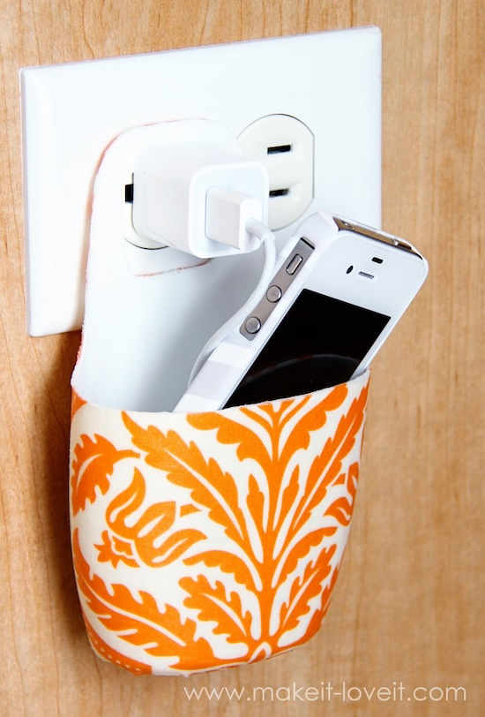
Examples of Upcycling
Cell phone holder from an empty lotion bottle.
This will help keep you organized and your phone will not get stepped on.
Search: upcycling & cell phone holder

Slide 6
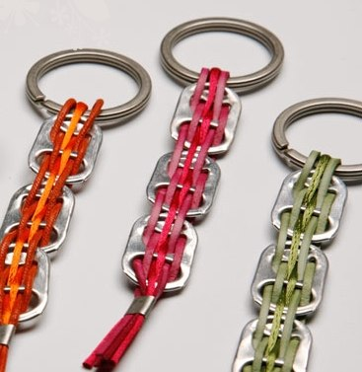
Examples of Upcycling
Pop tab key chain
Do you loose you key and PED all the time. Here is a quick idea that is also stylish.
Search: upcycling, pop tab, & key chain

Slide 7
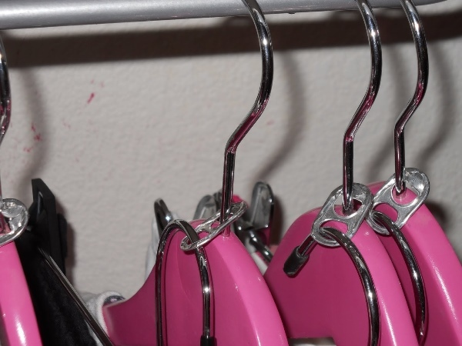
Examples of Upcycling
Pop tab hangers
You have pretty limited closet space in your room. Here is a great way to expand your usable space in no time!
Search: upcycling, pop tab, & hanger

Slide 8
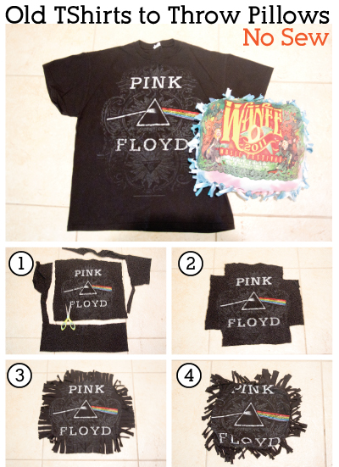
Examples of Upcycling
No sew t-shirt pillow
Do you have old t-shirts that don’t fit or are worn out? Give them new life as a pillow.
Search: upcycle, t-shirt, & pillow

Slide 9
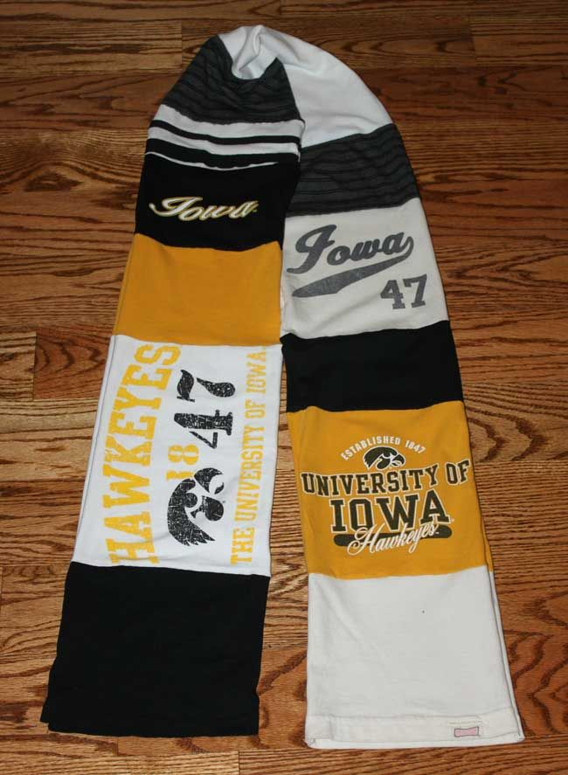
Examples of Upcycling
Winter is coming
Do you have a drawer full of free t-shirts? You can turn them into a scarf to show school spirit and keep you warm.
Search: upcycling, t-shirt, & scarf

Slide 10
Sources
Pinterest.com
http://hipcycle.com/what-is-upcycling
http://www.unclebobs.com/getstorganized/index.php/the-art-of-upcycling/

