Slide 1
Slide Information (Not to be posted with bulletin board)
Thanks for using these pre-made slides!
You can obviously change the design of the slides and color scheme if you desire
If you need any more info about anything on this slide, go to the website bgsu.edu/sustainability because there is tons more info there
If you have any questions please just ask!
Contact BG Sustainability:
Dr. Nick Hennessey
greenbg@bgsu.edu
419-372-9949
I hope you enjoy our resources!

Slide 2
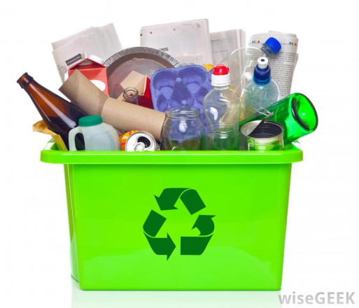
Single Stream Recycling
BGSU Recycling is provided through Waste Management
www.wm.com
Lift each page to see answers

Slide 3
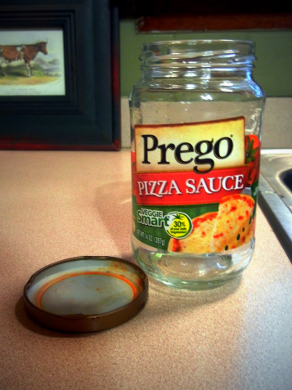
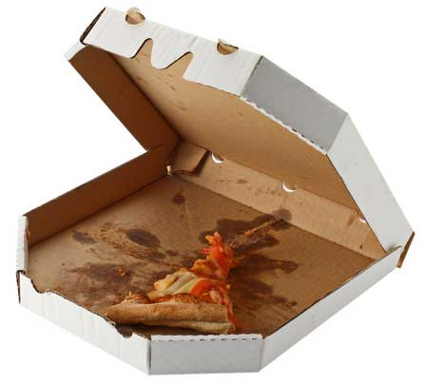
Keep it Clean!
One dirty product, or one with food waste still in it, can contaminate an entire bale, containing thousands of pounds of collected plastics and other materials.
This can cause thousands of recyclable items to go to a landfill instead of being recycled.
Lift here for answers
Recyclable?
Recyclable?

Slide 4
Keep it Clean!
All containers should be rinsed out and remove lids/caps before recycling.
Hopefully, this was an easy one. Containers with food waste in them will contaminate the recycling process.
YES!
NO!

Slide 5
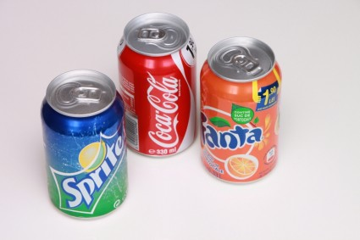
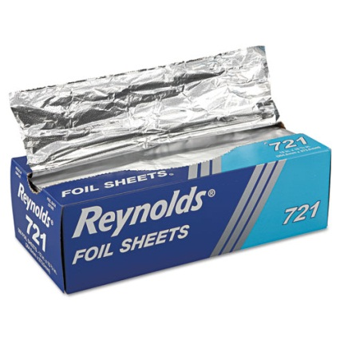
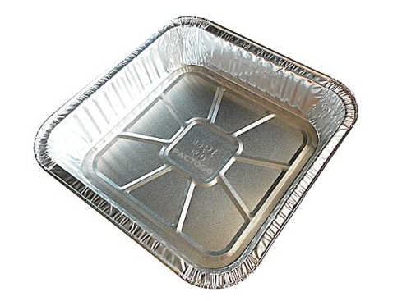
Aluminum
On average, Americans drink one beverage from an aluminum can every day.
Americans discarded 460,000 tons of foil in 2010.
During World War II, Americans saved aluminum foil and even peeled off the silver wrapping from chewing gum wrappers to contribute to the war effort.
Recyclable?
Recyclable?
Recyclable?

Slide 6
Aluminum
Aluminum is one of the recyclable items that can be recycled over and over.
Americans recycle just over 49% of the cans we use.
Recycling one aluminum can saves enough energy to run a television for three hours.
Aluminum foil is recyclable, but just like everything else it must be clean.
Aluminum pans are recyclable, but just like everything else it must be clean.
YES!
YES, But…
YES, But…

Slide 7
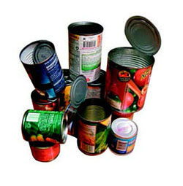
Steel Cans and Tin Cans
These are generally soup cans, veggie cans, coffee cans, etc.
How can you tell a steel or tin can from an aluminum one? See if a magnet attaches to it. Steel is magnetic, and aluminum is not.
Steel cans make up about 90% of the U.S. food can market.
Americans use about 100 million steel cans every day. That's 36.5 billion cans a year.
Recyclable?

Slide 8
Steel Cans and Tin Cans
About 71% of steel cans are recycled, making them one of the most recycled packaging products in America.
In addition, steel cans typically contain at least 25% recycled steel, but many are made almost entirely of recycled steel.
Recycling steel saves at least 75% of the energy it would take to create steel from raw materials. That's enough energy to power 18 million homes.
YES!

Slide 9
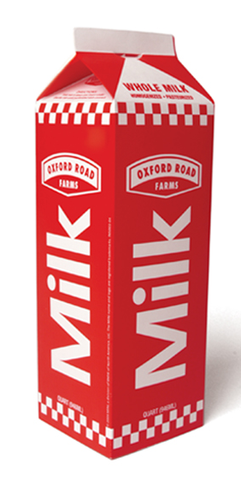
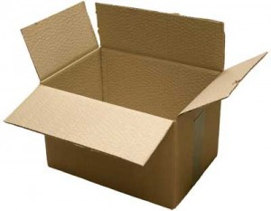
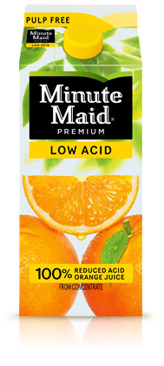
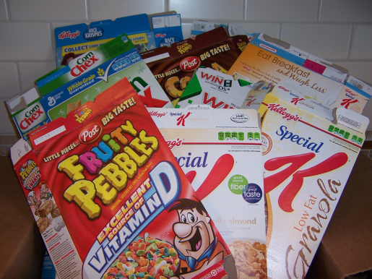
Cardboard
Recyclable?
Milk and juice cartons are made of about 80% high-quality paper fiber, a renewable resource, and 20% polyethylene, a type of plastic that keeps the paper from getting wet.
Once used mainly for products such as breakfast cereal boxes, paperboard is now being used for many other kinds of packaging.
Recyclable?
Recyclable?
Recyclable?

Slide 10
Cardboard
YES!
Corrugated cardboard is typically what large boxes are made from
Cardboard milk and juice containers are recyclable if they have been rinsed and the cap removed
Cereal boxes and similar boxes are made from a material which is essentially a heavy paper product. Make sure you remove the bag before recycling.
Each building has a specific cardboard dumpster outside of the building for large boxes. It is orange and had “Cardboard Only” on it.
YES!
YES!
YES!

Slide 11
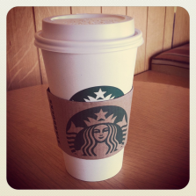
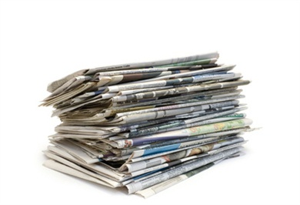
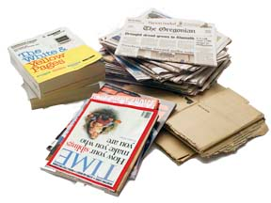
Paper
Recyclable?
Paper products make up about 71 million tons (or 29 percent) of the municipal waste stream, according to the Environmental Protection Agency (EPA).
Recyclable?
Recyclable?
Recyclable?
Recyclable?

Slide 12
Paper
NO/YES
The company that BGSU uses for recycling does not take Starbucks cups but you can recycle the paper sleeve.
More than 73% of all newspapers in the United States are collected and recycled.
Only about 45% of magazines are being recycled today.
Just over 45% of office paper is recovered for recycling today.
YES!
YES!
YES!
YES!

Slide 13
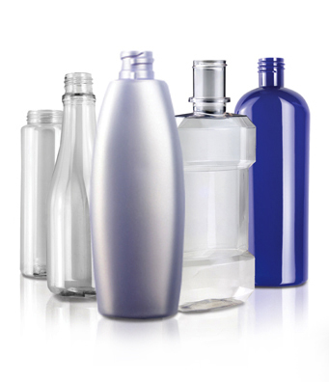
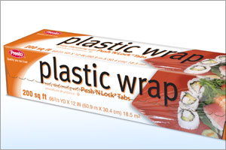
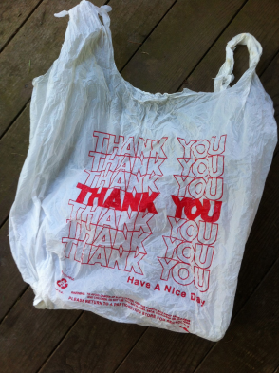
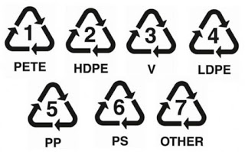
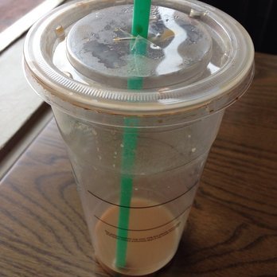
Plastic
How can you tell what kinds of plastic to put into your recycling bin?
BGSU accepts plastic marked with numbers 1 through 7
Recyclable?
Recyclable?
Recyclable?
Recyclable?

Slide 14
Plastic
It takes more than 1.5 million barrels of oil to produce a year's supply of water bottles. That's enough oil to fuel 100,000 cars for a year.
Plastic wrap is not recyclable, so try to use containers that have lids that can be reused
Recycle plastic bags at the supermarket/store
Starbucks cups are recyclable, but the one in the picture still has coffee, and would need to be rinsed. (straws are not recyclable)
YES! #1-7
NO!
NO, But…
YES, But…

Slide 15
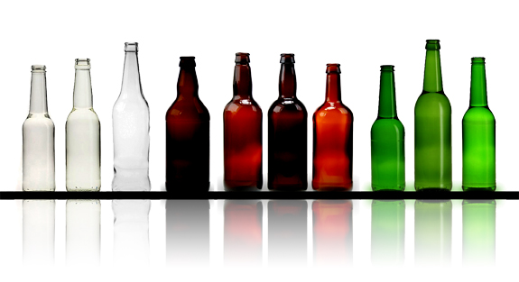
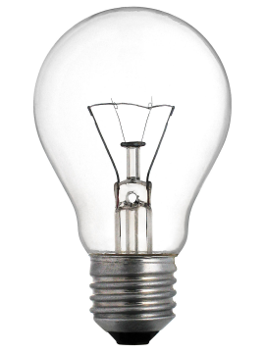
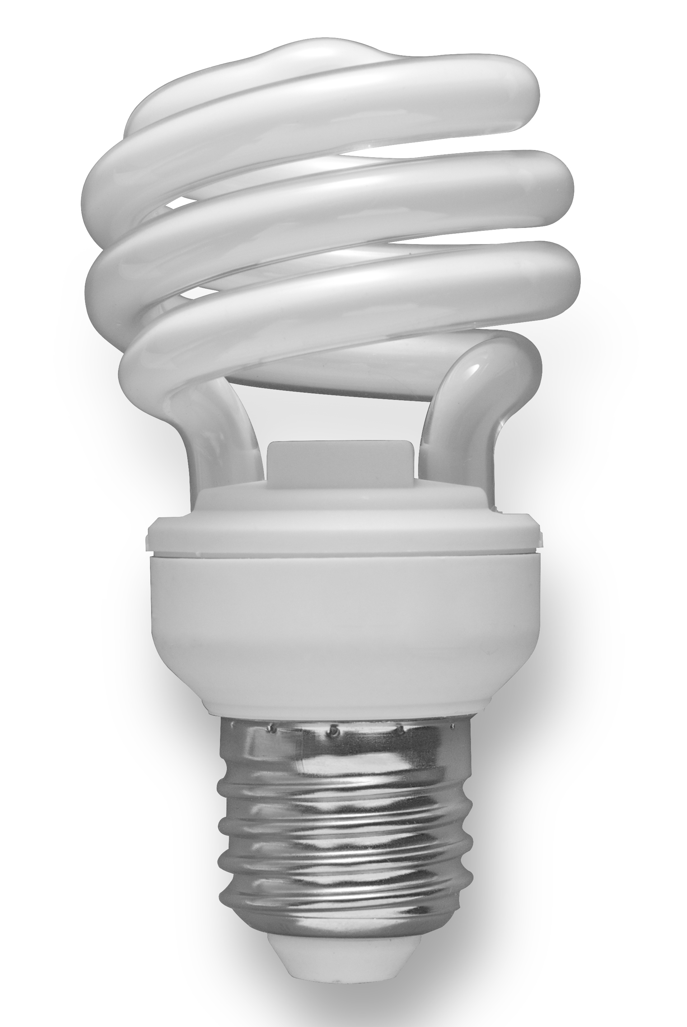
Glass
Recyclable?
Recyclable?
About 61% of glass containers produced in this country are clear.
About 31% of glass containers produced in this country are brown in color.
About 7% of glass containers produced in this country are green in color.
Colored glass is designed to keep out harmful light to light sensitive products.
Recyclable?
Recyclable?

Slide 16
Glass
YES!
YES!
Once the brown or green color is put into the glass it cannot be taken out. All colors are recyclable at BGSU.
Compact fluorescent bulbs contain small amounts of mercury. If the CFL bulb breaks before it's properly recycled, people can be exposed to this harmful metal.
You should check with your local recycling agency to see how to properly dispose of light bulbs.
YES!
NO!

Slide 17
Important Information
The most important take away from this is that items need to be rinsed/clean in order to recycle.
Recycling saves energy and resources
If you have any questions contact BG’s Office of Campus Sustainability at greenbg@bgsu.edu

Slide 18
Board Instructions
This is an interactive bulletin board.
Attach the sheet of paper that has whether the item is recyclable or not directly to the bulletin board.
Then you will attach the corresponding top page with staples or glue in only the top corners so people can lift the page to see the answers.

