Slide 1
Slide Information (Not to be posted with bulletin board)
Thanks for using these pre-made slides!
You can obviously change the design of the slides and color scheme if you desire
If you need any more info about anything on this slide, go to the website bgsu.edu/sustainability because there is tons more info there
If you have any questions please just ask!
Contact BG Sustainability:
Dr. Nick Hennessey
greenbg@bgsu.edu
419-372-9949
I hope you enjoy our resources!

Slide 2
DITCH THE BOTTLE

Slide 3
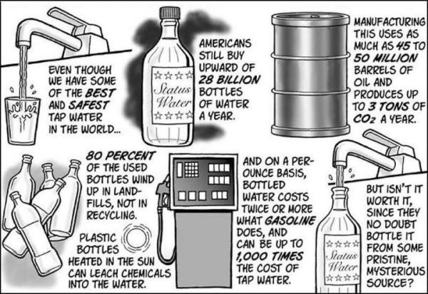

Slide 4
The True Cost of Bottled Water
On average, bottled water costs about $10 per gallon.
Tap water costs less than $0.01 per gallon.
Do the math: Bottled water is, on average, 1,000 times more expensive than tap water!
For about $10 each, you can purchase a 16-ounce or 32-ounce Nalgene bottle, saving you hundreds of dollars a year on bottled water.

Slide 5
Bottled Water is Safer… FALSE!
A report by Food And Water Watch says that almost half of all bottled water is derived from tap water 47.8% (in 2009), to be exact.
Heavy hitters like Pepsi's Aquafina (in 2001, 13 percent of the market) and Nestle Pure Life were forced to change their labels a few years ago to accurately describe where their water came from: public water sources.

Slide 6
Bottled Water is Safer… FALSE!
In the U.S., public water is regulated by the Environmental Protection Agency (EPA), which requires multiple daily tests for bacteria and makes results available to the public. The Food and Drug Administration, which regulates bottled water, only requires weekly testing and does not share its findings with the EPA or the public

Slide 7
Bottled Water Fun Facts
Making bottles to meet America’s demand for bottled water uses more than 17 million barrels of oil annually, enough to fuel 1.3 million cars for a year.
And that’s not even including the oil used for transportation.

Slide 8
Bottled Water Fun Facts
The recommended eight glasses of water a day, at U.S. tap rates equals about $.49 per year; that same amount of bottled water is about $1,400.
The energy we waste using bottled water would be enough to power 190,000 homes.

Slide 9
Bottled Water Fun Facts
Americans used about 50 billion plastic water bottles last year. However, the U.S.’s recycling rate for plastic is only 23 percent, which means 38 billion water bottles – more than $1 billion worth of plastic – are wasted each year.

Slide 10
Bottled Water Fun Facts
Last year, the average American used 167 disposable water bottles, but only recycled 38.
One water pitcher filter can effectively replace as much as 300 standard 16.9-ounce bottles. So you can get great-tasting water without so much waste.

Slide 11
Cut out facts and place around board
Fact #1. Bottles used to package water take over 1,000 years to bio-degrade and if incinerated, they produce toxic fumes. It is estimated that over 80% of all single-use water bottles used in the U.S. simply become "litter."

Slide 12
Cut out facts and place around board
Fact #2. Recycling is only feasible in limited circumstances because only PET bottles can be recycled. All other bottles are discarded. Only 1 out of 5 bottles are sent to the recycle bin.

Slide 13
Cut out facts and place around board
Fact #3. U.S. landfills are overflowing with 2 million tons of discarded water bottles alone.
Fact #5. It is estimated that actually 3 liters of water is used to package 1 liter of bottled water.

Slide 14
Cut out facts and place around board
Fact #1. Bottles used to package water take over 1,000 years to bio-degrade and if incinerated, they produce toxic fumes. It is estimated that over 80% of all single-use water bottles used in the U.S. simply become "litter."

Slide 15
Cut out facts and place around board
Fact #4. It takes over 1.5 million barrels of oil to meet the demand of U.S. water bottle manufacturing. This amount of oil far exceeds the amount needed to power 100,000 for a year, which does not include fossil fuel and emissions costs of green house gases needed to transport the final product to market.

Slide 16
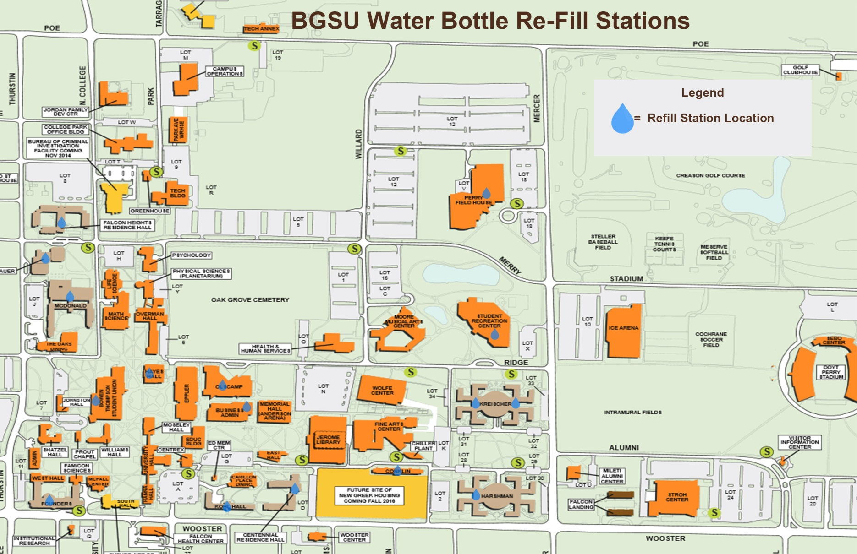
Bottle Filling Stations
Hayes Hall lobby
Olscamp near bathroom
Falcon Heights lobby
Perry Field House lobby
Offenhauer lobby
Rec Center @ every water fountain
McDonald lobby
Kreischer A/B lobby
BTSU Across from Info Desk and 2nd floor near theater
Kreischer C/D lobby
Business Admin
Harshman A/B lobby
Founders lobby
Kohl lobby
Centennial lobby
Conklin lobby

Slide 17
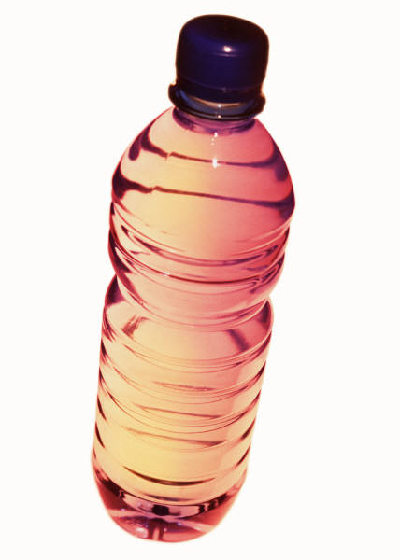

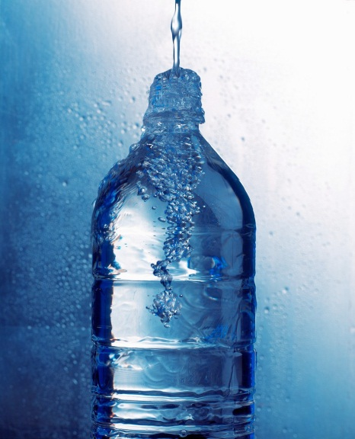

Slide 18
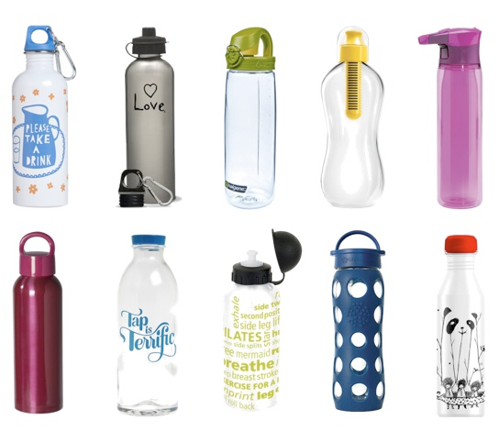

Slide 19
Sources
http://www.collegefashion.net/uncategorized/special-earth-day-feature-the-truth-about-bottled-water/
http://www.banthebottle.net/bottled-water-facts/
http://thewaterproject.org/bottled_water_wasteful
http://www.businessinsider.com/facts-bottled-water-industry-2011-10?op=1

